Slide 1
Target language independent
article generation for popular schools and
hospitals
Project By:
Bhavyajeet Singh UG-3
Aman Kashyap UG-3
Amogh Bhole PG-2
Himani Bhardwaj PG-2

Slide 2
Introduction
Auto generate wiki articles from a dataset(schools and hospitals).
Create a language independent framework.
Combining the functionality of translate and transliterate.
Using multiple language independent templates.
User interface to generate specific articles

Slide 3
Various Phases of Project
Data collection
Data cleaning
Template creation in Hindi and Marathi.
Generate language independent articles in wiki format.

Slide 4

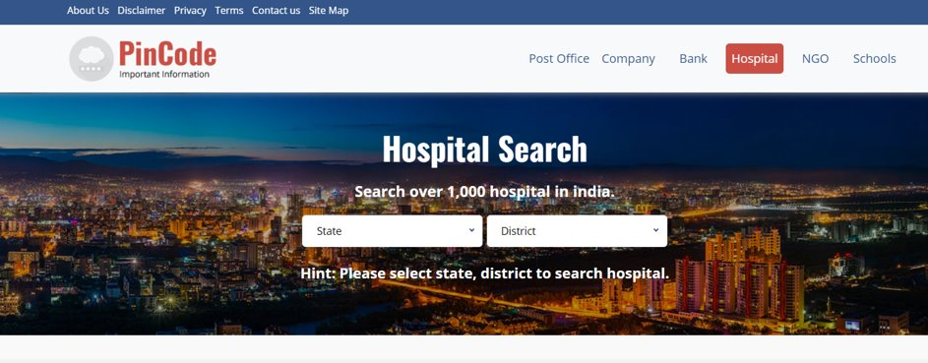
Data Collection
https://pin-code.org.in/hospitals/listing

Slide 5
Data Cleaning
Finding the relevant fields
Removing the rows with irrelevant data.
Replacing garbage value with blanks.

Slide 6
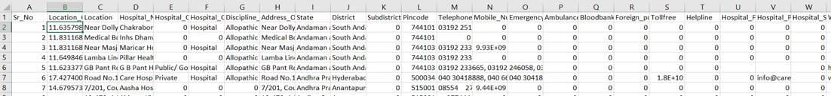
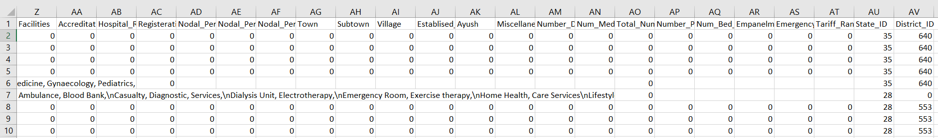

Slide 7
Template Creation
Fixed format for any language template
$key_name are the used to replace the data from dataset.

Slide 8
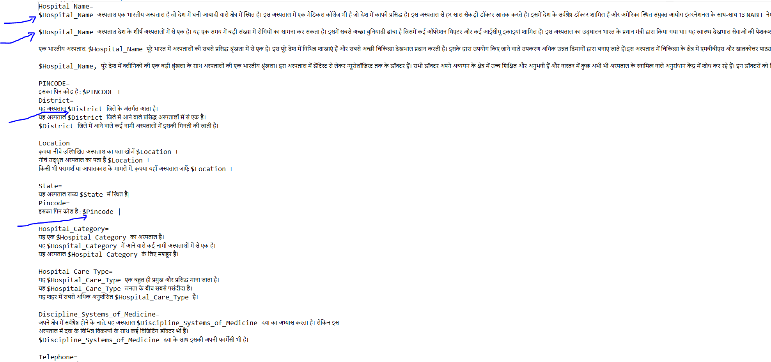
Hindi Template

Slide 9
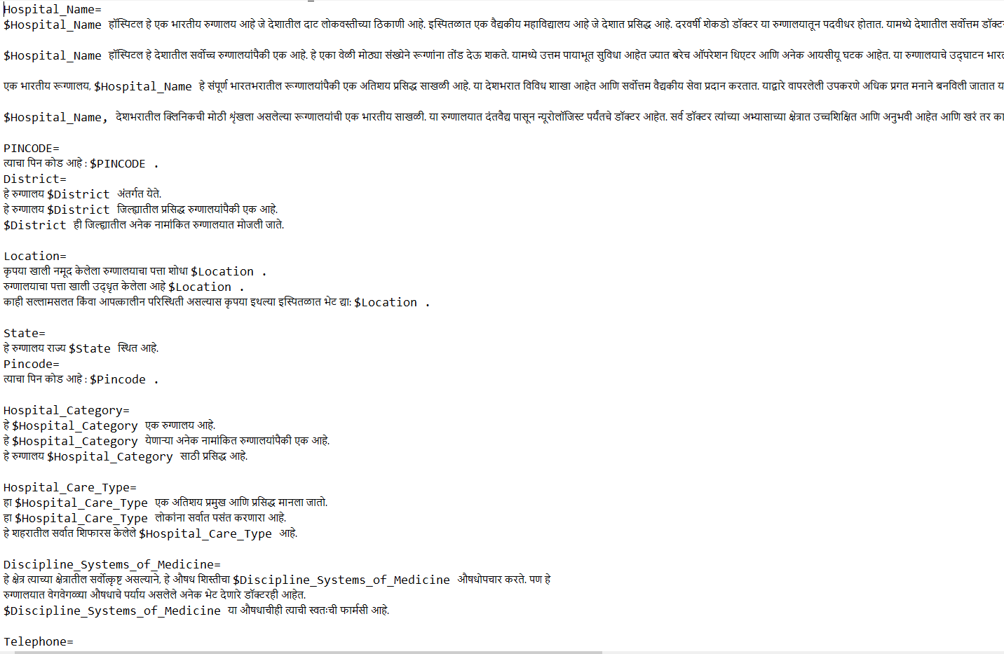
Marathi Template

Slide 10
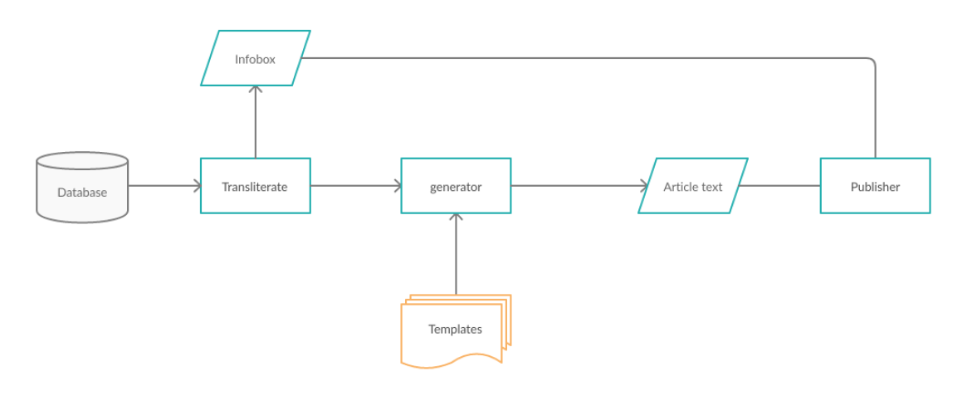
Architecture

Slide 11
Algorithm
T-input language template
D-input dataset in csv format
K-keys used
For each row in D:
tval=tranlate/transliterate each cell
create a dict with keys (K) and tval
parse the template and fill the respective $key with its corresponding value
output the final article data in wikipedia format

Slide 12
Results

Slide 13
Challenges
Bad transliteration
Data collection from multiple sources
Multiple approaches possible

Slide 14
Thank You

