Slide 1

A/B Testing Scenario Group6: Menu Layout Change
CB.EN.U4CSE22327
K.Hasmith
CB.EN.U4CSE22328
K.Bhavya
CB.EN.U4CSE22329
K.Bhavana
CB.EN.U4CSE22331
Krishnam Abhina
CB.EN.U4CSE22332
K.Sanjay

Slide 2

Problem Description
A trendy restaurant wants to test if changing their menu layout will increase the average spend per customer. They believe that highlighting certain high-margin dishes might influence customer choices.Customers are randomly divided into 2 groups
1
Group A
Customers who see the current menu layout.(Control Group)
2
Group B
Customers who see the new menu layout with high-margin dishes highlighted.(Test Group)

Slide 3
Hypothesis
1.Null Hypothesis (H₀):
There is no association between the menu layout and customer spending(there is no significant difference between the two groups). The proportion of customers spending ≥$50 is the same for both the current menu layout and the new menu layout. H₀: p₁ = p₂
2.Alternative Hypothesis(H₁):
There is an association between the menu layout and customer spending(there is a significant difference between the two groups). The proportion of customers spending ≥$50 is different for the current menu layout compared to the new menu layout. H₁: p₁ ≠ p₂
p₁ is the proportion of customers spending ≥$50 with the current menu layout
p₂ is the proportion of customers spending ≥$50 with the new menu layout

Slide 4
Step-by-Step Solution:
1.Observed Table
The restaurant records the number of customers who spend more than a certain amount and those who spend less for both versions of the menu. Assume the threshold is set at $50.
Group
Spend ≥ $50
Spend < $50
Total
Group A (Current Menu)
80
120
200
Group B (New Menu)
110
90
200
Total
190
210
400

Slide 5
2.Expected Values
To calculate the expected values for the chi-square test.
The formula:
E= (RowTotal)×(ColumnTotal) ​/ (GrandTotal)
Group
Spend ≥ $50
Spend < $50
Total
Group A (Current Menu)
95
105
200
Group B (New Menu)
95
105
200
Total
190
210
400

Slide 6








3.Chi-Square Test Statistic
The formula for the chi-square test statistic is: χ2=∑(Oi​−Ei​)^2​/Ei​
χ2 is the chi-square statistic.
Oi​ is the observed frequency for the i-th category.
Ei​ is the expected frequency for the i-th category.
∑ indicates summing over all categories.
Group A, Spend ≥ $50
Group A, Spend < $50
Group B, Spend ≥ $50
Group B, Spend < $50
Chi-square test statistic is: 2.368+2.143+2.368+2.143
:9.022

Slide 7
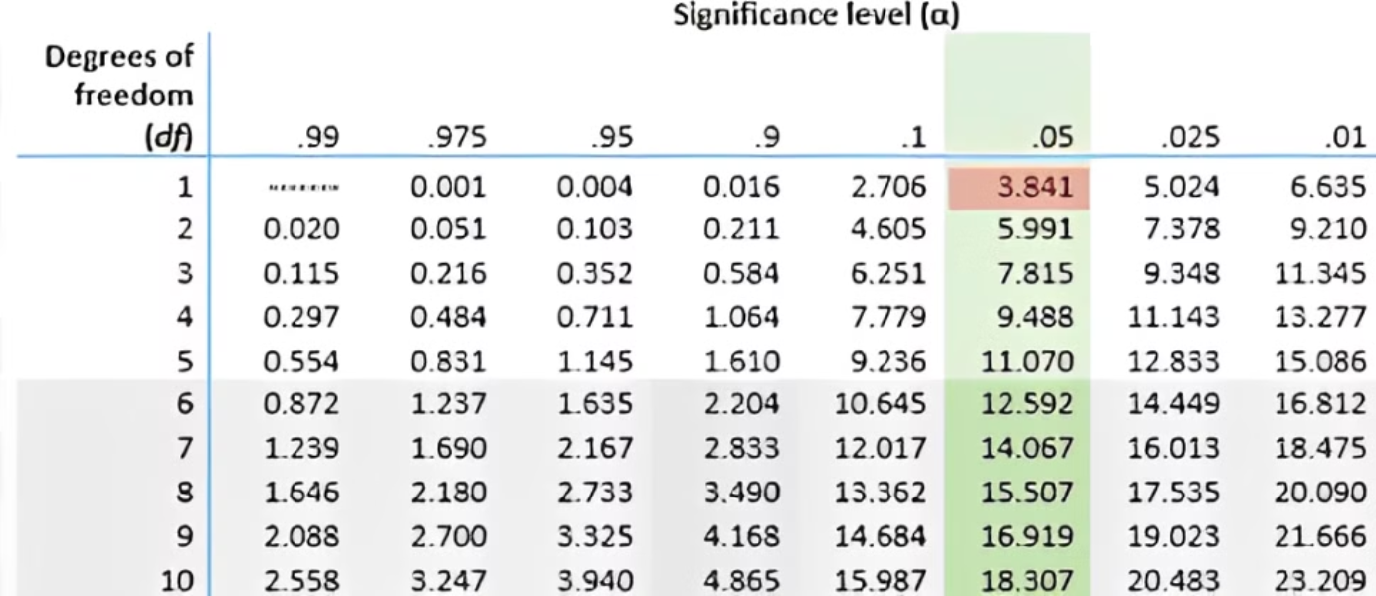
4.Chi-Square Critical Value
The degrees of freedom (df) for the test are calculated as: df=(r−1)(c−1).Where,r is the number of rows, and c is the number of columns.
In this case: df=(2−1)(2−1)=1
For a significance level of α=0.05 and 1 degree of freedom, the critical chi-square value from the chi-square distribution table is 3.841

Slide 8
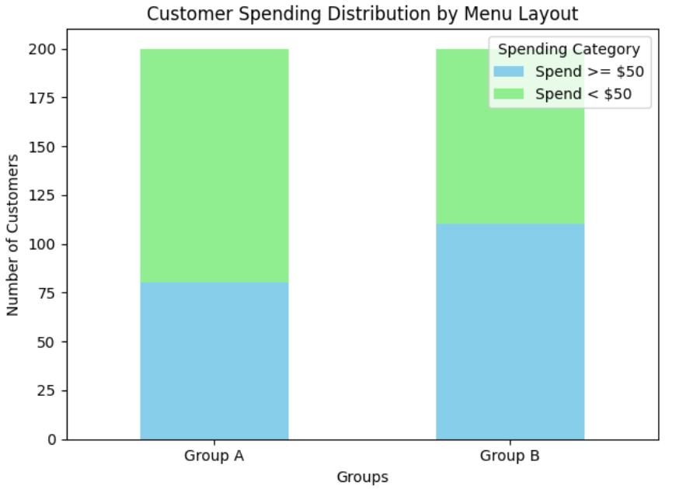
Conclusion:
Calculated Chi-Square Statistic: 9.022
Critical Chi-Square Value: 3.841
Since the calculated chi-square statistic (9.022) is greater than the critical value (3.841), we reject the null hypothesis. This means there is a statistically significant difference in customer spending between the two menu layouts. The new menu layout, highlighting high-margin dishes, has likely influenced customer spending behavior.

