Slide 1

Snake and Ladder Game AI Agent
Principles Of Artificial Intelligence (19CSE451) Case Study
Kosuri Bhavya Naga Sai
CB.EN.U4CSE22328
Krishnam Abhina
CB.EN.U4CSE22331

Slide 2



Problem Statement:
AI Agent Goal
Objective
Strategy
To find the Minimum number of dice rolls to reach square 100.
Find the shortest path, prioritizing ladders and avoiding snakes. Simulate and evaluate each roll, adjusting moves based on the board layout.
Represent the board as a directed graph. Use Breadth-First Search (BFS) to find the shortest path, adjusting for ladders and snakes.

Slide 3
Problem Explanation
Graph Representation
Ladders and Snakes
Shortest Path
The Snake and Ladder board is modeled as a directed graph, where each square on the board corresponds to a vertex in the graph
If moving to any of these vertices leads to a square with a ladder, the edge is redirected to the top of the ladder.
The objective is to find the shortest path from the starting vertex (1) to the final vertex (100), which is the winning position.
If it leads to a square with a snake, the edge is redirected to the tail of the snake.
From any vertex v, there are directed edges to v+1,v+2,v+3,v+4,v+5andv+6, reflecting the possible moves based on the outcome of a dice throw.
This is effectively a shortest path problem in a directed graph, and we will use the Breadth-First Search (BFS) algorithm to solve it.
.

Slide 4
Choice of Algorithm:
Breadth First Search Algorithm:
BFS is ideal for optimizing Snake and Ladder gameplay by exploring all possible moves level by level, ensuring the shortest path (minimum moves) is found. Each board position is treated as a node, with dice rolls as transitions between nodes. BFS systematically checks all move sequences, ensuring the agent finds the optimal path to reach the last square (100) while efficiently utilizing ladders and avoiding snakes.
Why Not Depth-First Search (DFS) or Other Algorithms?
DFS explores one path as deep as possible before backtracking, which can lead to inefficient paths and does not guarantee the shortest solution in an unweighted graph.
Dijkstra’s Algorithm is typically used for weighted graphs, but since all moves in Snake and Ladder have the same "cost" (1 dice roll), Dijkstra’s complexity is unnecessary.
A* is used when you have a specific heuristic (estimated cost to goal), but in Snake and Ladder, there's no obvious heuristic better than simply advancing forward.
Thus, BFS is both simple and effective for solving this shortest-path problem in a uniform graph like Snake and Ladder.

Slide 5
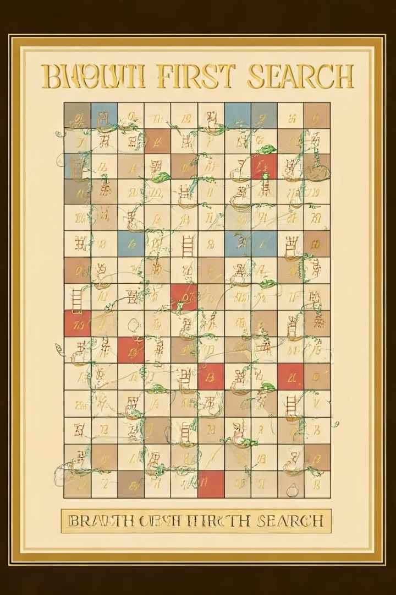
Algorithm
Initialize graph: Create an adjacency list of the directed graph
Add edges: Connect squares with possible moves, redirecting for ladders/snakes.
Implement BFS:Initialize a queue to facilitate BFS.
Keep track of discovered vertices to avoid revisiting them.
Enqueue the starting vertex (1) with an initial distance of 0.
While the queue is not empty:
Dequeue the front vertex and check if it is the destination (100).
If it is the destination, return the distance (minimum moves).
For each adjacent vertex, if it has not been discovered:Mark it as discovered and enqueue it with an incremented distance.
Return result: If the destination is reached during BFS, return the total number of moves taken to reach it.

Slide 6
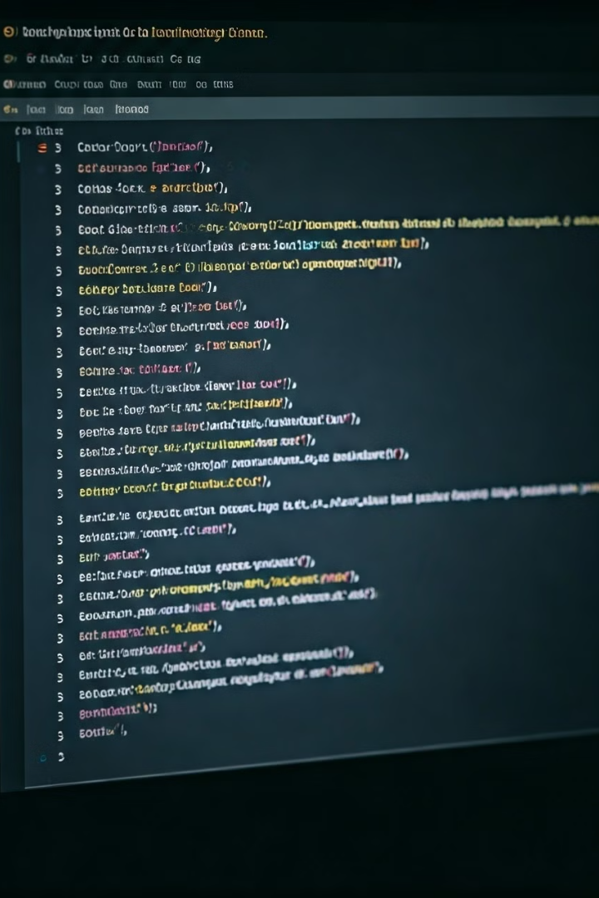

Implementation:
click below to view the code

Slide 7
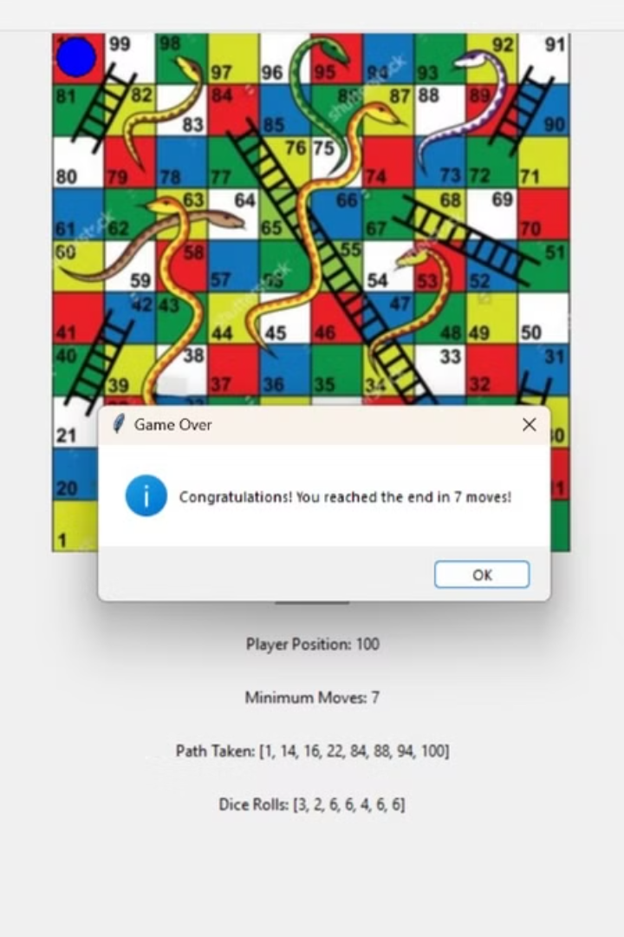
Python Code: Game Setup
ladder = {4(start):14(end), 9: 31, 21: 42, 28: 84, 51: 67, 72: 91, 80: 99}
snake = {17(start):7(end), 54: 34, 63: 18, 64: 60, 87: 36, 92: 73, 95: 75, 98: 79}
Python Code: Output
Minimum Moves: 7
Path Taken:[1,14,16,22,84,94,100]
Dice Rolls:[3,2,6,6,4,6,6]

Slide 8
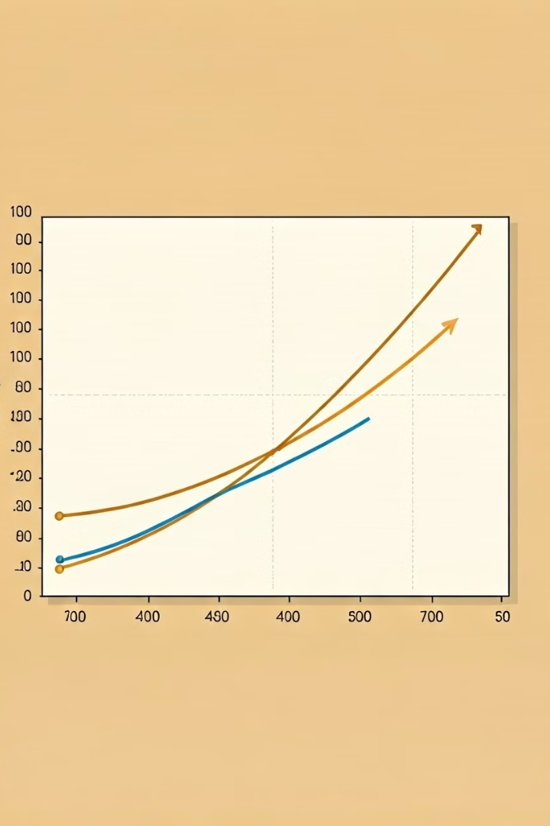
Complexity Analysis
Time Complexity
O(N) - as every cell is added and removed only once from the queue. And a typical enqueue or dequeue operation takes O(1) time.
Space Complexity
O(N) - Queue size can be up to N.

