Slide 1

Wi-Fi Coverage Optimization for a Smart Campus
A Case Study at Amrita University
Group 2:
K. Bhavya Naga Sai [CB.EN.U4CSE22328]
N. Sreya [CB.EN.U4CSE22059]
S. Keerthana [CB.EN.U4CSE22050]
Harini Krishna [CB.EN.U4CSE22138]
April 06, 2025

Slide 2
Introduction
Problem: The Wi-Fi network at Amrita University has coverage gaps in classrooms, hostels, and outdoor spaces.
Challenges: High user density and interference degrade performance.
Approach: Used Netspot to simulate Wi-Fi coverage and measure signal strength.

Slide 3
Objectives
Simulate coverage and signal strength using Netspot.
Identify Wi-Fi dead zones across the campus.
Propose an optimized access point (AP) placement strategy.
Recommend frequency planning, beamforming, and MIMO techniques.

Slide 4
Methodology
f
Data: Collected Wi-Fi signal strength records (Signal in dBm, Channels, APs).
Tool: Netspot for simulation and signal measurement.
Analysis: Python with Pandas, Matplotlib, and DBSCAN(Density-Based Spatial Clustering of Applications with Noise) clustering to detect dead zones.

Slide 5
RSSI - Received Signal Strength Indicator
Signal (dBm) | Quality | What it Means
-30 dBm | Excellent | Perfect signal strength
-50 dBm | Very Good | Reliable for HD video & gaming
-60 dBm | Good | OK for general use (browsing, calls)
-70 dBm | Fair | Usable, but might lag or buffer
-80 dBm | Weak | Poor connection, likely unstable
-90 dBm | Very Weak | Barely usable, may not connect

Slide 6
Signal Strength Insights
Average: -71.50 dBm (moderate).
Minimum: -90 dBm (poor).
Dead Zones: 38.04% of readings ≤ -80 dBm.
Channels: Mostly 5 GHz (e.g., 161), some 2.4 GHz (e.g., 6).

Slide 7
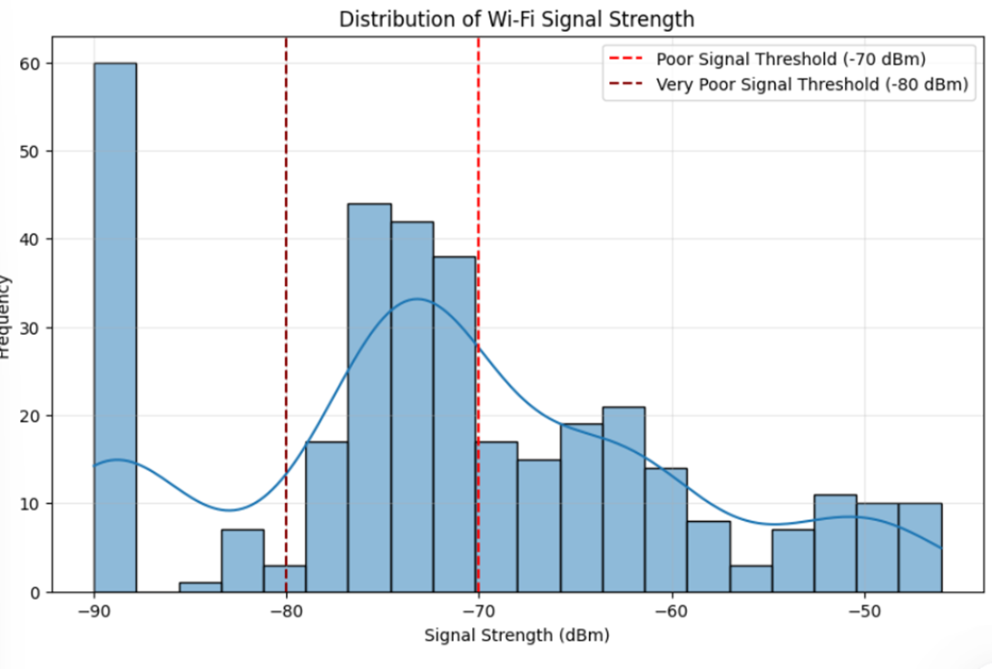
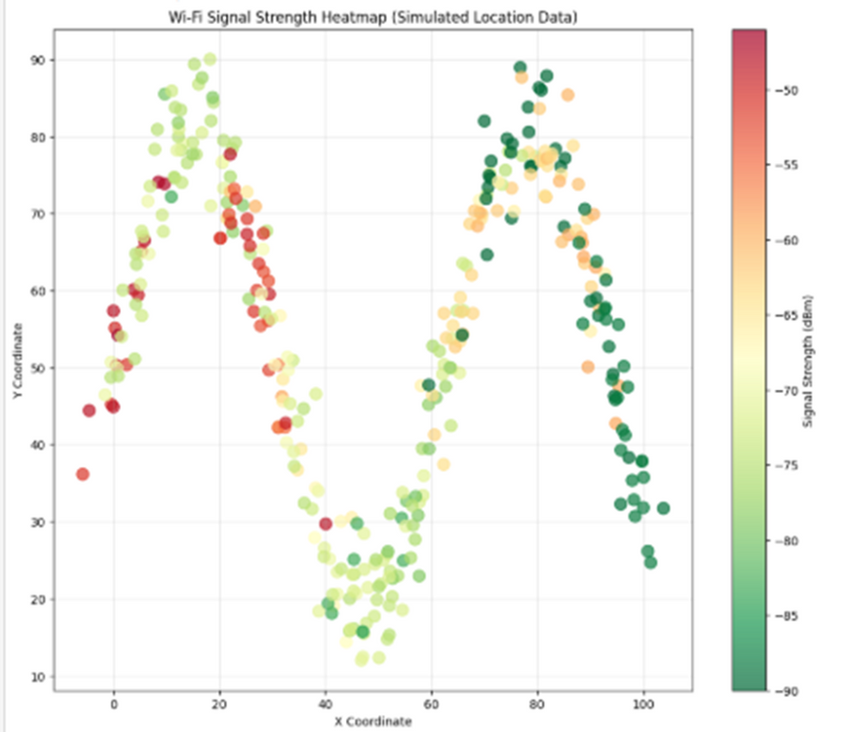

Slide 8
Dead Zone Detection
Method: DBSCAN clustering on signals ≤ -80 dBm.
Findings: Clusters of poor signals indicate dead zones (e.g., classrooms, hostels).
Issue: Uneven coverage despite 11 APs.

Slide 9
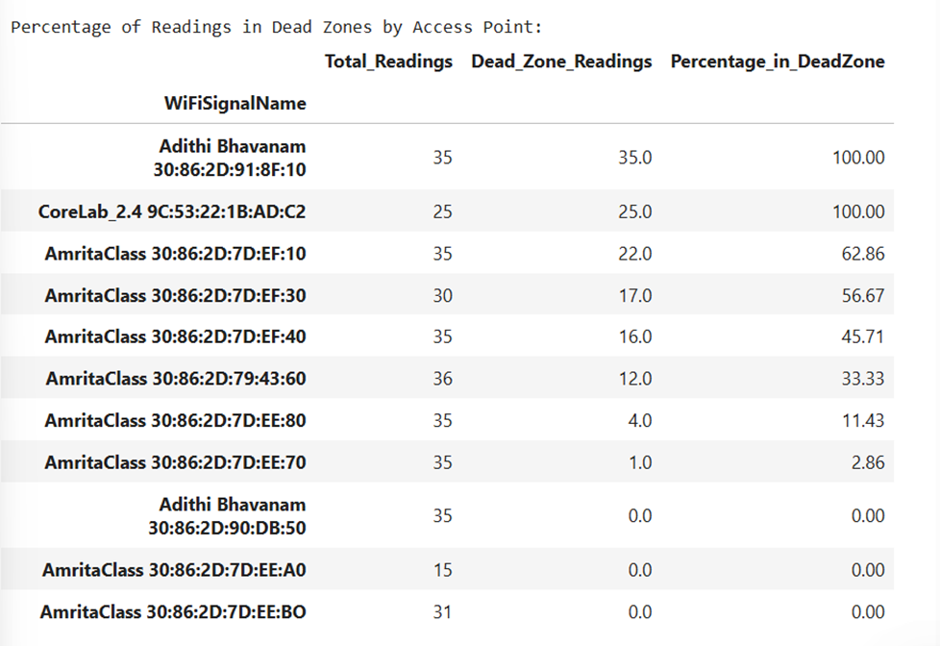

Slide 10
Current Network Challenges
Coverage Gaps: Signals drop to -90 dBm in key areas.
Interference: Overlapping channels (e.g., multiple APs on 161, 6).
Density: High user load weakens signals in busy zones.

Slide 11
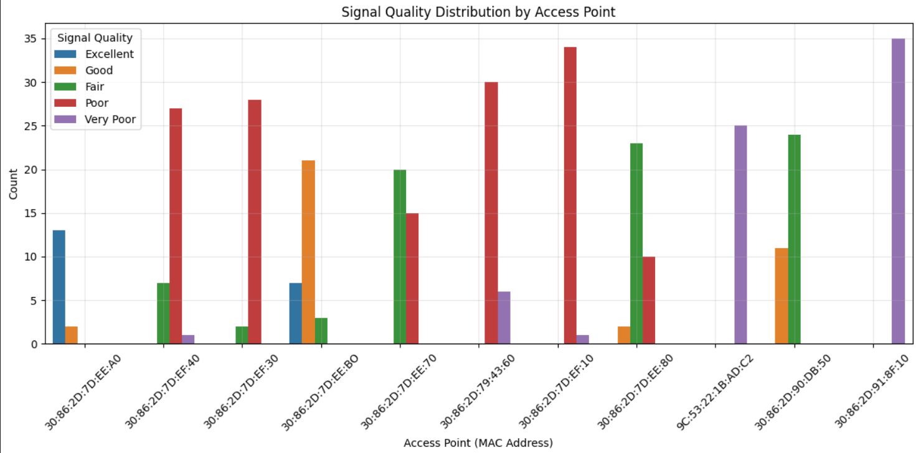

Slide 12
Optimized AP Placement
Strategy: Add 3-5 APs in dead zone clusters.
Focus Areas: Classrooms, hostels, outdoor spaces with ≤ -80 dBm.
Adjustment: Reposition existing APs for balanced coverage.

Slide 13
Frequency Planning
Issue: Channel overlap detected.
Recommendations:
Use 5 GHz channels (e.g., 36, 44, 149, 161).
Dynamic Channel Assignment is a part of Radio Resource Management (RRM) where Wi-Fi access points automatically select the best wireless channel based on real-time conditions like:
1. Signal strength
2. Channel congestion
3. Interference levels
4. Number of connected devices
20 MHz in high-interference zones, 40/80 MHz elsewhere.
Channel reuse for 11 APs.

Slide 14
Beamforming Techniques
Goal: Enhance signal in dead zones.
Recommendations:
Enable explicit beamforming (802.11ac/ax).
Target clusters with ≤ -80 dBm.
Use adaptive beamforming for mobility.
Optimize power with beamforming.

Slide 15
MIMO Techniques
Goal: Boost capacity and coverage.
Recommendations:
Deploy MU-MIMO (Wi-Fi 6).
Use 4x4 or 8x8 MIMO APs in dense areas.
Place in dead zone centroids.
Combine with beamforming.

Slide 16
Integrated Strategy
Frequency: 5 GHz + RRM.
Beamforming: Wi-Fi 6 APs in dead zones.
MIMO: 4x4/8x8 MU-MIMO in high-traffic areas.
Steps:
Pilot in one cluster.
Measure (target: > -65 dBm).
Scale campus-wide.

Slide 17
Expected Outcomes
Coverage: Dead zones < 10%.
Interference: Reduced overlap.
Capacity: Higher user support.
Metric: Average signal > -65 dBm.

Slide 18
Thank you

