Slide 1
Deterministic Data Reconciliation System
Numeric-Aware Fuzzy Matching with AI-Assisted Explainability
Presented by: [Vaishnavi, aaa, bbb, and ccc]
Date: January 29, 2026

Slide 2
Agenda
Problem Statement
Proposed Solution
Key Features
Technology Stack
System Architecture
Methodology: Deterministic Matching
AI & ML Integration
Conclusion & Future Scope

Slide 3
Problem Statement
Inaccurate Matching: Traditional fuzzy matching often ignores or underweights numeric identifiers (e.g., "Invoice 123" vs "Invoice 124").
High False Positives: Causes incorrect mappings in critical financial and operational datasets.
Non-Deterministic Results: Same inputs can produce inconsistent results across different runs.
Lack of Explainability: "Black box" matching provides no human-readable justification for compliance.

Slide 4
Proposed Solution
Numeric-Awareness: Explicitly compares numbers embedded in text to enforce consistency.
Deterministic Logic: Guaranteed repeatability and stability of results.
AI-Assisted Explainability: GenAI generates natural language reasons for match decisions.
Confidence Analysis: ML models classify matches as HIGH, MEDIUM, or LOW confidence.
Auditability: Full traceability of every match decision.

Slide 5
Key Features
Deterministic Matching Engine: Text similarity (RapidFuzz) + Strict numeric comparison.
GenAI Explanations: Human-readable justifications for ACCEPT/REJECT decisions.
ML-Based Confidence Scoring: Independent verification of match quality.
Role-Based Access Control (RBAC): Secure access for Analysts and Admins.
Comprehensive Audit Trail: Logs every decision, score, and explanation.

Slide 6
Technology Stack
Frontend:
  React 19 (TypeScript)
  Secure Authentication (JWT)
Backend:
  Flask 3.x (Python 3.12)
  REST API Architecture
Data & AI:
  PostgreSQL (Database)
  Google Gemini (GenAI for explanations)
  Scikit-learn (ML for confidence scoring)
  RapidFuzz (String matching)

Slide 7
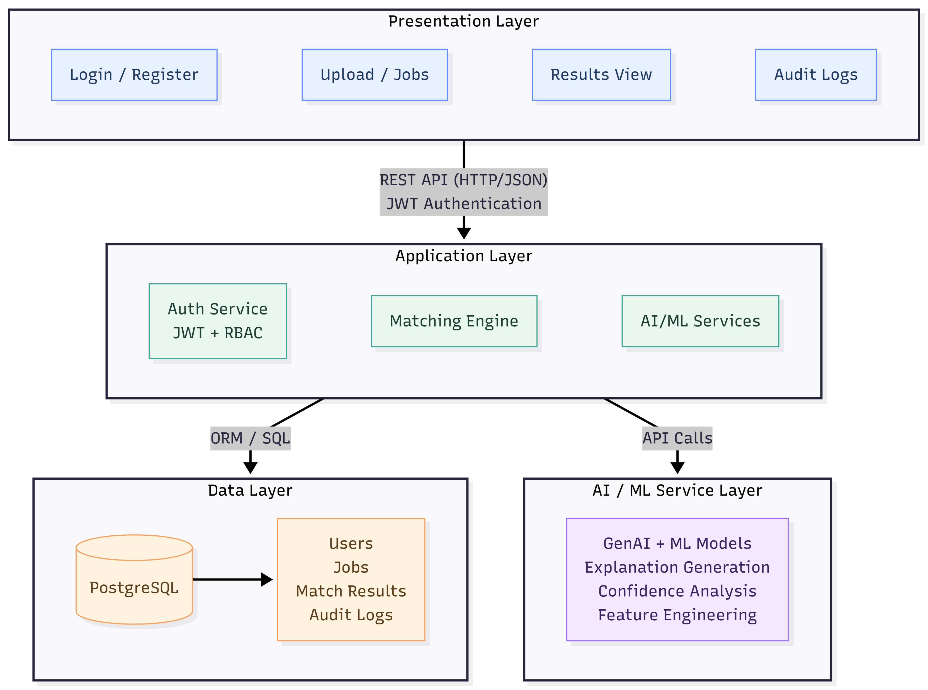
System Architecture
N-Tier Enterprise Architecture
1. Presentation Layer: React UI for job submission and result visualization.
2. Application Layer: Flask API handling business logic, auth, and orchestration.
3. Core Engine: Deterministic matching logic + AI/ML Service integration.
4. Data Layer: PostgreSQL storing Users, Jobs, Matches, and Audit Logs.

Slide 8
Methodology - The Matching Logic
How it works:
Input Processing: Ingests source and target datasets (Excel/CSV).
Signal Extraction: Extracts text tokens and numeric values from records.
Hybrid Scoring:
- Calculates Text Similarity Score.
- Performs Strict Numeric Check (Pass/Fail).
Decision Making:
- If Numeric Check fails -> REJECT (regardless of text similarity).
- If Text Score > Threshold AND Numeric Check passes -> MATCH.
AI Augmentation: Generates explanation and confidence score for the result.

Slide 9
AI & ML Integration
Beyond Simple Matching:
GenAI (Google Gemini):
  Input: Source text, Target text, Scores.
  Output: "Matched because description is 95% similar and numeric identifiers '1001' are identical."
ML Confidence Model:
  Features used: Text Score, Numeric Presence, Token Overlap.
  Output: Confidence Level (HIGH / MEDIUM / LOW).
  Benefit: Helps analysts prioritize manual review for Low/Medium confidence matches.

Slide 10
Conclusion & Future Scope
Conclusion:
  Solves the "numeric blindness" of traditional fuzzy matching.
  Provides compliance-ready audit trails with AI explanations.
  Reduces manual effort and operational risk.
Future Scope:
  Real-time stream processing (Kafka/RabbitMQ).
  Self-learning feedback loops to improve ML models.
  Advanced visualization dashboards for match statistics.

