Slide 1
Project
File created on: 14-06-2022 13:56:38

Slide 2
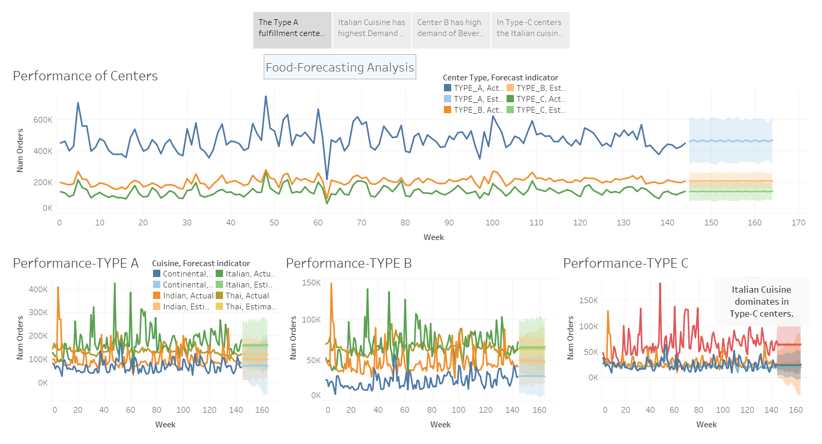

Slide 3
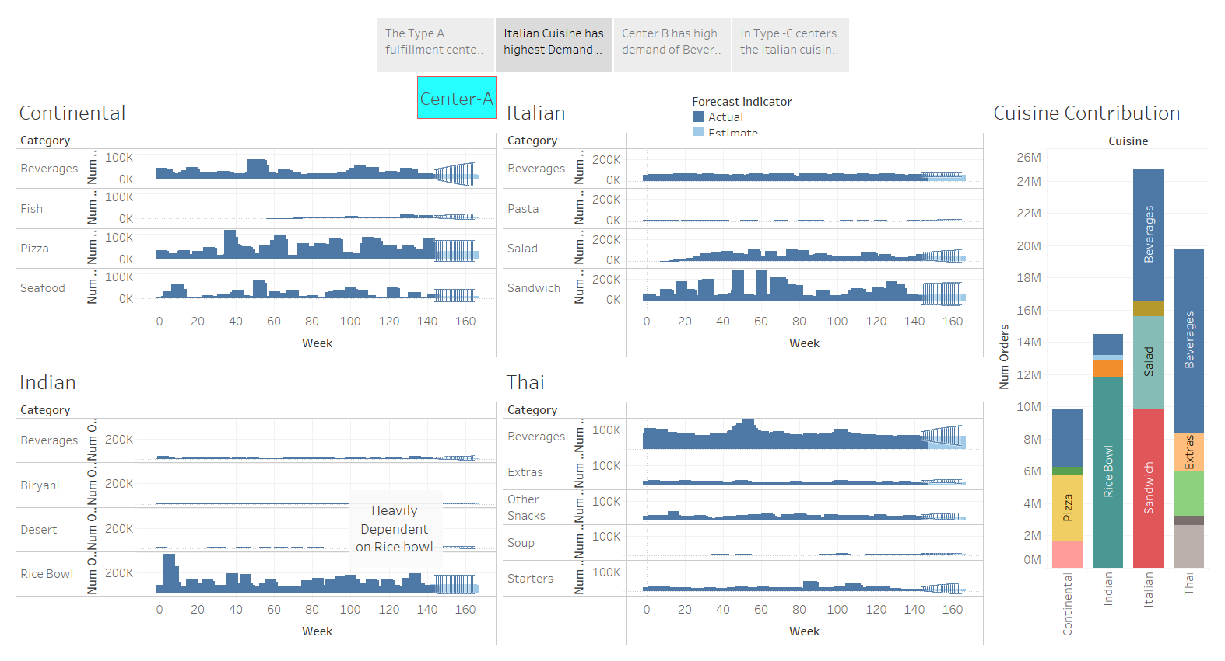

Slide 4
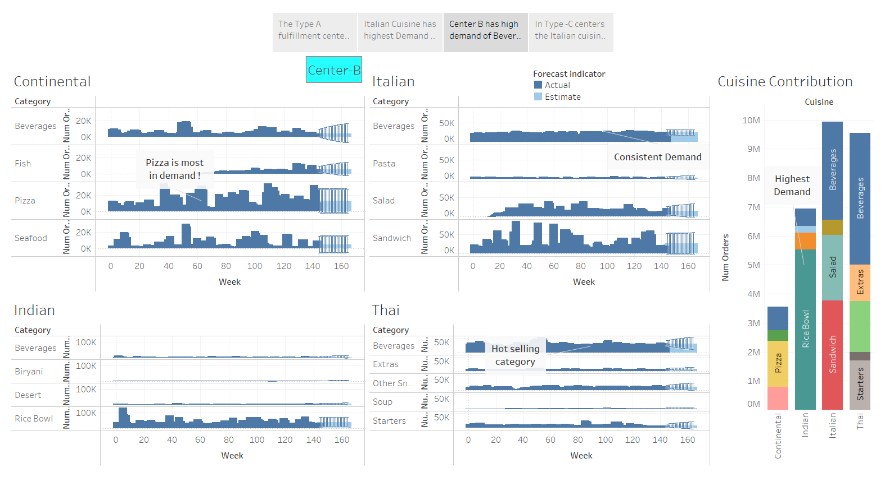

Slide 5
