Slide 1
ShellX – Student Linux Toolkit
An All-in-One Menu-Driven Linux Utility for Students
Team Name: Tech Together
Guide: Dr. Pavan Kumar Pagadala
Team Members:
Roll No. | Name
2510030379 | P.Bhavya
2510030350 | Sejal Heda
2510030330 | T.Hansika
2510030325 | B.Siri

Slide 2
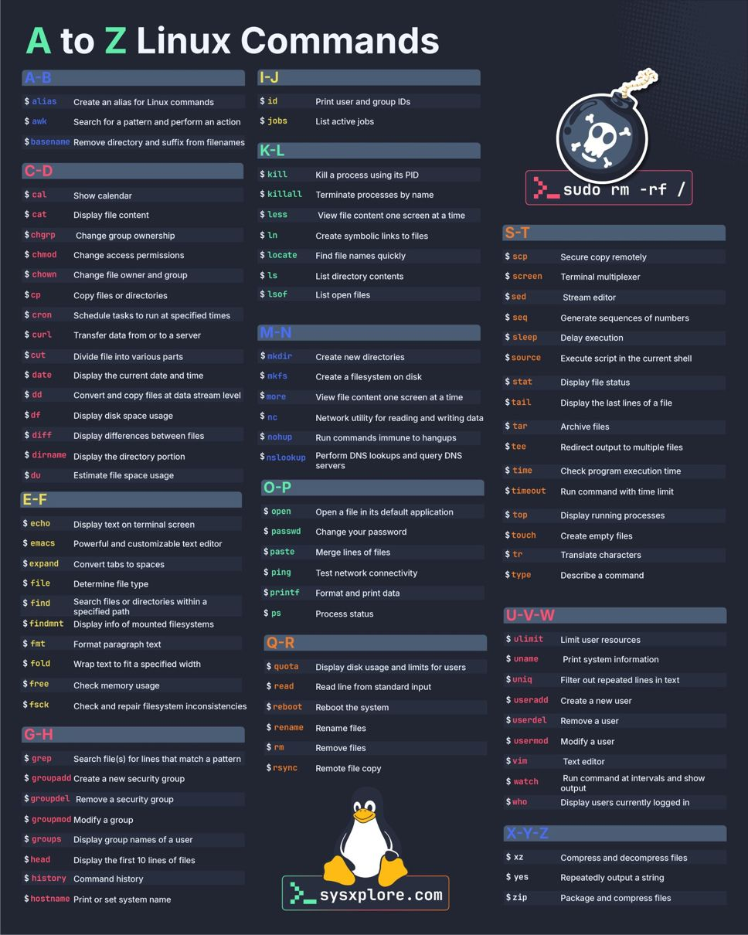
Problem Statement
Many beginners find Ubuntu and Linux commands difficult to remember for everyday tasks such as file management, system information, and command execution. ShellX simplifies these tasks by providing a single menu-driven application, making Linux easier to learn while offering practical experience with C programming and Operating System concepts.

Slide 3
Core Modules
Module | Description
File Manager | Create, delete, rename, copy, move, search, and display files.
Command Runner | Execute common Linux commands like ls, pwd, date, and whoami.
Notes Manager | Create, view, edit, and delete personal notes stored in text files.
Calculator | Perform basic arithmetic operations.
System Information | Display current user, date, time, CPU, RAM, disk usage, and current directory.
Help Guide | Provides a quick reference for commonly used Linux commands.
Password Generator | Generates secure random passwords based on user-defined length.

Slide 4
Objectives
01
02
03
04
Simplify Linux Operations
Enhance Practical Learning
Apply OS Concepts
User-Friendly Toolkit
Develop a menu-driven toolkit that allows beginners to perform common Linux tasks without remembering multiple terminal commands.
Provide hands-on experience with Ubuntu, Linux commands, and C programming through an interactive application.
Implement Operating System concepts such as file handling, process execution, system information, and command execution.
Create a modular, easy-to-use application that can be expanded with additional Linux utilities throughout the semester.

Slide 5
Technologies Used
Technology | Purpose
C Language | Core programming language used to develop the project
Ubuntu Linux | Development and execution environment
GCC Compiler | Compiles the C source code
Makefile | Automates project compilation
Git | Version control
GitHub | Project collaboration and repository management
Linux Terminal | Running and testing the application

Slide 6
Application Workflow
User
│
▼
ShellX Main Menu
│
┌─────────────┼─────────────┐
│ │ │
▼ ▼ ▼
File Command Notes
Manager Runner Manager
│ │ │
▼ ▼ ▼
Performs Requested Operation
│
▼
Display Result
│
▼
Return to Main Menu

Slide 7
Extra Features
Feature | Description
Welcome Screen | Displays project title, team details, and current date & time.
Colored Terminal Interface | Makes the terminal interface more attractive and user-friendly.
Command History | Displays recently executed commands for quick reference.
Favorite Commands | Saves frequently used Linux commands for easy access.
Digital Clock | Displays the current system time.
Calendar Viewer | Displays the monthly calendar.
Session Log | Records user activities during the current session.
Help Menu | Provides information about modules and Linux commands.

Slide 8
User Interaction Flow
Module | User Action | Output | C Concepts Used
Welcome Screen | Start Application | Welcome message with date & time | printf(), <time.h>
File Manager | Create/Delete/Rename Files | Success/Error Message | File Handling (fopen(), fprintf())
Command Runner | Select Linux Command | Command Output | system() (initially)
Notes Manager | Add/View Notes | Notes Saved or Displayed | File I/O, Strings
Calculator | Enter Numbers | Calculated Result | Functions, switch-case
System Information | Select Module | Displays System Details | system(), Strings
Password Generator | Enter Length | Random Password | rand(), Arrays

Slide 9
Expected Outcome
After completion, ShellX will provide a centralized Linux toolkit that enables beginners to perform common Linux tasks through a simple menu-driven interface.
The project will improve students' understanding of Ubuntu, Linux commands, C programming, and basic Operating System concepts while providing practical hands-on experience.

Slide 10
THANK YOU!

