Slide 1

ShellX — Student Linux Toolkit
Review 2 · Literature Review & Research Gap Analysis
OSSP PROJECT · B.TECH 2ND YEAR · TEAM: TECH TOGETHER
P.Bhavya - 2510030379
Sejal Heda - 2510030350
B.Siri - 2510030325
Hansika - 2510030330

Slide 2





Problem Background & Motivation
The Core Challenge
Beginner
Linux command-line interfaces are powerful but present a steep initial learning curve for beginners. Users must simultaneously remember commands, syntax, options, and command sequences — creating a significant cognitive burden.
Encounters the CLI for the first time
Command Syntax
Must recall exact commands & flags
"How can Linux operations be made easier for beginners without completely hiding the underlying command-line concepts?"
Memory Load
Cognitive overload from options
Errors & Barrier
Mistakes → frustration → learning barrier

Slide 3
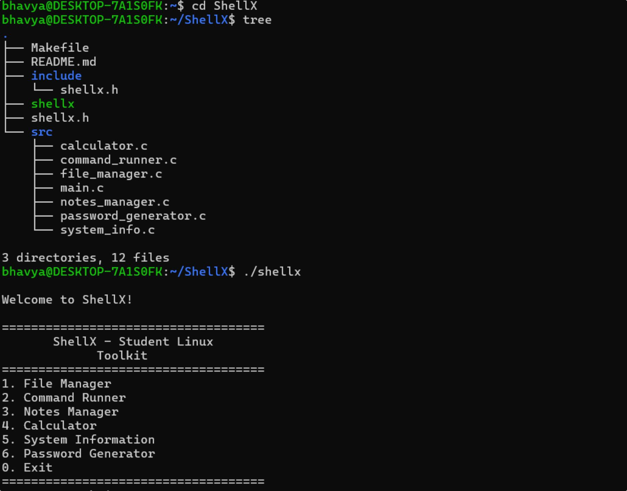
ShellX Project Structure & Implementation Overview
This screenshot illustrates the proposed modular architecture of ShellX, showcasing its main menu system and various core modules: File Manager, Command Runner, Notes Manager, Calculator, System Information, and Password Generator. This design emphasizes ease of navigation and a clear separation of functionalities for a streamlined user experience.

Slide 4


Literature Review — Novice Command-Line Interaction
1
2
3
Lewis & Jamison (1989)
Herrera & Ward (2005)
Durham & Emurian (1998)
"Problem Solving in Naive Users"
Focus: Unix Tutor and novice Unix users; menu-based assistance for beginners.
Key Insight: Guided interaction can support novice Unix users.
Limitation: Focused on Unix learning rather than an integrated student utility toolkit.
"Training Wheels for the Command Line"
Focus: Assistance mechanisms using visible choices, guidance, feedback and documentation.
Key Insight: Guided command construction reduces the burden on beginners.
Limitation: Focused on command-line assistance rather than a broader student toolkit.
"Learning and Retention with a Menu and a Command Line Interface"
Focus: Compared menu-based and command-line interaction for Unix learning.
Key Insight: Interface style directly affects learning and retention outcomes.
Limitation: Focused on interface comparison rather than integrating multiple Linux utilities.
Key Literature Insight: Guidance can reduce the initial difficulty of CLI interaction, while still allowing users to understand the underlying commands.

Slide 5



Literature Review — Modern Learning & Command Assistance
Winder et al. (2024) — Shell Tutor
tldr-pages
Traditional Linux man pages
Concise, practical examples for Linux commands — makes documentation accessible for beginners. Limitation: Primarily a command-reference/documentation system with no task integration.
"An Intelligent Tutoring System for the UNIX Command Shell and Git"
Supports structured shell learning with tutoring-oriented assistance and interaction logging. Limitation: Primarily tutoring-oriented, not an integrated everyday Linux utility environment.
Comprehensive and authoritative command reference. Limitation: Difficult for beginners due to the volume and technical depth of information presented.
Documentation
Command Assistance
Tutoring
Integration

Slide 6
Comparison of Existing Solutions
The table below positions ShellX against reviewed tools across key dimensions. ShellX is a proposed integrated toolkit; this comparison represents project positioning and does not claim superiority over specialised systems.
Solution
Beginner Guidance
Command Help
Practical Linux Tasks
System Utilities
Integrated Toolkit
Learning Focus
Traditional CLI
Low
Manual
✓
✓
—
Low
Unix Tutor
High
✓
Limited
Limited
—
High
Training Wheels
High
✓
Limited
Limited
—
High
Shell Tutor
High
✓
Limited
Limited
—
High
tldr-pages
Medium
✓
—
—
—
Medium
ShellX (Proposed)
High
✓
✓
✓
✓
High

Slide 7

Research Gaps Identified
1
G1 — Fragmented Functionality
Existing solutions often focus on documentation, tutoring, or command assistance in isolation rather than providing an integrated student toolkit.
2
G2 — Learning vs. Practical Usage
Learning commands and performing everyday Linux tasks are not consistently addressed together in a single environment.
3
G3 — Command Memorization Burden
Traditional CLI interaction requires users to recall commands, syntax, and options from memory, increasing cognitive load.
4
G4 — Limited OS/C Concept Connection
An opportunity exists to connect common Linux operations with concepts such as file I/O, processes, and system-level operations.
5
G5 — Lack of Student-Oriented Integration
There is an opportunity for a lightweight toolkit focused specifically on common student Linux tasks in one place.
Existing Work
Unaddressed Opportunity
Documentation, tutoring, command assistance
Existing Limitations
Integrated student toolkit for practical use
Fragmented functionality; siloed tools

Slide 8


From Research Gap to Proposed ShellX Direction
CLI Difficulty
→ Menu-driven interaction
Command Memorization
Proposed Interaction Flow
→ Guided options + command help
Fragmented Utilities
→ Single integrated toolkit
ShellX Menu
Guided Operation
Linux / C Mechanism
Learning vs. Practical Use
Student
Result
→ Learn while performing common Linux operations
ShellX is a proposed direction; implementation is not presented as complete.
Weak OS/C Connection
→ Connect user operations with Linux and C/OS concepts

Slide 9








Proposed ShellX Scope
File Manager
Command Runner
Notes Manager
Create, delete, rename, copy, move and manage files through a guided interface.
Execute selected Linux commands through a guided, menu-driven interface.
Create and manage notes using file I/O operations.
Calculator
System Information
Help Guide
Basic arithmetic functionality for quick student use.
Display useful system, user, and environment information.
Beginner-friendly Linux command reference built in.
Student Utilities
Lightweight utilities such as clock and calendar.
PROPOSED TECHNICAL DIRECTION: C · UBUNTU/LINUX · GCC · MAKEFILE · GIT/GITHUB

Slide 10


Expected Contribution & Next Stage
Expected Contribution
Project Review Timeline
Beginner-Friendly Linux Interaction
Guided Exposure to Linux Commands
"The identified research gap will guide the methodology and system design developed in the next stage."
Guided menus reduce the initial CLI learning barrier for students.
Users learn commands in context while performing real operations.
Integration of Common Student Utilities
Practical Application of C & OS Concepts
A single toolkit covering the most frequent student Linux tasks.
Connects everyday operations with file I/O, processes, and system calls.
Lightweight Modular Design
Each module is independently scoped for maintainability and extensibility.
Review 1
Project Identification
Review 2 — CURRENT STAGE
Literature Review + Research Gap Analysis
Review 3
Methodology + System Design
Review 4
Validation + Evaluation

Slide 11
References
01
02
03
C. M. Lewis and W. Jamison, "Problem Solving in Naive Users," Proceedings of the Human Factors Society Annual Meeting, 1989. DOI: 10.1177/154193128903300540
D. Herrera and N. Ward, "Training Wheels for the Command Line," Human-Computer Interaction International, 2005.
A. G. Durham and H. H. Emurian, "Learning and Retention with a Menu and a Command Line Interface," Computers in Human Behavior, vol. 14, no. 4, pp. 597–620, 1998. DOI: 10.1016/S0747-5632(98)00026-0
04
05
J. Winder, E. Falor, S. Poulsen, and J. Edwards, "The Shell Tutor: An Intelligent Tutoring System for the UNIX Command Shell and Git," Proceedings of ITiCSE 2024, pp. 548–554. DOI: 10.1145/3649217.3653631
tldr-pages, "Simplified and community-driven man pages," project documentation.
SHELLX · TEAM TECH TOGETHER · B.TECH 2ND YEAR OSSP · REVIEW 2

