Slide 1

AI vs Human: Strategic Integration for Sustainable Edge
Aligning technology with talent
March 2026 | Strategic Advisory Team

Slide 2
Functional Impact
Key market shifts

Slide 3
AI Augmentation Delivers 14% Average Productivity Uplift
14%
Productivity uplift
Across finance, supply chain, support

Slide 4
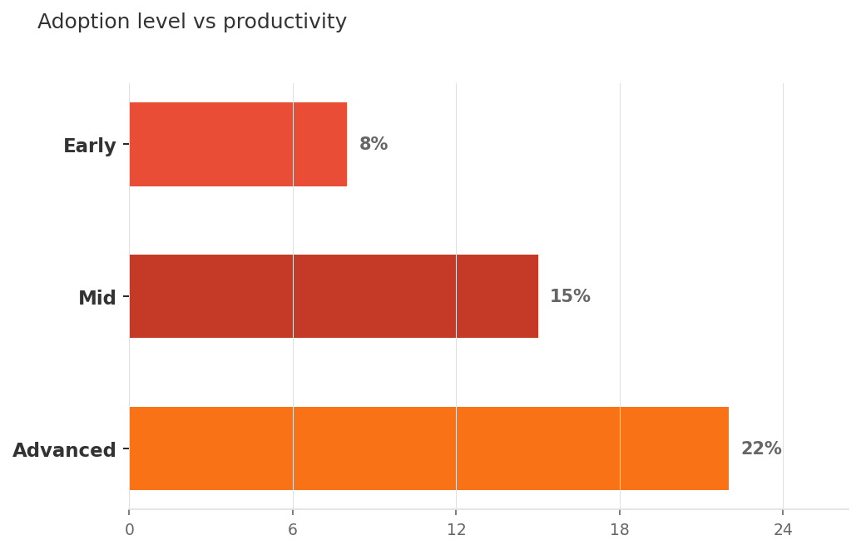
Higher AI Maturity Correlates With 10‑20% Output Gains
Adoption level vs productivity

Slide 5
AI Strengths Complement Human Expertise Across Capabilities
Capability Comparison
Capability | AI | Human
Pattern detection | Fast, high volume | Contextual nuance
Decision speed | Milliseconds | Ethical judgment
Scalability | Unlimited | Relationship building

Slide 6

Roadmap: Pilot, Scale, Integrate AI–Human Collaboration
▸ Pilot high‑impact, low‑risk functions first
▸ Scale with standardized model‑ops and governance
▸ Integrate AI into core processes with human oversight

