Slide 1
Color-Centric Genre Prediction and Recommendation System for Movies
Presented By:Abbas Khan-22BCE5004,
Bhavya Shukla-22BCE1365,
Karthik Reddy-22BCE1984
Course code: BCSE403L
Course name : Digital image processing
Faculty name: Geetha S
University name : Vellore Institute of technology , Chennai campus

Slide 2
Introduction
Color schemes in movies play a crucial role in setting the mood and enhancing storytelling. This project aims to automate the extraction of color palettes using advanced techniques, resulting in better insights into cinematic design and classification. this project seeks to move beyond subjective analysis of movie visuals. The resulting color palettes will then be analyzed for patterns and trends across different genres and directors. This data-driven approach promises to offer a more objective understanding of how color contributes to the emotional impact and thematic elements of films. Ultimately, this research could lead to more nuanced movie genre classification models and provide valuable insights for filmmakers and critics alike."

Slide 3
Abstract
we propose a visual content-based movie genre prediction and recommendation based on dominant color palettes. We obtain representative color schemes of movies by scene segmentation, keyframe detection, and salient region extraction from saliency maps. From the extracted palettes, we calculate the dominant color in RGB space and employ it as a semantic descriptor to predict the genre of the film. In addition, we employ color similarity to provide recommendations with common visual tones for movies, providing a contrast to conventional metadata-based systems. Without access to a pre- existing dataset, we tested a varied set of freely available movies with diverse genres. The findings indicate that dominant color can capture narrative tone and stylistic aspects, posing as an effective signal for light-weight genre classification and visually consistent recommendations.

Slide 4
Problem Statement
In the absence of structured metadata and large labeled datasets, current movie recommendation and genre classification systems often fail to deliver accurate results, particularly for lesser-known or visually unique films. Traditional approaches heavily depend on textual metadata, user history, or deep learning-based visual embeddings, which require extensive computational resources and are not always interpretable.
This research aims to develop a lightweight, visual content-based system that predicts a movie’s genre and provides visually coherent recommendations by leveraging the dominant color palettes extracted from keyframes of the movie. The proposed solution bypasses the need for deep networks by using saliency-based frame selection and RGB clustering to determine dominant tones, offering an accessible and interpretable alternative for genre inference and aesthetic movie recommendations.

Slide 5
Objective
Develop an automated pipeline for extracting color schemes from movies.
Enhance storytelling analysis through color-based insights.
Improve the accuracy of extracted palettes using machine learning and clustering techniques.
Optimize processing speed for large-scale movie datasets.
Provide a foundation for applications in film analysis, content creation, and AI-powered search engines.

Slide 6
System Overview
The system includes:
1.Scene boundary detection
2. keyframe extraction
3. Dominant colour extraction
4. Feature vector construction
5. Genre classification
6.Genre display

Slide 7
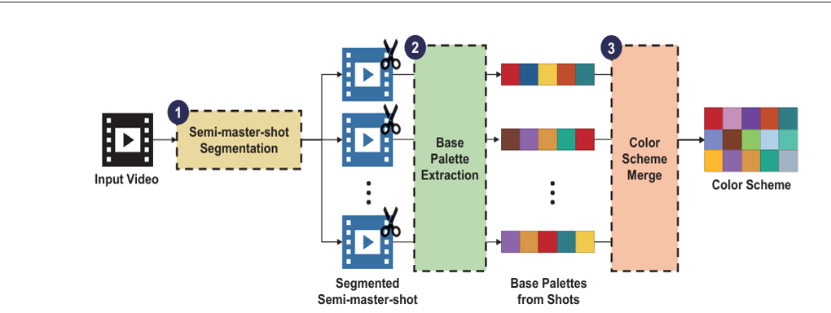
Architecture

Slide 8
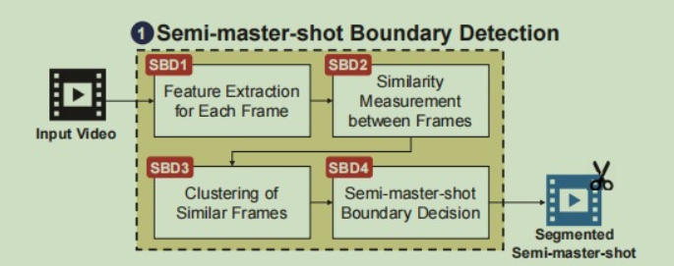
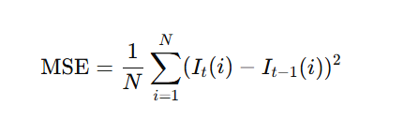
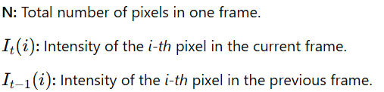
Scene Boundary detection
To obtain representative shots from a video, we employ a smaller variant of semi-master-shot boundary detection (SBD). The neighboring frames are mapped to grayscale and aligned on Mean Squared Error (MSE). Scene boundary detection is made on the basis of a threshold on MSE. If the gap is more than a threshold value (say 1000), the frame is stored as a keyframe. This results in a sparse set of frames that are assumed to represent distinct visual changes in the movie.

Slide 9
Key Frame Extraction
After computing the Mean Squared Error (MSE) between consecutive grayscale frames, keyframe extraction is performed by comparing each MSE value to a predefined threshold. If the MSE exceeds this threshold (e.g., 1000), it signifies a significant visual change, and the corresponding frame is marked as a keyframe. Frames with lower MSE values are skipped to avoid redundancy and ensure only meaningful scene transitions are captured. This method results in a sparse collection of keyframes that effectively represent distinct scenes throughout the video. this approach ensures computational efficiency by reducing the number of frames processed. It also enhances the visual diversity of selected frames, capturing the essence of different scenes. As a result, the extracted keyframes serve as a compact yet comprehensive summary of the movie's visual narrative.

Slide 10


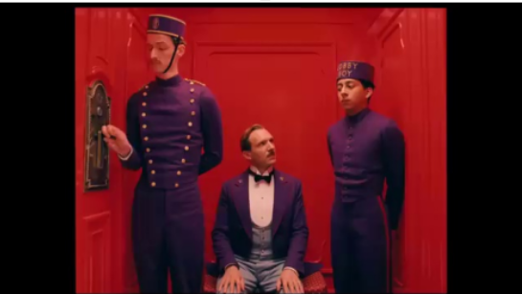
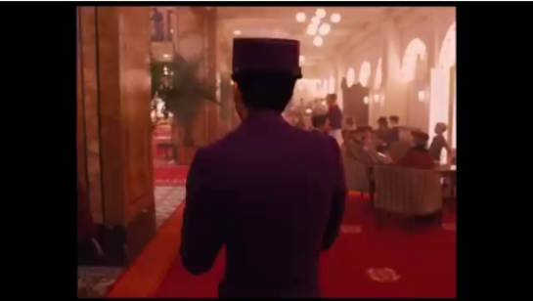
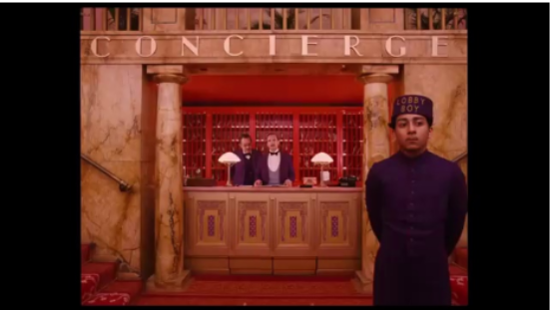
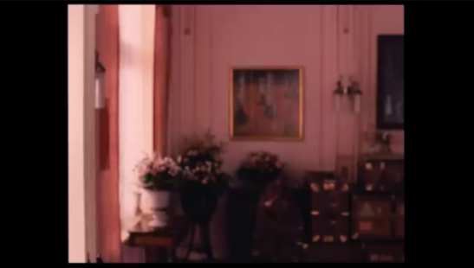
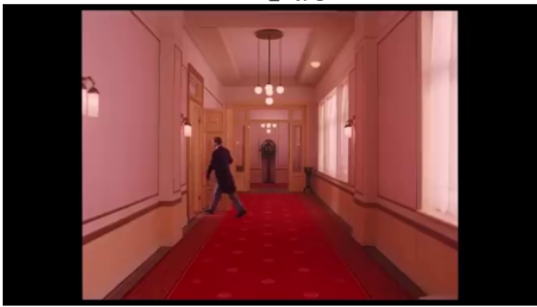
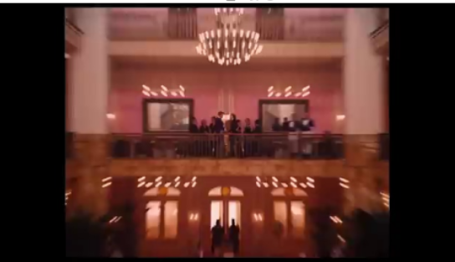
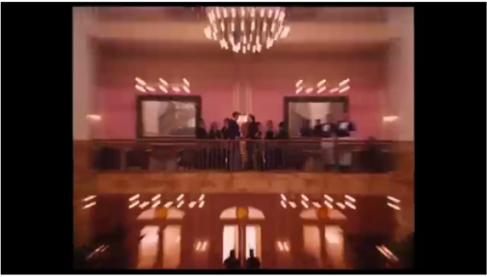
Sample Key frames of a movie

Slide 11
Saliency Mapping
After keyframe extraction, saliency mapping is applied to highlight the most visually important regions in each keyframe. Using OpenCV’s StaticSaliencyFineGrained function, a saliency map is generated that assigns higher values to areas likely to attract human attention, based on contrast, edges, and texture. This map acts as a mask, filtering out background or less relevant pixels and retaining only the salient regions. These salient areas are then used for color extraction, ensuring that the resulting color palette reflects the dominant visual elements that define the scene’s mood and tone. This process improves the relevance and accuracy of genre prediction by focusing on meaningful visual content.

Slide 12




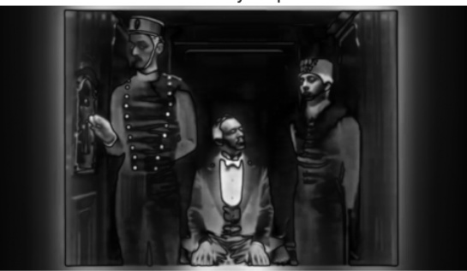
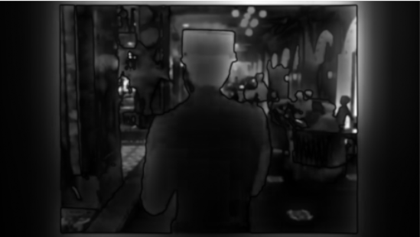
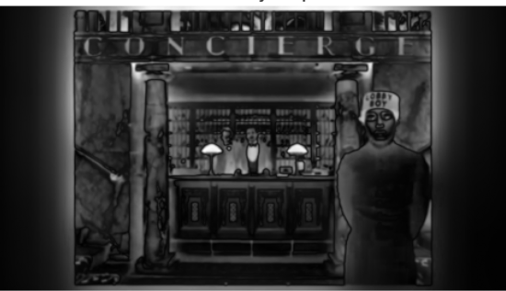
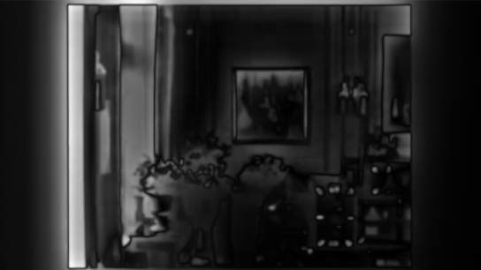
Saliency mapped frames

Slide 13
K-Means clustering
After saliency mapping pinpoints the visually significant areas of an image, the subsequent k-means clustering process concentrates on the color information within these regions. The colors of the pixels residing in the highlighted salient areas are extracted, and often transformed into a perceptually uniform color space. The k-means algorithm then initializes a set number of 'k' cluster centers within this color space. It iteratively assigns each color from the salient pixels to its closest cluster center and then recalculates the position of these centers based on the average color of the assigned pixels. This iterative process continues until the cluster centers stabilize, effectively grouping similar colors from the salient parts of the image. The final positions of these cluster centers represent the dominant colors that are most representative of the visually important content.

Slide 14
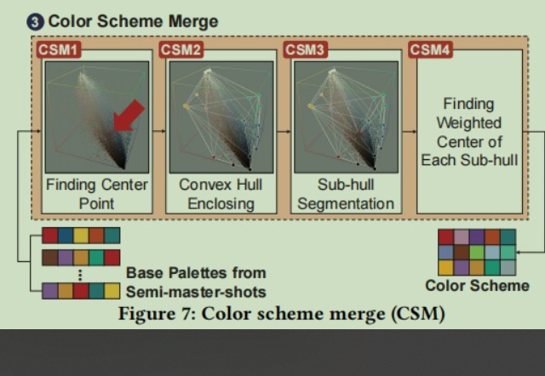
Colour Scheme Merging
a color similarity merging algorithm takes the initial set of 'k' dominant colors (the cluster centroids) as its input. The primary goal is to refine this palette by identifying and merging colors that are perceptually very similar, thus creating a more concise and visually distinct set of representative colors. This process begins by defining a metric to measure the similarity between any two colors, often using a color difference formula in a perceptually uniform color space like Lab to better align with human vision. A threshold is then established for this similarity metric.The algorithm then iterates through pairs of the dominant colors obtained from k-means. For each pair, the color similarity is calculated.

Slide 15
Feature Vector Construction
After extracting the dominant colors from keyframes using techniques like saliency mapping and K-Means clustering, we convert this color information into a feature vector. This feature vector is a fixed-size list (or array) of numbers that summarizes the color characteristics of a movie. feature vector construction transforms dominant colors from keyframes into a structured numerical format. Each keyframe’s prominent colors are identified using saliency mapping and K-Means clustering. The RGB values and their relative percentages are extracted. These are combined to form a single vector. This vector represents the visual style of the movie. It is used by machine learning models for genre prediction and recommendations

Slide 16
Genre classification
After dominant colors are extracted and refined into a feature vector, this data is fed into a machine learning classifier (such as a decision tree, SVM, or neural network). The model has been trained on labeled data, where each feature vector corresponds to a known genre. It learns patterns and associations between certain color combinations and specific genres. When a new movie’s feature vector is input, the model uses its learned knowledge to classify the movie into a likely genre, enabling accurate and automated genre prediction

Slide 17
Genre inference
The function takes a tuple of three integers, representing the dominant red, green, and blue (RGB) color values of an image as input.
These three integers would typically be generated by analyzing an image, perhaps a movie poster or a key frame from a film. An image processing algorithm would be used to identify the most prevalent or visually impactful color within the image and extract its RGB components.
Once these dominant red, green, and blue values are obtained, they are passed to the function. The function then calculates the luminance of this color using a standard formula that weights the green component most heavily, followed by red, and then blue.
Based on this calculated luminance and the individual red, green, and blue values, the function infers a movie genre.
If the luminance is very low (below 50), the function categorizes the genre as "Sci-Fi/Thriller," suggesting a dark and potentially intense visual style.

Slide 18
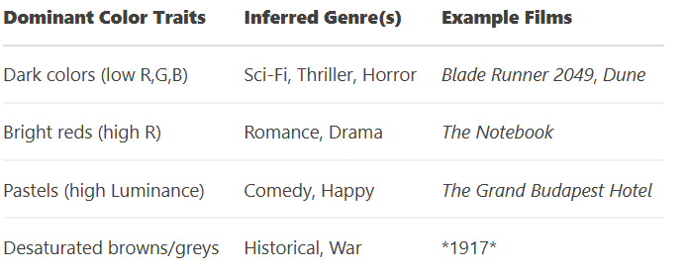
Dominant Color and Genre
If the red value is high (above 150) while both the green and blue values are low (below 100), the function predicts "Romance/Drama," possibly indicating warm, passionate tones often associated with these genres. Conversely, if the luminance is very high (above 180), suggesting a bright and light color palette, the function returns "Comedy." As a final catch-all, if none of the preceding conditions are met, the function defaults to "Drama.“

Slide 19
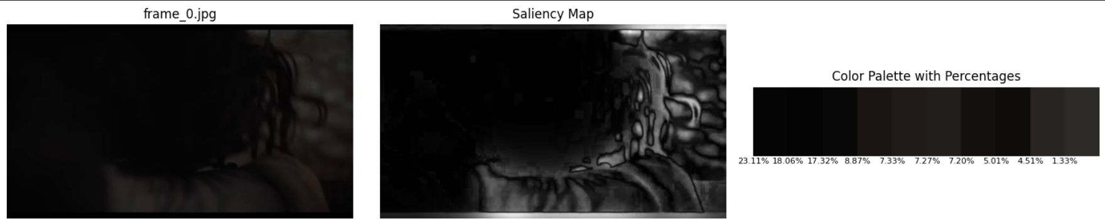
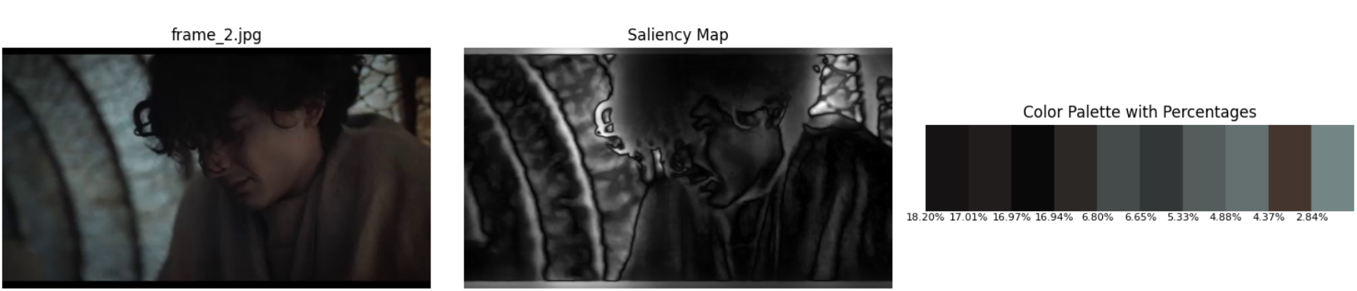
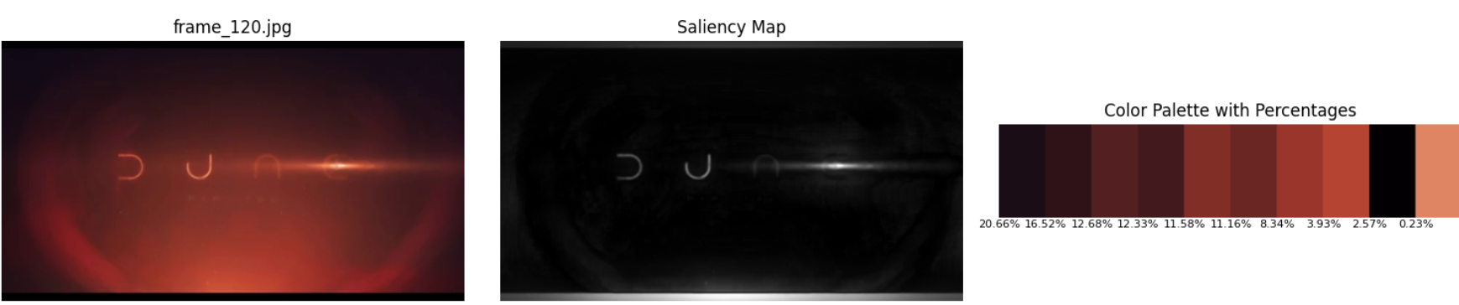

Example1:Dune 2

Slide 20
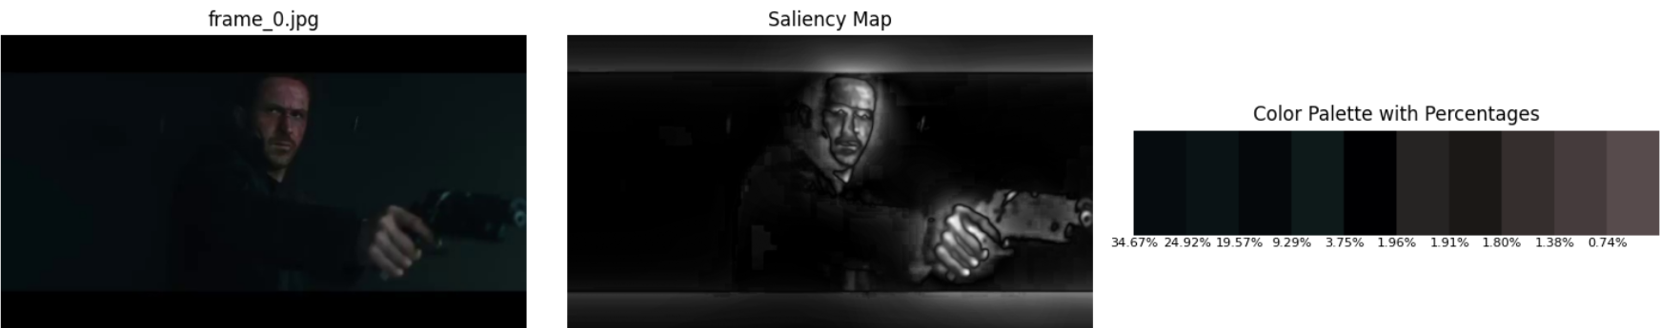
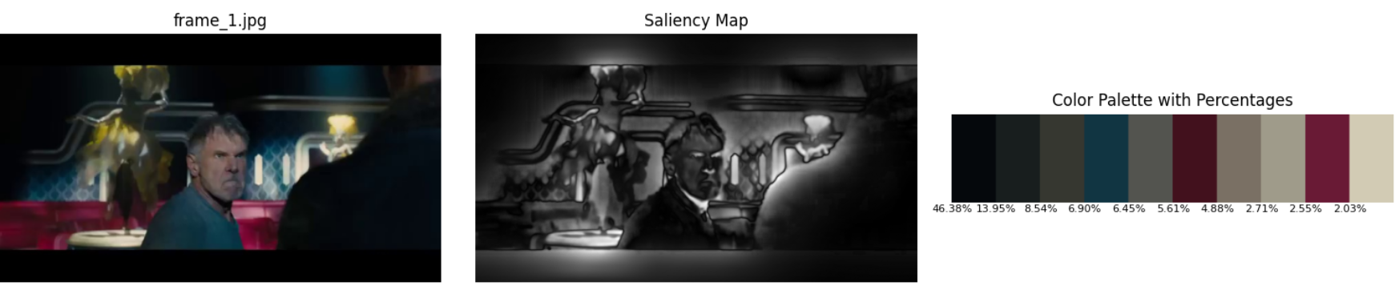
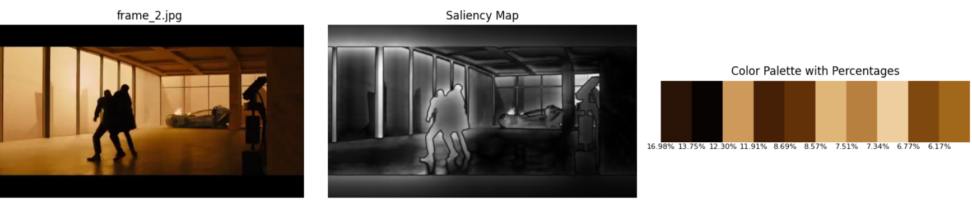

Example 2:Blade Runner 2049

Slide 21
Advantages
1)Focus on Perceptually Important Information
2)Abstraction from Low-Level Pixel Data
3)Capture of High-Level Visual Style
4) Art Analysis and History
5) Insights into Cinematic Design

Slide 22
Challenges
Accurately detecting shot boundaries in complex movie sequences.
Handling variations in lighting, contrast, and color grading across different films.
Selecting the optimal clustering approach for effective palette extraction.
Ensuring computational efficiency while processing high-resolution video frames.
Maintaining color consistency across different extracted palettes.

Slide 23
Thank you

