Slide 1
What is Business?
Broadly, business is considered an organization or an economic institution that seeks profit in return of providing goods or services. The main motivation is the pursuit of profit. Even at loss, an organization is a business as still it’s has the aim of profit making. It is not necessary for a business to be a company, corporation, partnership or any other formal organization. Small scale activities pursuing profit are also business example: street peddlers. An important characteristic of business is creation of utility or catering to needs of people. Business is a continuous activity. A single transaction of trade for profit can’t be called a business. Business is notoriously known to be associated with risks and uncertainty. Non-profit organizations running for a charitable cause are also considered business by some.

Slide 2
Here is a comparison between two sweets and snacks shops at my place. Both have the same items around the same prices.
PARAMETER | APNA SWEETS | JMB
No. of customers | More number of customers | Less number of customers
Customer satisfaction | Less number of satisfied customers | More number of satisfied customers
Quality | Average quality | Critically acclaimed for quality
No of outlets | 7 | 7+2(acquired by taking over another shop)
Established year | 1987 | 1954
Gained popularity in | Was always a popular name | Recently became popular and expanded in the last few years
Location | First shop situated at the heart of the city. | First shop situated in the less developed part of the city which has developed in the recent years.
Target customers | Targets regular customers who come for daily breakfast over sweet buying kind. | Targets less frequent customers who purchase sweets in a span of few days over daily kind.
Focus | Focuses more on local items like poha, jalebi, dhokla although has all kinds of items. | Focuses more on Bengali and Indian food and sweets although has all kinds of items.

Slide 3
PARAMETER | APNA SWEETS | JMB
Online reach | Has both website and a poorly rated App(2017). Mainly operational via other food apps like Swiggy or Zomato. | Has both website and a poorly rated App(2020). Mainly operational via other food apps like Swiggy or Zomato.
Ratings | Rated between 3.8-4 at different platforms. However higher number of reviews exist. | Rated between 4.1-4.2 at different platforms. Lesser number of reviews(compared to former) exist.
Advertising | No major advertising. However sponsors events or radio shows. | Advertisement through hoardings and FMs around opening of new shop or new service.
Expansion | Has started to collaborate with other companies and co-own resorts, restaurants, game parks ,etc. It has also started its own pizza outlet on Indian theme. | Has bought a previously famous but declining similar company and is slowly converting it into a retail shop. It has also started JMB caterers which is successfully running since 3-4 years.

Slide 4
Which will be the most profitable sector?
There exists a common consensus of software sector being the most profitable sector in the coming 5-10 years and I have similar opinion on this. The primary reason being that it is scalable and still has a huge market to cater to in developed, developing and underdeveloped countries. Although the stages of markets will be different in all of them. Therefore with lesser investments soaring profits can be made. Further, as robotics and AI is the future focus, AI software will be the center of focus. Business giants today have already started shifting their focus on the same. AI industry is predicted to break $500 billion mark with a compound annual growth rate (CAGR) of 17.5% by 2024! Here software has 88% of the total AI revenue. AI software market is predicted to increase at a CAGR OF 32.7%! All of the points prove that software will continue to be the most profitable sector in the next 5-10 years.

Slide 5
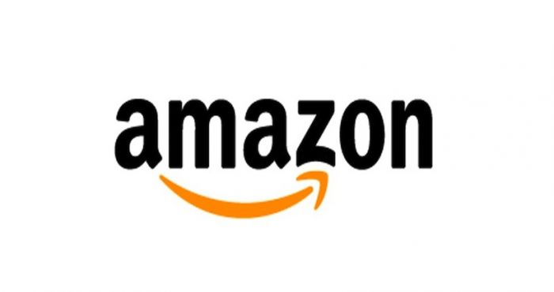
Amazon is overall my favorite startup. What fascinates me the most about it is its growth and expansion. Taking the example of India, it was launched in India in June 2013 and today is a local name. its branding techniques such as “apani dukaan” helped remove hostility from the minds of Indian people. It has also established Amazon prime, Prime video, Amazon music, Amazon pay, Echo, Kindle, Alexa, Fire , Amazon pantry, Fire tablets, Fire TV and so many more products and services each one being a success. Its recent partnership with Shopify is turning out very profitable as it is slowly taking over Google’s ad business. It is believed it may even do so. According to Fortune’s list of fastest growing companies in terms of revenue, stocks and profits for 2020, it stands at 10th position globally. In the end, I would point out that Amazon has changed lifestyle, culture and demands of people. It itself creates it demand. Even in the times of pandemic where most businesses are struggling it has seen a huge growth of revenue.

Slide 6
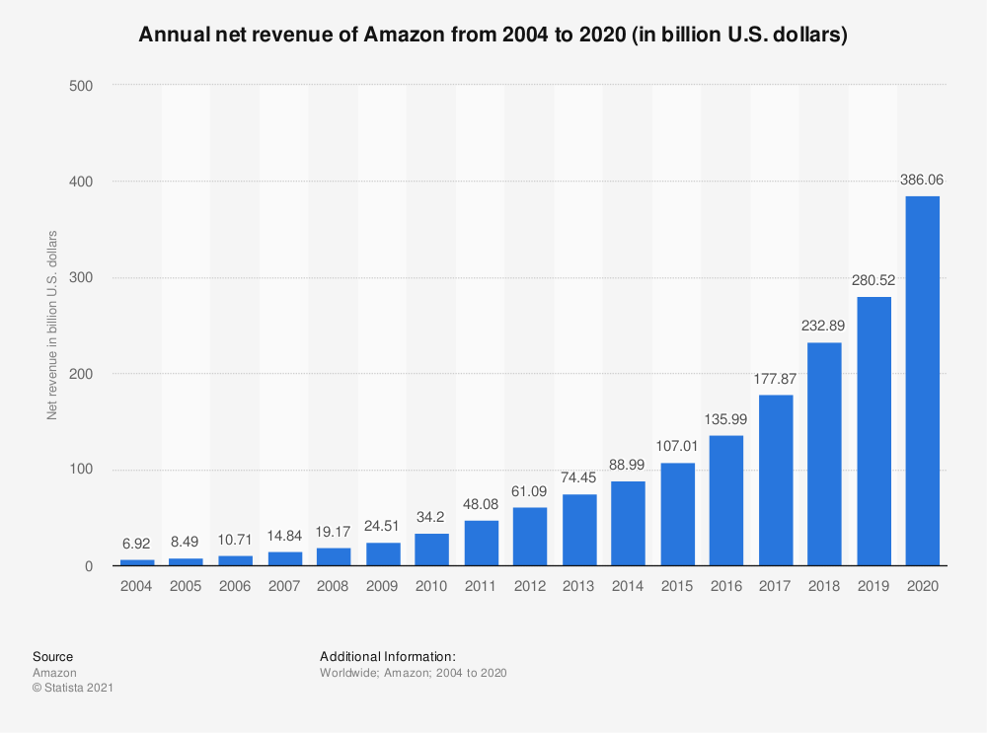

Slide 7
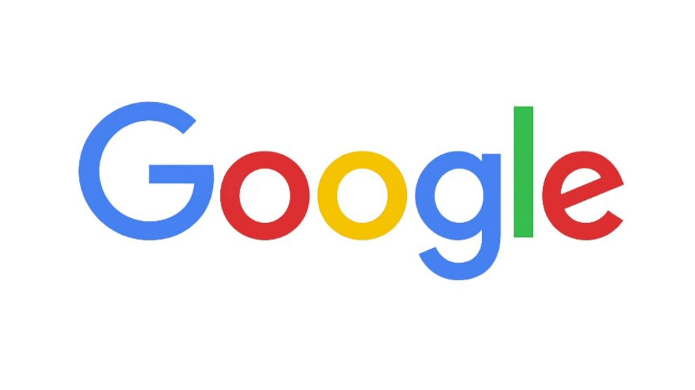
Without any second thoughts, Google is my favorite startup as a consumer. The primary reason being the revolution and ease it has brought in our lives at negligible costs. Its products and services like Google search, Google docs, Google slides, Google sheets, Gmail, Google drive, Google maps, Google earth, Google translate, Google calendar, Google Keep, Google podcast, Jamboard, Google Assistant, Gpay, Google home (and the list goes on ) look at all the small needs of the user. Every single one of them is an indispensable part of our lives. It has also dived in other ventures like fiber, automobile, technology, etc. It has also dived in the smartphone industry as Pixel. As a consumer another thing that fascinates me is that all of these services are interconnected and can be accessed and managed by a single google account. The regular upgradation and new features catering indigenous needs is just another factor. As compared to its contemporary companies, it has lesser accusations of breaching privacy and security of users. Overall, each of these features make it consumer favorite.

Slide 8
PARAMETER | GOOGLE | AMAZON
PROFITABLE OR NOT? | Definitely. Lies in the top 10 most valuated companies in the world. | Definitely. Lies in the top 10 most valuated companies in the world.
CAPITAL INTENSIVE? | Yes. Google is one of the most capital intensive companies. Huge investments are required for further expansions. In the last few years, it is increasingly spending huge capitals. However huge profits are also experienced. | Yes. Amazon is also a capital intensive company. Huge investments are done in expansion and will be done for launching in new countries , etc. However huge profits are experienced.
SCALABLE? | Yes. Software sector is already a scalable business. Nearly all of its ventures are scalable barring the new ventures in hardware and technological sector. | Yes. Overall, it is a scalable venture again because it is software based. In some areas increased labor has also been required. Some of its future prospects like robotics, hardware and delivery company may not be as scalable.

Slide 9
PARAMETER | GOOGLE | AMAZON
BARRIERS TO ENTRY | •Huge funding required. • existing competitors. •Quality workforce required consequently higher pay. • Government guidelines and their variation in country to country. • Distrust of people relating to security and privacy. | •Huge funding required . • Existing competitors like Walmart , etc. • Hostility and concerns of people regarding the quality and high discounts offered. • Privacy and security concerns. • Establishment of huge network and supply chain to the very grassroot level and maintaining its efficiency.
WHY SHOULD CUSTOMERS SHOULD CHOOSE THEM? | • Trusted and established company. • Easy access to other products and services of the company via a single account. • More upgraded and regularly updated. • Caters to local needs and personalised user experience. | • Trusted and established company. • Easy access to other products and services of the company via a single account. • Great customer service and genuine verified rating and reviews of products.

Slide 10
PARAMETER | GOOGLE | AMAZON
STARTUP vs COMPETITORS | It has clearly surpassed all its competitors. The primal reason being the quality of services offered along with expansion and updating technology at regular intervals. However, new names are now posing a threat to the business. | It has clearly surpassed all its competitors in these years including Walmart, flipkart, etc. due to better services, range of products, good customer service , better offers and amazing marketing strategies it has managed to do so.
COST OF BRINGING NEW CUSTOMERS AND FUTURE OF MARKET. | As it is scalable the cost of bringing in new customers is not much. However, as the company is expanding in the technological and hardware sector, some huge investments will be required. Future ventures of Google seem very promising but some serious threats exist. One of them is the Brave browser and other is reducing share of revenue in ads due to Amazon’s venture in the same. As Google’s revenue is mostly based on ads this is alarming. | Bringing in new customers will require more investments for amazon as compared to Google. It’s future ventures are very promising and its recent acquisitions and partnerships are very profitable. It is also diving in robotics, hair salons, biometric payment, food delivery, game streaming, innovative healthcare, cars, own delivery service and airplane industry.

Slide 11
Marketing
•If not the most but “luxury” is definitely one of the most profitable and soaring sector in the world. Even in pandemic we have seen Bernard Arnault , the owner of the luxury conglomerate LVMH become the richest person. The list of richest people or companies in the world will further prove my point. Amazon however has not fully dived in this sector. One of the suggestions will be opening “ Amazon Luxury” and partnering with luxury brands for the same.
• Amazon can start expanding and penetrating the local markets of the other nations where it is not operational. The strategy should be like the one employed in India. The brand name should be made familiar to people ( ”apni dukaan”, etc). It should further establish networks and supply chain through the local markets.
•Further it may also include medicines, spectacles in the diverse products they offer.

