Slide 1
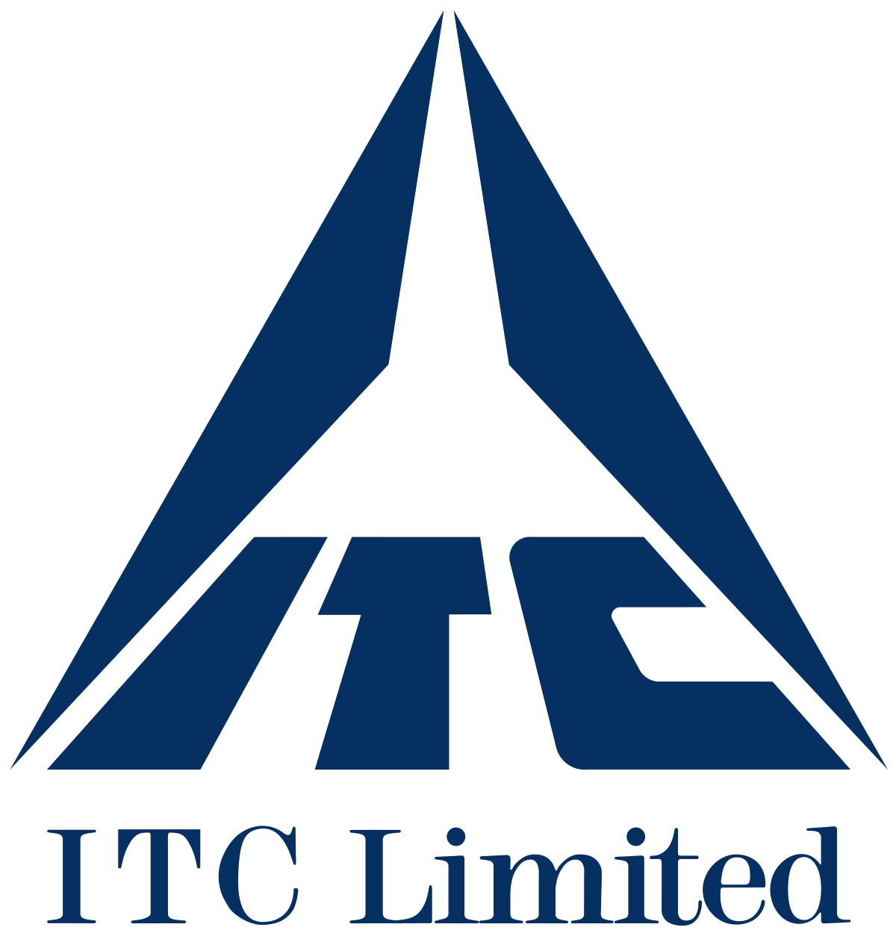
ITC LIMITED: A WALK THROUGH THE BUSINESS
Project mentees: Nishika Jain and Bhavya Sikarwar

Slide 2
COMPANY OVERVIEW
India Tobacco Company Limited(ITC.Ltd) is one of India's foremost private sector companies. It has been acknowledged as India's most valuable business corporations with a gross sale value of ₹76,097.31 crore and a net profit of ₹15,136.05 crores (as on 31/03/2020). From being a part of Forbes 2000 list to being ranked as India's most admired company by the Fortune, it has many accolades. It’s diverse business spans across:
FAST MOVING CONSUMER GOODS(FMCG)
  ITC is one of India's leading marketer in the FMCG business. Their products range across cigarettes, cigars, foods, personnel care, education and stationery, lifestyle, safety matches, agarbatti and dhoop.
HOTELS
  From being a trailblazer in green hoteliering, it is one of the fastest growing hospitality chains in India. Their hotel properties are classified under four major brands:
  Welcomhotel
  Fortune Hotels
  Welcomheritage
  The Luxury Collection- tie up with Marriott

Slide 3
COMPANY OVERVIEW
AGRI BUSINESS
ITC owns one of India's largest integrated Agri business enterprises with significant presence across every node of the Agri value chain. It is the second largest exporter of Agri products from the country. It focuses on trading of:
  Feed ingredient
  Food grains
  Marine products
  Processed food
  Coffee
PAPERBOARDS AND SPECIALITY PAPER BUSINESS
ITC’s paperboard and specialty paper division is India's largest, technologically advanced and most eco-friendly paper and paperboard business. From cigarette papers, FMCG cartons, electrical insulation paper to bio- based barrier coated board it caters to a vast industrial need.

Slide 4
COMPANY OVERVIEW
INFORMATION TECHNOLOGY
ITC infotech is a leading global technology services and solutions provider led by business and technology consulting.
PACKAGING AND PRINTING
ITC's Packaging & Printing Business is the largest value-added converter of paperboard packaging in South Asia. It converts over 70,000 tonnes of paper, paperboard and laminates per annum into a variety of value-added packaging solutions for the food & beverage, personal products, cigarette, liquor and consumer goods industries.

Slide 5
COMPANY OVERVIEW

Slide 6
COMPANY OVERVIEW

Slide 7
SECTOR ANALYSIS
As we have seen, ITC is involved in a variety of sectors but as evident from the revenue chart the major source of revenue are the cigarette, FMCG, Agri and paper industry. So, for the sake of sector analysis, we will examine only the major ones.

Slide 8
SECTOR ANALYSIS
Cigarettes And Tobacco
Tobacco is one of the most economically significant agricultural crops in the world. India stands behind China and Brazil, as one of the largest producers and exporter of this product. Let us have a closer look at this industry in India. The key statistics are as follows:
Export Value: 64billion INR | Production Value: 240m Kg
Revenue: 356 Billion INR | Production Value In Karnataka: 107m Kg
Share Of Revenue From Legal Cigarettes: 80% | Production Value In Andhra Pradesh: 133m Kg
Developments in the Indian tobacco industry have not been in line with international trends. The share of cigarettes in the total tobacco consumption in India is about 20%, compared with 85% globally. Internationally, there has been a shift from traditional forms of tobacco to cigarettes. For example, the share of cigarettes in the US increased from 2% in 1880 to 84% currently. In the UK, cigarette share went up from 12% to 79%. In Italy, cigarettes constitute 98% of consumption today compared to 5% in 1900. Even in neighbouring Pakistan, the share of cigarettes has increased - from 40% in 1971 to 58% today. Quite the opposite, however, has happened in India. The share of cigarettes has declined to 20% from 23% in 1971, while overall tobacco consumption has grown.

Slide 9
SECTOR ANALYSIS
Cigarettes And Tobacco

Slide 10
SECTOR ANALYSIS
FMCG Sector
Fast-moving consumer goods (FMCG) sector is India’s fourth largest sector with household and personal care accounting for 50% of FMCG sales in India. Growing awareness, easier access and changing lifestyles have been the key growth drivers for the sector. The urban segment (accounts for a revenue share of around 55%) is the largest contributor to the overall revenue generated by the FMCG sector in India. However, in the last few years, the FMCG market has grown at a faster pace in rural India compared to urban India. Semi-urban and rural segments are growing at a rapid pace and FMCG products account for 50% of the total rural spending.

Slide 11
SECTOR ANALYSIS
FMCG Sector
The rural FMCG sector is expected to reach 220 billion USD by 2025.

Slide 12
SECTOR ANALYSIS
FMCG Sector

Slide 13
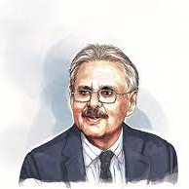
Founders and Evolution
The Company was incorporated on August 24, 1910, under the name Imperial Tobacco Company of India Limited.
Turn to its shareholding pattern ,government-owned financial institutions hold around 37 per cent. BAT, the British MNC that founded Imperial Tobacco Co. in India in 1910, had a stake of around 31 per cent. And there were the shares with the public. Things started changing after Ajit Narain Haksar became the first Indian chairman in 1969. (Indian shareholding had begun in 1954.)As the Company's ownership progressively Indianized, the name of the Company was changed to India Tobacco Company Limited in 1970 and then to I.T.C. ITC Limited is now a diversified conglomerate with businesses spanning Fast Moving Consumer Goods comprising Foods, Personal Care, Cigarettes and Cigars, Branded Apparel, Education & Stationery Products, Incense Sticks and Safety Matches; Hotels, Paperboards and Packaging, Agri Business and Information Technology. However, the major events that contributed to its evolution can be summarized as-

Slide 14
1.1925: Packaging and Printing: Backward Integration
Though the first six decades of the Company's existence were primarily devoted to the growth and consolidation of the Cigarettes and Leaf Tobacco businesses, ITC's Packaging & Printing Business was set up in 1925 as a strategic backward integration for ITC's Cigarettes business.
2.1975: Entry into the Hospitality Sector - A 'Welcom' Move
3.1979: Paperboards & Specialty Papers - Development of a Backward Area
4.1985: Nepal Subsidiary - First Steps beyond National Borders
5.1990: Paperboards & Specialty Papers - Consolidation and Expansion
6.1990: Agri Business - Strengthening Farmer Linkages
7.2002: Education & Stationery Products - Offering the Greenest products
ITC launched line of premium range of notebooks under brand Paperkraft in 2002. To augment its offering and to reach a wider student population, the Classmate range of notebooks was launched in 2003. Classmate over the years has grown to become India's largest notebook brand and has also increased its portfolio to occupy a greater share of the school bag.
8.2000: Lifestyle Retailing - Premium Offerings
FOUNDERS AND EVOLUTION

Slide 15
9.2000: Information Technology - Business Friendly Solutions
I10.2001: Branded Packaged Foods - Delighting Millions of Households
ITC's foray into the Foods business is an outstanding example of successfully blending multiple internal competencies to create a new driver of business growth. It began in August 2001 with the introduction of 'Kitchens of India' ready-to-eat Indian gourmet dishes.
11.2002: Agarbattis & Safety Matches - Supporting the Small and Cottage Sector
12.2005: Personal Care Products - Expert Solutions for Discerning Consumers
13.2010: Expanding the Tobacco Portfolio
In 2010, ITC launched its hand rolled cigar, Armenteros, in the Indian market. Armenteros cigars are available exclusively at tobacco selling outlets in select hotels, fine dining restaurants and exclusive clubs.
FOUNDERS AND EVOLUTION

Slide 16
Here is a brief comparison of ITC and its competitors:
COMPANY | EMPLOYEES | FUNDING | REVENUE
ITC | 28,115 | $0 | $7.6B
Marico | 1,684 | $27.3M | $1.1B
Emami Limited | 3,200 | ------- | $380.9M
Patanjali | 25,000 | $505.1M | $1.1B
Hindustan Uniliver Ltd | 7,082 | ------- | $6.3B
P&G | 92,000 | $54.1M | $74.9B
Himalaya | 4,200 | ------- | $358.5M
Parle Agro | 4,050 | ------- | $289.1M
Dabur | 7,740 | ------- | $1.3B
PEER COMPANIES COMPARISON

Slide 17
Here is a brief comparison of ITC and its competitors in the tobacco business:
COMPANY | MARKET CAPITALIZATION(Rs. Cr) | NET SALES (Rs. Cr ) | NET PROFIT(Rs. Cr) | TOTAL ASSETS | DEBT | INTEREST
ITC | 252,392.5 | 45,485.11 | 12,934.49 | 71,580.54 | 2,401.79 | 47.47
VST | 5,552.14 | 1,110.98 | 310.79 | 1,485.79
Godfrey Phillip | 5,333.28 | 2,925.74 | 356.94 | 3,518.36 | 314.78 | 30.7
The Indian Wood | 317.94 | 194.66 | 7.59 | 527.67 | 83.6 | 6.53
Golden Tobacco | 90.86 | 23.43 | -1.65 | 232.87 | 0.00 | 10.82
NTC Industries | 79.25 | 14.15 | 2.8 | 55.15 | 5.33 | 0.31
Raghunath Inves | 4.61 | 0.15 | 0.19 | 8.19
PEER COMPANIES COMPARISON

Slide 18
From the previous data it is crystal clear that ITC rules the tobacco business in India while its competitors fail to perform as good. The possible reasons for the same may be:
ITC has been in business for over 100 years and has already controlled the market since a long time.
ITC diversified itself, earning soaring profits. Despite the turbulent years while expansion, it has not only managed to grow but also change its image from a tobacco company to a regular consumer company.
The primary reason for ITC's market leadership and success is its backward integration (producing the buy rather than buying the produce). ITC procures its key raw materials directly from producers, which helps it retain superior operating margins of 36 per cent.
Its distribution network, reputed brands and customer loyalty give its business an edge over others.
As we looked earlier, the tobacco sector has been falling in India and COVID may give it the ultimate blow. ITC’s growth makes sure it bears this as it has shifted its focus to non-tobacco sector.
In the hotel business, the motto of sustainability, green hoteliering and platinum certifications have made it unique.
In late years, ITC has thoroughly polished its image. This had in a way lead to its huge growth in the paper, FMCG and other sectors.
PEER COMPANIES COMPARISON

Slide 19
Here is a profit analysis of ITC Ltd for last 5 years (Taking into consideration reported PAT)-
Year | Reported PAT (in Rs. Cr.)
Mar'21 | 12934.49
Mar'20 | 15136.05
Mar'19 | 12464.32
Mar'18 | 11223.25
Mar'17 | 10200.90
PROFIT ANALYSIS
Looking at the reported PAT (Profit after tax) of ITC Ltd of last 5 years, we observe an increase, making us conclude that the management has worked efficiently and fulfilled the very motive and not indulge in any kind of controversies .

Slide 20
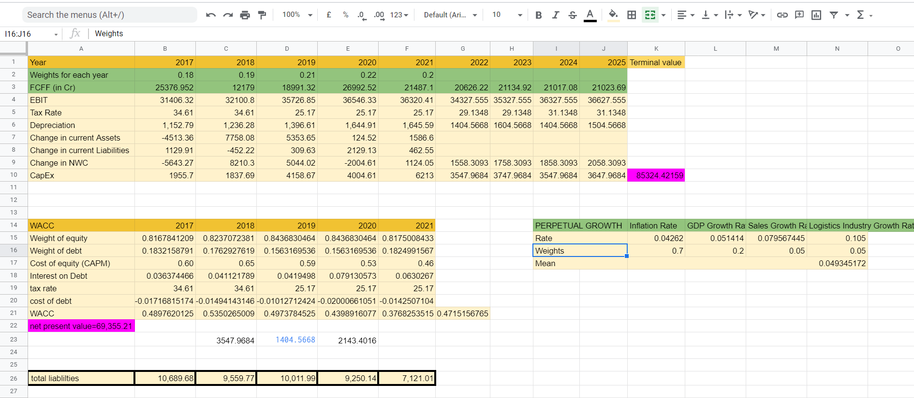
https://docs.google.com/spreadsheets/d/1s2O-R2tMYgnuecOEhlyQ5v8czVoKHpAIdjt-6h-nDjc/edit?usp=sharing

Slide 21
In our valuation method we assumed the weights based on the following priority order:
Profits> Revenue> taxes
For simplicity only profits have been taken from percent of profits the weights have been assigned.
ASSUMPTIONS
Market will correct itself in the long run.

Slide 22
ITC’s management has been quite effective for the last few years. They have managed to expand and diversify even in the turbulent times and drastically polished their image. Its growth and the numbers speak for themselves about how the management is. However, it was always not the same. In the 1980s and 1990s ITC and its management faced a lot of backlash, enquiries over legal disputes and frauds.
In 1996, ED conducted raids on IT’s tobacco establishments and hotels. It was found to be violate foreign exchange regulation act(FERA) to the tune of $100 million. It was found to manipulate export invoices, over invoicing of machinery imported, transfer of $4 million to Swiss bank account, excise fraud and payment to non-resident shareholders. It had to face a penalty of 74 crore rupees in excise evasion fraud and 2 former chairmen and 8 executive directors were arrested.
Since then, it has come a long way with a refined public image of charitability and sustainability.
However, it is still accused of illegal ways and government is also blamed to cover and support it to remain the “tobacco king” in the market.
MANAGEMENT

