Slide 1
TITLE

Slide 2
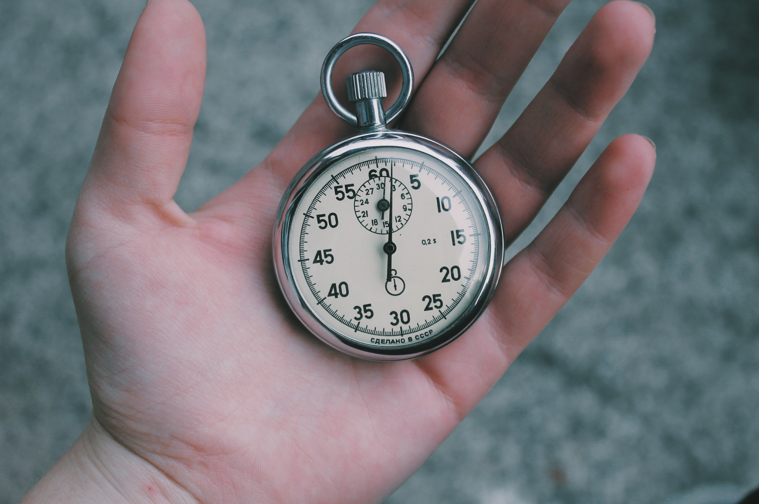
INTRODUCTION
Introduction
What is a Countdown Timer?
A countdown timer is a tool used to measure the time remaining until a specific event or deadline.
It can be used in various applications, such as tracking the time left for an exam, a presentation, or a project deadline.
Why Use Python for Countdown Timers?
Python is a popular programming language known for its simplicity and versatility.
It provides a wide range of libraries and modules that make it easy to create countdown timers with various functionalities and customizations.
Benefits of Using Python for Countdown Timers
Python offers an extensive library ecosystem, including libraries like datetime and tkinter, which can be used to implement countdown timers.
Python's syntax is easy to understand and write, making it accessible for beginners and experienced programmers alike.
Python allows for flexibility and customization, enabling developers to create countdown timers with different styles, formats, and features.
Python's cross-platform compatibility allows countdown timers to be used on different operating systems, including Windows, macOS, and Linux.
In this Presentation
In this presentation, we will explore how to create a countdown timer using Python.
We will cover the basics of working with dates and times in Python, as well as demonstrate different approaches to implement countdown timers using popular libraries and frameworks. Let's dive in!

Slide 3
Creating the Countdown Function
you can use the time module. Here is an example of how you can implement a countdown function:
import time
def countdown(seconds):
while seconds > 0:
print(seconds) time.sleep(1) seconds -= 1
print('Countdown complete!’)
# Example usage countdown(10)
In this example, the countdown function takes an input seconds which represents
the number of seconds to count down from.
The function uses a while loop to repeatedly print the current value of seconds,
pause for 1 second using the time.sleep function, and decrement seconds by 1.
Once seconds reaches 0, the function prints 'Countdown complete!' to indicate that the countdown is finished.

Slide 4
steps to create a countdown timer:
Step 1: Import the time module.
Step 2: Then ask the user to input the length of the countdown in seconds.
Step 3: This value is sent as a parameter ‘t’ to the user-defined function countdown(). Any variable read using the input function is a string. So, convert this parameter to ‘int’ as it is of string type.
Step 4: In this function, a while loop runs until time becomes 0.
Step 5: Use divmod() to calculate the number of minutes and seconds. You can read more about it here.
Step 6: Now print the minutes and seconds on the screen using the variable timeformat.
Step 7: Using end = ‘\r’ we force the cursor to go back to the start of the screen (carriage return) so that the next line printed will overwrite the previous one.
Step 8: The time.sleep() is used to make the code wait for one sec.
Step 9: Now decrement time so that the while loop can converge.
Step 10: After the completion of the loop, we will print “Fire in the hole” to signify the end of the countdown.

Slide 5
CONCLUSION
Key Findings
The countdown timer using Python is a versatile tool that can be used in various applications, such as event management, project scheduling, and productivity enhancement.
It provides a simple and efficient way to track and manage time, allowing users to stay organized and meet deadlines.
The timer can be customized to suit individual needs, with options for different countdown durations, alerts, and notifications.
Insights
Based on these findings, the countdown timer using Python is a valuable resource for individuals and organizations looking to improve time management and increase productivity.
It offers a user-friendly interface and flexible features that make it accessible to users of all skill levels.
By incorporating the countdown timer into their daily routines, users can optimize their time and achieve their goals more effectively.

