Slide 1
FALL FEST
THE EXPERIMENT
QPU
SENTINEL
q0
H
C
M
q1
H
C
M
Measured QAOA and a
scalable research interface
q2
H
C
M
q3
H
C
M
QAOA layers -> Aer simulation
Circuit motif is schematic; execution was simulated.
CLASSICAL OPTIMUM
FEASIBLE SAMPLES
FINAL SAMPLE
0110
86.28%
8,192
ASSET_B + ASSET_C
7,068 of 8,192 shots
Qiskit Aer shots
SIMULATOR ONLY | HYPOTHETICAL INPUTS | NO HARDWARE OR ADVANTAGE CLAIM

Slide 2
01 / PROBLEM
A small, explicit optimization problem
Choose exactly two of four assets
HYPOTHETICAL INPUTS
RETURN
VARIANCE*
minimize risk_aversion * x.T @ covariance @ x - expected_returns @ x
ASSET_A
0.12
0.0400
risk_aversion = 2.0 | sum(x_i) = 2 | x_i in {0, 1}
ASSET_B
0.10
0.0225
Expected return is balanced against covariance-based portfolio risk. Classical exhaustive search checks all 6 feasible selections.
ASSET_C
0.07
0.0100
ASSET_D
0.15
0.0625
* Diagonal entries of the covariance matrix.
Illustrative data only - not live market data or investment advice.
The question is intentionally small enough to validate every candidate, end to end.
QPU SENTINEL / FALL FEST
02

Slide 3
02 / QUBO
Encode the constraint, then verify every state
PENALIZED ENERGY
E(x) = 2.0 * x.T @ covariance @ x - expected_returns @ x + (sum(x) - 2)^2
VERIFIED LOWEST-ENERGY STATE
0110
The quadratic penalty discourages selections that do not contain exactly two assets.
ASSET_B + ASSET_C
01
Enumerate
All 16 binary strings
QUBO energy
02
Compare
QUBO vs penalized objective
-0.093
03
Assert
Every configuration matches
Exhaustive verification passed for all 16 configurations in the saved notebook run.
QPU SENTINEL / FALL FEST
03

Slide 4
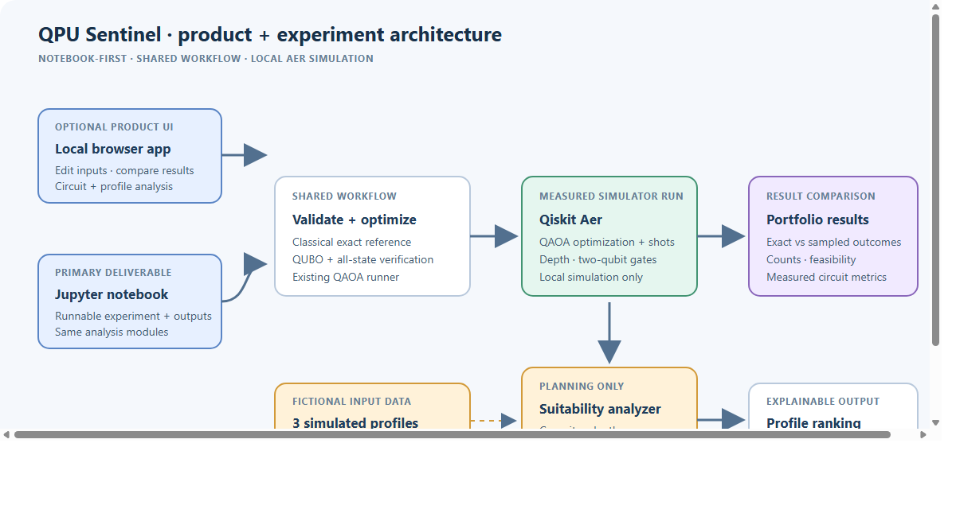
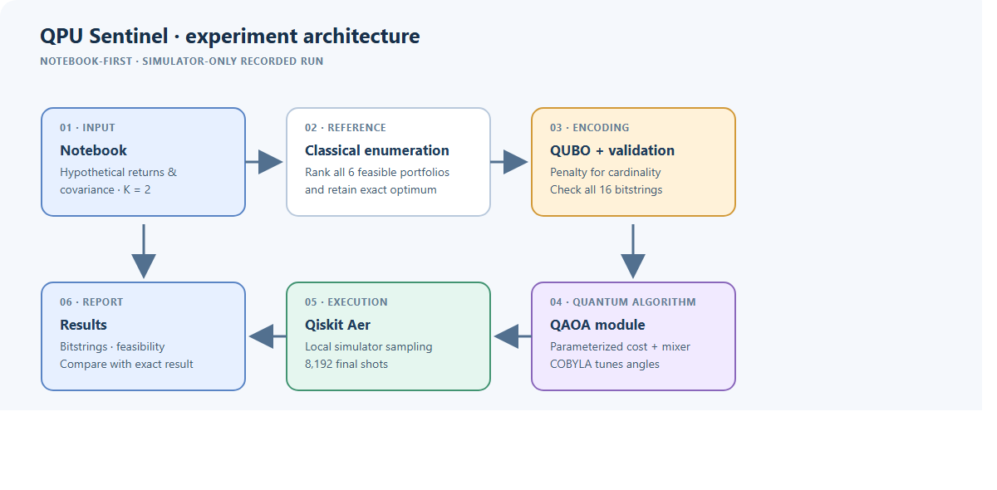
03 / ARCHITECTURE
Notebook reference and scalable experiment platform
Inputs -> matched methods -> QUBO checks -> QAOA/Aer -> SQLite -> history + comparison
QPU SENTINEL / FALL FEST
04

Slide 5
04 / METHOD
QAOA optimizes sampled QUBO energy
PARAMETERIZED CIRCUIT | DEPTH p = 2
RECORDED EXECUTION SETTINGS
OPTIMIZER EVALUATIONS
FINAL SHOTS
H
U_C
U_B
M
39
8,192
->
->
->
Uniform
initialization
QUBO cost
layers
RX mixer
layers
Measure
bitstrings
COBYLA objective calls
Aer simulator
CIRCUIT DEPTH
TWO-QUBIT GATES
COBYLA minimizes sampled QUBO energy; the optimized circuit is then sampled for the final distribution.
15
12
After transpilation
After transpilation
Local Aer only. UI circuit explorer shows logical gates; depth 15 and 12 two-qubit gates are measured after transpilation.
QPU SENTINEL / FALL FEST
05

Slide 6
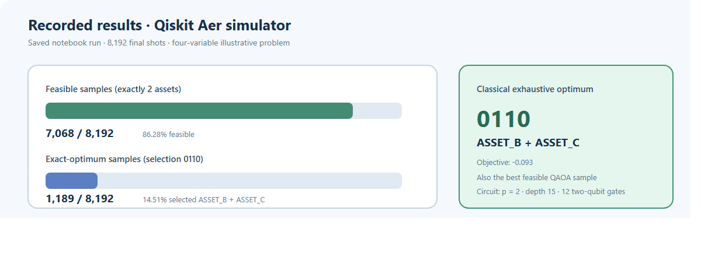
05 / RESULTS
The best feasible sample matched the exact optimum
Saved run: 7,068 feasible shots (86.28%); 1,189 optimal-selection shots (14.51%).
QPU SENTINEL / FALL FEST
06

Slide 7
06 / READOUT
The output is a distribution, not a single answer
OBSERVED FEASIBLE BITSTRINGS | FINAL-SHOT COUNTS
0101
1,235
SAMPLE ACCOUNTING
1001
1,204
7,068
feasible shots
0110
1,189
1,124
infeasible shots
1010
1,170
0110 | 1,189 shots
1100
1,162
The optimum is one of several frequently sampled feasible states; the other 10 bitstrings are infeasible.
0011
1,108
All six feasible portfolios appeared in the final sample.
Benchmark Lab has 60 on-demand recipes; Experiment Studio persists matched runs for 3-20 assets.
QPU SENTINEL / FALL FEST
07

Slide 8
07 / CLOSE
Demo the product; keep hardware claims evidence-based
LIKELY JUDGE QUESTIONS
REPRODUCE THE PRIMARY DELIVERABLE
01 Install
Hardware run? Local Aer simulation only.
Python 3.12 + pinned requirements.txt
Quantum advantage? None claimed; exact search is the reference.
02 Launch interface
Run src.webapp; open 127.0.0.1:8000
Are these IBM devices? No; all three profiles are fictional.
03 Inspect results
Live AI provider? Optional; no hosted key is configured by default.
Run Experiment Studio; inspect history, circuit, profiles and report
notebooks/qpu_sentinel_qaoa.ipynb
Demo: Studio run -> review history -> inspect circuit -> optional consent-gated assistant.
QPU SENTINEL / FALL FEST
08

