Slide 1

Comparison Of Multiple Algorithms For Stock Price Prediction Based On Accuracy
K Chandra Priya(1SJ23AD021)
S Bhavya Sree (1SJ23AD051)
Pallavi B . Gowda(1SJ23AD035)
M . Gagana Sree (1SJ23AD028)
Under the guidance of
Mr.Darshan A
Assistant Professor, Dept of AI&DS,SJCIT

Slide 2
ABSTRACT
The stock market plays a vital role in the economy, and predicting a real-world challenge. By comparing multiple Algorithms, we can find the most efficient algorithm for predicting future stock prices, which makes our project unique and valuable.
Stock prices change every day and are hard to predict. In this project, different AI algorithms such as Linear Regression, Random forest, prophet and LSTM are compared to find which one predicts better.

Slide 3
INTRODUCTION
A stock means you own a small part (share) of a company. Stock markets are highly dynamic and influenced by several factors such as economic news, company performance and global events. We focus on comparing multiple algorithms for stock price prediction based on accuracy. We use historical stock price data and apply multiple algorithms. Each algorithm has its own way of learning patterns from past data.

Slide 4
LITERATURE SURVEY
SL.NO | AUTHOR NAME | TITLE OF RESEARCH PAPER | ADVANTAGES | DISADVANTAGES | IMPLEMENTATION
1 | A. Kumar, R . Mehta(2021) | Accuracy Comparison of LSTM , Random Forest , and Linear Regression for Stock Prediction | LSTM works well on time series trends. Random Forest handles non linear patterns . Linear Regression is Simple | LSTM needs more training time . RF can overfit. Linear Regression has low accuracy | Used historical stock data set(2010-2020);preprocessing with scaling ; implemented three models.
2 | S . Banerjee(2020) | Deep Learning vs Traditional ML Approaches in Financial Forecasting | Deep models detect complex signals. high accuracy in volatile markets | Requires high computation. Traditional models fail in trend reversals | Implemented LSTM, using python Sklearn Compared performance over multi year data
3 | M . Patel , k. Singh (2022) | Hybrid LSTM-Random Forest Model for stock price movement | Hybrid method reduces prediction error . more stable error more stable than single models | More complex architecture Long training time | Combined RF for feature selection + LSTM for prediction; tested on NSE daily data

Slide 5
PROBLEM STATEMENT
The stock market is unpredictable, making price forecasting a big challenge. This project uses and compares different algorithms to predict stock prices. After testing models like LSTM, Random Forest, Prophet and Linear Regression.

Slide 6
OBJECTIVES
To analyze historical stock market data and identify patterns or trends that influence stock prices.
To determine which algorithm provides the most accurate and reliable stock price predictions.
Selection of best algorithm for the stock price prediction.

Slide 7
SOFTWARE SPECIATION REQUIREMENTS
  Python IDE (VS Code)
  Libraries :NumPy , Pandas , Scikit-Learn, Matplotlib
  Dataset: Historical stock prices (CSV)

Slide 8
DESIGN
The design of the stock price prediction system is structured into four main components: data input, preprocessing, model training, and accuracy comparison. Historical stock data is collected and cleaned to remove missing values, normalize features, and prepare time-series inputs. This processed data is then given to multiple machine learning algorithms—LSTM, Random Forest, Linear Regression, and Prophet—each trained separately to learn patterns and trends. After training, each model predicts stock prices.

Slide 9
METHODOLOGY
Data collection
Collect historical stock price data.
Source is downloaded from datasets.
Data pre processing
Checks the missing values.
Remove or fill missing values
Algorithm
Selection
Comparison
It train the model.
Selects the best algorithm based on accuracy.
Identify the most accurate algorithm.
Analyze differences between algorithms.

Slide 10
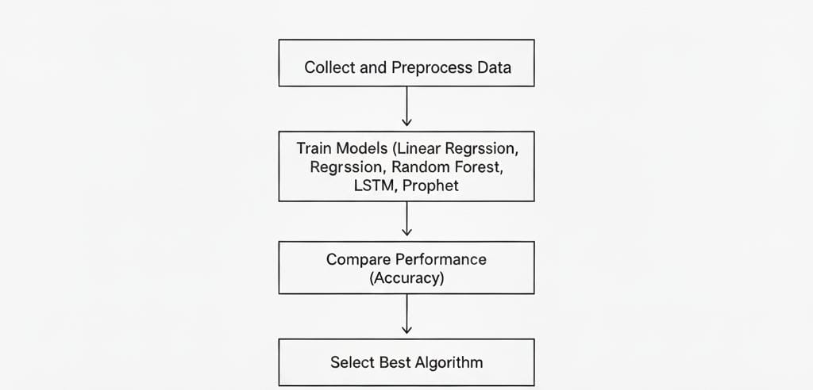
Data Flow Diagram

Slide 11
Algorithms
Linear Regression
  Works well for simple linear trends.
  Fast and easy to train.
  Accuracy: Moderate.
Random Forest
  Captures non-linear stock patterns.
  Ensemble of many decision trees.
  Accuracy: High.

Slide 12
LSTM (Long Short-Term Memory)
  Best for time-series forecasting.
  Remembers long-term trends.
  Accuracy: Very High.
Prophet
  Handles seasonality and trend changes.
  Simple to tune and fast.
  Accuracy: Moderate to High.

Slide 13
IMPLEMENTATION
Import data from historical stock data.
Selecting algorithms.
Train the model for given stock.
Gives predicted and historical graph.
Comparison of algorithms.
Predicts the best algorithm.

Slide 14
TESTING
Functional Testing
Pre process the data
Generating prediction
System Testing
Performance Testing
Run the multiple algorithms.
Frontend(Flask)
Backend(python models)
Database(mysql)
To check prediction testing.
Its handles large csv files.

Slide 15
CONCLUSION
In this project, we developed a stock price prediction system using four different machine learning algorithms—LSTM, Random Forest, Linear Regression, and Prophet—and compared their performance based on accuracy. Each model analyzed historical stock data to identify patterns and predict future price trends.

Slide 16
FUTURE ENHANCEMENT
In the future, the model can be improved by adding real-time data and news analysis to make predictions more accurate.
More advanced algorithms like Transformers or hybrid models can be used to improve prediction accuracy.
The project can be enhanced by including social media and sentiment data to better understand market behavior.

Slide 17
REFERENCES
[1] Ernest Kwame Ampomah, Gabriel Nyame, Zhiguang Qin, Prince
Clement Addo, Enoch Opanin Gyamfi and Michael Gyan, “Stock Market
Prediction with Gaussian Naïve Bayes Machine Learning Algorithm”,
2020.
[2] Omar D. Madeeh and Hasanen S. Abdullah, “An Efficient Prediction
Model based on Machine Learning Techniques for Prediction of the Stock
Market”, 2020.
[3] M. J. Awan, M. Shafry, H. Nobanee, A. Munawar and A. Yasin, “Social
Media and Stock Market Prediction: A Big Data Approach”, 2020

Slide 18
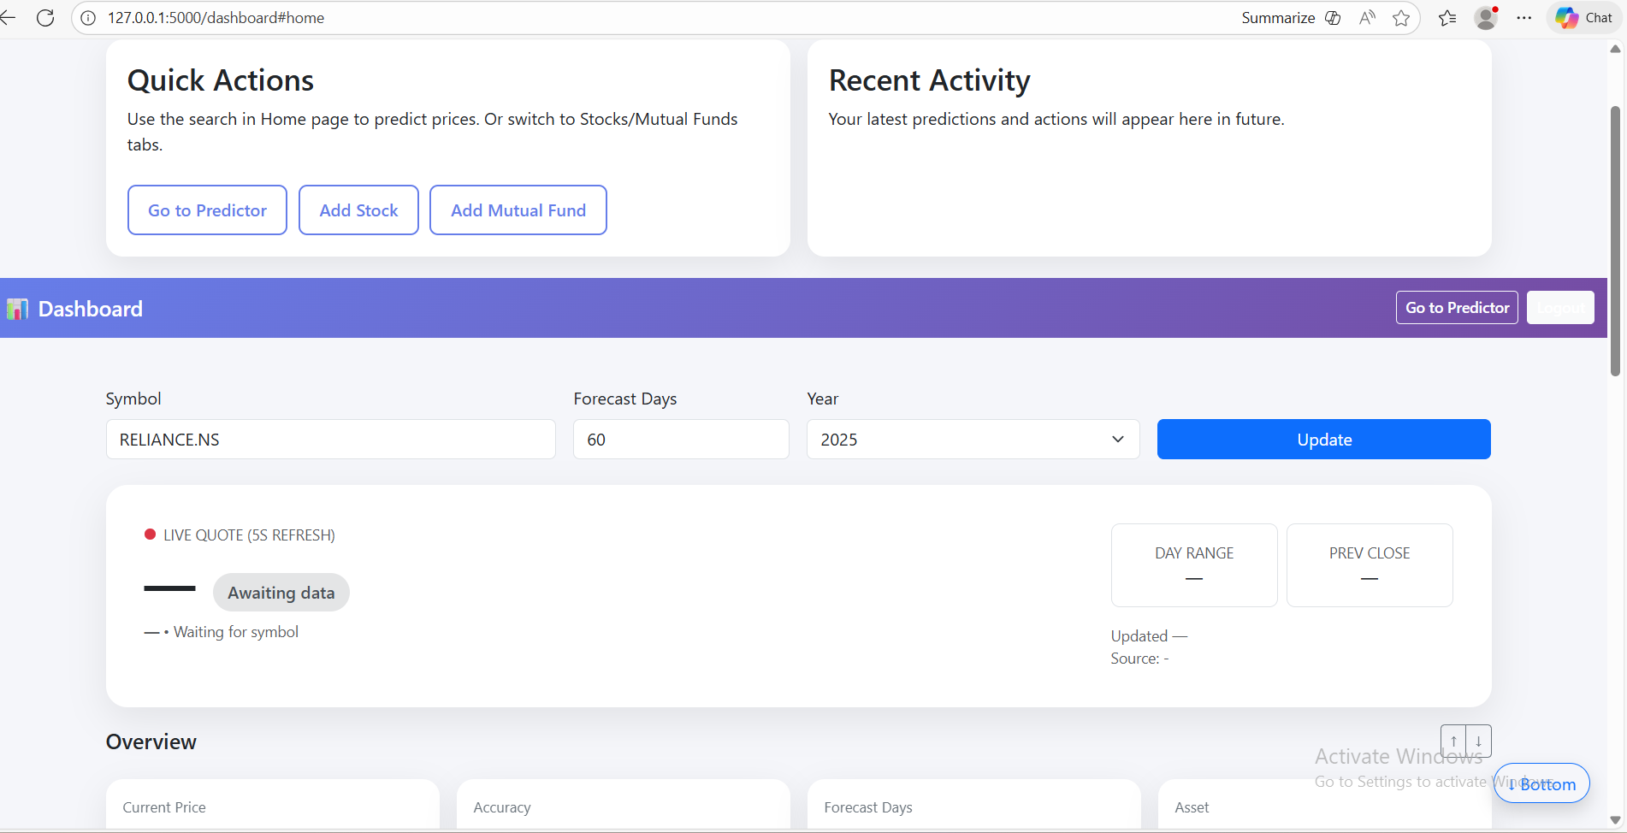
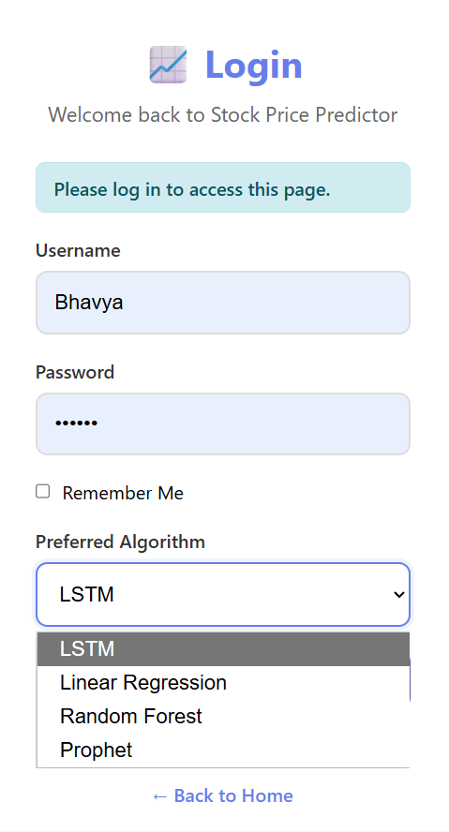
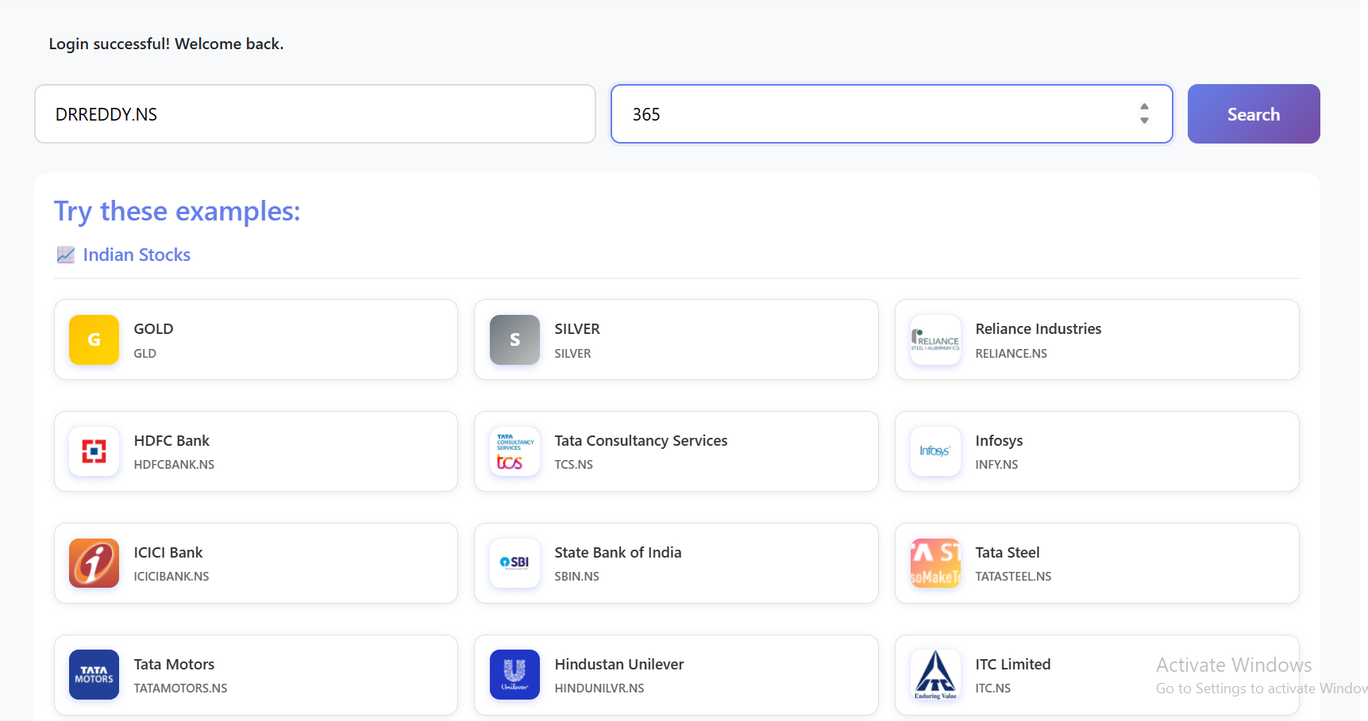
0UTPUTS
http://127.0.0.1:5000
Fig:2 Dashboards
Fig1:Login page
Fig3:Indian stocks

Slide 19
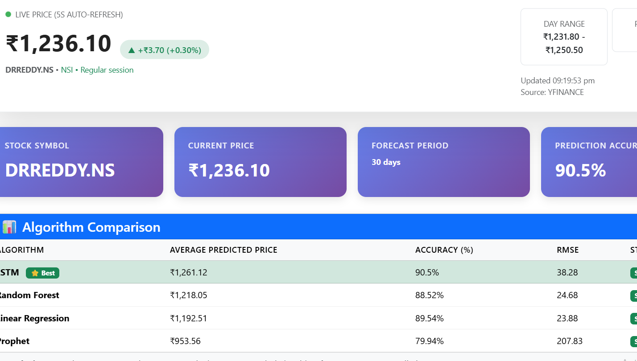
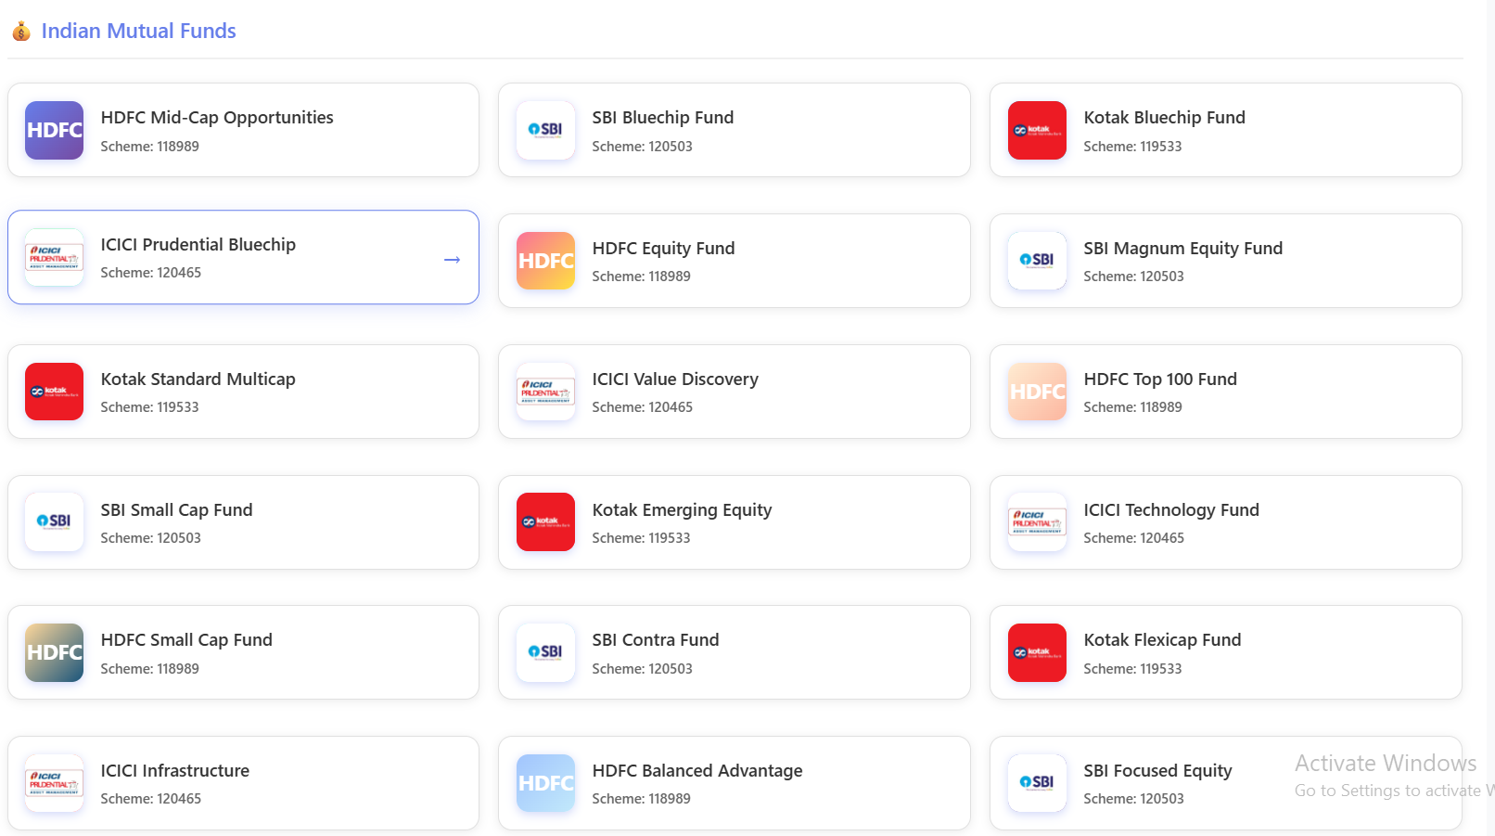
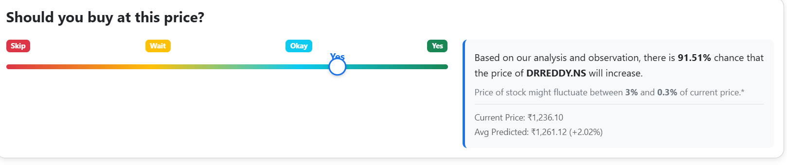
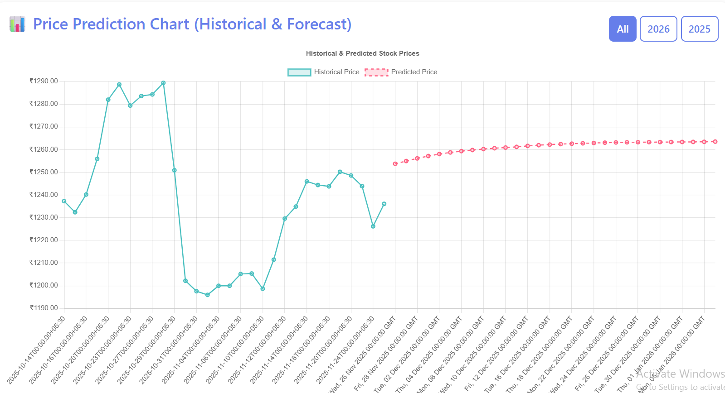
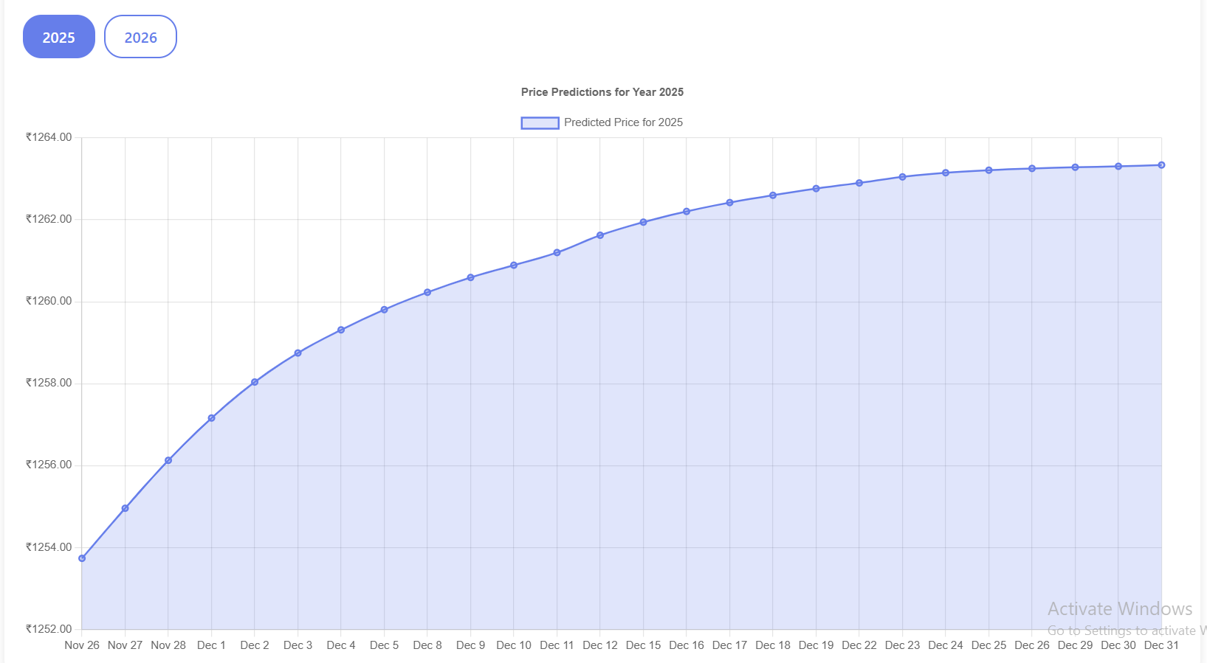
Fig5:comparison of Algorithms
Fig4:Indian Mutual funds
Fig6:Historical graph
Fig7:predicted graph

Slide 20
Pseudo Code
Dashboard – High-Level Flow
ON user login:
→ Verify username & password
→ If valid:
- Load user preferences (algorithm, forecast_days, etc.)
- Load recent prediction history (stocks + mutual funds)
- Load latest gold & silver prices (optional)
→ Open DASHBOARD page
DASHBOARD shows:
- Input box for symbol (Stock / Mutual Fund)
- Dropdown for algorithm (LSTM / RF / Linear / Prophet)
- Forecast period selection (e.g., 30 / 60 / 90 days)
- Cards:
• Current price
• Predicted average price
• Accuracy & RMSE
• Buy / Wait indication
- Charts:
• Historical price graph
• Future prediction graph (line chart)
• Algorithm comparison (bar chart – accuracy / RMSE)
ON user click "Predict":
→ Send symbol + forecast_days + algorithm to backend `/predict` API
→ Receive JSON with predictions + metrics
→ Update dashboard cards, tables, and charts in real-time
→ Option: allow user to download CSV of predictions
Live Market Prediction – High-Level Flow
USER SIDE (Dashboard):
1. User enters:
- Symbol (Stock / Mutual Fund)
- Algorithm (e.g., LSTM / RF / Linear / Prophet)
- Mode = "Live"
2. Frontend starts a TIMER (e.g., every 30–60 seconds):
- Call backend `/live-predict` API with symbol + algorithm
- Update:
• Live price card
• Short-term predicted price
• Mini chart (last X minutes + next few points)

Slide 21
THANK YOU

