Slide 1
Appliance Energy Prediction

Slide 2
Agenda
Introduction
Industrial Overview
Business Problem Statement
Data Description
Exploratory Data Analysis
Data Preprocessing
Regression Modelling
Model Evaluation
Significant Improvements
Model Explanation
Technical Information
conclusion

Slide 3
Introduction
The Appliances Energy Prediction dataset includes variables related to home appliances, weather patterns, and other environmental elements. Its main goal is to predict a household's energy usage based on the input features. Each instance in the dataset represents 10 minutes, totaling more than 19,735 instances. The information was collected over 4.5 months. The primary objective is for Machine Learning research to create and evaluate models for energy prediction tasks that can help optimize energy utilization.

Slide 4
Industrial Overview
Appliance energy prediction uses machine learning to estimate how much energy appliances will use. This is important for things like:
Smart homes: Optimizing energy use to save money and reduce environmental impact.
Demand response: Predicting energy needs to balance the grid.
Fault detection: Identifying appliances that are using more energy than expected.

Slide 5
Problem Statement
The problem of appliance energy prediction arises due to the growing need to reduce household energy consumption. Machine learning algorithms offer a promising approach to address this problem and the ability to identify relevant features and select appropriate algorithms.
Aim
Appliance energy prediction aims to develop machine learning models that accurately estimate energy consumption based on historical data and external factors. Machine learning algorithms must be trained on large datasets of appliance usage data. The resulting models should be able to predict energy consumption to provide actionable insights accurately.

Slide 6
Data Description
The dataset was collected from the UCI Machine Learning Repository. Link for the dataset: Appliance Energy Prediction Dataset
Number of Instances = 19,735
Number of Attributes = 29

Slide 7
Exploratory Data Analysis

Slide 8
Null Value Check
Checking for null values in the dataset for all the variables. The dataset had no null values. Hence no treating or imputation was required.
Appliances are the target variable in our dataset. The variable we are attempting to estimate or predict using data from other variables in the dataset is the target variable in machine learning. It goes by the name's dependent variable, the response variable, and the outcome variable. The appliance variable gives us the energy consumption of a household in Wh.
Target Variable

Slide 9
Distribution of the target variable (Appliances energy consumption)
Correlation matrix to identify relationships between features
Scatter plot to visualize the relationship between two features and the target variable
Box plot to identify outliers in a specific feature
Pair plot to visualize relationships between multiple features and the target variable
5 EDA Purposes

Slide 10
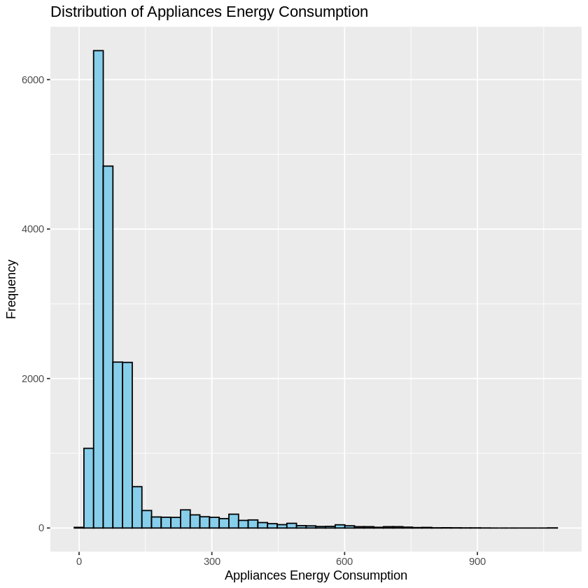
Distribution of the target variable (Appliances energy consumption)

Slide 11
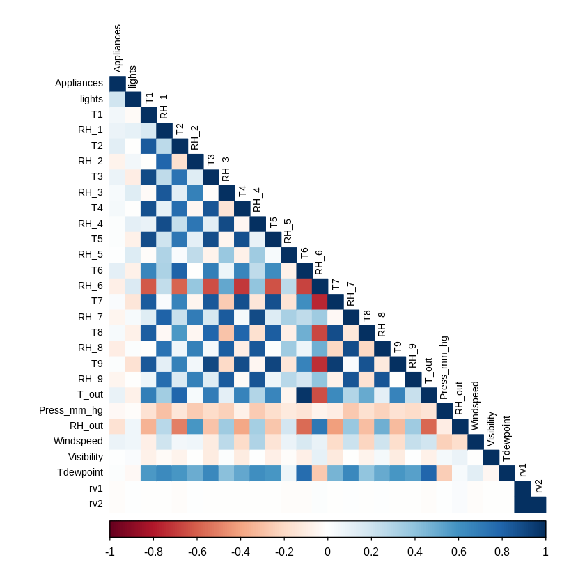
Correlation matrix to identify relationships between features

Slide 12
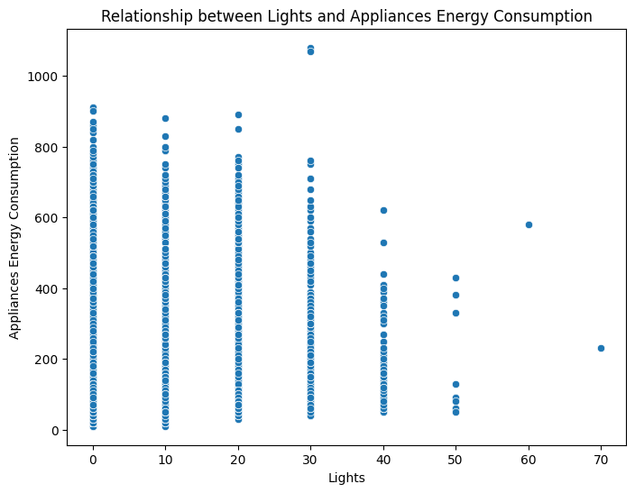
Scatter plot to visualize the relationship between two features and the target variable

Slide 13
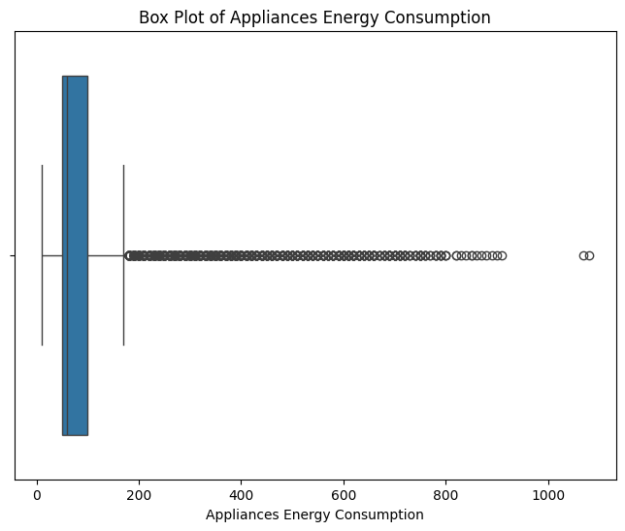
Box plot to identify outliers in a specific feature

Slide 14
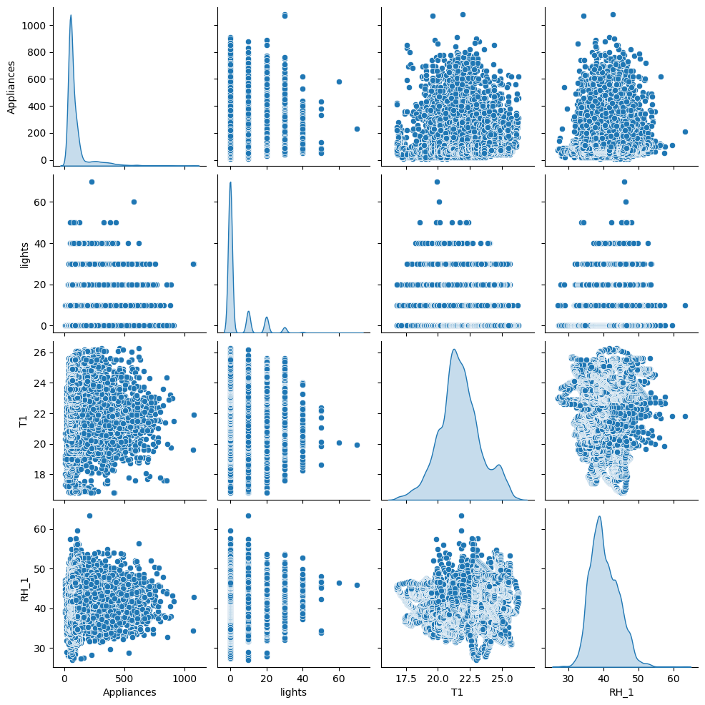

Pair plot to visualize relationships between multiple features and the target variable

Slide 15
Data Preprocessing

Slide 16
Data Wrangling (Data Munging)
Data wrangling is the process of cleaning, transforming, and organizing raw data into a format that is more suitable for analysis. Raw data is often incomplete, inconsistent, or contains errors, and wrangling helps to ensure that the data is accurate, complete, and structured correctly.
Key Steps in Data Wrangling:
Data Collection
Data Cleaning
Data Transformation
Data Integration
Data Validation

Slide 17
Feature engineering is the process of selecting, modifying, or creating new features (variables or attributes) that improve the performance of machine learning models. The goal is to transform raw data into meaningful features that help the model better capture patterns in the data.
Key Steps in Feature Engineering:
Feature Selection
Feature Transformation
Encoding Categorical Features
Feature Creation
Feature Engineering

Slide 18
Regression Modelling

Slide 19
Data Splitting
In machine learning, data splitting is the process of dividing a dataset into multiple subsets to evaluate how well a model will generalize to unseen data. The most common splits are training, validation, and testing datasets.
Here are the reasons for splitting the data:
Avoiding Overfitting
Training vs. Evaluation
Hyperparameter Tuning
Preventing Data Leakage

Slide 20
Linear Regression is a simple and widely used algorithm in machine learning for predicting a continuous outcome based on one or more input features. In the context of Appliance Energy Prediction, Linear Regression is often used to model the relationship between energy consumption and various factors that might influence it, such as temperature, humidity, and time of day. Linear Regression is a statistical technique employed to establish the relationship between a dependent variable and one or more independent variables. Gradient Descent and Stochastic Gradient Descent are used for optimization.
Linear Regression

Slide 21
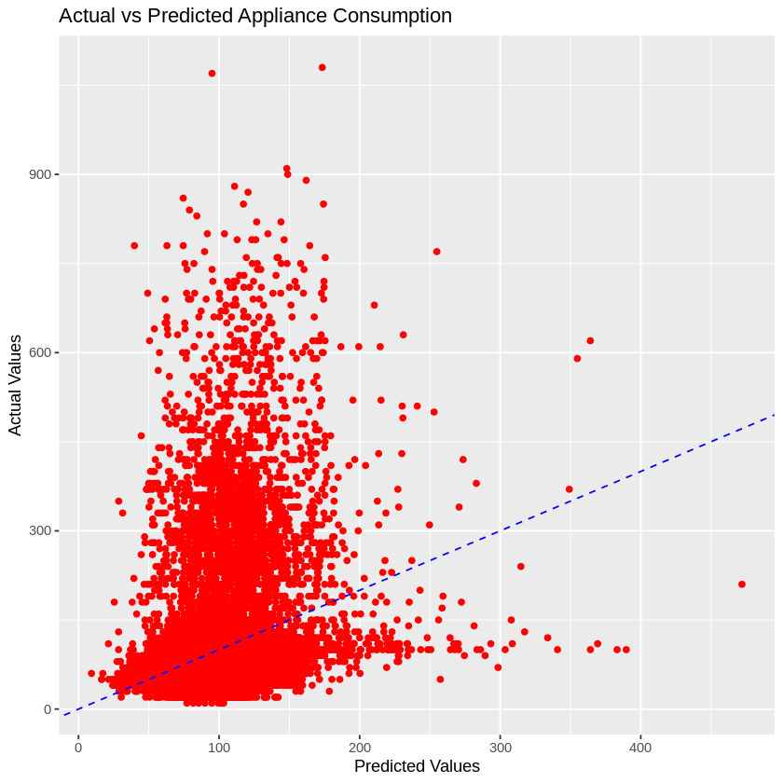
By using Linear Regression, one can obtain a simple, interpretable model that provides insights into the factors affecting appliance energy consumption, although more sophisticated models might be required to capture more complex patterns in the data.

Slide 22
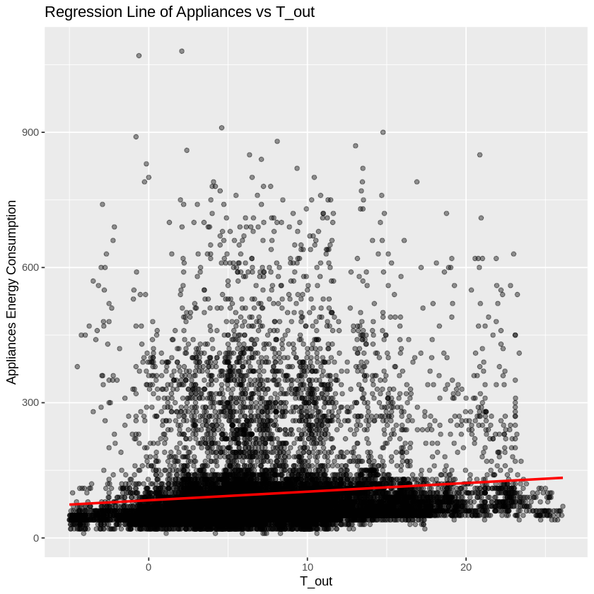
Regression Line

Slide 23
Model Evaluation
The evaluation metrics for your appliance energy prediction model are:
Root Mean Squared Error (RMSE): 91.09
R-squared (R²): 0.17
Model Performance:
The high RMSE value (91.09) indicates that the model's predictions deviate significantly from the actual energy consumption values.
The low R² value (0.17) reveals that the model is only explaining 17% of the variance in the energy consumption data.
Model Fit:
The current model is likely underfitting the data, meaning that it is too simplistic to capture the complex relationships between the features and the target variable.

Slide 24
Significant Improvements Due to Hyperparameter Tuning
Hyperparameter tuning can significantly enhance the performance of models, including both simple models like Linear Regression and more complex models like Random Forest or Gradient Boosting. Proper tuning of hyperparameters optimizes the model's ability to capture underlying patterns in the data, leading to better predictions and generalization
Significant improvements observed when hyperparameter tuning is applied:
Reduced Overfitting and Underfitting
Improved Prediction Accuracy
Enhanced Interpretability and Feature Importance
Improved Speed and Efficiency
Optimized Regularization for Better Generalization
Better Handling of Imbalanced Data
Reduction of Model Complexity Without Loss of Performance

Slide 25
Model Explanation
Model explainability refers to understanding and interpreting how machine learning models arrive at their predictions. In the context of appliance energy prediction, explainability helps clarify how the model predicts energy consumption based on various factors, such as temperature, humidity, time of day, and appliance usage. It allows stakeholders to gain insights into the prediction process, which is crucial for trust, decision-making, and optimizing energy consumption.
Importance of Explainability:
Model explainability builds trust by revealing how the model makes its predictions. For instance, businesses or homeowners using a model to predict appliance energy usage want to know whether the model is behaving logically and basing predictions on reasonable factors.

Slide 26
Importance of Explainability
Explainability reveals the key drivers behind energy consumption, such as the time of day when appliances are used or how outside temperature affects heating or cooling systems. These insights enable businesses or homeowners to take practical actions to reduce energy consumption.
In energy management, there may be regulations or sustainability goals that require transparency in energy usage predictions. Explainability ensures that models meet regulatory standards and provide justifications for their predictions.

Slide 27
Optimization of Energy Usage: Explainability allows businesses or homeowners to identify the most influential factors driving energy consumption.
Cost Savings: Clear explanations of why and when energy consumption is high can lead to targeted interventions, such as scheduling appliance use during off-peak hours, upgrading inefficient appliances, or improving insulation during extreme weather.
Sustainability Goals: Explainability helps businesses and consumers align with sustainability goals by identifying high energy usage areas and finding ways to minimize environmental impact.
Improved Decision-Making: With model explanations, businesses can make data-driven decisions about energy usage.
Enhancing Model Performance: Explainable models help identify which features are most useful for predictions and which may be irrelevant.
Business impact on Model Explainability

Slide 28
Technical Information
Data Collection: Smart Meters and Sensors track how much energy each appliance consumes.
Energy Prediction Models: Machine Learning Algorithms are used for predicting energy consumption. Time-Series Forecasting predicts future energy consumption analyzing previous data.
Features Affecting Prediction: Appliance Type: Larger appliances consume more energy. How often and when appliances are used also affects.
Techniques for Enhancing Accuracy: Feature Engineering add new variables improves precision. By grouping similar appliances based on consumption behavior, prediction becomes more targeted.
Applications: EMS use energy prediction to optimize operation for cost saving. Demand Response Programs, Smart Homes also helps in reduces usage of energy.

Slide 29
Step-by-Step Approach
Define the Problem: Determine the scope (e.g., predicting energy for a specific appliance or household) and the timeframe (hourly, daily, monthly).
Collect Data: Use smart meters to gather time-stamped energy usage and integrate external factors like weather or occupancy.
Preprocess Data: Clean the data by handling missing values, removing anomalies, and normalizing it for better accuracy.
Select Features: Identify key factors (e.g., appliance type, usage time, external variables like temperature) that impact energy consumption.
Choose a Model: Start with basic models like Linear Regression and progress to more advanced techniques (e.g., Random Forest or Neural Networks).
Train and Test: Split the data, train the model, and evaluate performance using metrics like MSE or R-squared.
Tune Parameters: Optimize model performance through hyperparameter tuning (e.g., adjusting tree depth or learning rate).
Deploy and Monitor: Implement the model for real-time predictions and periodically retrain with new data to maintain accuracy.

Slide 30
Conclusion
The linear regression model for appliance energy prediction has provided encouraging results, successfully identifying key relationships between the input features and energy consumption. The model's performance, as reflected in the evaluation metrics like R-squared (R²), Mean Squared Error (MSE), indicates that it effectively captures the main trends and patterns in the data.
Predictive Power: The R² score shows that the model explains a large part of the variation in appliance energy use, providing useful insights for practical applications like energy management and optimization.
Simplicity and Efficiency: Linear regression offers fast predictions, efficiency, and clear understanding of relationships between features and energy use.
Scalability: The model scales well, making it ideal for large datasets or real-time energy monitoring, and provides a strong base for future predictive models.
Potential for Enhancement: The model performs well, but accuracy can improve with complex techniques or more features.
Overall, the linear regression model has proven to be a valuable tool for appliance energy prediction, offering solid performance with the potential for further refinement and improvement.

Slide 31
https://github.com/Thomas-George-T/Appliance-Energy-Prediction
https://www.kaggle.com/code/joegurt/appliance-energy-time-series-eda-and-regression
https://github.com/akifkashif/Captsone-Project---Data-Application-Energy-Linear-Regression-
References

Slide 32
Thank You
Bhavyasri Gudavalli
bhavyasri0234@gmail.com
221FA14081

