Slide 1
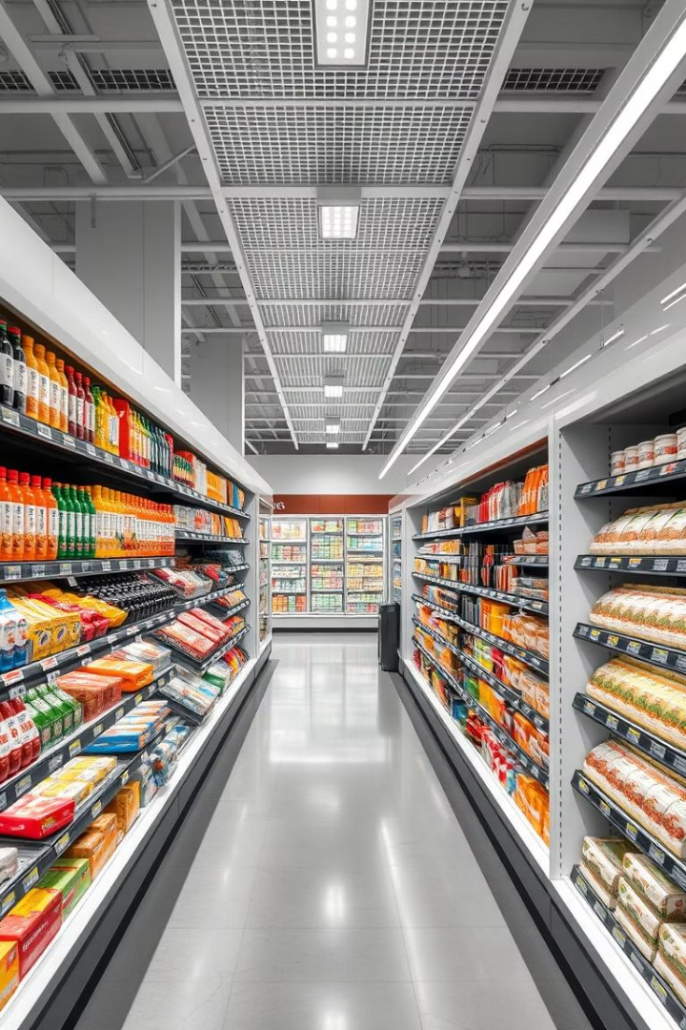
Submitted by
DHANUSH GAMIDI AP23110010867
BHAVA SRI PULIKHANDAM AP23110010929
CSE SECTION M
Grocery Store Management System
This project is submitted to SRM University – AP, Andhra Pradesh, for the partial fulfilment of the Bachelor of Technology degree in Computer Science and Engineering. Guided by MS.DR. Banee Bandana Das Mam, the system aims to design a robust relational database for an e-commerce platform managing grocery store operations efficiently.

Slide 2

Introduction and Project Objectives
Project Introduction
E-commerce has transformed business operations by offering convenience and efficiency in online shopping. Efficient data management is crucial for tracking orders, inventory, and customer details to ensure smooth operations and enhanced user experience.
Objectives
The project aims to design a relational database system that ensures data consistency, scalability for future features like recommendations, and efficient query processing using indexing, views, and joins for optimized data retrieval.

Slide 3
Dataset and Data Collection
Data Collection Method
Data Structure & Attributes
The dataset was designed based on real-world e-commerce components using online articles, academic textbooks, and open-source sample data sets to ensure accuracy and relevance.
Customers: ID, name, email, address
Orders: ID, customer ID, date, total amount
Order Items: product details and quantities
Products: ID, name, price, stock
Categories: product classifications

Slide 4
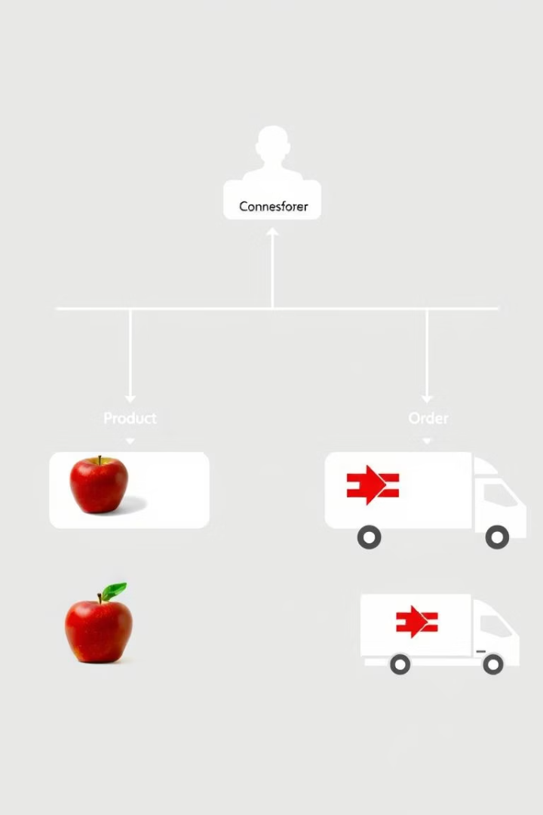
Methodology: ER Diagram and Relationships
Entities
Relationships
Includes Customers, Orders, Order Items, Products, Categories, and Suppliers with defined attributes and keys.
One-to-many between customers and orders, orders and order items; many-to-one between order items and products, products and categories, suppliers and products.
Constraints
Primary keys ensure unique records; foreign keys maintain referential integrity across tables.

Slide 5
Normalization and Database Efficiency
Normalization Process
Benefits
1NF: Eliminates duplicate columns, ensures atomic data
Optimized storage and reduced redundancy
2NF: Removes partial dependencies
Faster query processing with efficient joins
3NF: Eliminates transitive dependencies
Maintains data integrity and scalability

Slide 6
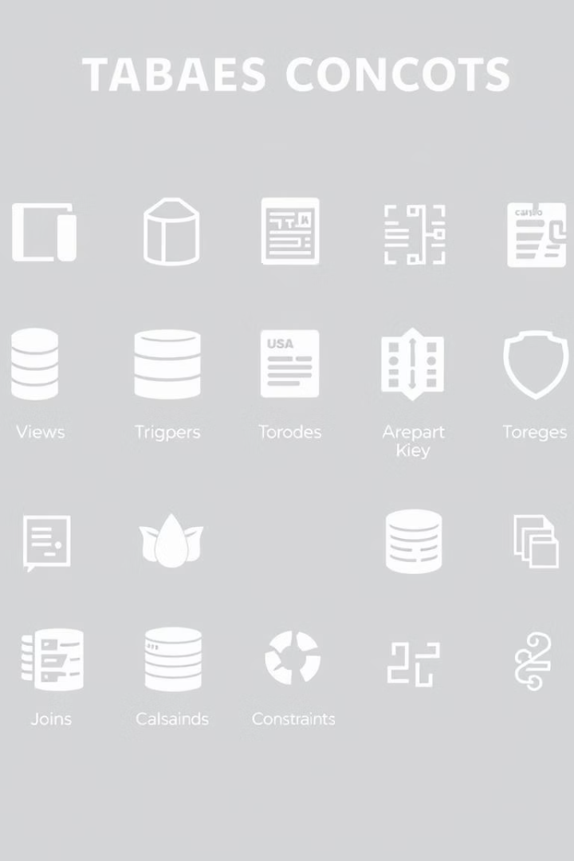
Concepts Used in Database Design
Views
Created to fetch consolidated reports like customer order summaries.
Triggers
Auto-update stock quantities when new orders are placed.
Joins
Used INNER and LEFT JOINs for efficient retrieval of complex relational data.
Foreign Key Constraints
Ensure referential integrity across related tables.

Slide 7
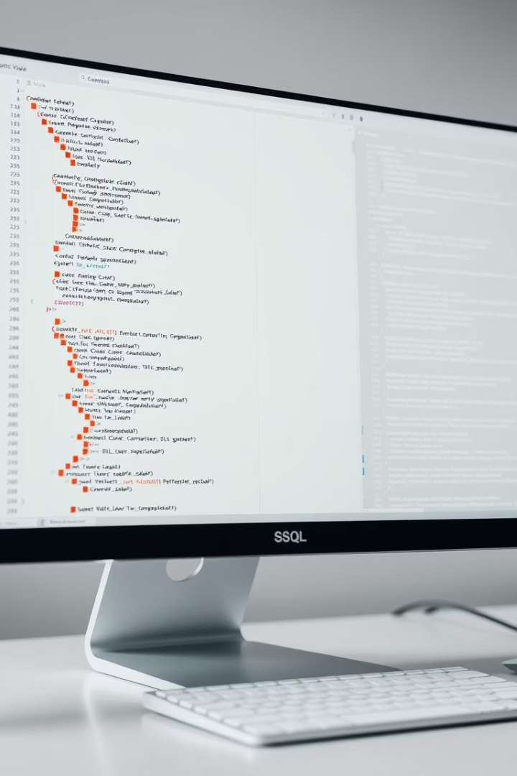



Results: Database Implementation and Testing
Table Creation
Entities structured with primary keys, foreign keys, and attributes using SQL CREATE TABLE commands.
Data Insertion
Sample records inserted to validate schema and relationships between orders, customers, and products.
Query Testing
JOIN queries successfully retrieved consolidated reports linking orders with customer names and total amounts.

Slide 8
Future Work and Enhancements
Admin Panel Interface
Inventory & Payment Integration
User Reviews & Recommendation Engine
Graphical interface for managing orders, customers, inventory with workflows and real-time alerts.
Real-time stock updates and low-stock alerts
AI-based filtering for reviews and personalised product recommendations based on purchase history and behaviour.
Secure payment gateways with transaction logs

