Slide 1
Computer Organization & Architecture
R

Slide 2
Computer Architecture and Organization-1
Architecture is those attributes visible to the programmer and having direct impact on the logical execution of the program
Instruction set, Number of bits used for data types, I/O mechanisms, Memory addressing techniques
e.g. x86 architecture, IBM/360 architecture
Organization is implementation of computer system in terms of its interconnection of functional units
Control signals
Interfaces between computer and peripherals
Memory technology

Slide 3
Computer Architecture and Organization-2
Architecture Question?
Is there a multiply/division instruction available?
Organization Question?
Is multiplication implemented by separate hardware or is it done by repeated addition?

Slide 4
Computer Organization vs. Computer Architecture
For example, it is an architectural design issue whether a computer will have a multiply instruction.
It is an organizational issue whether that instruction will be implemented by a special multiply unit or by a mechanism that makes repeated use of the add unit of the system
Many computer manufacturers offer a family of computer models, all with the same architecture but with differences in organization.
Different models in the family have different price and performance characteristics.
A prominent example of both these phenomena is the IBM system /370 architecture. It is first introduced in 1970 and included a number of models.
This gives code compatibility
At least backwards
Organization differs between different versions

Slide 5
Structure and Functions of various components of a computer system.
Structure is the way in which components relate to each other.
Structure = static relations among components
Function is the operation of individual components as part of the structure.
Function = dynamic behaviour of each component
In terms of description, we have two choices, starting at the bottom and building up to a complete description or beginning with a top view and decomposing the system into the subparts.
The computer system will be described from top down.

Slide 6
How to Describe Computer System?
Computer is a complex system!!!
Contains millions of electronics components
Function is the operation of individual components as part of the structure
Structure is the way in which components are related to each other

Slide 7
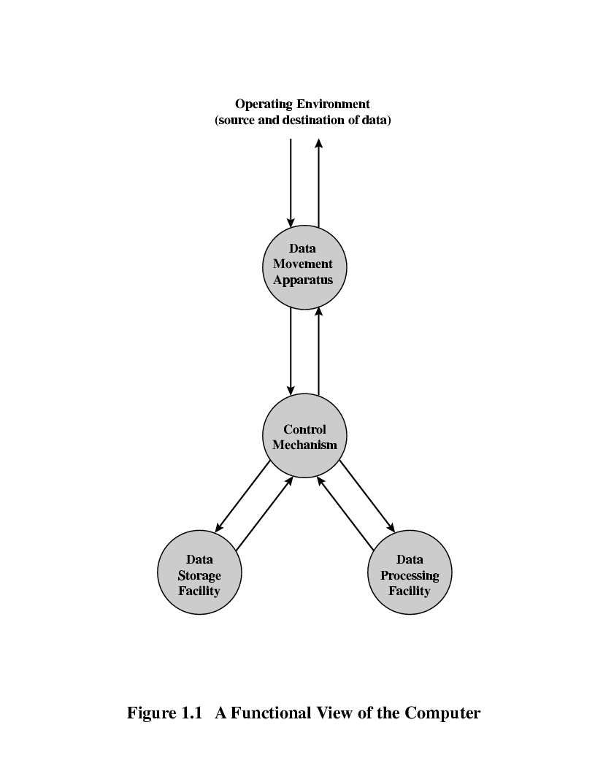
Functional View of Computer
All computer functions are:
Data processing
Data storage
Data movement
Control

Slide 8
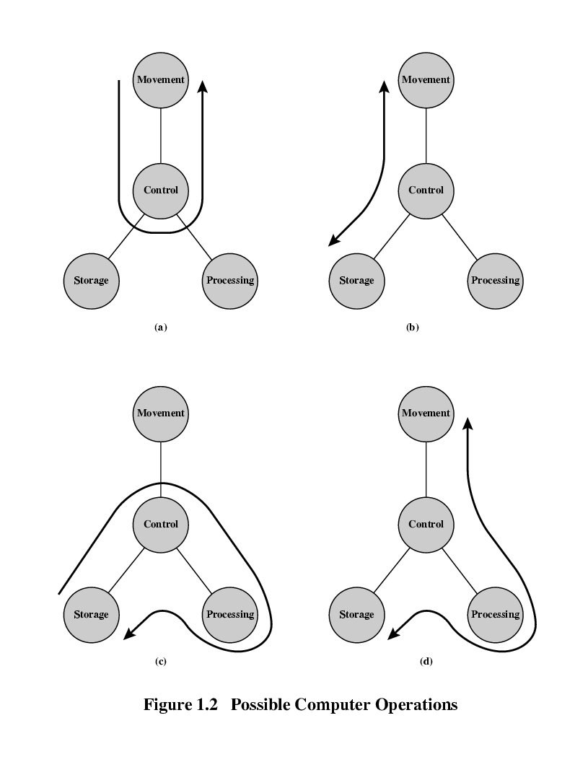

Computer Operations
Operations (b) Storage
Operation (c) Processing from/to storage
Operations (a) Data movement
Operation (d) Processing from storage to I/O

Slide 9
Structure
The figure shows the simplest depiction of a computer.
The computer interacts in some fashion with its external environment.
In general, all of its linkages to the external environment can be classified as peripheral devices or communication lines.
Peripherals
COMPUTER
Storage
processing
Communication lines
The Computer

Slide 10
Structural View of a Computer
Peripherals
Computer
Central
Processing
Unit
Main
Memory
Computer
Systems
Interconnection
Input
Output
Communication
lines

Slide 11
There are four main structural components:
Central processing unit (CPU): controls the operation of the computer and performs its data processing functions; often simply referred to as processor.
Main memory: Stores data.
I/O: Moves data between the computer and its external environment.
System Interconnection: Some mechanism that provides for communication among CPU, main memory and I/O.

Slide 12
Structural View of the CPU
CPU
Computer
Arithmetic
and
Logic Unit
I/O
Registers
System
Bus
CPU
Internal CPU
Interconnection
Memory
Control
Unit

Slide 13
Structural View of the CPU
A common example of system interconnection is by means of a system bus, consisting of number of conducting wires to which all the other components attach.
The most complex component is the CPU and its major structural components are as follows:
Control unit: Controls the operation of the CPU and hence the computer.
Arithmetic and logic unit (ALU): Performs the computers data processing functions.
Registers: Provides storage internal to the CPU.
CPU Interconnection: Some mechanism that provides for communication among the control unit, ALU and registers.

Slide 14
Brief History of Computers
ENIAC was the first general purpose electronic digital computer
By John Mauchly and John Eckert in 1946
Von Neumann Machine (1946) called as IAS( Institute of advanced study)
Based on stored program concept
PDP-1 Computer (1957)
Developed by Digital Equipment Corporation (DEC)
First step towards mini computers
IBM SYSTEM/360 (1964)
First planned family of computers

Slide 15
ENIAC - background
Electronic Numerical Integrator And Computer
Eckert and Mauchly
University of Pennsylvania
Trajectory tables for weapons
Started 1943
Finished 1946
Too late for war effort
Used until 1955

Slide 16
ENIAC - details
Decimal (not binary)
20 accumulators of 10 digits
Programmed manually by switches
18,000 vacuum tubes
30 tons
15,000 square feet
140 kW power consumption
5,000 additions per second

Slide 17
von Neumann/Turing
Stored Program concept
Main memory storing programs and data
ALU operating on binary data
Control unit interpreting instructions from memory and executing
Input and output equipment operated by control unit
Princeton Institute for Advanced Studies
IAS ( Institute for Advanced Study)
Completed 1952

Slide 18
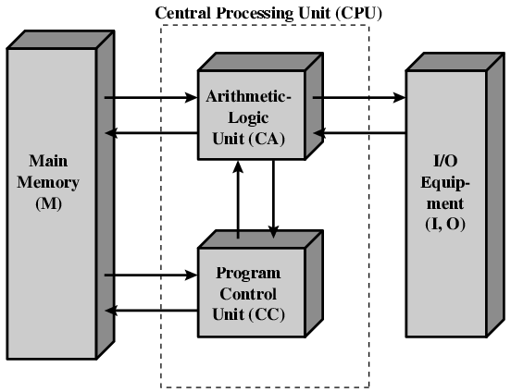
Structure of von Neumann machine

Slide 19
IAS - details
1000 x 40 bit words
Binary number
memory of the IAS consists of 4,096 storage locations, called words, of 40 binary digits (bits) each
2 x 20 bit instructions
Set of registers (storage in CPU)
Memory Buffer Register
Memory Address Register
Instruction Register
Instruction Buffer Register
Program Counter
Accumulator
Multiplier Quotient

Slide 20
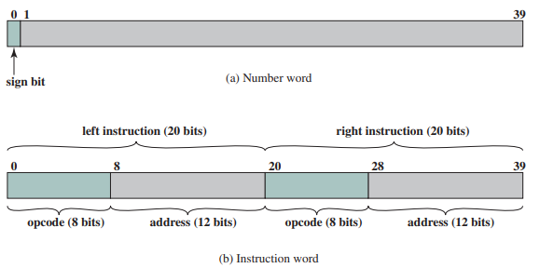
IAS - details

Slide 21
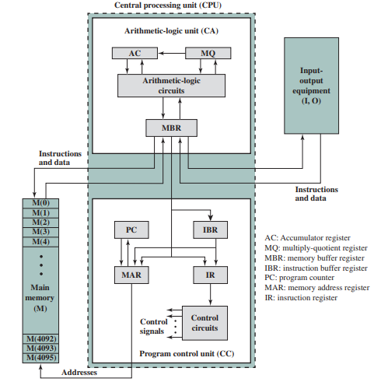
Structure of IAS – detail

Slide 22
Commercial Computers
1947 - Eckert-Mauchly Computer Corporation
UNIVAC I (Universal Automatic Computer)
US Bureau of Census 1950 calculations
Became part of Sperry-Rand Corporation
Late 1950s - UNIVAC II
Faster
More memory
IBM
Punched-card processing equipment
1953 - the 701
IBM’s first stored program computer
Scientific calculations
1955 - the 702
Business applications
Lead to 700/7000 series

Slide 23
Transistors
Replaced vacuum tubes
Smaller
Cheaper
Less heat dissipation
Solid State device
Made from Silicon (Sand)
Invented 1947 at Bell Labs
William Shockley et al

Slide 24
Transistor Based Computers
Second generation machines
NCR & RCA produced small transistor machines
IBM 7000
DEC - 1957
Produced PDP-1(Programmed Data Processor)

Slide 25
Microelectronics
Literally - “small electronics”
A computer is made up of gates, memory cells and interconnections
These can be manufactured on a semiconductor
e.g. silicon wafer

Slide 26
DEC PDP-8
1964
First minicomputer (after miniskirt!)
Did not need air conditioned room
Small enough to sit on a lab bench
$16,000
$100k+ for IBM 360
Embedded applications & OEM(original equipment manufacturers)
BUS STRUCTURE

Slide 27
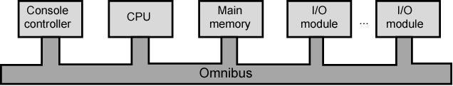
DEC - PDP-8 Bus Structure
models of the PDP-8 used a structure that became virtually universal for microcomputers: the bus structure

Slide 28
IBM 360 series
1964
Replaced (& not compatible with) 7000 series
First planned “family” of computers
Similar or identical instruction sets
Similar or identical O/S
Increasing speed
Increasing number of I/O ports (i.e. more terminals)
Increased memory size
Increased cost
Multiplexed switch structure

Slide 29
Semiconductor Memory
1970
Fairchild
Size of a single core
i.e. 1 bit of magnetic core storage
Holds 256 bits
Non-destructive read
Much faster than core
Capacity approximately doubles each year

Slide 30
Intel
1971 - 4004
First microprocessor
All CPU components on a single chip
4 bit
Followed in 1972 by 8008
8 bit
Both designed for specific applications
1974 - 8080
Intel’s first general purpose microprocessor

Slide 31
Computer Generations
Vacuum tube (1946-1957) & Transistor (1958-1964)
Integrated Circuits
Small scale integration - 1965 on
Up to 100 devices on a chip
Medium scale integration - to 1971
100 - 3,000 devices on a chip
Large scale integration - 1971-1977
3,000 - 100,000 devices on a chip
Very large scale integration - 1978 -1991
100,000 - 100,000,000 devices on a chip
Ultra large scale integration – 1991 onwards
Over 100,000,000 devices on a chip

Slide 32
x86 Evolution-1
1971 - 4004
First microprocessor of 4 bit
All CPU components on a single chip
Followed in 1972 by 8008 (8 bit processor)
Both designed for specific applications
8080
First general purpose microprocessor
Process/move 8 bit data at a time
Used in first personal computer – Altair

Slide 33
x86 Evolution-2
8086
Much more powerful (16 bit data)
Instruction cache, pre-fetch few instructions
8088 (8 bit external bus) used in first IBM PC
80286
16 MByte memory addressable
Up from 1MB (in 8086)
80386
32 bit processor with multitasking support

Slide 34
x86 Evolution-3
80486
Sophisticated powerful cache and instruction pipelining
Built in maths co-processor
Pentium
Superscalar
Multiple instructions executed in parallel
Pentium Pro
Increased superscalar organization
Aggressive register renaming
Branch prediction and Data flow analysis

Slide 35
x86 Evolution-4
Pentium II
MMX technology, graphics, video & audio processing
Pentium III
Additional floating point instructions for 3D graphics
Pentium 4
Further floating point and multimedia enhancements
Itanium Series
64 bit with Hardware enhancements to increase speed
What’s next???
Multi core architectures

Slide 36
Fetch and Execute cycles

Slide 37
What is a program?
A logical group of instructions to achieve a specific task.
An instruction is a sequence of steps
For each step an arithmetic or logical operation or data movement is done.

Slide 38
Addition of Two Numbers
Start
Load Load
R1,A R2,B
R3=R1+R2
Store C,R3
End of program

Slide 39
Components (start here)
The Control Unit and the Arithmetic and Logic Unit constitute the Central Processing Unit
Data and instructions need to get into the system and results out
Input/output
Temporary storage of code and results is needed
Main memory

Slide 40
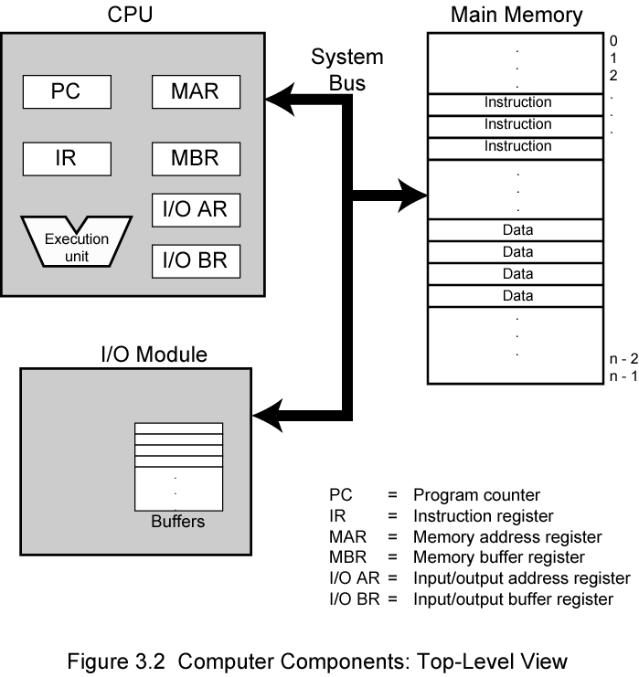
Computer Components: Top Level View

Slide 41
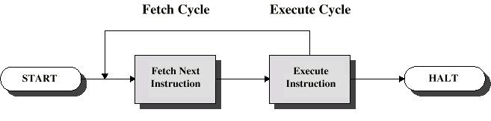
Instruction Cycle
Two steps:
Fetch
Execute

Slide 42
Fetch Cycle
Program Counter (PC) holds address of next instruction to be fetched
Processor fetches instruction from memory location pointed to by PC
Increment PC
Unless told otherwise
Instruction loaded into Instruction Register (IR)
Processor interprets instruction and performs required actions

Slide 43
Execute Cycle
Processor-memory
data transfer between CPU and main memory
Processor I/O
Data transfer between CPU and I/O module
Data processing
Some arithmetic or logical operation on data
Control
Alteration of sequence of operations
e.g. jump
Combination of above

Slide 44
0 3 4 15
Instruction format
The instruction format provides 4 bits for the opcode, so that there can be as many as 2⁴ = 16 different opcodes.
,and up to 2¹² = 4096 (4K) words of memory can be directly addressed.
opcode function
0001 Load AC from memory
0010 Store AC to Memory
0101 Add to AC from Memory
Opcode Address

Slide 45
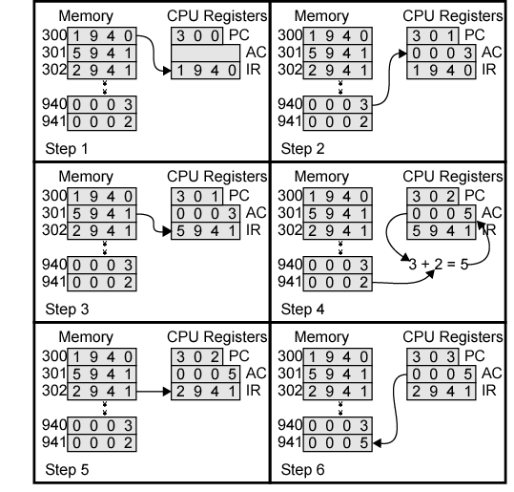
Example of Program Execution
The program fragment shown adds the contents of the memory word at address 940 to the contents of the memory word at address 941 and stores the result in the latter location

Slide 46
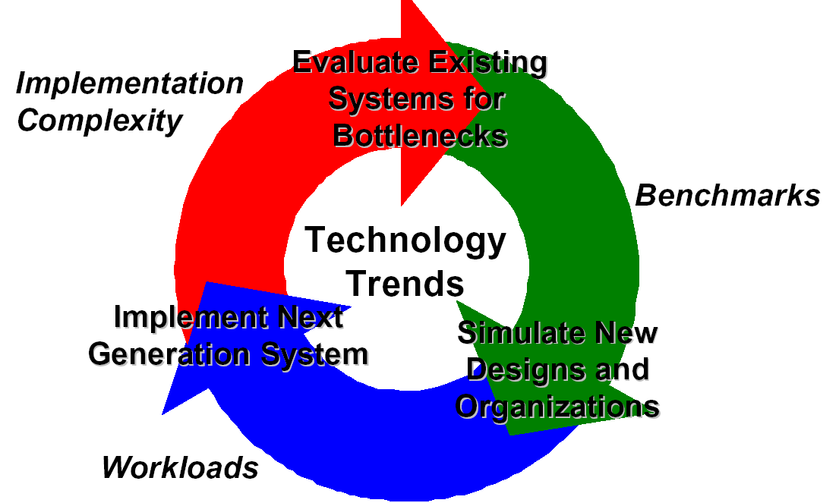
The Role of Performance

Slide 47
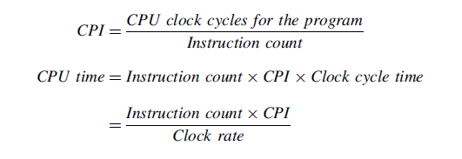

Slide 48
CPU Performance Equation
Multiple aspects to performance: helps to isolate them
Latency = seconds / program =
(insns / program) * (cycles / insn) * (seconds / cycle)
Insns / program: dynamic insn count
Impacted by program, compiler, ISA
Cycles / insn: CPI
Impacted by program, compiler, ISA, micro-arch
Seconds / cycle: clock period (Hz)
Impacted by micro-arch, technology
For low latency (better performance) minimize all three
Difficult: often pull against one another
Example we have seen: RISC vs. CISC ISAs
RISC: low CPI/clock period, high insn count
CISC: low insn count, high CPI/clock period

Slide 49
PERFORMANCE
Performance is one of the key parameter to
evaluate a system.
If we say one system is better than another
we consider
Response Time
Throughput

Slide 50
Computer Performance
Performance is one of the key parameter to-
Evaluate processor hardware
Measure requirement for new systems
When we say one computer has better performance than another, what does it mean?
Criterion for the performance?
Response Time (Single computer), Throughput (Data center)

Slide 51
Clock Rate
Operation performed by processor are governed by system clock (fundamental level of processor speed measurement)
Generated by quartz crystal
A clock cycle is the basic unit of time to execute one operation.
Clock Rate (clock cycles per second in MHz or GHz) is inverse of clock cycle time (clock period)
one clock period

Slide 52
Is Clock Rate Enough?
As we know, instruction execution takes several discrete steps
Fetching, decoding, ALU operation, fetching data etc.
It takes multiple clock cycles for its execution
Different instructions takes different number of cycles for their execution
LOAD, ADD, SUB, JUMP etc.
Thus clock speed doesn’t tell the whole story!!!

Slide 53
Performance: Application Specific
Performance
How a processor performs when executing a given application
Application performance depends upon
Speed of the processor
Instruction set
Choice of language
Efficiency of the compiler
Programming skill of the user

Slide 54
CPU Performance
To maximize performance, need to minimize execution time
performance = 1 / execution_time
If X is n times faster than Y, then
performance_{X} execution_time_{Y}
-------------------- = --------------------- = n
performance_{Y} execution_time_{X}

Slide 55

A Relative Performance Example
If computer A runs a program in 10 seconds and computer B runs the same program in 15 seconds, how much faster is A than B?

Slide 56
Cycles Per Instruction (CPI)
For any given processor, number of cycles required varies for different types of instructions
e.g. load, store, branch, add, mul etc.
Hence CPI is not a constant value for a processor
Needs to calculate average CPI for processor

Slide 57
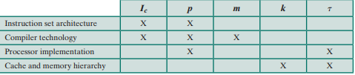
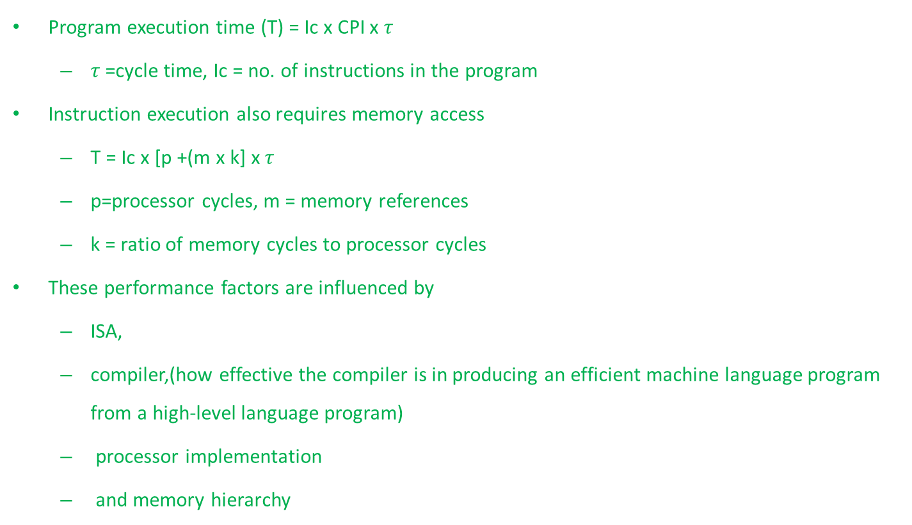
CPU Performance and it’s Factors
Program execution time (T) = Ic x CPI x $τ$
$τ$=cycle time, Ic = no. of instructions in the program
Instruction execution also requires memory access
T = Ic x [p +(m x k] x $τ$
p=processor cycles, m = memory references
k = ratio of memory cycles to processor cycles
These performance factors are influenced by
ISA,
compiler,(how effective the compiler is in producing an efficient machine language program from a high-level language program)
processor implementation
and memory hierarchy

Slide 58
MIPS Rate
Common measure of performance
Millions Instructions Per Second (MIPS) rate
Ic/(Execution time x 10⁶)
This can be written as:
=Ic/ cycle time x (Ic x CPI )x 10⁶
= f/ CPI x 10⁶

Slide 59
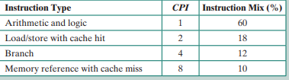
In class Example1
Consider the execution of a program that results in the execution of 2 million instructions on a 400-MHz processor. The program consists of four major types of instructions. The instruction mix and the CPI for each instruction type are given below, based on the result of a program trace experiment
The average CPI when the program is executed on a uniprocessor with the above trace results is CPI = 0.6 + (2 * 0.18) + (4 * 0.12) + (8 * 0.1) = 2.24.
MIPS rate = I_{c} /T * 10⁶ = f /CPI * 10⁶
The corresponding MIPS rate is (400 * 10⁶ )/(2.24 * 10⁶ ) ≈ 178.

Slide 60
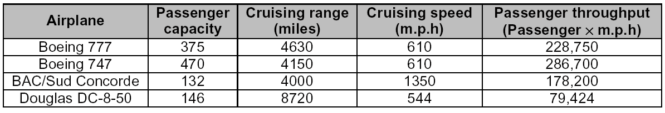
Example of Performance Measure

Slide 61
Limitation of MIPS Rate
MIPS rate or instruction execution rate is also inadequate to measure CPU performance. Why?
Because of differences in ISA
Ex. To execute a high level language statement A=B+C (A,B and C are in memory) may need different number of low level instructions for different ISA

Slide 62
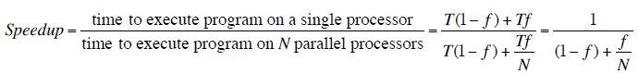
Amdahl’s Law Formula
For program running on single processor
Fraction f of code infinitely parallelizable with no scheduling overhead
Fraction (1-f) of code inherently serial
T is total execution time for program on single processor
N is number of processors that fully exploit parralle portions of code
Conclusions
f small, parallel processors has little effect
N ->∞, speedup bound by 1/(1 – f)
Diminishing returns for using more processors

Slide 63
Amdahl’s Law
How much will an optimization improve performance?
P = proportion of running time affected by optimization
S = speedup
What if I speedup 25% of a program’s execution by 2x?
1.14x speedup
What if I speedup 25% of a program’s execution by ∞?
1.33x speedup

Slide 64
In class Example2
Suppose we have made the following measurements:
Frequency of FP operations = 50%
Average CPI of FP operations = 4.0
Average CPI of other instructions = 1.33
Frequency of FPSQR= 20%
CPI of FPSQR = 20
Assume that the two design alternatives are to decrease the CPI of FPSQR to 2 or to decrease the average CPI of all FP operations to 2.5. Compare these two design alternatives using the processor performance equation.

Slide 65


Apply Amdahl's Law to the above question and observe the result
Amdahl’s Law eqn:
With FPSQR Speedup_{overall}
=
With FP Speedup_{overall}=
We get the same result using Amdahl's Law

Slide 66
In class Example3
A benchmark program is run on a 40 MHz processor.The executed program consists of
100,000 instruction executions, with the following instruction mix and clock cycle count:
Instruction Type Instruction Count Cycles per Instruction
arithmetic 45000 1
Data transfer 32000 2
Floating point 15000 2
Control transfer 8000 2
Determine the effective CPI, MIPS rate, and execution time for this program.

Slide 67
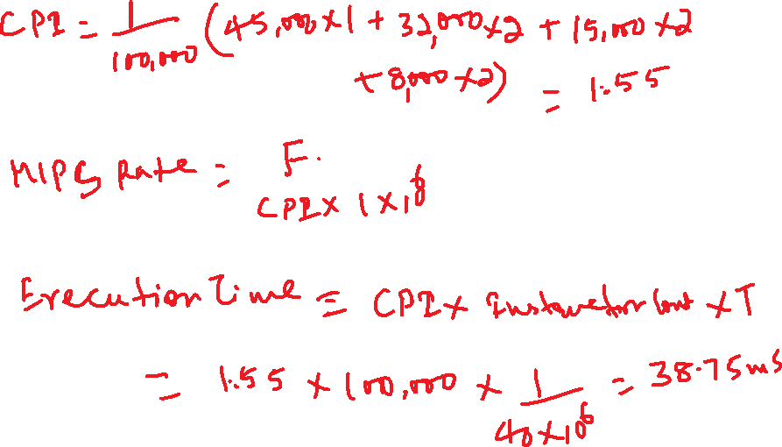
In class Example3 contnd
SOL: CPI =1.55,MIPS RATE = 25.8,
execution time =38.75ms

Slide 68
In class Example4
Q2. Early examples of CISC and RISC are the VAX 11/780 and the IBM RS/6000, respectively. Using a typical benchmark program, the following machine characteristics results:
The final column shows that the VAX required 12 times longer than the IBM measured in CPU time.
What is the relative size of the instruction count of the machine code for this benchmark program running on the two machines?
What are the CPI (Cycles Per Instruction) values for the two machines?
Processor | Clock Frequency | Performance | CPU time
VAX 11/780 | 5 MHz | 1MIPS | 12 x seconds
IBM RS/6000 | 25 MHz | 18 MIPS | x seconds

Slide 69
Sol: We can express the MIPS rate as: [(MIPS rate)/10⁶] = Ic/T.
So that:
Ic = T × [(MIPS rate)/10⁶].
a)The ratio of the instruction count of the RS/6000 to the VAX is
[x × 18]/[12x × 1] = 1.5
b) For the Vax, CPI = (5 MHz)/(1 MIPS) = 5
For the RS/6000, CPI = 25/18 = 1.39

Slide 70
Benchmark Programs
It is a collection of a programs that provides representative test of a computer in a particular application area
e.g. SPEC (System Performance Evaluation Corporation) benchmark suites
SPEC CPU 2006 is used for measuring performance for the computational based applications

Slide 71
Review Questions
Differentiate between computer organization and architecture?
What are the four main functions of a computer?
What are the basic structural components of a computer?
Describe the computer generations in brief.
What was the first general purpose microprocessor?
Consider two implementation of the same ISA. Computer A clock cycle time of 250 ns and a CPI of 2 for a program. Computer B has a clock cycle time of 500 ns and a CPI of 1.2 for the same program. Which computer is faster for this program and by how much?
A program runs on computer A with a 2 GHz clock in 10 seconds. Another computer B with 4 GHz run this program in 6 seconds. To accomplish this, computer B will require P times as many clock cycles as computer A to run the program. Find the value of P.

Slide 72
Practice questions
Practice question

Slide 73
Performance revision
Consider two different machines, with two different instruction sets, both of which have a clock rate of 200 MHz. The following measurements are recorded on the two machines running a given set of benchmark programs:
Instruction Type Instruction Count (millions) Cycles per Instruction
Machine A
Arithmetic and logic 8 1
Load and store 4 3
Branch 2 4
Others 4 3
Machine B
Arithmetic and logic 10 1
Load and store 8 2
Branch 2 4
Others 4 3
a. Determine the effective CPI, MIPS rate, and execution time for each machine.
b. Comment on the results.

Slide 74
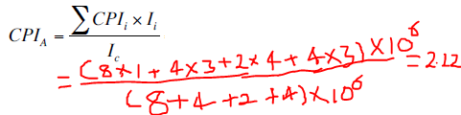
Performance revision
clock rate of 200 MHz. :
Instruction Type Instruction Count (millions) Cycles per Instruction
Machine A
Arithmetic and logic 8 1
Load and store 4 3
Branch 2 4
Others 4 3
a. Determine the effective CPI, MIPS rate, and execution time for each machine.
b. Comment on the results.

Slide 75
Performance revision
clock rate of 200 MHz. :
Instruction Type Instruction Count (millions) Cycles per Instruction
Machine A
Arithmetic and logic 8 1
Load and store 4 3
Branch 2 4
Others 4 3
a. Determine the effective CPI, MIPS rate, and execution time for each machine.
b. Comment on the results.
Time for 1 cycle = 1/f Hz
Time for 1 instruction= CPI X 1/f
CPI X 1/f secs for 1 instruction
There fore in 1 sec no of instructions= f/ CPI
And this MIPS= f/ (CPI X 10⁶)

Slide 76


Performance revision
clock rate of 200 MHz. :
Instruction Type Instruction Count (millions) Cycles per Instruction
Machine A
Arithmetic and logic 8 1
Load and store 4 3
Branch 2 4
Others 4 3
a. Determine the effective CPI, MIPS rate, and execution time for each machine.
b. Comment on the results.
And this MIPS= f/ (CPI X 10⁶)

Slide 77
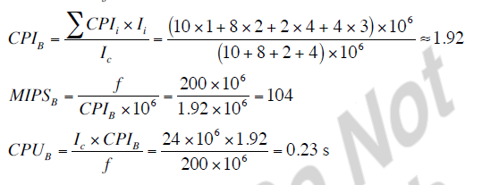
Performance revision
clock rate of 200 MHz. :
Instruction Type Instruction Count (millions) Cycles per Instruction
Machine B
Arithmetic and logic 10 1
Load and store 8 2
Branch 2 4
Others 4 3
a. Determine the effective CPI, MIPS rate, and execution time for each machine.
b. Comment on the results.

Slide 78
Thank You!

