Slide 1
COMPUTER ORGANISATION AND ARCHITECTURE
R.K.Tiwary

Slide 2
Contact Session 3
Computer System Components and Interconnections

Slide 3

IMP Note to Self

Slide 4
IMP Note to Students
It is important to know that just login to the session does not guarantee the attendance.
Once you join the session, continue till the end to consider you as present in the class.
IMPORTANTLY, you need to make the class more interactive by responding to Professors queries in the session.
Whenever Professor calls your number / name ,you need to respond, otherwise it will be considered as ABSENT

Slide 5
Inter Connections
All the units must be connected
Different type of connection for different type of unit
Memory
Input/Output
CPU

Slide 6
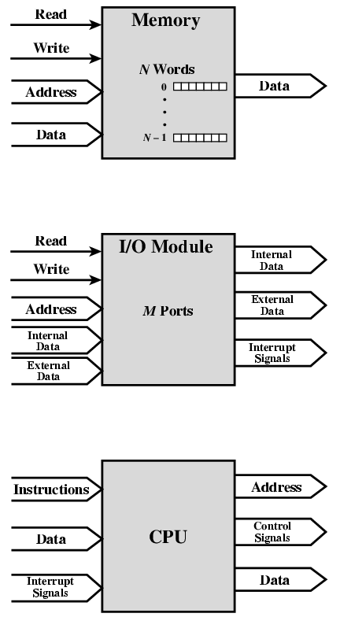
Computer Modules
■ I/O module: I/O is functionally similar to memory. There are two operations; read and write.
I/O module may control more than one external device.
Refer to each of the interfaces to an external device as a port and give each a unique address (e.g., 0, 1, … , M-1).
In addition, there are external data paths for the input and output of data with an external device.
Finally, an I/O module may be able to send interrupt signals to the processor.

Slide 7
CPU & MEMORY Connection
Reads instruction and data
Writes out data (after processing)
Sends control signals to other units
Receives (& acts on) interrupts
Memory Connection
Receives and sends data
Receives addresses (of locations)
Receives control signals
Read
Write
Timing

Slide 8
Input/Output Connection
Similar to memory from computer’s viewpoint
Output
Receive data from computer
Send data to peripheral
Input
Receive data from peripheral
Send data to computer
Receive control signals from computer
Send control signals to peripherals
e.g. spin disk
Receive addresses from computer
e.g. port number to identify peripheral
Send interrupt signals (control)

Slide 9
Input/Output Connection
Similar to memory from computer’s viewpoint
Output
Receive data from computer
Send data to peripheral
Input
Receive data from peripheral
Send data to computer
Receive control signals from computer
Send control signals to peripherals
e.g. spin disk
Receive addresses from computer
e.g. port number to identify peripheral
Send interrupt signals (control)

Slide 10
Concept of BUS

Slide 11
Buses
There are a number of possible interconnection systems
it has gradually given way to various point-to-point interconnection structures, which now dominate computer system design
Single and multiple BUS structures are most common
e.g. Control/Address/Data bus (PC)
e.g. Unibus (DEC-PDP)
A communication pathway connecting two or more devices is a bus.
Parallel lines on circuit boards
Ribbon cables
Strip connectors on motherboards
Sets of wires

Slide 12
Different Bus
Data Bus
Carries data
Remember that there is no difference between “data” and “instruction” at this level
Width is a key determinant of performance
8, 16, 32, 64 bit
Address bus
Identify the source or destination of data
e.g. CPU needs to read an instruction (data) from a given location in memory
Bus width determines maximum memory capacity of system
e.g. 8080 has 16 bit address bus giving 64k address space

Slide 13
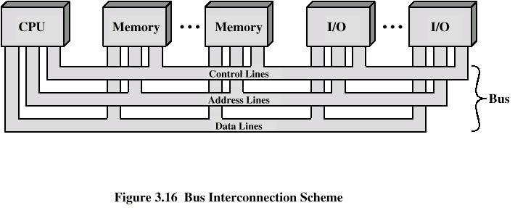
Control Bus
Control and timing information
Memory read/write signal
Interrupt request
Clock signals

Slide 14
Single Bus Problems
Lots of devices on one bus leads to:
Propagation delays
Long data paths mean that co-ordination of bus use can adversely affect performance
If aggregate data transfer approaches bus capacity
Most systems use multiple buses to overcome these problems

Slide 15
Multiple Bus Hierarchies
A great number of devices on a bus will cause performance to suffer
Propagation delay - the time it takes for devices to coordinate the use of the bus
The bus may become a bottleneck as the aggregate data transfer demand approaches the capacity of the bus (in available transfer cycles/second)
Traditional Hierarchical Bus Architecture
Use of a cache structure insulates CPU from frequent accesses to main memory
Main memory can be moved off local bus to a system bus
Expansion bus interface
buffers data transfers between system bus and I/O controllers on expansion bus
insulates memory-to-processor traffic from I/O traffic

Slide 16
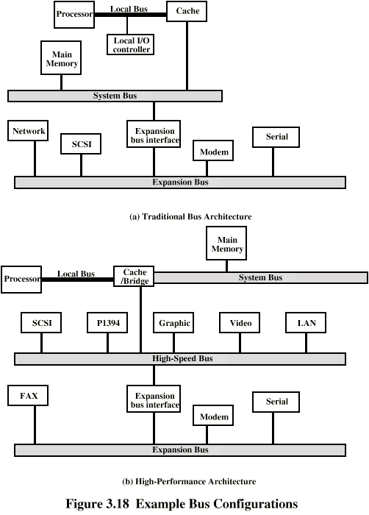
Traditional (ISA Industry Standard Architecture) (with cache)
Main memory can be moved off of the local bus onto a system bus.
make use of one or more expansion buses
small computer system interface
LANs
WANs

Slide 17
High Performance Bus
High-performance Hierarchical Bus Architecture
Traditional hierarchical bus breaks down as higher and higher performance is seen in the I/O devices
Incorporates a high-speed bus
specifically designed to support high-capacity I/O devices
brings high-demand devices into closer integration with the processor and at the same time is independent of the processor
Changes in processor architecture do not affect the high-speed bus, and vice versa
Sometimes known as a mezzanine architecture
to high-speed LANs, such as Fast Ethernet at 100 Mbps

Slide 18
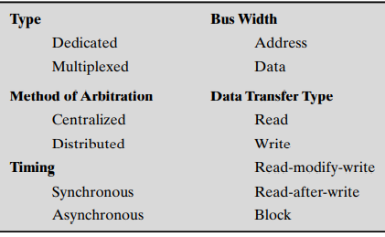
Bus Types
Dedicated
Separate data & address lines
Multiplexed
Shared lines
Address valid or data valid control line
Advantage - fewer lines
Disadvantages
More complex control
Reduction in performance (cannot take place in parallel)

Slide 19
Bus Arbitration
More than one module controlling the bus
e.g. CPU and DMA controller
Only one module may control bus at one time
Arbitration may be centralised or distributed
Centralised
Single hardware device controlling bus access
Bus Controller
May be part of CPU or separate
Distributed
Each module may claim the bus
Control logic on all modules

Slide 20
What is Bus Arbitration, Bus Mastering and DMA?
Bus Arbitration – an elaborate system for resolving bus control conflicts and assigning priorities to the requests for control of the bus.
Bus Mastering – a method of enabling different device controllers on the bus to ‘talk’ to one an other, without having to go through the CPU.
DMA(Direct Memory Access) – a method of transferring data from a hard disk to main memory without having to go through the CPU.

Slide 21
Bus Arbitration Methods
Centralized
Centralized bus arbitration requires hardware (arbiter)that will grant the bus to one of the requesting devices. This hardware can be part of the CPU or it can be a separate device on the motherboard.
Decentralized
Decentralized arbitration there isn't an arbiter, so the devices have to decide who goes next. This makes the devices more complicated, but saves the expense of having an arbiter.

Slide 22
Centralized arbitration
B
B
S
Y
B
R
Processor
DMA
DMA
controller
controller
BG1
1
BG2
2
Bus arbiter may be the processor or a separate unit connected to the bus.
Normally, the processor is the bus master, unless it grants bus membership to one of the DMA controllers.
DMA controller requests the control of the bus by asserting the Bus Request (BR) line.
In response, the processor activates the Bus-Grant1 (BG1) line, indicating that the controller may use the bus when it is free.
BG1 signal is connected to all DMA controllers in a daisy chain fashion.
BBSY signal is 0, it indicates that the bus is busy. When BBSY becomes 1, the DMA controller which asserted BR can acquire control of the bus.

Slide 23
Centralized arbitration (contd..)
DMA controller 2
asserts the BR signal.
T
ime
Processor asserts
the BG1 signal
B
R
BG1
BG1 signal propagates
to DMA#2.
BG2
B
B
S
Y
Bus
master
Processor
DMA controller 2
Processor
Processor relinquishes control
of the bus by setting BBSY to 1.

Slide 24
Centralized arbitration (contd..)
Centralized arbitration scheme with one Bus-Request (BR) line and one Bus-Grant (BG) line forming a daisy chain.
Several pairs of BR and BG lines are possible, perhaps one per device as in the case of interrupts.
Bus arbiter has to ensure that only one request is granted at any given time.
It may do so according to a fixed priority scheme, or a rotating priority scheme.
Rotating priority scheme:
There are four devices, and initial priority is 1,2,3,4.
After the request from device 1 is granted, the priority changes to 2,3,4,1.

Slide 25
Distributed arbitration
All devices waiting to use the bus share the responsibility of carrying out the arbitration process.
Arbitration process does not depend on a central arbiter and hence distributed arbitration has higher reliability.
Each device is assigned a 4-bit ID number.
All the devices are connected using 5 lines, 4 arbitration lines to transmit the ID, and one line for the Start-Arbitration signal.
To request the bus a device:
Asserts the Start-Arbitration signal.
Places its 4-bit ID number on the arbitration lines.
The pattern that appears on the arbitration lines is the logical-OR of all the 4-bit device IDs placed on the arbitration lines.

Slide 26
Distributed arbitration
Device A has the ID 5 and wants to request the bus:
- Transmits the pattern 0101 on the arbitration lines.
Device B has the ID 6 and wants to request the bus:
- Transmits the pattern 0110 on the arbitration lines.
Pattern that appears on the arbitration lines is the logical OR of the patterns: - Pattern 0111 appears on the arbitration lines.
Arbitration process:
Each device compares the pattern that appears on the arbitration lines to its own ID, starting with MSB.
If it detects a difference, it transmits 0s on the arbitration lines for that and all lower bit positions.
Device A compares its ID 5 with a pattern 0101 to pattern 0111.
It detects a difference at bit position 2, as a result, it transmits a pattern 0100 on the arbitration lines.
The pattern that appears on the arbitration lines is the logical-OR of 0100 and 0110, which is 0110.
This pattern is the same as the device ID of B, and hence B has won the arbitration.

Slide 27
Timing
Co-ordination of events on bus
Synchronous
Events determined by clock signals and synchronized on leading edge of clock
All devices can read clock line
Usually a single cycle for an event
Asynchronous
The occurrence of one event on a bus depends on the occurrence of a previous event
Events on the bus are not synchronized with the clock

Slide 28
Synchronous bus
Bus clock
Bus cycle

Slide 29
Synchronous bus(contnd.)
T
ime
Bus clock
Address and
command
Data
t
0
t
1
t
2
Master places the
device address and
command on the bus,
and indicates that
it is a Read operation.
Bus cycle
Addressed slave places
data on the data lines
Master “strobes” the data
on the data lines into its
input buffer, for a Read
operation.
In case of a Write operation, the master places the data on the bus along with the
address and commands at time t₀.
The slave strobes the data into its input buffer at time t₂.

Slide 30
Synchronous bus(contnd.)
Once the master places the device address and command on the bus, it takes time for this information to propagate to the devices:
This time depends on the physical and electrical characteristics of the bus.
Also, all the devices have to be given enough time to decode the address and control signals, so that the addressed slave can place data on the bus.
Width of the pulse t₁ - t₀ depends on:
Maximum propagation delay between two devices connected to the bus.
Time taken by all the devices to decode the address and control signals, so that the addressed slave can respond at time t₁.

Slide 31
Synchronous bus(contnd.)
At the end of the clock cycle, at time t₂, the master strobes the data on the data lines into its input buffer if it’s a Read operation.
“Strobe” means to capture the values of the data and store them into a buffer.
When data are to be loaded into a storage buffer register, the data should be available for a period longer than the setup time of the device.
Width of the pulse t₂ - t₁ should be longer than:
Maximum propagation time of the bus plus
Set up time of the input buffer register of the master.

Slide 32
Synchronous bus(contnd.)
T
ime
Address &
command
appear on the
bus.
Bus clock
Data reaches
the master.
Seen by
master
t
AM
Address and
command
Address &
command reach
the slave.
Data
t
DM
Seen by slave
t
AS
Data appears
on the bus.
Address and
command
Data
t
DS
t
t
1
t
0
Signals do not appear on the bus as soon as they are placed on the bus, due to the
propagation delay in the interface circuits.
Signals reach the devices after a propagation delay which depends on the
characteristics of the bus.
Data must remain on the bus for some time after t₂ equal to the hold time of the buffer.
2

Slide 33
Synchronous bus(contnd.)
Most buses have control signals to represent a response from the slave.
Control signals serve two purposes:
Inform the master that the slave has recognized the address, and is ready to participate in a data transfer operation.
Enable to adjust the duration of the data transfer operation based on the speed of the participating slaves.
High-frequency bus clock is used:
Data transfer spans several clock cycles instead of just one clock cycle as in the earlier case.

Slide 34
Synchronous bus(contnd.)
Slave-ready signal is an acknowledgement from the slave to the master to confirm that the valid data has been sent. Depending on when the slave-ready signal is asserted, the duration of the data transfer can change.
Address & command
requesting a Read
operation appear on
the bus.
T
ime
1
2
3
4
Clock
Address
Command
Master strobes data
into the input buffer.
Data
Sla
v
e-ready
Slave places the data on the bus,
and asserts Slave-ready signal.
Clock changes are seen by all the devices
at the same time.

Slide 35
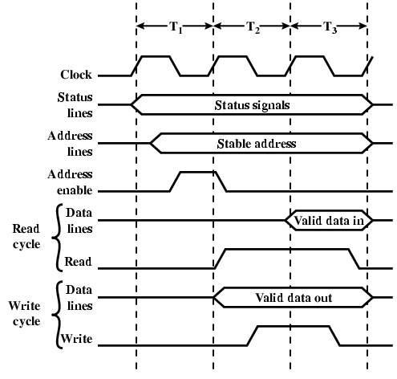
Synchronous Timing Diagram

Slide 36
Asynchronous bus
Data transfers on the bus is controlled by a handshake between the master and the slave.
Common clock in the synchronous bus case is replaced by two timing control lines:
Master-ready,
Slave-ready.
Master-ready signal is asserted by the master to indicate to the slave that it is ready to participate in a data transfer.
Slave-ready signal is asserted by the slave in response to the master-ready from the master, and it indicates to the master that the slave is ready to participate in a data transfer.

Slide 37
Asynchronous bus(contnd.)
T
ime
Address
and command
Master-ready
Slave-ready
Data
t
0
t
1
t
2
t
3
t
4
t
5
Bus cycle
t₀ - Master places the address and command information on the bus.
t₁ - Master asserts the Master-ready signal. Master-ready signal is asserted at t₁ instead of t₀
t₂ - Addressed slave places the data on the bus and asserts the Slave-ready signal.
t₃ - Slave-ready signal arrives at the master.
t₄ - Master removes the address and command information.
t₅ - Slave receives the transition of the Master-ready signal from 1 to 0. It removes the data and the Slave-ready signal from the bus.

Slide 38
Asynchronous vs. Synchronous bus
Advantages of asynchronous bus:
Eliminates the need for synchronization between the sender and the receiver.
Can accommodate varying delays automatically, using the Slave-ready signal.
Disadvantages of asynchronous bus:
Data transfer rate with full handshake is limited by two-round trip delays.
Data transfers using a synchronous bus involves only one round trip delay, and hence a synchronous bus can achieve faster rates.

Slide 39
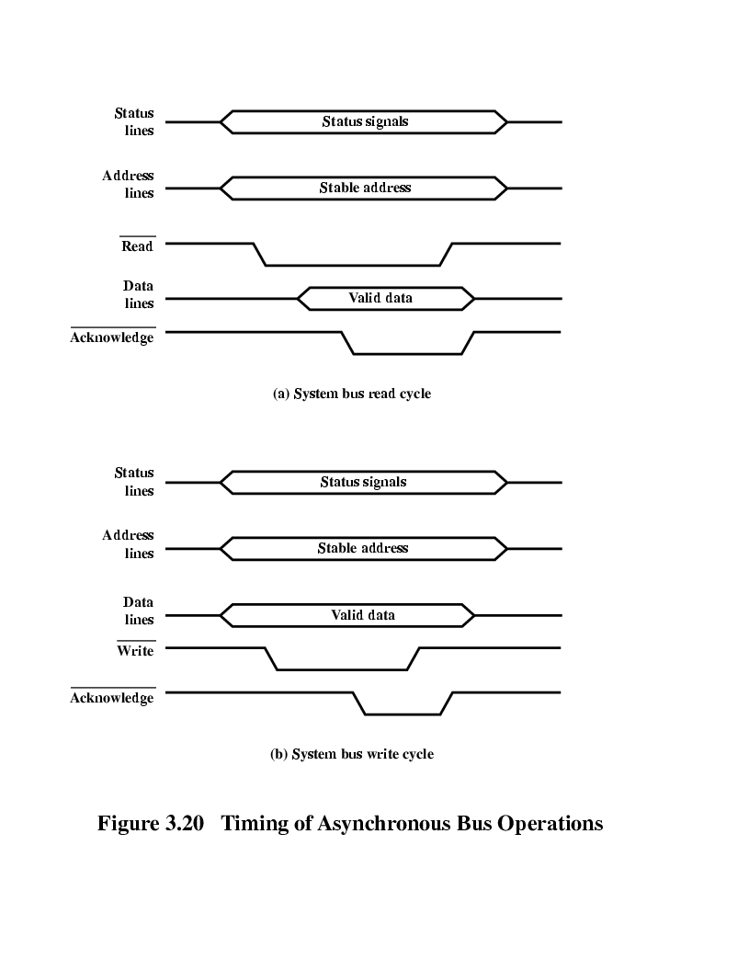
Asynchronous Timing – Read Diagram

Slide 40
Asynchronous Timing – Write Diagram

Slide 41
PCI Bus
Peripheral Component Interconnect
Introduced in 1992
Low-cost bus
Processor independent
Plug-and-play capability
In today’s computers, most memory transfers involve a burst of data rather than just one word. The PCI is designed primarily to support this mode of operation.
The bus supports three independent address spaces: memory, I/O, and configuration.
we assumed that the master maintains the address information on the bus until data transfer is completed. But, the address is needed only long enough for the slave to be selected. Thus, the address is needed on the bus for one clock cycle only, freeing the address lines to be used for sending data in subsequent clock cycles. The result is a significant cost reduction.
A master is called an initiator in PCI terminology. The addressed device that responds to read and write commands is called a target.

Slide 42
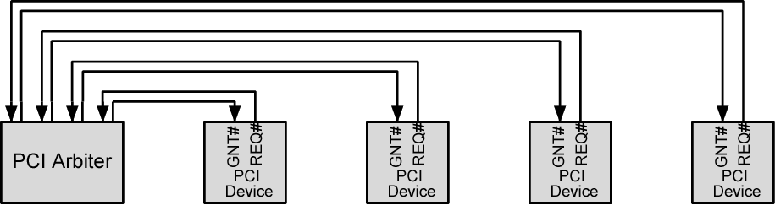
PCI Bus Arbiter
PCI makes use of a centralized, synchronous arbitration scheme
each master has a unique request (REQ) and grant (GNT) signal
does not dictate a particular arbitration algorithm
a first-come-first-served approach
a round-robin approach
or some sort of priority scheme.

Slide 43
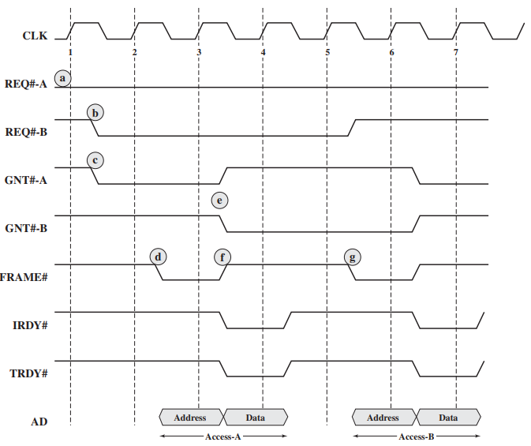
PCI Bus Arbitration
devices A and B are arbitrating
IRDY# s/t/s Initiator Ready.
Driven by current bus master (initiator of transaction). During a read, indicates that the master is prepared to accept data; during a write, indicates that valid data are present on AD.
TRDY# s/t/s Target Ready.
Driven by the target (selected device). During a read, indicates that valid data are present on AD; during a write, indicates that target is ready to accept data

Slide 44
PCI Bus Arbitration between Two Masters
At some point prior to the start of clock 1, A has asserted its REQ signal. The arbiter samples this signal at the beginning of clock cycle 1.
During clock cycle 1, B requests use of the bus by asserting its REQ signal.
At the same time, the arbiter asserts GNT-A to grant bus access to A.
Bus master A samples GNT-A at the beginning of clock 2 and learns that it has been granted bus access. It also finds IRDY and TRDY de-asserted, indicating that the bus is idle. Accordingly, it asserts FRAME and places the address information on the address bus and the command on the C/BE bus (not shown). It also continues to assert REQ-A, because it has a second transaction to perform after this one

Slide 45
PCI Bus Arbitration between Two Masters
e. The bus arbiter samples all REQ lines at the beginning of clock 3 and makes an arbitration decision to grant the bus to B for the next transaction. It then asserts GNT-B and deasserts GNT-A. B will not be able to use the bus until it returns to an idle state.
f. A deasserts FRAME to indicate that the last (and only) data transfer is in progress. It puts the data on the data bus and signals the target with IRDY.The target reads the data at the beginning of the next clock cycle.
g. At the beginning of clock 5, B finds IRDY and FRAME deasserted and so is able to take control of the bus by asserting FRAME. It also deasserts its REQ line, because it only wants to perform one transaction.
Subsequently, master A is granted access to the bus for its next transaction.

Slide 46
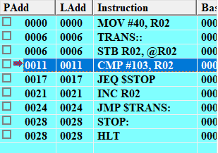
Program
https://yasmin-cpu-os-simulator.software.informer.com/6.1/

Slide 47

IMP Note to Self

