Slide 1
RKTiwary
COA -IS ZC353

Slide 2
Chapter 9
Computer Arithmetic
Notes:
We begin our examination of the processor with an overview of the arithmetic and
logic unit (ALU). The chapter then focuses on the most complex aspect of the ALU,
computer arithmetic.

Slide 3
Arithmetic & Logic Unit (ALU)
Part of the computer that actually performs arithmetic and logical operations on data
All of the other elements of the computer system are there mainly to bring data into the ALU for it to process and then to take the results back out
Based on the use of simple digital logic devices that can store binary digits and perform simple Boolean logic operations
Notes:
The ALU is that part of the computer that actually performs arithmetic and logical
operations on data. All of the other elements of the computer system—control unit,
registers, memory, I/O—are there mainly to bring data into the ALU for it to process
and then to take the results back out. We have, in a sense, reached the core or
essence of a computer when we consider the ALU.

Slide 4
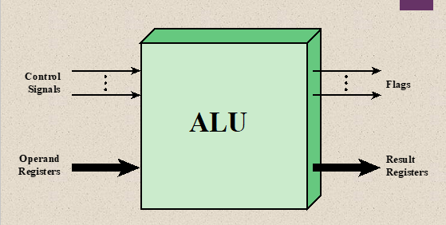
ALU Inputs and outputs
Fig 9.1
Notes:
Figure 9.1 indicates, in general terms, how the ALU is interconnected with
the rest of the processor. Operands for arithmetic and logic operations are presented
to the ALU in registers, and the results of an operation are stored in registers.
These registers are temporary storage locations within the processor that are
connected by signal paths to the ALU . The ALU may also set
flags as the result of an operation. For example, an overflow flag is set to 1 if the
result of a computation exceeds the length of the register into which it is to be stored.
The flag values are also stored in registers within the processor. The processor
provides signals that control the operation of the ALU and the movement of the
data into and out of the ALU.
The flag values are also stored in registers within the processor. The processor provides
signals that control the operation of the ALU and the movement of the data
into and out of the ALU.

Slide 5
Integer Representation
In the binary number system arbitrary numbers can be represented with:
The digits zero and one
The minus sign (for negative numbers)
The period, or radix point (for numbers with a fractional component)
For purposes of computer storage and processing we do not have the benefit of special symbols for the minus sign and radix point
Only binary digits (0,1) may be used to represent numbers
Notes:
In the binary number system, arbitrary numbers can be represented with just the
digits zero and one, the minus sign (for negative numbers), and the period, or radix
point (for numbers with a fractional component).
For purposes of computer storage and processing, however, we do not have the benefit
of special symbols for the minus sign and radix point. Only binary digits (0 and 1)
may be used to represent numbers. If we are limited to nonnegative integers, the
representation is straightforward.

Slide 6

Signed Nos 2’s complement representation
Eg +6= 0110
-6= 1010

Slide 7
Consider any binary number in 2’s complement
101101

Slide 8
Consider any binary number in 2’s complement
101101
= -2⁶⁻¹.1 + 2⁴.0 + 2³.1 + 2².2 + 2¹.0+ 2⁰.1

Slide 9
Consider any binary number in 2’s complement
101101
= -2⁶⁻¹.1 + 2⁴.0 + 2³.1 + 2².1 + 2¹.0+ 2⁰.1
=-32 + 0 + 8 + 4 + 0 + 1= -19

Slide 10
Consider any binary number in 2’s complement
101101
= -2⁶⁻¹.1 + 2⁴.0 + 2³.1 + 2².1 + 2¹.0+ 2⁰.1
=-32 + 0 + 8 + 4 + 0 + 1= -19
The 2’s complement of 101101 is 010011= 19

Slide 11
Consider any binary number in 2’s complement
101101
= -2⁶⁻¹.1 + 2⁴.0 + 2³.1 + 2².1 + 2¹.0+ 2⁰.1
=-32 + 0 + 8 + 4 + 0 + 1= -19
The 2’s complement of 101101 is 010011= 19
Now if a 1 is appended then 1101101 ?

Slide 12
Consider any binary number in 2’s complement
101101
= -2⁶⁻¹.1 + 2⁴.0 + 2³.1 + 2².1 + 2¹.0+ 2⁰.1
=-32 + 0 + 8 + 4 + 0 + 1= -19
The 2’s complement of 101101 is 010011= 19
Now if a 1 is appended then 1101101 ?
1101101= -2⁷⁻¹.1 + 2⁵.1 + 2⁴.0 + 2³.1 + 2².1+ 2¹.0 + 2⁰.1
= -64+ 32 +0 + 8 + 4 + 0 + 1
= -19

Slide 13
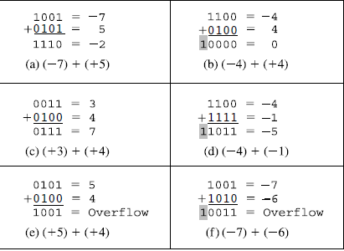
Addition and Subtraction
OVERFLOW RULE: If two numbers are added, and they are both positive or both negative, then overflow occurs if and only if the result has the opposite sign.

Slide 14
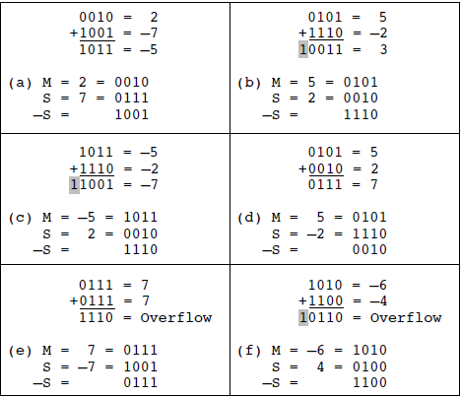
Addition and Subtraction
SUBTRACTION RULE: To subtract one number (subtrahend) from another (minuend), take the twos complement (negation) of the subtrahend and add it to the minuend.

Slide 15
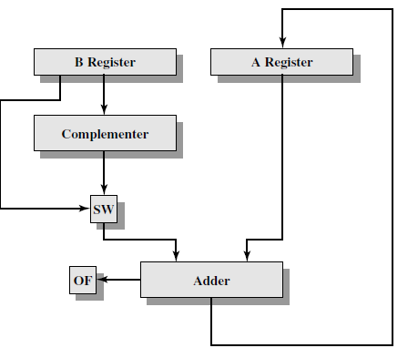
Block Diagram of Hardware for Addition and Subtraction
OF= Overflow bit
SW =Switch (select addition or subtraction)

Slide 16
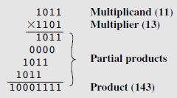
Multiplication of UNSIGNED INTEGERS
1. Multiplication involves the generation of partial products, one for each digit in the multiplier. These partial products are then summed to produce the final product.
2. The partial products are easily defined. When the multiplier bit is 0, the partial product is 0.When the multiplier is 1, the partial product is the multiplicand.
3. The total product is produced by summing the partial products. For this operation, each successive partial product is shifted one position to the left relative to the preceding partial product.
4. The multiplication of two n-bit binary integers results in a product of up to 2n bits in length (e.g., 11 X 11=1001).

Slide 17
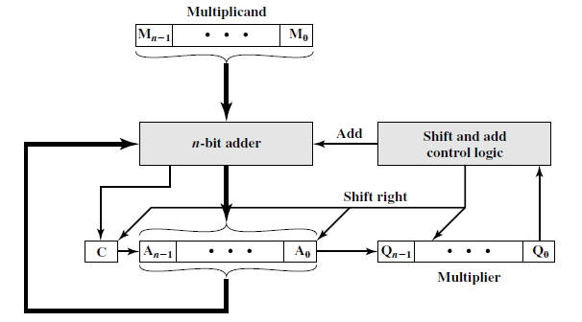
Multiplication of UNSIGNED INTEGERS

Slide 18
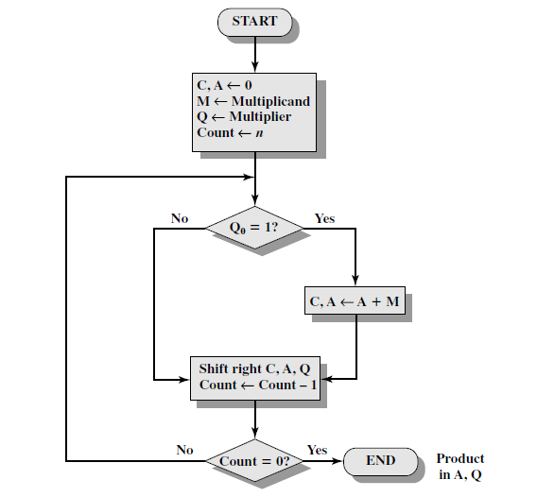
Multiplication of UNSIGNED INTEGERS

Slide 19
Multiplication of UNSIGNED INTEGERS
C | A | Q | M
0 | 0000 | 1101 | 1011 | Initial value

Slide 20
Multiplication of UNSIGNED INTEGERS
C | A | Q | M
0 | 0000 | 1101 | 1011 | Initial value
0 | 1011 | 1101 | 1011 | Add | First cycle
0 | 0101 | 1110 | 1011 | Shift

Slide 21
Multiplication of UNSIGNED INTEGERS
C | A | Q | M
0 | 0000 | 1101 | 1011 | Initial value
0 | 1011 | 1101 | 1011 | Add | 1st cycle
0 | 0101 | 1110 | 1011 | Shift
0 | 0010 | 1111 | 1011 | shift | 2nd cycle

Slide 22
Multiplication of UNSIGNED INTEGERS
C | A | Q | M
0 | 0000 | 1101 | 1011 | Initial value
0 | 1011 | 1101 | 1011 | Add | 1st cycle
0 | 0101 | 1110 | 1011 | Shift
0 | 0010 | 1111 | 1011 | shift | 2nd cycle
0 | 1101 | 1111 | 1011 | Add

Slide 23
Multiplication of UNSIGNED INTEGERS
C | A | Q | M
0 | 0000 | 1101 | 1011 | Initial value
0 | 1011 | 1101 | 1011 | Add | 1st cycle
0 | 0101 | 1110 | 1011 | Shift
0 | 0010 | 1111 | 1011 | shift | 2nd cycle
0 | 1101 | 1111 | 1011 | Add | 3rd cycle
0 | 0110 | 1111 | 1011 | shift

Slide 24
Multiplication of UNSIGNED INTEGERS
C | A | Q | M
0 | 0000 | 1101 | 1011 | Initial value
0 | 1011 | 1101 | 1011 | Add | 1st cycle
0 | 0101 | 1110 | 1011 | Shift
0 | 0010 | 1111 | 1011 | shift | 2nd cycle
0 | 1101 | 1111 | 1011 | Add | 3rd cycle
0 | 0110 | 1111 | 1011 | shift
1 | 0001 | 1111 | 1011 | Add

Slide 25
Multiplication of UNSIGNED INTEGERS
C | A | Q | M
0 | 0000 | 1101 | 1011 | Initial value
0 | 1011 | 1101 | 1011 | Add | 1st cycle
0 | 0101 | 1110 | 1011 | Shift
0 | 0010 | 1111 | 1011 | shift | 2nd cycle
0 | 1101 | 1111 | 1011 | Add | 3rd cycle
0 | 0110 | 1111 | 1011 | shift
1 | 0001 | 1111 | 1011 | Add | 4th cycle
0 | 1000 | 1111 | 1011 | Shift | 143

Slide 26
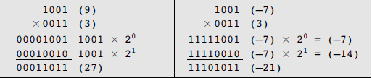
Multiplication of SIGNED INTEGERS
11 (1011) by 13 (1101) to get 143 (10001111)
-5(1011) times -3 (1101) equals -113 (10001111)

Slide 27
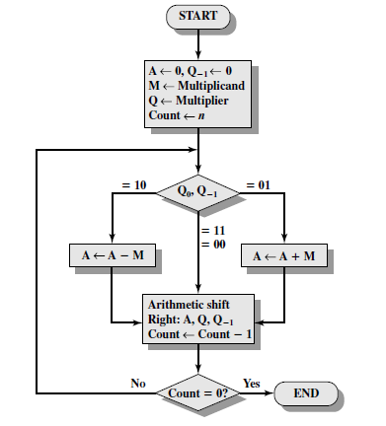
Booth Multiplier

Slide 28
Multiplication of -8 X 5
01 A+M
10 A-M
A | Q(multiplier) | Q-1 | M(Multiplicand | Comments
00000 | 00101 | 0 | 11000 | Initial value

Slide 29
Multiplication of -8 X 5
01 A+M
10 A-M
A | Q(multiplier) | Q-1 | M(Multiplicand | Comments
00000 | 00101 | 0 | 11000 | Initial value
01000 | 00101 | 0 | 11000 | A-M

Slide 30
Multiplication of -8 X 5
01 A+M
10 A-M
A | Q(multiplier) | Q-1 | M(Multiplicand | Comments
00000 | 00101 | 0 | 11000 | Initial value
01000 | 00101 | 0 | 11000 | A-M
00100 | 00010 | 1 | 11000

Slide 31
Multiplication of -8 X 5
01 A+M
10 A-M
A | Q(multiplier) | Q-1 | M(Multiplicand | Comments
00000 | 00101 | 0 | 11000 | Initial value
01000 | 00101 | 0 | 11000 | A-M
00100 | 00010 | 1 | 11000
11100 | 00010 | 1 | 11000 | A+M

Slide 32
Multiplication of -8 X 5
01 A+M
10 A-M
A | Q(multiplier) | Q-1 | M(Multiplicand | Comments
00000 | 00101 | 0 | 11000 | Initial value
01000 | 00101 | 0 | 11000 | A-M
00100 | 00010 | 1 | 11000
11100 | 00010 | 1 | 11000 | A+M
11110 | 00001 | 0 | 11000

Slide 33
Multiplication of -8 X 5
01 A+M
10 A-M
A | Q(multiplier) | Q-1 | M(Multiplicand | Comments
00000 | 00101 | 0 | 11000 | Initial value
01000 | 00101 | 0 | 11000 | A-M
00100 | 00010 | 1 | 11000
11100 | 00010 | 1 | 11000 | A+M
11110 | 00001 | 0 | 11000
00110 | 00001 | 0 | 11000 | A-M

Slide 34
Multiplication of -8 X 5
01 A+M
10 A-M
A | Q(multiplier) | Q-1 | M(Multiplicand | Comments
00000 | 00101 | 0 | 11000 | Initial value
01000 | 00101 | 0 | 11000 | A-M
00100 | 00010 | 1 | 11000
11100 | 00010 | 1 | 11000 | A+M
11110 | 00001 | 0 | 11000
00110 | 00001 | 0 | 11000 | A-M
00011 | 00000 | 1 | 11000

Slide 35
Multiplication of -8 X 5
01 A+M
10 A-M
A | Q(multiplier) | Q-1 | M(Multiplicand | Comments
00000 | 00101 | 0 | 11000 | Initial value
01000 | 00101 | 0 | 11000 | A-M
00100 | 00010 | 1 | 11000
11100 | 00010 | 1 | 11000 | A+M
11110 | 00001 | 0 | 11000
00110 | 00001 | 0 | 11000 | A-M
00011 | 00000 | 1 | 11000
11011 | 00000 | 1 | 11000 | A-M

Slide 36
Multiplication of -8 X 5
01 A+M
10 A-M
A | Q(multiplier) | Q-1 | M(Multiplicand | Comments
00000 | 00101 | 0 | 11000 | Initial value
01000 | 00101 | 0 | 11000 | A-M
00100 | 00010 | 1 | 11000
11100 | 00010 | 1 | 11000 | A+M
11110 | 00001 | 0 | 11000
00110 | 00001 | 0 | 11000 | A-M
00011 | 00000 | 1 | 11000
11011 | 00000 | 1 | 11000 | A-M
11101 | 10000 | 0 | 11000

Slide 37
Multiplication of -8 X 5
01 A+M
10 A-M
A | Q(multiplier) | Q-1 | M(Multiplicand | Comments
00000 | 00101 | 0 | 11000 | Initial value
01000 | 00101 | 0 | 11000 | A-M
00100 | 00010 | 1 | 11000
11100 | 00010 | 1 | 11000 | A+M
11110 | 00001 | 0 | 11000
00110 | 00001 | 0 | 11000 | A-M
00011 | 00000 | 1 | 11000
11011 | 00000 | 1 | 11000 | A-M
11101 | 10000 | 0 | 11000
11110 | 11000 | 0 | 11000 | shift

Slide 38
Multiplication of -8 X 5
01 A+M
10 A-M
A | Q(multiplier) | Q-1 | M(Multiplicand | Comments
00000 | 00101 | 0 | 11000 | Initial value
01000 | 00101 | 0 | 11000 | A-M
00100 | 00010 | 1 | 11000
11100 | 00010 | 1 | 11000 | A+M
11110 | 00001 | 0 | 11000
00110 | 00001 | 0 | 11000 | A-M
00011 | 00000 | 1 | 11000
11011 | 00000 | 1 | 11000 | A-M
11101 | 10000 | 0 | 11000
11110 | 11000 | 0 | 11000 | shift
11110 | 11000 | -40 | -512+472 | Final result

Slide 39
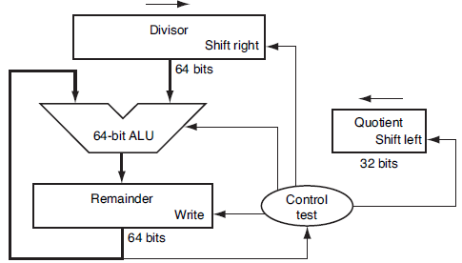
The basic grammar school division algorithm
Division Algorithm and Hardware
The Divisor register, ALU, and Remainder register are all 64 bits wide, with only the Quotient register being 32 bits.
The 32-bit divisor starts in the left half of the Divisor register and is shifted right 1 bit each iteration.
The remainder is initialized with the dividend. Control decides when to shift the Divisor and Quotient registers and when to write the new value into the Remainder register.
Dividend = Quotient x Divisor + Remainder

Slide 40
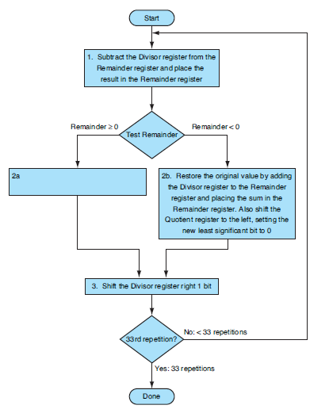
2a: shift the quotient register to the left , setting up the new rightmost bit to 1
it takes n + 1 steps to get the proper quotient and remainder

Slide 41
Division 7/2
Shift left logical (sll)

Slide 42
9/4
n | step | Quotient | Divisor | remainder
0 | Initial value | 0000 | 0100 0000 | 0000 1001

Slide 43
9/4
n | step | Quotient | Divisor | remainder
0 | Initial value | 0000 | 0100 0000 | 0000 1001
1 | 1: Rem= Rem-Div | 0000 | 0100 0000 | 1100 1001

Slide 44
n | step | Quotient | Divisor | remainder
0 | Initial value | 0000 | 0100 0000 | 0000 1001
1 | 1: Rem= Rem-Div | 0000 | 0100 0000 | 1100 1001
 | 2b: Rem<0 => +Div, sll Q, Q0=0 | 0000 | 0100 0000 | 0000 1001

Slide 45
n | step | Quotient | Divisor | remainder
0 | Initial value | 0000 | 0100 0000 | 0000 1001
1 | 1: Rem= Rem-Div | 0000 | 0100 0000 | 1100 1001
 | 2b: Rem<0 => +Div, sll Q, Q0=0 | 0000 | 0100 0000 | 0000 1001
 | 3: Shift Div Right | 0000 | 0010 0000 | 0000 1001

Slide 46
n | step | Quotient | Divisor | remainder
0 | Initial value | 0000 | 0100 0000 | 0000 1001
1 | 1: Rem= Rem-Div | 0000 | 0100 0000 | 1100 0000
 | 2b: Rem<0 => +Div, sll Q, Q0=0 | 0000 | 0100 0000 | 0000 1001
 | 3: Shift Div Right | 0000 | 0010 0000 | 0000 1001
2 | 1: Rem= Rem-Div | 0000 | 0010 0000 | 1110 1001
 | 2b: Rem<0 => +Div, sll Q, Q0=0 | 0000 | 0010 0000 | 0000 1001
 | 3: Shift Div Right | 0000 | 0001 0000 | 0000 1001

Slide 47
n | step | Quotient | Divisor | remainder
0 | Initial value | 0000 | 0100 0000 | 0000 1001
1 | 1: Rem= Rem-Div | 0000 | 0100 0000 | 1100 0000
 | 2b: Rem<0 => +Div, sll Q, Q0=0 | 0000 | 0100 0000 | 0000 1001
 | 3: Shift Div Right | 0000 | 0010 0000 | 0000 1001
2 | 1: Rem= Rem-Div | 0000 | 0010 0000 | 1110 1001
 | 2b: Rem<0 => +Div, sll Q, Q0=0 | 0000 | 0010 0000 | 0000 1001
 | 3: Shift Div Right | 0000 | 0001 0000 | 0000 1001
3 | 1: Rem= Rem-Div | 0000 | 0001 0000 | 1111 1001
 | 2b: Rem<0 => +Div, sll Q, Q0=0 | 0000 | 0001 0000 | 0000 1001
 | 3: Shift Div Right | 0000 | 0000 1000 | 0000 1001

Slide 48
n | step | Quotient | Divisor | remainder
0 | Initial value | 0000 | 0100 0000 | 0000 1001
1 | 1: Rem= Rem-Div | 0000 | 0100 0000 | 1100 0000
 | 2b: Rem<0 => +Div, sll Q, Q0=0 | 0000 | 0100 0000 | 0000 1001
 | 3: Shift Div Right | 0000 | 0010 0000 | 0000 1001
2 | 1: Rem= Rem-Div | 0000 | 0010 0000 | 1110 1001
 | 2b: Rem<0 => +Div, sll Q, Q0=0 | 0000 | 0010 0000 | 0000 1001
 | 3: Shift Div Right | 0000 | 0001 0000 | 0000 1001
3 | 1: Rem= Rem-Div | 0000 | 0001 0000 | 1111 1001
 | 2b: Rem<0 => +Div, sll Q, Q0=0 | 0000 | 0001 0000 | 0000 1001
 | 3: Shift Div Right | 0000 | 0000 1000 | 0000 1001
4 | 1: Rem= Rem-Div | 0000 | 0000 1000 | 0000 0001
 | 2a: Rem>0 => sll Q, Q0=1 | 0001 | 0000 1000 | 0000 0001
 | 3: Shift Div Right | 0001 | 0000 0100 | 0000 0001
5 | 1: Rem= Rem-Div | 0001 | 0000 0100 | 1111 1101
 | 2b: Rem<0 => +Div, sll Q, Q0=0 | 0010 | 0000 0100 | 0000 0001
 | 3: Shift Div Right | 0010 | 0000 0010 | 0000 0001

Slide 49

Signed Division
Remember the signs of the divisor and dividend and then negate the quotient if the signs disagree.
Dividend = Quotient × Divisor + Remainder
Look at the example of
$$± 11÷ ±5$$
$$\frac{+11}{+5}=+2 and +1; \frac{−11}{+5}= −2 and −1$$
The 1st case is easy
+11 ÷ +5: Quotient = +2, Remainder = +1
Checking the results:
11 = 2 × 5 + (+1) = 10 + 1

Slide 50

Signed Division
Dividend = Quotient × Divisor + Remainder
$$± 11÷ ±5$$
$$\frac{+11}{+5}=+2 and +1; \frac{−11}{+5}= −2 and −1$$
2nd case If we change the sign of the dividend, the quotient must change as well:
–11 ÷ +5: Quotient = –2
Rewriting our basic formula to calculate the remainder:
Remainder = (Dividend – Quotient × Divisor) = –11 – (–2 × +5)
= –11–(–10) = –1
So,
–11 ÷ +5: Quotient = –2, Remainder = –1

Slide 51
Signed Division
Dividend = Quotient × Divisor + Remainder
$$± 11÷ ±5$$
$$\frac{+11}{+5}=+2 and +1; \frac{−11}{+5}= −2 and −1$$
Checking the results again:
–11 = –2 ⋅ 5 + (–1) = – 10 – 1
The same result is obtained if
–11 = –3 ⋅ 5 + (4) = – 15 + 4
absolute value of the quotient would then change
How to avoid this?

Slide 52
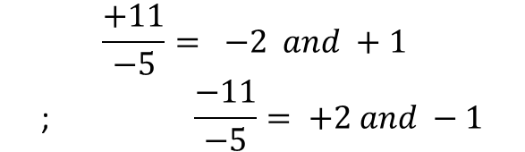
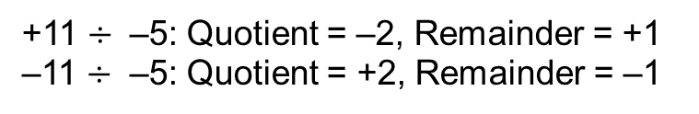
Signed Division
Dividend = Quotient × Divisor + Remainder
$$± 11÷ ±5$$
$$\frac{+11}{+5}=+2 and +1; \frac{−11}{+5}= −2 and −1$$
This anomalous behavior is avoided by following the rule that the dividend and remainder must have the same signs, no matter what the signs of the divisor and quotient.
$$\frac{+11}{−5}= −2 and +1$$
$$\text{; }\frac{−11}{−5}= +2 and −1$$
+11 $÷$ –5: Quotient = –2, Remainder = +1
–11 $÷$ –5: Quotient = +2, Remainder = –1
Thus the correctly signed division algorithm negates the quotient if the signs of the operands are opposite and makes the sign of the nonzero remainder match the dividend

