Slide 1
Data Structures and Algorithms Design
Harish Aggarwal

Slide 2
Algorithm Analysis - 2

Slide 3
Re-Cap
Lecture-01
Introduction
Handout
Text Books, Reference Books
Marks Distribution
Algorithm Analysis
Pseudo Code
Random Access model
Time Complexity of Algorithms
Asymptotic Notations
Basic Maths Needed in the course
Lecture-02
Abstract Data Types
Arrays and Linked Lists
List, Stack, Queues
Array and Linked Implementation
Add, Remove operations
Applications
Infix, PreFix, PostFix Notations

Slide 4
Agenda
Mathematical analysis of Non-recursive algorithms
Mathematical analysis of Recursive algorithms
Iteration vs Recursion
Recurrence Tree
Iterative Substitution
Masters Theorem with example

Slide 5
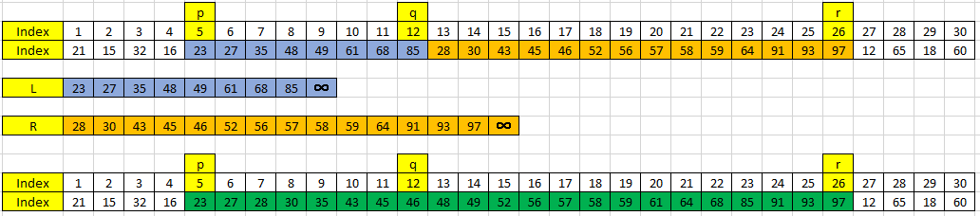
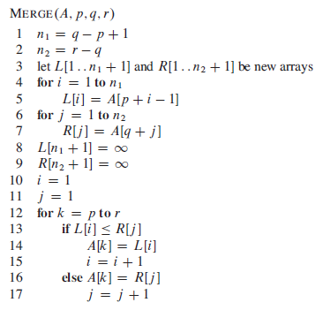
Merge Sort
Function Merge
Just merges two sorted sequences and gives a new sequence which is sorted
No. of elements
First Sequence = n₁ = q-p+1 = 12 – 5 +1 = 8
Second Sequence = n₂ = r – q = 26-12 = 14
Overall = n = n₁ ₊ n₂ = r – p + 1 = 26 – 5 + 1 = 22
Time Complexity
Line 1 and 2 = 1 + 1
Line 4 to 7 = n₁ + n₂ = n times = Θ(n) times
Line 12 to 17 = n times
Hence Θ(n)

Slide 6
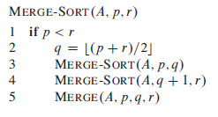
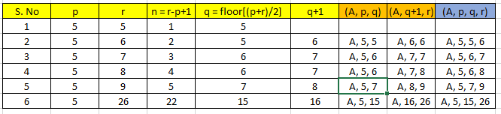
Merge Sort (Contd)
Function Merge-Sort
Sort an array using the Merge Sort process
No. of elements
n = r – p + 1
In order to sort an array A[1..n] make the initial call
MERGE-SORT(A, 1, n) or MERGE-SORT(A, 1, A.length)

Slide 7


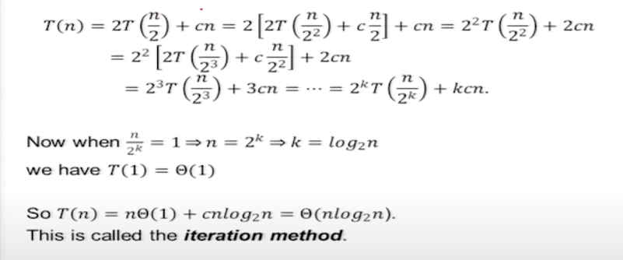
Merge Sort (Contd)
T(n) = 2T(n/2) + cn
T(n/2) = 2T(n/4) + c(n/2)
T(n/4) = 2T(n/8) + c(n/4)
..
..

Slide 8
Recurrence Relation –
The substitution method
Recurrence Relation can be solved using three way
The Substitution Method
Recursion Tree Method
The Master Theorem

Slide 9
Recurrence Relation
Recursion Tree Method
Recursion tree can be used to obtain a good guess for the substitution method
In a recursion tree each node represents the cost of a sub-problem somewhere in the set of recursive function invocations.
Eaxmple
Let us solve
T(n) = 3T(└n/4┘) + Θ(n²)
We look for an upper bound so we can write
T(n) = 3T(n/4) + cn² c > 0

Slide 10

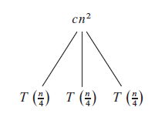
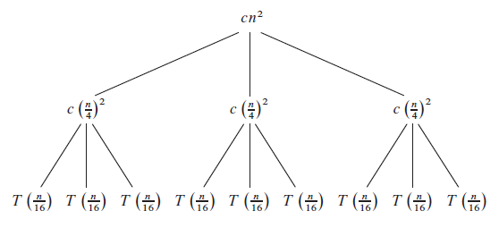
Recurrence Relation
Recursion Tree Method
T(n) = 3T(n/4) + cn²

Slide 11
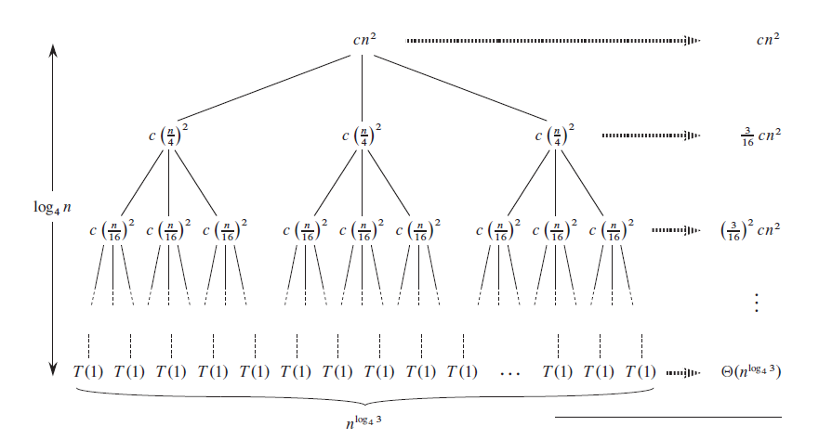
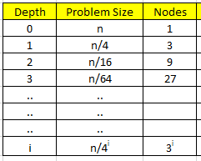
Recurrence Relation
Recursion Tree Method
T(n) = 3T(n/4) + cn²

Slide 12
Recurrence Relation
Recursion Tree Method
T(n) = 3T(n/4) + cn²
What is the depth of the Tree ??
The sub-problem size at depth i is given as n/4^{i}
At leaf level the sub-problem size is 1
Hence at depth i
n/4^{i} = 1
n = 4^{i}
i = log₄ n
Number of Nodes at depth i (Leaf Level) = 3^{i}
(Assume n is exact power of 4 so that all sub-problem size is an integer)

Slide 13
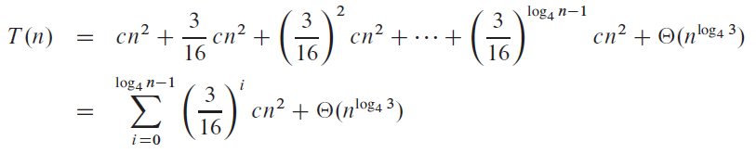
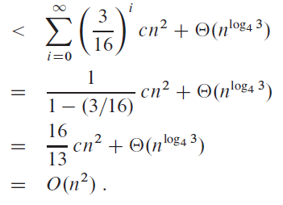
Recurrence Relation
Recursion Tree Method
Depth = i = log₄ n
Number of Nodes at depth i = 3^{i} = 3^(log₄ n) = n^(log₄ 3)
***
Upper Bound is O(n²)
Since the very first step takes cn², that is Θ(n²), the lower bound is Ω(n²)
Hence complexity is Tight Bound, that is Depth Θ(n²)

Slide 14
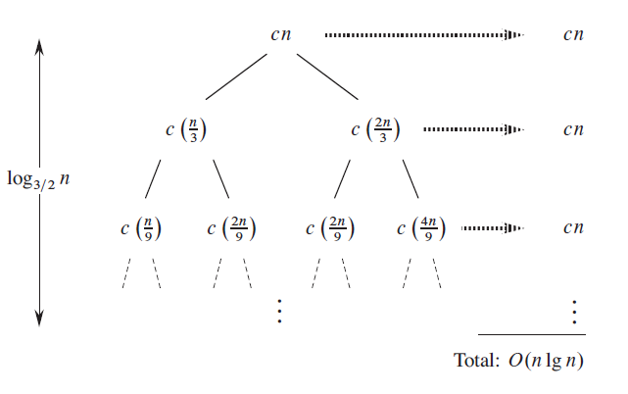



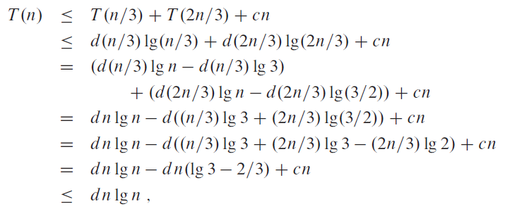
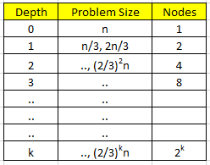
Recurrence Relation
Recursion Tree Method
Another Example
Given –
Total Cost -
Using Substitution Method
Assume -

Slide 15
Recurrence Relation
Recursion Tree Method
Using Substitution Method
Assume -

Slide 16


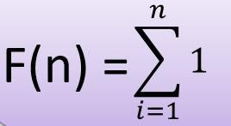

General rules to determine running time of algorithm
Loops: The running time of a loop is, at most, the running time of the statements inside the loop (including tests) multiplied by the number of iterations.
//executes n-times
for(i=1;i<=n;i++)
… // constant time
Total number = a constant 𝑐 × 𝑛 = 𝑐𝑛 =O(n)

Slide 17
General rules to determine running time of algorithm
Nested loops: Analyze from inside out. Total running time is the product of the sizes of all the loops
//outer loop executed n-times
for(i=1;i<=n;i++){
//inner loop execute n-times
for(j=1;j<=n;j++)
//constant time
k=k+1;
}
Total number = 𝑐 × 𝑛 × 𝑛 = 𝑐𝑛² = O(n²)

Slide 18
General rules to determine running time of algorithm
If-then-else statements: worst-case running time: the test, plus either the
then part or the else part (whichever is the larger).
//test: constant c₀ If (length()==0){
return false; // then part: constant c₁
}
else { //else part : (constant c₂ +constant c₃)× n for(int n =0; n<length();n++){
//another if: constant + constant (no else part) if(! List[n].equals(otherlist.list[n]))
//constant
return false;
}
}
Total time = c₀ + c₁ + (c₂ + c₃) × n = O(length())

Slide 19
General rules to determine running time of algorithm
Logarithmic Complexity: an algorithm is O(log n) if it takes constant time to cut the problem size by a fraction (usually by ½)
As an example let us consider the following program
for(i=1; i<=n;)
i=i*2;
At k^{th} step 2^{k}=n and we come out of loop
Taking logarithm on both sides, gives log(2^{k}) = log n
klog2 = log n
k = log n // if we assume base ~ 2.
Total number = O(log n)

Slide 20
Problem-1
What is the complexity of the program given below
void function (int n){
for (i =1; i<=n; i++)
for (j=1;j+n/2<=n;j=j++)
//loop execute logn times
for (k=1; k<=n; k=k*2)
count++;
}
Time complexity of the above function is O(n²logn) More on it in the discussion thread …

Slide 21
Problem-2
function (int n){
//constant time
if(n==1) return;
//outer loop execute n times
for (int i =1;i<=n;i++){
// inner loop executes only one time due to break statement
for (int j =1;j<=n;j++){
printf(“*”);
break;
}
}
}
Time complexity of the above function is?
Time Complexity of the above function O(n). Even though the inner loop is bounded by n, but due to the break statement, it is executing only once.

Slide 22
Complexity Definition
Linear Complexity: Processing time or storage space is directly proportional to the number of input elements to be processed.
Quadratic complexity: An algorithm is of quadratic complexity if the processing time is proportional to the square of the number of input elements.
Cubic complexity: In the case of cubic complexity, the processing time of an algorithm is proportional to the cube of the input elements.
Logarithmic complexity: An algorithm is of logarithmic complexity if the processing time is proportional to the logarithm of the input elements. The logarithm base is typically 2

Slide 23
Analysis of Algorithms
Techniques employed by algorithms to solve problems
Iterative
Recursion
What is Recursion
The process in which a function calls itself directly or indirectly is called recursion and the corresponding function is called as recursive function
Define a procedure P that is allowed to make calls to itself, provided those calls to P are for solving sub-problems of smaller size.
Condition for recursive procedure
A recursive procedure should always define a base case
Base case
Small sized problem which can be solved by the algorithm

Slide 24
Recursive Algorithm
if problem is “small enough”
solve it directly
else
break into one or more smaller sub problems
solve each sub problem recursively
combine results into solution to whole problem

Slide 25
Requirements for Recursive Solution
At least one “small” case that you can solve directly
A way of breaking a larger problem down into:
One or more smaller sub problems
Each of the same kind as the original
A way of combining sub problem results into an overall
solution to the larger problem

Slide 26
Recursive Algorithm - Example
Recursive algorithm for finding length of a string:
if string is empty (no characters)
return 0 ← base case
else ← recursive case
compute length of string without first character
return 1 + that length

Slide 27
Recursive Design Example: Code
Recursive algorithm for finding length of a string:
public static int length (String str) {
if (str == null || str.equals(“”))
return 0
else
return length(str.substring(1)) + 1
}

Slide 28
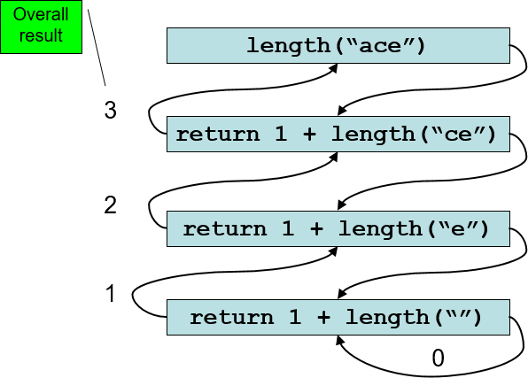
Tracing a Recursive Method

Slide 29
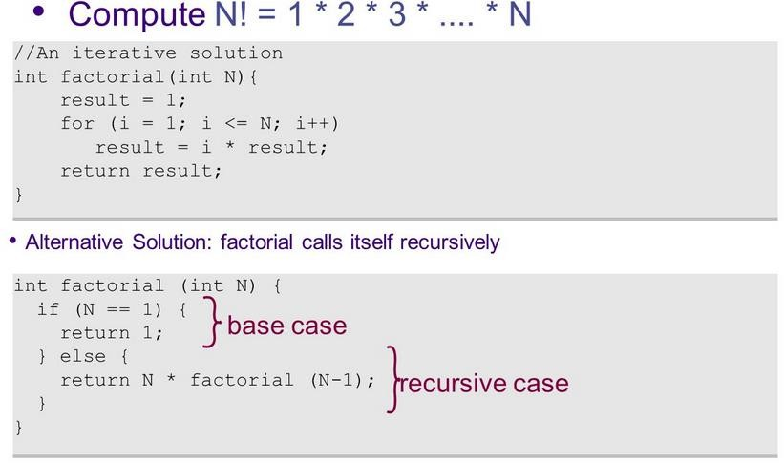
Example

Slide 30
Analysis of recursive Algorithms
Based on the input size, determine the number of parameters to be considered.
Identify the basic operation in the algorithm
Obtain the number of times the basic operation is executed on different inputs of the same size.
Obtain the recurrence relation with an appropriate initial
condition.
Solve the recurrence relation and obtain the order of growth and express using asymptotic notations.
Recurrence equation
– When an algorithm contains a recursive call to itself, its running time can often be described by a recurrence. A recurrence is an equation or inequality that describes a function in terms of its

Slide 31
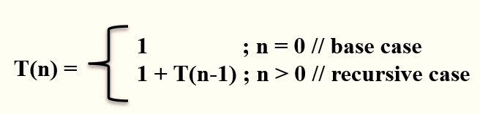
Solution to recurrence equations
Recursion tree method
Iterative substitution method
Master’s theorem

Slide 32
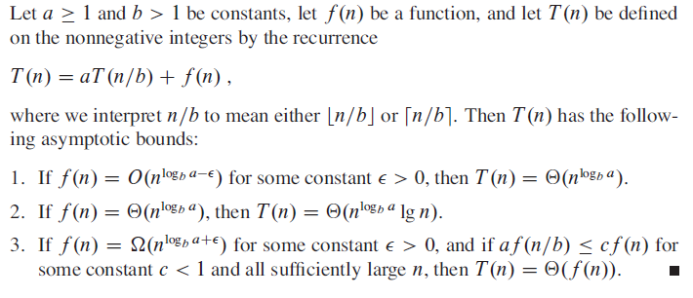
Recurrence Relation
The Master Theorem

Slide 33
Simplified version of Master Theorem
T(n) = aT(n/b) + f(n)
Where f(n) =θ(n^{k}log^{p}n)
n = size of the problem
a = number of subproblems in the recursion and a >= 1
n/b = size of each subproblem
b > 1, k >= 0 and p is a real number.
Case 1. if log_{b}a > k, then T(n) = θ(n^{log}_{b} ª)
Case 2. if log_{b}a = k, then
if p > -1, then T(n) = θ(n^{k}log^{p+1}n)
if p = -1, then T(n) = θ(n^{k}loglogn)
if p < -1, then T(n) = θ(n^{k})
Case 3. if log_{b}a < k, then
if p >= 0, then T(n) = θ(n^{k}log^{p}n)
if p < 0, then T(n) = θ(n^{k})

Slide 34
Simplified version Case 1 Example
Case 1: if log_{b}a > k, then T(n) = θ(n^{log a})
b
Consider T(n) = 2T(n/2) + 1
Solution:
T(n) = aT(n/b) + f(n) where f(n) =θ(n^{k}log^{p}n)
Step 01: Here, a = 2, b = 2, f(n) = 1 which can
happen when θ(n⁰log⁰n). So, k=0 and p=0
Step 02: log_{b}a = log₂ 2 = 1 and k = 0
Step 03: From step 02, log_{b}a > k
Step 04: From SMT(Simplified Master theorem) Case 1:
T(n) = θ(n^{log a})
b
Hence, T(n) = θ(n¹)
= θ(n)

Slide 35
Simplified version Case 2 (a) Example
Case 2: if log_{b}a = k, then
(a) if p > -1, then T(n) = θ(n^{k}log^{p+1}n)
Consider T(n) = 2 T(n/2) + n
Solution:
T(n) = aT(n/b) + f(n) where f(n) =θ(n^{k}log^{p}n) Step 01: Here, a = 2, b = 2 , k=1 and p=0
Step 02: log_{b}a = log₂ 2 = 1 and k = 1
Step 03: From step 02, log_{b}a = k so goto case 2
Step 04: P > -1 so goto 2(a) of simplified
masters theorem.
So, T(n)= θ(n^{k}log^{p+1}n)
Hence, T(n) = θ(n¹log⁰⁺¹n)= θ(nlogn)

Slide 36
Simplified version Case 2 (b) Example
Case 2 : if log_{b}a = k, then
(b) if p = -1, then T(n) = θ(n^{k}loglogn)
Consider T(n) = 2 T(n/2) + n/log n
Solution:
T(n) = aT(n/b) + f(n) where f(n) =θ(n^{k}log^{p}n)
Step 01: Here, a = 2, b = 2 ,
n/log n is n¹*log⁻¹n so k = 1 and p = -1
Step 02: log_{b}a = log₂ 2 = 1 and k = 1
Step 03: From step 02, log_{b}a = k so goto Case 2
Step 04: P = -1 So, goto simplified Masters
Theorem Case 2b.
So, T(n)= θ(n^{k}log log n)
Hence, T(n) = θ(n¹log logn)= θ(nloglogn)

Slide 37
Simplified version Case 2 (c) Example
Case 2 : if log_{b}a = k, then
(c) if p < -1, then T(n) = θ(n^{k})
Consider T(n) = 2 T(n/2) + n/log² n
Solution:
T(n)= sT(n.b) + f(n) where f(n) = θ(n^{k}log^{p}n)
Step 01: Here, a = 2, b = 2,
n/log² n is n¹*log⁻²n so k = 1 and p = -2
Step 02: log_{b}a = log₂ 2 = 1 and k = 1
Step 03: From step 02, log_{b}a = k so goto Case 2
Step 04: P < -1 So, goto simplified Masters Theorem Case 2c.
So, T(n) = θ(n^{k})
Hence, T(n) = θ(n¹) =θ(n)

Slide 38
Simplified version Case 3 (a) Example
Case 3 : if log_{b}a < k, then
(a) if p >= 0, then T(n) = θ(n^{k}log^{p}n)
Consider T(n) = 4T(n/2) + n³ log n
Solution:
T(n) = aT(n/b) + f(n) where f(n)=θ(n^{k}log^{p}n) Step 01: Here, a = 4, b = 2 , k = 3 and p = 1 Step 02: log_{b}a = log₂ 4= 2 and k = 3
Step 03: From step 02, log_{b}a < k so goto Case 3
Step 04: P > 0 So, goto simplified Masters Theorem
Case 3a.
So, T(n) = θ(n^{k}log^{p}n)
Hence, T(n) = θ(n³log¹n) =θ(n³logn)

Slide 39
Simplified version Case 3 (b) Example
Case 3 : if log_{b}a < k, then
(b) if p < 0, then T(n) = θ(n^{k})
Consider T(n) = 2 T(n/2) + n²/log² n
Solution:
T(n) = aT(n/b) + f(n) where f(n)=θ(n^{k}log^{p}n)
Step 01: Here, a = 2, b = 2 , k = 2 and p = -2 (
because n²*log⁻²n )
Step 02: log_{b}a = log₂ 2 = 1 and k = 2
Step 03: From step 02, log_{b}a < k so goto Case 3
Step 04: P < 0 So, goto simplified Masters
Theorem Case 3b.
So, T(n) = θ(n^{k})
Hence, T(n) = θ(n²)

Slide 40
Master Method Capability
Not all recurrence relations can be solved with the use of the master theorem i.e. if
T(n) is not of the form as mentioned earlier, ex: T(n) = sin n
f(n) is not a polynomial, ex: T(n) = 2T(n/2) + 2^{n}

Slide 41
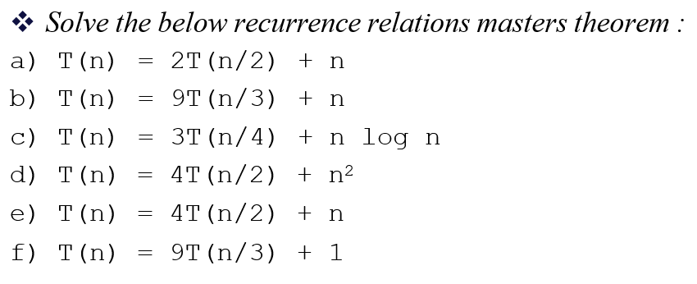
Exercises

Slide 42
Additional Reading
Appendix

Slide 43

Recurrence Relation
The Master Theorem – Example
T(n) = 9T(n/3) + n
f(n) = n
a = 9, b = 3
log_{b} a = log₃ 9 = 2
n^{logb a} = n²
f(n) = n = O(n ^{logb a - Є}) = O(n²⁻¹) = n Є = 1
Apply case 1
T(n) = Θ(n^{logb a}) = Θ(n²)

Slide 44
Recurrence Relation
The Master Theorem – Example 2
T(n) = T(2n/3) + 1
f(n) = 1
a = 1, b = 3/2
log_{b} a = log_{3/2} 1 = 0
n^{logb a} = n⁰ = 1
f(n) = 1 = Θ(n^{log3/2 1}) = Θ(n⁰) = Θ(1)
Apply case 2
T(n) = Θ(n^{logb a} * lg n) = Θ(1 * lg n)
T(n) = Θ(lg n)

Slide 45
Recurrence Relation
The Master Theorem – Example 3
T(n) = 3T(n/4) + n*lg n
f(n) = n*lg n
a = 3, b = 4
log_{b} a = log₄ 3 = 0.793
n^{logb a} = n^{0.793}
f(n) = n*lg n = Ω(n^{log4 3 + Є}) = Ω(n^{0.793+0.207}) = Ω(n¹) = Ω(n) Є = 0.207
Apply case 3
T(n) = Θ(n lg n)

Slide 46
Recurrence Relation
The Master Theorem – Example 4
T(n) = 2T(n/2) + nlg (n)
f(n) = n*lg(n)
a = 2, b = 2,
n^{logb a} = n^{log2 2} = n
f(n) = n*lg(n) = Ω(n^{1+ Є})
So it may seem like we can apply case 3.
But for any Є > 0, lg (n) is asymptotically less than n^{Є}
Hence n*lg(n) = Ω(n^{1+ Є}) will not be true and case 3 cannot be applied

