Slide 1
Data Structures and Algorithms Design
Harish Aggarwal

Slide 2
Trees

Slide 3
Re-Cap
Lecture-01
Introduction
Handout
Text Books, Reference Books
Marks Distribution
Algorithm Analysis
Pseudo Code
Random Access model
Time Complexity of Algorithms
Asymptotic Notations
Basic Maths Needed in the course
Lecture-03
General Rules and Problems
Mathematical analysis of Non-recursive algorithms
Mathematical analysis of Recursive algorithms
Iteration vs Recursion
Recurrence Tree
Iterative Substitution
Masters Theorem with example
Lecture-02
Abstract Data Types
Arrays and Linked Lists
List, Stack, Queues
Array and Linked Implementation
Add, Remove operations
Applications
Infix, PreFix, PostFix Notations

Slide 4
ReCap – (Lecture-1)
Algorithm, Pseudo Code
Algorithm Analysis – Random Access Machine Model)
Basic Mathematics – Logs, Induction
Time Complexity of Algorithms (n, log n, n*log n, sqr(n), cube(n)
Asymptotic Notations
OrderOf (Max)
Theta (=)
Omega (Min)
Properties of Asymptotic Notations –
Example
Search an element in the Array - OrderOf – O(n)
Find Max Value in the array - Theta

Slide 5
ReCap – (Lecture-2) (1)
Arrays
List, Stack, Queues
Can be built on top of Array or chain
Primary Operations –
Add (Insert)
Delete (Remove, Erase)
Find (Search, Peek, Get, etc)
Given an index, find node (Data)
Given Data find index
Singly-linked lists and doubly-linked lists
These are all Linear Data Structures
These all have the property that their elements can be adequately displayed in a straight line

Slide 6
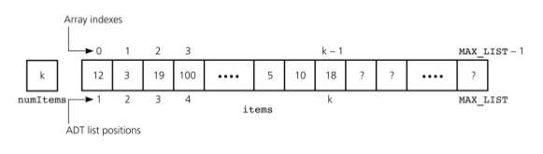
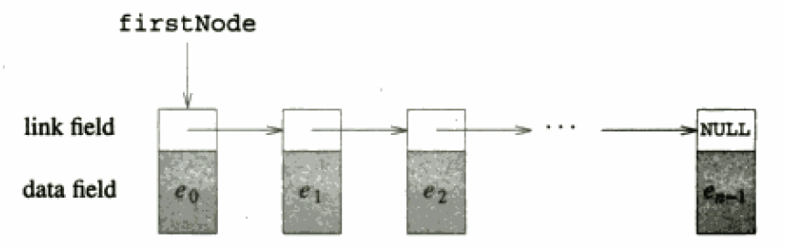
ReCap – (Lecture-2) (2)
List
Add, Delete, Find at any position in the list – Start, middle, end
ADT Operations
empty(), size(), get(index), indexOf(x), erase(index), insert(index, x)
Array representation
Advantages/DisAdvantages –
Get(index) is fast (1)
Add, remove requires shifting of entire array O(n)
Waste of space - ArraySize can be too big compared to ListSize
ArraySize can be too small compared to ListSize, Increasing AarraySize is costly
Linked Implementation
Find requires traversing the List
Addition, Deletion does not require shifting
Circularly Linked List, Doubly Linked List

Slide 7
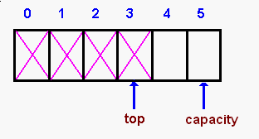
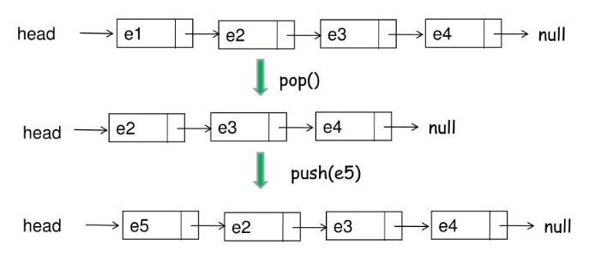
ReCap – (Lecture-2) (3)
Stack
Add, Delete, Find only at top of the List - LIFO
ADT Operations
empty(), size(), top(), pop(), push(x)
Array representation
Advantages/DisAdvantages –
Find is fast O(1)
Add, remove does not requires shifting of entire array O(1)
ArraySize needs to varied as per StackSize. Can be costly
Chain Implementation
Find is fast. O(1)
Addition, Deletion is fast O(1)

Slide 8
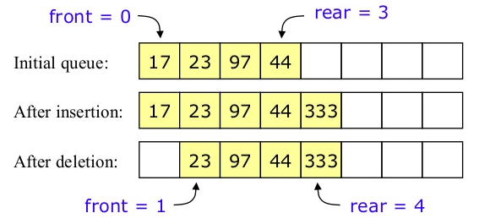
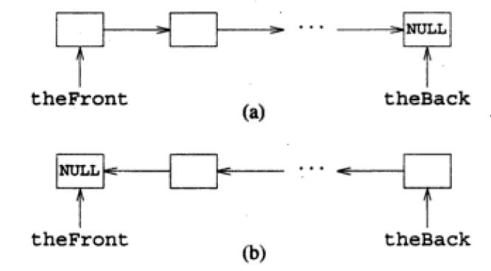
ReCap – (Lecture-2) (4)
Queues
Add in Rear. Deletion from Front - FIFO
ADT Operations
empty(), size(), front(), back(), pop(), push(x)
Array representation
Advantages –
Find is fast O(1)
Add, remove does not requires shifting of entire array O(1)
Have to use circular representation within Array
ArraySize cannot be varied. Process will be too costly.
Chain Implementation
Find is fast. O(1)
Addition, Deletion is fast O(1).

Slide 9
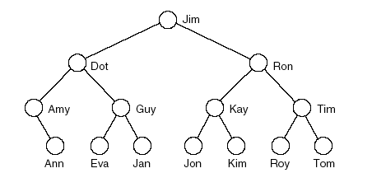
Tree
Tree represents hierarchy.
Examples of trees:
Directory tree
Family tree
Company organization chart
Table of contents
Structure resembles branches of a “Tree”, hence the name
Each Item can have multiple children
Root has no Parent, All other Nodes have exactly one Parent.

Slide 10
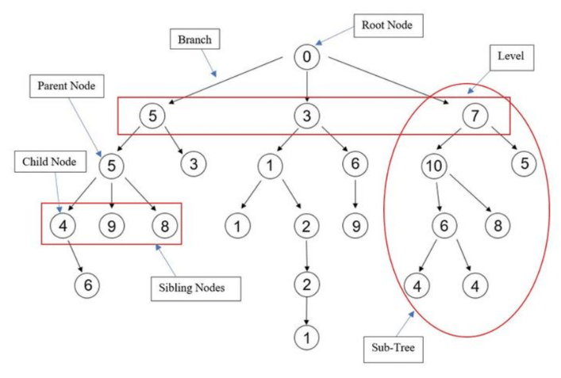
Trees Definitions

Slide 11
Tree Definitions
Nodes or Vertex – An item Stored in a Tree. A vertex (or node) is a object that can have a name and can carry other associated information
Root Node - The first or top most node in a tree. Trees that we consider are rooted. Only One Root. Only node without a Parent
Child – A node immediately below and directly connected to a given node
A node can have more than one child
Its children are viewed as organized in left-to-right order.
The leftmost child is called as first child and rightmost child is called as last child
Parent – A node immediately above and directly connected to a given node. A node can have only one parent. Every node (except the root) has a parent..
Siblings – The children of a common parent. Nodes that share parents
External Nodes and Leaves – No Children.
Internal Nodes – A node that has at least one child
Edges/Branch/Link - That connect the nodes. Parent to its child.
Descendant – A node’s children. Its children’s children and so on down to the leaves
Ancestor – A Node’s parent, its parent’s parent and so on, up to the root.

Slide 12
Tree Definitions
Path in a tree is a list of distinct vertices in which successive vertices are connected by edges in the tree. Between two nodes there is always only one path. The defining property of a tree is that there is precisely one path connecting any two nodes.
Forest - A disjoint set of trees is called a forest
Path Length – The number of Edges in a Path
Depth – The Depth of a Node equals the length of the path connecting it to the root.
Depth of root node is 0.
Depth of any other node is 1 greater than depth of its parent.
Level - The number of edges between a node and the root, i.e. (Depth). Root has Level 0
Height of a Tree : Maximum of all depths.
Subtree:- Any node of a tree, with all of its descendants.
Degree – The number of its children
The Size of a tree is the number of nodes in it
Each node except the root has exactly one node above it in the tree, (i.e. it’s parent), and we extend the family analogy talking of children, siblings, or grandparents
Forest – Set of Disjoint Trees

Slide 13
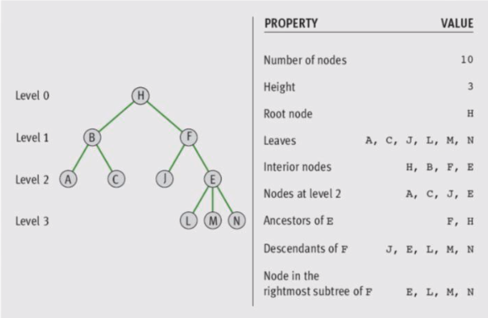
Trees Definitions

Slide 14
Tree ADT
We use positions to abstract nodes
Generic methods:
integer size():Return the number of nodes in the tree. boolean isEmpty() : Return if tree is empty
ObjectIterator elements():Return an iterator of all the elements
stored at nodes of the tree.
Accessor methods:
position root():Return the root of the tree
position parent(p):Return the parent of node p; error if p is root. positionIterator children(p):Return an iterator of the children of node p.

Slide 15
Tree ADT
Query methods:
boolean isInternal(v):Test whether node v is internal.
boolean isExternal(v):Test whether node v is external
boolean isRoot(v):Test whether node v is the root.
Update methods:
swapElements(v, w):Swap the elements stored at the nodes v and w.
object replaceElement(v, e):Replace with e and return the element stored at node v

Slide 16
TREE ADT-Depth and Height
Let v be a node of a tree T.
The depth of v is the number of ancestors of v, excluding v itself
If v is the root, then the depth of v is 0.
Otherwise, the depth of v is one plus the depth of the parent of v.
Algorithm depth(T, v):
if T. isRoot(v) then
return 0
else
return 1 + depth (T, T. parent(v))
The running time of algorithm depth (T, v) is O(1 + d_{v}), where d_{v}
denotes the depth of the node v in the tree T.
In the worst case, the depth algorithm runs in O (n) time, where n is the total number of nodes in the tree T

Slide 17
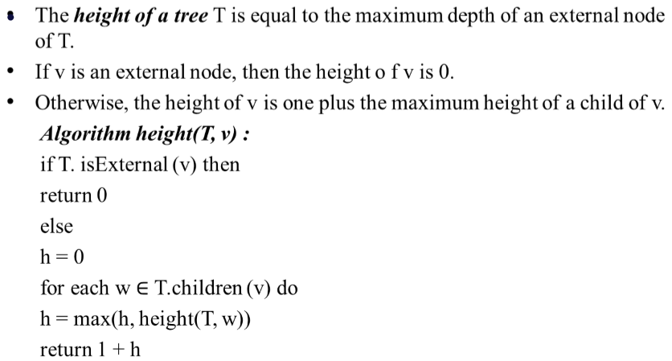
TREE ADT- Depth and Height
The height of a tree T is obtained by
calling height(T,T.root())

Slide 18
Binary Trees
Definition: A binary tree is either empty or it consists of a root together with two binary trees called the left subtree and the right subtree.
A binary tree is a tree in which each node has atmost 2 children

Slide 19
Types of Binary trees
Proper Binary Tree
(Strict/Full Binary Tree)
- Each internal node has exactly two children
Let
n - number of nodes
n_{e} – number of external nodes or leaves
n_{i} – number of internal nodes
h – height of T, Then the following holds:
h+1 <= n_{e} <= 2^{h}
h <= n_{i} <= 2^{h} – 1
2h + 1 <= n <= 2^{h+1} -1
log(n+1) – 1 <= h <= (n -1)/2
n_{i} =4 n_{e} =5 h=4, n=9

Slide 20
Complete Binary Trees
Nodes in trees can contain keys (letters, numbers, etc)
Complete binary tree: A binary tree in which every level, except possibly the deepest, is completely filled. At depth n, the height of the tree, all nodes must be as far left as possible.
14
10
16
8
12
15
18
7
9
11
13

Slide 21

Complete Binary Trees: Array Representation
Complete Binary Trees can be represented in memory with the use of an array A so that all nodes can be accessed in O(1) time:
Label nodes sequentially top-to-bottom and left-to-right
Left child of A[i] is at position A[2i]
Right child of A[i] is at position A[2i + 1]
Parent of A[i] is at A[i/2]
1
14
2
3
10
16
4
5
6
7
8
12
15
18
8
9
10
11
7
9
11
13

Slide 22
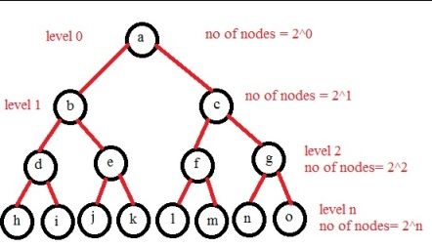
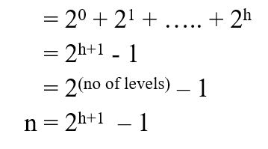
Perfect Binary Trees:
A perfect binary tree is a binary tree in which all interior nodes have two children and all leaves have the same depth or same level
Maximum no of nodes in a binary tree with height h
Now you can find the high of a tree, with n
n = 2^{h+1} – 1
2^{h+1} = n+1
h = log₂(n+1) – 1
Height of complete binary tree h = floor (log₂n)

Slide 23
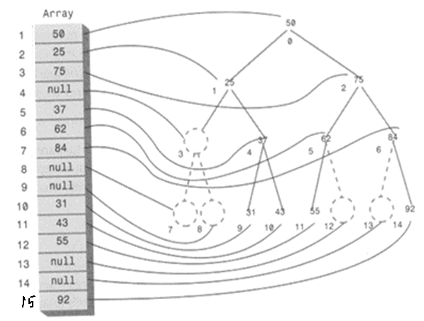
Binary Trees: Array Representation

Slide 24
Binary Trees: Linked List Representation
A Binary tree is a linked data structure. Each node contains data (including a key and satellite data), and pointers left, right and p.
Left points to the left child of the node.
Right points to the right child of the node.
p points to the parent of the node.
If a child is missing, the pointer is NIL.
If a parent is missing, p is NIL.
The root of the tree is the only node for which p is NIL.
Nodes for which both left and right are NIL are leaves.

Slide 25
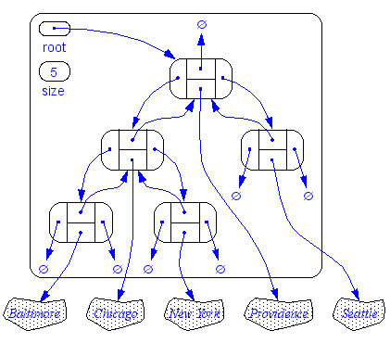
Binary Trees: Linked List Representation

Slide 26
Binary Tree Traversals
A binary tree is defined recursively: it consists of a root, a left subtree and a right subtree
To traverse (or walk) the binary tree is to visit each node in the binary tree exactly once.
Tree traversals are naturally recursive.
Since a binary tree has three parts, there are six possible ways to traverse the binary tree:
root, left, right : preorder (root, right, left)
left, root, right: inorder (right, root, left)
left, right, root: postorder (right, left, root)

Slide 27
Binary Tree Traversals
1
preorder: 1 2 3
inorder: 2 1 3
postorder: 2 3 1
2
3

Slide 28
Tree Traversal: InOrder
In-order traversal
Visit left subtree (if there is one) In Order
print the key of the current node
Visit right subtree (if there is one) In Order

Slide 29
Tree Traversal: PreOrder
Another common traversal is PreOrder.
It goes as deep as possible (visiting as it goes) then left to right
print root
Visit left subtree in PreOrder
Visit right subtree in PreOrder

Slide 30
Tree Traversal: PostOrder
PostOrder traversal also goes as deep as possible, but only visits internal nodes during backtracking.
recursive:
Visit left subtree in PostOrder
Visit right subtree in PostOrder
print root

Slide 31
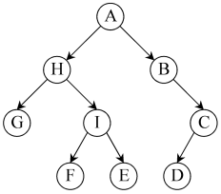
Tree Traversal: examples
* Preorder (DLR) traversal yields: A, H, G, I, F, E, B, C, D
* Postorder (LRD) traversal yields: G, F, E, I, H, D, C, B, A
* In-order (LDR) traversal yields: G, H, F, I, E, A, B, D, C

