Slide 1
Data Structures and Algorithms Design
Harish Aggarwal

Slide 2
Sorting Algorithms
Heaps

Slide 3
Re-Cap
Lecture-01
Introduction
Handout
Text Books, Reference Books
Marks Distribution
Algorithm Analysis
Pseudo Code
Random Access model
Time Complexity of Algorithms
Asymptotic Notations
Basic Maths Needed in the course
Lecture-03
General Rules and Problems
Mathematical analysis of Non-recursive algorithms
Mathematical analysis of Recursive algorithms
Iteration vs Recursion
Recurrence Tree
Iterative Substitution
Masters Theorem with example
Lecture-02
Abstract Data Types
Arrays and Linked Lists
List, Stack, Queues
Array and Linked Implementation
Add, Remove operations
Applications
Infix, PreFix, PostFix Notations
Lecture-04
Recurrence relation
Recursion Method (With help from Merge sort)
Substitution Method
Tree – Definitions
Binary Tree –
Proper, (Strict/Full), Complete, Perfect
Tree Traversal – PreOrder, InOrder, PostOrder

Slide 4
Agenda
Bubble Sort
Insertion Sort
Selection Sort
Bucket Sort
Quick Sort
Complexity of Sorting Algorithms
Heaps
Q&A

Slide 5












Bubble Sort
Bubble Sort
Compare adjacent elements
(1,2), (2,3), (3,4)………………………….(n-1, n)
Swap if elements are not in order
In the first pass the max element will reach to the last position
Repeat the above steps n-1 time (One time less than previous pass)
Repeat till only first two elements are compared
Max element gets Bubbled up to its position in each pass
Complexity of Bubble Sort
O(n²)
Average case –Θ(n²)

Slide 6
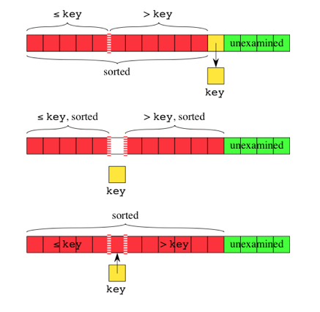
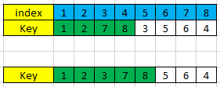

Insertion Sort
Insertion Sort
All the elements prior to the key are all sorted in ascending order
Find the right position where key needs to be inserted
Shift all the elements to the right of the inserted key to one place right
Repeat this for all unsorted elements.
Complexity of Insertion Sort
O(n²)
Best case – When the array is already sorted – Θ(n)

Slide 7
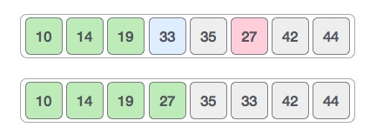
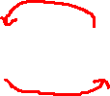
Selection Sort
Selection Sort
Parse the entire array of unsorted elements
Select the Min element
Swap it with the first element of unsorted elements
Repeat above three steps for remaining unsorted elements.
Complexity of Selection Sort
O(n²)
Average case –Θ(n²)

Slide 8
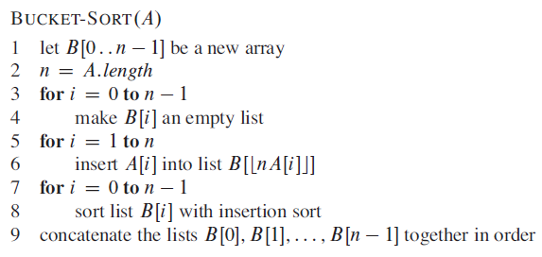
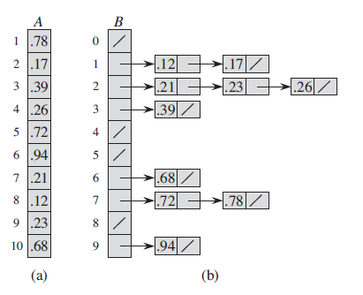

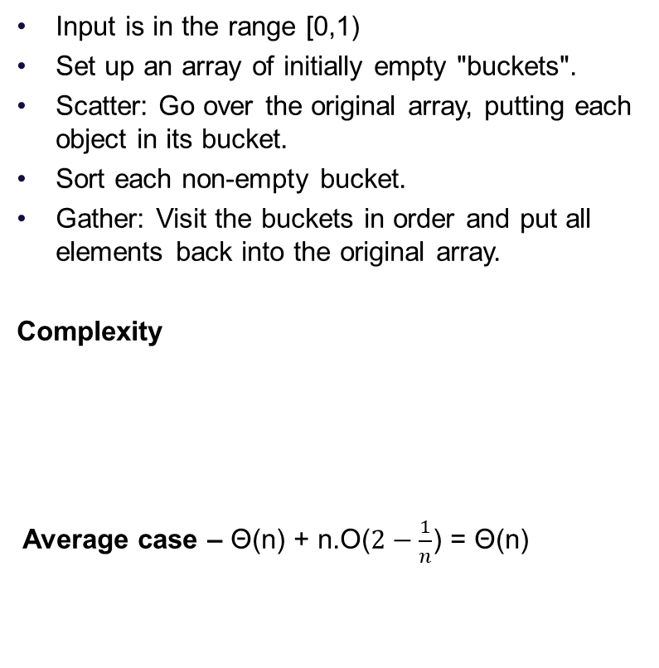
Bucket Sort
Input is in the range [0,1)
Set up an array of initially empty "buckets".
Scatter: Go over the original array, putting each object in its bucket.
Sort each non-empty bucket.
Gather: Visit the buckets in order and put all elements back into the original array.
Complexity
Average case – Θ(n) + n.O($2−\frac{1}{n}$) = Θ(n)

Slide 9
Divide and Conquer –
Quick Sort
Consider the sorting problem.
Input - A sequence of n number <a₁, a₂, a₃, a₄,………………….a_{n}>
Output - A permutation (reordering) <a₁ ’, a₂ ’, a₃ ’, a₄ ’,………………….a_{n} ’ > of the input sequence such that a₁’ $≤$ a₂ ’ $≤$ a₃ ’ $≤$ a₄ ’ $≤$ …………………. $≤$a_{n} ’
Divide : Partition (rearrange) the array A[p ..r] into two (possibly empty) subarrays A[p ..q-1] and A[q+1..r] such that each element of A[p..q-1] is less than or equal to A[q], which is, in turn, less than or equal to each element of A[q+1..r]. Compute the index q as part of this partitioning procedure.
Conquer: Sort the two subarrays A[p ..q-1] and A[q +1..r] by recursive calls to quicksort.
Combine : Because the subarrays are already sorted, no work is needed to combine them. The entire array A[p ..r] is now sorted.

Slide 10
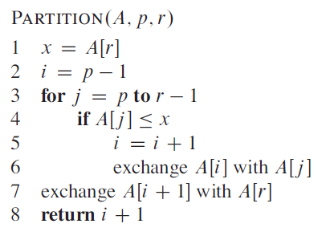
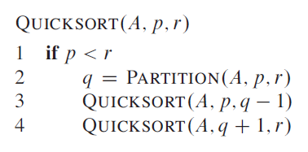
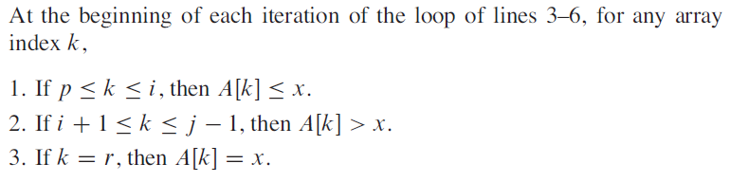
Divide and Conquer –
Quick Sort
Hence there are two key operations
Partitioning the array
Calling quicksort recursively on the partitioned subarrays

Slide 11
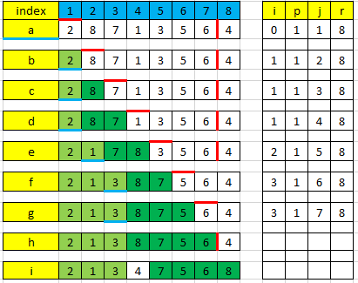
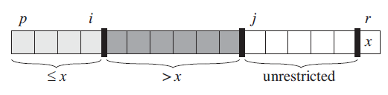
Divide and Conquer –
Quick Sort
Partition
Make the last element of the array as Pivot
Start parsing the array from the beginning.
Compare each element with pivot
If element is smaller than pivot, update the array segment that has all elements smaller than pivot.
If element is larger than pivot, update the array segment that has all elements larger than pivot
Move pivot between the smaller array and larger array

Slide 12
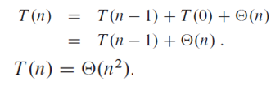

Divide and Conquer –
Quick Sort
Complexity of Partition function
Θ(n)
Complexity of Quick Sort
Worst Case partitioning
Entire array is already is sorted in ascending order.
Best Case partitioning
Pivot is such that array is divided into two equal halves
And this happens recursively all the time.
Balanced partitioning
Average case running time of quick sort is much closer to the best case than to the worst case.

Slide 13
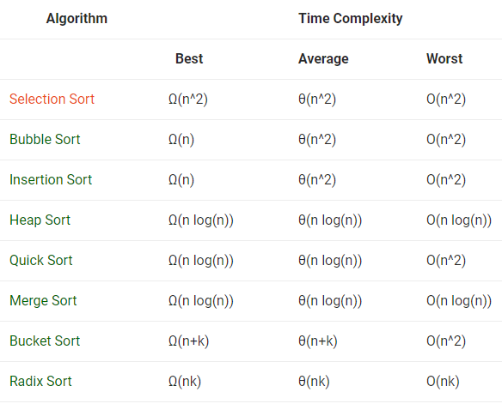
Sorting Algorithms –
Time complexity of sorting Algorithms

Slide 14
Heaps
Max Tree – Is a tree in which the value in each node is Greater than or equal to those in its children.
May not be Binary Tree
A Max Heap is a Max Tree that is also a complete Binary Tree
Max Element is at the Root
Min Tree and Min Heap – Just like Max Tree and Max Heap
Primary Operations
Build Heap or Insertion – In already existing heap
Deletion – From a heap
Heapify – Make a heap out of Complete Binary Tree
55
53
86
31
84
55
13
44
53
60
2
13
22

Slide 15

Heaps (Insertion)
Insertion -
Place the element in next empty place in Complete Binary Tree
Bubble up the new element up the tree until parent >= New Element
It is O(log n).
53
55
53
55
53

Slide 16
Heaps (Insertion)
55
60
53
60
53
55
60
95
53
55
60
55
95
53

Slide 17
Heaps (Insertion)
95
95
60
55
86
55
53
86
53
60

Slide 18
Heaps (Insertion)
95
95
86
55
86
55
53
60
13
44
53
60
13

Slide 19
Heaps (Insertion)
95
95
86
55
86
55
53
60
13
44
53
84
13
44
2
13
22
84
2
13
22
60

Slide 20
Heaps (Insertion)
95
86
55
53
84
13
44
95
2
13
22
60
29
86
55
53
84
29
44
2
13
22
60
13

Slide 21
Heaps (Insertion)
95
86
55
53
84
29
44
2
13
22
60
13
16
83
95
86
83
53
84
29
55
2
13
22
60
13
16
44

Slide 22
Heaps (Insertion)
95
86
83
53
84
29
83
51
13
22
60
13
16
44
55
2

Slide 23
Heaps (Deletion)
Deletion
Since Max Element is to be Deleted, remove the Root Position of the Tree
Replace it with the right-most node in the last level
Re-Heapify
If New Root is less than any or both of child
Swap the new-root with the greater child.
Keep doing this till the condition of max tree is met
O(height) = O(log n)
60
95
86
55
86
55
84
13
44
53
84
13
44
53
13
60
2
13
22
2
22

Slide 24
Heaps (Deletion)
86
60
84
55
86
55
53
60
13
44
53
84
13
44
2
13
22
2
13
22

Slide 25

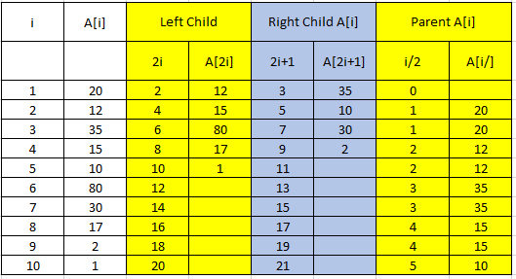
Heaps (Initialization-Heapify)
Complete Binary Trees can be represented in memory with the use of an array A so that all nodes can be accessed in O(1) time
Label nodes sequentially top-to-bottom and left-to-right
Left child of A[i] is at position A[2i]
Right child of A[i] is at position A[2i + 1]
Parent of A[i] is at A[i/2]
1
20
2
3
12
35
4
5
6
7
15
10
80
30
17
2
1
10
8
9

Slide 26
Heaps (Initialization-Heapify)
Steps
Start with Element i = n/2
Make Sub Tree Rooted at this element as Max-Tree
Swap the Root with the Larger of the Childs
Ensure that Sub-Tree with the Swapped Child is also a Max-Tree
Do this for all elements from n/2 To 1 (Root)
1
20
2
3
12
35
4
5
15
10
80
30
17
2
1

Slide 27
Heaps (Initialization-Heapify)
1
20
2
3
12
35
4
15
10
80
30
1
20
17
2
1
2
3
12
35
17
10
80
30
15
2
1

Slide 28
Heaps (Initialization-Heapify)
1
20
2
3
12
35
17
10
80
30
1
20
15
2
1
2
3
12
80
17
10
35
30
15
2
1

Slide 29
Heaps (Initialization-Heapify)
1
20
2
12
80
17
10
35
30
1
20
15
2
1
2
17
80
15
10
35
30
12
2
1

Slide 30
Heaps (Initialization-Heapify)
1
20
17
80
15
10
35
30
80
12
2
1
17
35
15
10
20
30
12
2
1

Slide 31
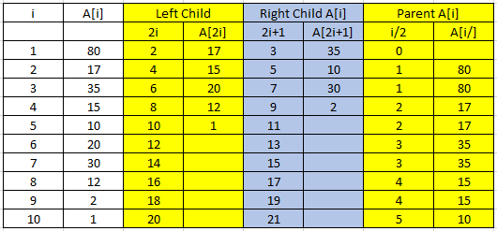
Heaps (Initialization-Heapify)
80
17
35
15
10
20
30
12
2
1
Number of times the step is repeated – n/2
Each time Maximum swaps done are O(h) = O(log n)
Hence it is of O(n/2*Log n)
But It can be proved that this is of O(n)

Slide 32

Heaps (Heap Sort)
Initialize or Heapify
20
12
35
15
10
80
30
80
17
2
1
17
35
15
10
20
30
12
2
1

Slide 33

Heaps (Heap Sort)
80
17
35
15
10
20
30
35
12
2
1
17
30
15
10
20
1
12
2

Slide 34

Heaps (Heap Sort)
35
17
30
15
10
20
1
30
12
2
17
20
15
10
2
1
12

Slide 35

Heaps (Heap Sort)
30
17
20
15
10
2
1
20
12
17
12
15
10
2
1

Slide 36

Heaps (Heap Sort)
20
17
12
15
10
2
1
17
15
12
1
10
2

Slide 37

Heaps (Heap Sort)
17
15
12
1
10
2
15
10
12
1
2

Slide 38

Heaps (Heap Sort)
15
10
12
1
2
12
10
2
1

Slide 39

Heaps (Heap Sort)
12
10
2
1
10
1
2

Slide 40


Heaps (Heap Sort)
10
2
1
2
1
2
1
1

Slide 41
Heaps (Heap Sort)
Given an Array, we can use Heap Sort to sort the array.
Steps –
Initialization – O(n) Step 1
Pop an Element – O(log n) Step - 2
This reduces the heap size to n-1
Place the Popped element to the last position
Repeat Step 2 till no more element is left to be sorted
Complexity
Step 2 is repeated n times
Each time popping an element takes Log n
Hence complexity to O(n*Log n)
Height of a Heap with n elements
h = ceil (log(n+1))-1 = floor(log (n))

Slide 42
Priority Queues
(An Application of Heap)
A priority queue is a data structure for maintaining a set S of elements, each with an associated value called a key/priority.
There’s no “real” FIFO rule anymore.
Two kinds : max-priority queues and min-priority queues, according to max-heaps and min-heaps.
The key denotes the priority
Max-heap is used to implement a max-Priority Queue
Always deletes & returns (extracts) an element with maximum priority
Min-heap is used to implement a min-Priority Queue
Always deletes & returns (extracts) an element with minimum priority

Slide 43
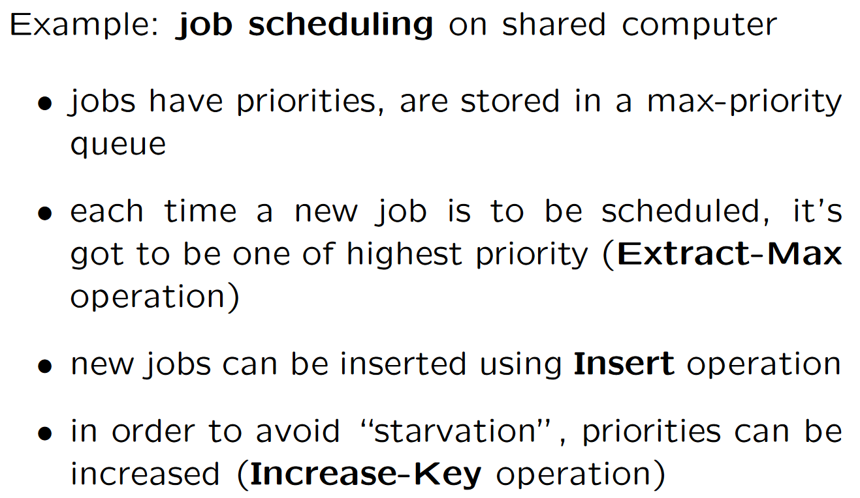
Max – Priority Queue
Applications

Slide 44
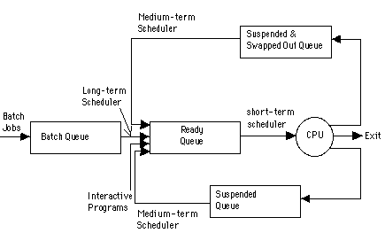
Max – Priority Queue
Applications

Slide 45
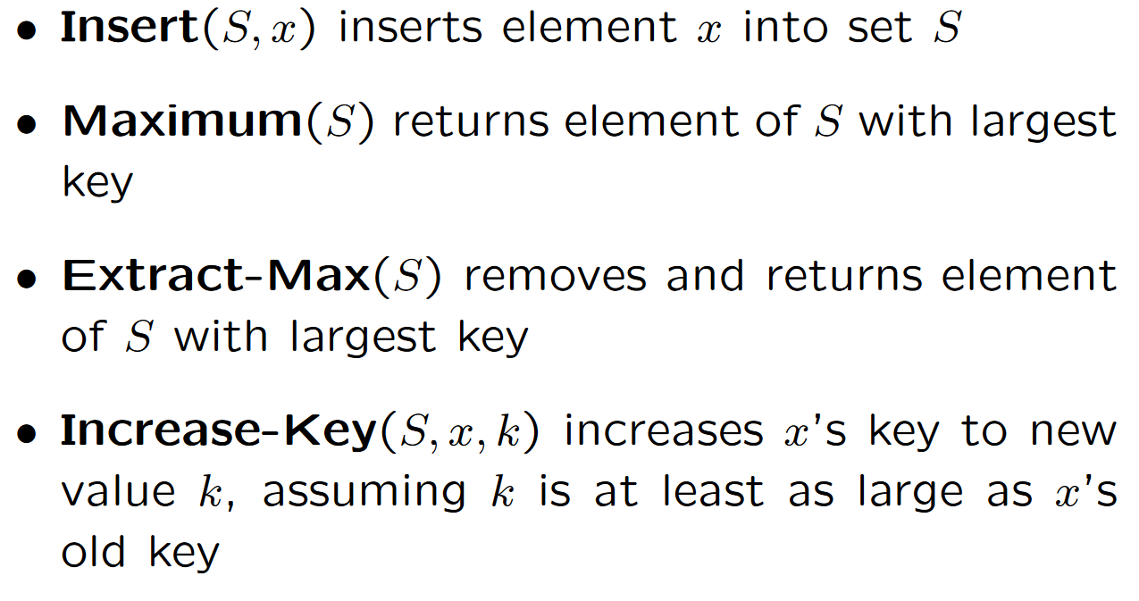
Max- Priority Queue Operations
Min-priority queues offer Insert, Minimum, Extract-Min, and Decrease-Key.

Slide 46
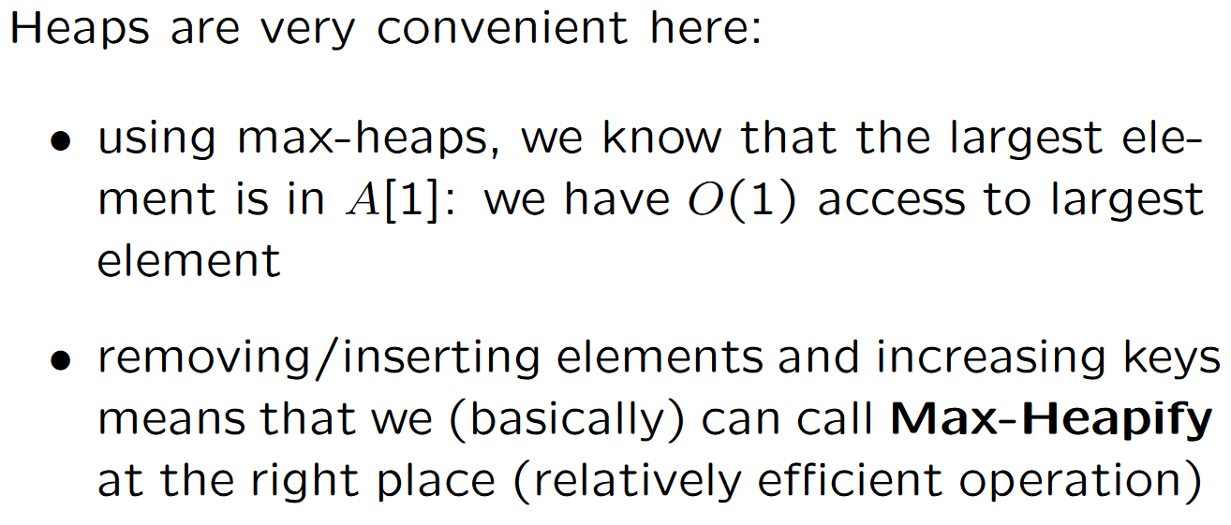
Max – Priority Queue

Slide 47
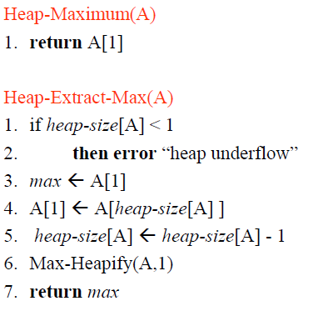
Max-Priority Queue Implementation
<------ O(1)
<------ O(log n)
Technically, this part is removal from heap!

Slide 48
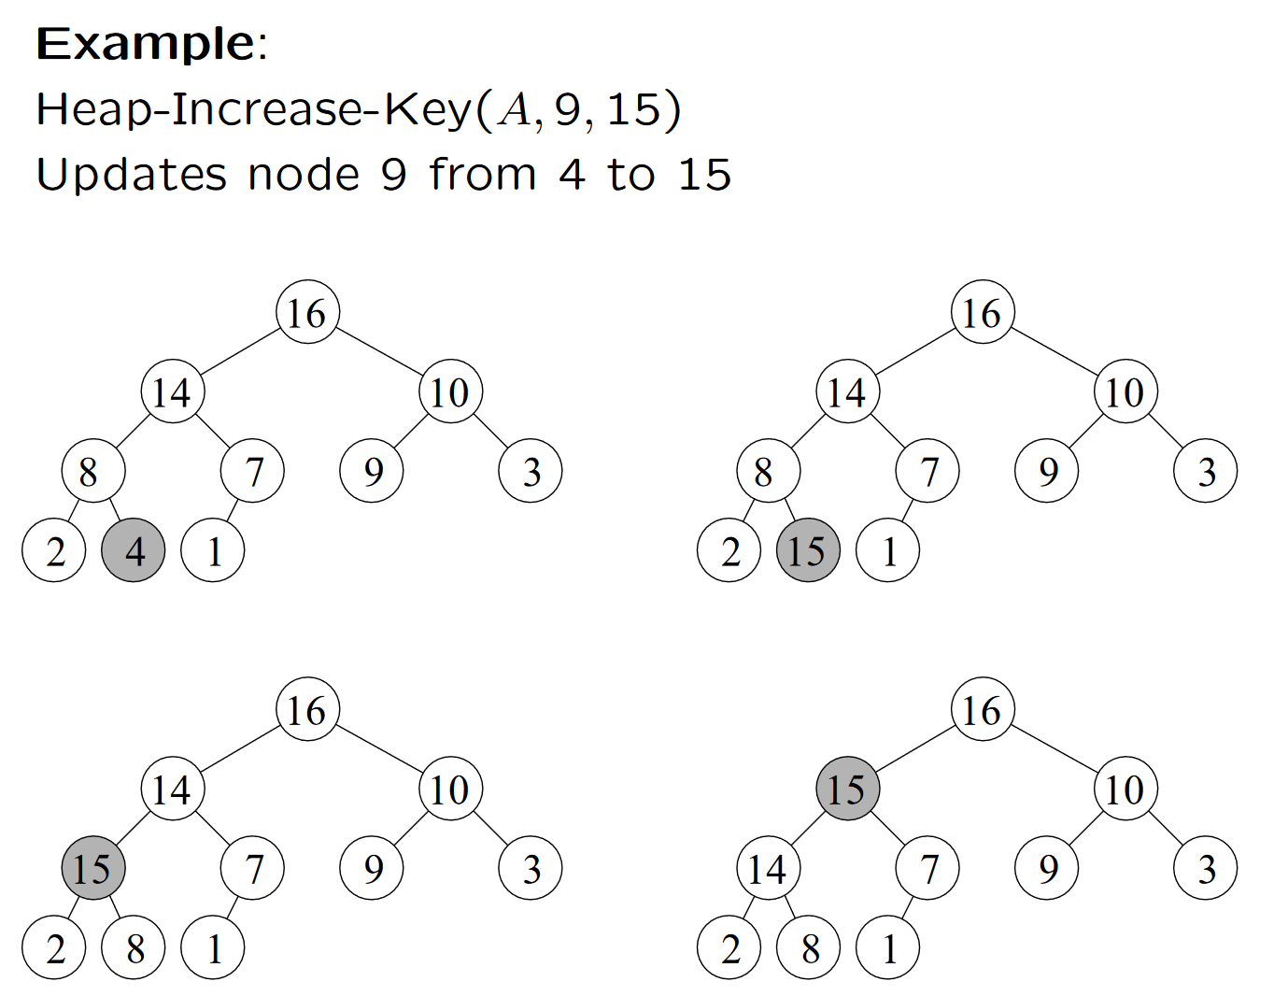
Example of Heap-Increase-Key
1
2
3
4
5
6
7
8
9
10

Slide 49
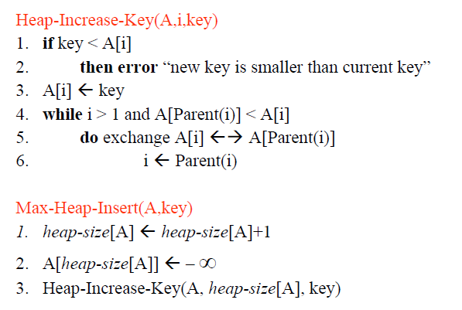
Max-Priority Queue Implementation
<------ O(log n)
Height of the tree
Technically, this part is insertion into heap!
<------ O(log n)

Slide 50
Applications of Heap
Heaps are used in heapsort!
Priority Queues: Priority queues can be efficiently implemented using Heaps
Order statistics: The Heap data structure can be used to efficiently find the kth smallest (or largest) element in an array.
Heap Implemented priority queues are used in Graph algorithms like Prim’s Algorithm and Dijkstra’s algorithm.

Slide 51
Additional Reading
Appendix

