Slide 1

Course Name :
Systems Programming
26th FEB 2023

Slide 2

IMP Note to Self
Systems Programming - V 3.0

Slide 3
IMP Note to Students
It is important to know that just login to the session does not guarantee the attendance.
Once you join the session, continue till the end to consider you as present in the class.
IMPORTANTLY, you need to make the class more interactive by responding to Professors queries in the session.
Whenever Professor calls your number / name ,you need to respond, otherwise it will be considered as ABSENT
Systems Programming - V 3.0

Slide 4
Agenda
System calls
System calls for Process management
Execution of a system calls
Systems Programming - V 3.0

Slide 5
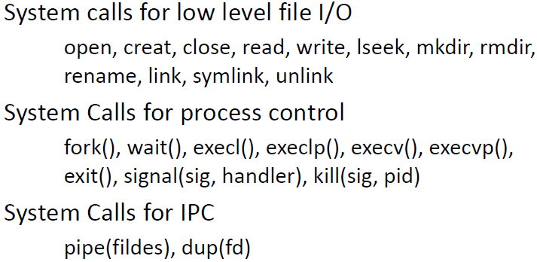
System Call
Systems Programming - V 3.0

Slide 6
System calls related to process
  fork :- For creating a duplicate process from the parent process.
  wait :- Processes are supposed to wait for other processes to complete their work.
  exec :- Loads the selected program into the memory.
  exit :- Terminates the process
  signal :- signal() system call installs a new signal handler for the signal with number signum.
  kill :- Takes two arguments. The first, pid, is the process ID you want to send a signal to, and the second, sig, is the signal you want to send. Therefore, you have to find some way to know the process ID of the other party.
  raise :- The raise() function sends the signal sig to the running program.

Slide 7
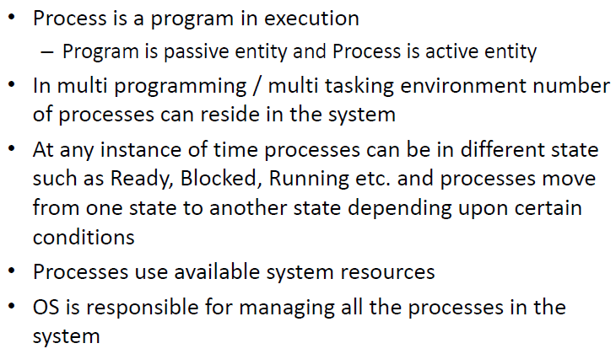
Process summary
Systems Programming - V 3.0

Slide 8
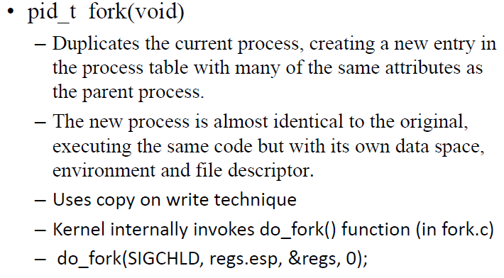
Process related system calls – fork
Systems Programming - V 3.0

Slide 9
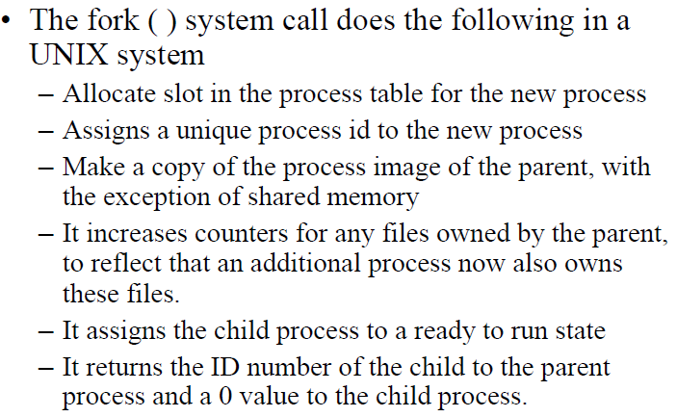
Process related system calls – fork
Systems Programming - V 3.0

Slide 10
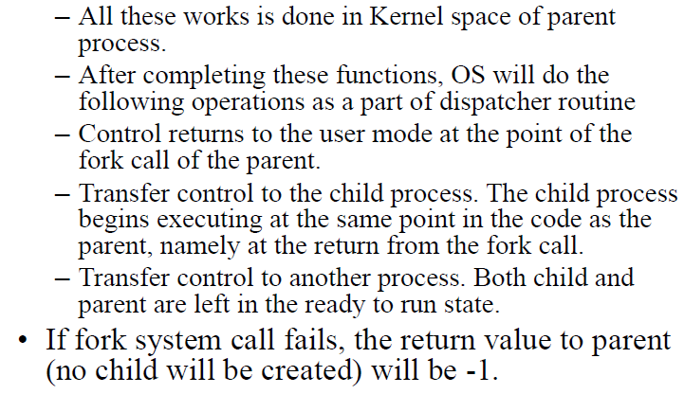
Process related system calls – fork
Systems Programming - V 3.0

Slide 11
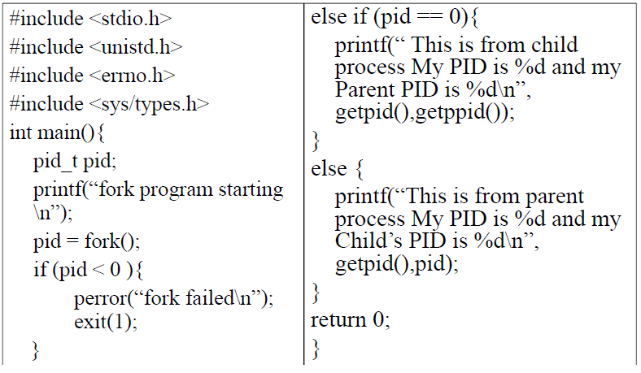
Process Creation Example
Systems Programming - V 3.0

Slide 12
Calling fork()
Calling fork()
Consider the following example in which we have used the fork() system call to create a new child process:
#include <stdio.h>
#include <sys/types.h>
#include <unistd.h>
int main()
{
fork();
printf("Using fork() system call\n");
return 0;
}
OUTPUT:
sysads@linuxhint $ gcc fork.c -o fork
sysads@linuxhint $ ./fork
Using fork() system call
Using fork() system call
In this program, we have used fork(), this will create a new child process. When the child process is created, both the parent process and the child process will point to the next instruction (same Program Counter).
That is 2^{n} times, where n is the number of fork() system calls.
Systems Programming - V 3.0

Slide 13
Calling fork()
#include <stdio.h>
#include <sys/types.h>
#include <unistd.h>
int main()
{
fork();
fork();
fork();
fork();
printf("Using fork() system call\n");
return 0;
}
Output:
sysads@linuxhint $ gcc fork.c -o fork
sysads@linuxhint $ ./fork
Now the total number of process created are 2⁴ = 16 and we have our print statement executed 16 times.
Systems Programming - V 3.0

Slide 14
#include <stdio.h>
#include <sys/types.h>
#include <unistd.h>
int main()
{
pid_t p;
p = fork();
if(p==-1)
{
printf("There is an error while calling fork()\n");
}
if(p==0)
{
printf("We are in the child process\n");
}
else
{
printf("We are in the parent process\n");
}
return 0;
}
Calling fork()
OUTPUT:
sysads@linuxhint $ gcc fork.c -o fork
sysads@linuxhint $ ./fork
We are in the parent process
We are in the child process
Systems Programming - V 3.0

Slide 15
Calling fork()
#include <stdio.h>
#include <unistd.h>
#include <sys/types.h>
//main function begins
int main()
{
pid_t p= fork(); //calling of fork system call
if(p==-1)
printf("Error occured while calling fork()");
else if(p==0)
printf("This is the child process");
else
printf("This is the parent process");
return 0;
}
Output:
This is the parent process
This is the child process
Systems Programming - V 3.0

Slide 16
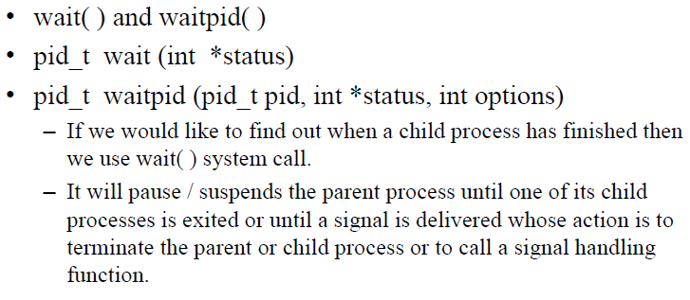
Process related system calls – wait
Systems Programming - V 3.0

Slide 17
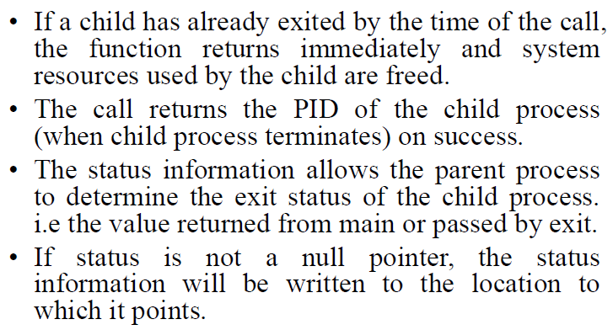
Process related system calls – wait
Systems Programming - V 3.0

Slide 18
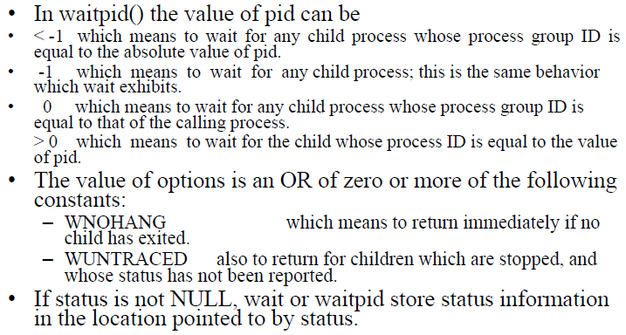
Process related system calls – wait
Systems Programming - V 3.0

Slide 19
C program to demonstrate working of wait()
#include<stdio.h>
#include<sys/wait.h>
#include<unistd.h>
int main(){
if (fork()== 0)
printf("HC: hello from child\n");
else
{
printf("HP: hello from parent\n");
wait(NULL);
printf("CT: child has terminated\n");
}
printf("Bye\n");
return 0;
}
[vasudevarao@localhost Systemcalls]$ gcc Wait1.c -o Wait1
[vasudevarao@localhost Systemcalls]$ ./Wait1
Hello from parent
Hello from child
Bye
Child has terminated
Bye
Systems Programming - V 3.0

Slide 20
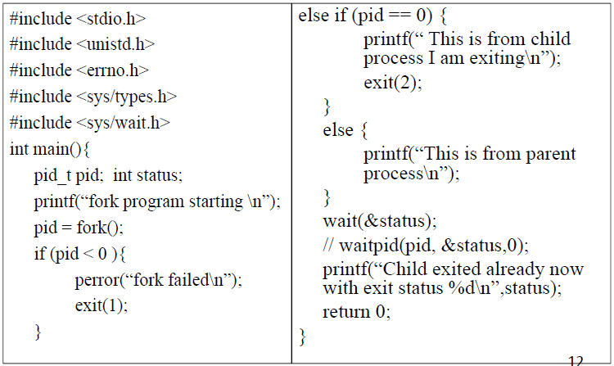
Process related system calls – wait
Systems Programming - V 3.0

Slide 21
Output of system calls – wait
[vasudevarao@localhost Systemcalls]$ gcc Wait.c -o Wait
[vasudevarao@localhost Systemcalls]$ ./Wait
fork program starting
This is from parent process
This is from child process I am exiting
Child exited already now with exit status 512
Systems Programming - V 3.0

Slide 22
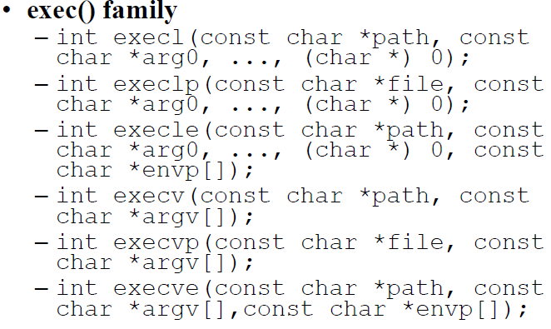
Process related system calls – exec
Systems Programming - V 3.0

Slide 23
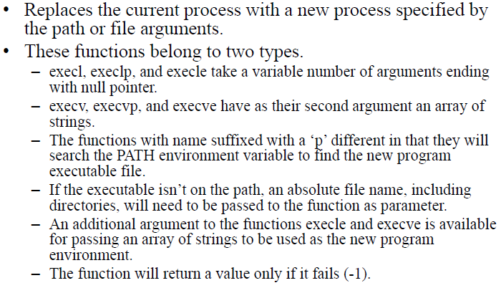
Process related system calls – exec
Systems Programming - V 3.0

Slide 24
Working of exec
Current process image is overwritten with a new process image.
New process image is the one you passed as exec argument
The currently running process is ended
New process image has same process ID, same environment, and same file descriptor (because process is not replaced process image is replaced)
The CPU stat and virtual memory is affected. Virtual memory mapping of the current process image is replaced by virtual memory of new process image.
Systems Programming - V 3.0

Slide 25
We have two c files here exec.c and helloexec.c
#include <stdio.h>
#include <unistd.h>
#include <stdlib.h>
int main(int argc, char *argv[])
{
printf("PID of exec.c = %d\n", getpid());
char *args[] = {"Helloexec", "C", "Programming", NULL};
execv("./helloexec", args);
printf("Back to exec.c");
return 0;
}
Systems Programming - V 3.0

Slide 26
c files here helloexec.c
#include <stdio.h>
#include <unistd.h>
#include <stdlib.h>
int main(int argc, char *argv[])
{
printf("We are in helloexec.c\n");
printf("PID of helloexec.c = %d\n", getpid());
return 0;
}
Output :
PID of exec.c = 4733
We are in helloexec.c
PID of helloexec.c = 4733
Systems Programming - V 3.0

Slide 27
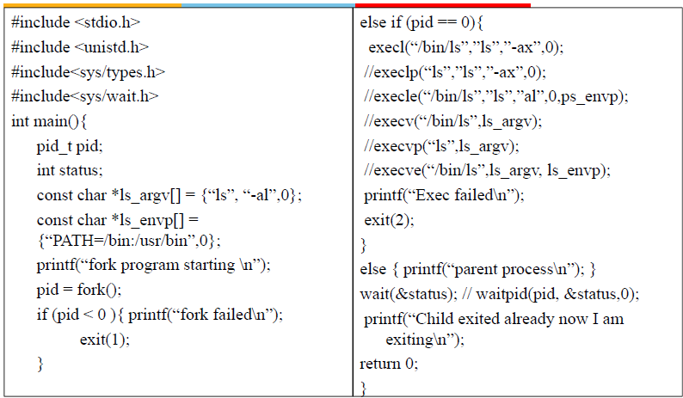
Systems Programming - V 3.0

Slide 28
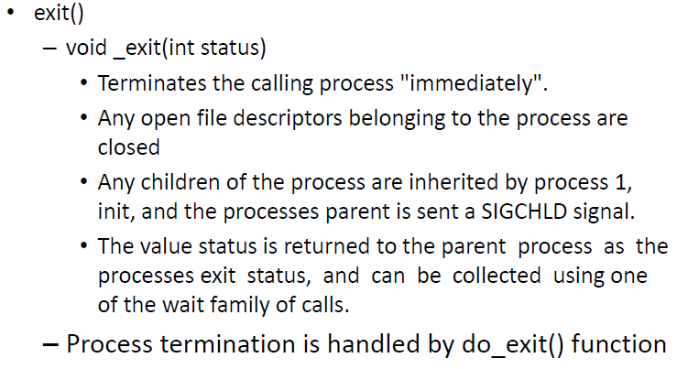
Process related system calls – exit
Systems Programming - V 3.0

Slide 29
#include <stdio.h>
#include <unistd.h>
#include<sys/types.h>
#include<sys/wait.h>
int main()
{
pid_t pid;
int status;
const char *ls_argv[] = {"ls", "-a",0};
const char *ls_envp[] = {"PATH=/bin:/usr/bin",0};
printf("fork program starting \n");
pid = fork();
if (pid < 0 )
{
printf("fork failed\n");
exit(1);
}
else if (pid == 0)
{
execl("/bin/ls","ls","-l",0);
printf("Exec failed\n");
exit(2);
}
else
{
printf("parent process\n");
}
wait(&status); // waitpid(pid, &status,0);
printf("Child exited already now I am exiting\n");
return 0;
}
Systems Programming - V 3.0

Slide 30
Output:
vasudevarao@localhost Systemcalls]$ ./exit
fork program starting
parent process
total 156
-rwxrwxr-x. 1 vasudevarao vasudevarao 21984 Feb 23 19:56 exec
-rwxrwxr-x. 1 vasudevarao vasudevarao 21984 Feb 23 19:49 exex
-rwxrwxr-x. 1 vasudevarao vasudevarao 21984 Feb 23 19:59 exit
-rw-r--r--. 1 vasudevarao vasudevarao 624 Feb 23 19:56 exit.c
Child exited already now I am exiting
Systems Programming - V 3.0

Slide 31
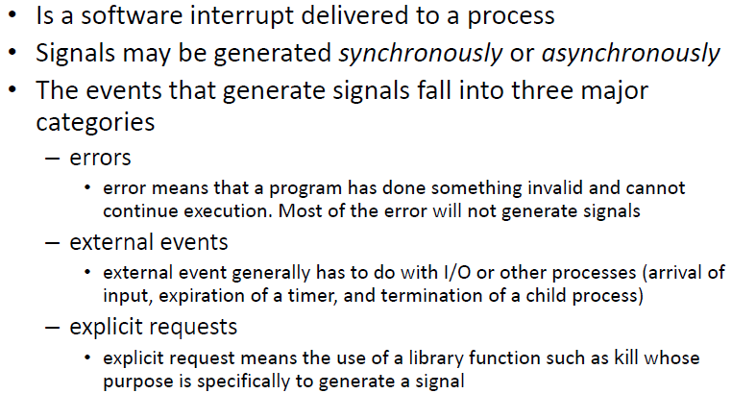
Signal
Systems Programming - V 3.0

Slide 32
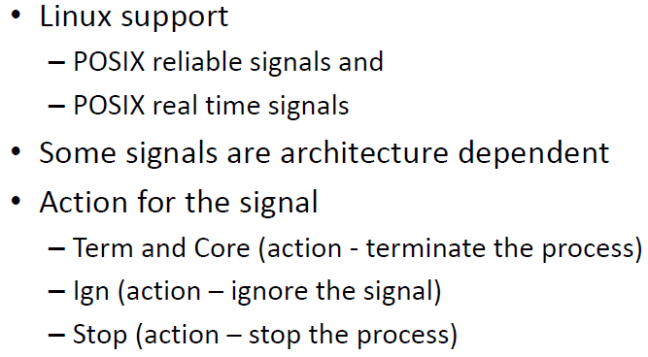
Signal
Systems Programming - V 3.0

Slide 33
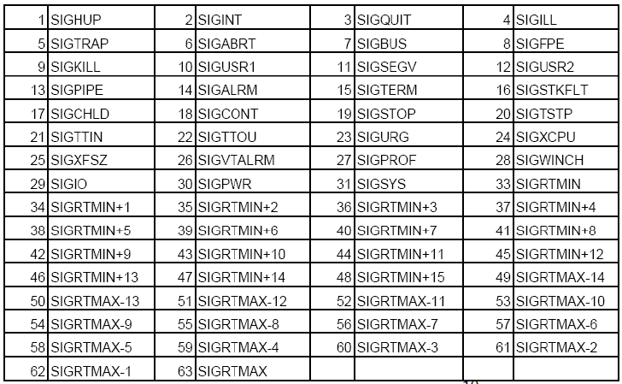
Signal
Systems Programming - V 3.0

Slide 34
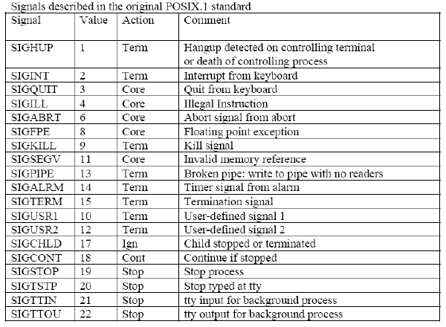
Signal
Systems Programming - V 3.0

Slide 35
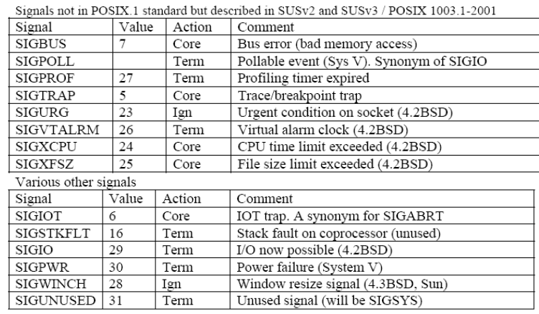
Signal
Systems Programming - V 3.0

Slide 36
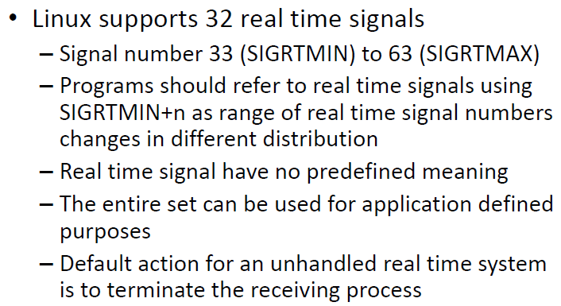
Signal
Systems Programming - V 3.0

Slide 37
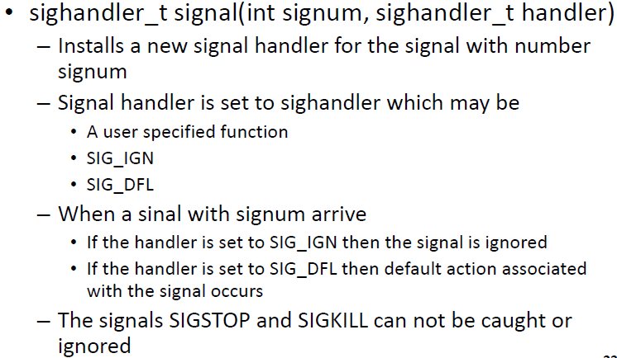
Signal
Systems Programming - V 3.0

Slide 38
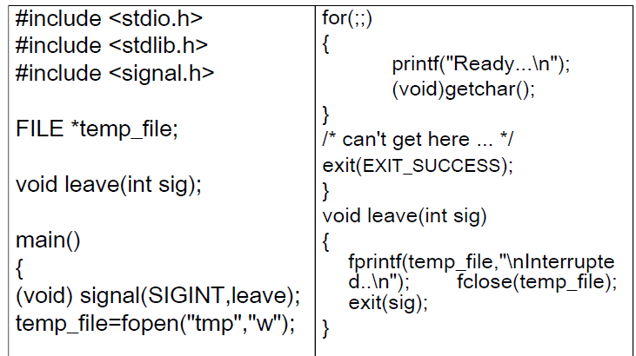
Signal
Systems Programming - V 3.0

Slide 39
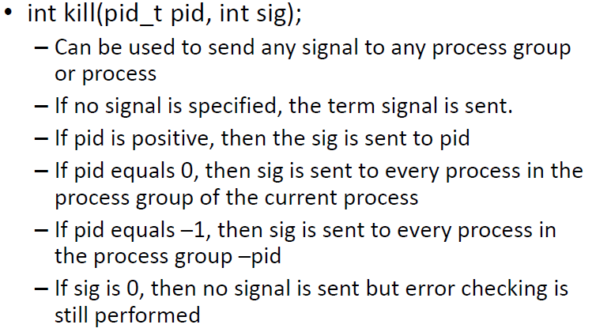
Kill
Systems Programming - V 3.0

Slide 40
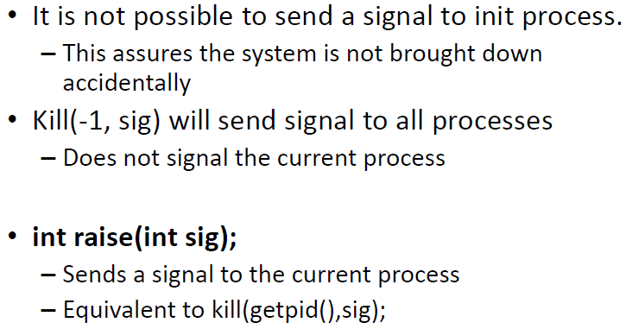
kill and raise
Systems Programming - V 3.0

Slide 41
pipe() System call
The pipe() system function is used to open file descriptors, which are used to communicate between different Linux processes. In short, the pipe() function is used for inter-process communication in Linux.
Systems Programming - V 3.0

Slide 42
#include <stdio.h>
#include <stdlib.h>
#include <unistd.h>
int main(void) {
int pipefds[2];
if(pipe(pipefds) == -1) {
perror("pipe");
exit(EXIT_FAILURE);
}
printf("Read File Descriptor Value: %d\n", pipefds[0]);
printf("Write File Descriptor Value: %d\n", pipefds[1]);
return EXIT_SUCCESS;
}
Systems Programming - V 3.0

Slide 43
OUTPUT:
[vasudevarao@localhost Systemcalls]$ gcc pipe.c -o pipe
[vasudevarao@localhost Systemcalls]$ ./pipe
Read File Descriptor Value: 3
Write File Descriptor Value: 4
Systems Programming - V 3.0

Slide 44
The header file of pipe() unistd.h first with the following line.
#include <unistd.h>
The main() function, defined the pipefds two element integer array with the following line. int pipefds[2];
Then, ran the pipe() function to initialize the file descriptors array pipefds as follows. pipe(pipefds)
also checked for errors using the return value of the pipe() function. I used the exit() function to terminal the program in case the pipe function fails.
if(pipe(pipefds) == -1) {
perror("pipe");
exit(EXIT_FAILURE);
}
Then, printed the value of the read and write pipe file descriptors pipefds[0] and pipefds[1] respectively.
Systems Programming - V 3.0

Slide 45
dup() - System Call
dup() and dup2() create a copy of the file descriptor oldfd.
After a successful return from dup() or dup2(),the old and new file descriptors may be used interchangeably. They refer to the same open file description (see open(2)) and thus share file offset and file status flags; for example, if the file offset is modified by using lseek(2) on one of the descriptors, the offset is also changed for the other.
Systems Programming - V 3.0

Slide 46
#include<unistd.h>
#include<stdio.h>
#include<fcntl.h>
int main()
{
int old_fd, new_fd;
old_fd=open("test.txt",O_RDWR);
printf("File descriptor is %d\n",old_fd);
new_fd=dup(old_fd);
printf("New file descriptor is %d\n",new_fd);
}
Systems Programming - V 3.0

Slide 47
OUTPUT:
[vasudevarao@localhost Systemcalls]$ gcc dup.c -o out
[vasudevarao@localhost Systemcalls]$ ./out
File descriptor is 3
New file descriptor is 4
Systems Programming - V 3.0

Slide 48

Systems Programming - V 3.0

Slide 49

IMP Note to Self
Systems Programming - V 3.0

