Slide 1

Course Name :
Systems Programming
05th MAR 2023

Slide 2

IMP Note to Self
Systems Programming - V 3.0

Slide 3
IMP Note to Students
It is important to know that just login to the session does not guarantee the attendance.
Once you join the session, continue till the end to consider you as present in the class.
IMPORTANTLY, you need to make the class more interactive by responding to Professors queries in the session.
Whenever Professor calls your number / name ,you need to respond, otherwise it will be considered as ABSENT
Systems Programming - V 3.0

Slide 4
Agenda
  Assemblers
  Assembler’s functions
  Assembler directives
  Object code structure
  Object code
  Two pass assembler
  Data structures for two pass assembler
  Operation code table
  Symbol table and location counter
Systems Programming - V 3.0

Slide 5
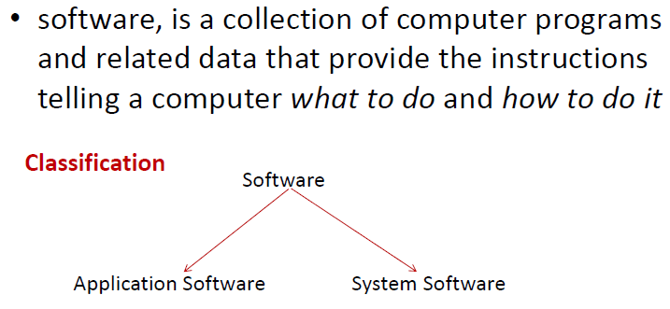
Software
Systems Programming - V 3.0

Slide 6
System software
System software is computer software designed to operate the computer hardware and to provide a platform for running application software.
• Examples :
  – Loaders
  – Assembler
  – Linkers
  – Operating system
  – Compilers
  – Editors
Systems Programming - V 3.0

Slide 7
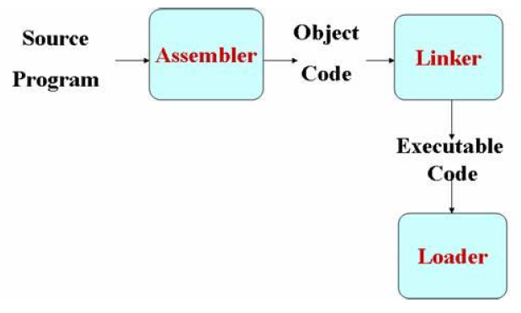
Assemblers
Systems Programming - V 3.0

Slide 8
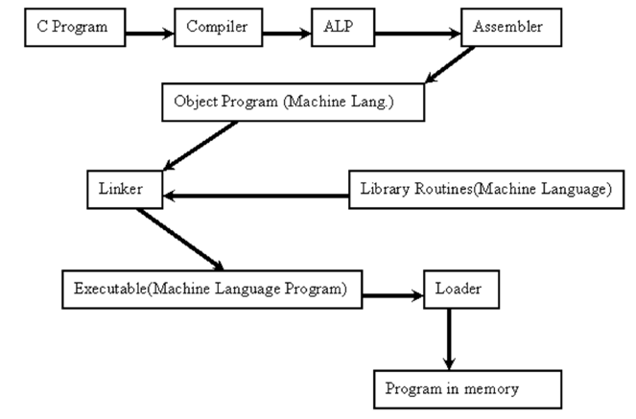
Assemblers
Systems Programming - V 3.0

Slide 9
Assembler’s functions
Convert mnemonic operation codes to their machine language equivalents
• Convert symbolic operands to their equivalent machine addresses
• Build the machine instructions in the proper format
• Convert the data constants to internal machine representations
• Write the object program and the assembly listing
Systems Programming - V 3.0

Slide 10
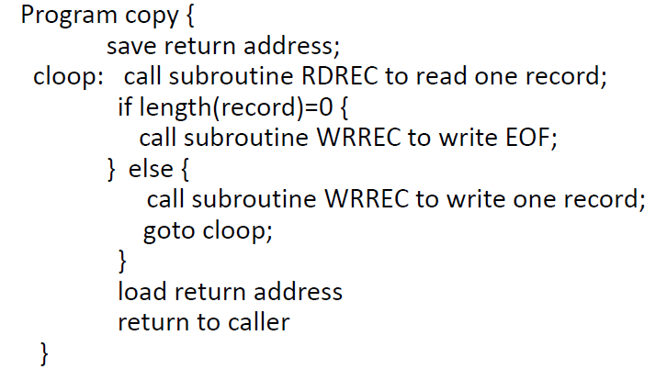
Pseudo code
Systems Programming - V 3.0

Slide 11
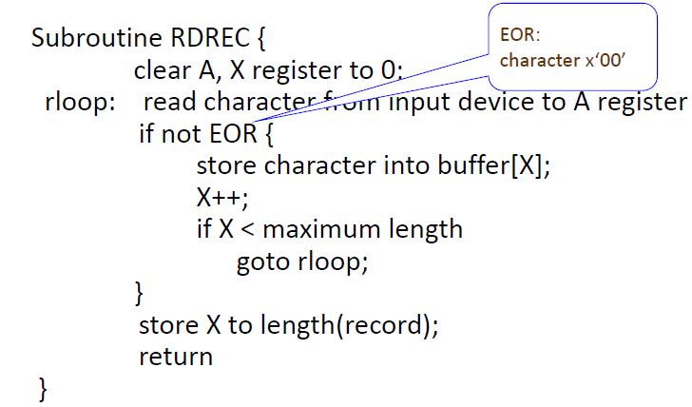
Pseudo code
Systems Programming - V 3.0

Slide 12
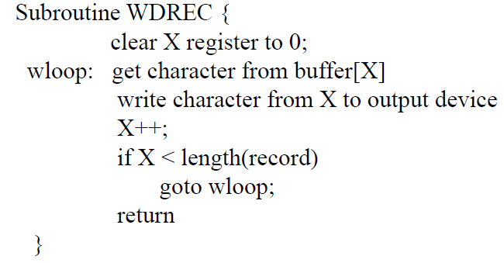
Pseudo code
Systems Programming - V 3.0

Slide 13
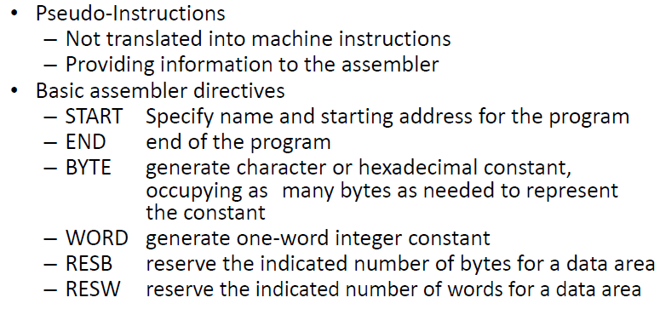
Assembler Directives
Systems Programming - V 3.0

Slide 14
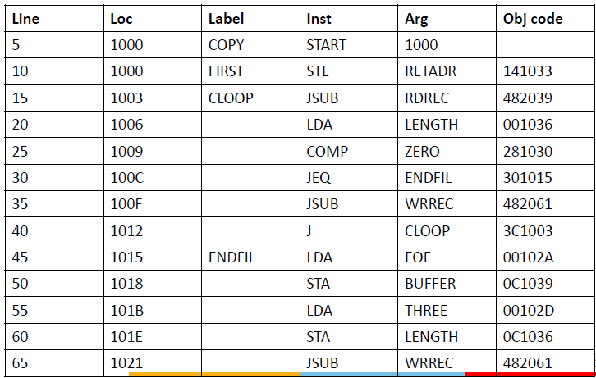
Program – takes input from input device
F1 and copies them to output device 05
Systems Programming - V 3.0

Slide 15
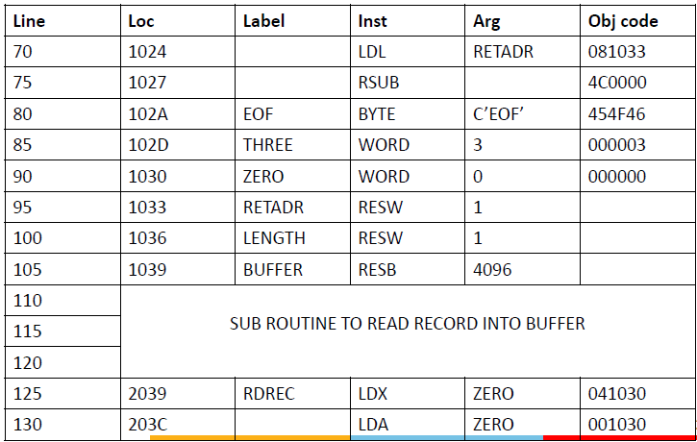
Program – takes input from input device
F1 and copies them to output device 05
Systems Programming - V 3.0

Slide 16
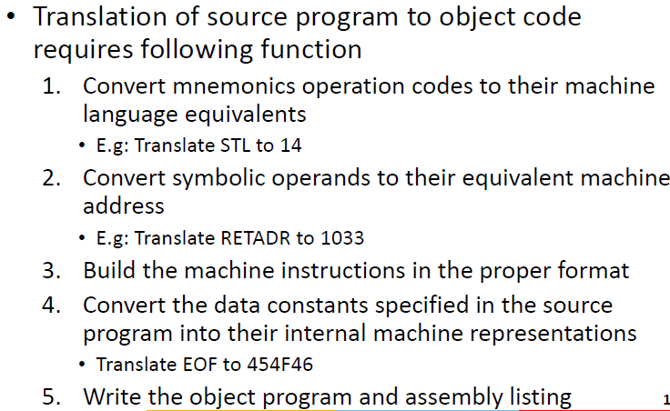
Assembler
Systems Programming - V 3.0

Slide 17
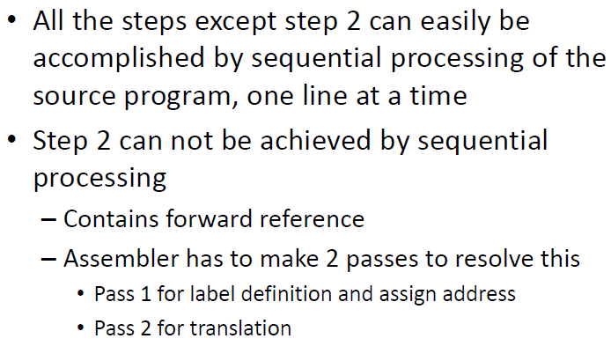
Assembler
Systems Programming - V 3.0

Slide 18
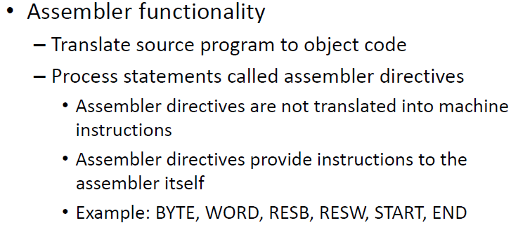
Assembler
Systems Programming - V 3.0

Slide 19
Object Program
Simple object program format contains 3 types of records
– Header
• Starting address, program name and length
– Text
• Translated instructions and data of the program
together with an indication of the addresses where
these are to be loaded
– End
• Marks the end of the program and specifies the address
in the program where the execution is to begin
Systems Programming - V 3.0

Slide 20
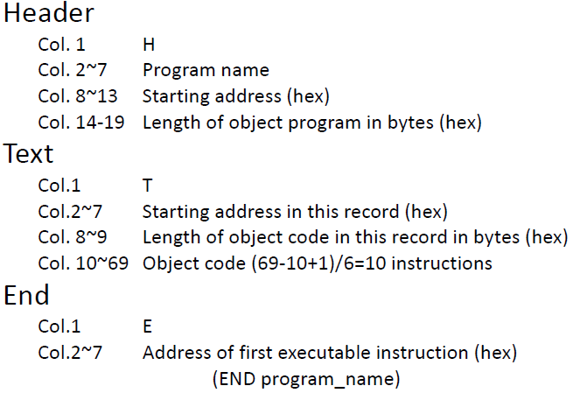
Object Program
Systems Programming - V 3.0

Slide 21
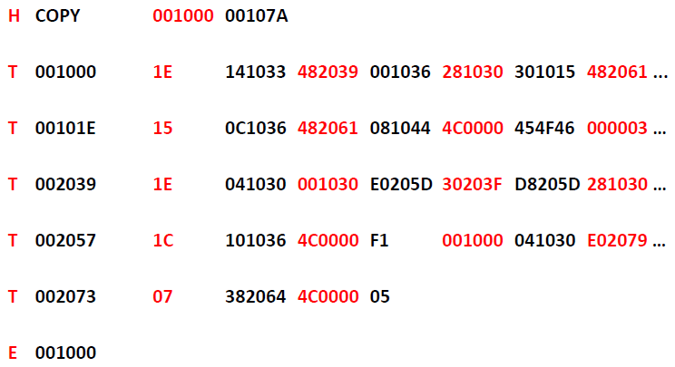
Object Code
Systems Programming - V 3.0

Slide 22
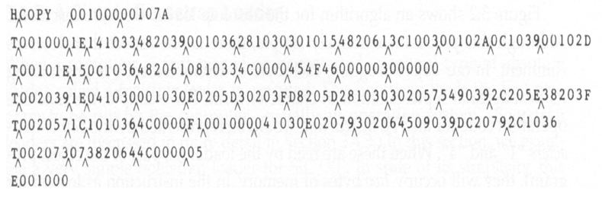
Object Code
Systems Programming - V 3.0

Slide 23
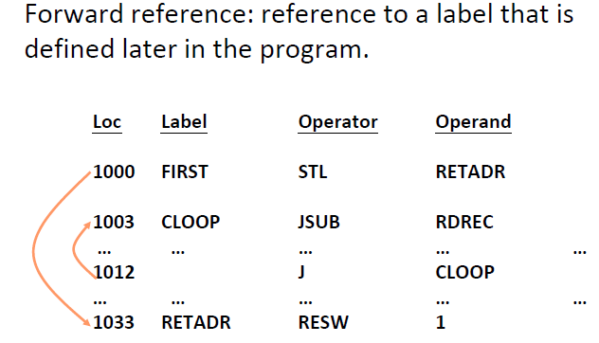
Difficulties: Forward Reference
Systems Programming - V 3.0

Slide 24
Two Pass Assembler
Pass 1
  Assign addresses to all statements in the program
  Save the values assigned to all labels for use in Pass 2
  Perform some processing of assembler directives
Pass 2
  Assemble instructions
  Generate data values defined by BYTE, WORD
  Perform processing of assembler directives not done in Pass 1
  Write the object program and the assembly listing
Systems Programming - V 3.0

Slide 25
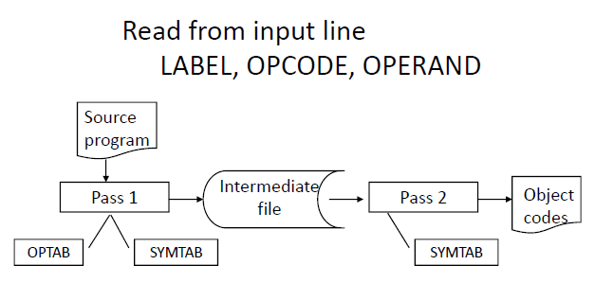
Two Pass Assembler
Systems Programming - V 3.0

Slide 26
Data Structures
Operation Code Table (OPTAB)
Symbol Table (SYMTAB)
Location Counter(LOCCTR)
Systems Programming - V 3.0

Slide 27
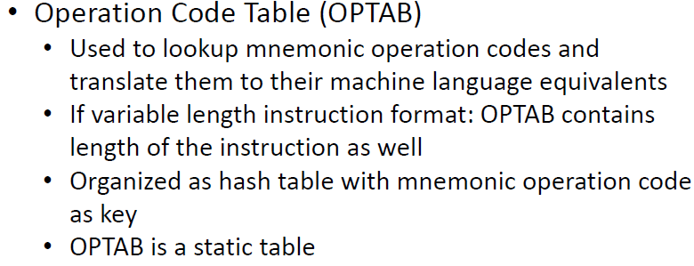
Data Structures
Systems Programming - V 3.0

Slide 28
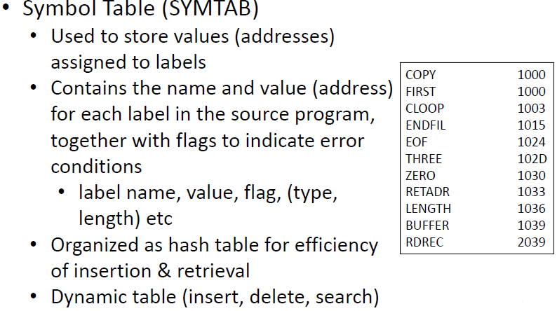
Data Structures
Systems Programming - V 3.0

Slide 29
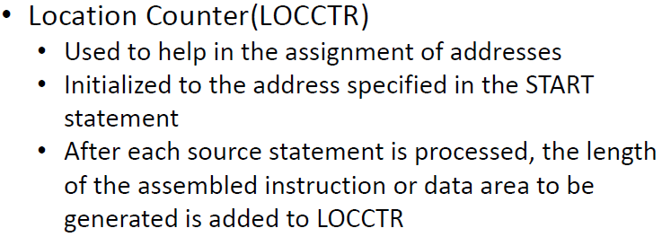
Data Structures
Systems Programming - V 3.0

Slide 30
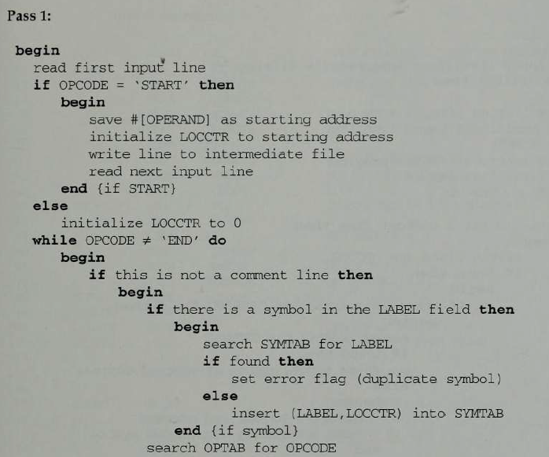
Algorithm for pass1 Assembler
Systems Programming - V 3.0

Slide 31
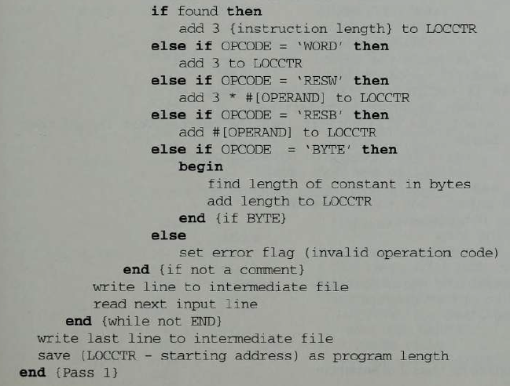
Algorithm for pass1 Assembler
Systems Programming - V 3.0

Slide 32
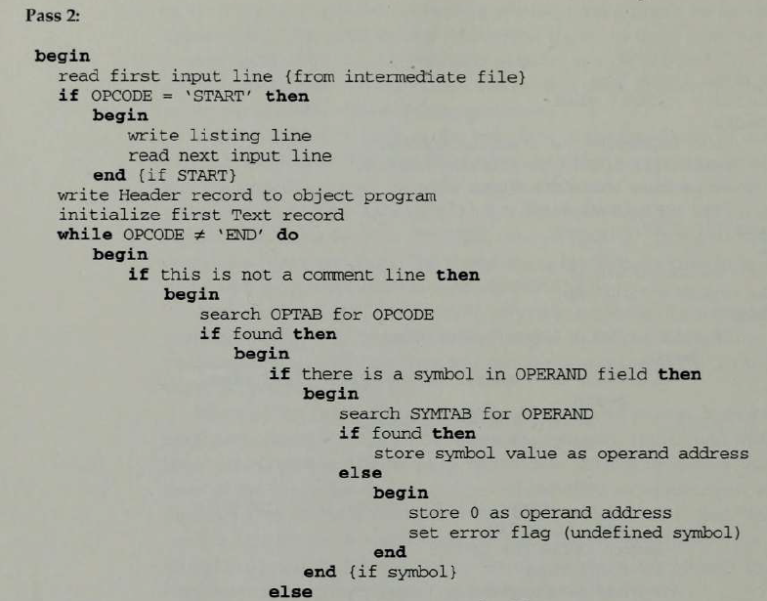
Algorithm for pass 2 Assembler
Systems Programming - V 3.0

Slide 33
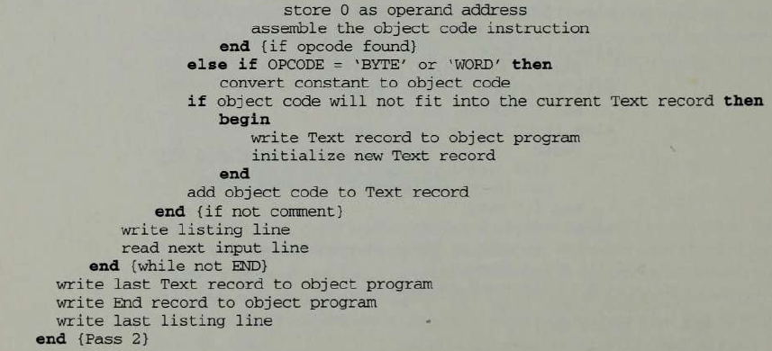
Algorithm for pass 2 Assembler
Systems Programming - V 3.0

Slide 34
Assembler Design
Machine Dependent Assembler Features
  instruction formats and addressing modes
  program relocation
Machine Independent Assembler Features
  literals
  symbol-defining statements
  expressions
  program blocks
  control sections and program linking
Systems Programming - V 3.0

Slide 35
Machine-dependent Assembler Features
Instruction formats and addressing modes
Program relocation
Systems Programming - V 3.0

Slide 36
Instruction Format and Addressing Mode
SIC/XE
  PC-relative or Base-relative addressing: op m
  Indirect addressing: op @m
  Immediate addressing: op #c
  Extended format: +op m
  Index addressing: op m,x
  register-to-register instructions
  larger memory -> multi-programming (program allocation)
Systems Programming - V 3.0

Slide 37
Translation
Register translation
  register name (A, X, L, B, S, T, F, PC, SW) and their values (0,1, 2, 3, 4, 5, 6, 8, 9)
  preloaded in SYMTAB
Address translation
  Most register-memory instructions use program counter relative or base relative addressing
  Format 3: 12-bit address field
    base-relative: 0~4095
    pc-relative: -2048~2047
  Format 4: 20-bit address field
Systems Programming - V 3.0

Slide 38
Assembler Design Options
One-pass assemblers
Multi-pass assemblers
Two-pass assembler with overlay structure
Systems Programming - V 3.0

Slide 39
Two-Pass Assembler with Overlay Structure
For small memory
  pass 1 and pass 2 are never required at the same time
  three segments
    root: driver program and shared tables and subroutines
    pass 1
    pass 2
  tree structure
  overlay program
Systems Programming - V 3.0

Slide 40
One-Pass Assemblers
Main problem
  forward references
    data items
    labels on instructions
Solution
  data items: require all such areas be defined before they are referenced
  labels on instructions: no good solution
Systems Programming - V 3.0

Slide 41
One-Pass Assemblers
Main Problem
  forward reference
    data items
    labels on instructions
Two types of one-pass assembler
  load-and-go
    produces object code directly in memory for immediate execution
  the other
    produces usual kind of object code for later execution
Systems Programming - V 3.0

Slide 42
Load-and-go Assembler
Characteristics
  Useful for program development and testing
  Avoids the overhead of writing the object program out and reading it back
  Both one-pass and two-pass assemblers can be designed as load-and-go.
  However one-pass also avoids the over head of an additional pass over the source program
  For a load-and-go assembler, the actual address must be known at assembly time, we can use an absolute program
Systems Programming - V 3.0

Slide 43
Forward Reference in One-pass Assembler
For any symbol that has not yet been defined
  1. omit the address translation
  2. insert the symbol into SYMTAB, and mark this symbol undefined
  3. the address that refers to the undefined symbol is added to a list of forward references associated with the symbol table entry
  4. when the definition for a symbol is encountered, the proper address for the symbol is then inserted into any instructions previous generated according to the forward reference list
Systems Programming - V 3.0

Slide 44
Load-and-go Assembler (Cont.)
At the end of the program
  any SYMTAB entries that are still marked with * indicate undefined symbols
  search SYMTAB for the symbol named in the END statement and jump to this location to begin execution
The actual starting address must be specified at assembly time
Systems Programming - V 3.0

Slide 45
Producing Object Code
When external working-storage devices are not available or too slow (for the intermediate file between the two passes
Solution:
  When definition of a symbol is encountered, the assembler must generate another Tex record with the correct operand address
  The loader is used to complete forward references that could not be handled by the assembler
  The object program records must be kept in their original order when they are presented to the loader
Systems Programming - V 3.0

Slide 46

Systems Programming - V 3.0

Slide 47

IMP Note to Self
Systems Programming - V 3.0

