Slide 1

Course Name :
Systems Programming
19th MAR 2023

Slide 2

IMP Note to Self
Systems Programming - V 3.0

Slide 3
IMP Note to Students
It is important to know that just login to the session does not guarantee the attendance.
Once you join the session, continue till the end to consider you as present in the class.
IMPORTANTLY, you need to make the class more interactive by responding to Professors queries in the session.
Whenever Professor calls your number / name ,you need to respond, otherwise it will be considered as ABSENT
Systems Programming - V 3.0

Slide 4
Agenda
Linker and Loader
Program linking
Implementation of linking loader
Dynamic linking
Dynamic linking implementation
Systems Programming - V 3.0

Slide 5
Linker and Loader
  Linking, which combines two or more separate object programs and supplies the information needed to allow references between them
  Loading and Allocation, which allocates memory location and brings the object program into memory for execution
  Linkers: combine many separate pieces of a program, re-organize storage allocation. Typically invoked invisibly by compilers.
Systems Programming - V 3.0

Slide 6
Three functions of a linker:
  Combine all the pieces of a program.
  Figure out a new memory organization so that all the pieces fit together (combine like sections).
  Touch up addresses so that the program can run under the new memory organization.
Result: a runnable program stored in a new object file called an executable.
Systems Programming - V 3.0

Slide 7
Problems linker must solve:
Assembler doesn't know addresses of external objects when assembling files separately.
E.g. where is printf routine?
  Assembler just puts zero in the object file for each
  unknown address
Assembler doesn't know where the things it's assembling will go in memory
  Assume that things start at address zero, let linker
  re-arrange.
Systems Programming - V 3.0

Slide 8
Program Linking
A program may be composed of many control sections.
These control sections may be assembled separately.
These control sections may be loaded at different addresses in memory.
External references to symbol defined in other
control sections can only be resolved (calculating their addresses in memory) after these control sections are loaded into memory.
Systems Programming - V 3.0

Slide 9
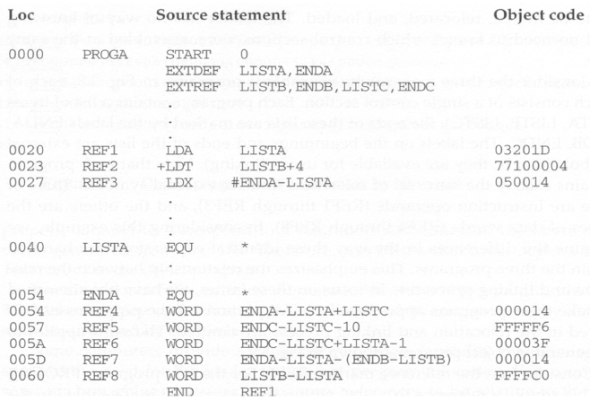
Program Linking Example ‐ PROGA
Systems Programming - V 3.0

Slide 10
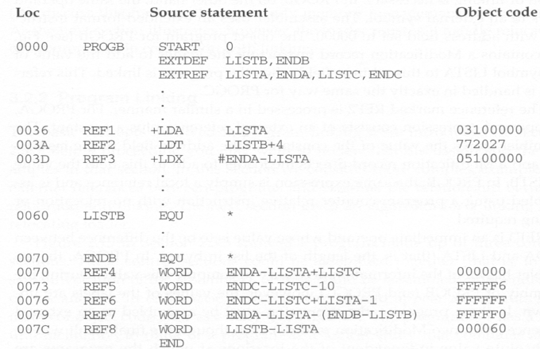
Program Linking Example ‐ PROGB
Systems Programming - V 3.0

Slide 11
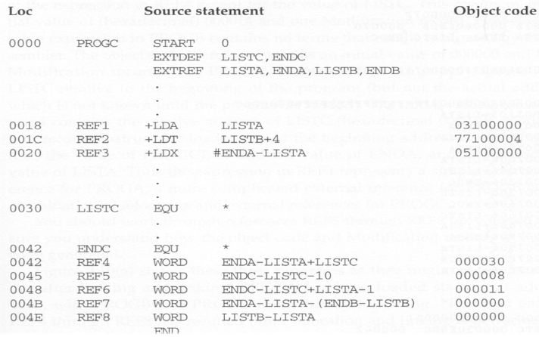
Program Linking Example ‐ PROGC
Systems Programming - V 3.0

Slide 12
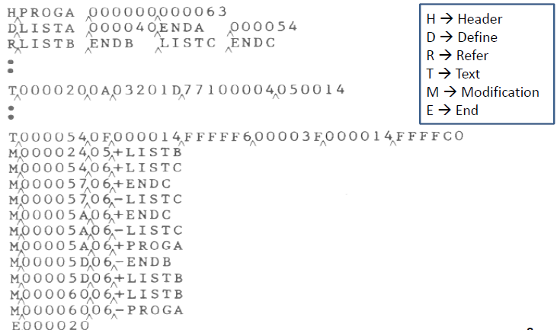
Object Program Example ‐ PROGA
Systems Programming - V 3.0

Slide 13
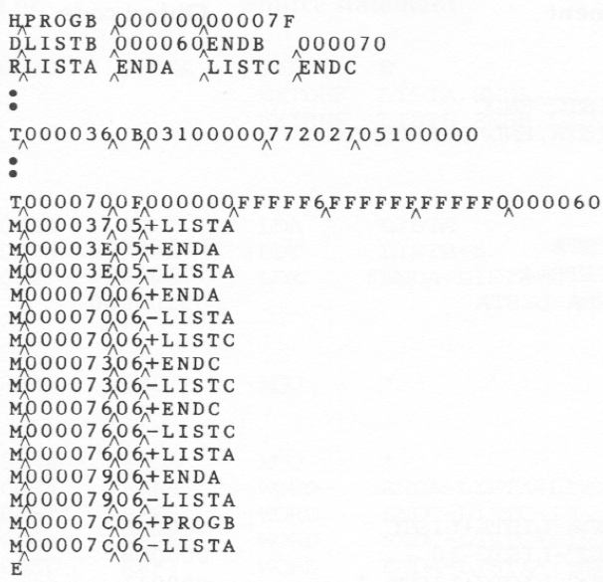
Object Program Example ‐ PROGB
Systems Programming - V 3.0

Slide 14
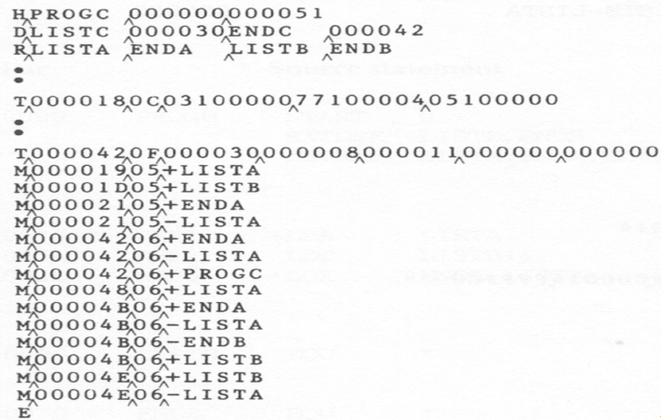
Object Program Example ‐ PROGC
Systems Programming - V 3.0

Slide 15
Program Linking Example
Notice that program A defines LISTA and ENDA,
program B defines LISTB and ENDB, and program defines LISTC and ENDC.
• Notice that the definitions of REF1, REF2, .., to REF8 in all of these three control sections are the same.
• Therefore, after these three control sections are loaded, no matter where they are loaded, the values of REF1 to REF8 in all of these programs should be the same.
Systems Programming - V 3.0

Slide 16
REF1 ‐ LISTA
Program A
– LISTA is defined in its own program and its address is
immediately available. Therefore, we can simply use program
counter‐relative addressing
• Program B
– Because LISTA is an external reference, its address is not
available now. Therefore an extended‐format instruction with
address field set to 00000 is used. A modification record in
inserted into the object code so that once LISTA’s address is
known, it can be added to this field.
• Program C
– The same as that processed in Program B.
Systems Programming - V 3.0

Slide 17
REF2 – (LISTB +4)
Program A
– Because LISTB is an external reference, its address is not
available now. Therefore an extended‐format instruction with
address field set to 00004 is used. A modification record is
inserted into the object code so that once LISTB’s address is
available, it can be added to this field.
• Program B
– LISTB is defined in its own program and its address is
immediately available. Therefore, we can simply use program
counter‐relative addressing
• Program C
– The same as that processed in Program A.
Systems Programming - V 3.0

Slide 18
REF3 – (ENDA – LISTA)
Program A
– The difference between ENDA and LISTA (14) is immediately
available during assembly.
Program B
– Because the values of ENDA and LISTA are unknown during
assembly, we need to use an extended‐format instruction with
its address field set to 0.
– Two modification records are inserted to the object program –
one for +ENDA and the other for –LISTA.
Program C
– The same as that processed in Program B.
Systems Programming - V 3.0

Slide 19
REF4 - (ENDA - LISTA + LISTC)
Program A
– The difference between ENDA and LISTA can be known now.
Only the value of LISTC is unknown. Therefore, an initial value
of 000014 is stored with one modification record for LISTC.
Program B
– Because none of ENDA, LISTA, and LISTC’s values can be
known now, an initial value of 000000 is stored with three
modification records for all of them.
Program C
– The value of LISTC is known now. However, the values for
ENDA and LISTA are unknown. An initial value of 000030 is
stored with two modification records for ENDA and LISTA.
Systems Programming - V 3.0

Slide 20
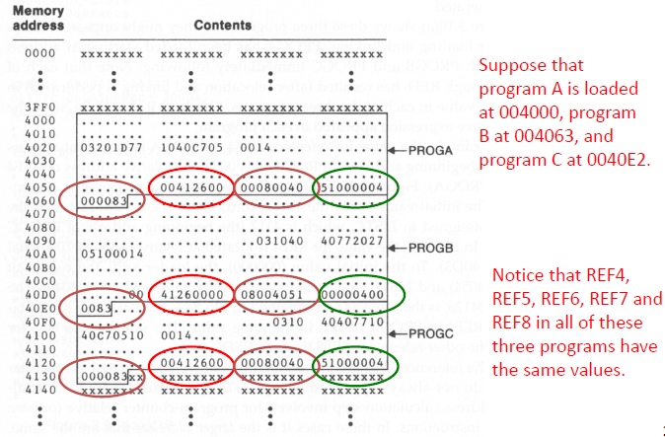
After Loading into Memory
Systems Programming - V 3.0

Slide 21
REF4 after Linking
Program A
– The value of REF4 is 004126. Why?
– REF4 = ENDA – LISTA + LISTC
– LISTA is 004000 [Program A is loaded at 004000] + 40
[relative address of LISTA in program A is 40] = 004040
– ENDA is 004000 + 54 [program A is loaded at 004000
and the relative address of ENDA within program A is 54] = 004054
– LISTC is 0040E2 [loaded address of program C] + 30
[relative address of LISTC in program C] = 004112
– REF4 = ENDA – LISTA + LISTC
= 004054 – 004040 + 004112 = 004126
Systems Programming - V 3.0

Slide 22
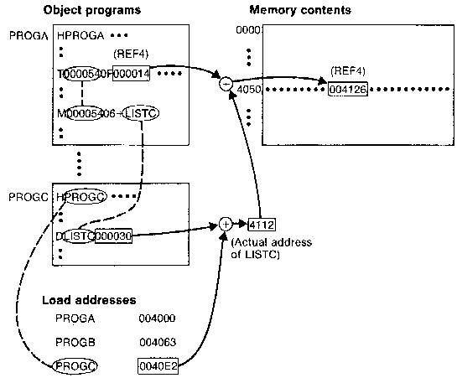
REF4 after Linking
Relocation and linking operations
performed on REF4 from PROGA
Systems Programming - V 3.0

Slide 23
REF4 after Linking
Program B
– The value of REF4 is 004126 because…
The address of LISTC is 004112
The address of ENDA is 004054
The address of LISTA is 004040
004054 + 004112 – 004040 = 004126
Systems Programming - V 3.0

Slide 24
The Implementation of a Linking Loader
A linking loader makes two passes over its input
– In pass 1: Assign addresses to external references
– In pass 2: Perform the actually loading, relocation,
and linking
ESTAB (external symbol table) – main data structure for a linking loader
•Very similar to what a two‐pass assembler does.
Systems Programming - V 3.0

Slide 25
Data Structures
External symbol table (ESTAB)
– Like SYMTAB, store the name and address of each external symbol in the set of control sections being loaded.
– It needs to indicate in which control section the symbol is defined.
• Program load address (PROGADDR)
– The beginning address in memory where the linked program is to be loaded. (given by the OS)
• Control section address (CSADDR)
– It contains the starting address assigned to the control section
currently being scanned by the loader.
– This value is added to all relative addresses within the control
sections.
Systems Programming - V 3.0

Slide 26
Algorithm
During pass 1, the loader is concerned only with HEADER and DEFINE record types in the control sections to build ESTAB.
• PROGADDR is obtained from OS.
• This becomes the starting address (CSADDR) for the first control section.
• The control section name from the header record is entered into ESTAB, with value given by CSADDR.
Systems Programming - V 3.0

Slide 27
Algorithm (Cont’d)
All external symbols appearing in the DEFINE records for the current control section are also entered into ESTAB.
• Their addresses are obtained by adding the value (offset) specified in the DEFINE to CSADDR.
• At the end, ESTAB contains all external symbols defined in the set of control sections together with the addresses assigned to each
Systems Programming - V 3.0

Slide 28
Algorithm (Cont’d)
When end record is read, control section length (CSLTH – saved from the header record) is added to CSADDR
– This calculation will give the starting address for the next control section in sequence
• A Load Map can be generated to show these symbols and their addresses.
Systems Programming - V 3.0

Slide 29
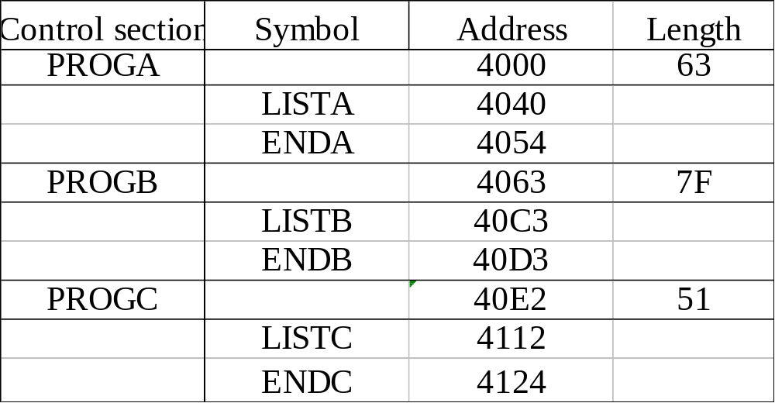
A Load Map
Systems Programming - V 3.0

Slide 30
PROGRAM LOGIC FOR PASS 1
Pass 1:
  - Assign addresses to all external symbols
Variables & Data structures
- PROGADDR (program load address) from OS
- CSADDR (control section address)
- CSLTH (control section length
- ESTAB
Systems Programming - V 3.0

Slide 31
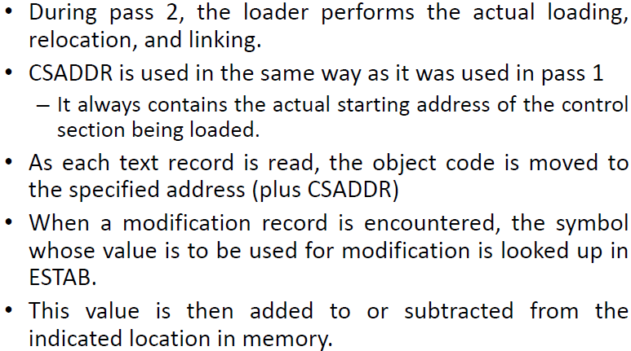
Algorithm (Cont’d)
Systems Programming - V 3.0

Slide 32
LINKING LOADERS
Object Program(s)
The source program is first assembled or compiled, producing an object program. A linking loader performs all linking and loading operations, and loads the program into memory for execution
Library
Linking loader
Memory
Processing of an Object program using LL
Systems Programming - V 3.0

Slide 33
LINKAGE EDITORS
Object Program (s)
Linkage editor
Library
Processing of an Object program using LE
Linked program
Relocating loader
Memory
Systems Programming - V 3.0

Slide 34
LINKAGE EDITORS
A linkage editor, produces a linked version of the program – often called a load module or an executable image – which is written to a file or library for later execution
The linked program produced is generally in a form that is suitable for processing by a relocating loader.
Systems Programming - V 3.0

Slide 35
SOME USEFUL FUNCTIONS…
An absolute object program can be created, if starting address is already known
New versions of the library can be included without changing the source program
Linkage editors can also be used to build packages of subroutines or other control sections that are generally used together
Linkage editors often allow the user to specify that external references are not to be resolved by automatic library search – linking will be done later by linking loader – linkage editor + linking loader – savings in space
Systems Programming - V 3.0

Slide 36
Dynamic Linking
Linkage editors perform linking before the program is loaded for execution.
Linking loaders perform these same operations at load time.
Dynamic linking postpones the linking function until execution time.
– A subroutine is loaded and linked to the test of the program when it is first called.
Systems Programming - V 3.0

Slide 37
Dynamic Linking Application
Dynamic linking is often used to allow several executing programs to share one copy of a subroutine or library.
• For example, a single copy of the standard C library can be loaded into memory.
• All C programs currently in execution can be linked to this one copy, instead of linking a separate copy into each object program.
Systems Programming - V 3.0

Slide 38
Dynamic Linking Application
In an object‐oriented system, dynamic linking is often used for references to software object.
• This allows the implementation of the object and its method to be determined at the time the program is run. (e.g., C++)
• The implementation can be changed at any time, without affecting the program that makes use of the object.
Systems Programming - V 3.0

Slide 39
Dynamic Linking Advantage
Allow several executing programs to share one copy of a subroutine or library
In an object oriented system, dynamic linking makes it possible for one object to be shared by several programs
However, without using dynamic linking, these subroutines must be loaded and linked every time the program is run.
Using dynamic linking can save both space for storing the object program on disk and in memory, and time for loading the bigger object program.
Systems Programming - V 3.0

Slide 40
Dynamic Linking Implementation
A subroutine that is to be dynamically loaded must be called via an operating system service request
– This method can also be thought of as a request to a part of the loader that is kept in memory during execution of the program
• Instead of executing a JSUB instruction to an external symbol, the program makes a load‐and call service request to the OS
• The parameter of this request is the symbolic name of the routine to be called
Systems Programming - V 3.0

Slide 41
Dynamic Linking Implementation
The OS examines its internal tables to determines whether the subroutine is already loaded.
If needed, the subroutine is loaded from the library.
Then control is passed from the OS to the subroutine being called.
When the called subroutine completes its processing, it returns to its caller (operating system).
The OS then returns control to the program that issues the request.
• After the subroutine is completed, the memory that was allocated to it may be released.
Systems Programming - V 3.0

Slide 42
Dynamic Linking Implementation
However, often this is not done immediately. If the subroutine is retained in memory, it can be used by later calls to the same subroutine without loading the same subroutine multiple
times.
Control can simply pass from the dynamic loader to the called routine directly
Systems Programming - V 3.0

Slide 43
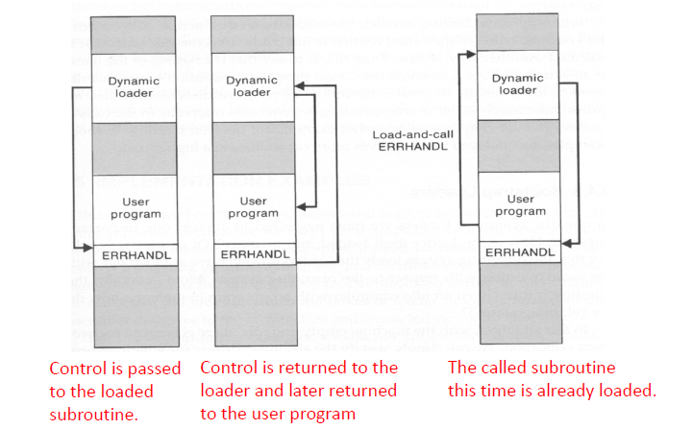
Implementation Example
Systems Programming - V 3.0

Slide 44
MS-DOS LINKER
Microsoft MS-DOS linker for Pentium and other x86 systems
Most MS-DOS compilers and assemblers (MASM) produce object modules - .OBJ files
MS-DOS LINK is a linkage editor that combines one or more object modules to produce a complete executable program - .EXE file
Systems Programming - V 3.0

Slide 45
SUNOS LINKERS
SunOS provides two different linkers – link-editor and run-time linker
Link-editor is invoked in the process of assembling or compiling a program – produces a single output module – one of the following types (next slide)
An object module contains one or more sections – representing instructions and data area from the source program, relocation and linking information, external symbol table
Systems Programming - V 3.0

Slide 46
TYPES OF OBJECT MODULE
A relocatable object module – suitable for further link-editing
A static executable – with all symbolic references bound and ready to run
A dynamic executable – in which some symbolic references may need to be bound at run time
A shared object – which provides services that can be bound at run time to one ore more dynamic executables
Systems Programming - V 3.0

Slide 47
RUN-TIME LINKER
Uses dynamic linking approach
Run-time linker binds dynamic executables and shared objects at execution time
Performs relocation and linking operations to prepare the program for execution
Systems Programming - V 3.0

Slide 48
CRAY MPP LINKER
Cray MPP (massively parallel processing ) Linker
T3E system contains large number of parallel processing elements (PEs) – Each PE has local memory and has access to remote memory (memory of other PEs)
The processing is divided among PEs - contains shared data and private data
The loaded program gets copy of the executable code, its private data and its portion of the shared data
Systems Programming - V 3.0

Slide 49
Cray MPP (massively parallel processing ) Linker
T3E system contains large number of parallel processing elements (PEs) – Each PE has local memory and has access to remote memory (memory of other PEs)
The processing is divided among PEs - contains shared data and private data
The loaded program gets copy of the executable code, its private data and its portion of the shared data
Systems Programming - V 3.0

Slide 50
PE0
PE1
PEn
Code
Code
Code
Private data
Private data
……………
Private data
Shared data-0
Shared data-1
Shared data-n
T3E program loaded on multiple PEs
Systems Programming - V 3.0

Slide 51

Systems Programming - V 3.0

Slide 52

IMP Note to Self
Systems Programming - V 3.0

