Slide 1
Data Structures and Algorithms Design
Harish Aggarwal

Slide 2
CS- 01
Algorithm Analysis

Slide 3
Contents
Introduction
Handout
Text Books, Reference Books
Marks Distribution
Algorithm Analysis
Pseudo Code
Random Access model
Time Complexity of Algorithms
Asymptotic Notations
Basic Maths Needed in the course
Question Answers

Slide 4
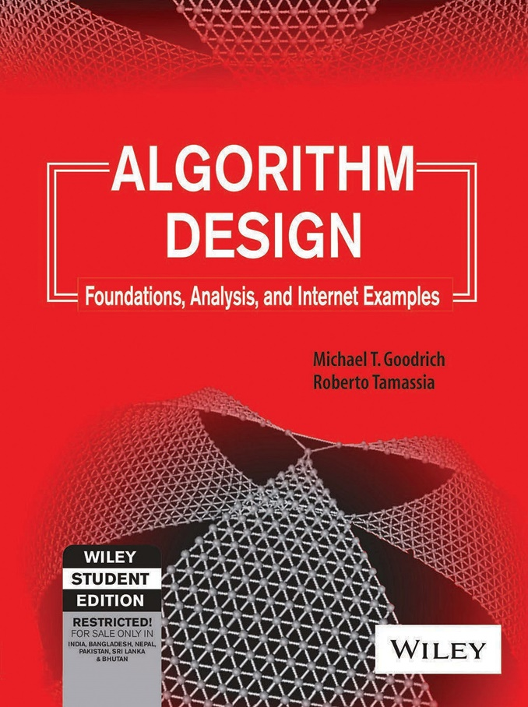
Text Book
Michael T. Goodrich and Roberto Tamassia: Algorithm Design: Foundations, Analysis and Internet examples (John Wiley &Sons, Inc., 2002)

Slide 5
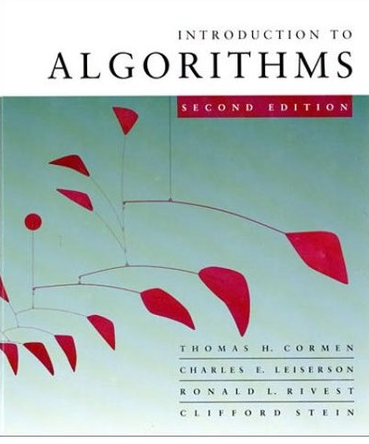




Reference Books
Also known as CLRS book

Slide 6
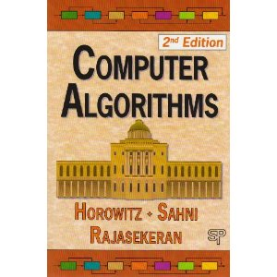
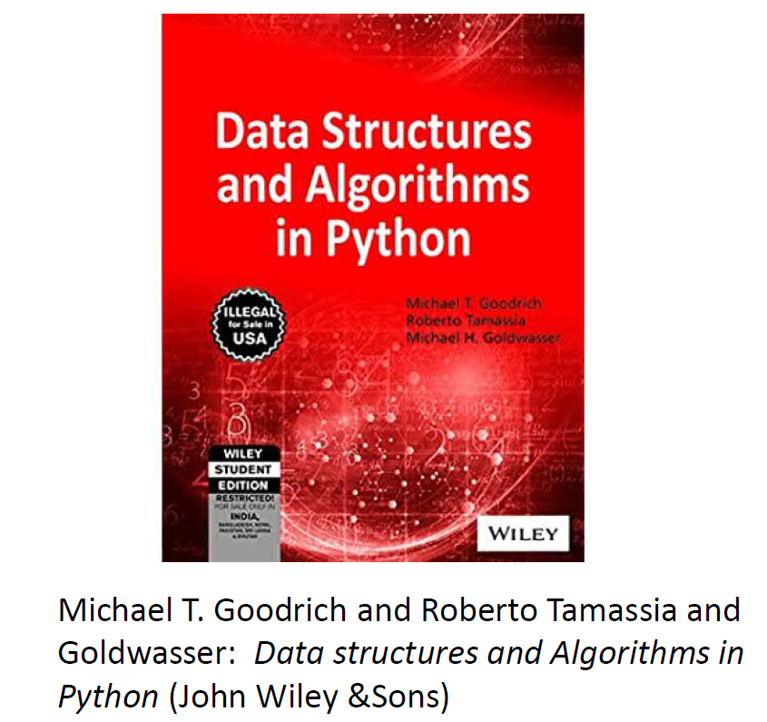
Reference Books
Ellis Horowitz, Sartaj Sahni, Sanguthevar Rajasekaran. Computer Algorithms

Slide 7
Ground Rules!
Be Regular
Be Punctual (2:00 means 2:00 (Not 02:02))
Enjoy Learning
Keep your questions for the Q&A section …
Code/Implement the problems yourself.
Have Discussions
Discuss for the sake of clarity not for the sake of proving ☺.
Communication Modes
harish.aggarwal@pilani.bits-pilani.ac.in (Preferred)
MS-Teams
e-Learn Portal

Slide 8
Algorithm Analysis
Algorithm - is a step-by-step procedure for performing some task in a finite amount of time
Data Structures - is a systematic way of organizing and accessing data, so that data can be used efficiently
Algorithms + Data Structures = Program
Analysis of any Algorithm – To Find -
Running time of Algorithm
Space Usage
Running time depends on-
Input size
Hardware Environment (processor, clock rate, memory, disk, etc.)
Software Environment (operating system, programming language, compiler, interpreter, etc.)
Algorithm design
Test Data

Slide 9
Properties of an Algorithm
Input : Each algorithm should have zero or more inputs
Output : The algorithm should produce correct results. Atleast one output has to be produced
Definiteness : Each instruction should be clear and unambiguous
Effectiveness : The instructions should be simple and should transform the given input to the desired output.
Finiteness : The algorithm must terminate after a finite sequence of instructions

Slide 10
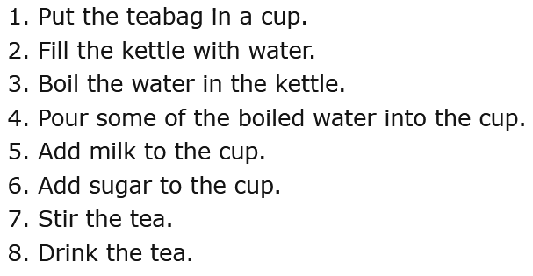
Example of an Algorithm
Let us first take an example of a real-life situation for creating algorithm. Here is the algorithm for making tea!
Some steps like 5,6 can be interchanged but some like 3,8 cannot be interchanged.

Slide 11


Algorithm Techniques – Brute Force
Brute Force Algorithms are exactly what they sound like – straightforward methods of solving a problem that rely on sheer computing power and trying every possibility rather than advanced techniques to improve efficiency.

Slide 12
Algorithm Techniques Outlook
Brute Force
Greedy Method
Knapsack
MST
Dijkstra’s
Divide & Conquer
Merge Sort
Quick Sort
Integer Multiplication Problem
Dynamic Programming
Matrix Chain Multiplication
Floyd – Warshall's
…
…

Slide 13
Algorithm Analysis
Alternate to Actually Running and finding runtime of Algorithm is – Algorithm Analysis
Algorithm Analysis can be done using Framework that –
Takes into account all possible inputs
Allows us to evaluate the relative efficiency of any two algorithms in a way that is independent from the hardware and software environment
Can be performed by studying a high-level description of the algorithm without actually implementing it or running experiments on it.
Components of Algorithm Analysis –
A language for describing algorithms
A computational model that algorithms execute within
A metric for measuring algorithm running time
An approach for characterizing running times, including those for recursive algorithms.

Slide 14
Pseudo-Code
Way to describe an Algorithm.
Not computer Program
More structured than usual Prose
Constructs of a Pseudo-Code –
Expressions: Numeric and Boolean expressions. Assignment and comparison.
Method declaration: name(param1, param2, ...).
Decision structures: If-Then-Else
While-loops.
Repeat-loops: repeat-until.
FOR-Loops -
Array indexing: A[i] represents the ith cell in the array A.
Method calls: object.method(args)
Method returns : Return value.

Slide 15
Pseudo-Code
Sample of a Pseudo-Code
Algorithm arrayMax(A, n):
Input: An array A storing n >= 1 integers.
Output: The maximum element in A.
currentMax <- A[0]
for i 1 to n — 1 do
if currentMax < A[i] then
currentMax <- A[i]
i = i+1
return currentMax

Slide 16
RAM (Random Access Machine) Model
Not Random Access Memory
Uses Primitive Operations to calculate the steps in a Pseudo-Code (Algorithm)
Primitive Operations Include
Assigning a value to a variable
Calling a method
Performing an arithmetic operation (for example, adding two numbers)
Comparing two numbers
Indexing into an array
Following an object reference
Returning from a method.

Slide 17
RAM (Random Access Machine) Model
Calculating Primitive Operations count – Example
Algorithm arrayMax(A, n):
Input: An array A storing n >= 1 integers.
Output: The maximum element in A.
currentMax <- A[0] 2 – Indexing and Assignment
for i 1 to n — 1 do 1 – Assignment first time + n-1 times comparison
if currentMax < A[i] then 2 – Indexing and comparison
currentMax <- A[i] 2 – Indexing and Assignment (Executed if match)
i = i+1 2 – Increment and assignment
return currentMax 1 - Return
Best Case –
2 + 1 + (n -1) + 4*(n-1)+1 = 5n -1
Worst Case
2 + 1 + (n – 1) + 6*(n-1)+1 = 7n-3
Average Case – Depends on Probability distribution on the set of inputs

Slide 18
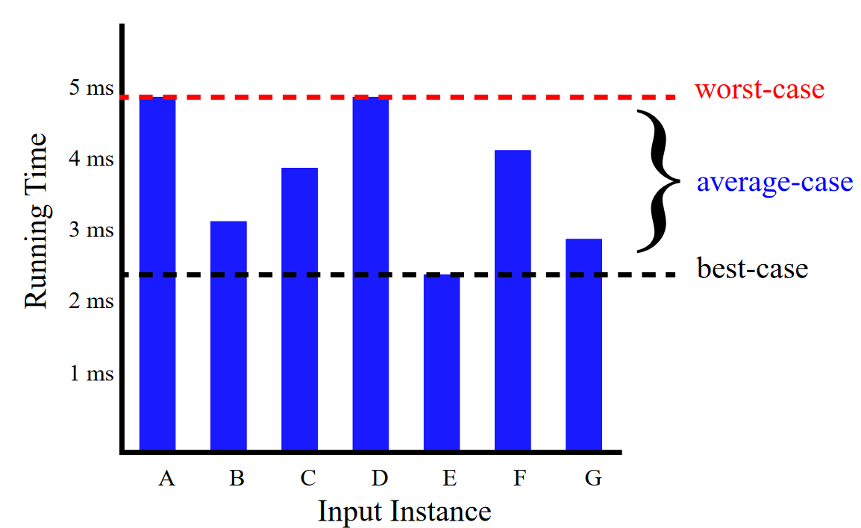
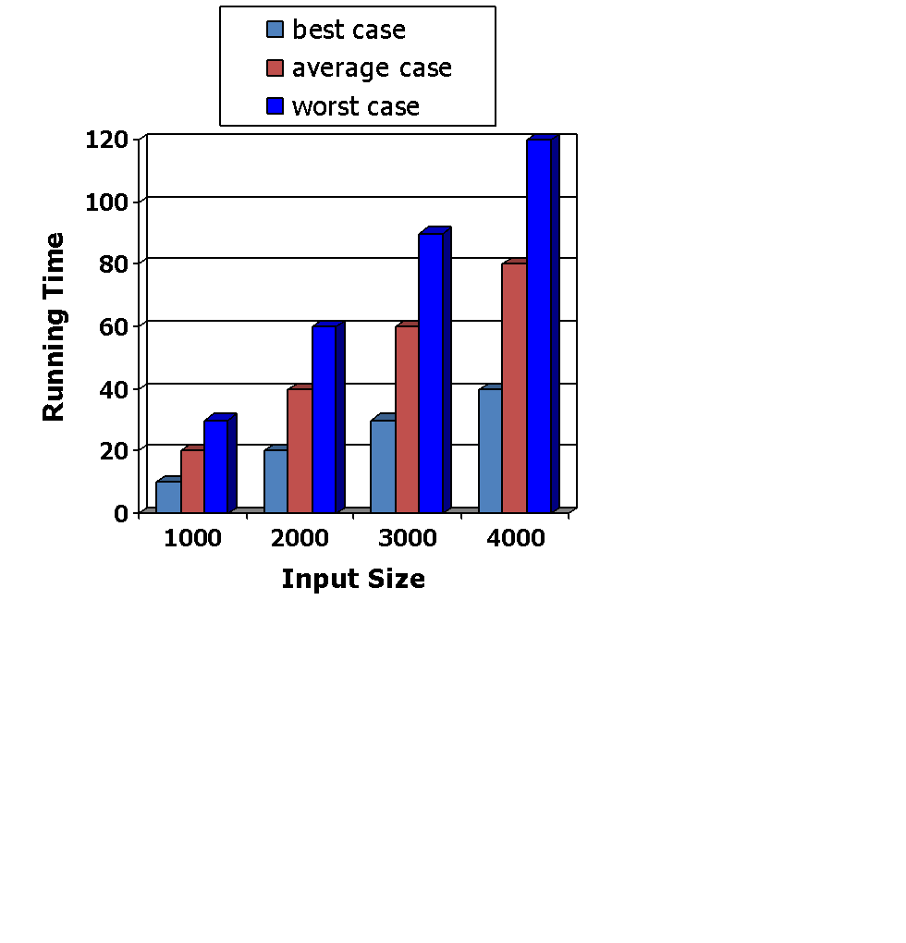
Running Time
What is best, average, worst case running of a problem?
An algorithm may run faster on certain data sets than on others.
Average case time is often difficult to determine – why?
We focus on the worst case running time.
Easier to analyze and best to bet
Crucial to applications such as games, finance and robotics
Performing well in worst case means it would perform well in normal input too!

Slide 19

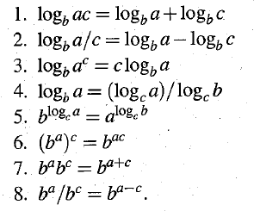
Basic Maths - Logarithms
If a, b and c are positive real numbers then
If base is 2, we can ignore writing base in Algorithm Analysis.
e.g.
Log 1024 = 10 (Base is 2 and is not mentioned. It is by default)

Slide 20
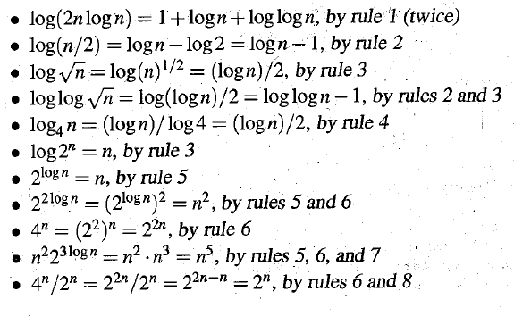
Basic Maths - Logarithms
Some interesting cases when Base is 2

Slide 21
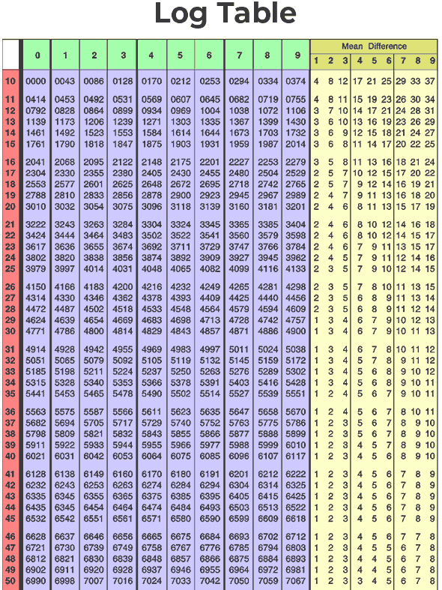
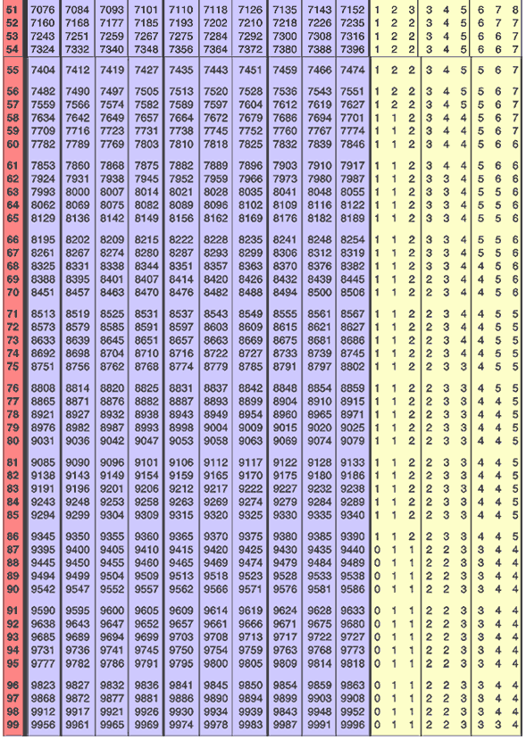
Log₁₀ 15.27 = 1 + .1818 + 20 = 1.1838
Which means 15.27 = 10^{1.1838}
Log₁₀ 152.7 = Log₁₀ 15.27 * 10
= Log₁₀ 15.27 + Log₁₀ 10
= 1 + 1 + .1818 + 20 = 2.1838
Which means 152.7 = 10^{2.1838}

Slide 22
Basic Maths - Induction
1 + 2 + 3 + 4 + ……………………………+ n = n*(n+1)/2
Can be proved by Induction -
Concept of Induction
Induction Base
Induction Hypothesis
Induction Step
Example -
Case 1: n = 2 Then 1 + 2 = 3, and n(n+1)/2 = 2(3)/2 = 3 (Induction Base)
Statement is true for case 1.
Case k: If n = k, then 1+…+ k = k(k+1)/2. (Induction Hypothesis)
When n = k + 1, then (1 + … + k) + (k + 1) (Induction Step)
= k(k+1)/2 + (k+1) = (k^2+k)/2 + 2(k+1)/2
= (k^2+k + 2(k+1)) / 2 = (k^2 + 3k + 2)/2
= ((k + 1) (k + 2))/2 = ((k + 1)(k + 1 + 1)) / 2
By induction, 1 + 2 + 3 + … + n = n (n+1)/2 for any n as a natural number.

Slide 23
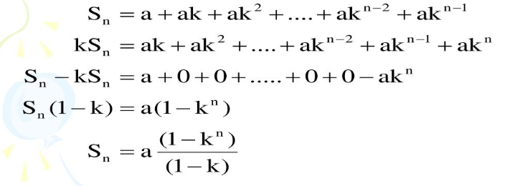

Basic Maths – Sum of GP

Slide 24
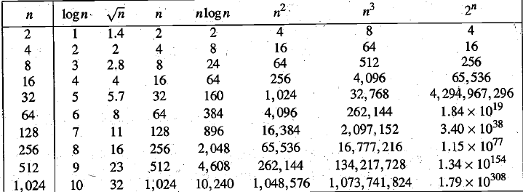
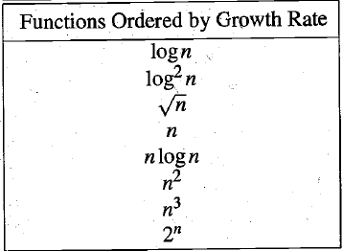
Time Complexity of Algorithms
Difference in Growth rate of functions -

Slide 25
Asymptotic Notations
Big O Notation –
“Big O notation is a mathematical notation that describes the limiting behavior of a function when the argument tends towards a particular value or infinity. It is a member of a family of notations invented by Paul Bachmann, Edmund Landau, and others, collectively called Bachmann–Landau notation or asymptotic notation.”
— Wikipedia’s definition of Big O notation
Few Examples of algorithm
Search an element in a list
Find Max element in a list
Sort a List

Slide 26
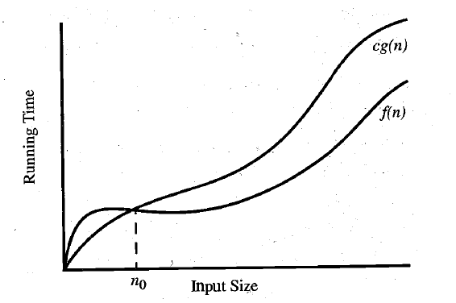
Asymptotic Notations
Big O Notation –
Let f(n) and g(n) be functions mapping nonnegative integers to real numbers. We say that f(n) is 0(g(n)) if there is a real constant c > 0 and an integer constant n₀ > 1 such that f(n) <= cg(n) for every integer n>=n₀. This definition is often referred to as the “big-Oh” notation, for it is sometimes pronounced as “f(n) is big- Oh of g(n).” Alternatively, we can also say “f(n) is order g(n).”
Let f(n) = n²/2-n/2 and g(n) = n²
n² is the Dominant term
We can find constants
c = 1 and n₀ = 0 so that f(n) <= cg(n)
for all N >= N₀

Slide 27
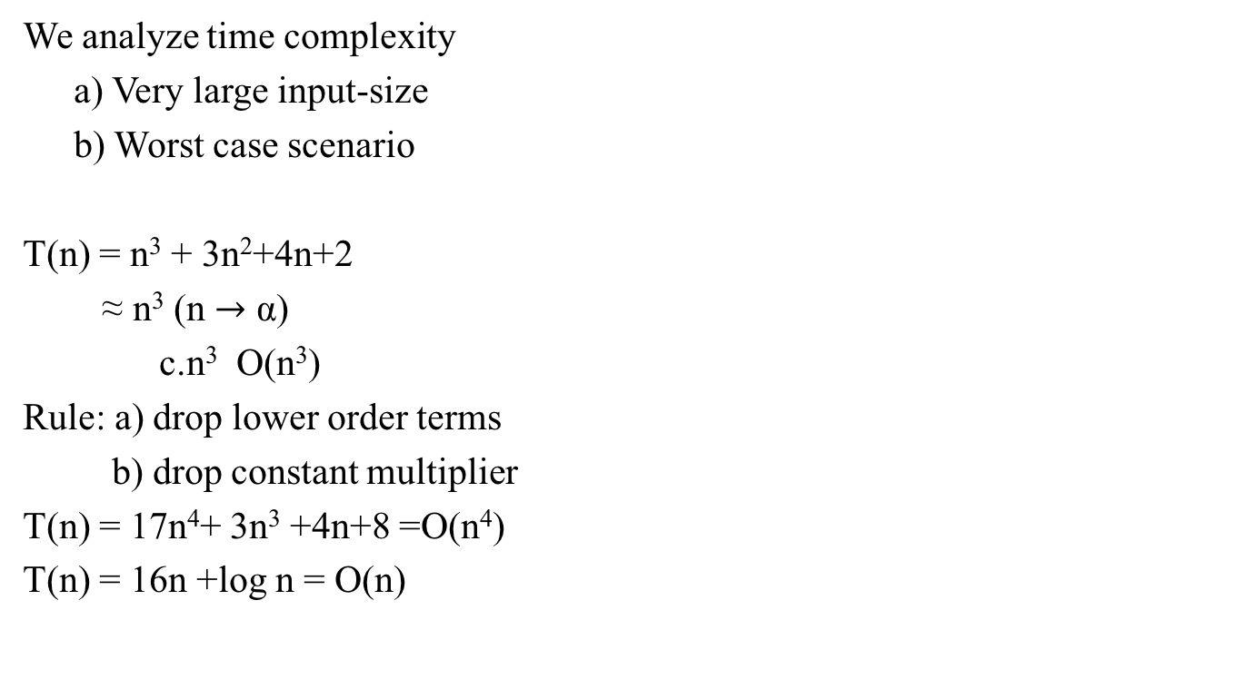
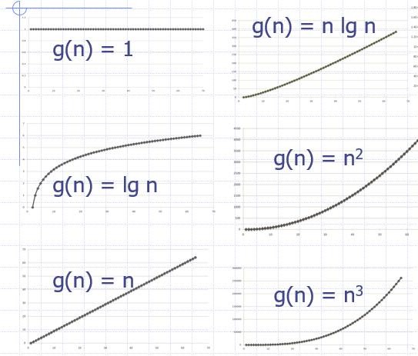
Time complexity Analysis-Some General Rules.

Slide 28
Asymptotic Notations
Big Omega Notation –
Let f(n) and g(n) be functions mapping integers to real numbers. We say that f(n) is Ω(g(n)) (pronounced “f(n) is big-Omega of g(n)”) if g(n) is 0(f(n)); that is, there is a real constant c > 0 and an integer constant n0>=1 such that f(n) > cg(n), for n >= n0. This definition allows us to say asymptotically that one function is greater than or equal to another, up to a constant factor.
Big –Theta
Likewise, we say that f(n) is Θ(g(n)) (pronounced “f(n) is big-Theta of g(n)”) if f(n) is O(g(n)) and f(n) is Ω(g(n)); that is, there are real constants c’ > 0 and c” > 0, and an integer constant n0 such that c’g(n) <= f(n) <= c"g(n), for n >= n0
The big-Theta allows us to say that two functions are asymptotically equal, up to a constant factor.

Slide 29
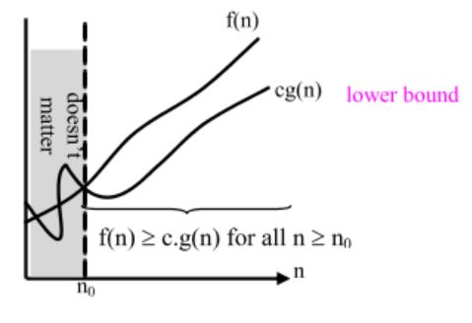
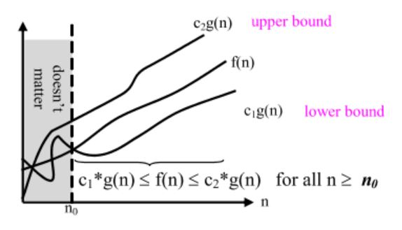
Asymptotic Notations
Big Omega Big –Theta

Slide 30
Asymptotic Notations
Big O: “f(n) is O(g(n))” iff for some constants c and N₀, f(N) ≤ cg(N) for all N > N₀
Omega: “f(n) is Ω(g(n))” iff for some constants c and N₀, f(N) ≥ cg(N) for all N > N₀
Theta: “f(n) is Θ(g(n))” iff f(n) is O(g(n)) and f(n) is Ω(g(n))
Little O: “f(n) is o(g(n))” iff f(n) is O(g(n)) and f(n) is not Θ(g(n))
—Formal Definition of Big O, Omega, Theta and Little O
In plain words:
Big O (O()) describes the upper bound of the complexity.
Omega (Ω()) describes the lower bound of the complexity.
Theta (Θ()) describes the exact bound of the complexity.
Little O (o()) describes the upper bound excluding the exact bound.

Slide 31
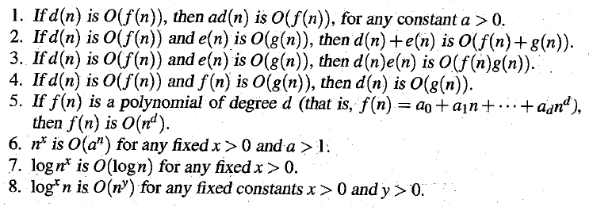
Asymptotic Notations
Let d(n), e(n), f(n), and g(n) be functions mapping nonnegative integers to nonnegative reals. Then

Slide 32
Additional Reading
Appendix

Slide 33

Asymptotic Notations
Little Oh Notation –
f(n) = o(g(n)) means for all c > 0 there exists some k > 0 such that 0 ≤ f(n) < cg(n) for all n ≥ k. The value of k must not depend on n, but may depend on c.
Means f(n) becomes insignificant relative to g(n) as n approaches infinity. The notation is read, "f of n is little oh of g of n".
Strict Upper Bound (Not asymptotically tight bound)
f(n) is o g(n)) if and only if
provided this limit exists.
The main difference between the little-oh and big-Oh notions is that
- f(n) is 0(g(n)) if there exist constants c > 0 and n₀>= 1 such that f(n) <= cg(n), for n >= n₀;
- whereas f(n) is o(g(n)) if for all constants c>0 there is a constant n₀ such that f(n) <= cg(n), for n>=n₀.

