Slide 1
Data Structures and Algorithms Design
Harish Aggarwal

Slide 2
List, Stack and Queues

Slide 3
Re-Cap
Lecture-01
Introduction
Handout
Text Books, Reference Books
Marks Distribution
Algorithm Analysis
Pseudo Code
Random Access model
Time Complexity of Algorithms
Asymptotic Notations
Basic Maths Needed in the course

Slide 4
Agenda
ADT – General Definition
ADT ; Array and Linked List Implementation
List
Stack
Queue
Stack Examples
Evaluation of Postfix Expression
Infix to Postfix conversion
Insertion and Deletion of Node
In Singly Linked List
In Doubly Linked List

Slide 5
Abstract Data Type
Abstract Data Type
In computer science, an abstract data type (ADT) is a mathematical model for a certain class of data structures that have similar behavior.
A method for achieving abstraction for data structures and algorithms
ADT = model + operations
Describes what each operation does, but not how it does it
An ADT is independent of its implementation
Typical operations on data
Add data to a data collection
Remove data from a data collection
Ask questions about the data in a data collection
Data abstraction
Asks you to think what you can do to a collection of data independently of how you do it
Allows you to develop each data structure in relative isolation from the rest of the solution
A natural extension of procedural abstraction

Slide 6
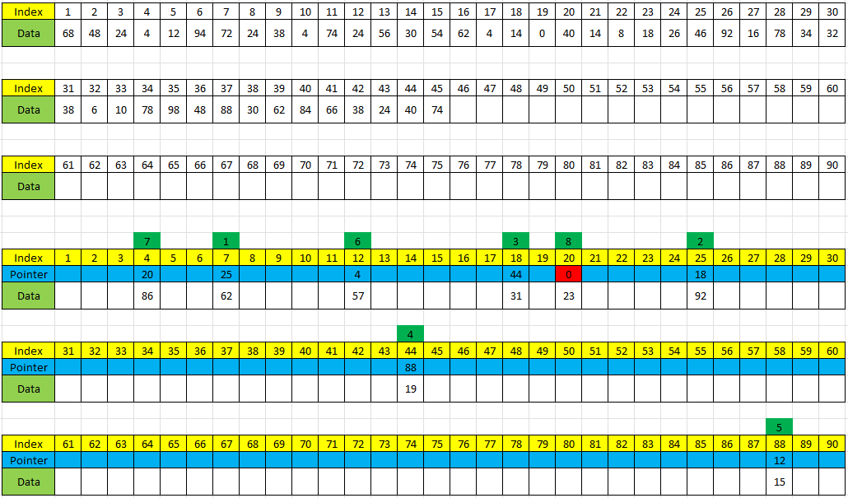
Lists

Slide 7
Lists
List Operations -
Create a linear list.
Destroy a linear list.
Determine whether the list is empty.
Determine the size of the list.
Find the element with a given index.
Find the index of a given element.
Delete, erase or remove an element given its index.
Insert a new element so that it has a given index.
Increasing the size of Array –
Double as and when listSize is greater than arrayLength
If array length is always increased by 1, time spent in increasing the array length O(n^2)
If array length is doubled then time spent in increasing the array length O(n)
Half when listSize < arrayLength/4

Slide 8
Lists (ADT)
AbstractDataType linearList
{
instances
ordered finite collections of zero or more elements
operations
empty() : return true if the list is empty, false otherwise
size() : return the list size (ie., number of elements in the list)
get(index) : return the indexth element of the list
indexOf(x) : return the index of the first occurrence of x in the list,
return —1 if x is not in the list
erase(index) : remove 'delete the indexth element, elements with higher
index have their index reduced by 1
insert(index, x) : insert x as the indexth element, elements with index > index
have their index increased by 1
output() : output the list elements from left to right
}

Slide 9
LinearLists (Abstract class Spec)
template<class T>
class linearList
{
public:
virtual ~linearList() {};
virtual bool empty() const = 0;
// return true iff list is empty
virtual int size() const = 0;
// return number of elements in list
virtual T& get(int theIndex) const = 0;
// return element whose index is theIndex
virtual int indexOf(const T& theElement) const = 0;
// return index of first occurence of theElement
virtual void erase(int theIndex) = 0;
// remove the element whose index is theIndex
virtual void insert(int theIndex, const T& theElement) = 0;
// insert theElement so that its index is theIndex
virtual void output(ostream& out) const = 0;
// insert list into stream out
};

Slide 10
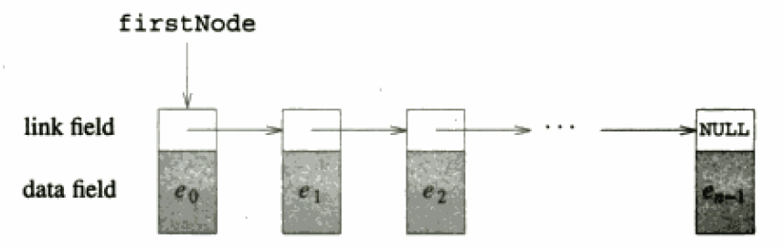
Linked Lists
Linked Representation
Chains, Circular Lists and doubly linked lists
Add an element
First, Middle, Last
Remove an element
First, Middle, Last

Slide 11
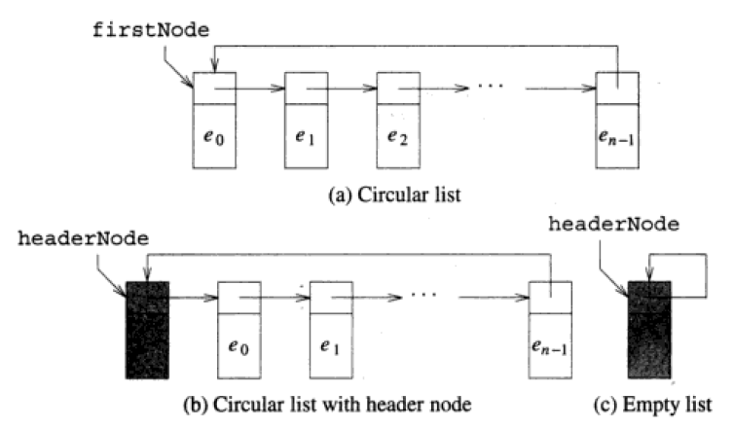
Circular Lists and Header Nodes

Slide 12
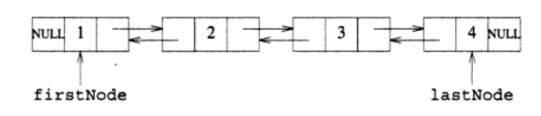
Doubly Linked Lists
Add an element
First, Middle, Last
Remove an element
First, Middle, Last

Slide 13
Doubly Linked Lists (Add a Node)
We visualize operation insertAfter(p, X), which returns position v
p
A
B
C
p
A
B
v
C
X
p
v
A
B
X
C

Slide 14
Doubly Linked Lists (Add a Node)
Algorithm insertAfter(p,e):
Create a new node v
v.setElement(e)
v.setPrev(p) {link v to its predecessor}
v.setNext(p.getNext()) {link v to its successor}
(p.getNext()).setPrev(v) {link p’s old successor to v}
p.setNext(v) {link p to its new successor, v}
return v {the position for the element e}
p
A
B
v
C
e

Slide 15
Doubly Linked Lists (Delete a Node)
We visualize remove(p), where p == last()
p
A
B
C
D
A
B
C
p
D
A
B
C

Slide 16
Doubly Linked Lists (Delete a Node)
Algorithm remove(p):
t = p.element {a temporary variable to hold the return value}
(p.getPrev()).setNext(p.getNext()) {linking out p}
(p.getNext()).setPrev(p.getPrev())
p.setPrev(null) {invalidating the position p}
p.setNext(null)
return t
p
A
B
C
D

Slide 17
Stack
A stack is a container of objects that are inserted and removed according to the last-in-first-out (LIFO) principle.
Objects can be inserted at any time, but only the last (the most-recently inserted) object can be removed.
Inserting an item is known as “pushing” onto the stack. “Popping” off the stack is synonymous with removing an item
Example –
Paper Tray on Printer
Stack of Trays in Cafeteria
Recursion in Computer Programming
Applications of Stack -
Match Left and Right parenthesis in an expression
Towers of Hanoi
Shunting Tracks in a RailRoad
Computer Aided Design of Circuits Field
Rat in a Maze Problem

Slide 18
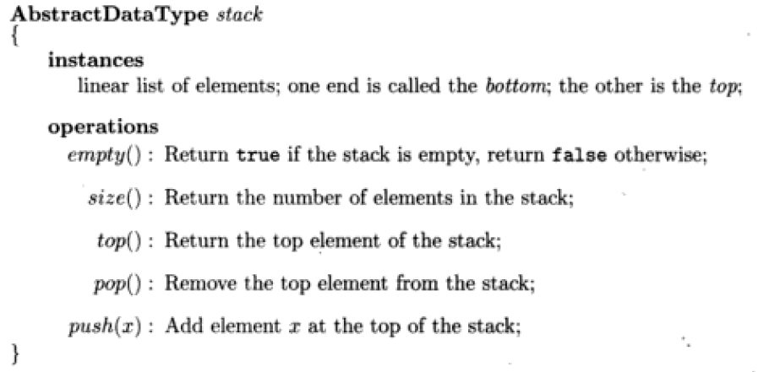
Stack (ADT)
** Can be implemented using Array linear List with some conditions

Slide 19
Stack (Abstract Class)
template<class T>
class stack
{
public:
virtual ~stack() {}
virtual bool empty() const = 0;
// return true iff stack is empty
virtual int size() const = 0;
// return number of elements in stack
virtual T& top() = 0;
// return reference to the top element
virtual void pop() = 0;
// remove the top element
virtual void push(const T& theElement) = 0;
// insert theElement at the top of the stack
};

Slide 20
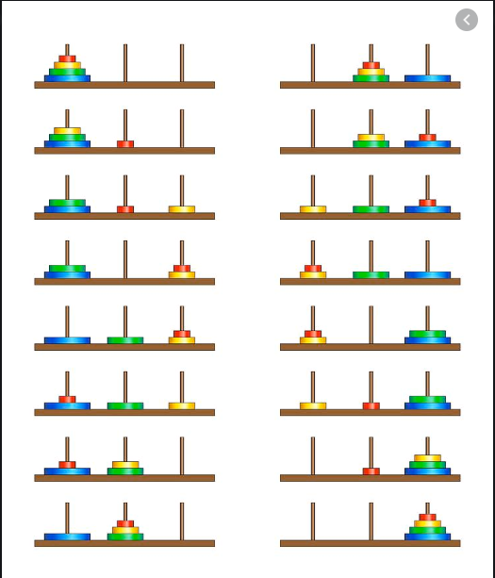
Stack - Applications
Match Left and Right parenthesis in an expression
Match Left and Right parenthesis in a string
(a+b+c)+d)
[4*{4-(9-0)}]
Evaluate AB+C-BA+C^ where A=1,B=2 and C=3 (Answer 27)
Towers of Hanoi

Slide 21
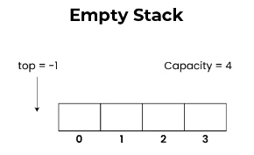
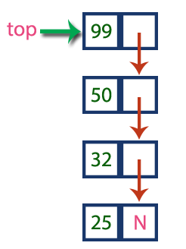
Stack –
Array and Linked implementation

Slide 22
Applications of Stack
Stacks can be used for expression evaluation. [In class]
Stacks can be used for Conversion from one form of expression to another.
Stacks can be used to check parenthesis matching in an expression.
Stack data structures are used in backtracking problems (recursion).

Slide 23
Forms of Expression
Arithmetic expressions can be written in 3 different forms or notations :
Infix Notation : Notation in which the operator symbol is placed in between its operands. Ex : A + B , C – D , A * D etc.
Pre-fix Notation : It is also called as Polish notation and refers to the notation in which the operator symbol is placed before its operands (when operator precedes the operands). Ex : +AB, -CD, *AD etc.
Post-fix Notation : It is also called as reverse polish notation and refers to the notation in which the operator symbol is placed after its operands (when operator follows the operands). Ex : AB+ , CD- , AD*

Slide 24
Algorithm: Evaluation of Postfix expression using Stack
Algorithm:
1) Add a right parentheses “)” at the end of the arithmetic expression F
2) Scan F from left to right and repeat step 3 and step 4 for each element of F until the sentinel “)” is encountered.
3) If an operand is encountered, put it onto stack
4) If an operator is encountered, then :
a. Remove the 2 top elements from the stack, where n1 is the top element and n2 is the next-to-top element.
b. Evaluate n2 n1
c. Place the result of (b) back on stack.
Endif
End of step 2 loop
5) Set value equal to the top element of stack.
6) Exit
X
X
X
: is any operator

Slide 25
Example: Evaluation of Postfix expression using stack
Evaluate AB+C-BA+C^- where A=1,B=2 and C=3
➔ 1 2 + 3 – 2 1 + 3 ^ - )
Symbol Encountered | N1 (top) | N2(2nd top) | Value = N2 op N1 | STACK
1 |  |  |  | 1
2 |  |  |  | 1 2
+ | 2 | 1 | 1+2 = 3 | 3
3 |  |  |  | 3 3
- | 3 | 3 | 3 -3 = 0 | 0
2 |  |  |  | 0 2
1 |  |  |  | 0 2 1
+ | 1 | 2 | 2+1 = 3 | 0 3
3 |  |  |  | 0 3 3
^ | 3 | 3 | 3^3 = 27 | 0 27
- | 27 | 0 | 0 – 27 = -27 | -27
) | - | - | -27 | Empty
Hence, the evaluation of this expression leads to the answer -27

Slide 26
Exercises
Evaluate the following postfix expressions :
ABC+*CBA-+* where A=1,B=2 and C=3
5 7 5 - * 12 4 * 24 / 6 + +
After you solve it, verify your answer by putting the postfix expression in this tool https://www.free-online-calculator-use.com/postfix-evaluator.html

Slide 27
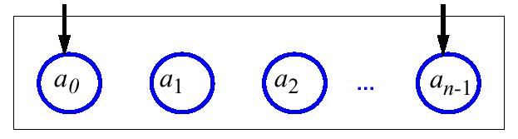
Queues
A queue differs from a stack in that its insertion and removal routines follows the first-in-first-out (FIFO) principle.
Elements may be inserted at any time, but only the element which has been in the queue the longest may be removed.
Elements are inserted at the rear (enqueued) and removed from the front (dequeued)
Example –
Queue to buy Cinema Hall Tickets
Queue to get Food in Cafeteria
Used in CPU scheduling
Used in Disk scheduling
Applications of Stack -
Shunting Tracks in a RailRoad
Shortest Path of a Wire that is to connect two given points (Rat in a Maze Problem)
Label the pixels of a binary image so that two pixels have the same label iff they are part of the same image component.
Machine Shop Simulation

Slide 28
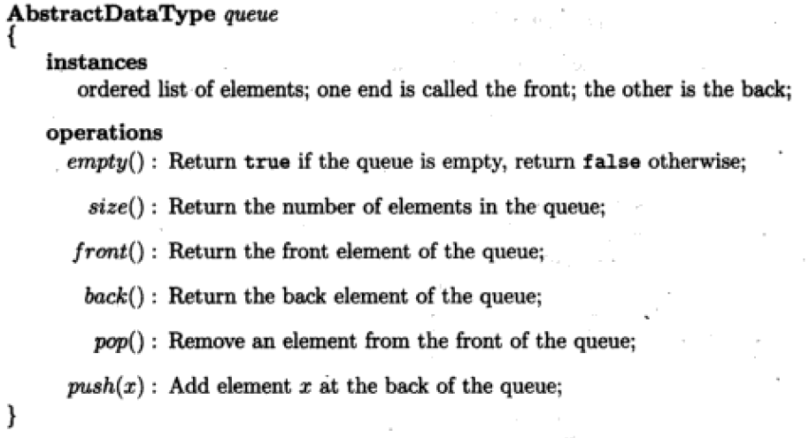
Queue (ADT)

Slide 29
Queue (Abstract Class)
template<class T>
class queue
{
public:
virtual ~queue() {}
virtual bool empty() const = 0;
// return true iff queue is empty
virtual int size() const = 0;
// return number of elements in queue
virtual T& front() = 0;
// return reference to the front element
virtual T& back() = 0;
// return reference to the back element
virtual void pop() = 0;
// remove the front element
virtual void push(const T& theElement) = 0;
// add theElement at the back of the queue
};

Slide 30
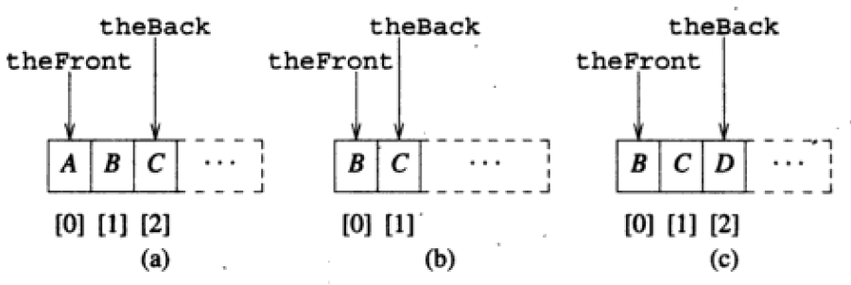

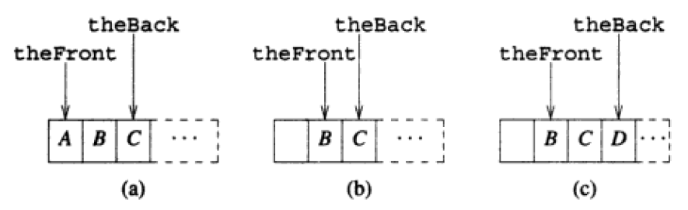
Queue (Array Representation)
queueFront = 0, size= queueBack+1
Empty queue : queueBack=-1
Shifting is need each time an element is deleted from front
queueFront = location(front element)
queueBack=location(last element)
Empty Queue :
queueBack < queueFront
Shifting is need each time an element is deleted from front

Slide 31
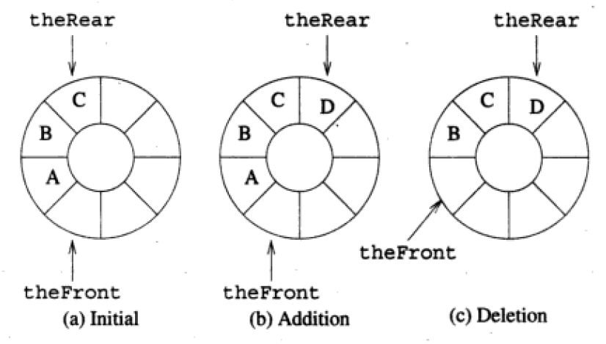
Queue (Array Representation)
Empty queue : queueFront=queueBack
Initially queueFront=queueBack=0
Always keep one space empty pointed by queueFront.
Increase arrayLength if queue becomes full

Slide 32
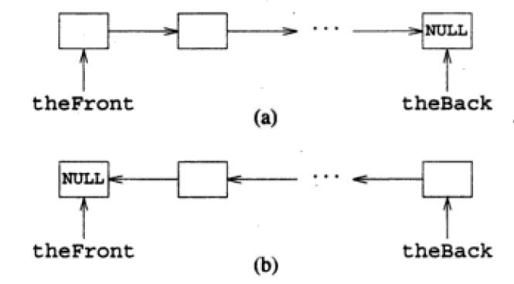
Queue (Linked Representation)
Any Linkage can be used. Front-to-Back or Back-To-Front
Front-to-Back is more efficient for pops.
Initially – queueFront=queueBack=NULL
queueFront=NULL iff queue is Empty

Slide 33
Additional Reading
Appendix

Slide 34
Appendix : Forms of Expression
Examples :
The computer usually evaluates an arithmetic expression in infix notation in 2 steps. First, it converts the expression to postfix notation, and then it evaluates the postfix expression. In both these steps, the stack is used !! Let us examine how stack is used ☺
# | Infix | Prefix | Postfix
1 | (A+B) * C | *+ABC | AB+C*
2 | A + ( B * C ) | +A*BC | ABC*+
3 | A ^ B * C – D | - * ^ ABCD | AB ^ C * D -
4 | (A+B)/(C-D) | /+AB-CD | AB+CD-/

Slide 35
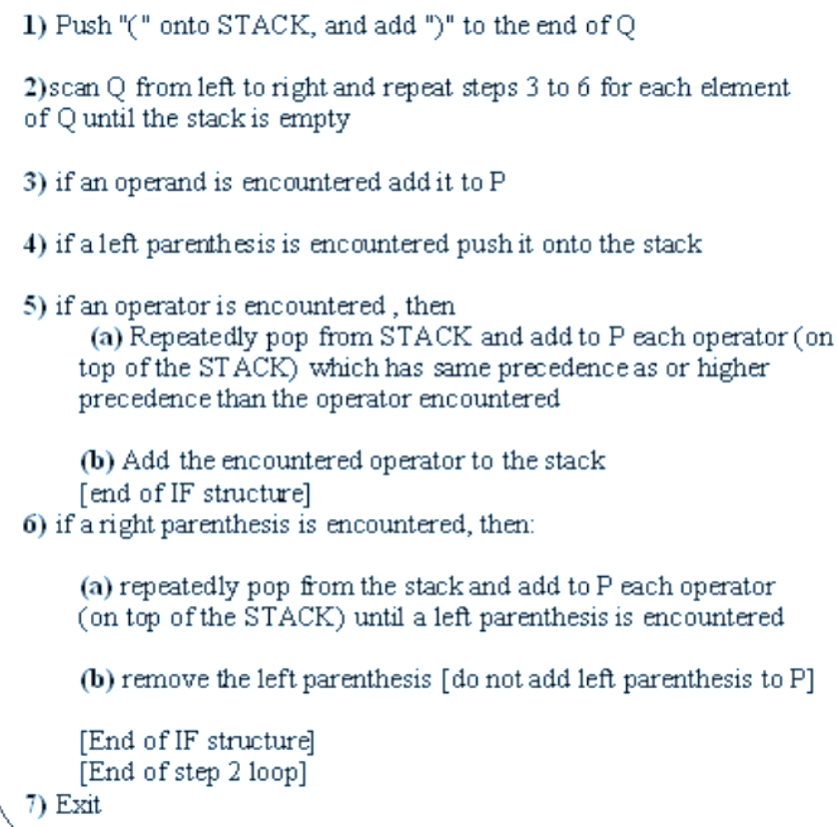
Appendix : Algorithm: Infix to Postfix using Stack
The following algorithm transforms the infix expression Q into its equivalent postfix expression P.

Slide 36
Appendix : Example : Converting Infix to Postfix using Stack
Consider the infix expression Q to be A + B * C → A+B*C)
Hence, the postfix expression P is ABC*+
# | Symbol Encountered | Postfix String P (Output) | STACK Contents
1 |  |  | (
2 | A | A | (
3 | + | A | (+
4 | B | AB | (+
5 | * | AB | (+*
6 | C | ABC | (+*
7 | ) | ABC* | (+
8 | - | ABC*+ | (
9 | - | ABC*+ | Empty

Slide 37
Appendix : Example : Converting Infix to Postfix using Stack
Consider the infix expression Q to be (A+B) * C ➔ (A+B) * C )
Hence, the postfix expression P is AB+C*
# | Symbol Encountered | Postfix String P (Output) | STACK Contents
1 |  |  | (
2 | ( |  | ((
3 | A | A | ((
4 | + | A | ((+
5 | B | AB | ((+
6 | ) | AB+ | (
7 | * | AB+ | (*
8 | C | AB+C | (*
9 | ) | AB+C* | Empty
10 | - | AB+C* | Empty

Slide 38
Appendix Exercise
1) Convert the following infix expressions into postfix
expressions using stack ( trace it as we did in class ) :
A+(B+C)*D
B+C-D/E*F
(A+B)+(C/D)*E
A+B*(C+D-E)*F
After you solve it, verify your answer by putting the infix expression in this tool : https://www.mathblog.dk/tools/infix-postfix-converter/

Slide 39
Stack (Abstract Class)
template<class T>
class stack
{ // Stack Definition
public:
virtual ~stack() {}
virtual bool empty() const = 0;
// return true iff stack is empty
virtual int size() const = 0;
// return number of elements in stack
virtual T& top() = 0;
// return reference to the top element
virtual void pop() = 0;
// remove the top element
virtual void push(const T& theElement) = 0;
// insert theElement at the top of the stack
};

Slide 40
derivedArrayStack (Definition)
template<class T>
class arrayList : public linearList<T>
{ // Array List Definition
public:
// constructor, copy constructor and destructor
arrayList(int initialCapacity = 10);
arrayList(const arrayList<T>&);
~arrayList() {delete [] element;}
// ADT methods
bool empty() const {return listSize == 0;}
int size() const {return listSize;}
T& get(int theIndex) const;
int indexOf(const T& theElement) const;
void erase(int theIndex);
void insert(int theIndex, const T& theElement);
void output(ostream& out) const;
// additional method
int capacity() const {return arrayLength;}
protected:
void checkIndex(int theIndex) const;
// throw illegalIndex if theIndex invalid
T* element; // 1D array to hold list elements
int arrayLength; // capacity of the 1D array
int listSize; // number of elements in list
};
template<class T>
class derivedArrayStack : private arrayList<T>,
public stack<T>
{
public:
derivedArrayStack(int initialCapacity = 10)
: arrayList<T> (initialCapacity) {}
bool empty() const
{return arrayList<T>::empty();}
int size() const
{return arrayList<T>::size();}
T& top()
{
if (arrayList<T>::empty())
throw stackEmpty();
return get(arrayList<T>::size() - 1);
}
void pop()
{
if (arrayList<T>::empty())
throw stackEmpty();
erase(arrayList<T>::size() - 1);
}
void push(const T& theElement)
{insert(arrayList<T>::size(), theElement);}
};
**

Slide 41
arrayStack (Definition)
template<class T>
class arrayStack : public stack<T>
{ // Array Stack Definition
public:
arrayStack(int initialCapacity = 10);
~arrayStack() {delete [] stack;}
bool empty() const {return stackTop == -1;}
int size() const
{return stackTop + 1;}
T& top()
{
if (stackTop == -1)
throw stackEmpty();
return stack[stackTop];
}
void pop()
{
if (stackTop == -1)
throw stackEmpty();
stack[stackTop--].~T(); // destructor for T
}
void push(const T& theElement);
private:
int stackTop; // current top of stack
int arrayLength; // stack capacity
T *stack; // element array
};
template<class T>
arrayStack<T>::arrayStack(int initialCapacity)
{ // Array Stack Constructor.
if (initialCapacity < 1)
{ostringstream s;
s << "Initial capacity = " << initialCapacity << " Must be > 0";
throw illegalParameterValue(s.str());
}
arrayLength = initialCapacity;
stack = new T[arrayLength];
stackTop = -1;
}
template<class T>
void arrayStack<T>::push(const T& theElement)
{ // Array Stack Push. Add theElement to stack.
if (stackTop == arrayLength - 1)
{// no space, double capacity
changeLength1D(stack, arrayLength, 2 * arrayLength);
arrayLength *= 2;
}
// add at stack top
stack[++stackTop] = theElement;
}

Slide 42
linkedStack (Definition)
template<class T>
class linkedStack : public stack<T>
{ // Linked Stack Definition
public:
linkedStack(int initialCapacity = 10)
{stackTop = NULL; stackSize = 0;}
~linkedStack();
bool empty() const
{return stackSize == 0;}
int size() const
{return stackSize;}
T& top()
{
if (stackSize == 0)
throw stackEmpty();
return stackTop->element;
}
void pop();
void push(const T& theElement)
{
stackTop = new chainNode<T>(theElement, stackTop);
stackSize++;
}
private:
chainNode<T>* stackTop; // pointer to stack top
int stackSize; // number of elements in stack
};
template<class T>
linkedStack<T>::~linkedStack()
{ // Linked Stack Destructor.
while (stackTop != NULL)
{// delete top node
chainNode<T>* nextNode = stackTop->next;
delete stackTop;
stackTop = nextNode;
}
}
template<class T>
void linkedStack<T>::pop()
{ // Linked Stack Pop. Delete top element.
if (stackSize == 0)
throw stackEmpty();
chainNode<T>* nextNode = stackTop->next;
delete stackTop;
stackTop = nextNode;
stackSize--;
}

Slide 43
arrayLists (Class Definition)
template<class T>
class arrayList : public linearList<T>
{ // Array List Definition
public:
// constructor, copy constructor and destructor
arrayList(int initialCapacity = 10);
arrayList(const arrayList<T>&);
~arrayList() {delete [] element;}
// ADT methods
bool empty() const {return listSize == 0;}
int size() const {return listSize;}
T& get(int theIndex) const;
int indexOf(const T& theElement) const;
void erase(int theIndex);
void insert(int theIndex, const T& theElement);
void output(ostream& out) const;
// additional method
int capacity() const {return arrayLength;}
protected:
void checkIndex(int theIndex) const;
// throw illegalIndex if theIndex invalid
T* element; // 1D array to hold list elements
int arrayLength; // capacity of the 1D array
int listSize; // number of elements in list
};

Slide 44
arrayLists (Class Constructors)
template<class T>
arrayList<T>::arrayList(int initialCapacity)
{ // Constructor.
if (initialCapacity < 1)
{ostringstream s;
s << "Initial capacity = " << initialCapacity << " Must be > 0";
throw illegalParameterValue(s.str());
}
arrayLength = initialCapacity;
element = new T[arrayLength];
listSize = 0;
}
template<class T>
arrayList<T>::arrayList(const arrayList<T>& theList)
{ // Copy constructor.
arrayLength = theList.arrayLength;
listSize = theList.listSize;
element = new T[arrayLength];
copy(theList.element, theList.element + listSize, element);
}

Slide 45
arrayLists (Method Implementation)
template<class T>
void arrayList<T>::checkIndex(int theIndex) const
{// Verify that theIndex is between 0 and listSize - 1.
if (theIndex < 0 || theIndex >= listSize)
{ostringstream s;
s << "index = " << theIndex << " size = " << listSize;
throw illegalIndex(s.str());
}
}
template<class T>
T& arrayList<T>::get(int theIndex) const
{// Return element whose index is theIndex.
// Throw illegalIndex exception if no such element.
checkIndex(theIndex);
return element[theIndex];
}
template<class T>
int arrayList<T>::indexOf(const T& theElement) const
{// Return index of first occurrence of theElement.
// Return -1 if theElement not in list.
// search for theElement
int theIndex = (int) (find(element, element + listSize, theElement)
- element);
// check if theElement was found
if (theIndex == listSize)
// not found
return -1;
else return theIndex;
}

Slide 46
arrayLists (Method Implementation)
template<class T>
void arrayList<T>::erase(int theIndex)
{// Delete the element whose index is theIndex.
// Throw illegalIndex exception if no such element.
checkIndex(theIndex);
// valid index, shift elements with higher index
copy(element + theIndex + 1, element + listSize,
element + theIndex);
element[--listSize].~T(); // invoke destructor
}
template<class T>
void arrayList<T>::insert(int theIndex, const T& theElement)
{// Insert theElement so that its index is theIndex.
if (theIndex < 0 || theIndex > listSize)
{// invalid index
ostringstream s;
s << "index = " << theIndex << " size = " << listSize;
throw illegalIndex(s.str());
}
// valid index, make sure we have space
if (listSize == arrayLength)
{// no space, double capacity
changeLength1D(element, arrayLength, 2 * arrayLength);
arrayLength *= 2;
}
// shift elements right one position
copy_backward(element + theIndex, element + listSize,
element + listSize + 1);
element[theIndex] = theElement;
listSize++;
}
template<class T>
void changeLength1D(T*& a, int oldLength, int newLength)
{
if (newLength < 0)
throw illegalParameterValue("new length must be >= 0");
T* temp = new T[newLength]; // new array
int number = min(oldLength, newLength); // number to copy
copy(a, a + number, temp);
delete [] a; // deallocate old memory
a = temp;
}

Slide 47
Linked Lists (Node)
template <class T>
struct chainNode
{
// data members
T element;
chainNode<T> *next;
// methods
chainNode() {}
chainNode(const T& element)
{this->element = element;}
chainNode(const T& element, chainNode<T>* next)
{this->element = element;
this->next = next;}
};

Slide 48
Linked Lists (Definition)
Compare with ArrayList
template<class T>
class chain : public linearList<T>
{
public:
// constructor, copy constructor and destructor
chain(int initialCapacity = 10);
chain(const chain<T>&);
~chain();
// ADT methods
bool empty() const {return listSize == 0;}
int size() const {return listSize;}
T& get(int theIndex) const;
int indexOf(const T& theElement) const;
void erase(int theIndex);
void insert(int theIndex, const T& theElement);
void output(ostream& out) const;
protected:
void checkIndex(int theIndex) const;
// throw illegalIndex if theIndex invalid
chainNode<T>* firstNode; // pointer to first node in chain
int listSize; // number of elements in list
};
template<class T>
class arrayList : public linearList<T>
{
public:
// constructor, copy constructor and destructor
arrayList(int initialCapacity = 10);
arrayList(const arrayList<T>&);
~arrayList() {delete [] element;}
// ADT methods
bool empty() const {return listSize == 0;}
int size() const {return listSize;}
T& get(int theIndex) const;
int indexOf(const T& theElement) const;
void erase(int theIndex);
void insert(int theIndex, const T& theElement);
void output(ostream& out) const;
// additional method
int capacity() const {return arrayLength;}
protected:
void checkIndex(int theIndex) const;
// throw illegalIndex if theIndex invalid
T* element; // 1D array to hold list elements
int arrayLength; // capacity of the 1D array
int listSize; // number of elements in list
};

Slide 49
Linked Lists (Constructor)
template<class T>
chain<T>::chain(int initialCapacity)
{// Constructor.
if (initialCapacity < 1)
{ostringstream s;
s << "Initial capacity = " << initialCapacity << " Must be > 0";
throw illegalParameterValue(s.str());
}
firstNode = NULL;
listSize = 0;
}
template<class T>
chain<T>::chain(const chain<T>& theList)
{ // Copy constructor.
listSize = theList.listSize;
if (listSize == 0)
{// theList is empty
firstNode = NULL;
return;
}
// non-empty list
chainNode<T>* sourceNode = theList.firstNode;
// node in theList to copy from
firstNode = new chainNode<T>(sourceNode->element);
// copy first element of theList
sourceNode = sourceNode->next;
chainNode<T>* targetNode = firstNode;
// current last node in *this
while (sourceNode != NULL)
{// copy remaining elements
targetNode->next = new chainNode<T>(sourceNode->element);
targetNode = targetNode->next;
sourceNode = sourceNode->next;
}
targetNode->next = NULL; // end the chain
}
template<class T>
chain<T>::~chain()
{// Chain destructor. Delete all nodes in chain.
while (firstNode != NULL)
{// delete firstNode
chainNode<T>* nextNode = firstNode->next;
delete firstNode;
firstNode = nextNode;
}
}

Slide 50
Linked Lists (Methods)
template<class T>
void chain<T>::checkIndex(int theIndex) const
{// Verify that theIndex is between 0 and listSize - 1.
if (theIndex < 0 || theIndex >= listSize)
{ostringstream s;
s << "index = " << theIndex << " size = " << listSize;
throw illegalIndex(s.str());
}
}
template<class T>
T& chain<T>::get(int theIndex) const
{// Return element whose index is theIndex.
// Throw illegalIndex exception if no such element.
checkIndex(theIndex);
// move to desired node
chainNode<T>* currentNode = firstNode;
for (int i = 0; i < theIndex; i++)
currentNode = currentNode->next;
return currentNode->element;
}
template<class T>
int chain<T>::indexOf(const T& theElement) const
{// Return index of first occurrence of theElement.
// Return -1 if theElement not in list.
// search the chain for theElement
chainNode<T>* currentNode = firstNode;
int index = 0; // index of currentNode
while (currentNode != NULL &&
currentNode->element != theElement)
{
// move to next node
currentNode = currentNode->next;
index++;
}
// make sure we found matching element
if (currentNode == NULL)
return -1;
else
return index;
}

Slide 51
Linked Lists (Methods)
template<class T>
void chain<T>::erase(int theIndex)
{// Delete the element whose index is theIndex.
// Throw illegalIndex exception if no such element.
checkIndex(theIndex);
// valid index, locate node with element to delete
chainNode<T>* deleteNode;
if (theIndex == 0)
{// remove first node from chain
deleteNode = firstNode;
firstNode = firstNode->next;
}
else
{ // use p to get to predecessor of desired node
chainNode<T>* p = firstNode;
for (int i = 0; i < theIndex - 1; i++)
p = p->next;
deleteNode = p->next;
p->next = p->next->next; // remove deleteNode from chain
}
listSize--;
delete deleteNode;
}
template<class T>
void chain<T>::insert(int theIndex, const T& theElement)
{// Insert theElement so that its index is theIndex.
if (theIndex < 0 || theIndex > listSize)
{// invalid index
ostringstream s;
s << "index = " << theIndex << " size = " << listSize;
throw illegalIndex(s.str());
}
if (theIndex == 0)
// insert at front
firstNode = new chainNode<T>(theElement, firstNode);
else
{ // find predecessor of new element
chainNode<T>* p = firstNode;
for (int i = 0; i < theIndex - 1; i++)
p = p->next;
// insert after p
p->next = new chainNode<T>(theElement, p->next);
}
listSize++;
}

Slide 52
arrayQueue (Definition)
template<class T>
class arrayQueue : public queue<T>
{
public:
arrayQueue(int initialCapacity = 10);
~arrayQueue() {delete [] queue;}
bool empty() const {return theFront == theBack;}
int size() const
{return (theBack - theFront + arrayLength) % arrayLength;}
T& front()
{// return front element
if (theFront == theBack)
throw queueEmpty();
return queue[(theFront + 1) % arrayLength];
}
T& back()
{// return theBack element
if (theFront == theBack)
throw queueEmpty();
return queue[theBack];
}
void pop()
{// remove theFront element
if (theFront == theBack)
throw queueEmpty();
theFront = (theFront + 1) % arrayLength;
queue[theFront].~T(); // destructor for T
}
void push(const T& theElement);
private:
int theFront; // 1 counterclockwise from theFront element
int theBack; // position of theBack element
int arrayLength; // queue capacity
T *queue; // element array
};
template<class T>
arrayQueue<T>::arrayQueue(int initialCapacity)
{// Constructor.
if (initialCapacity < 1)
{ostringstream s;
s << "Initial capacity = " << initialCapacity << " Must be > 0";
throw illegalParameterValue(s.str());
}
arrayLength = initialCapacity;
queue = new T[arrayLength];
theFront = 0;
theBack = 0;
}

Slide 53
arrayQueue (Methods)
template<class T>
void arrayQueue<T>::push(const T& theElement)
{// Add theElement to queue.
// increase array length if necessary
if ((theBack + 1) % arrayLength == theFront)
{// double array length
// allocate a new array
T* newQueue = new T[2 * arrayLength];
// copy elements into new array
int start = (theFront + 1) % arrayLength;
if (start < 2)
// no wrap around
copy(queue + start, queue + start + arrayLength - 1, newQueue);
else
{ // queue wraps around
copy(queue + start, queue + arrayLength, newQueue);
copy(queue, queue + theBack + 1, newQueue + arrayLength - start);
}
// switch to newQueue and set theFront and theBack
theFront = 2 * arrayLength - 1;
theBack = arrayLength - 2; // queue size arrayLength - 1
arrayLength *= 2;
queue = newQueue;
}
// put theElement at the theBack of the queue
theBack = (theBack + 1) % arrayLength;
queue[theBack] = theElement;
}

Slide 54
LinkedQueue (Definition)
template<class T>
class linkedQueue : public queue<T>
{
public:
linkedQueue(int initialCapacity = 10)
{queueFront = NULL; queueSize = 0;}
~linkedQueue();
bool empty() const
{return queueSize == 0;}
int size() const
{return queueSize;}
T& front()
{
if (queueSize == 0)
throw queueEmpty();
return queueFront->element;
}
T& back()
{
if (queueSize == 0)
throw queueEmpty();
return queueBack->element;
}
void pop();
void push(const T&);
private:
chainNode<T>* queueFront; // pointer to queue front
chainNode<T>* queueBack; // pointer to queue back
int queueSize; // number of elements in queue
};
template<class T>
linkedQueue<T>::~linkedQueue()
{// Destructor.
while (queueFront != NULL)
{// delete front node
chainNode<T>* nextNode = queueFront->next;
delete queueFront;
queueFront = nextNode;
}
}
template <class T>
struct chainNode
{
// data members
T element;
chainNode<T> *next;
// methods
chainNode() {}
chainNode(const T& element)
{this->element = element;}
chainNode(const T& element, chainNode<T>* next)
{this->element = element;
this->next = next;}
};

Slide 55
LinkedQueue (Methods)
template<class T>
void linkedQueue<T>::pop()
{// Delete front element.
if (queueFront == NULL)
throw queueEmpty();
chainNode<T>* nextNode = queueFront->next;
delete queueFront;
queueFront = nextNode;
queueSize--;
}
template<class T>
void linkedQueue<T>::push(const T& theElement)
{// Add theElement to back of queue.
// create node for new element
chainNode<T>* newNode = new chainNode<T>(theElement, NULL);
// add new node to back of queue
if (queueSize == 0)
queueFront = newNode; // queue empty
else
queueBack->next = newNode; // queue not empty
queueBack = newNode;
queueSize++;
}

