Slide 1

Course Name :
Systems Programming
27th NOV 2022

Slide 2

IMP Note to Self
Systems Programming - V 3.0

Slide 3
IMP Note to Students
It is important to know that just login to the session does not guarantee the attendance.
Once you join the session, continue till the end to consider you as present in the class.
IMPORTANTLY, you need to make the class more interactive by responding to Professors queries in the session.
Whenever Professor calls your number / name ,you need to respond, otherwise it will be considered as ABSENT
Systems Programming - V 3.0

Slide 4
Agenda
Stat, df, & du commandas.
I/O in UNIX – Block and Character devices, device drivers, I/O queuing and interrupt handling
Inodes
Structure of a regular file
Conversion of given path name to inode in UFS with more examples.
Systems Programming - V 3.0

Slide 5
Stat command
stat is a command which gives information about the file and filesystem. Stat command gives information such as the size of the file, access permissions and the user ID and group ID, birth time access time of the file.
syntax of using stat command:
stat --options filenames
Systems Programming - V 3.0

Slide 6
Stat command
-L, --dereference follow links
-f, --file-system display file system status instead of file status
-c --format=FORMAT use the specified FORMAT instead of the default; output a newline after each use of FORMAT
Systems Programming - V 3.0

Slide 7
Information we get from stat
File: The file name, If the provided file is a symlink, then the name will be different.
Size: The size of a given file in Bytes.
Blocks: Total number of allocated blocks to the file on hard disk.
File type: Regular files, special files, directories, or symbolic links.
Device: Device number in hexadecimal format.
Inode: Inode number of the file.
Links: Number of hard links of the file.
Access: The last time at which the file was accessed.
Modify: The last time at which file was modified.
Change: The last time the at which file’s attribute or content was changed.
Birth: The time at which the file was created.
Systems Programming - V 3.0

Slide 8
du Command
du command displays the number of blocks used for files. If the File parameter specified is actually a directory, all files within the directory are reported on. If no File parameter is provided, the du command uses the files in the current directory.
Notes:
Files with multiple links are counted and written for only one entry.
Block counts are based only on file size
Systems Programming - V 3.0

Slide 9
du Command
Flags
-a Displays disk usage for each file specified, or displays the individual disk usage for each file in a directory.
-k Calculates the block count in 1024-byte units rather than the default 512-byte units.
-l Allocates blocks evenly among the links for files with multiple links. By default, a file with two or more links is counted only once.
-s Displays the total disk usage for all specified files, or displays the total disk usage for all files in a directory.
syntax of du command
du [OPTION]... [FILE]...
Systems Programming - V 3.0

Slide 10
df Command
df command (short for disk filesystem) is used to show disk utilization for a Linux system.
Display information of device name, total blocks, total disk space, used disk space, available disk space and mount points on a file system
Display all the file system, use -a option. df –a
Use -h option to display size in power of 1024 df -h /home/WASE
Use -H option to display sizes in power of 1000 df -H /home/WASE
Use -T option to display file type df -T /home/WASE
Systems Programming - V 3.0

Slide 11
df Command
To display information about /boot file system,
df /boot
We can display information in various block format. For instance see 1M-byte blocks, run:
  df -m
  df -m /boot
Show statistics about the number of free and used inodes
Pass the -i as follows to display index node (inodes) info:
  df -i
  df -i -H
  df -i -H -T
Systems Programming - V 3.0

Slide 12
Inodes
Each file is represented by a structure, called an inode.
Each inode contains the description of the file: file type, access rights, owners, timestamps, size, pointers to data blocks.
The addresses of data blocks allocated to a file are stored in its inode. When a user requests an I/O operation on the file, the kernel code converts the current offset to a block number, uses this number as an index in the block addresses table and reads or writes the physical block.
Systems Programming - V 3.0

Slide 13
Directories
Directories are structured in a hierarchical tree. Each directory can contain files and subdirectories.
Directories are implemented as a special type of files. Actually, a directory is a file containing a list of entries. Each entry contains an inode number and a file name. When a process uses a pathname, the kernel code searchs in the directories to find the corresponding inode number. After the name has been converted to an inode number, the inode is loaded into memory and is used by subsequent requests.
Systems Programming - V 3.0

Slide 14
Links
The inode contains a field containing the number associated with the file.
Adding a link simply consists in creating a directory entry, where the inode number points to the inode, and in incrementing the links count in the inode.
When a link is deleted, i.e. when one uses the rm command to remove a filename, the kernel decrements the links count and deallocates the inode if this count becomes zero.
Systems Programming - V 3.0

Slide 15
Device special files
Devices can be accessed via special files. A device special file does not use any space on the filesystem. It is only an access point to the device driver.
Two types of special files exist: character and block special files. The former allows I/O operations in character mode while the later requires data to be written in block mode via the buffer cache functions.
When an I/O request is made on a special file, it is forwarded to a device driver. A special file is referenced by a major number, which identifies the device type, and a minor number, which identifies the unit.
Systems Programming - V 3.0

Slide 16
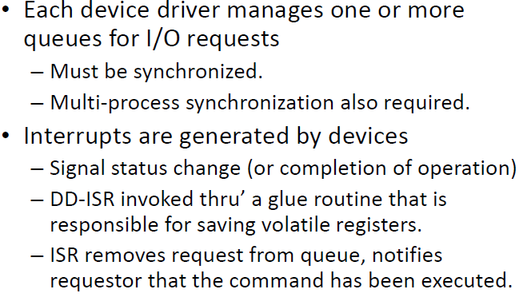
I/O Queuing and Interrupt Handling
Systems Programming - V 3.0

Slide 17
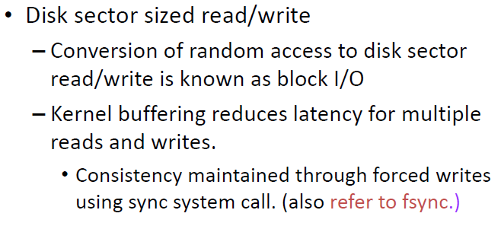
I/O in Unix – Block Devices and I/O
Systems Programming - V 3.0

Slide 18
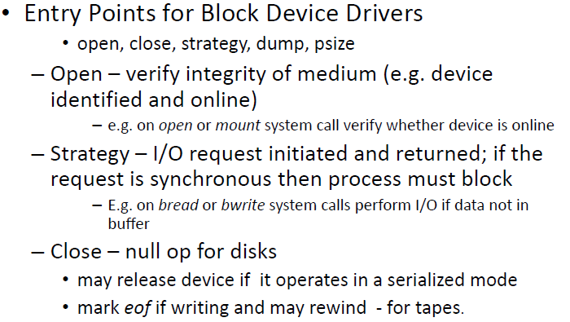
I/O in Unix – Block Devices and I/O
Systems Programming - V 3.0

Slide 19
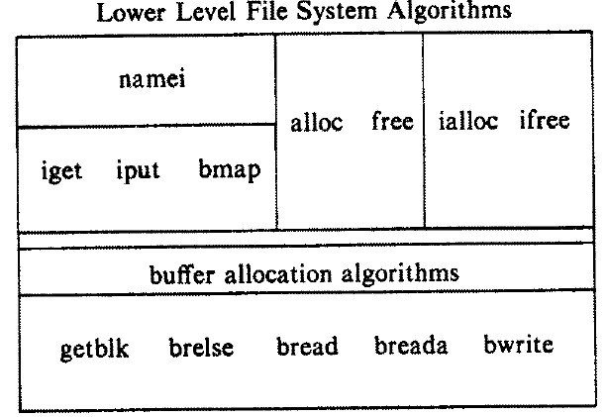
File System Algorithms
Every file a UNIX system has a unique inode. Processes interact with files using well defined system calls. The users specify a file with a character string which is the file's path and then the system get the inode which is mapped to the file which corresponds to the path.
Systems Programming - V 3.0

Slide 20
inode
Contains the information necessary for a process to access a file
Exits in a static form on disk and the kernel
reads them into an in-core inode
Systems Programming - V 3.0

Slide 21
inodes
Disk inodes consists of the following fields
- file owner identifier
- file type
- file access permissions
- file access times
- number of links to the file
- table of contents for the disk address of data in a file
- file size

Slide 22
inodes
in-core copy of the inode contains the following fields in addition to the fields of the disk inode:
- status of the in-core inode (The inode is locked, a process is waiting for the inode to become unlocked)
- logical device number of file system that contains the file
- inode number are stored in a linear array on disk, the kernel identifies the number of a disk mode by its position in the array.
- pointers to other in-core inodes
- reference count, indicating the number of instances of the file that are active (such as when opened).

Slide 23
Accessing Inodes
The algorithm iget allocates an in-core copy of an inode.
If the inode is not found on a hash queue, it allocates an inode from the free list and reads the disk copy into the in-core inode.
It already knows the inode number and device number. It calculates the logical block number on which the disk inode resides according to how many inodes fit into one disk block.
The formula for calculating the logical block number is:
block number = ((inode number - 1) / number of inodes per block) + start block of inode list
Systems Programming - V 3.0

Slide 24
Algorithm iput
- The kernel locks the inode if it has not been already locked
- The kernel decrements inode reference count
- The kernel checks if reference count is 0 or not
- If the reference count is 0 and the number of links to the file is 0, then the kernel releases disk blocks for file(algorithm free), free the inode(algorithm ifree)
• If the file was accessed or the inode was changed or the
file was changed , then the kernel updates the disk inode
• The kernel puts the inode on free list
- If the reference count is not 0, the kernel releases the inode lock
Systems Programming - V 3.0

Slide 25
iput (inode_no) //releaseIncoreInode
  lock inode if not locked
  decrement inode refernece count
  if (refernce count==0)
    if (inode link==0)
      free disk block
      set file type to 0
      free inode
    if (file accessed or inode changed or file changed)
      update disk inode
    put inode on free list
  Release inode lock
Systems Programming - V 3.0

Slide 26
Structure of a Regular File
In UNIX, the data in files is not stored sequentially on disk.
If it was to be stored sequentially, the file size would not be flexible without large fragmentation.
In case of sequential storage, the inode would only need to store the starting address and size. Instead, the inode stores the disk block numbers on which the data is present. But for such strategy, if a file had data across 1000 blocks, the inode would need to store the numbers of 1000 blocks and the size of the inode would differ according to the size of the file.
Systems Programming - V 3.0

Slide 27
Structure of a Regular File
The inodes have array of size 13 which for storing the block numbers, although, the number of elements in array is independent of the storage strategy.
The first 10 members of the array are "direct addresses", meaning that they store the block numbers of actual data.
The 11th member is "single indirect", it stores the block number of the block which has "direct addresses".
The 12th member is "double indirect", it stores block number of a "single indirect" block.
And the 13th member is "triple indirect", it stores block number of a "double indirect" block.
This strategy can be extended to "quadruple" or "quintuple" indirect addressing.
Systems Programming - V 3.0

Slide 28
Structure of a regular file
Inode
Data Blocks
direct0
direct1
direct2
direct3
direct4
direct5
direct6
direct7
direct8
direct9
single indirect
double indirect
triple indirect
Systems Programming - V 3.0

Slide 29
Structure of a regular file
Suppose System V UNIX
Assume that a logical on the file system holds 1K bytes and that a block number is addressable by a 32 bit integer, then a block can hold up to 256 block numbers
10 direct blocks with 1K bytes each=10K bytes
1 indirect block with 256 direct blocks= 1K*256=256K bytes
1 double indirect block with 256 indirect blocks=
256K*256=64M bytes
1 triple indirect block with 256 double indirect blocks=
64M*256=16G bytes
Systems Programming - V 3.0

Slide 30
Structure of a regular file
Processes access data in a file by byte offset and view a file as a stream of bytes
The kernel accesses the inode and converts the logical file block into the appropriate disk block
algorithm bmap
- The kernel calculates logical block number in file from byte offset
- The kernel calculates start byte in block for I/O
- The kernel calculates number of bytes to copy to user
- The kernel checks if read-ahead is applicable, then marks inode
- The kernel determines level of indirection
Systems Programming - V 3.0

Slide 31
Structure of a regular file
- While it’s not at necessary level of indirection,
the kernel calculates index into inode or indirect block from logical block number in file, gets disk block number from inode or indirect block and release buffer from previous disk read
• If there is no more levels of indirection , the kernel stops conversing
• Otherwise the kernel reads indirect disk block(bread) and adjusts logical block number in file according to level of indirection
Systems Programming - V 3.0

Slide 32
Conversion of Path Name to an Inode
The kernel parses the path by accessing each inode in the path and finally returning the inode of the required file.
Every process has a current directory. The current directory of process 0 is the root directory.
For every other process, it is the current directory of its parent process.
Later the process can change the current directory with the system call chdir. The inode of the current directory is stored in the u-area.
Systems Programming - V 3.0

Slide 33
Path conversion to an inode
if (path name starts with root)
  working inode= root inode
else
  working inode= current directory inode
while (there is more path name)
  read next component from input
  read directory content
  if (component matches an entry in directory)
    get inode number for matched component
    release working inode
    working inode=inode of matched component
  else
  return no inode
return (working inode)
Systems Programming - V 3.0

Slide 34
Algorithm namei
- If path name starts from root, then the kernel assigns root inode(iget) to working inode
- Otherwise, the kernel assigns current directory inode to working inode
- While there is more path name, the kernel reads next path name component from input, and verifies that working inode is of directory, access permissions OK
• If working inode is of root and component is ‘..’, then the kernel checks whether there is more path name or not
• Otherwise the kernel reads directory by repeated use of bmap,bread,brelse
Systems Programming - V 3.0

Slide 35
Path conversion to an inode
• If the kernel finds a match, it records the inode number of the matched directory entry, releases the block and the old working inode, and allocates the inode of the match component
• If the kernel does not match the path name in the block, it releases the block, adjusts the byte offset by the number of bytes in a block, converts the new offset to a disk block number and reads the new block
Systems Programming - V 3.0

Slide 36
Superblock contents
size of the file system.
number of free blocks in the file system.
list of free blocks in the file system.
pointer to the next free block in the free blocks list
size of the inodes list.
number of free inodes in the file system.
list of free inodes in the file system.
pointer to the next free inode in the free inodes list.
lock fields for the free blocks and free inodes list.
a field indicating whether the super block has changed.
The kernel periodically writes the superblock to the disk if it had been modified so that it is consistent with the data on the disk
Systems Programming - V 3.0

Slide 37
Inode assignment to a new file
algorithm ialloc : assigns a disk inode to a newly created file
-super block is unlocked
1.There are inodes in super block inode list and inode is free
get inode number from super block inode list
get inode (iget)
initialize inode
write inode to disk
decrement file system free inode count
2. There are inodes in super block inode list but inode is not free
get inode number from super block inode list
get inode (iget)
write inode to disk
release inode (iput)
Systems Programming - V 3.0

Slide 38
Inode assignment to a new file
3. Inode list in super block is empty
lock super block
get remembered inode for free inode search
search disk for free inode until super block full or
no more free inodes(bread and brelse)
unlock super block
super block becomes free
if no free inodes found on disk , stop
otherwise, set remembered inode for next free inode
search
- If super block is locked, sleep
Systems Programming - V 3.0

Slide 39

Systems Programming - V 3.0

Slide 40

IMP Note to Self
Systems Programming - V 3.0

