Slide 1

Course Name :
Systems Programming
04th DEC 2022

Slide 2

IMP Note to Self
Systems Programming - V 3.0

Slide 3
IMP Note to Students
It is important to know that just login to the session does not guarantee the attendance.
Once you join the session, continue till the end to consider you as present in the class.
IMPORTANTLY, you need to make the class more interactive by responding to Professors queries in the session.
Whenever Professor calls your number / name ,you need to respond, otherwise it will be considered as ABSENT
Systems Programming - V 3.0

Slide 4
Agenda
The vi basics
Input mode – entering and replacing text
Saving text and quitting – the ex mode
Navigation
Editing text
Undoing last editing instructions
Repeating the last command
Searching for a pattern
Substitution – search and replace
cp, cut, paste commands.
Systems Programming - V 3.0

Slide 5
vi basics
To write and edit some programs and scripts, we require editors
UNIX provides vi editor for BSD system – created by Bill Joy
Bram Moolenaar improved vi editor and called it as vim (vi improved) on Linux OS
Systems Programming - V 3.0

Slide 6
The vi Editor
The three modes of vi Editor:
Command Mode: The default mode of the editor where every key pressed is interpreted as a command to run on text. To copy, delete text & navigate, this mode is used.
Input Mode: Every key pressed after switching to this mode actually show up as text. To input text, this mode is used.
ex Mode(Last Line Mode): The mode used to handle files (like saving) and perform substitution.
Systems Programming - V 3.0

Slide 7
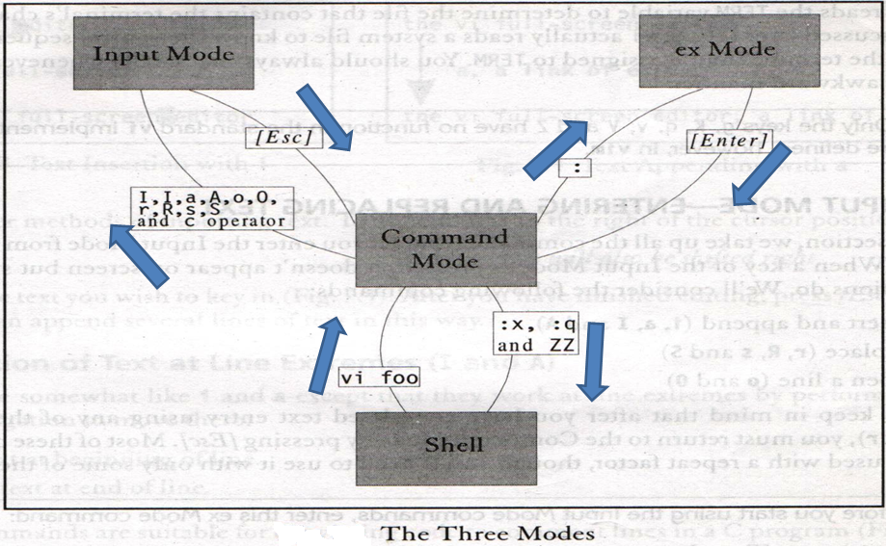
The vi Editor
Systems Programming - V 3.0

Slide 8
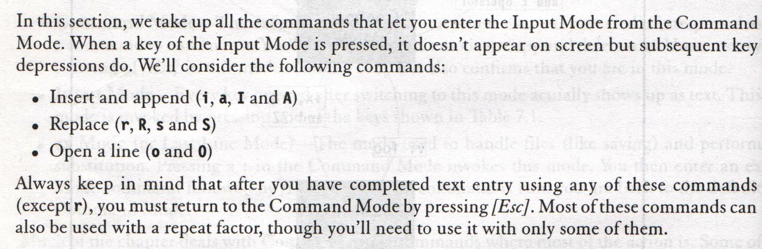
INPUT MODE – ENTERING AND REPLACING TEXT
Systems Programming - V 3.0

Slide 9
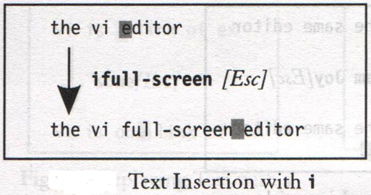
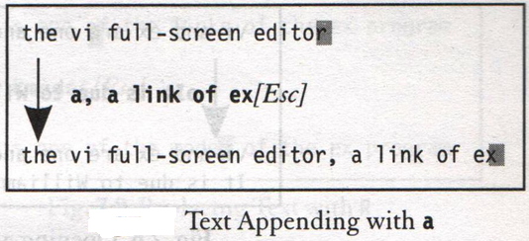
INPUT MODE – ENTERING AND REPLACING TEXT
Insertion of Text (i and a)
Systems Programming - V 3.0

Slide 10
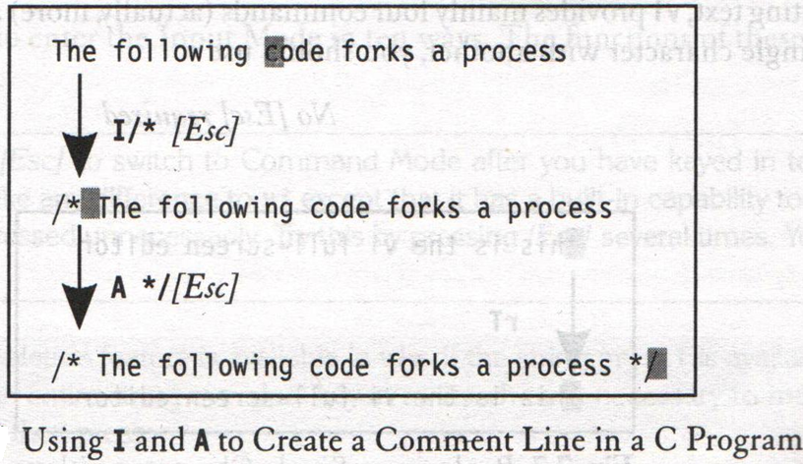
INPUT MODE – ENTERING AND REPLACING TEXT
Insertion of Text at Line Extremes (I and A)
Systems Programming - V 3.0

Slide 11
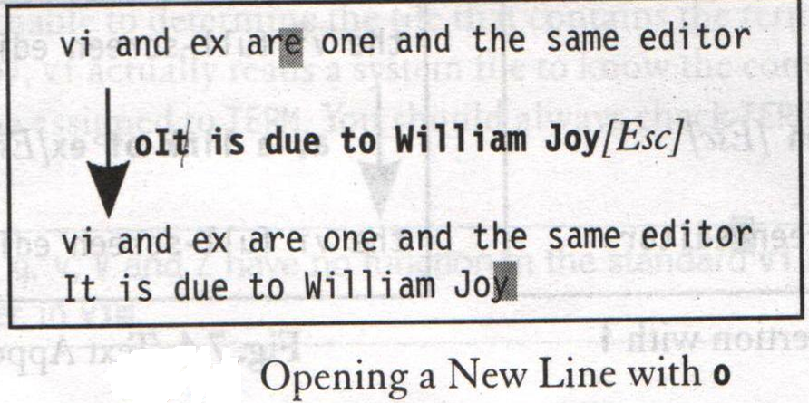
INPUT MODE – ENTERING AND REPLACING TEXT
Opening a New Line (o and O)
Systems Programming - V 3.0

Slide 12
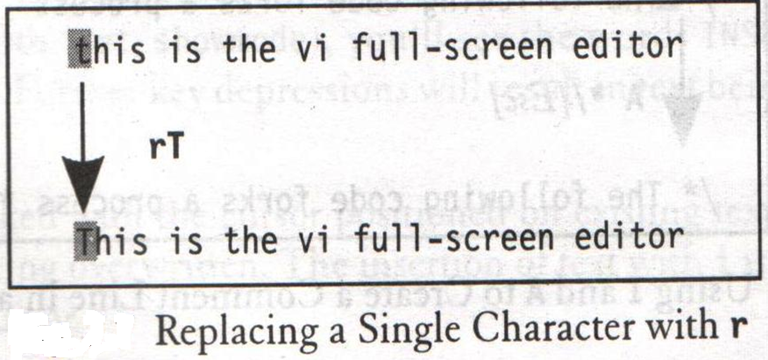
INPUT MODE – ENTERING AND REPLACING TEXT
Replacing Text (r, s, R and S)
Systems Programming - V 3.0

Slide 13
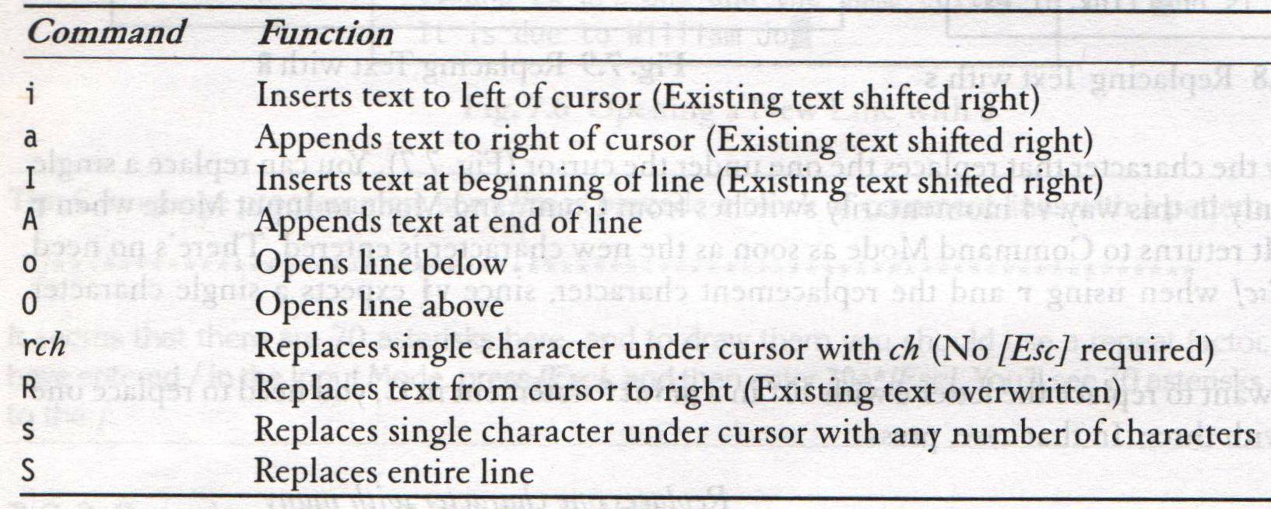
INPUT MODE – ENTERING AND REPLACING TEXT
Input Mode Commands
Systems Programming - V 3.0

Slide 14
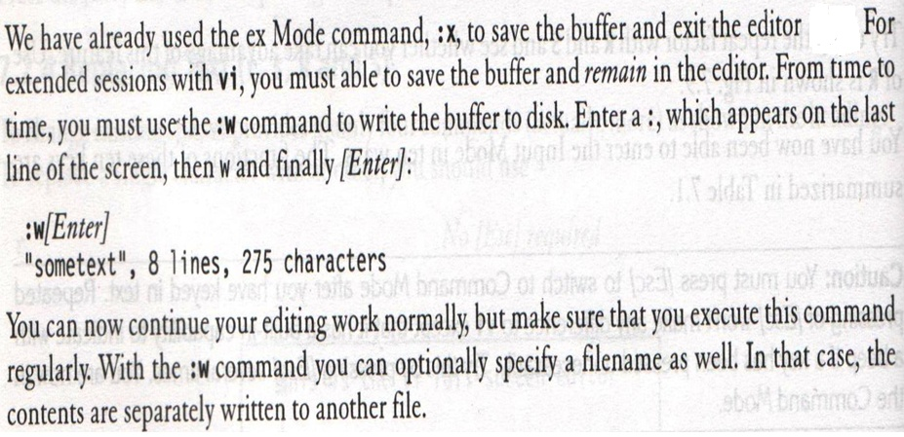
ex MODE – SAVING TEXT AND QUITTING
Saving the Work (:w)
Systems Programming - V 3.0

Slide 15
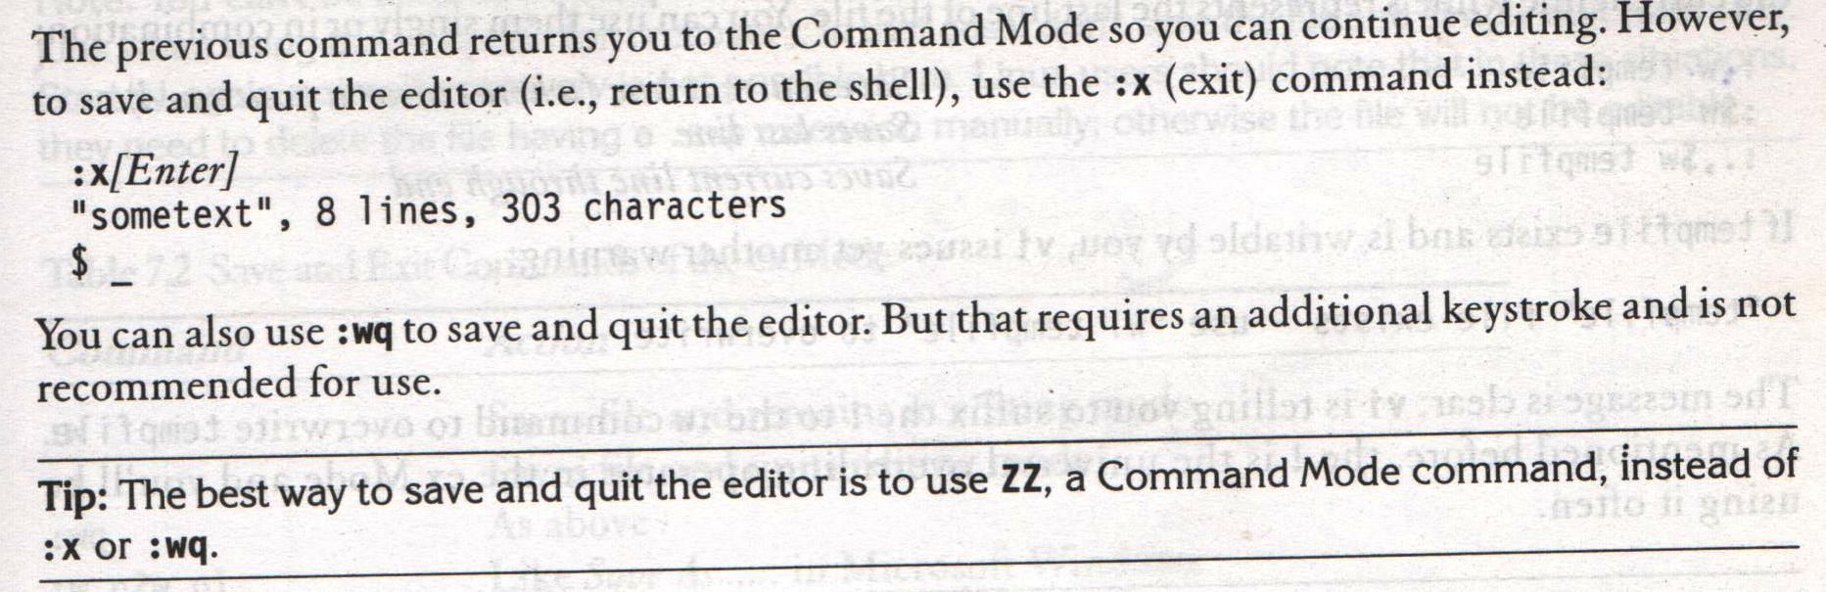
ex MODE – SAVING TEXT AND QUITTING
Saving and Quitting (:x and :wq)
Systems Programming - V 3.0

Slide 16
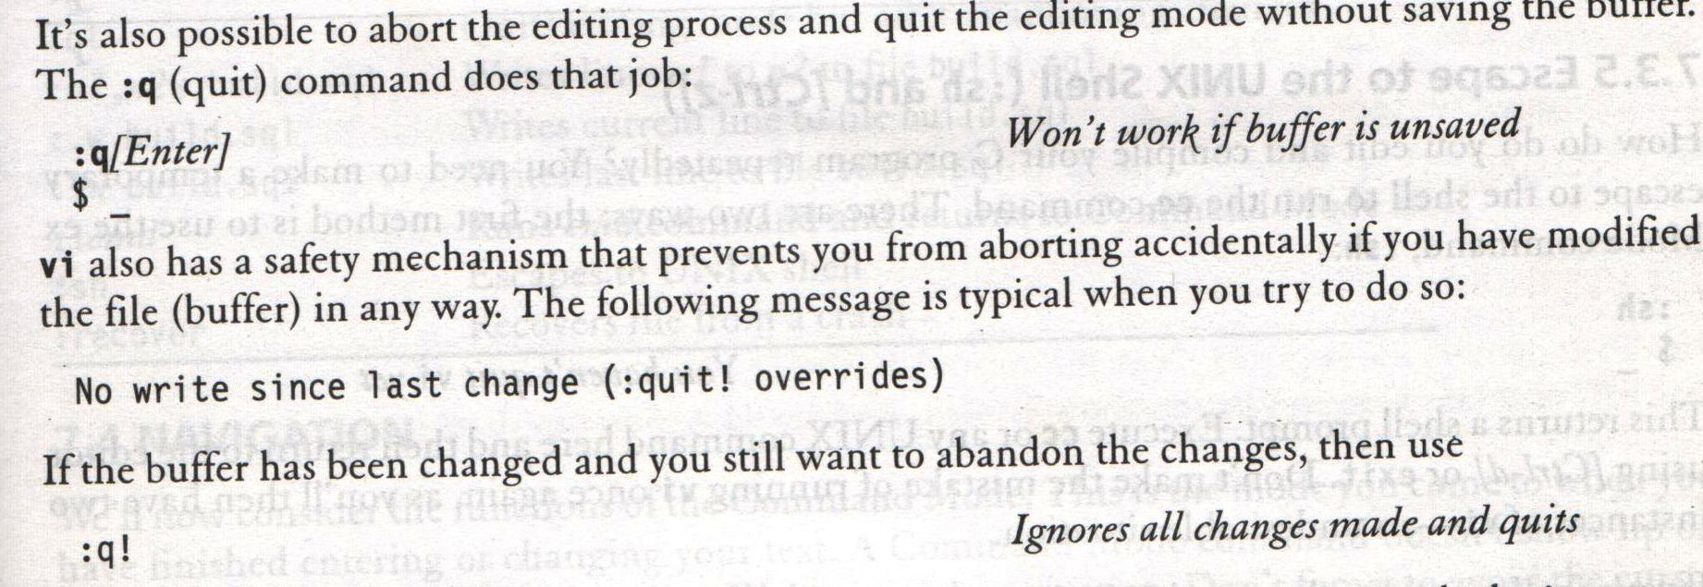
ex MODE – SAVING TEXT AND QUITTING
Aborting Editing (:q)
Systems Programming - V 3.0

Slide 17
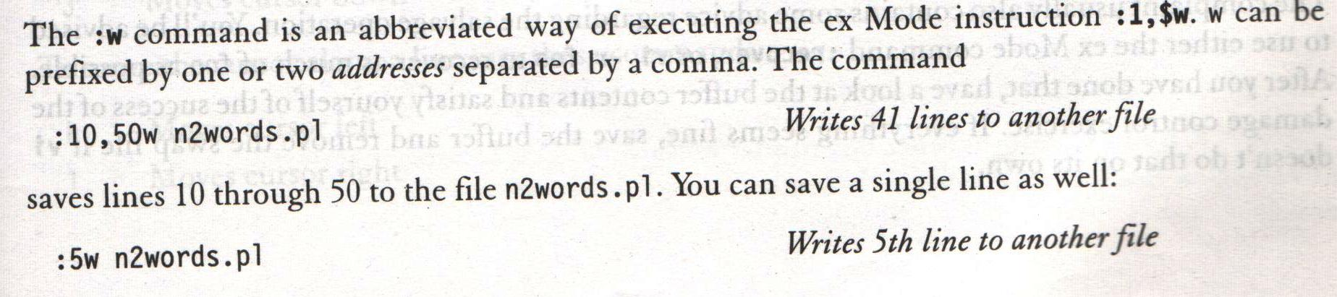
ex MODE – SAVING TEXT AND QUITTING
Writing Selected Lines
Systems Programming - V 3.0

Slide 18
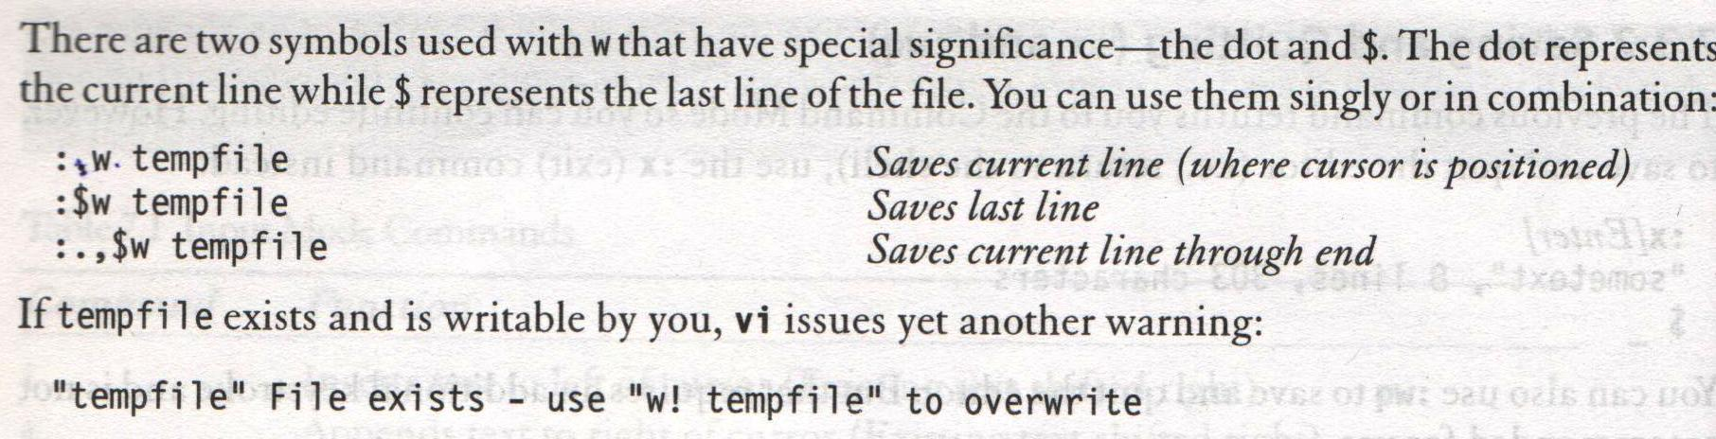
ex MODE – SAVING TEXT AND QUITTING
Writing Selected Lines
Systems Programming - V 3.0

Slide 19
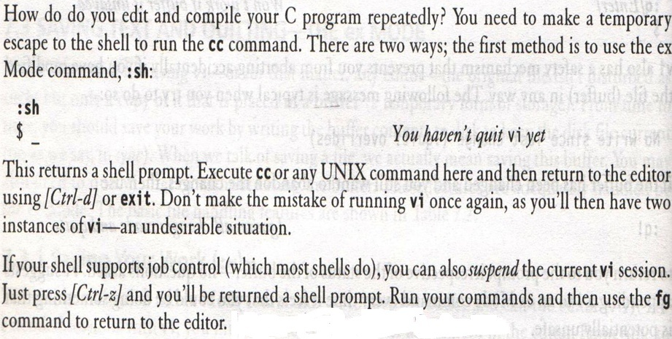
ex MODE – SAVING TEXT AND QUITTING
Escape to the UNIX Shell (:sh and [Ctrl-z])
Systems Programming - V 3.0

Slide 20
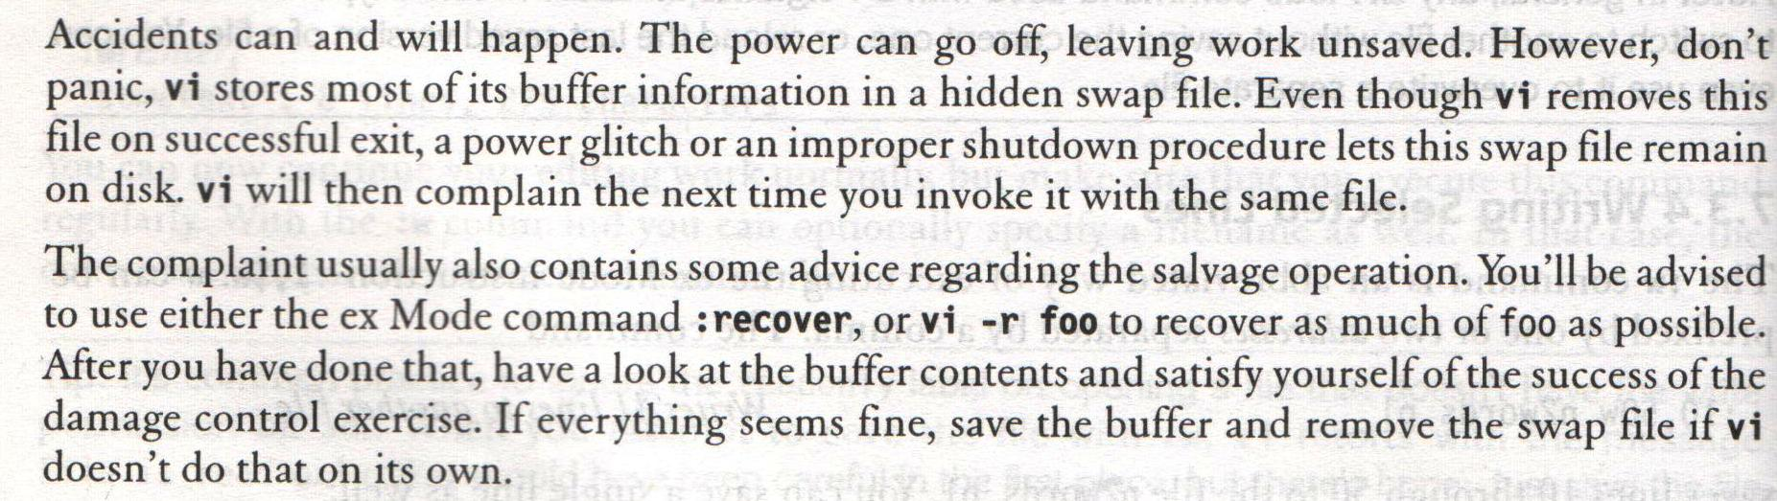
ex MODE – SAVING TEXT AND QUITTING
Recovering from a Crash (:recover and –r)
Systems Programming - V 3.0

Slide 21
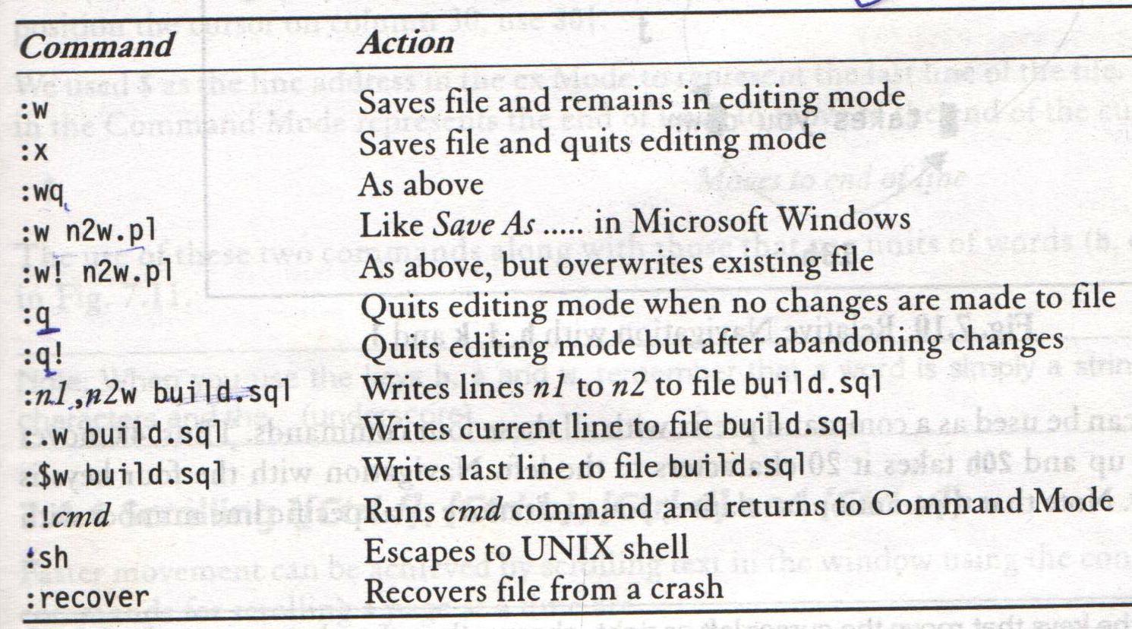
ex MODE – SAVING TEXT AND QUITTING
Save and Exit Commands of the ex Mode
Systems Programming - V 3.0

Slide 22
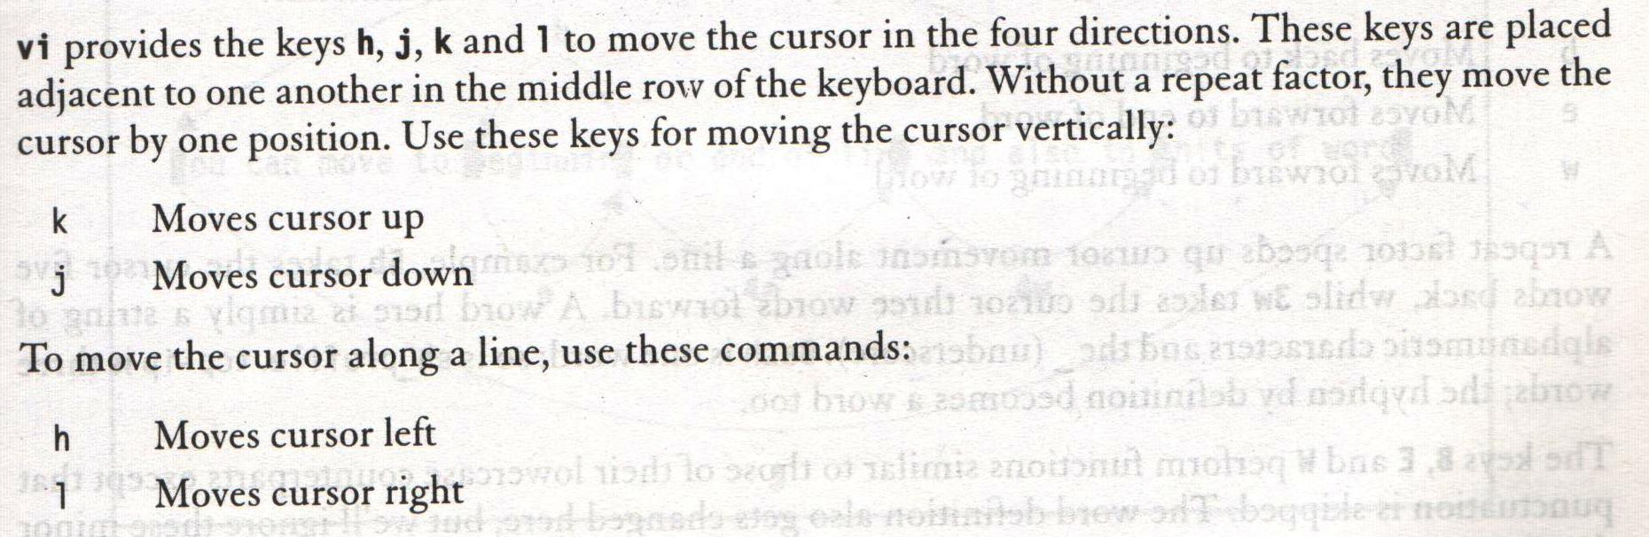
Command MODE – NAVIGATION
Movement in the Four Directions (h, j, k and l)
Systems Programming - V 3.0

Slide 23
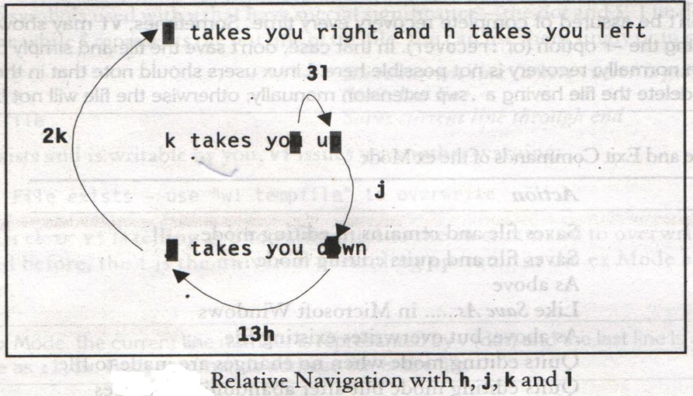
Command MODE – NAVIGATION
Movement in the Four Directions (h, j, k and l)
Systems Programming - V 3.0

Slide 24
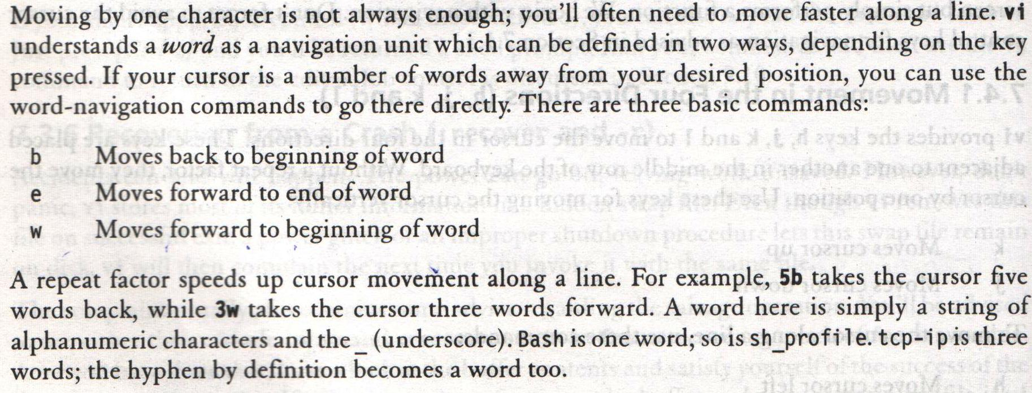
Command MODE – NAVIGATION
Word Navigation (b, e and w)
Example
  5b takes the cursor 5 words back
  3w takes the cursor 3 words forward
Systems Programming - V 3.0

Slide 25
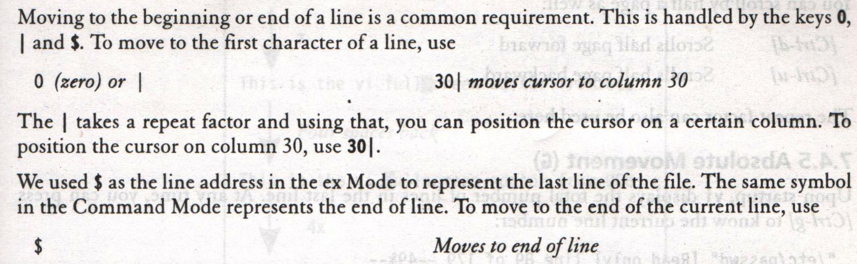
Command MODE – NAVIGATION
Moving to Line Extremes (0, | and $)
Systems Programming - V 3.0

Slide 26
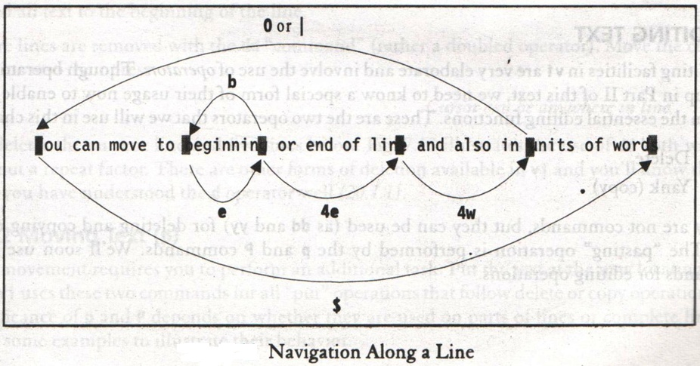
Command MODE – NAVIGATION
Moving to Line Extremes (0, | and $)
Systems Programming - V 3.0

Slide 27
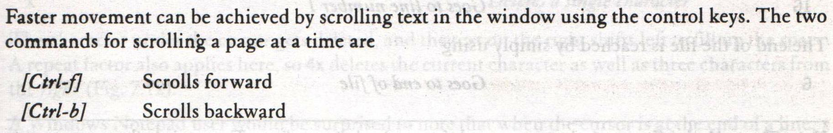
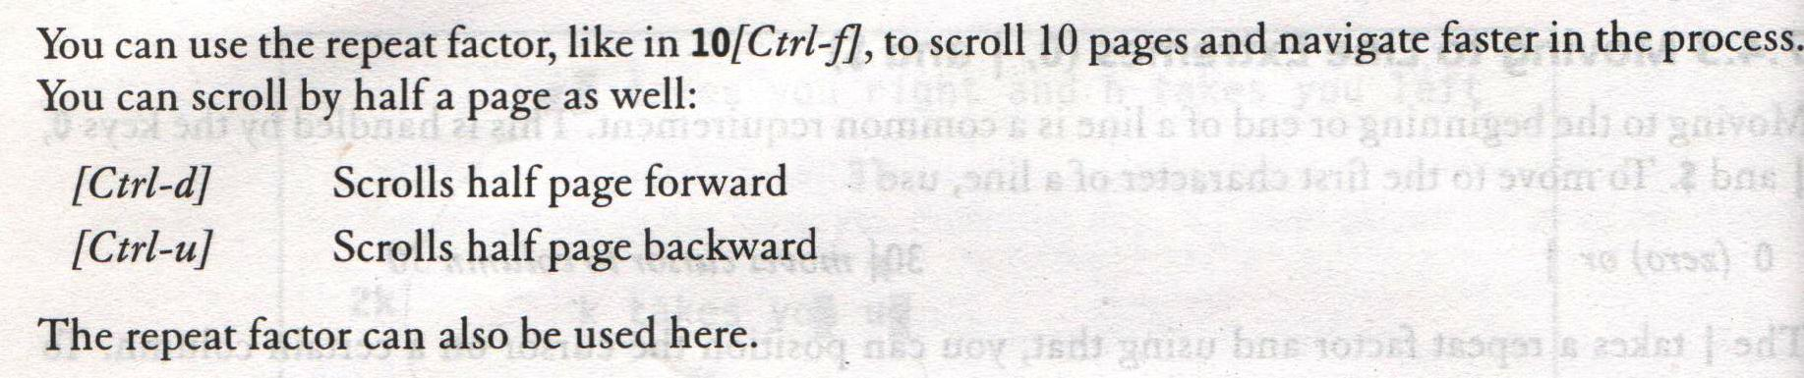
Command MODE – NAVIGATION
Scrolling ([Ctrl-f], [Ctrl-b], [Ctrl-d] and [Ctrl-u])
Systems Programming - V 3.0

Slide 28
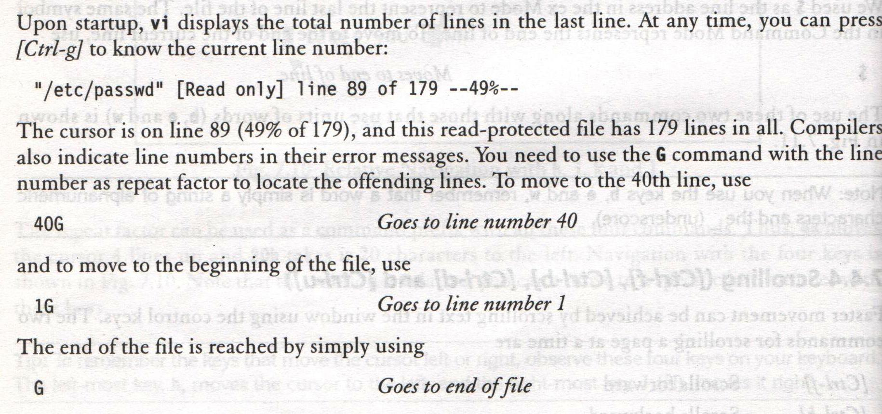
Command MODE – NAVIGATION
Absolute Movement (G)
Systems Programming - V 3.0

Slide 29
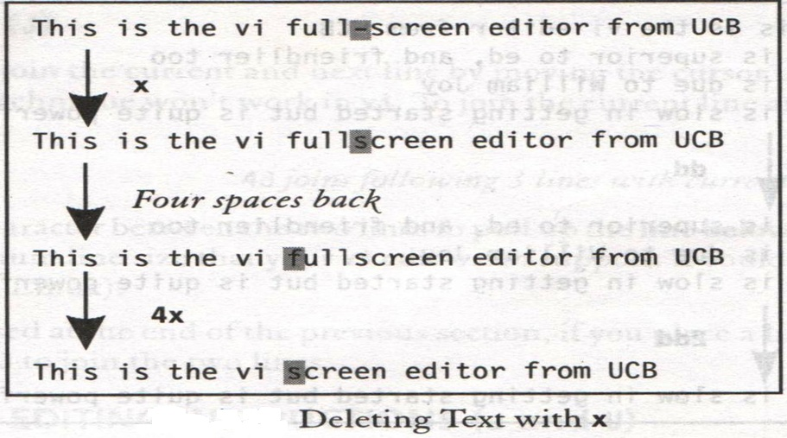
Command MODE – EDITING TEXT
Editing Text – Deleting characters (x, X)
Systems Programming - V 3.0

Slide 30
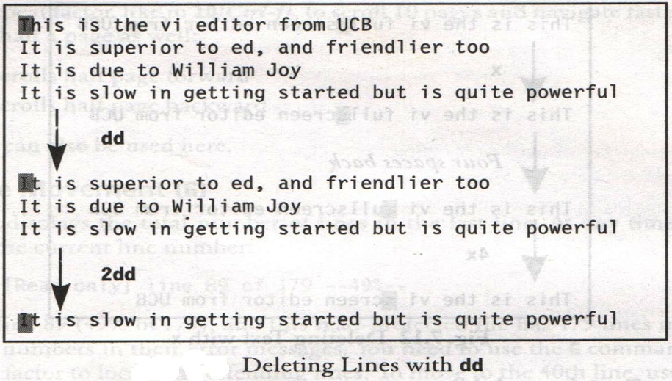
Command MODE – EDITING TEXT
Editing Text – Deleting lines (dd)
Systems Programming - V 3.0

Slide 31
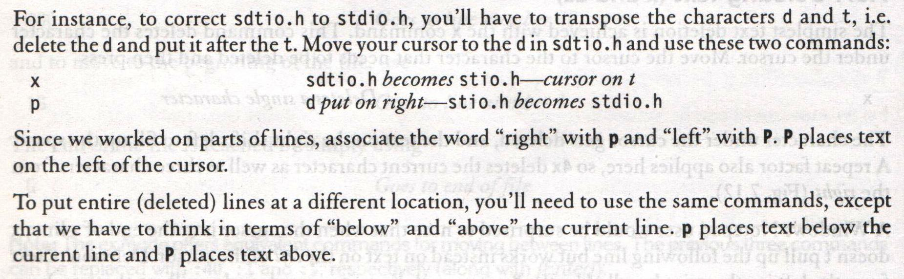
Command MODE – EDITING TEXT
Editing Text – Moving Text (p, P)
Systems Programming - V 3.0

Slide 32
Command MODE – EDITING TEXT
Editing Text)
They use operators, such as,
d delete
y yank (copy)
dd delete entire line
yy copy entire line
6dd deletes the current line and five lines below
Systems Programming - V 3.0

Slide 33
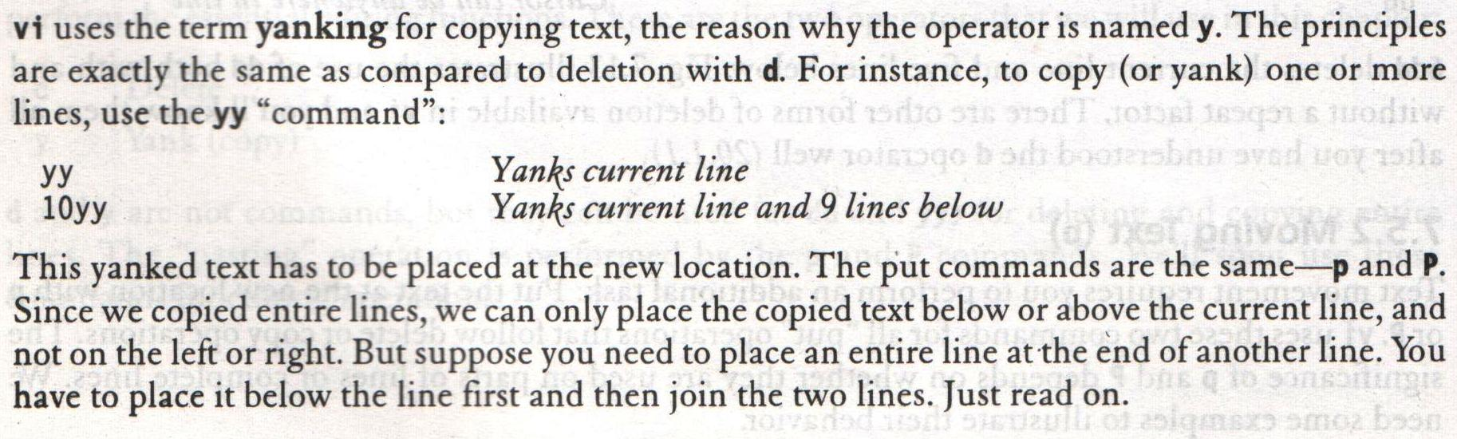
Command MODE – EDITING TEXT
Editing Text – Copying Text (y and p)
Systems Programming - V 3.0

Slide 34
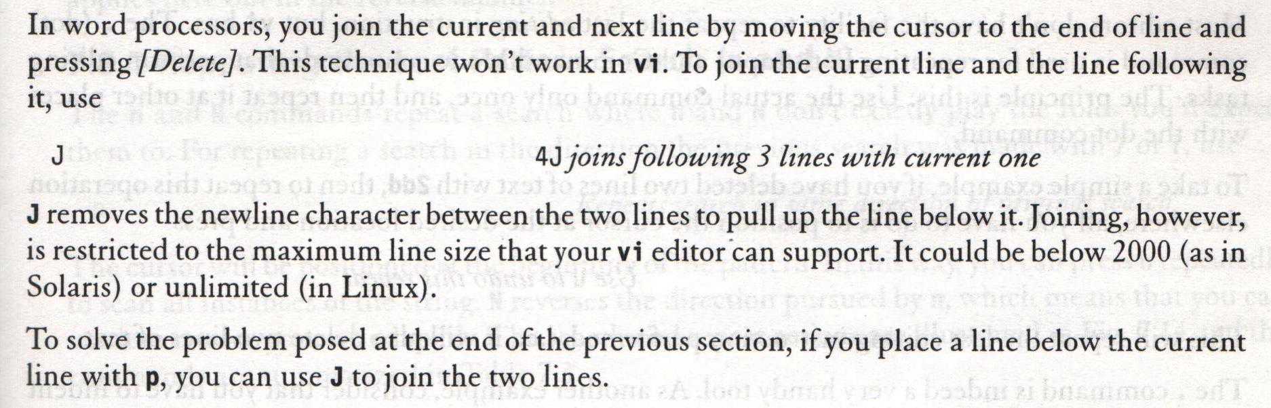
Command MODE – EDITING TEXT
Editing Text – Joining Lines (J)
Systems Programming - V 3.0

Slide 35
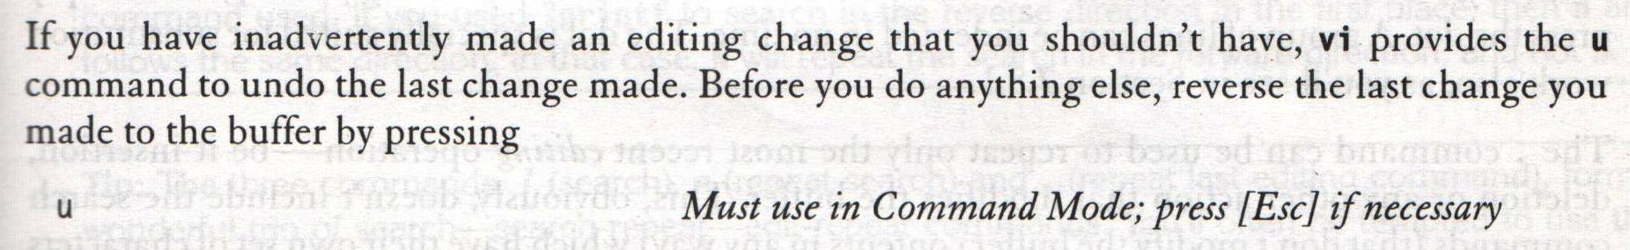
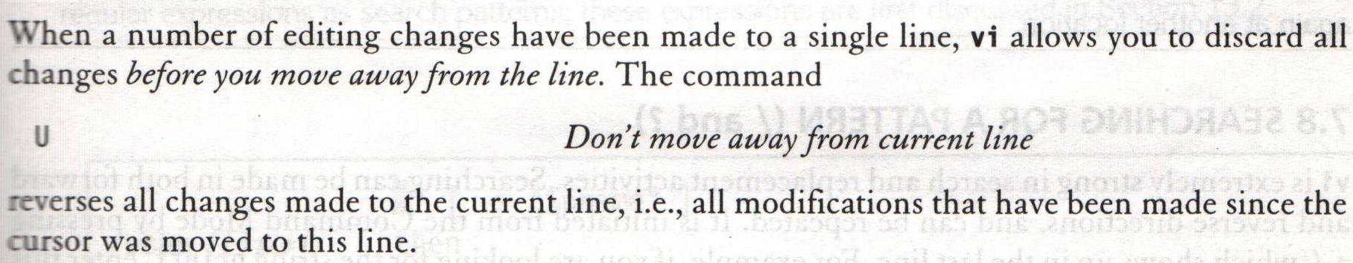
Command MODE – EDITING TEXT
Undoing Last Editing Instructions (u and U)
Systems Programming - V 3.0

Slide 36
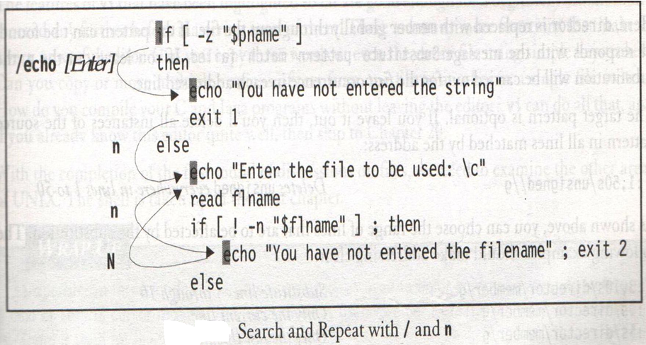
Command MODE – EDITING TEXT
Repeating the Last Pattern Search (n and N)
Systems Programming - V 3.0

Slide 37
SEARCHING FOR A PATTERN
/ search forward
? search backward
/printf The search begins forward to position the
cursor on the first instance of the word
?pattern Searches backward for the most previous
instance of the pattern
n Repeats search in same direction of original search
Systems Programming - V 3.0

Slide 38
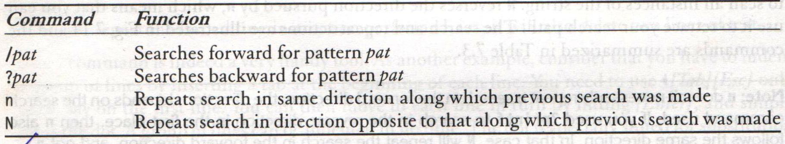
Command MODE – EDITING TEXT
Search and Repeat Commands
Systems Programming - V 3.0

Slide 39
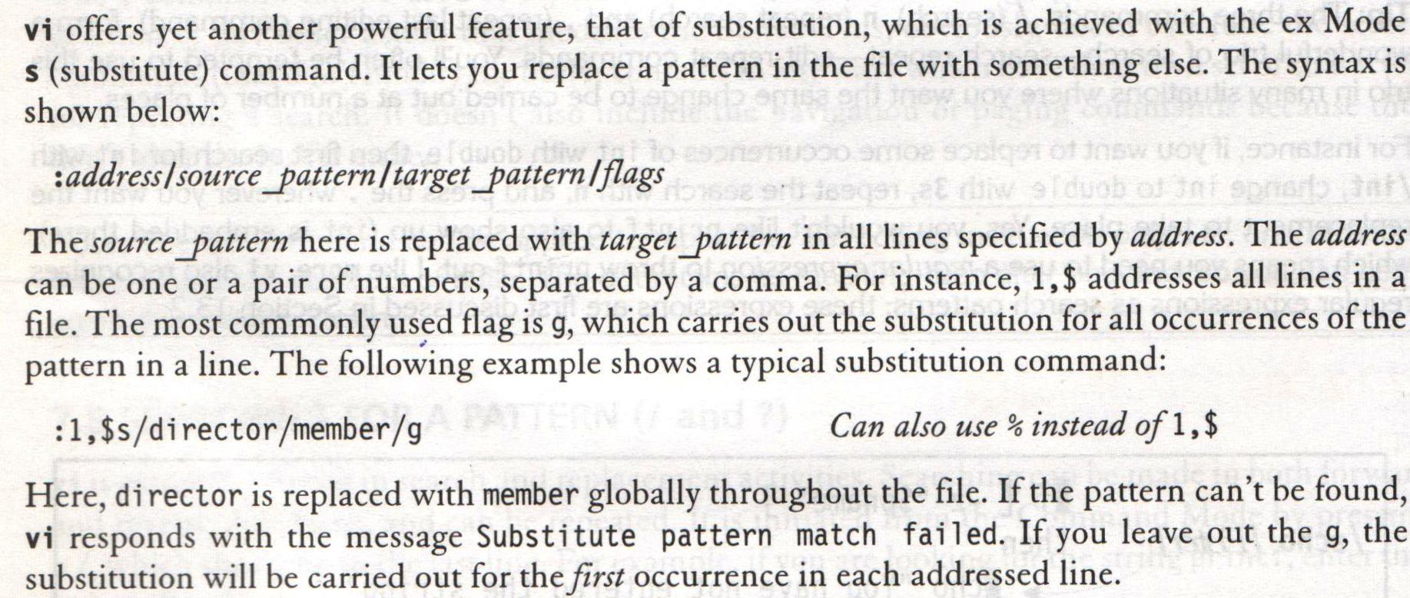
ex MODE
Substitution – Search and Replace ( :s )
Systems Programming - V 3.0

Slide 40
ex MODE
Substitution – Search and Replace ( :s )
We can perform search and replace in ex mode using :s
Its syntax is,
:address/source_pattern/target_pattern/flags
:1,$s/director/member/g
:1,50s/unsigned//g
:3,10s/director/member/g
:.s/director/member/g
:$s/director/member/g
Systems Programming - V 3.0

Slide 41
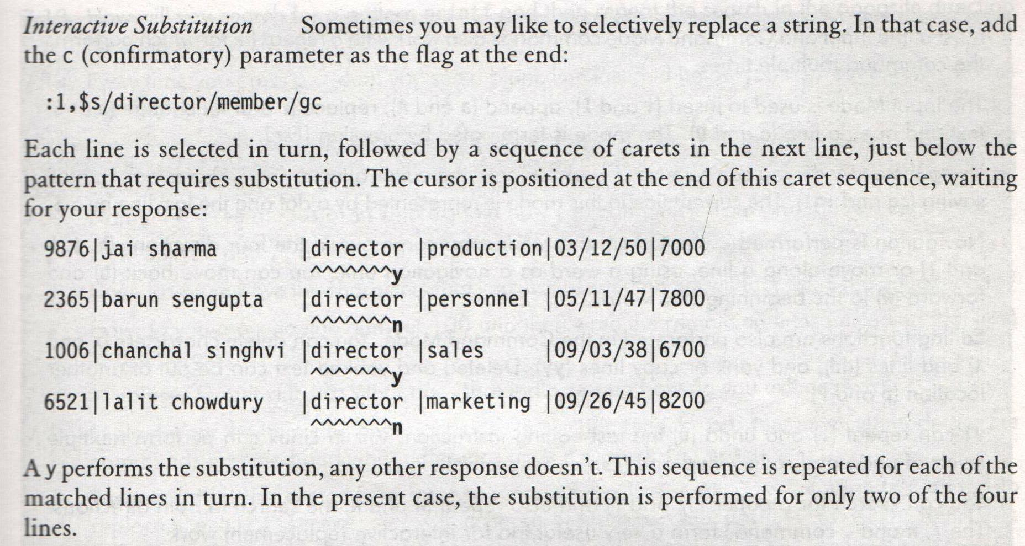
ex MODE
Substitution – Search and Replace ( :s )
Systems Programming - V 3.0

Slide 42
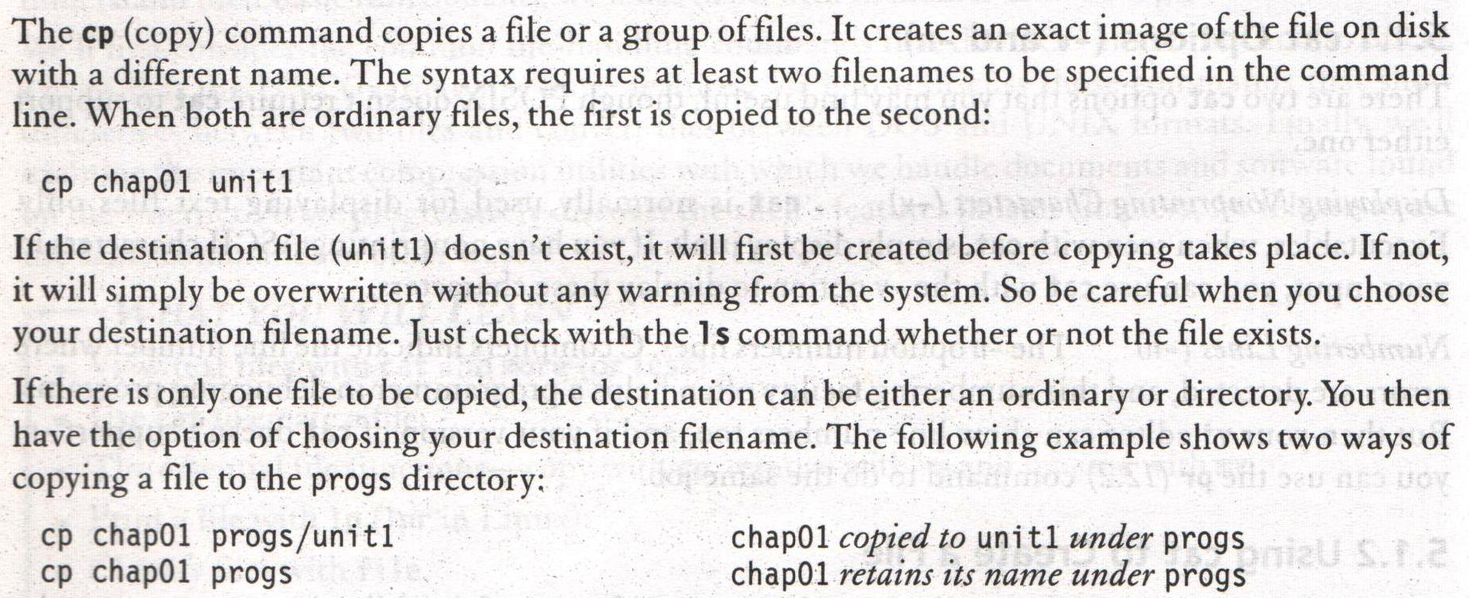
cp – COPYING A FILE
Systems Programming - V 3.0

Slide 43
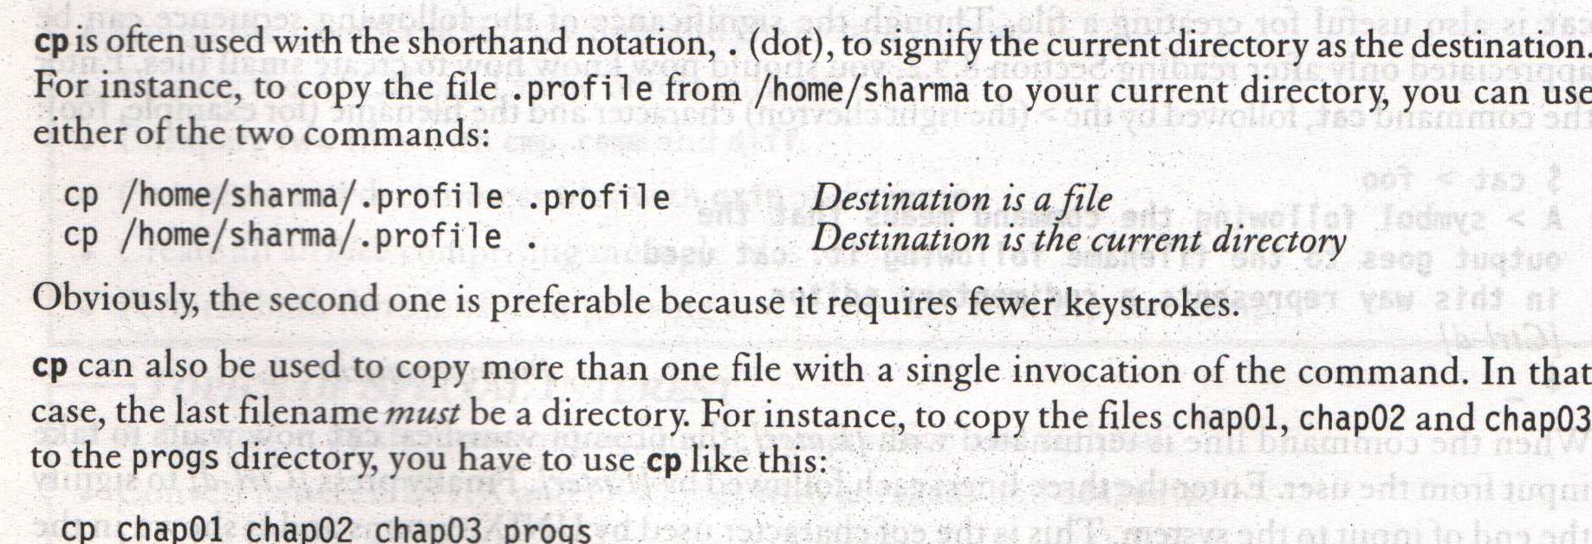
cp – COPYING A FILE
Systems Programming - V 3.0

Slide 44
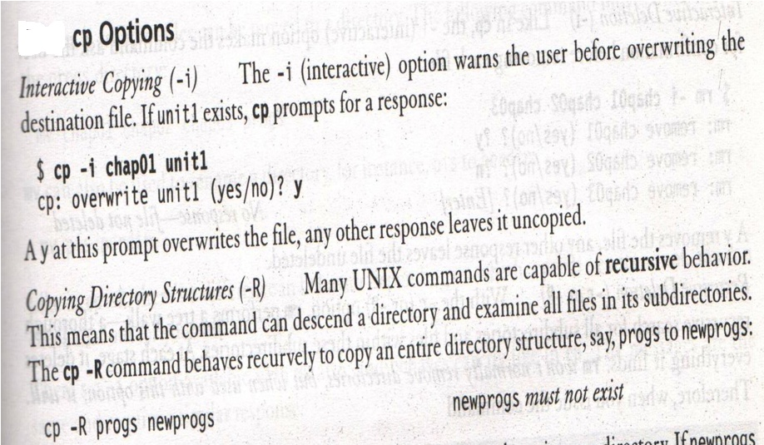
cp – COPYING A FILE
Systems Programming - V 3.0

Slide 45
cut Command
It is used for slitting the file vertically
head -n 5 emp.lst | tee shortlist
will select the first five lines of emp.lst and saves it to shortlist
We can cut by using -c option with a list of column numbers, delimited by a comma (cutting columns)
  cut -c 6-22,24-32 shortlist
  cut -c -3,6-22,28-34,55- shortlist
Systems Programming - V 3.0

Slide 46
cut Command
Most files don’t contain fixed length lines, so we have to cut fields rather than columns (cutting fields)
-d for the field delimiter
-f for the field list
cut -d \ | -f 2,3 shortlist | tee cutlist1
will display the second and third columns of shortlist and saves the output in cutlist1. here | is escaped to prevent it as pipeline character
Systems Programming - V 3.0

Slide 47
cut Command
To print the remaining fields, we have
cut –d \ | -f 1,4- shortlist > cutlist2
Systems Programming - V 3.0

Slide 48
paste Command
When we cut with cut, it can be pasted back with the paste command, vertically
paste cutlist1 cutlist2
We can view two files side by side
Systems Programming - V 3.0

Slide 49
paste: pasting file (contd.,)
We can specify one or more delimiters with -d
paste -d “|” cutlist1 cutlist2
Where each field will be separated by the delimiter |
Systems Programming - V 3.0

Slide 50
paste Command
Joining lines (-s)
Let us consider that the file address book contains the details of three persons
cat addressbook
paste -s addressbook -to print in one single line
paste -s -d ”| | \n” addressbook -are used in a circular manner
Systems Programming - V 3.0

Slide 51

Systems Programming - V 3.0

Slide 52

IMP Note to Self
Systems Programming - V 3.0

