Slide 1

Course Name :
Systems Programming
18th DEC 2022

Slide 2

IMP Note to Self
Systems Programming - V 3.0

Slide 3
IMP Note to Students
It is important to know that just login to the session does not guarantee the attendance.
Once you join the session, continue till the end to consider you as present in the class.
IMPORTANTLY, you need to make the class more interactive by responding to Professors queries in the session.
Whenever Professor calls your number / name ,you need to respond, otherwise it will be considered as ABSENT
Systems Programming - V 3.0

Slide 4
Agenda
Commands : grep
Pattern matching and Shell Meta characters
What is Shell Programming
Need for Shell Programming
Shell Programming Variants
Writing some Scripts
Interactive shell scripting
Arithmetic in shell
Variables in shell with more examples.
Systems Programming - V 3.0

Slide 5
grep Command
grep to search a file(s) for a pattern and display.
grep options to display, count, line numbers or filenames
Regular expressions
  Basic regular expressions (BRE)
  Extended regular expressions (ERE)
  sed to edit / manipulate an input stream
  substitution features
  repeated and remembered patterns
Systems Programming - V 3.0

Slide 6
grep Command
grep : searching for a pattern
grep options
Basic regular expressions (BRE)
An introduction
The character class
The *
The dot
Specifying pattern locations Metacharacters
Systems Programming - V 3.0

Slide 7
grep Command
It scans the file / input for a pattern and displays lines containing the pattern, the line numbers or filenames where the pattern occurs
It’s a command from a special family in UNIX for handling search requirements
grep options pattern filename(s)
Systems Programming - V 3.0

Slide 8
emp.lst (Data used for grep)
2233 | a.k.shukla | g.m | sales | 12/12/52 | 6000
9876 | jai sharma | director | production | 12/03/50 | 7000
5678 | sumit chakrobarty | d.g.m. | marketing | 19/04/43 | 6000
2365 | barun sengupta | director | personnel | 11/05/47 | 7800
5423 | n.k.gupta | chairman | admin | 30/08/56 | 5400
1006 | chanchal singhvi | director | sales | 03/09/38 | 6700
6213 | karuna ganguly | g.m. | accounts | 05/06/62 | 6300
1265 | s.n. dasgupta | manager | sales | 12/09/63 | 5600
4290 | jayant choudhury | executive | production | 07/09/50 | 6000
2476 | anil aggarwal | manager | sales | 01/05/59 | 5000
6521 | lalit chowdury | directir | marketing | 26/09/45 | 8200
3212 | shyam saksena | d.g.m. | accounts | 12/12/55 | 6000
3564 | sudhir agarwal | executive | personnel | 06/07/47 | 7500
2345 | j. b. sexena | g.m. | marketing | 12/03/45 | 8000
0110 | v.k.agrawal | g.m.| marketing | 31/12/40 | 9000
Systems Programming - V 3.0

Slide 9
grep Command
grep “sales” emp.lst
Patterns with and without quotes is possible
Its generally safe to quote the pattern
Quote is mandatory when pattren involves more than one word
It returns the prompt in case the pattren can’t be located
grep president emp.lst
Systems Programming - V 3.0

Slide 10
grep Command
When grep is used with multiple filenames, it displays the filenames along with the output
grep “director” emp1.lst emp2.lst
Where it shows filename followed by the contents
Systems Programming - V 3.0

Slide 11
grep frequently used options
-i ignores case for matching
-v doesn’t display lines matching expression
-n displays line numbers along with lines
-c displays count of number of occurrences
-l displays list of filenames only
Systems Programming - V 3.0

Slide 12
grep Command
-e exp specifies expression with this option
-x matches pattern with entire line
-f file takes pattrens from file, one per line
-E treats pattren as an extended RE
-F matches multiple fixed strings
Systems Programming - V 3.0

Slide 13
grep Command
1. grep -i ‘agarwal’ emp.lst
2. grep -v ‘director’ emp.lst > otherlist
wc -l otherlist will display 11 otherlist
grep –n ‘marketing’ emp.lst
grep –c ‘director’ emp.lst
grep –c ‘director’ emp*.lst
will print filenames prefixed to the line count
Systems Programming - V 3.0

Slide 14
grep Command
grep -i ‘manager’ *.lst
will display filenames only
grep -e 'Agarwal' -e 'aggarwal' -e 'agrawal' emp.lst
will print matching multiple patterns
Systems Programming - V 3.0

Slide 15
BASIC REGULAR EXPRESSIONS
It is tedious to specify each pattern separately with the -e option
grep uses an expression of a different type to match a group of similar patterns
if an expression uses meta characters, it is termed a regular expression
Some of the characters used by regular expression are also meaningful to the shell
Systems Programming - V 3.0

Slide 16
BRE character subset
* Zero or more occurrences
g* nothing or g, gg, ggg, etc.
. A single character
.* nothing or any number of characters
[pqr] a single character p, q or r
[c1-c2] a single character within the ASCII range represented by c1 and c2
Systems Programming - V 3.0

Slide 17
The character class
grep supports basic regular expressions (BRE) by default and extended regular expressions (ERE) with the –E option
A regular expression allows a group of characters enclosed within a pair of [ ], in which the match is performed for a single character in the group
Systems Programming - V 3.0

Slide 18
grep Command
grep “[aA]g[ar][ar]wal” emp.lst
A single pattern has matched two similar strings
The pattern [a-zA-Z0-9] matches a single alphanumeric character. When we use range, make sure that the character on the left of the hyphen has a lower ASCII value than the one on the right
Negating a class (^) (caret)
Systems Programming - V 3.0

Slide 19
THE *
* Zero or more occurrences of the previous character
g* nothing or g, gg, ggg, etc.
grep “[aA]gg*[ar][ar]wal” emp
Notice that we don’t require to use –e option three times to get the same output!!!!!
Systems Programming - V 3.0

Slide 20
THE DOT
A dot matches a single character
.* signifies any number of characters or none
grep “j.*saxena” emp.lst
Systems Programming - V 3.0

Slide 21
^ and $
Most of the regular expression characters are used for matching patterns, but there are two that can match a pattern at the beginning or end of a line
^ for matching at the beginning of a line
$ for matching at the end of a line
Systems Programming - V 3.0

Slide 22
grep Command
grep “^2” emp.lst
Selects lines where emp_id starting with 2
grep “7…$” emp.lst
Selects lines where emp_salary ranges between 7000 to 7999
grep “^[^2]” emp.lst
Selects lines where emp_id doesn’t start with 2
Systems Programming - V 3.0

Slide 23
When meta characters lose their meaning
It is possible that some of these special characters actually exist as part of the text
Sometimes, we need to escape these characters
Eg: when looking for a pattern g*, we have to use \
To look for [, we use \[
To look for .*, we use \.\*
Systems Programming - V 3.0

Slide 24
EXTENDED RE (ERE)
If current version of grep doesn’t support ERE, then use egrep but without the –E option
-E option treats pattern as an ERE
+ matches one or more occurrences of the previous character
? Matches zero or one occurrence of the previous
character
Systems Programming - V 3.0

Slide 25
grep ERE
b+ matches b, bb, bbb, etc.
b? matches either a single instance of b or nothing
These characters restrict the scope of match as compared to the *
grep –E “[aA]gg?arwal” emp.lst
Systems Programming - V 3.0

Slide 26
The ERE set
ch+ matches one or more occurrences of
character ch
ch? Matches zero or one occurrence of character ch
exp1|exp2 matches exp1 or exp2
(x1|x2)x3 matches x1x3 or x2x3
Systems Programming - V 3.0

Slide 27
Matching multiple patterns
grep -E 'sengupta|dasgupta' emp.lst
We can locate both without using –e option twice,
or
grep -E '(sen|das)gupta' emp.lst
Systems Programming - V 3.0

Slide 28
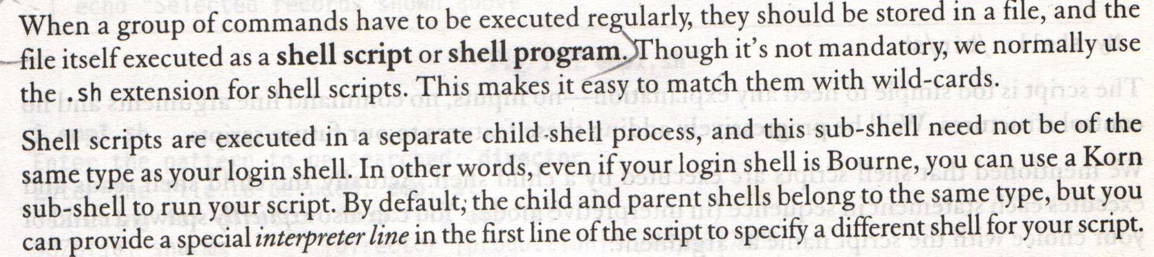
Essential Shell programming
Systems Programming - V 3.0

Slide 29
What is Shell?
• A Shell Is a program that interprets commands
• It allows a user to execute commands
• Either manually at a terminal or
automatically in programs called shell scripts
• A shell is not an operating system
• It is a way to interface with the operating
system and execute commands
• Login shell is BASH = Bourne Again Shell
Systems Programming - V 3.0

Slide 30
Advantage of using Shell
1. File name short hands
– Can pick up a whole set of file names as arguments to a program by specifying a pattern for the names
– Shell will find all the filenames that match the pattern
2. Input – Output redirection
– Can take input from a file and can redirect output to a file
3. Personalizing the environment
– Can define own commands and short hands
Systems Programming - V 3.0

Slide 31
Bash
Shell provides a mechanism for generating a list
of file names that match a pattern
– Example: ls ‐l *.c
– All file names in the current directory that end in .c
– The character * is a pattern that will match any string
including the null string
– This mechanism is useful both to save typing and to
select names according to some pattern
Systems Programming - V 3.0

Slide 32
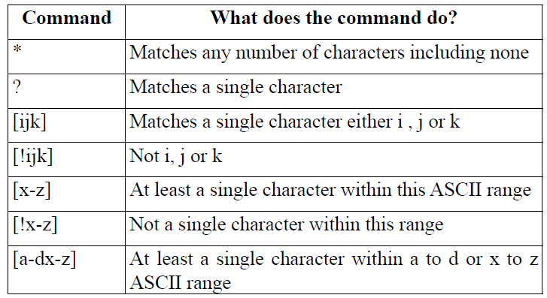
Wild cards
Wild cards – Special characters interpreted by shell
Systems Programming - V 3.0

Slide 33
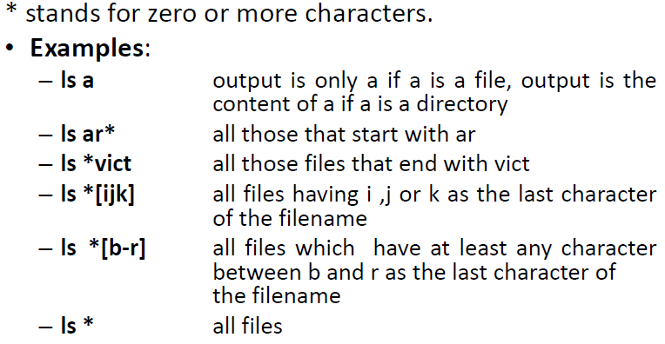
Wild card – “*”
Systems Programming - V 3.0

Slide 34
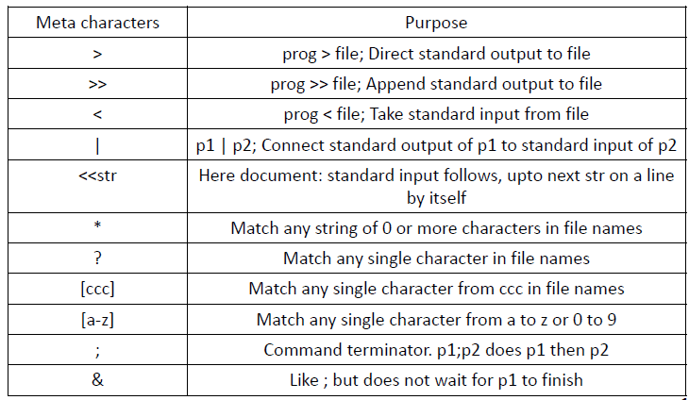
Shell Meta characters
Systems Programming - V 3.0

Slide 35
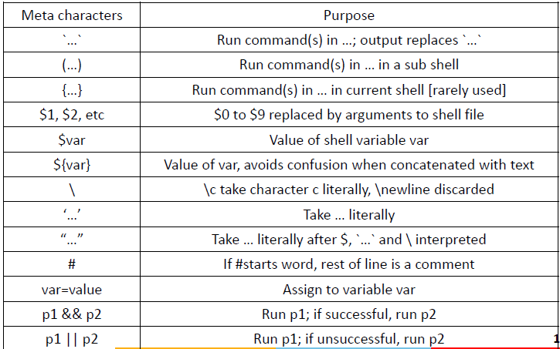
Shell Meta characters
Systems Programming - V 3.0

Slide 36
Shell Scripts
The shell may be used to read and execute
commands contained in a file
• Assume a scenario where commands who, ls and
date are executed one after the other
• To write a shell script to achieve this:
– Open a new file [say firstShellPgm.sh] in vi editor
– Type all the commands that you want to get
executed one after the other. i.e. who, ls and date
– Save the file using :wq option.
Systems Programming - V 3.0

Slide 37
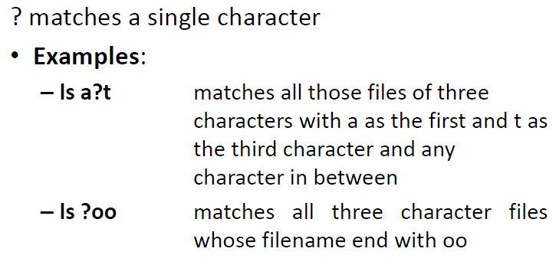
Wild card – “?”
Systems Programming - V 3.0

Slide 38
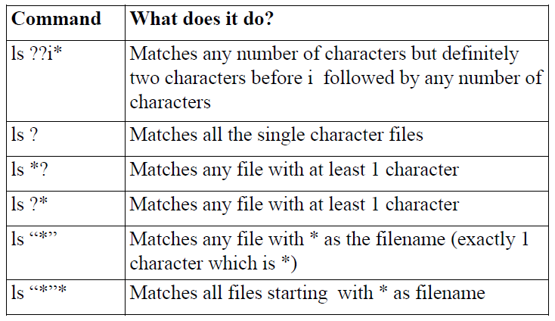
Examples
Systems Programming - V 3.0

Slide 39
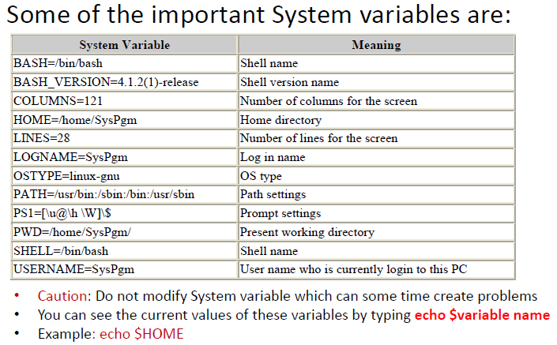
System Variables in Shell
Systems Programming - V 3.0

Slide 40
What is Shell Programming
Grouping a set commands
Programming constructs used
Systems Programming - V 3.0

Slide 41
Need for Shell Programming
To execute a set of commands regularly
Typing every time every command is laborious & time consuming
To have control on the sequence of
commands to be executed based previous results
Systems Programming - V 3.0

Slide 42
Shell Scripts/Shell Programs
Group of commands have to be executed
regularly
Stored in a file
File itself executed as a shell script or a shell
program by the user.
A shell program runs in interpretive mode.
Shell scripts are executed in a separate child shell
process which may or may not be same as the
login shell.
Systems Programming - V 3.0

Slide 43
Shell Scripts
Example: script.sh
#! /bin/sh
# script.sh: Sample Shell Script
echo “Welcome to Shell Programming”
echo “Today’s date : `date`”
echo “This months calendar:”
cal `date “+%m 20%y”` This month’s calendar.
echo “My Shell :$ SHELL”
Systems Programming - V 3.0

Slide 44
Shell Scripts
To run the script we need to first make it executable. This is achieved by using the chmod command as shown below:
$ chmod +x script.sh
Then invoke the script name as:
$ script.sh
Systems Programming - V 3.0

Slide 45
Shell Scripts
Explicitly spawn a child with script name as argument:
sh script.sh
Note: Here the script neither requires a executable permission nor an interpreter line.
Systems Programming - V 3.0

Slide 46
Read: Making Scripts Interactive
Shell’s internal tool for making scripts interactive
Used with one or more variables.
Inputs supplied with the standard input are read
into these variables.
Ex: read name
causes the script to pause at that point to take
input from the keyboard.
Systems Programming - V 3.0

Slide 47
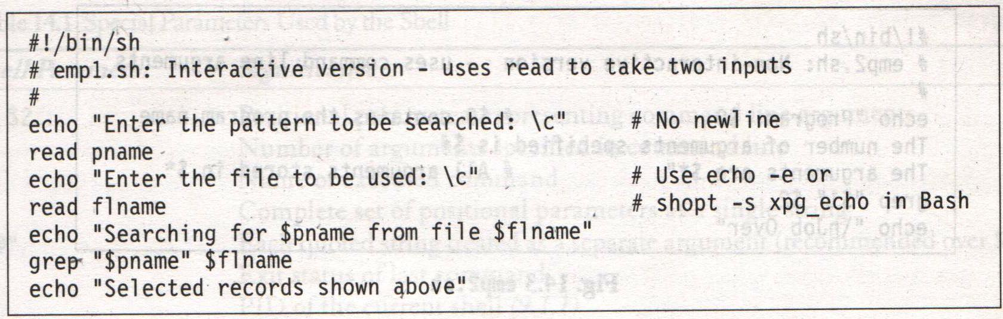
Read: Making Scripts Interactive
Systems Programming - V 3.0

Slide 48
Using Command Line Arguments
Shell scripts accept arguments from the command line.
Run non interactively
Arguments are assigned to special shell variables (positional parameters).
Represented by $1, $2, etc;
Systems Programming - V 3.0

Slide 49
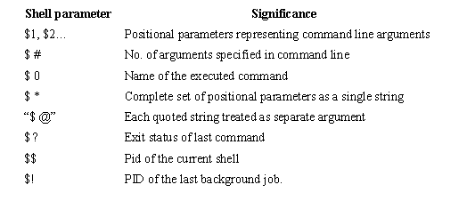
Using Command Line Arguments
Systems Programming - V 3.0

Slide 50
Using Command Line Arguments
#! /bin/sh
echo “Program Name : $0”
echo “No of Arguments : $#”
echo “Arguments are : $*”
$ chmod +x 2.sh
$ 2.sh A B C
o/p→ Program Name : 2.sh
No of Arguments : 3
Arguments are : A B C
Systems Programming - V 3.0

Slide 51

Systems Programming - V 3.0

Slide 52

IMP Note to Self
Systems Programming - V 3.0

