Slide 1

Course Name :
Systems Programming
05th FEB 2023

Slide 2

IMP Note to Self
Systems Programming - V 3.0

Slide 3
IMP Note to Students
It is important to know that just login to the session does not guarantee the attendance.
Once you join the session, continue till the end to consider you as present in the class.
IMPORTANTLY, you need to make the class more interactive by responding to Professors queries in the session.
Whenever Professor calls your number / name ,you need to respond, otherwise it will be considered as ABSENT
Systems Programming - V 3.0

Slide 4
Agenda
Decision making constructs
Shell scripts with more examples
Conditional structure
Looping constructs.
Systems Programming - V 3.0

Slide 5
Shell Scripts/Shell Programs
Group of commands have to be executed regularly
Stored in a file
File itself executed as a shell script or a shell program by the user.
A shell program runs in interpretive mode.
Shell scripts are executed in a separate child shell
process which may or may not be same as the login shell.
Systems Programming - V 3.0

Slide 6
Using Command Line Arguments
Shell scripts accept arguments from the command line.
Run non interactively
Arguments are assigned to special shell variables (positional parameters).
Represented by $1, $2, etc;
Systems Programming - V 3.0

Slide 7
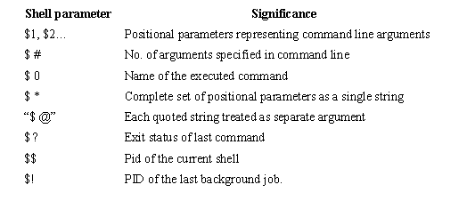
Using Command Line Arguments
Systems Programming - V 3.0

Slide 8
Shell Scripts
#!/bin/bash
echo "Hello, Student”
# This script displays the date, time, username and
# current directory.
echo "Date and time is "
date
echo
echo -e "Your username is: `whoami` \n"
echo -e "Your current directory is: \c"
pwd
Systems Programming - V 3.0

Slide 9
Shell Scripts
#Reading user input
#To read standard input into a shell script use the read command.
echo "Please enter your name:"
read name
echo "Welcome to Testing Department Mr. $name"
# This prompts the user for input, assigns this to the variable name and then displays the value of this variable to standard output.
# If there is more than one word in the input, each word can be assigned to a different variable.
# Any words left over are assigned to the last named variable.
echo -e "\nPlease enter your surname\n"
echo -e "Followed by your first name: \c"
read name1 name2
echo -e "\nWelcome to Wipro $name2 $name1“
Systems Programming - V 3.0

Slide 10
Shell Scripts
# Script to print user information who currently login , current date & time
#
clear
echo -e "\nHello $USER"
echo -e "\nToday is \c ";date
echo -e "\nNumber of user login : \c" ; who | wc -l
echo -e "\nCalendar\n"
cal
# declaration and printing of string variable
#!/bin/bash
x='Beautiful World'
echo $x
echo x # just string 'x'
Systems Programming - V 3.0

Slide 11
Shell Scripts
# printing of string constant
#!/bin/bash
echo 'hello'
echo "hello"
echo hello
#!/bin/bash
# Script that demos, command line args
echo "Total number of command line argument are $#"
echo "$0 is script name"
echo "$1 is first argument"
echo "$2 is second argument"
echo "All of them are :- $* "
Systems Programming - V 3.0

Slide 12
Shell Scripts
# printing of string constant
#!/bin/bash
echo 'hello'
echo "hello"
echo hello
#!/bin/bash
# Script that demos, command line args
echo "Total number of command line argument are $#"
echo "$0 is script name"
echo "$1 is first argument"
echo "$2 is second argument"
echo "All of them are :- $* "
Systems Programming - V 3.0

Slide 13
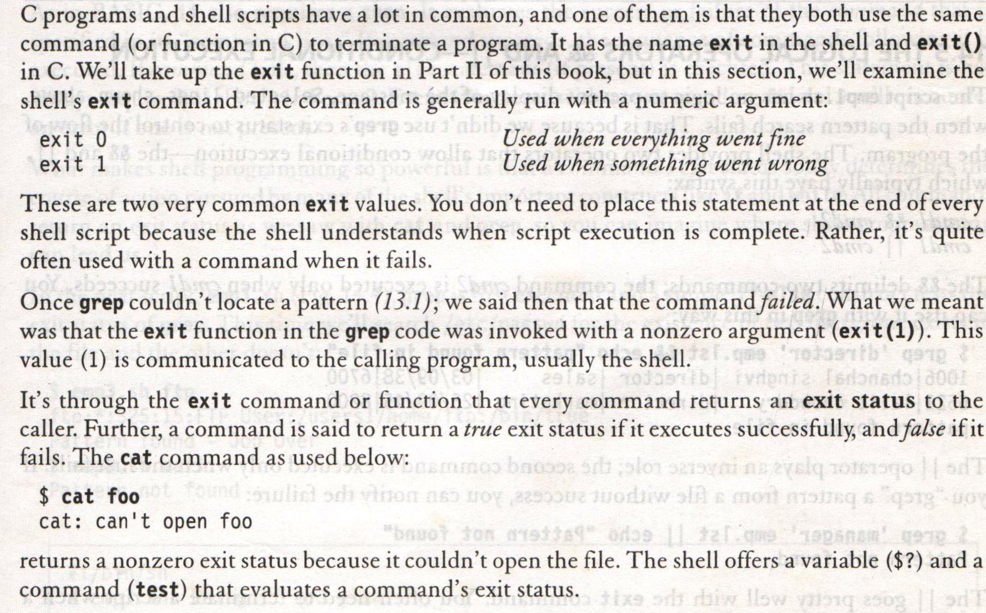
exit and Exit Status of Command
Systems Programming - V 3.0

Slide 14
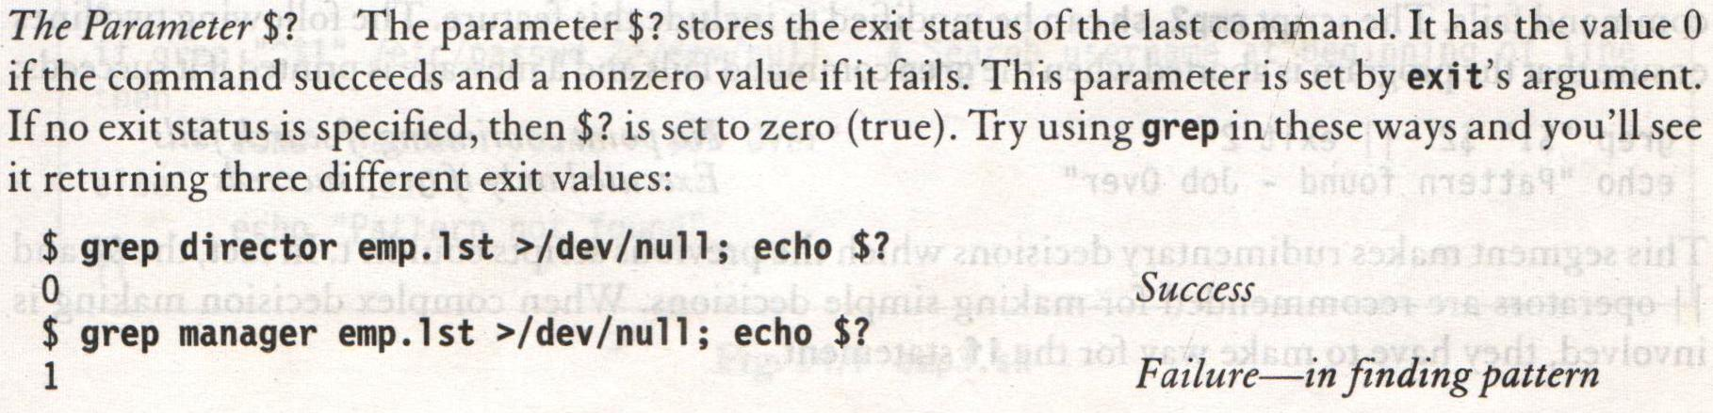
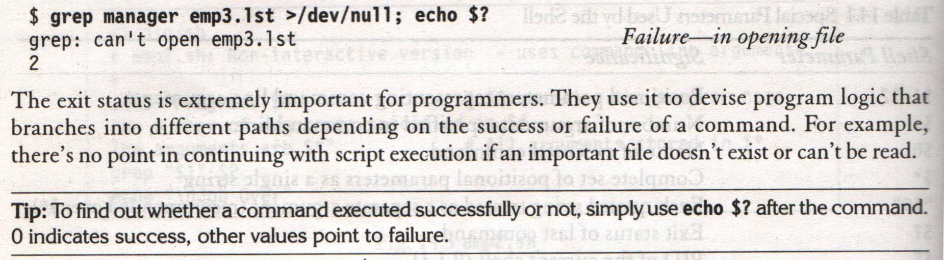
exit and Exit Status of Command
Systems Programming - V 3.0

Slide 15
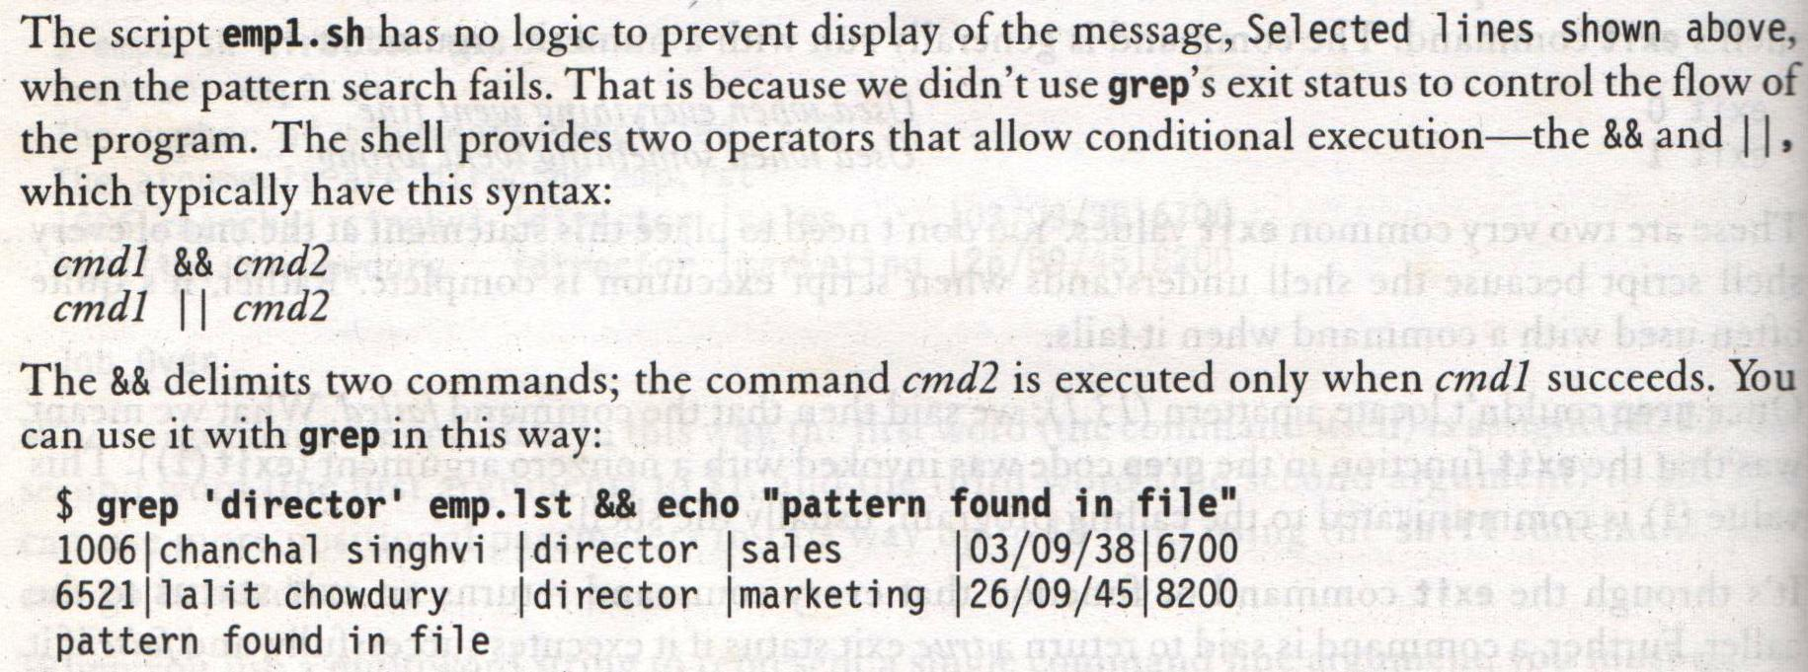
The Logical Operators && and ||- Conditional Execution
Systems Programming - V 3.0

Slide 16
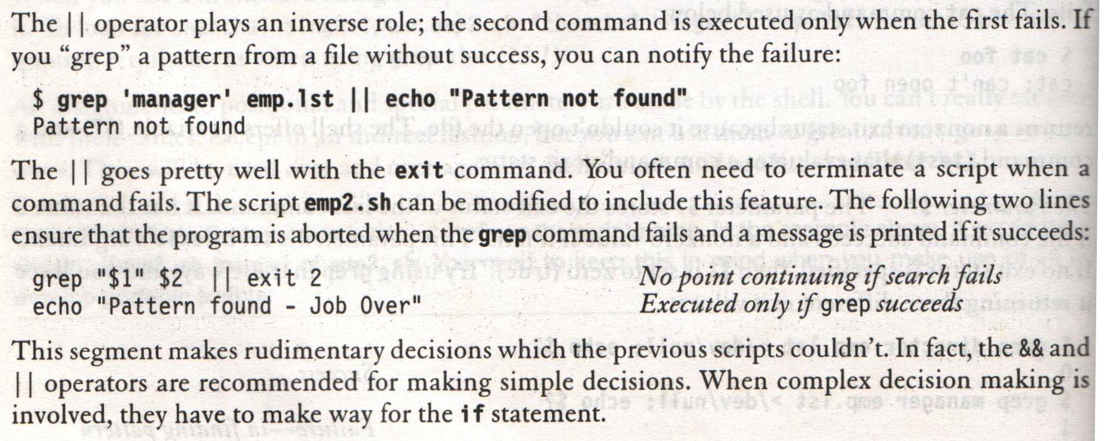
The Logical Operators && and ||- Conditional Execution
Systems Programming - V 3.0

Slide 17
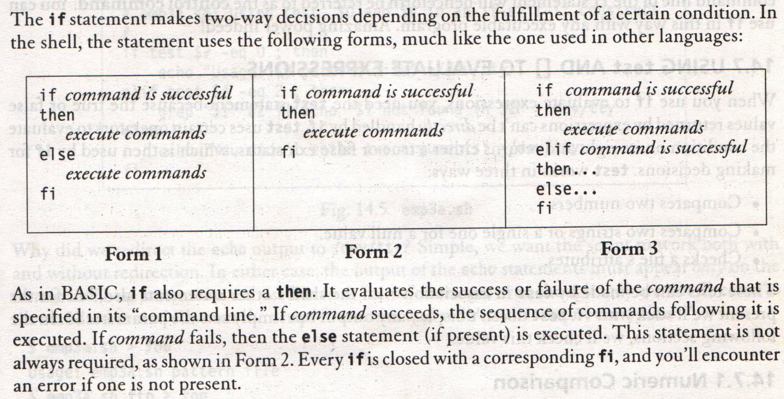
The if Conditional
Systems Programming - V 3.0

Slide 18
Shell Scripts
#!/bin/bash
#Script to print file
if cat $1
then
echo -e "\n\nFile $1, found and successfully echo ed“
fi
#!/bin/bash
# Script to see whether argument is positive
if test $1 -ge 0
then
echo "$1 number is positive“
fi
Systems Programming - V 3.0

Slide 19
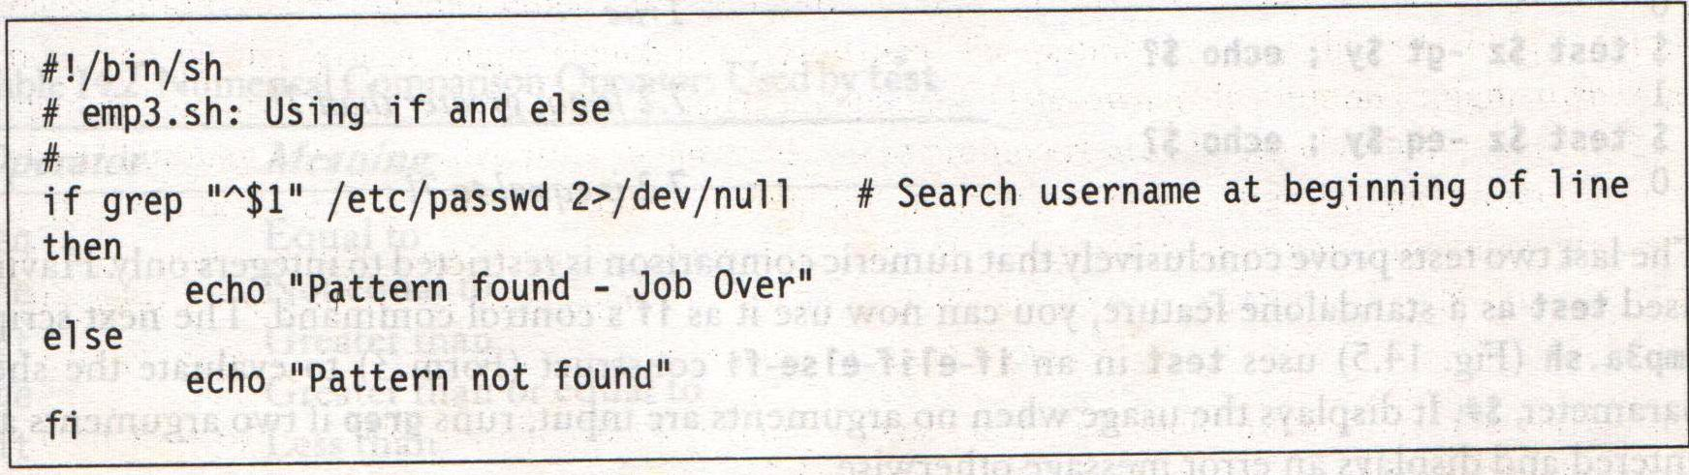
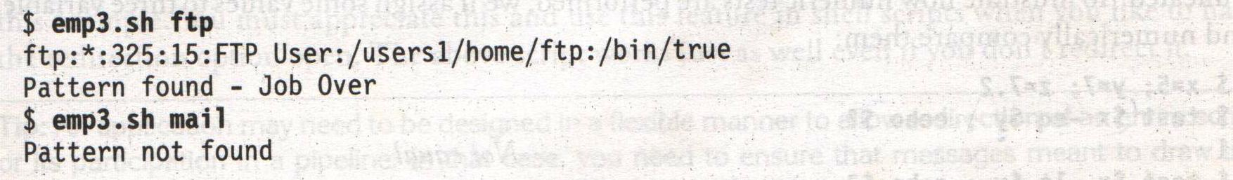
The if Conditional
Systems Programming - V 3.0

Slide 20
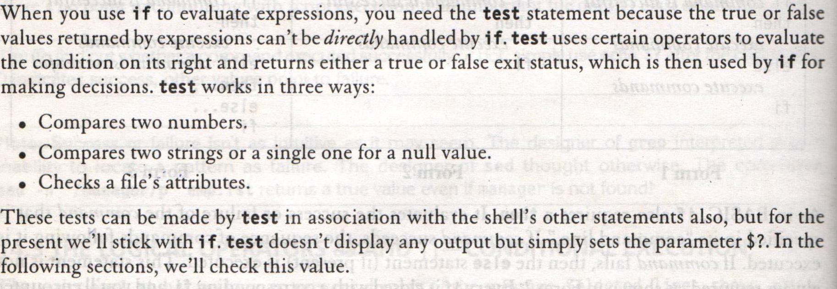
Using test and [] to evaluate expressions
Systems Programming - V 3.0

Slide 21
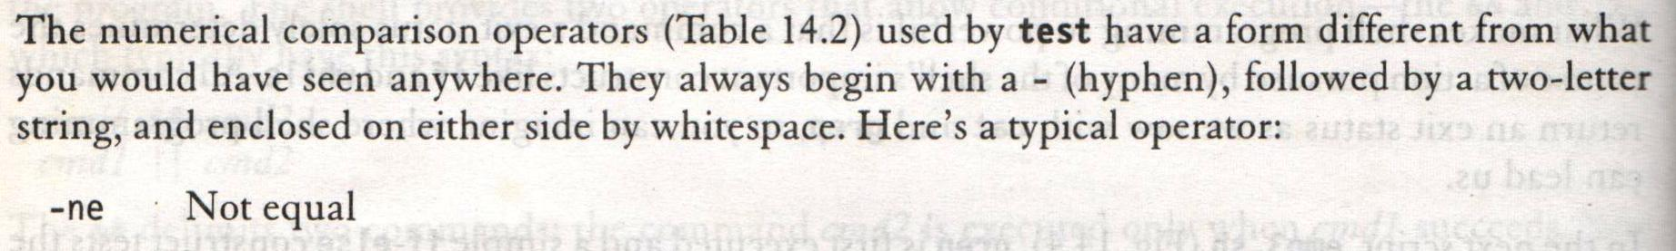
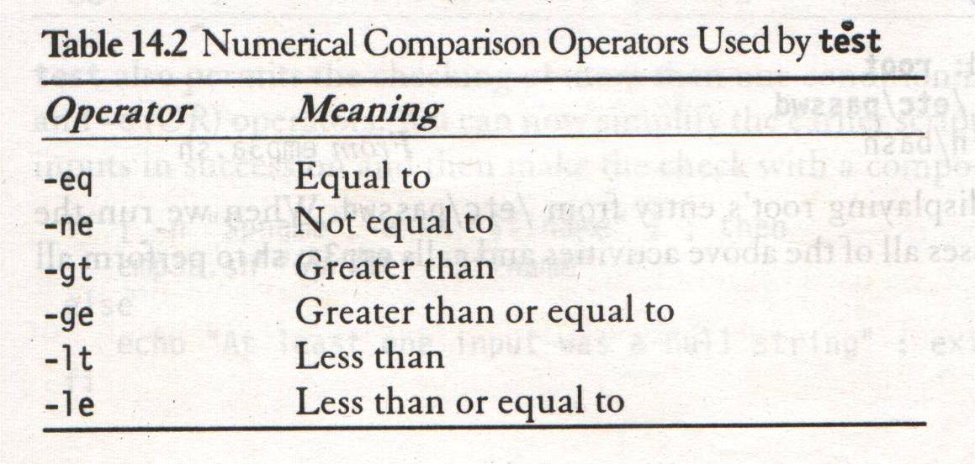
Using test and [] to evaluate expressions – Numeric Comparison
Systems Programming - V 3.0

Slide 22
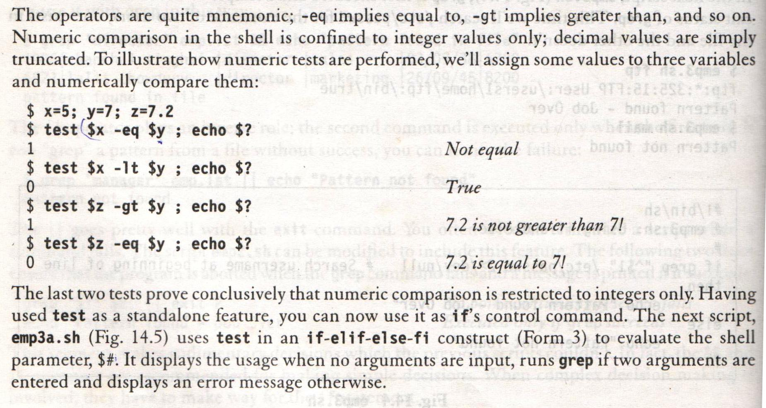
Using test and [] to evaluate expressions – Numeric Comparison
Systems Programming - V 3.0

Slide 23
Shell Scripts
# very simple 'if'
#!/bin/bash
echo 'Enter a number '
read x
if [ $x -eq 10 ]
then
echo "Entered value is 10"
fi
#!/bin/bash
echo 'Enter a number'
read x
if [ $x -eq 10 ]
then
echo "Entered value is 10"
else
echo "Entered value is not 10"
fi
Systems Programming - V 3.0

Slide 24
Shell Script
# if ... elif ... else
#!/bin/bash
echo 'Enter a number'
read x
if [ $x -eq 10 ]
then
echo "Entered value is 10"
elif [ $x -eq 100 ]
then
echo "Entered value is 100"
else
echo "Entered value is not 10 and not 100"
fi
Systems Programming - V 3.0

Slide 25
Shell Scripts
# comparison -lt and -gt, nested if
#!/bin/bash
echo -n 'Enter a number'
read x
if [ $x -gt 10 ]
then
if [ $x -lt 100 ]
then
echo "Entered value is greatedthan 10 and lessthan 100"
fi
fi
Systems Programming - V 3.0

Slide 26
Shell Scripts
#!/bin/bash
# Script to see whether argument is positive
if test $1 -gt 0
then
echo "$1 number is positive"
fi
# Script to test rm command and exist status
if rm $1
then
echo "$1 file deleted"
fi
Systems Programming - V 3.0

Slide 27
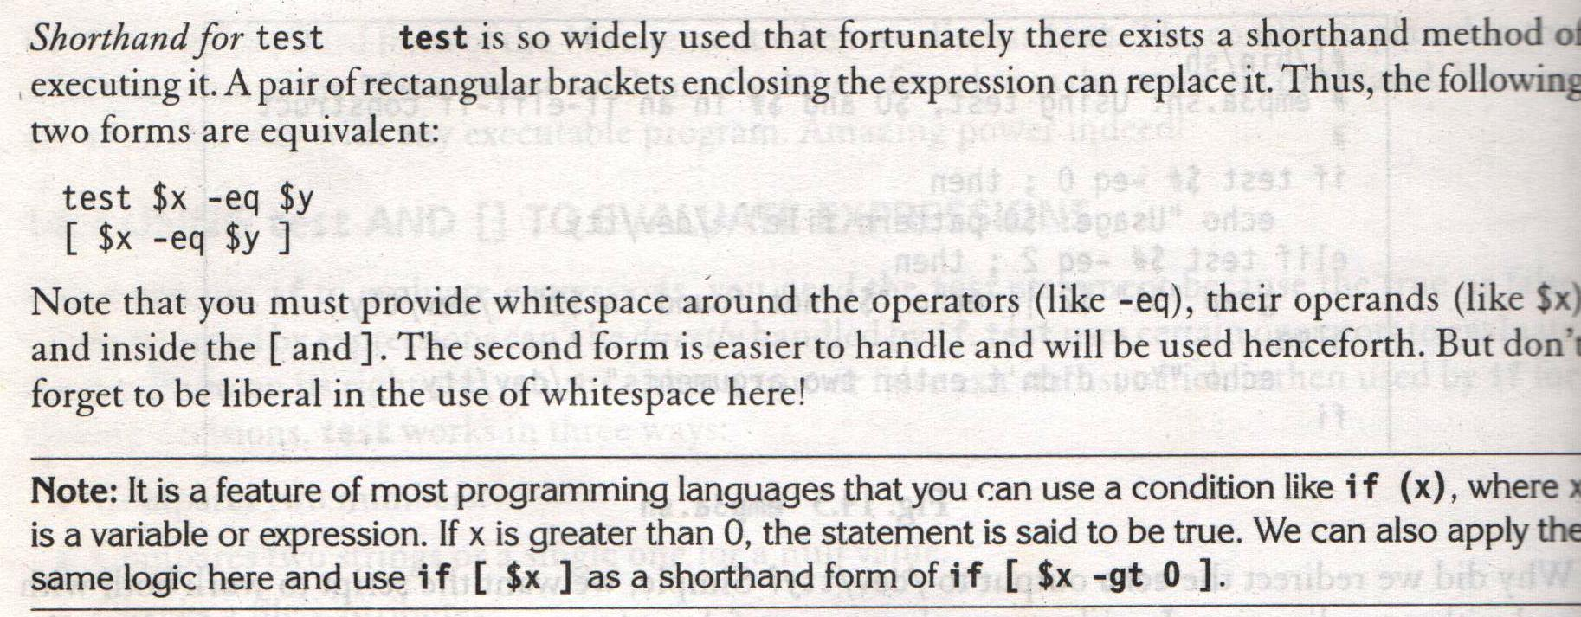
Using test and [] to evaluate expressions – Numeric Comparison
Systems Programming - V 3.0

Slide 28
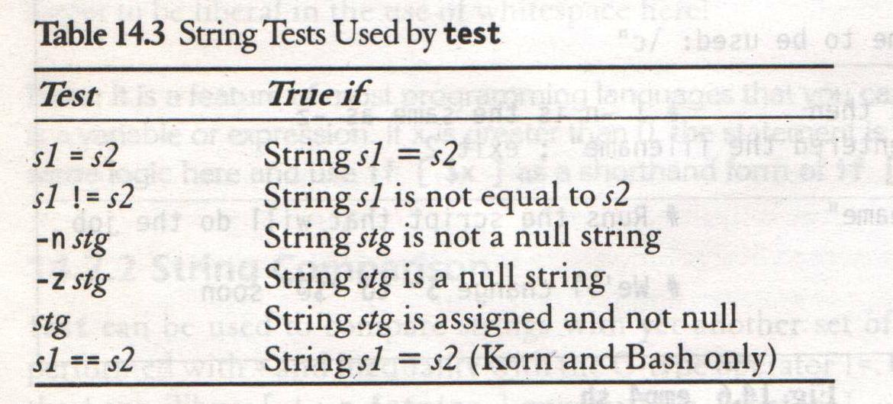
Using test and [] to evaluate expressions – Numeric Comparison
Systems Programming - V 3.0

Slide 29
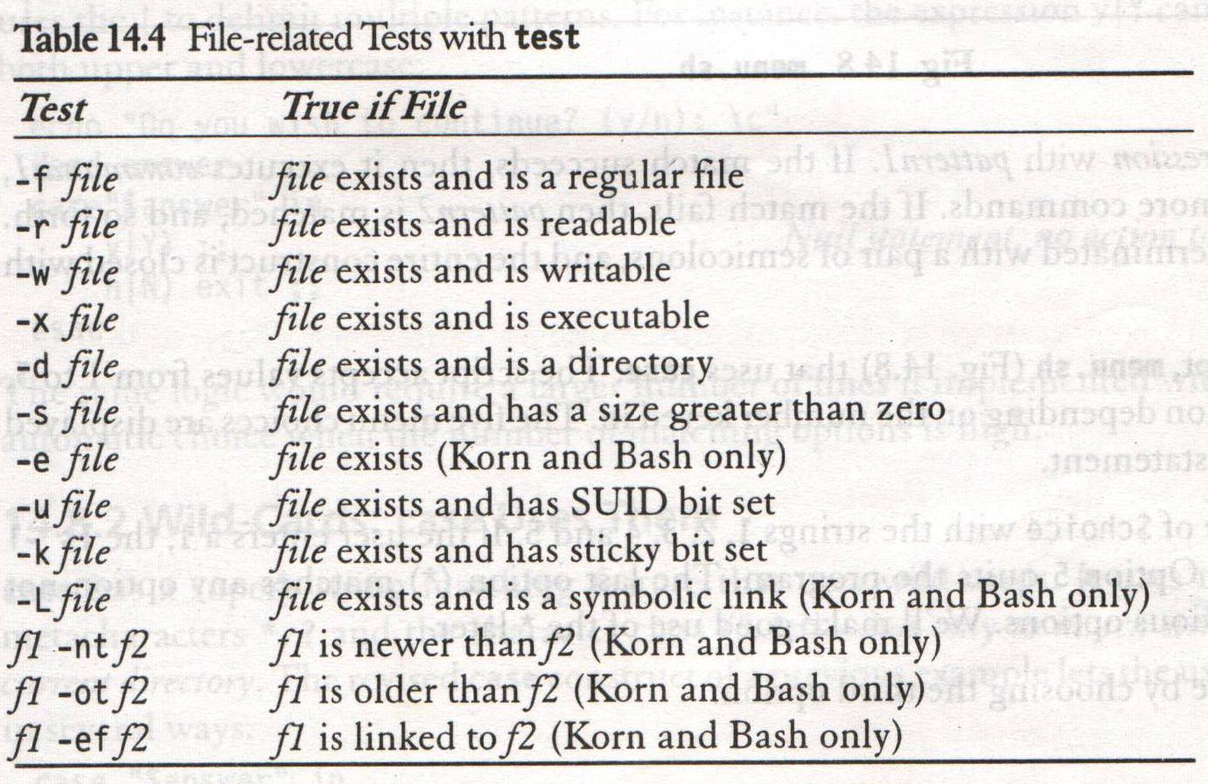
Using test and [] to evaluate expressions – Numeric Comparison
Systems Programming - V 3.0

Slide 30
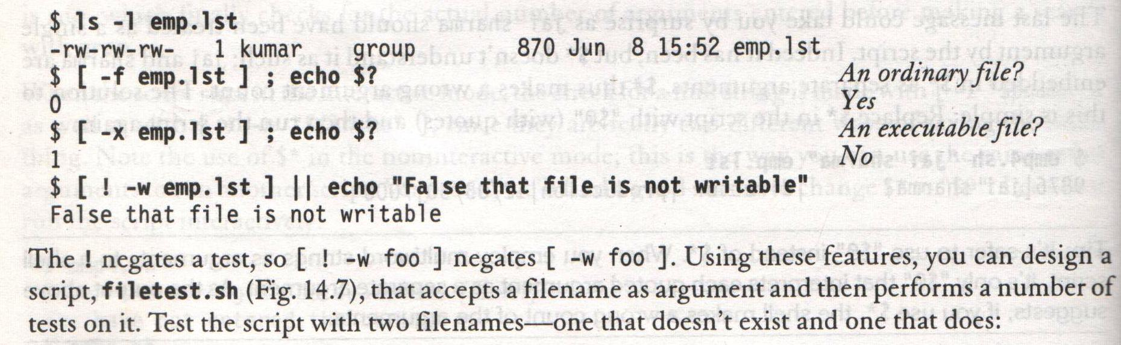
Using test and [] to evaluate expressions – Numeric Comparison
Systems Programming - V 3.0

Slide 31
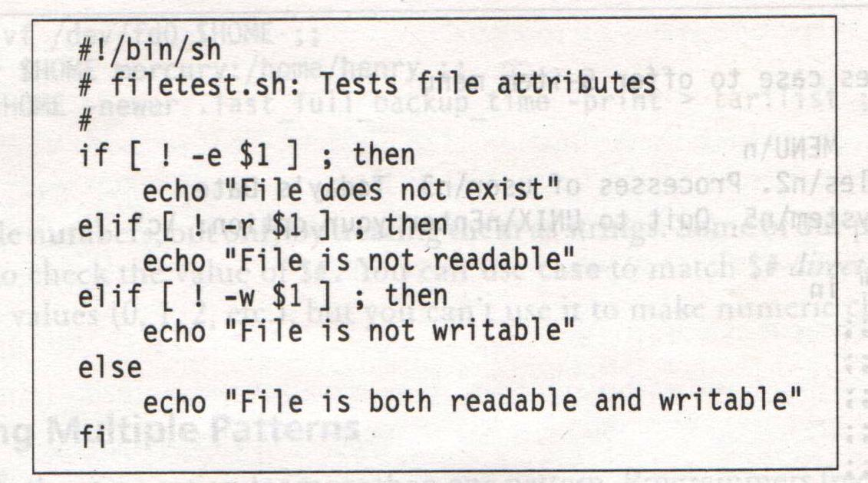
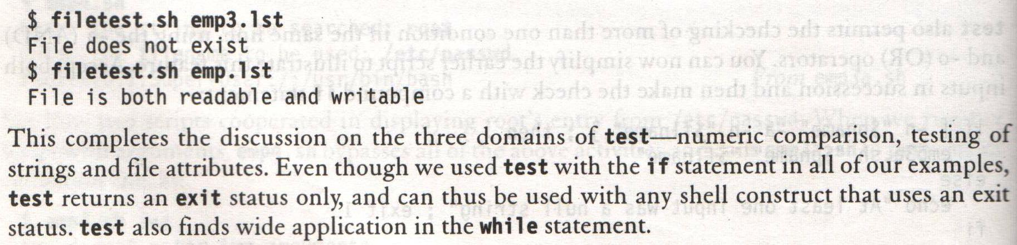
Using test and [] to evaluate expressions – Numeric Comparison
Systems Programming - V 3.0

Slide 32
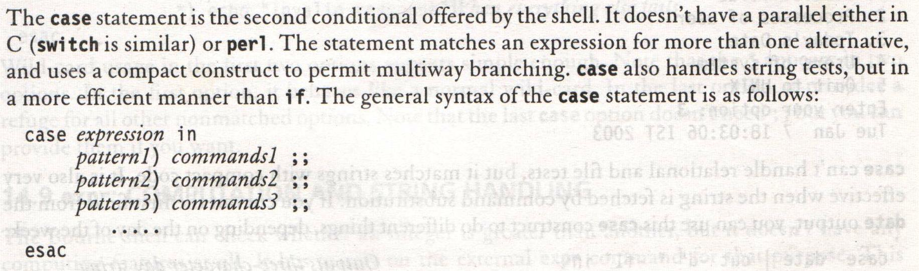
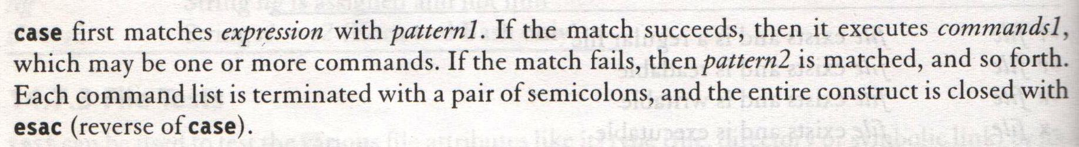
The case Conditional
Systems Programming - V 3.0

Slide 33
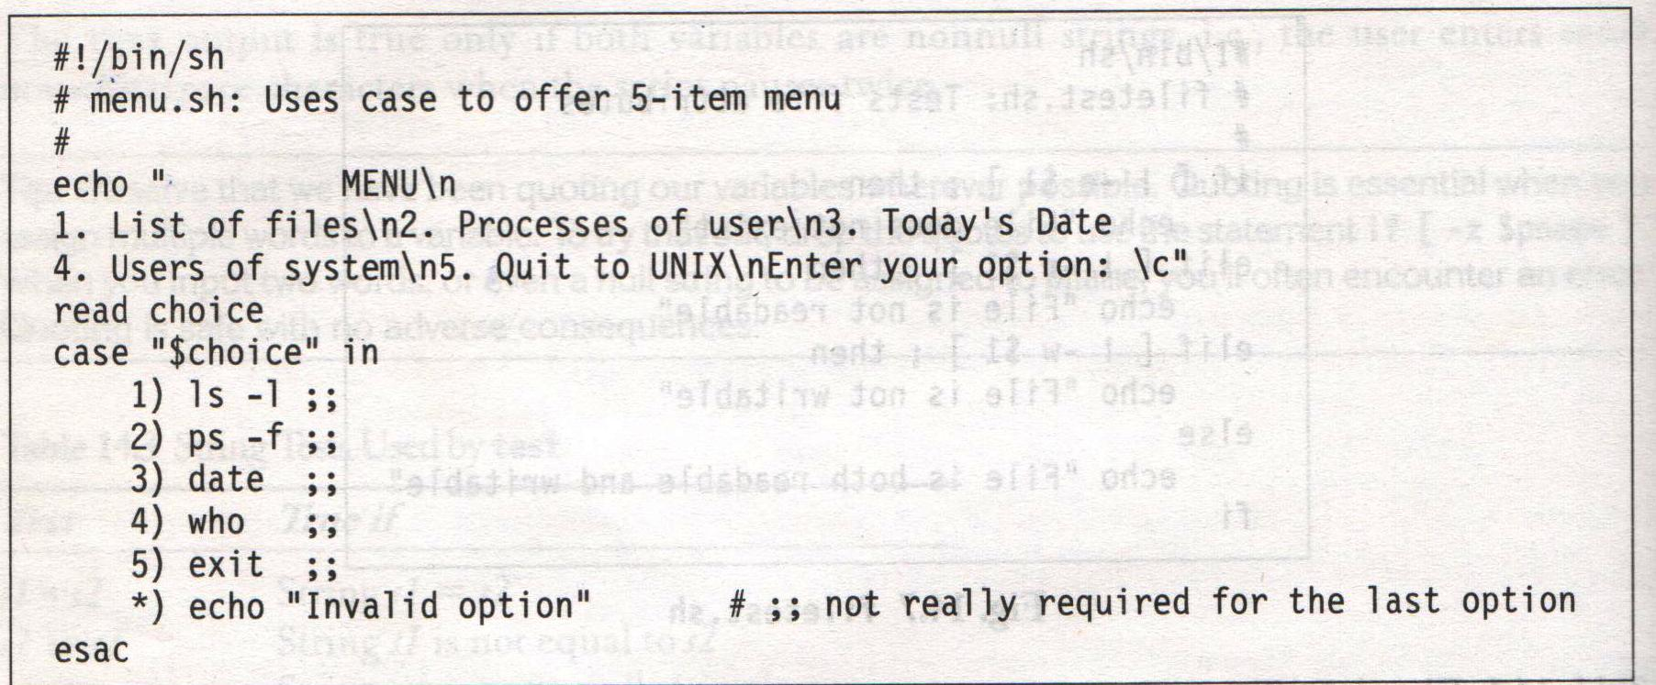
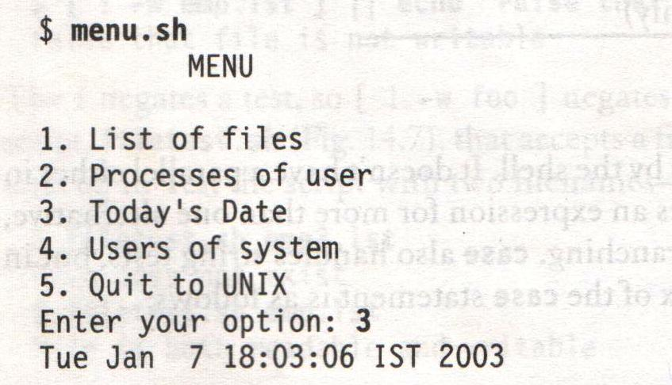
The case Conditional
Systems Programming - V 3.0

Slide 34
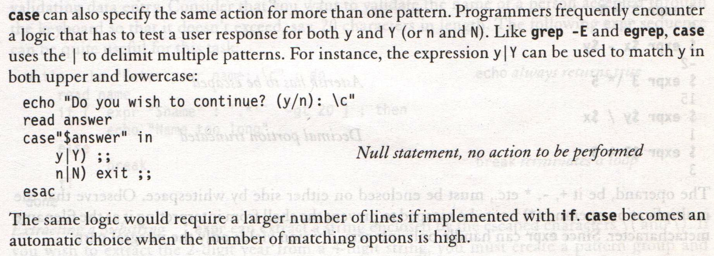
The case Conditional – Matching Multiple Patterns
Systems Programming - V 3.0

Slide 35
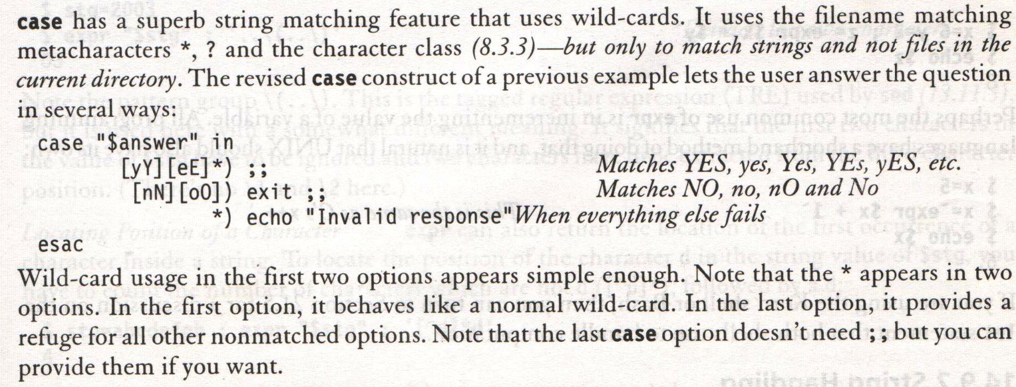
The case Conditional – Wild-Cards
Systems Programming - V 3.0

Slide 36
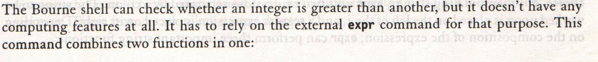
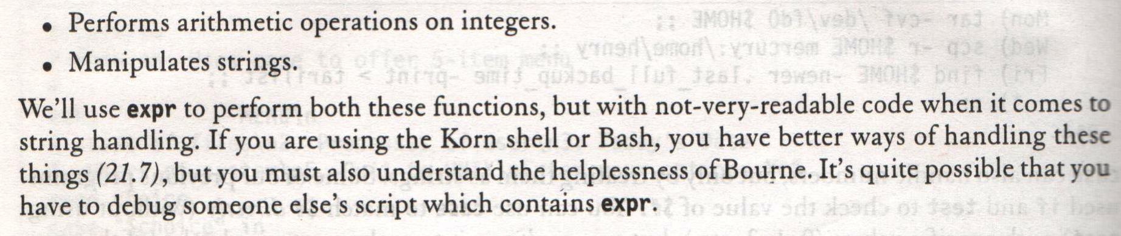
expr – Computation and String handling
Systems Programming - V 3.0

Slide 37
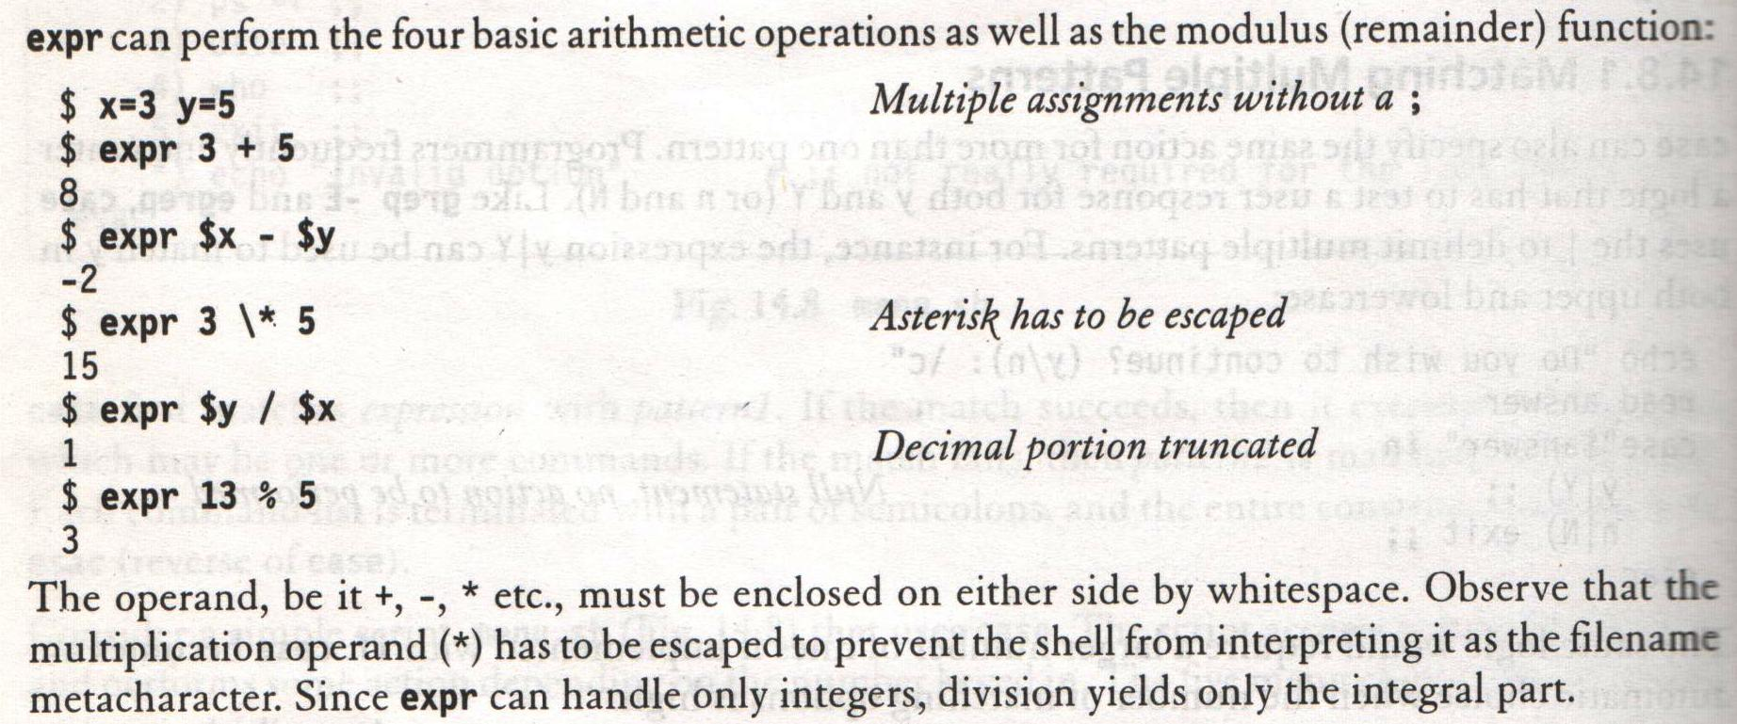
expr – Computation
Systems Programming - V 3.0

Slide 38
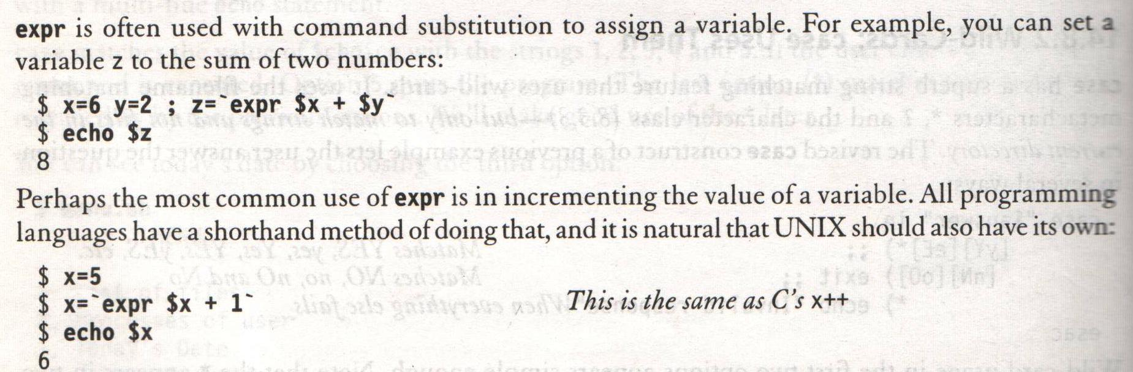
expr – Computation
Systems Programming - V 3.0

Slide 39
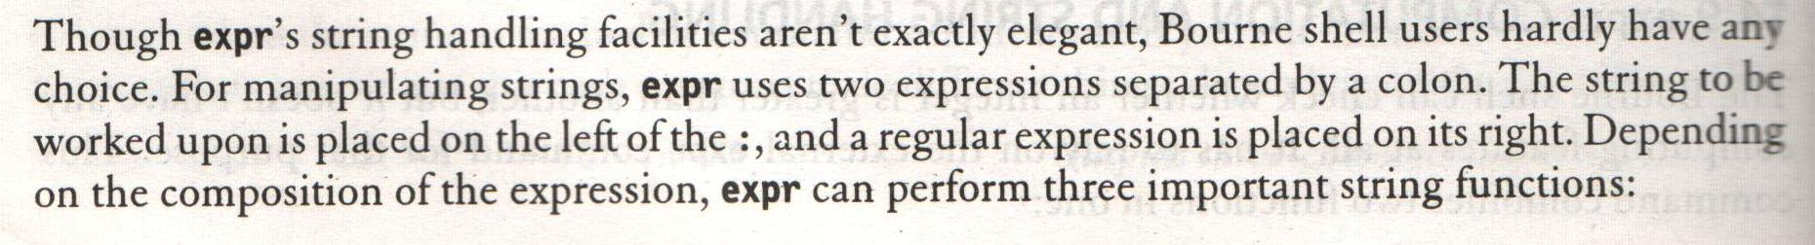
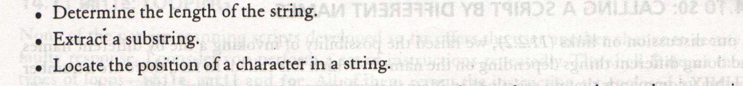
expr – String Handling
Systems Programming - V 3.0

Slide 40
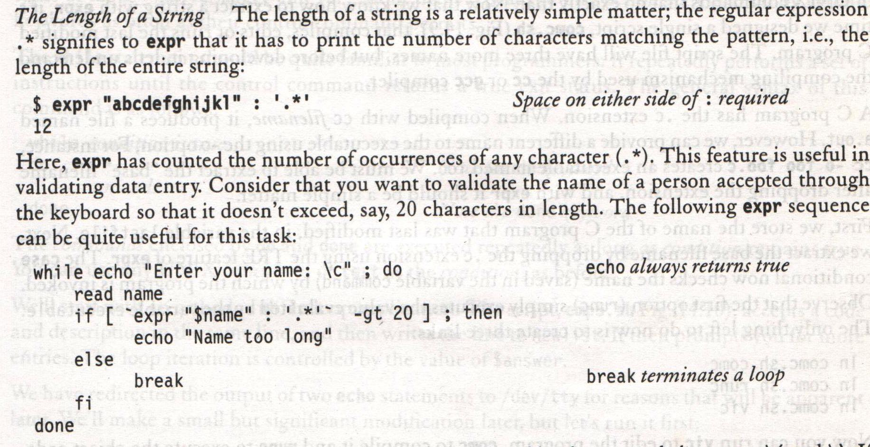
expr – String Handling
Systems Programming - V 3.0

Slide 41
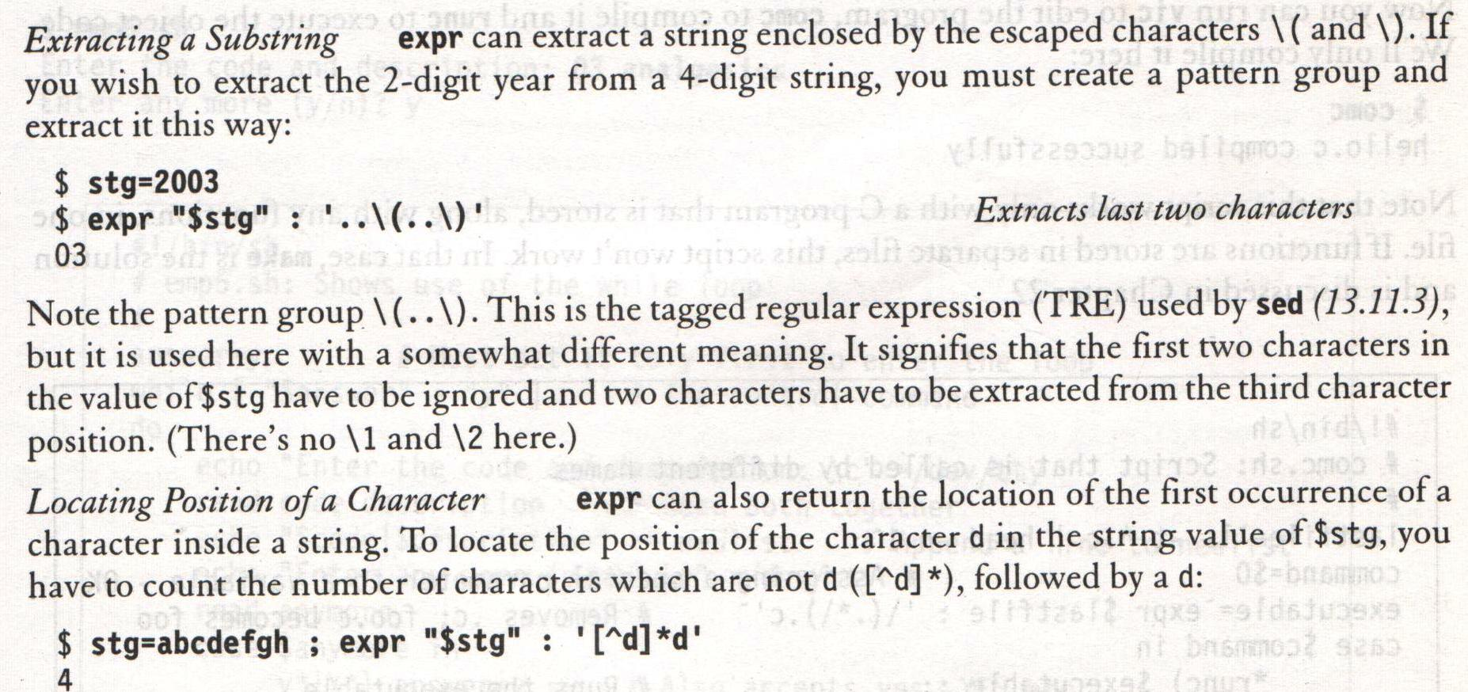
expr – String Handling
Systems Programming - V 3.0

Slide 42

Systems Programming - V 3.0

Slide 43

IMP Note to Self
Systems Programming - V 3.0

