Slide 1

Course Name :
Systems Programming
09th FEB 2023

Slide 2

IMP Note to Self
Systems Programming - V 3.0

Slide 3
IMP Note to Students
It is important to know that just login to the session does not guarantee the attendance.
Once you join the session, continue till the end to consider you as present in the class.
IMPORTANTLY, you need to make the class more interactive by responding to Professors queries in the session.
Whenever Professor calls your number / name ,you need to respond, otherwise it will be considered as ABSENT
Systems Programming - V 3.0

Slide 4
Agenda
Loop constructs in Shell with examples
Shell scripting with file examples
set & shift Commands
Systems Programming - V 3.0

Slide 5
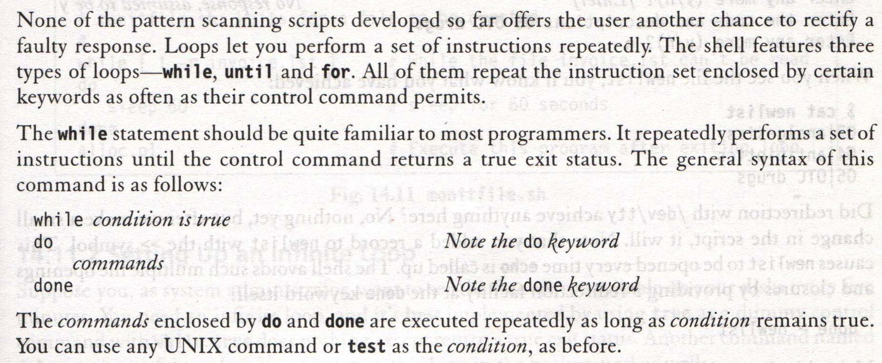
while: Looping
Systems Programming - V 3.0

Slide 6
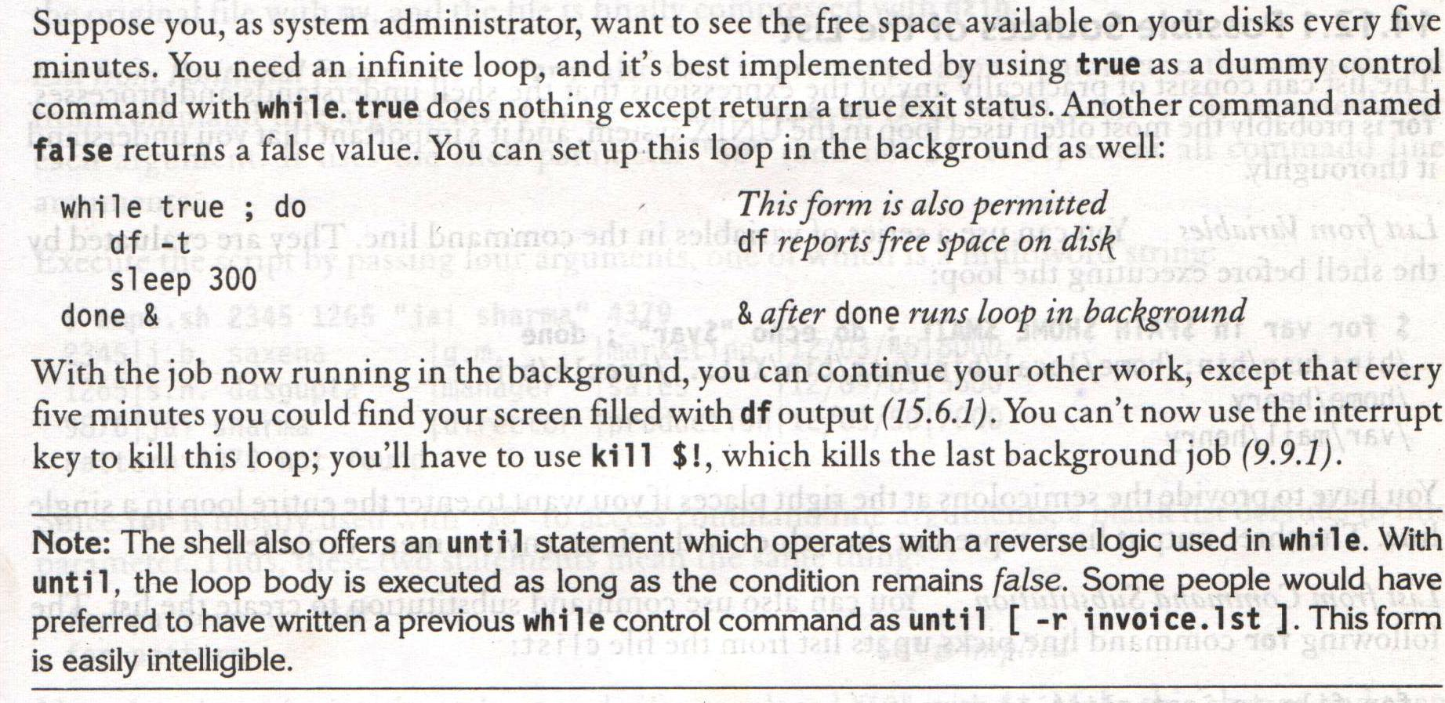
while: Looping – Setting up an Infinite loop
Systems Programming - V 3.0

Slide 7
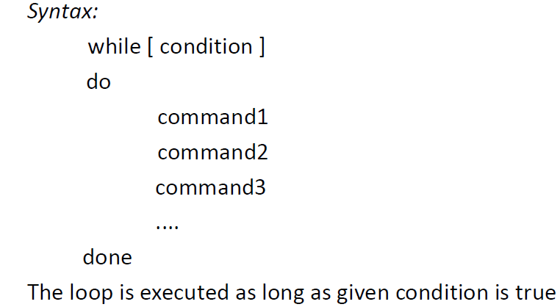
while: Looping
Systems Programming - V 3.0

Slide 8
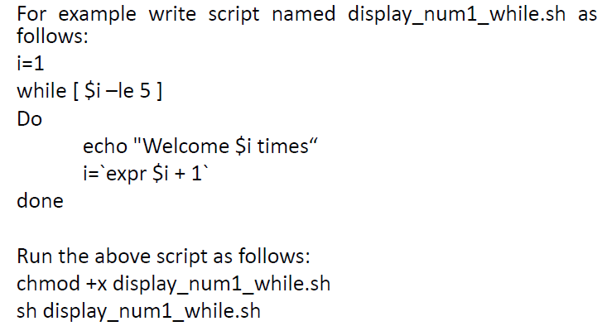
while: Looping
Systems Programming - V 3.0

Slide 9
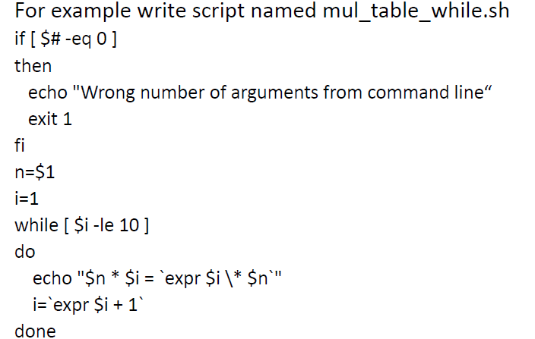
while: Looping
Systems Programming - V 3.0

Slide 10
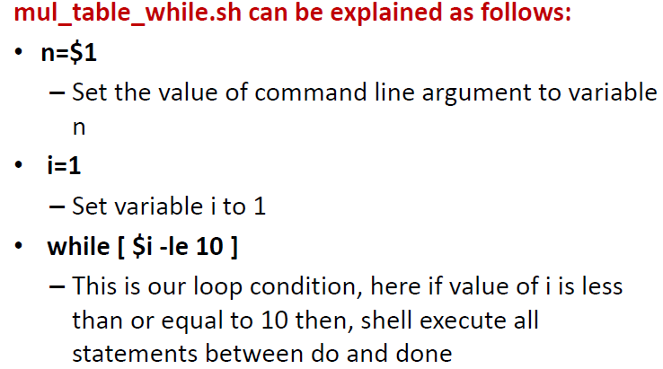
while: Looping
Systems Programming - V 3.0

Slide 11
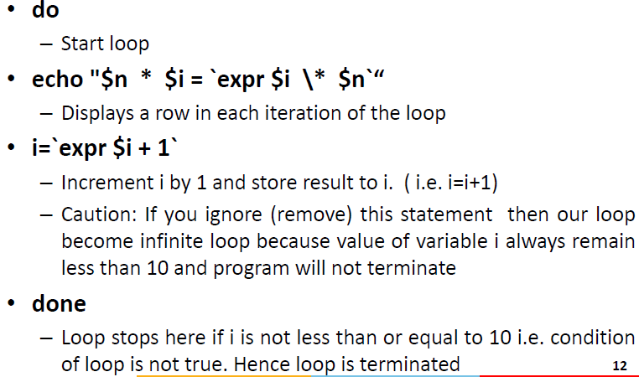
while: Looping
Systems Programming - V 3.0

Slide 12
Print numbers as 5,4,3,2,1 using while loop
#!/bin/bash
i=5
while test $i != 0
do
echo "$i"
i=`expr $i - 1`
done
O/P
5
4
3
2
1
Systems Programming - V 3.0

Slide 13
if [ $# -eq 0 ]
then
echo "Wrong number of arguments from command line"
exit 1
fi
n=$1
i=1
while [ $i -le 10 ]
do
echo "$n * $i = `expr $i \* $n`"
i=`expr $i + 1`
done
sh filename.sh 5
O/P
5 * 1 = 5
5 * 2 = 10
5 * 3 = 15
5 * 4 = 20
5 * 5 = 25
5 * 6 = 30
5 * 7 = 35
5 * 8 = 40
5 * 9 = 45
5 * 10 = 50
Systems Programming - V 3.0

Slide 14
1 , 1
1 , 2
1 , 3
1 , 4
2 , 1
2 , 2
2 , 3
2 , 4
3 , 1
3 , 2
3 , 3
3 , 4
4 , 1
4 , 2
4 , 3
4 , 4
i=1
while [ $i -le 4 ] # Outer for loop
do
j=1
while [ $j -le 4] # Inner for loop
do
echo "$i , $j "
j=`expr $j + 1`
done
echo " " #print the new line
i=`expr $i + 1`
done
Systems Programming - V 3.0

Slide 15
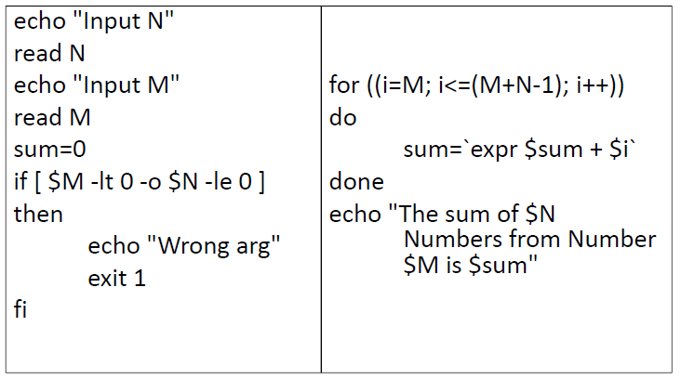
while: Looping
Shell script to find sum of first N numbers from number M (take N and M from the user)
Systems Programming - V 3.0

Slide 16
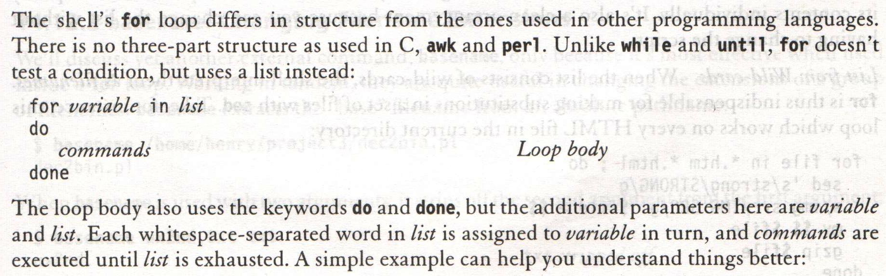
for: Looping with a list
Systems Programming - V 3.0

Slide 17
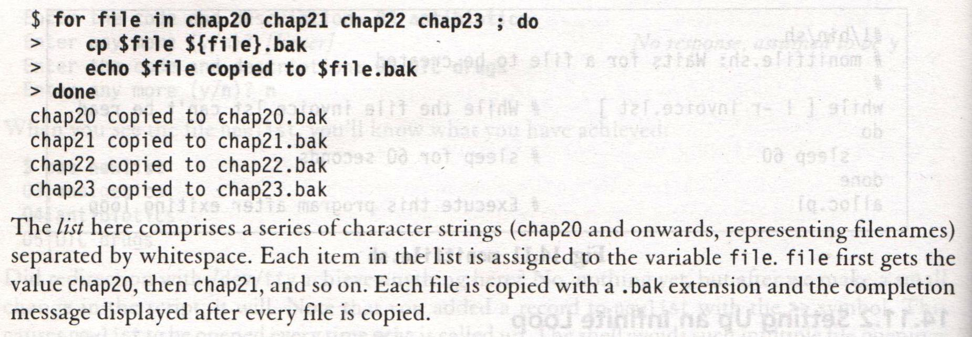
for: Looping with a list
Systems Programming - V 3.0

Slide 18
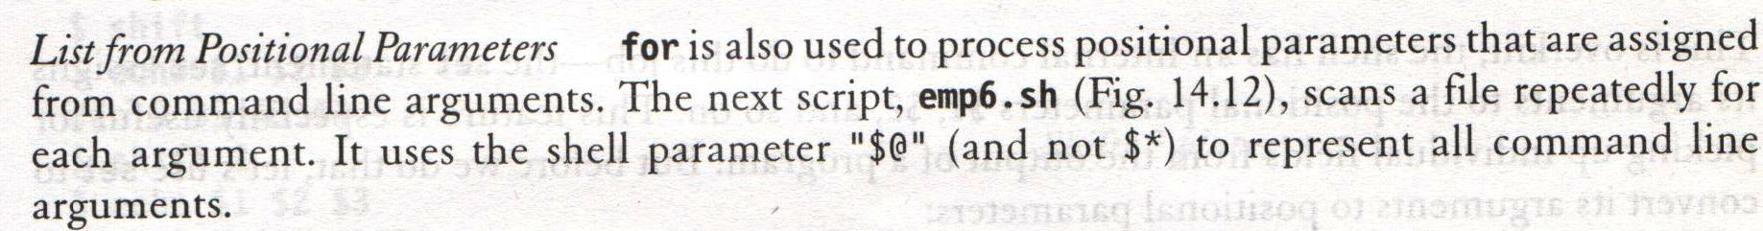
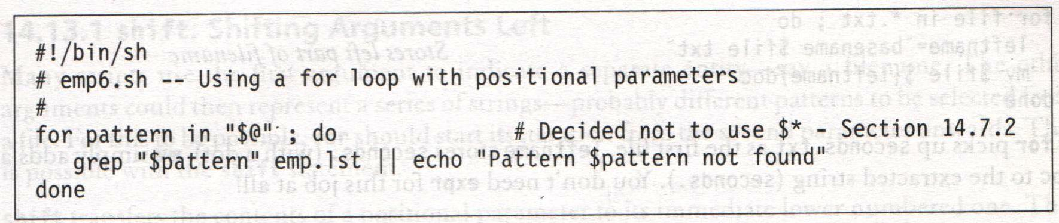
for: Looping with a list – Possible sources of the List
Systems Programming - V 3.0

Slide 19
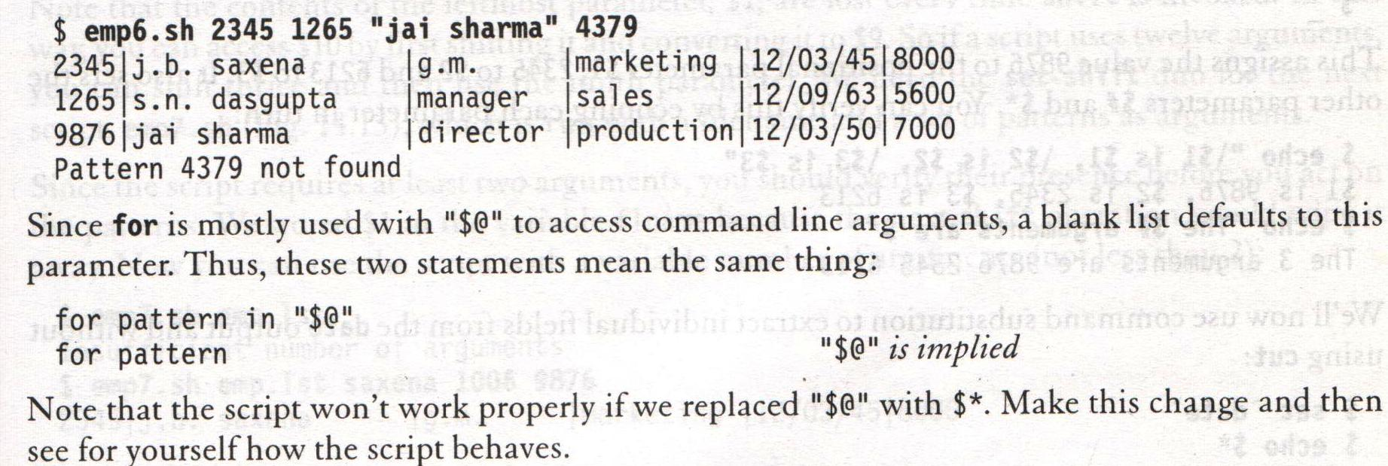
for: Looping with a list – Possible sources of the List
Systems Programming - V 3.0

Slide 20
You can break out of a for loop using 'break' command as shown below
clear
i=1
for day in Mon Tue Wed Thu Fri
do
echo "Weekday $((i++)) : $day"
if [ $i -eq 3 ]; then
break;
fi
done
O/P:
Weekday 1 : Mon
Weekday 2 : Tue
Systems Programming - V 3.0

Slide 21
Example adds "(WEEKEND)" to Sat and Sun, and "(weekday)" to rest of the days.
clear
i=1
for day in Mon Tue Wed Thu Fri Sat Sun
do
echo -n "Day $((i++)) : $day"
if [ $i -eq 7 -o $i -eq 8 ]; then
echo " (WEEKEND)"
continue;
fi
echo " (weekday)"
done
O/P
Day 1 : Mon (weekday)
Day 2 : Tue (weekday)
Day 3 : Wed (weekday)
Day 4 : Thu (weekday)
Day 5 : Fri (weekday)
Day 6 : Sat (WEEKEND)
Day 7 : Sun (WEEKEND)
Systems Programming - V 3.0

Slide 22
# Shell script to compute the sum of numbers
# passed to its argument on command line and display the result.
clear
if [ $# -eq 0 ]
then
echo "No arguments passed"
exit
fi
sum=0
for i in $*
do
sum=`expr $sum + $i`
done
echo "Sum of Numbers is : $sum"
O/P
sh filename.sh 20 30 40 10 50
Sum of Numbers is : 150
Systems Programming - V 3.0

Slide 23
Shell script program to find factorial of a positive integer N (take N from the user). fact(N)=1×2×…..×N
Using while loop
echo "Input N"
read N
fact=1
if [ $N -lt 0 ]
then
echo "Wrong arguments"
exit 1
fi
i=1
while [ $i -le $N ]
do
fact=`expr $fact \* $i`
i=`expr $i + 1`
done
echo "The factorial of $N is $fact"
Systems Programming - V 3.0

Slide 24
Shell script program to find factorial of a positive integer N (take N from the user). fact(N)=1×2×…..×N
Using for loop
echo "Input N"
read N
fact=1
if [ $N -lt 0 ]
then
echo "Wrong arguments"
exit 1
fi
for ((i=1; i<=N; i++))
do
fact=`expr $fact \* $i`
done
echo "The factorial of $N is $fact"
sh filename.sh
Input N
5
The factorial of 5 is 120
Systems Programming - V 3.0

Slide 25
Script to print the first N numbers in Fibonacci series
Given, f0=0, f1=1, and fn=fn‐1+fn‐2 for all n>=2, N is taken from the user by using read command, for loop
echo "Input N"
read N
fib0=0
fib1=1
fib2=1
if [ $N -lt 0 ]
then
echo "Wrong arg"
exit 1
fi
for ((i=0; i<N; i++))
do
echo "$fib0 "
fib0=$fib1
fib1=$fib2
fib2=`expr $fib0 + $fib1`
done
O/P
Input N
5
0
1
1
2
3
Systems Programming - V 3.0

Slide 26
Using while loop
echo "Input N"
read N
fib0=0
fib1=1
fib2=1
if [ $N -lt 0 ]
then
echo "Wrong arg"
exit 1
fi
for ((i=0; i<N; i++))
do
echo "$fib0 "
fib0=$fib1
fib1=$fib2
fib2=`expr $fib0 + $fib1`
done
O/P
Input N
5
0
1
1
2
3
Systems Programming - V 3.0

Slide 27
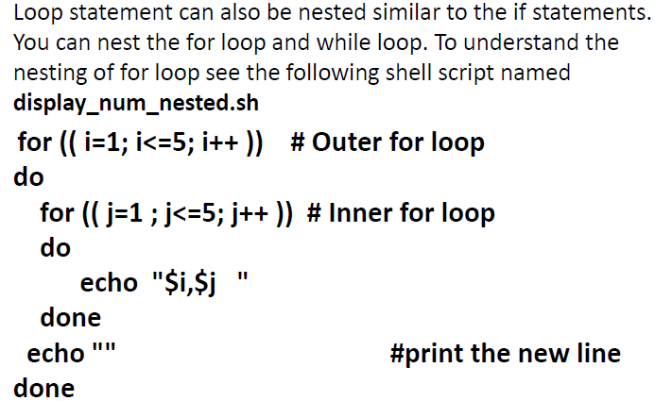
Nesting of Loops [for and while]
Systems Programming - V 3.0

Slide 28
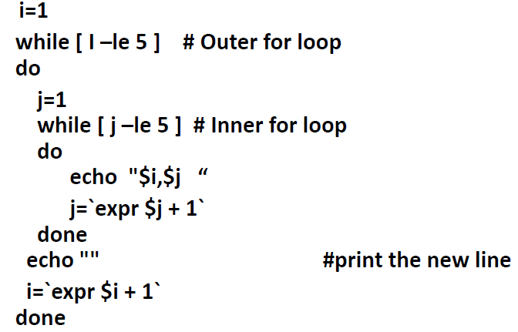
Nesting of Loops [for and while]
Systems Programming - V 3.0

Slide 29
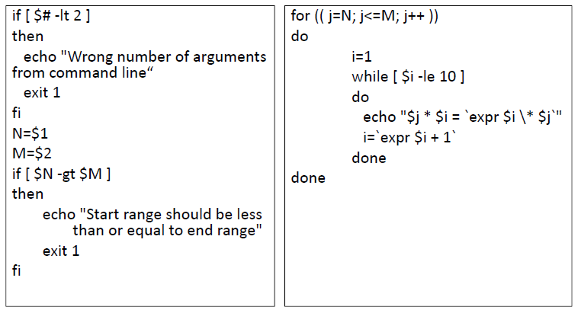
Nesting of Loops [for and while]
Take two integer numbers N and M from user
• Display all the Multiplication table between N and M
Systems Programming - V 3.0

Slide 30
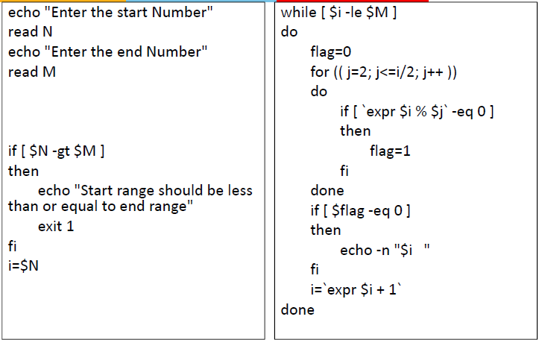
Take start range as N and end range as M from user
• Find all prime numbers between N and M
Systems Programming - V 3.0

Slide 31
Files using Shell Scripting
[Create a text file called integernos.txt and
store some random numbers in it (one
number in one line).]
Write a shell script program to display all the
even numbers from the file.
Systems Programming - V 3.0

Slide 32
Files using Shell Scripting
while read line
do
  x=`expr $line % 2`
  if [ $x ‐eq 0 ]
  then
  echo $line
  fi
done < integernos.txt
Systems Programming - V 3.0

Slide 33
Files using Shell Scripting
Task
• Copy numLine number of lines from the
starting line number startNum of the file
named data.txt
• Store the copied lines in a file named
datanew.txt
• Take numLine and startNum as user input
Systems Programming - V 3.0

Slide 34
Files using Shell Scripting
Method I
echo "Enter the start line number:”
read startNum
echo “Enter the number of lines to be displayed:”
read numLine
endLine=$((startNum + numLine – 1))
head ‐n$endLine integernos.txt | tail ‐n$numLine >
datanew.txt
Systems Programming - V 3.0

Slide 35
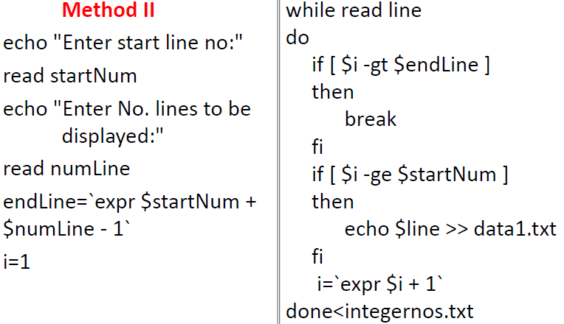
Files using Shell Scripting
Systems Programming - V 3.0

Slide 36
Files using Shell Scripting
Copy the odd lines of the file named data.txt
to a file named odd.txt and copy the even
lines of the file named even.txt
Systems Programming - V 3.0

Slide 37
Files using Shell Scripting
i=1
while read line
do
  if [ `expr $i % 2` ‐eq 0 ]
  then
  echo $line >> even.txt
  else
  echo $line >> odd.txt
  fi
  i=`expr $i + 1`
done<integernos.txt
Systems Programming - V 3.0

Slide 38
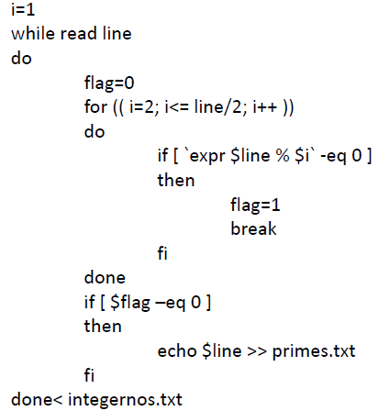
Write a shell script to find all prime numbers
from integernos.txt file and store in another file
called primes.txt
Systems Programming - V 3.0

Slide 39
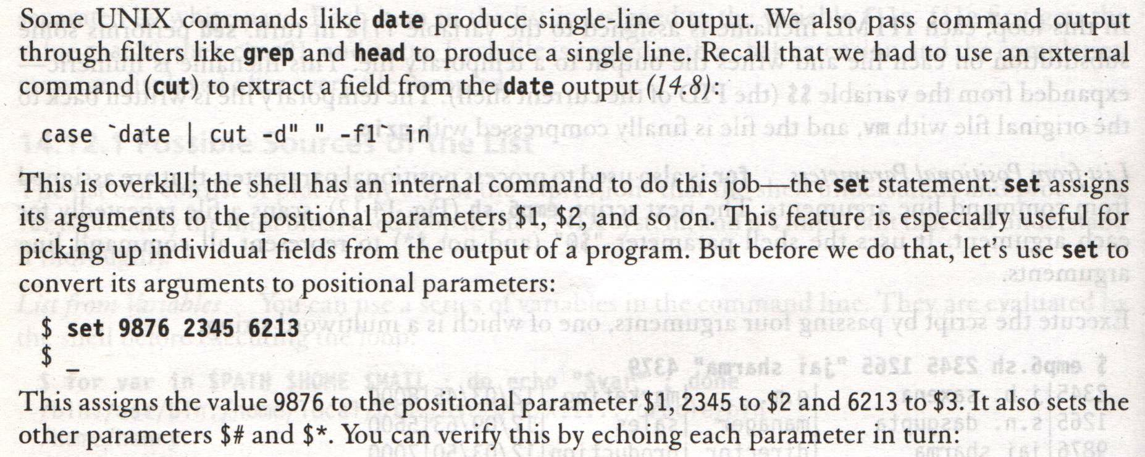
set and shift: Manipulating the Positional Parameters
Systems Programming - V 3.0

Slide 40
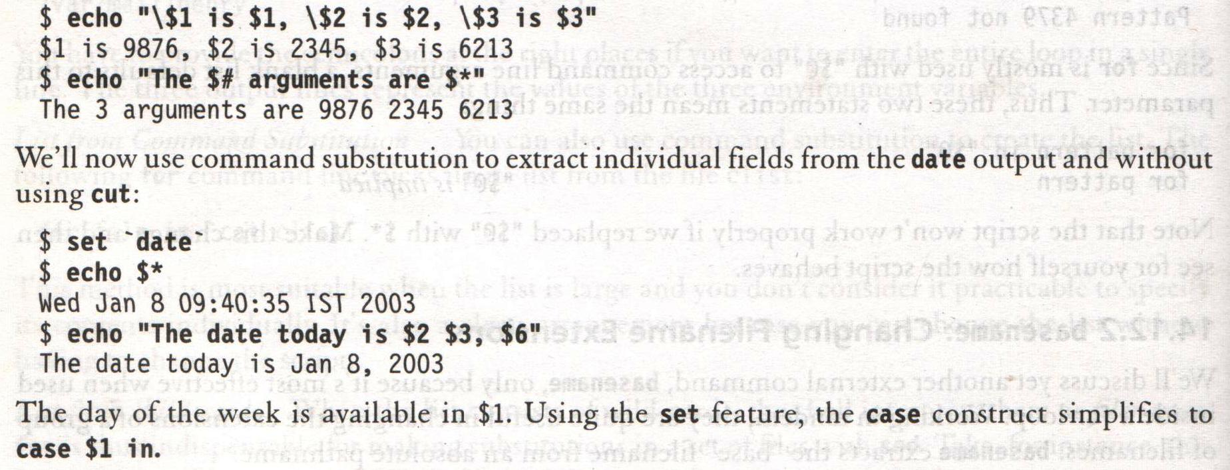
set and shift: Manipulating the Positional Parameters
Systems Programming - V 3.0

Slide 41
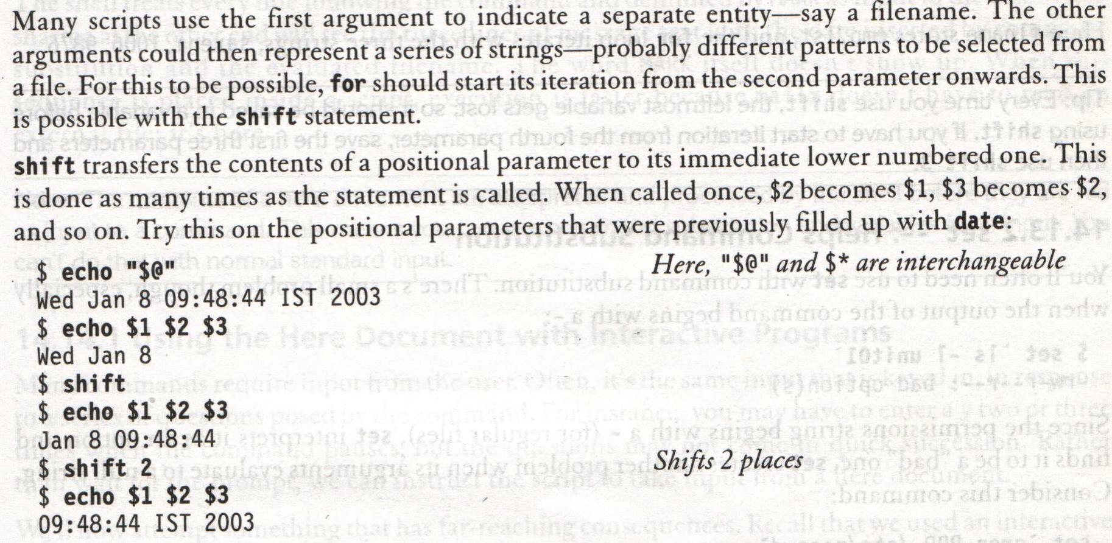
shift: Shifting Arguments left
Systems Programming - V 3.0

Slide 42
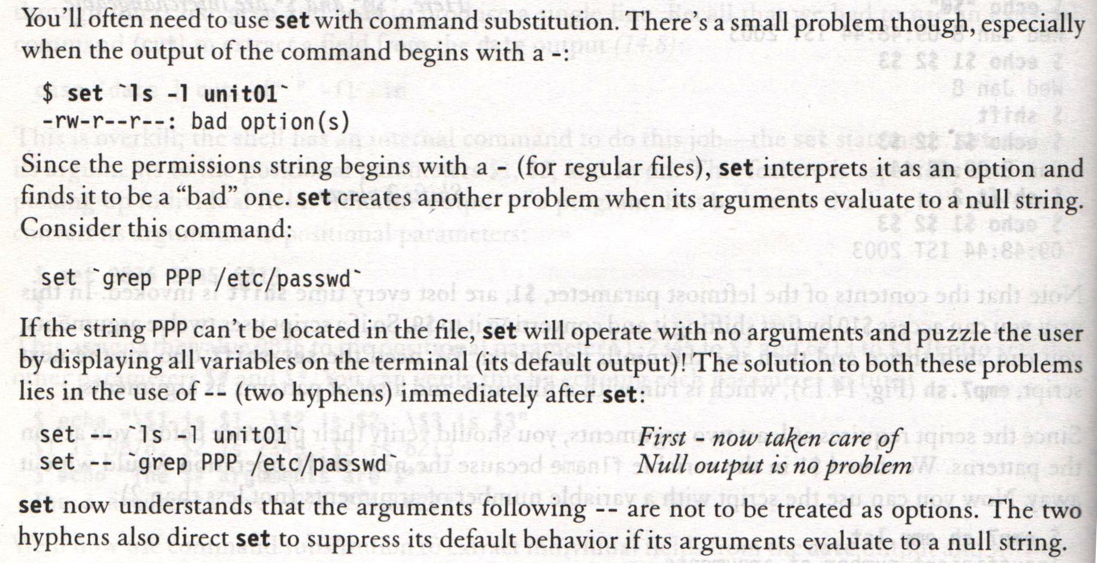
Set -- : Helps Command Substitution
Systems Programming - V 3.0

Slide 43

Systems Programming - V 3.0

Slide 44

IMP Note to Self
Systems Programming - V 3.0

