Slide 1

Course Name :
Systems Programming
19th FEB 2023

Slide 2

IMP Note to Self
Systems Programming - V 3.0

Slide 3
IMP Note to Students
It is important to know that just login to the session does not guarantee the attendance.
Once you join the session, continue till the end to consider you as present in the class.
IMPORTANTLY, you need to make the class more interactive by responding to Professors queries in the session.
Whenever Professor calls your number / name ,you need to respond, otherwise it will be considered as ABSENT
Systems Programming - V 3.0

Slide 4
Agenda
Need for protection
System calls
Communication between user mode and Kernel mode
Execution of a system calls
Difference between system call & function call
Systems Programming - V 3.0

Slide 5
Protection
Protection refers to a mechanism which controls the access of programs, processes, or users to the resources defined by a computer system.
We can take protection as a helper to multi programming operating system, so that many users might safely share a common logical name space such as directory or files.
Systems Programming - V 3.0

Slide 6
Why we need protection?
To prevent the access of unauthorized users
To ensure that each active programs or processes in the system uses resources only as the stated policy
To improve reliability by detecting latent errors
In single task / programming environment
– To protect OS from incorrect program
In multiprogramming / multitasking environment
– To protect OS and other programs from incorrect program
Systems Programming - V 3.0

Slide 7
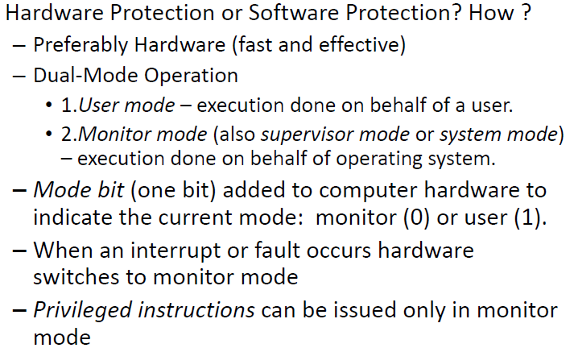
How to Protect the system
Systems Programming - V 3.0

Slide 8
System calls
A system call is a function that allows a process to communicate with the Linux kernel.
System calls expose the operating system’s resources to user programs through an API (Application Programming Interface).
System calls can only access the kernel framework.
System calls are needed for all the services that need resources.
Systems Programming - V 3.0

Slide 9
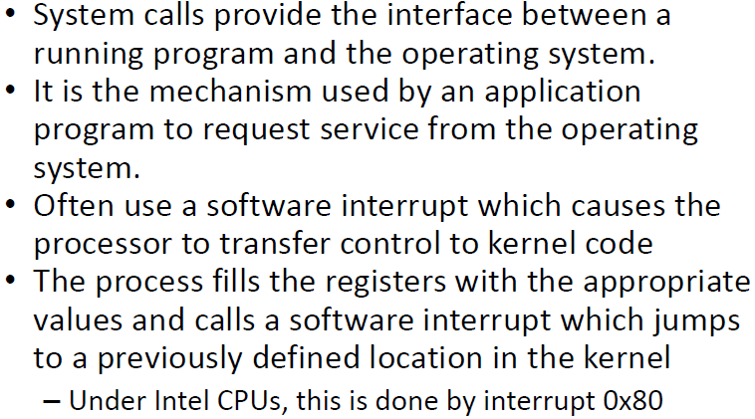
System calls
Systems Programming - V 3.0

Slide 10
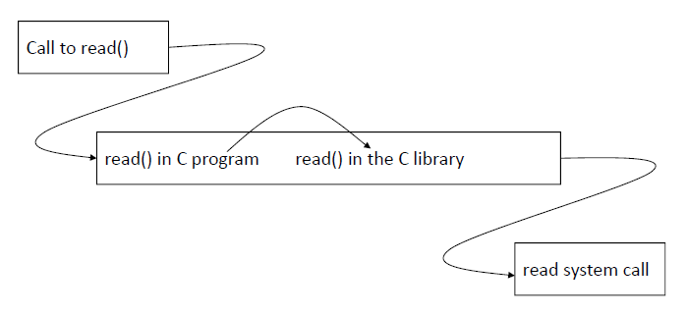
fscanf system call execution
Systems Programming - V 3.0

Slide 11
scanf() work inside the OS
scanf() and printf() are functions in libc (the C standard library), and they call the read() and write() operating system syscalls respectively,
Talking to the file descriptors stdin and stdout respectively (fscanf and fprintf allow you to specify the file stream you want to read/write from).
Systems Programming - V 3.0

Slide 12
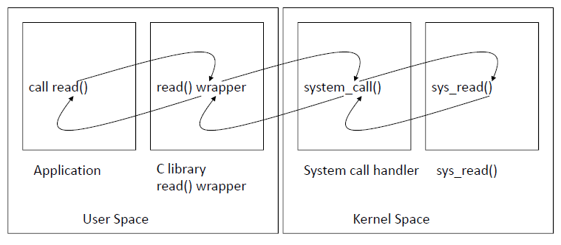
Invoking system call handler &
executing system call
Systems Programming - V 3.0

Slide 13
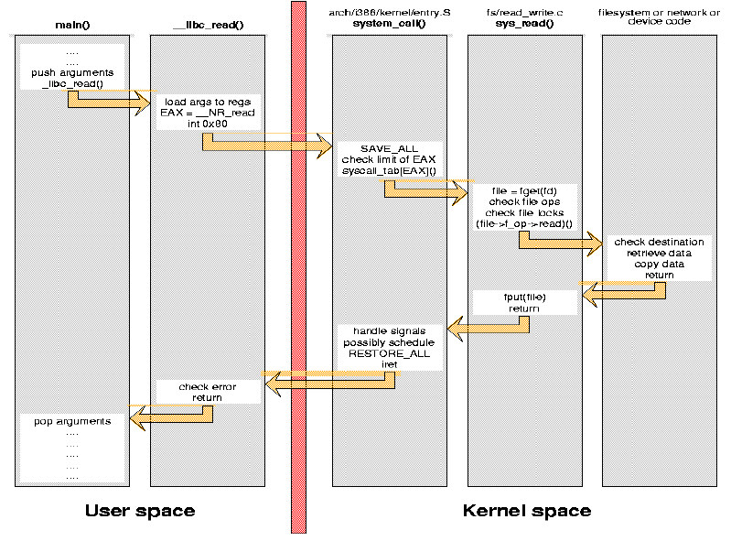
Steps for Making a System Call (Example: read call)
Systems Programming - V 3.0

Slide 14
Steps for Making a System Call
(Example: read call)
A system call is implemented by a ``software interrupt'' that transfers control to kernel code;
in Linux/i386 this is ``interrupt 0x80''. The specific system call being invoked is stored in the EAX register, and its arguments are held in the other processor registers.
In our example, the number associated to read is __NR_read, defined in <asm/unistd.h>.
After the switch to kernel mode, the processor must save all of its registers and dispatch execution to the proper kernel function, after checking whether EAX is out of range.
The system call we are looking at is implemented in the sys_read function.
The read finally performs the data transfer and all the previous steps are unwound up to the calling user function.
Systems Programming - V 3.0

Slide 15
Steps for Making a System Call
(Example: read call)
Using a system call
  Each arrow in the figure represents a jump in CPU instruction flow, and each jump may require flushing the prefetch queue and possibly a ``cache miss'' event.
  Transitions between user and kernel space are especially important, as they are the most expensive in processing time and prefetch behavior.
Systems Programming - V 3.0

Slide 16
Why do you need system calls in Operating System?
There are various situations where you must require system calls in the operating system.
It is must require when a file system wants to create or delete a file.
Network connections require the system calls to sending and receiving data packets.
If you want to read or write a file, you need to system calls.
If you want to access hardware devices, including a printer, scanner, you need a system call.
System calls are used to create and manage new processes.
Systems Programming - V 3.0

Slide 17
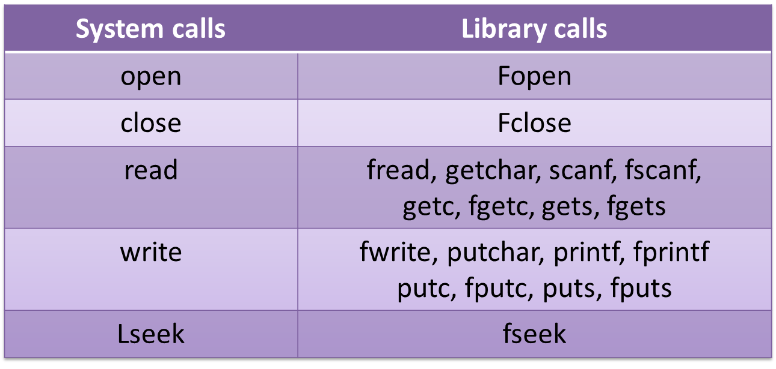
System calls vs. libc
Each I/O system call has corresponding procedure calls from the standard I/O library.
Systems Programming - V 3.0

Slide 18
Examples of System Calls
Example:
  getuid() //get the user ID
  fork() //create a child process
  exec() //executing a program => execve (2)
  in Linux
Don’t confuse system calls with libc calls
  Differences?
  Is printf() a system call?
  Is rand() a system call?
Systems Programming - V 3.0

Slide 19
System Call Example
#include <syscall.h>
#include <unistd.h>
#include <stdio.h>
#include <sys/types.h>
int main(void)
{
  long ID1, ID2;
  /* direct system call */
  /* SYS_getpid (func no. is 20) */
  ID1 = syscall(SYS_getpid);
  printf ("syscall(SYS_getpid)=%ld\n“,ID1);
  /* "libc" wrapped system call */
  /* SYS_getpid (Func No. is 20) */
  ID2 = getpid();
  printf ("getpid()=%ld\n", ID2);
  return(0);
}
Systems Programming - V 3.0

Slide 20
User mode and Kernel mode Switching
The User mode is normal mode where the process has limited access. While the Kernel mode is the privileged mode where the process has unrestricted access to system resources like hardware, memory, etc. A process can access I/O Hardware registers to program it, can execute OS kernel code and access kernel data in Kernel mode. Anything related to Process management, IO hardware management, and Memory management requires process to execute in Kernel mode.
This is important to know that a process in Kernel mode get power to access any device and memory, and same time any crash in kernel mode brings down the whole system. But any crash in user mode brings down the faulty process only.
Systems Programming - V 3.0

Slide 21
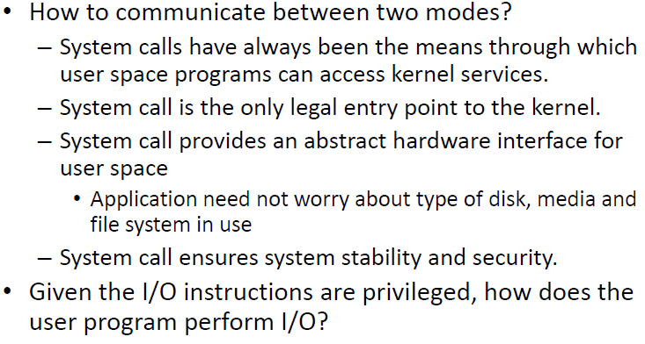
How to communicate ?
Systems Programming - V 3.0

Slide 22
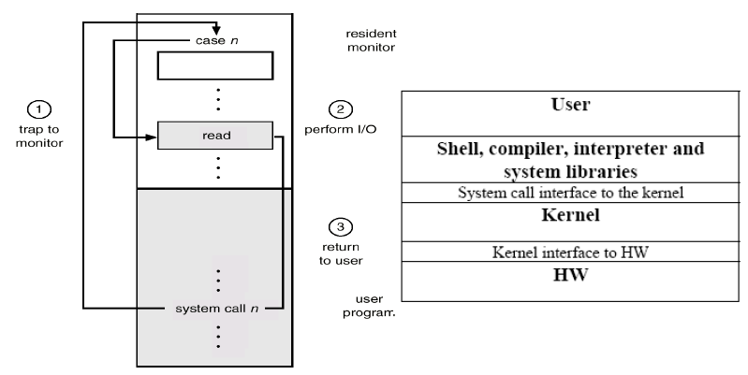
Use of A System Call to Perform I/O
Systems Programming - V 3.0

Slide 23
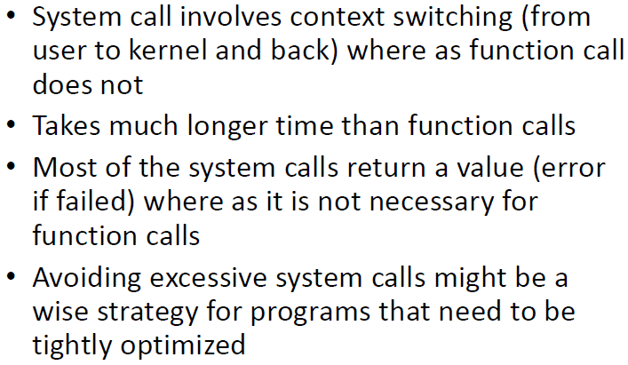
Difference between System call
and function call
Systems Programming - V 3.0

Slide 24
System Calls versus Function Calls
Function Call
System Call
Process
Process
fnCall()
sysCall()
OS
Caller and callee are in the same
Process
- Same user
- Same “domain of trust”
- OS is trusted; user is not.
OS has super-privileges; user does not
Must take measures to prevent abuse
Systems Programming - V 3.0

Slide 25
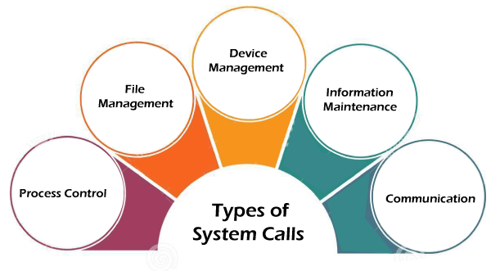
Types of System Calls
Systems Programming - V 3.0

Slide 26
Types of System Calls
Process Control
Process control is the system call that is used to direct the processes. Some process control examples include creating, load, abort, end, execute, process, terminate the process, etc.
File Management
File management is a system call that is used to handle the files. Some file management examples include creating files, delete files, open, close, read, write, etc.
Systems Programming - V 3.0

Slide 27
Types of System Calls
Device Management
Device management is a system call that is used to deal with devices. Some examples of device management include read, device, write, get device attributes, release device, etc.
Information Maintenance
Information maintenance is a system call that is used to maintain information. There are some examples of information maintenance, including getting system data, set time or date, get time or date, set system data, etc.
Communication
Communication is a system call that is used for communication. There are some examples of communication, including create, delete, etc.
Systems Programming - V 3.0

Slide 28
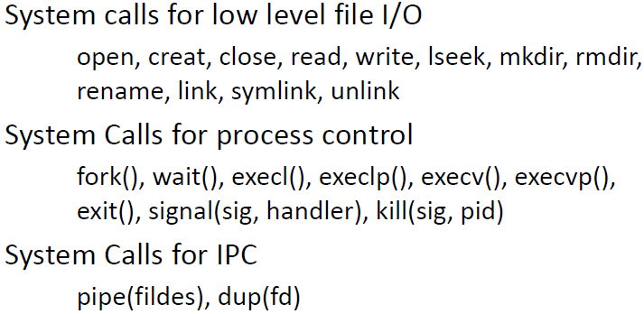
System Call
Systems Programming - V 3.0

Slide 29
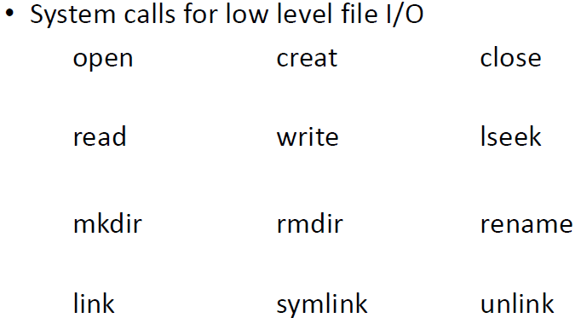
Systems Programming - V 3.0

Slide 30
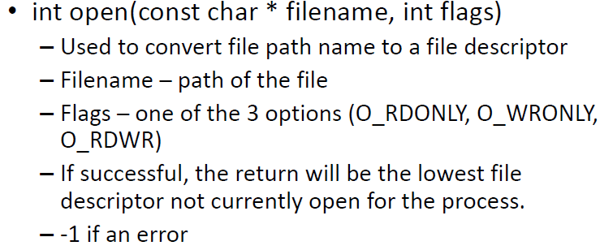
File related system calls ‐ open
Systems Programming - V 3.0

Slide 31
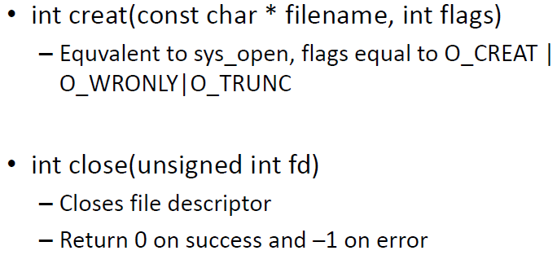
File related system calls – creat, close
Systems Programming - V 3.0

Slide 32
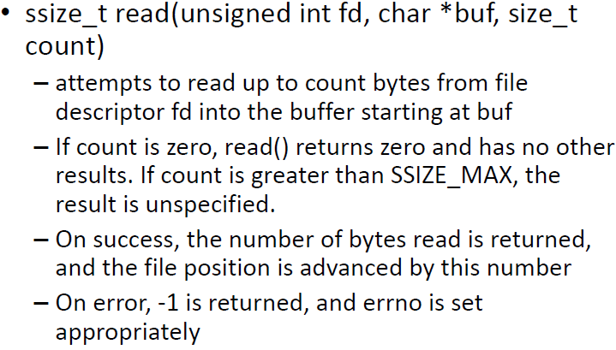
File related system calls – read
Systems Programming - V 3.0

Slide 33
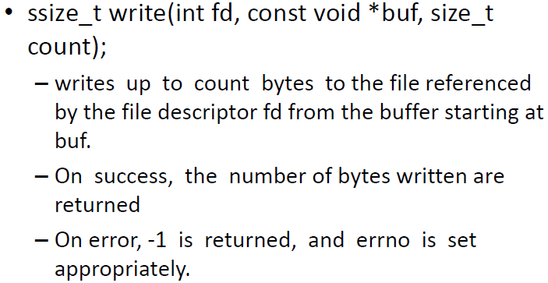
File related system calls – write
Systems Programming - V 3.0

Slide 34
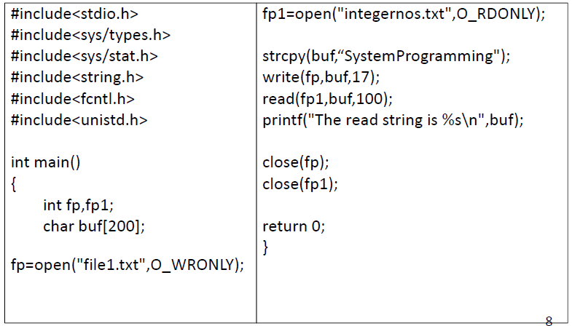
System call program example
Systems Programming - V 3.0

Slide 35
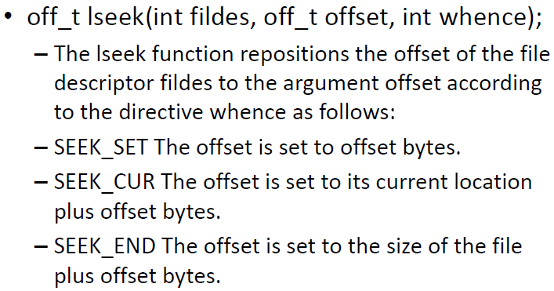
File related system calls – lseek
Systems Programming - V 3.0

Slide 36
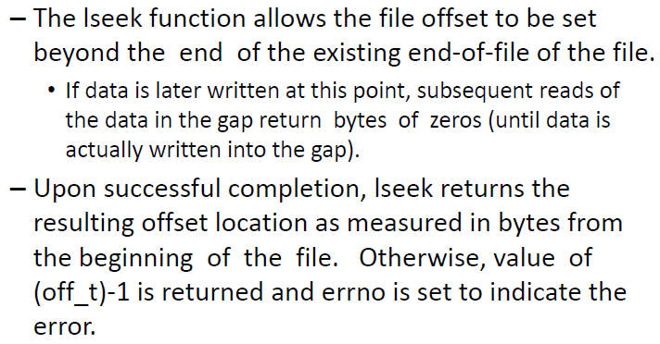
File related system calls – lseek
Systems Programming - V 3.0

Slide 37
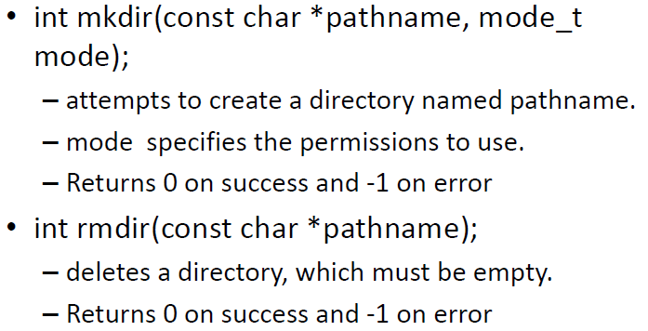
File related system calls – mkdir, rmdir
Systems Programming - V 3.0

Slide 38
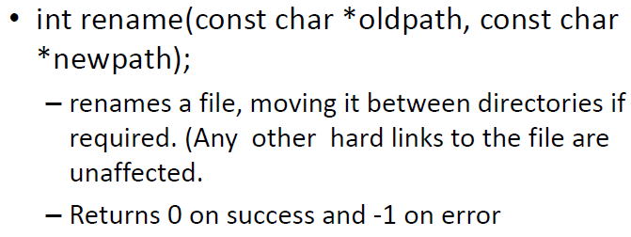
File related system calls – rename
Systems Programming - V 3.0

Slide 39
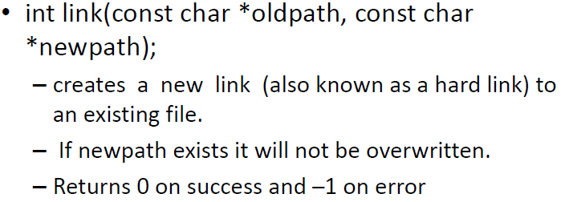
File related system calls – link
Systems Programming - V 3.0

Slide 40
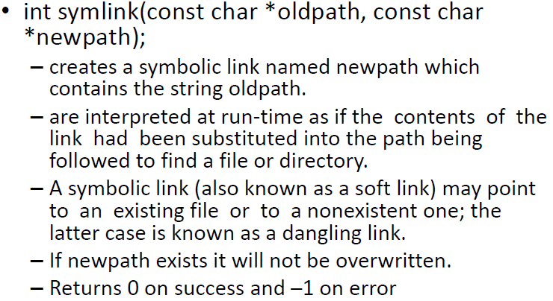
File related system calls – symlink
Systems Programming - V 3.0

Slide 41
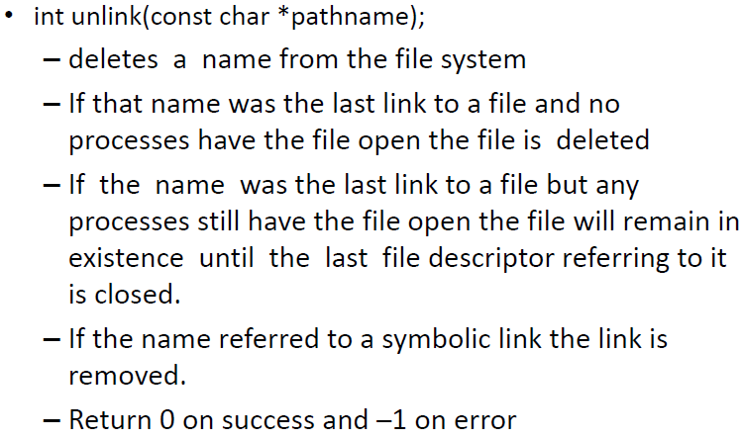
File related system calls – unlink
Systems Programming - V 3.0

Slide 42
System calls related to process
  – fork
  – wait
  – exec
  – exit
  – signal
  – kill
  – raise

Slide 43
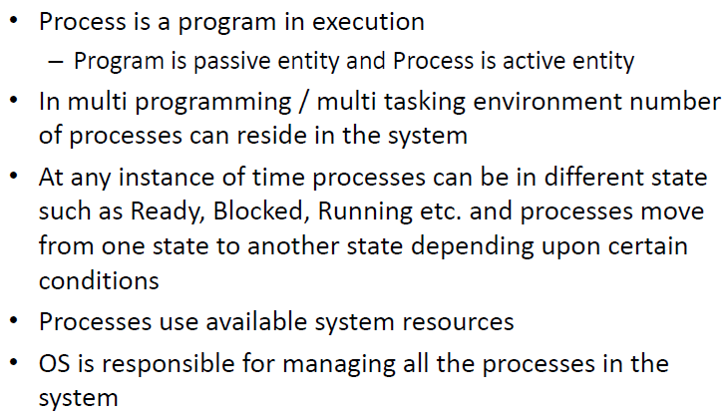
Process summary
Systems Programming - V 3.0

Slide 44
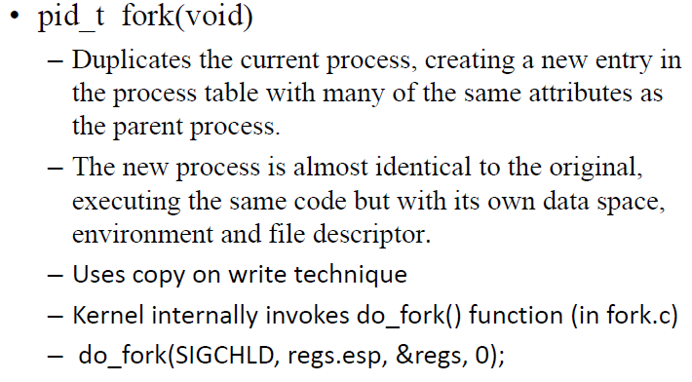
Process related system calls – fork
Systems Programming - V 3.0

Slide 45
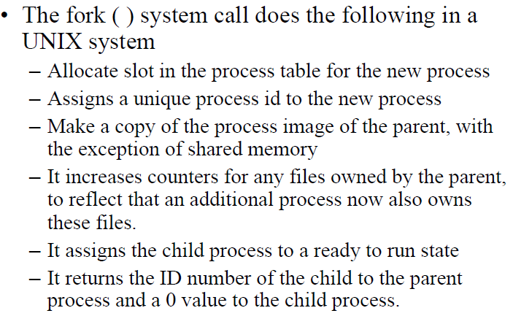
Process related system calls – fork
Systems Programming - V 3.0

Slide 46
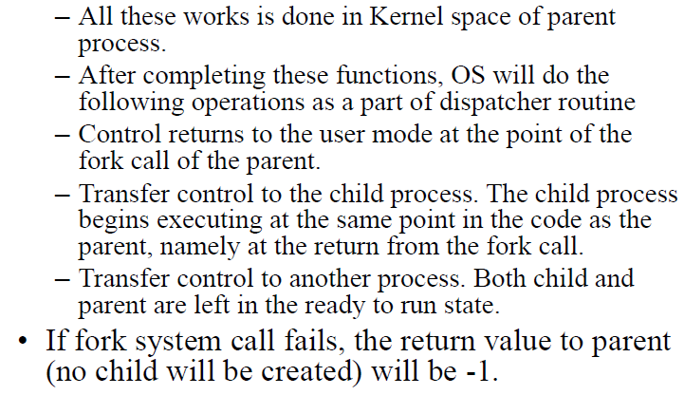
Process related system calls – fork
Systems Programming - V 3.0

Slide 47
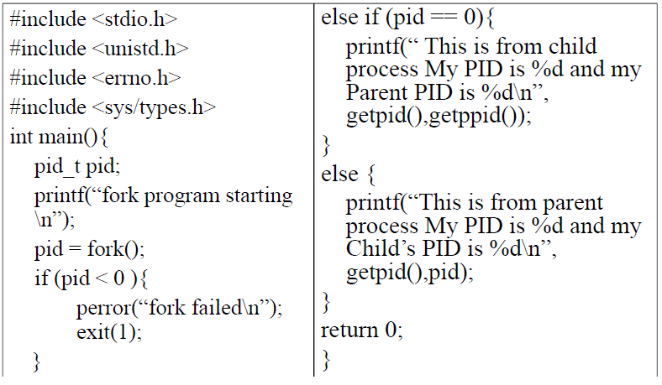
Process Creation Example
Systems Programming - V 3.0

Slide 48
Calling fork()
Calling fork()
Consider the following example in which we have used the fork() system call to create a new child process:
#include <stdio.h>
#include <sys/types.h>
#include <unistd.h>
int main()
{
fork();
printf("Using fork() system call\n");
return 0;
}
OUTPUT:
sysads@linuxhint $ gcc fork.c -o fork
sysads@linuxhint $ ./fork
Using fork() system call
Using fork() system call
In this program, we have used fork(), this will create a new child process. When the child process is created, both the parent process and the child process will point to the next instruction (same Program Counter).
That is 2^{n} times, where n is the number of fork() system calls.
Systems Programming - V 3.0

Slide 49
Calling fork()
#include <stdio.h>
#include <sys/types.h>
#include <unistd.h>
int main()
{
fork();
fork();
fork();
fork();
printf("Using fork() system call\n");
return 0;
}
Output:
sysads@linuxhint $ gcc fork.c -o fork
sysads@linuxhint $ ./fork
Now the total number of process created are 2⁴ = 16 and we have our print statement executed 16 times.
Systems Programming - V 3.0

Slide 50
#include <stdio.h>
#include <sys/types.h>
#include <unistd.h>
int main()
{
pid_t p;
p = fork();
if(p==-1)
{
printf("There is an error while calling fork()\n");
}
if(p==0)
{
printf("We are in the child process\n");
}
else
{
printf("We are in the parent process\n");
}
return 0;
}
Calling fork()
OUTPUT:
sysads@linuxhint $ gcc fork.c -o fork
sysads@linuxhint $ ./fork
We are in the parent process
We are in the child process
Systems Programming - V 3.0

Slide 51
Calling fork()
#include <stdio.h>
#include <unistd.h>
#include <sys/types.h>
//main function begins
int main(){
pid_t p= fork(); //calling of fork system call
if(p==-1)
printf("Error occured while calling fork()");
else if(p==0)
printf("This is the child process");
else
printf("This is the parent process");
return 0;
}
Output:
This is the parent process
This is the child process
Systems Programming - V 3.0

Slide 52

Systems Programming - V 3.0

Slide 53

IMP Note to Self
Systems Programming - V 3.0

