Slide 1
Data Structures and Algorithms Design
Harish Aggarwal

Slide 2
Graphs

Slide 3
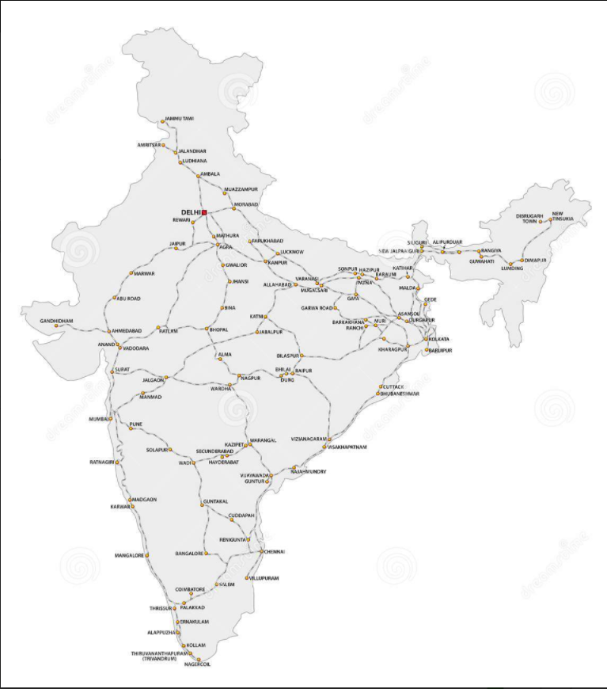
Graphs

Slide 4
Definition of Graphs
A Graph is a finite set of nodes with edges between nodes
Vertex, Edge, Adjacent, incident, degree, cycle, path, connected component, and spanning tree.
Types of Graphs – Undirected, Directed, Weighted,
Common Graph Representations: adjacency matrix, array adjacency lists, and linked adjacency lists
Standard graph search methods: breadth-first and depth-first search
Algorithms in Graphs
Find Path in a graph
Find the connected components of an undirected graph
Find a spanning tree of a connected undirected graph
Other graph algorithms

Slide 5
Definition of Graphs
A graph is a finite set of nodes with edges between nodes
Formally, a graph G is a structure (V,E) consisting of
a finite set V called the set of nodes, and
a set E that is a subset of VxV. That is, E is a set of pairs of the form (x,y) where x and y are nodes in V
1
1
4
1
4
3
2
2
3
5
3
2
4
6
7
5

Slide 6
Definition of Graphs
4
1
1
1
3
4
2
2
3
5
2
3
4
6
7
5
G = (V,E)
V = Vertices or Nodes
E = Edges or Arcs or lines. Edge joins two different vertices of V
G₁ = (V₁, E₁),
V₁ = {1,2,3,4}; E₁ = {(1,2), (1,3), (2,3), (1,4), (3,4)}
V₂ = {1,2,3,4,5,6,7}; E₂ = {(1,2), (1,3), (4,5), (5,6), (5,7), (6,7)}
V₃ = {1,2,3,4,5}; E₃ = {(1,2), (2,3), (3,4), (4,3), (3,5), (5,4)}

Slide 7
Definition of Graphs
1
1
4
1
4
3
2
2
3
5
3
2
4
6
7
5
Edge with Orientation is called as Directed Edge
Edge with No Orientation is called as Undirected Edge
Adjacent – if there is an Edge (i, j) in the Graph, then i and j are adjacent Vertices
Undirected Edge –Both the vertices are adjacent to each other.
Directed Edge – (i,j) –
vertex i is adjacent To vertex
vertex j is adjacent From vertex
Incident on and Incident to
Undirected Edge – Edge is incident on Both the vertices.
Directed Edge – (i,j) – Incident from vertex i and Incident to vertex j

Slide 8
Definition of Graphs
1
1
4
1
4
3
2
2
3
5
3
2
4
6
7
5
Undirected Graph – If all Edges in a Graph are Undirected Edges.
Directed Graph – If all Edges in a Graph are Directed Edges
Also called as Digraph
A Graph cannot contain Self-Edges (Also called as Loop). For e.g. (i, i) is not permitted.
If weight is assigned to an Edge, it is called as Weighted Graph. Also called as Network
Weighted Undirected Graph
Weighted Digraph

Slide 9

Definition of Graphs
Null Graph – A Graph having No Edges.
Trivial Graph : A graph with only one
a

Slide 10
Definition of Graphs
1
1
4
1
4
3
2
2
3
2
5
3
6
7
4
5
Path – A sequence of Vertices P = i₁, i₂, …..i_{k} is an i₁ to i_{k} path in the Graph G=(V, E) iff the edge (i_{j}, i_{j+1}) is in E for every j, 1 ≤ j < k
V₁ = {1,2,3,4}; E₁ = {(1,2), (1,3), (2,3), (1,4), (3,4)}
V₂ = {1,2,3,4,5,6,7}; E₂ = {(1,2), (1,3), (4,5), (5,6), (5,7), (6,7)}
V₃ = {1,2,3,4,5}; E₃ = {(1,2), (2,3), (3,4), (4,3), (3,5), (5,4)}
A Simple Path is a path in which all the vertices, except possibly the first and last are different. E.g. 1, 2, 3, 5. But not 1, 2, 3, 4, 3, 5
Length of path is sum of the lengths of the edges on the path.

Slide 11
Definition of Graphs
1
1
4
4
1
3
2
2
3
5
3
2
4
6
7
5
Let G = (V, E) be the undirected Graph
G is Connected if there is a path between every pair of vertices in G
A Graph can remain connected even if some of its edges are removed
A Graph H is a Subgraph of another Graph G iff its vertex and Edge Sets are subsets of those of G
V_{h1} = {1,2,3}; E_{h1} = {(1,2), (1,3), (2,3)}
A Cycle is a Simple Path with same Start and End Vertex
1, 2, 3, 1
V₁ = {1,2,3,4}; E₁ = {(1,2), (1,3), (2,3), (1,4), (3,4)}
V₂ = {1,2,3,4,5,6,7}; E₂ = {(1,2), (1,3), (4,5), (5,6), (5,7), (6,7)}
V₃ = {1,2,3,4,5}; E₃ = {(1,2), (2,3), (3,4), (4,3), (3,5), (5,4)}

Slide 12
Definition of Graphs
1
1
4
4
1
3
2
2
3
5
3
2
4
6
7
5
Connectivity in Directed Graph
A digraph is said to be connected if the undirected graph obtained by ignoring the edge directions in G is connected.
A directed graph is said to be Strongly Connected if for every pair of vertices u_{i} and v_{i} there exists at least one directed path from u_{i} and v_{i} and at least one from v_{i} to u_{i}.
A digraph which is connected but not strongly connected is called Weakly Connected.
A disconnected digraph (like a disconnected undirected graph) consists of connected components.
A Weakly Connected digraph consists of strongly-connected components.
V₁ = {1,2,3,4}; E₁ = {(1,2), (1,3), (2,3), (1,4), (3,4)}
V₂ = {1,2,3,4,5,6,7}; E₂ = {(1,2), (1,3), (4,5), (5,6), (5,7), (6,7)}
V₃ = {1,2,3,4,5}; E₃ = {(1,2), (2,3), (3,4), (4,3), (3,5), (5,4)}

Slide 13
Definition of Graphs
1
1
1
1
2
3
2
3
2
3
2
3
4
4
4
4
1
1
1
2
3
2
3
2
3
4
4
4
Let G = (V, E) be the undirected Graph
A Connected Undirected Graph that contains No Cycle is a Tree
A Subgraph of G that contains all the vertices of G and is a Tree is a Spanning Tree
V₁ = {1,2,3,4}; E₁ = {(1,2), (1,3), (2,3), (1,4), (3,4)}

Slide 14
Definition of Graphs
1
5
2
6
3
7
4
8
9
If all the Vertex of a Graph can be divided into two subsets, so that every edge has one endpoint in one Set and other end point in other set, then Graph with such a property is called as Bipartite Graph

Slide 15
Definition of Graphs
1
1
4
4
1
2
3
2
3
5
3
2
4
6
7
5
Degree d_{i} of vertex i of an undirected graph is the number of edges incident on vertex i.
d₁ = 3, d₂ = 2, d₃ = 3, d₄ = 2
Let G be the digraph.
The in-degree d_{i}^{in} of vertex i is the number of edges incident to vertex i.
The out-degree d_{i}^{out} of vertex i is the number of edges incident from (Leaving) vertex i.
d_{1(in)} = 0, d_{1(out)} = 1, d_{2(in)} = 1, d_{2(out)} = 1, d_{3(in)} = 2, d_{3(out)} = 2
V₁ = {1,2,3,4}; E₁ = {(1,2), (1,3), (2,3), (1,4), (3,4)}
V₂ = {1,2,3,4,5,6,7}; E₂ = {(1,2), (1,3), (4,5), (5,6), (5,7), (6,7)}
V₃ = {1,2,3,4,5}; E₃ = {(1,2), (2,3), (3,4), (4,3), (3,5), (5,4)}

Slide 16
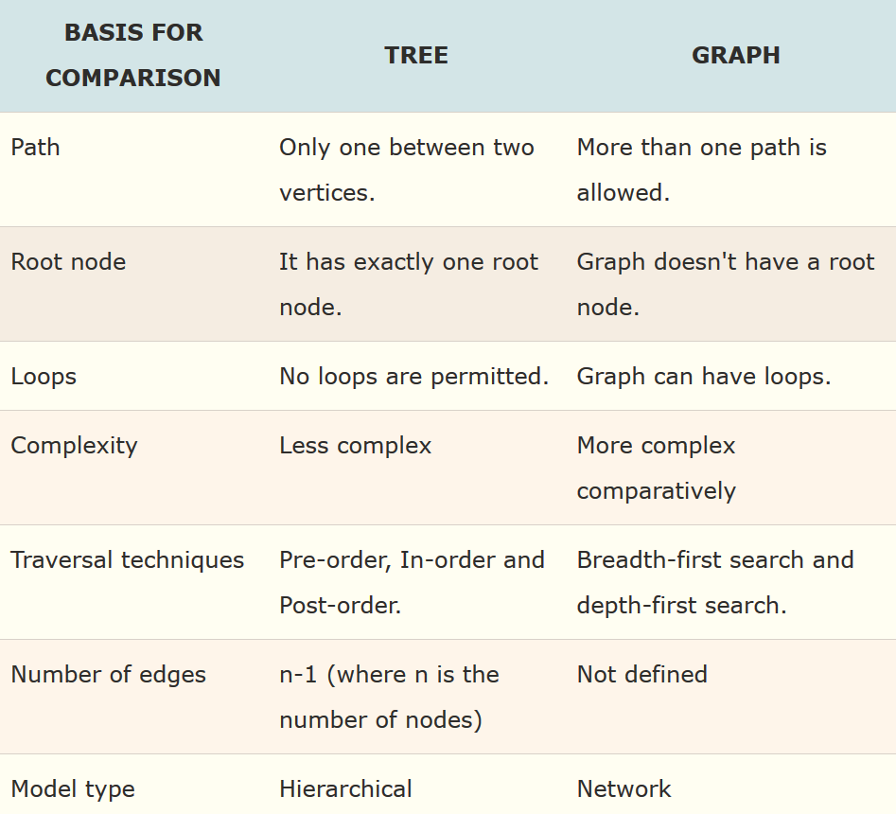
Tree vs Graph

Slide 17
Some Applications of Graphs
Airlines Routes/ Railways Routes
Weight can be Distance
Weight can be Fare
Weight can be time taken
Planning Projects
Nodes can represent stage
Edges can represent an activity between two stages
Weight to an Activity can be time, cost, etc
Communication Network. Each tower can represent a Node
Weight can be Distance
Weight can be the Type of Communication between two towers (3g, 4g, 5g, etc)
Others like Molecular Structure of a chemical compound, Genetic studies, Statistical Mechanics, social sciences, etc

Slide 18
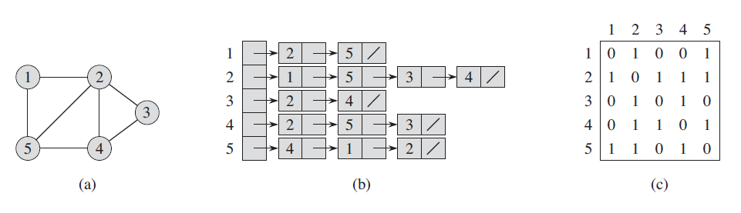
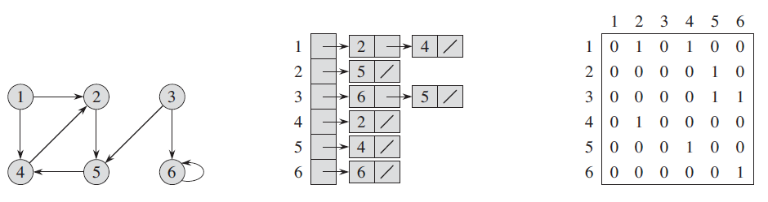
Graphs Representation
For graphs to be computationally useful, they have to be conveniently represented in programs
There are two computer representations of graphs:
Adjacency matrix representation
Adjacency lists representation

Slide 19
Adjacency Lists Representation
A graph of n nodes is represented by a one-dimensional array L of linked lists, where
L[i] is the linked list containing all the nodes adjacent from node i.
The nodes in the list L[i] are in no particular order
Pros:
Saves on space (memory): the representation takes as many memory words as there are nodes and edge.
Cons:
It can take up to O(n) time to determine if a pair of nodes (i, j) is an edge: one would have to search the linked list L[i], which takes time proportional to the length of L[i].

Slide 20
Adjacency Matrix Representation
In this representation, each graph of n nodes, (without parallel edges) is represented by an NxN matrix A, that is, a two-dimensional array A
The nodes are (re)-labeled 1,2,…,n
A[i][j] = 1 if (i, j) is an edge
A[i][j] = 0 if (i, j) is not an edge
Pros:
Simple to implement
Easy and fast to tell if a pair (i, j) is an edge: simply check if A[i][j] is 1 or 0
Cons:
No matter how few edges the graph has, the matrix takes O(n²) in memory

Slide 21
Graph Traversal
There are two standard graph traversal techniques:
Breadth-First Search (BFS)
Depth-First Search (DFS)
In both BFS and DFS, the nodes of the undirected graph are visited in a systematic manner so that every node is visited exactly one.
Both BFS and DFS give rise to a tree:
When a node x is visited, it is labeled as visited, and it is added to the tree
If the traversal got to node x from node y, y is viewed as the parent of x, and x a child of y

Slide 22
Breadth-First Search
BFS follows the following rules:
Select an unvisited node x, visit it, have it be the root in a BFS tree being formed. Its level is called the current level.
From each node z in the current level, in the order in which the level nodes were visited, visit all the unvisited neighbors of z. The newly visited nodes from this level form a new level that becomes the next current level.
Repeat step 2 until no more nodes can be visited.
If there are still unvisited nodes, repeat from Step 1.
Observations:
the first node visited in each level is the first node from which to proceed to visit new nodes.
This suggests that a queue is the proper data structure to remember the order of the steps

Slide 23
BFS: the Color Scheme
White vertices have not been discovered
All vertices start out white
Grey vertices are discovered but not fully explored
They may be adjacent to white vertices
Black vertices are discovered and fully explored
They are adjacent only to black and gray vertices
Explore vertices by scanning adjacency list of grey vertices

Slide 24
Example
A
B
C
D
E
F
G
H
I
J
K
L
M
N
O
P

Slide 25
Example
0
A
B
C
D
E
F
G
H
I
J
K
L
M
N
O
P

Slide 26
Example
0
A
B
C
D
1
E
F
1
G
H
1
I
J
K
L
M
N
O
P

Slide 27
Example
0
A
B
C
D
1
2
E
F
1
G
H
1
2
I
J
K
L
M
N
O
P

Slide 28
Example
0
A
B
C
D
2
3
1
E
F
1
G
H
1
3
3
2
I
J
K
L
3
M
N
3
O
P

Slide 29
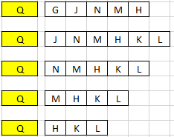
Example
0
A
B
C
D
3
1
2
E
F
1
G
H
1
3
4
3
2
I
J
K
4
L
4
3
M
N
3
O
P

Slide 30
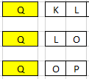
Example
0
A
B
C
D
3
1
2
E
F
1
G
H
1
3
4
3
2
I
J
K
4
L
4
M
N
O
5
P
3
3
5

Slide 31
Example
Pink lines depict
Cross edges and
Blue lines depict the discovery edges
0
A
B
C
D
3
1
2
E
F
1
G
H
1
3
4
3
2
I
J
K
4
L
4
M
N
O
5
P
3
3
5

Slide 32
Example
0
A
B
C
D
3
1
2
E
F
1
G
H
1
3
4
3
2
I
J
K
4
L
4
M
N
O
5
P
3
3
5

Slide 33
Example
0
A
B
C
D
3
1
2
E
F
1
G
H
1
3
4
3
2
I
J
K
4
L
4
M
N
O
5
P
3
3
5

Slide 34
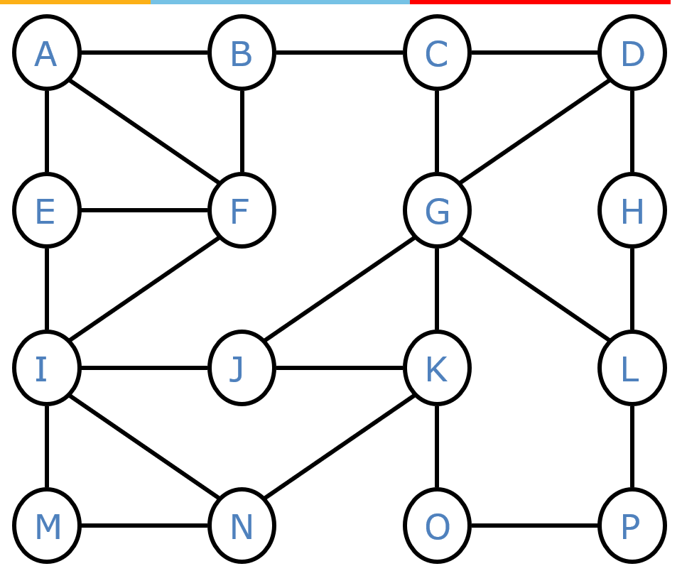
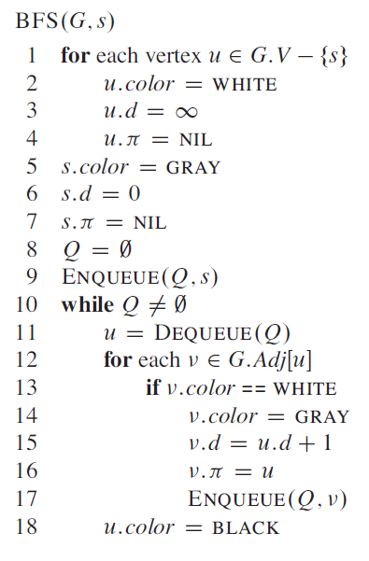
BFS: Algorithm
Any Node is u
Each Node u has
Color (WHITE, GRAY, BLACK)
d – Distance of Node from s
π - Value of predecessor
For all nodes except the starting node, Initially set the values of nodes to
Color (WHITE)
d – ∞
π - NIL
For Starting Node, Put it in Q and set the value of node to
Color (GRAY)
d – 0
π - NIL

Slide 35
BFS: Algorithm
Thus Initially the Queue has only one element (Node) which is the starting Node
While there are elements in Queue
Pull out Node from queue
For this Node find all its Adjacent Nodes
Out of these adjacent Nodes, if they have never been visited (WHITE) then Update their color (GRAY), d and π values and insert them all in the queue
Mark the Node that is pulled out from Queue to be BLACK, that is Visited

Slide 36
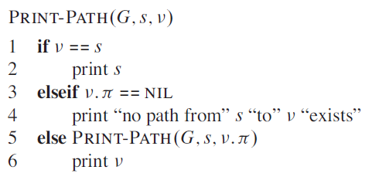
BFS: Shortest Path Distance
Shortest Path Distance from s to v given by Ϩ(s,v)
Is given by v.d in the BFS Search
If v.d = ∞, it means that no path exist from s to v
Following algorithm will print out the vertices on the shortest path from s to v, assuming that BFS has already computed a Breadth First Tree

Slide 37
BFS: Complexity Analysis
Queuing time is O(V) and scanning all edges requires O(E)
Overhead for initialization is O (V)
So, total running time is O(V+E)

Slide 38
Breadth First Tree
0
A
B
C
D
3
1
2
1
E
F
1
G
3
H
4
3
2
I
J
K
4
L
4
M
N
O
5
P
3
3
5
The Procedure BFS builds a breadth-first Tree as it searches the Graph
The Tree corresponds to the π (Predecessor) attributes

Slide 39
Depth Search First
DFS follows the following rules:
Select an unvisited node x, visit it, and treat as the current node
Find an unvisited neighbor of the current node, visit it, and make it the new current node;
If the current node has no unvisited neighbors, backtrack to the its parent, and make that parent the new current node;
Repeat steps 3 and 4 until no more nodes can be visited.
If there are still unvisited nodes, repeat from step 1.
DFS Color Scheme
Vertices initially colored white
Then colored gray when discovered
Then black when finished

Slide 40
Example
0
1
0
1
2
4
9
4
2
10
5
7
5
9
11
8
6
7
11
6
8
10
Graph G
DFS Tree

Slide 41
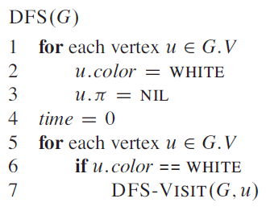
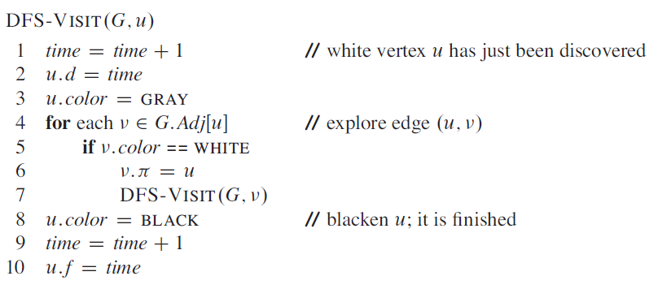
DFS: Algorithm
v.π - Value of predecessor
Predecessor sub-graph in DFS does not give tree as was the case in BFS. Rather, in DFS predecessor sub-graph can be composed of many trees.
Depth-First Forest comprising of many Depth-First Trees
Each Vertex v has two timestamps
v.d when v is first discovered
v.f when search finishes examining v adjacency list.

Slide 42
DFS: Complexity Analysis
Initialization complexity is O(V)
DFS_VISIT is called exactly once for each vertex
And DFS_VISIT scans all the edges which causes cost of O(E)
Overall complexity is O(V + E)

Slide 43
Additional Reading
Appendix

Slide 44
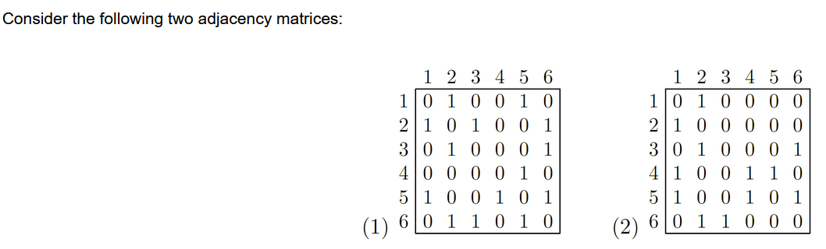
Exercise
For each, answer the following questions:
(a) Can this matrix be the adjacency matrix of an undirected graph? Could it represent a directed graph? Why or why not?
(b) For both adjacency matrices draw the corresponding undirected graph if possible, otherwise draw the corresponding directed graph.
(c) Give the adjacency list representation for both graphs.

Slide 45
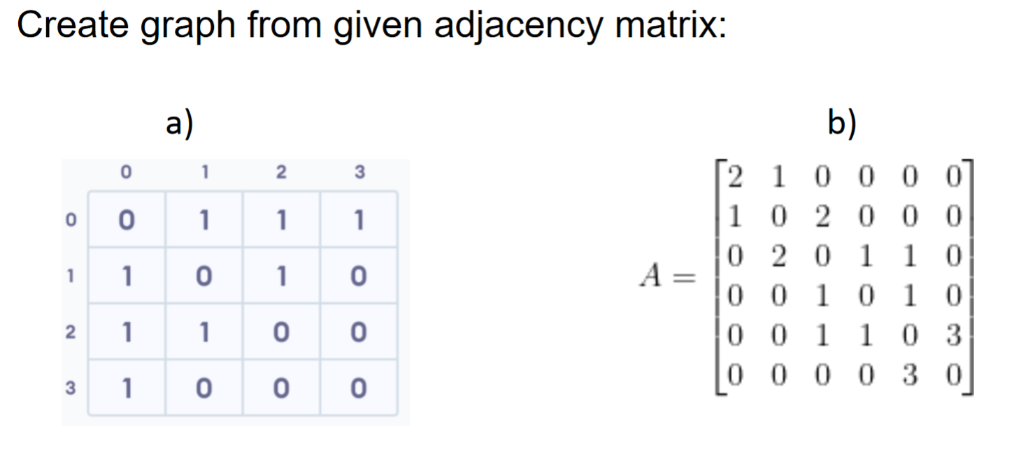
Exercise

