Slide 1
Data Structures and Algorithms Design
Harish Aggarwal

Slide 2
Greedy Algorithms
Kruskal
Prims

Slide 3
Re-Cap
Lecture-01
Introduction
Handout
Text Books, Reference Books
Marks Distribution
Algorithm Analysis
Pseudo Code
Random Access model
Time Complexity of Algorithms
Asymptotic Notations
Basic Maths Needed in the course
Lecture-02
General Rules and Problems
Mathematical analysis of Non-recursive algorithms
Mathematical analysis of Recursive algorithms
Iteration vs Recursion
Recurrence Tree
Iterative Substitution
Masters Theorem with example
Lecture-03
Abstract Data Types
Arrays and Linked Lists
List, Stack, Queues
Array and Linked Implementation
Add, Remove operations
Applications
Infix, PreFix, PostFix Notations
Lecture-04
Recurrence relation
Recursion Method (With help from Merge sort)
Substitution Method
Tree – Definitions
Binary Tree –
Proper, (Strict/Full), Complete, Perfect
Tree Traversal – PreOrder, InOrder, PostOrder

Slide 4
Re-Cap
Lecture-05
Sorting –
Bubble Sort
Insertion Sort
Selection Sort
Bucket Sort
Quick Sort
Complexity of Sorting Algorithms
Heaps
Heaps
Heapify
Heap Sort
Lecture-06
Hashing
Collisions
Handling collisions –
Chaining,
Linear Probing,
Quadratic Probing
Double Hashing
Lecture-07
Binary Search Tree
Addition, Deletion of Node
Search
Lecture-08
Revision
Lecture-09
AVL Trees
Lecture-10
Graphs
BFS and DFS Traversal

Slide 5
Agenda
Greedy Method
Design Principles and Strategy
Fractional Knapsack problem
Minimum Spanning Tree – Kruskal
Minimum Spanning Tree – Prims
Introduction to Greedy algorithms!
What is Greedy technique ?
Fractional Knapsack problem
Job Sequencing problem
Scheduling problem
Others

Slide 6
Greedy Algorithms
There are a lot of algorithmic types :
Brute force algorithms
Simple recursive algorithms
Greedy algorithms
Divide and conquer algorithms
Dynamic programming algorithms
Backtracking algorithms
Branch and bound algorithms
Randomized algorithms
Approximation algorithms

Slide 7
Optimization problems
An optimization problem is one in which you want to find, not just a solution, but the best solution ☺
A “greedy algorithm” sometimes works well for optimization problems
A greedy algorithm works in phases. At each phase:
You take the best you can get right now, without regard for future consequences
You hope that by choosing a local optimum at each step, you will end up at a global optimum

Slide 8
Counting Money
Suppose you want to count out a certain amount of money, using the fewest possible bills and coins
A greedy algorithm would do this would be: At each step, take the largest possible bill or coin that does not overshoot
Example: To make $6.39, you can choose:
a $5 bill
a $1 bill, to make $6
a 25¢ coin, to make $6.25
a 10¢ coin, to make $6.35
four 1¢ coins, to make $6.39
For US money, the greedy optimum solution.
Try for other currencies …
algorithm always gives the

Slide 9
A failure of the Greedy Algorithm
In some (fictional) monetary system, “krons” come in 1 kron, 7 kron, and 10 kron coins
Using a greedy algorithm to count out 15 krons, you would get
A 10 kron piece
Five 1 kron pieces, for a total of 15 krons
This requires six coins
A better solution would be to use two 7 kron pieces and one 1 kron piece
This only requires three coins
In this case, the greedy algorithm results in a feasible solution, but
not in an optimal solution !!

Slide 10
Greedy Algorithms
Greedy Algorithms are also used for optimization problems.
A Greedy Algorithm always makes the choice that looks best at that moment.
Greedy Algorithms do not always yield optimal solutions, but for many problems they do.
Examples
Fractional Knapsack problem
0/1 Knapsack problem
Container problem (Volume and Profit)
Data Compression (Huffman) Codes
Activity Selection Problem
Task Scheduling problem - Scheduling several competing activities that require exclusive use of a common resource, with a goal of selecting a maximum-size set of mutually compatible activities.

Slide 11
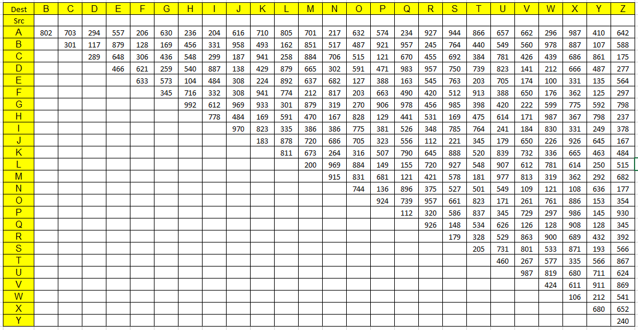
Minimum Spanning Tree
Examples
Electronic Circuit Designs – Wiring pins of components
Road Network in the country - Cost of construction of road between two cities.
Data below is the Cost of construction of road between two cities
Find which all road should be build

Slide 12
Minimum Spanning Tree
For all n nodes to be connected in a Graph, n-1 edges are needed
1
2
1
1
2
3
4
2
3
5
1
2
3
1
1
2
6
2
4
4
3
6
3
7
5
5

Slide 13

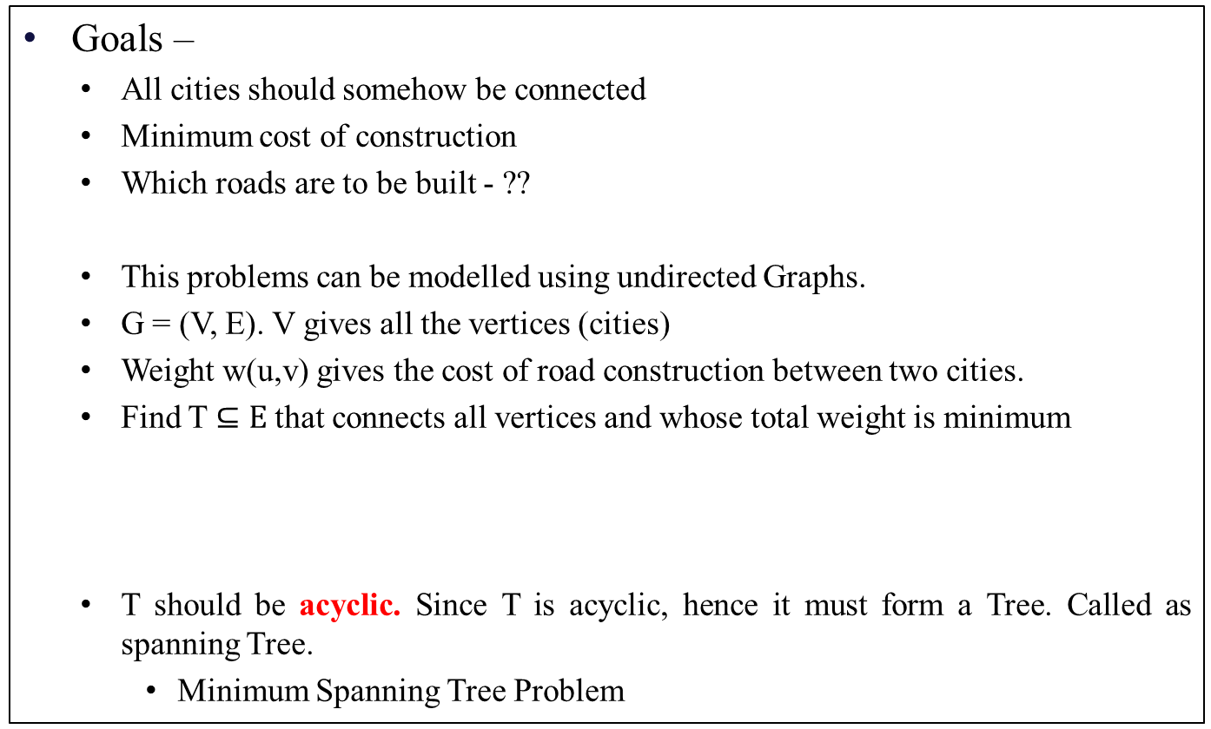
Minimum Spanning Tree
Goals –
All cities should somehow be connected
Minimum cost of construction
Which roads are to be built - ??
This problems can be modelled using undirected Graphs.
G = (V, E). V gives all the vertices (cities)
Weight w(u,v) gives the cost of road construction between two cities.
Find T $⊆E$that connects all vertices and whose total weight is minimum
T should be acyclic. Since T is acyclic, hence it must form a Tree. Called as spanning Tree.
Minimum Spanning Tree Problem

Slide 14
Minimum Spanning Tree
Example of Minimum Spanning Tree problem –
8
7
b
c
d
4
9
2
14
a
11
i
4
e
7
6
8
10
h
1
g
2
f

Slide 15
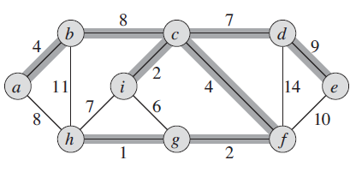
Minimum Spanning Tree
Example of Minimum Spanning Tree problem –
8
7
b
c
d
4
9
2
14
a
11
i
4
e
7
6
8
10
h
1
g
2
f

Slide 16
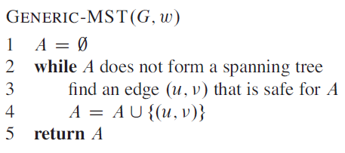
MST Algorithm
Generic method that each Algorithm follows –
Let A be set of Edges.
Prior to each iteration, A is a subset of some minimum spanning Tree T.
Initially A is empty.
We add first edge to A which would be the first edge in MST.
We keep adding and edge to A while maintaining that A always is subset of MST
Call this as Safe Edge
Tricky part is to find safe edge in Line 3
This safe edge is there in T and not in A
On completion of iteration this safe edge gets added to A.

Slide 17
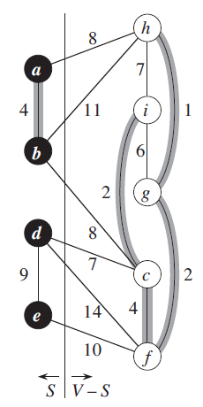
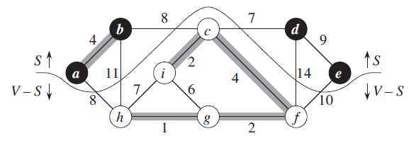
MST Algorithm
Cut (S, V-S) of an undirected graph G = (V,E) is partition of V
Edge (u,v) crosses cut (S, V-S) if one endpoint is in S and other in V-S
A Cut respects a set A if no edge in A crosses the cut.
An edge is a light edge if its weight in minimum of any edge crossing the Cut.

Slide 18
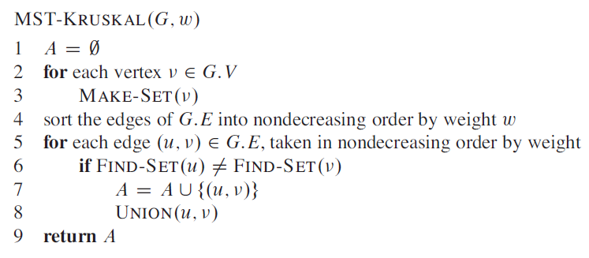
Kruskal’s Algorithm
Based on Generic-MST
The Set A is a forest whose vertices are all those of the Given Graph
The safe edge added to A is always a least-weight edge in the Graph that connects two distinct components
(u,v) is a safe edge if it is least weight and connects to trees C1 and C2
Algorithm maintains a disjoint-set data structure to maintain disjoints sets of elements
FIND-SET(u) returns the set that contains u.

Slide 19
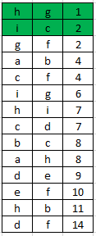
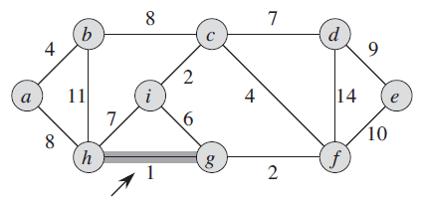
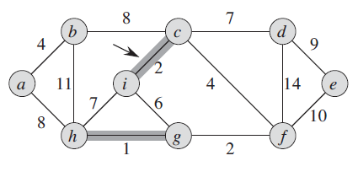
Kruskal’s Algorithm
Initially A is set to NIL
Line 1-3. Create a forest with one Vertex in each forest. For every Vertex in the Graph
Line 5-9
Take min edge and find if the end points of this edge are in same forest
If yes, ignore this edge
Else, Add this edge to A (Growing MST) and also merge the forests of u and v
Set = {a, b, c, d, e, f, g, h, i}
Set = {a, b, c, d, e, f, (g, h), i}
Set = {a, b, d, e, f, (g, h), (c, i)}

Slide 20
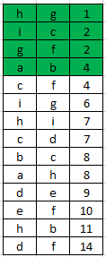
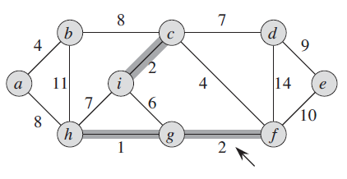
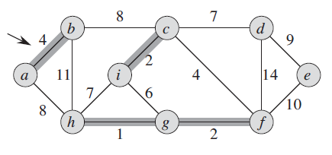
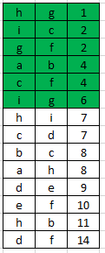
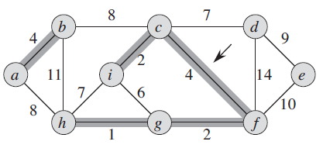
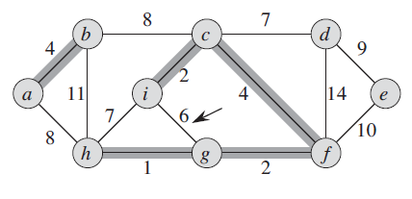
Kruskal’s Algorithm
Set = {a, b, d, e, (f, g, h), (c, i)}
Set = {(a, b), d, e, (f, g, h), (c, i}
Set = {(a, b), d, e, (c, f, g, h, i)}
Set = {(a, b), d, e, (c, f, g, h, i)}

Slide 21
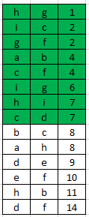
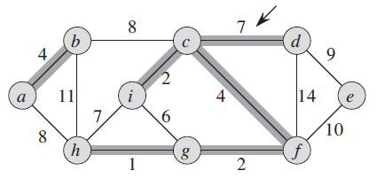
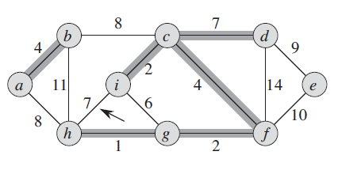
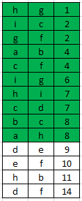
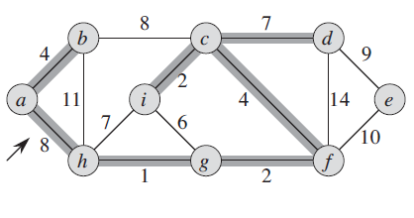
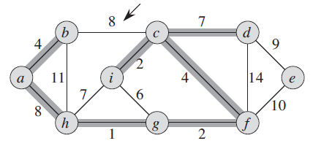
Kruskal’s Algorithm
Set = {(a, b), e, (c, d, f, g, h, i)}
Set = {(a, b), e, (c, d, f, g, h, i)}
Set = {(a, b, c, d, f, g, h, i), e}
Set = {(a, b, c, d, f, g, h, i), e}

Slide 22
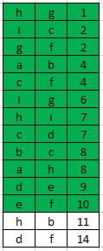
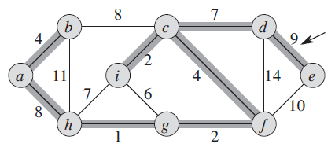
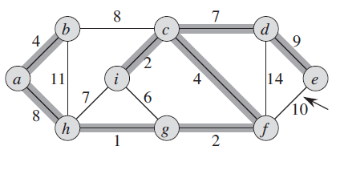
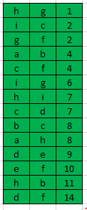
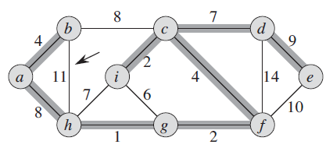
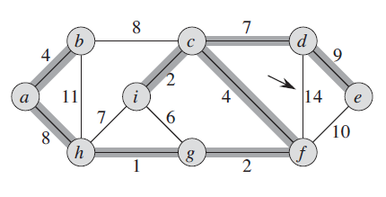
Kruskal’s Algorithm
Set = {(a, b, c, d, f, g, h, i, e)}
Set = {(a, b, c, d, f, g, h, i, e)}
Set = {(a, b, c, d, f, g, h, i, e)}
Set = {(a, b, c, d, f, g, h, i, e)}

Slide 23
Kruskal’s Algorithm
Running time
Line 1 – O(1)
Line 4 – Sorting Edges – E*log E
Line 2-3 O(V)*MAKE-SET Operations
Line 5-8 O(E)*(FIND-SET and UNION) Operations
Together MAKE-SET, FIND-SET, UNION takes α(V)
Hence the algorithm takes O((V+E)* α(V))
= O((E)* α(V)) Since |E| ≥ |V| - 1
= O((E)* α(V)) Since α(|V|) = O(log V) = O(Log E)
= O(E* Log E)
= O(E* Log V) Since |E| < |V|² => log |E| = O(log V)

Slide 24
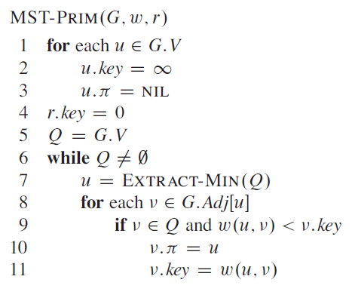
Prism’s Algorithm
Based on Generic-MST
Greedy algorithm
Edges in A always form a single Tree
Tree starts from arbitrary root vertex r and grows until the tree spans all the vertices in V
Each iteration adds a safe edge to A

Slide 25
Prism’s Algorithm
G – Graph, w – Weight, r –root Vertex
Set v.key (distance from root) for all nodes to infinity
Set parent of all nodes to NIL
Q is min priority Queue of all nodes in Graph based on key value. Initially key for Nodes is infinity, so the order does not matter.
Pull an element from the Queue. Look at all its adjacent nodes. If the adjacent node is still in the queue and edge value is less than adjacent node key, then update the key value of adjacent node
Adjacent node still remains in the queue
After key value is updated, the min-queue order is updated so that min-queue is remains a min-queue.

Slide 26
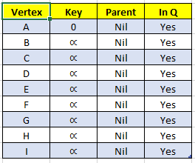
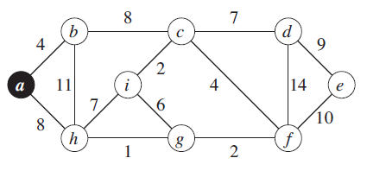
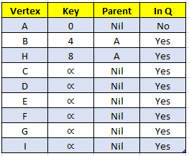
Prism’s Algorithm
Light Edge that crosses (V-Q, Q) to A

Slide 27
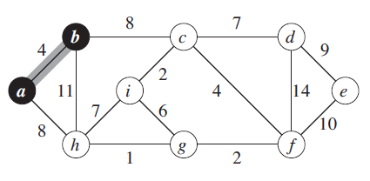
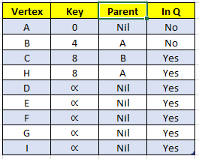
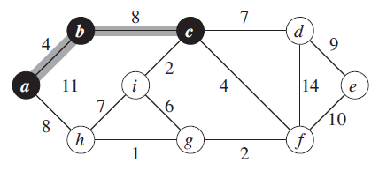
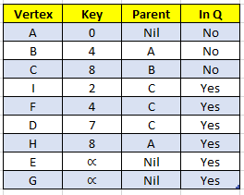
Prism’s Algorithm

Slide 28
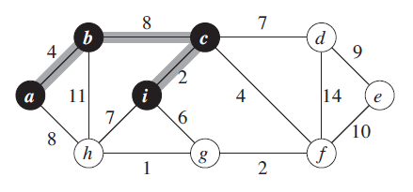
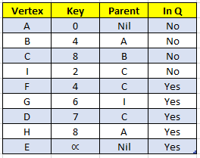
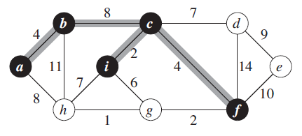
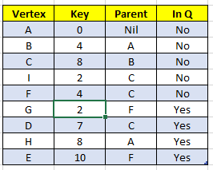
Prism’s Algorithm

Slide 29
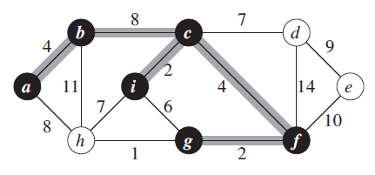
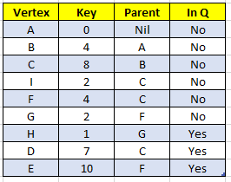
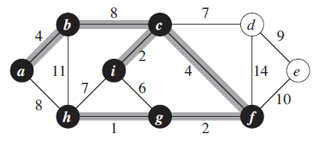
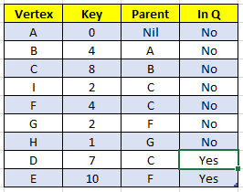
Prism’s Algorithm

Slide 30
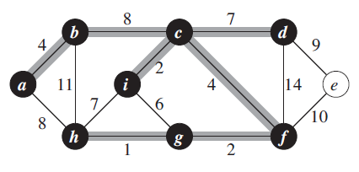
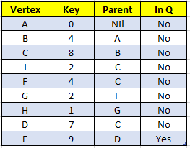
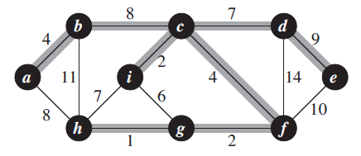
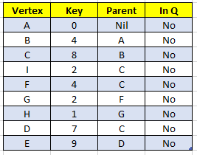
Prism’s Algorithm

Slide 31
Prism’s Algorithm
Running time
Line 1-3 – O(V)
Line 4 – O(1)
Line 5 – Building a min-Heap - O(V)
While loop executes |V| times
Line 7 – Extract operation takes O(log V)
Hence overall Extract Operation takes (Vlog V)
For Loop – O(E) times
Line 9. Comparisons can be made in constant time
Line 11 – Assignment and maintain min-heap – O(log V)
Hence line 8-11 take Overall O(E log V)
Overall complexity O(V log V + E Log V) = O(E log V)
Same as Kruskal’s algorithm

