Slide 1
Data Structures and Algorithms Design
Harish Aggarwal

Slide 2
Greedy - Shortest Path –
Dijkstra’s Algorithm
Bellman Ford

Slide 3
Re-Cap
Lecture-01
Introduction
Handout
Text Books, Reference Books
Marks Distribution
Algorithm Analysis
Pseudo Code
Random Access model
Time Complexity of Algorithms
Asymptotic Notations
Basic Maths Needed in the course
Lecture-02
General Rules and Problems
Mathematical analysis of Non-recursive algorithms
Mathematical analysis of Recursive algorithms
Iteration vs Recursion
Recurrence Tree
Iterative Substitution
Masters Theorem with example
Lecture-03
Abstract Data Types
Arrays and Linked Lists
List, Stack, Queues
Array and Linked Implementation
Add, Remove operations
Applications
Infix, PreFix, PostFix Notations
Lecture-04
Recurrence relation
Recursion Method (With help from Merge sort)
Substitution Method
Tree – Definitions
Binary Tree –
Proper, (Strict/Full), Complete, Perfect
Tree Traversal – PreOrder, InOrder, PostOrder

Slide 4
Re-Cap
Lecture-05
Sorting –
Bubble Sort
Insertion Sort
Selection Sort
Bucket Sort
Quick Sort
Complexity of Sorting Algorithms
Heaps
Heaps
Heapify
Heap Sort
Lecture-06
Hashing
Collisions
Handling collisions –
Chaining,
Linear Probing,
Quadratic Probing
Double Hashing
Lecture-07
Binary Search Tree
Addition, Deletion of Node
Search
Lecture-08
Revision
Lecture-09
AVL Trees
Lecture-10
Graphs
BFS and DFS Traversal
Lecture-11
Graphs
Minimum Spanning Tree
Prims
Kruskals

Slide 5
Agenda
Greedy Method
Shortest Path Problem –
Dijkstra’s Algorithm
Bellman Ford

Slide 6


Graph Definitions and Basics
w(p) is the weight of path p = <v₀, v₁,…v_{k}> and is equal to sum of the weights of its constituent edges
Shortest Path Weight between vertex u and v is given by Ϩ(u,v)

Slide 7
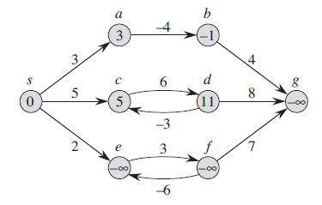
Graph Definitions and Basics
Lemma – Subpaths of shortest paths are shortest paths
Given a weighted, directed graph G = (V, E)
Let p = <v₀, v₁, ... ,v_{k}> be a shortest path from vertex v₀ to vertex v_{k}
For any i and j such that 0 < i < j < k, let p_{ij} = <v_{i},v_{i+i},..,v_{j}> be the subpath of p from vertex v_{i} to vertex v_{j}.
Then, p_{ij} is a shortest path from v_{i} to v_{j}
Negative Weighted edges and Negative Weighted Cycles.
Shortest path cannot have Negative Weighted Cycles.

Slide 8
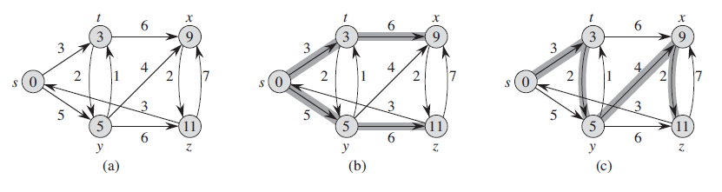
Graph Definitions and Basics
Shortest path does not contain
Negative weighted cycles or
Even positive weighted cycles (s, c, d, c)
If there is cycle in a shortest path it can be removed and new shortest path can be found.
Shortest paths have no cycles and are thus simple path
Shortest paths are not necessarily unique

Slide 9
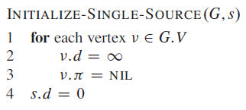
Graph Definitions and Basics
Since any acyclic path in a Graph can contain at most |V| vertices, shortest path can have at most |V|-1 Edges
For any vertex v, we have the attributes –
v.d – Shortest path estimate
v.ᴨ - Parent of v
Initialize –
Initially for all vertices set the values of d and ᴨ –
v.d = ∞
v.ᴨ = Nil
Since s is the source vertex, its shortest-path distance is 0

Slide 10
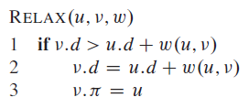
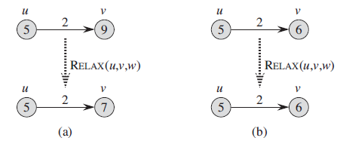
Graph Definitions and Basics
Relaxation – Given two vertices u and v and their shortest distance from source as u.d and v.d respectively. Then
v.d = u.d + w(u,v) if
v.d > u.d + w(u,v)

Slide 11
Graph Definitions and Basics
Triangle inequality - For any edge (u, v), Ϩ(s, v) < Ϩ(s, u) + w(u, v).
Upper-bound property - v.d > Ϩ(s, v) for all vertices, and once v.d achieves the value Ϩ(s, v), it never changes.
No-path property - If there is no path from s to v, then v.d = Ϩ(s, v) = ∞.
Convergence property – If u.d = Ϩ(s, u) at any time prior to relaxing edge (u, v), then v.d = Ϩ(s, v) at all times afterward.
Predecessor-subgraph property - Once v.d = Ϩ(s, v) for all vertices, the predecessor subgraph is a shortest-paths tree rooted at s.

Slide 12
Graph Definitions and Basics
Shortest Path Problems
Single Source Shortest Path Problem (Given Source to all Vertex)
Bellman Ford – Negative edges allowed but No negative cycles. If there is negative cycle, it will detect and report it.
Dijkstra – No negative edges
Single Destination Shortest Path Problem (All Vertex to Given Destination)
Single Pair Shortest Path Problem (One Source – One Destination)
All Pair Shortest Path Problem (All Vertex (Source) to all Vertex (Destination))
Flyod-Warshall Algorithm – No Neagtive cycles

Slide 13
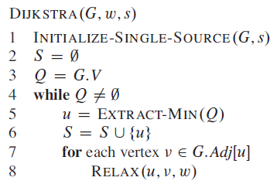
Dijkstra’s Algorithm
Single source shortest path problem
On a weighted directed Graph G = (V, E)
All Edged Weights are non-negative
Maintain a min-priority Q of vertices ordered by their d value
Initially for all vertices set the values of d and ᴨ –
v.d = ∞
v.ᴨ = Nil
Since s is the source vertex, its shortest-path distance is 0

Slide 14
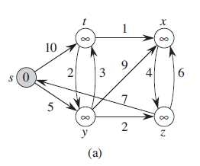
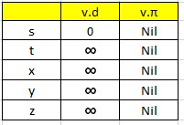
Dijkstra’s Algorithm

Slide 15

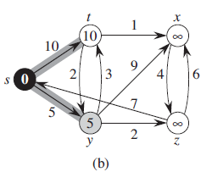
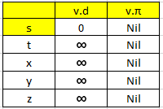
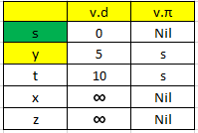
Dijkstra’s Algorithm

Slide 16

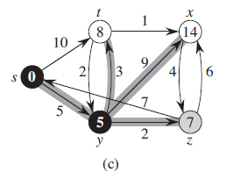
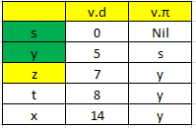
Dijkstra’s Algorithm

Slide 17

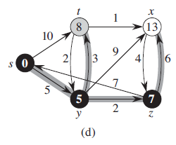
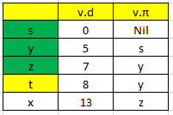
Dijkstra’s Algorithm

Slide 18

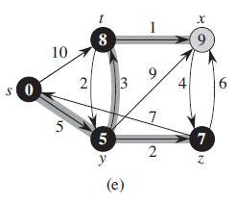
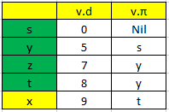
Dijkstra’s Algorithm

Slide 19

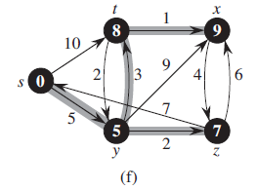
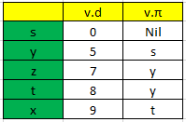
Dijkstra’s Algorithm

Slide 20
Dijkstra’s Algorithm
Greedy Algorithm - Chooses the lightest vertex as next step
Maintains a min-priority Q of vertices ordered by their d value
Hence operations on Min-Q are
Line 3 – Insert
Line 5 – Extract-Min (|V| times)
Line 8 – Decrease-Key (Implicit in Relax) (|E| times)
Extract-Min and Decrease-Key takes O(log V)
Hence overall complexity is O((V+E)(log V)) or
O(E log V)
Bellman-Ford Vs Dijkstra
Bellman Ford can work on negative Weights as well. Also it can identify negative cycles if there are any.
Dijkstra can work only on positive weights. Better in complexity than Bellman Ford.
Dijkstra takes Greed approach whereas Bellman Ford takes Dynamic Programming approach.

Slide 21
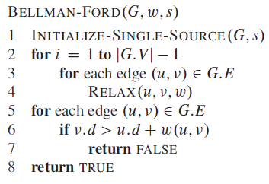
Bellman-Ford Algorithm
If a ≠ -∞ then a + ∞ = ∞ + a = ∞
If a ≠ ∞ then a + (-∞) = (-∞) + a = -∞
Assumption - Graph is stored in the form of adjacency List
Negative weighted cycle is not allowed. If such cycle exist, the algorithm will return FALSE indicating no solution exist.
Runs in O(VE)

Slide 22
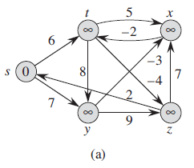
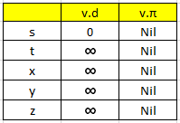
Bellman-Ford Algorithm

Slide 23
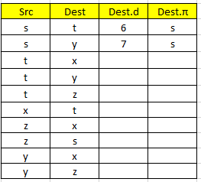
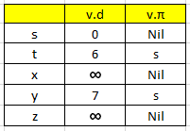
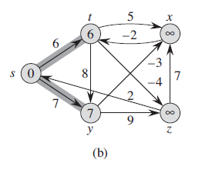
Bellman-Ford Algorithm

Slide 24
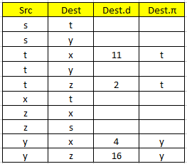
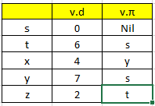
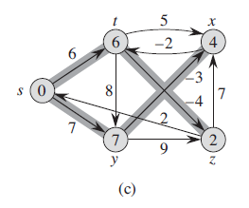
Bellman-Ford Algorithm

Slide 25
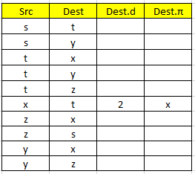
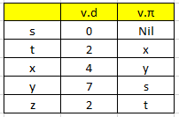
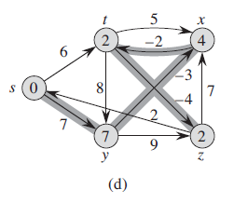
Bellman-Ford Algorithm

Slide 26
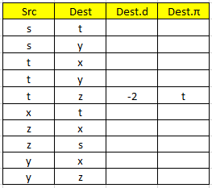
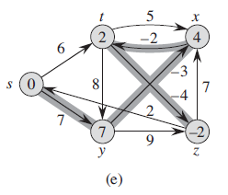
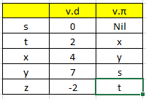
Bellman-Ford Algorithm

