Slide 1
Data Structures and Algorithms Design
Harish Aggarwal

Slide 2
Multi-way Trees
(2,4) Trees

Slide 3
Re-Cap
Lecture-01
Introduction
Handout
Text Books, Reference Books
Marks Distribution
Algorithm Analysis
Pseudo Code
Random Access model
Time Complexity of Algorithms
Asymptotic Notations
Basic Maths Needed in the course
Lecture-02
General Rules and Problems
Mathematical analysis of Non-recursive algorithms
Mathematical analysis of Recursive algorithms
Iteration vs Recursion
Recurrence Tree
Iterative Substitution
Masters Theorem with example
Lecture-03
Abstract Data Types
Arrays and Linked Lists
List, Stack, Queues
Array and Linked Implementation
Add, Remove operations
Applications
Infix, PreFix, PostFix Notations
Lecture-04
Recurrence relation
Recursion Method (With help from Merge sort)
Substitution Method
Tree – Definitions
Binary Tree –
Proper, (Strict/Full), Complete, Perfect
Tree Traversal – PreOrder, InOrder, PostOrder

Slide 4
Re-Cap
Lecture-05
Sorting –
Bubble Sort
Insertion Sort
Selection Sort
Bucket Sort
Quick Sort
Complexity of Sorting Algorithms
Heaps
Heaps
Heapify
Heap Sort
Lecture-06
Hashing
Collisions
Handling collisions –
Chaining,
Linear Probing,
Quadratic Probing
Double Hashing
Lecture-07
Binary Search Tree
Addition, Deletion of Node
Search
Lecture-08
Revision
Lecture-09
AVL Trees
Addition, Deletion of Node
Search
Lecture-10
Graphs
BFS and DFS Traversal

Slide 5
Re-Cap
Lecture-11
Graphs
Minimum Spanning Tree
Prims
Kruskals
Lecture-12
Shortest Path Algorithsm
Dijkstra’s Algorithm
Bellman Ford

Slide 6
Agenda
Multiway Trees
(2,4) Trees
Concept
Insertion
Deletion
Analyses of Operations

Slide 7
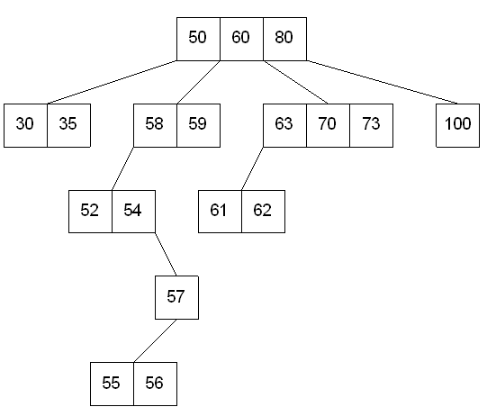
Multiway Search Trees
Multi-Way Search Trees
Search trees, that is, trees with internal nodes that have two or more children.
4-Way Search Tree

Slide 8
Multiway Search Trees
Each node can have more than two children
A node with k children has k – 1 keys
Keys are sorted within nodes
Subtrees are placed between keys
All keys in the left subtree < key1 < middle subtree < key2 < right subtree.
M-Way Search tree of order m – Each node can have 0-m subtrees
It is not balanced

Slide 9
Multiway Search Trees
Insertion
Search for the insertion point: Start at the root and search for the key K.
In each node, use a linear search to find the correct position for K among the existing keys.
If K is less than the first key, follow the first (leftmost) child pointer.
If K is between two keys, follow the child pointer between those keys.
If K is greater than the last key, follow the last (rightmost) child pointer.
Continue this process until you find the leaf node where the key should be inserted.
Insert the key: Once the correct leaf node is found, insert K while maintaining the sorted order of keys within that node.
If the leaf node is full (i.e., it contains m-1 keys) :
Create a new node.
Place the new key and its corresponding child pointer (if any) into this new child node.
Update the parent node to point to this new child.
In contrast to balanced trees, no splitting or promoting of keys is necessary.

Slide 10
Multiway Search Trees
Deletion
Search for the key: Search the tree for the key K to be deleted.
If the key K is in a leaf node, simply remove it and shift the remaining keys to maintain the sorted order.
Delete from an internal node: If the key K is in an internal node, follow the same procedure as a standard binary search tree.
Find a replacement key: Find the inorder successor or predecessor of K. This is typically the largest key in the left subtree or the smallest key in the right subtree.
Replace and delete: Copy the replacement key into K's position. Then, recursively delete the replacement key from its original leaf node location.
No rebalancing: After deletion, the tree might have a node with fewer keys than other nodes, or it may become more skewed. No rotations, merging, or borrowing from sibling nodes occur because there is no balancing mechanism to maintain.

Slide 11
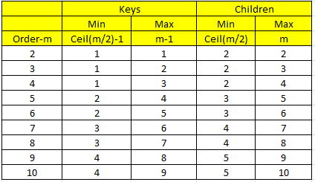
B-Trees
Type of Multiway Search Tree
Self-Balancing
B-tree of a given order (or degree) m –
Each internal node can have up to m children and must contain between ceil(m/2)-1 and m-1 keys. The keys are stored in a sorted order within the node.
Self-balancing: All leaf nodes are at the same depth.
Root node is an exception and can have less than ceil(m/2)-1 keys.
Summary for B-Tree of Order 2 (2-3 Tree):
Root: 1 key, 2 children.
Internal Nodes: 1 key, 2 children.
Leaf Nodes: 1 key, 0 children.

Slide 12
B-Tree
30 | 80
20
50 | 60
90
10
25
35 | 40
55
70
82 | 85
95
All leaf Nodes are at same level
Order is 3. Hence d=ceil(m/2)=2. That is every internal node shall have at least 2 children
Order of keys is maintained at all levels.

Slide 13
B-Tree
Searching is exactly as in m-way Search Tree
Inserting a node.
Find the location at which Node needs to be inserted by traversing from root to the leaf node.
If the Leaf node where the element is to be inserted is not full, then insert the node in the leaf node
(For B-Tree of order m, Node is full if it has m-1 elements)
If the Leaf node where node is to be inserted is full, then –
Insert the element in Leaf node so that number of elements there is m
Split the Node into three parts each.
If m is odd, parts have (m-1)/2 + 1 + (m-1)/2 elements.
If m is Even, the tree parts have m/2 -1, 1, m/2 nodes
Left and right Node remain at this level and center Node is pushed up and inserted in Parent Node.
Recursion may occur if the parent is also full and so on.
This in B-Tree the insertion of element will cause Tree to grow upwards.

Slide 14
B-Tree - Insertion
Insert the following elements in B-Tree of Order 5
10
10 | 20
10 | 20 | 50
10 | 20 | 50 | 60
40
10 | 20
50 | 60

Slide 15
B-Tree - Insertion
Insert the following elements in B-Tree of Order 5
40
40
40
10 | 20
50 | 60
10 | 20
50 | 60 | 80
10 | 20
50 | 60 | 80 | 100
40 | 70
40 | 70
10 | 20
50 | 60
80 | 100
10 | 20
50 | 60
80 | 100 | 130

Slide 16
B-Tree - Insertion
Insert the following elements in B-Tree of Order 5
40 | 70
40 | 70
10 | 20
50 | 60
10 | 20
50 | 60
80 | 90 | 100 | 130
80 | 100 | 130
40 | 70
40 | 70 | 100
10 | 20 | 30
50 | 60
80 | 90 | 100 | 130
10 | 20 | 30
50 | 60
80 | 90
120 | 130

Slide 17
B-Tree - Insertion
Insert the following elements in B-Tree of Order 5
40 | 70 | 100
10 | 20 | 25 | 30
50 | 60
80 | 90
120 | 130 | 140
25 | 40 | 70 | 100
10 | 20
30 | 35
50 | 60
80 | 90
120 | 130 | 140

Slide 18
B-Tree - Insertion
Insert the following elements in B-Tree of Order 5
25 | 40 | 70 | 100
10 | 20
30 | 35
50 | 60
80 | 90
120 | 130 | 140 | 160
25 | 40 | 70 | 100 | 140
10 | 20
30 | 35
50 | 60
80 | 90
120 | 130
160 | 180

Slide 19
B-Tree - Insertion
Insert the following elements in B-Tree of Order 5
25 | 40 | 70 | 100 | 140
10 | 20
30 | 35
50 | 60
80 | 90
120 | 130
160 | 180
70
100 | 140
25 | 40
10 | 20
30 | 35
50 | 60
80 | 90
120 | 130
160 | 180

Slide 20
B-Tree - Deletion
Deleting a node.
Find the Node to be Deleted.
There will be Two cases
Node is a Leaf
Node is a Non-Leafe Node
If Node is a Non-Leaf Node,
Find the Largest Element in Left Sub Tree (In-Order predecessor) or Least Element in Right Sub-Tree (In-Order Successor)
Replace the Deleted Node with this Node.
In Nut-Shell we will always have the problem of deleting an Element from the Leaf Node
To Delete an Element from the Leaf Node.
If after Deletion the number of elements left in the node is greater than Ceil(m/2)-1, then we are OK. Just Delete the Node
If on Deletion, the number of elements remaining is less than Ceil(m/2)-1, then we have to take following steps
Check left sibling or right sibling. If they have enough elements that after deleting one node from them, they are still OK, then just borrow one element from them. (Move element to Parent and Take element from Parent). See Example 1
If they too get starved, then merge the two nodes with one element from Parent as well. If Parent is starved, this policy applies on parent and its sibling as well. Can recursively go to the root. See Example 2 and 3

Slide 21
B-Tree - Deletion
Example -1
B-Tree of Order 7
Max Element in Node = 6
Min Elements in Node = ceil(m/2)-1 = 3
Delete 25
10 | 40 | 80
2 | 3 | 4 | 6
20 | 25 | 30
50 | 60 | 70
82 | 84 | 86 | 88
6 | 40 | 80
2 | 3 | 4
10 | 20 | 30
50 | 60 | 70
82 | 84 | 86 | 88

Slide 22
B-Tree - Deletion
Example -2
B-Tree of Order 7
Max Element in Node = 6
Min Elements in Node = ceil(m/2)-1 = 3
Delete 25
10 | 40 | 80
2 | 3 | 4
20 | 25 | 30
50 | 60 | 70
82 | 84 | 86 | 88
10 | 80
2 | 3 | 4
20 | 30 | 40 | 50 | 60 | 70
82 | 84 | 86 | 88

Slide 23
(2,4) Search Tree
Self-balancing multiway search tree that is a specific type of B-tree where each internal node has between two and four children
The properties of a (2,4) tree are:
2-node: A node with one key and two children.
3-node: A node with two keys and three children.
4-node: A node with three keys and four children.
All keys within a node are kept in sorted order.
All leaves are at the same depth, which ensures the tree is always balanced.
The tree's height is always logarithmic with respect to the number of keys.
A (2,4) tree maintains its balance through a special set of rules for insertion and deletion.

Slide 24
(2,4) Search Tree
Insertion
Insertion
Search: Traverse the tree from the root down to the correct leaf node, following the search tree rules.
Insert: Insert the key into the leaf node while maintaining sorted order.
Handle overflow: If a node becomes a "5-node" (with four keys), it has overflowed. To fix this, perform a split operation:
The middle key is promoted to the parent node.
The two outer keys are placed into new nodes.
The middle key is inserted into the parent. This may cause a cascade of splits if the parent node also overflows

Slide 25
(2,4) Search Tree
Deletion
Deletion can involve keys in both internal and leaf nodes.
Find and swap: If the key to be deleted is in an internal node, it is swapped with its in-order successor (the smallest key in the right child's subtree). This reduces all deletions to the case of removing a key from a leaf node.
Remove from leaf: Delete the key from the leaf node.
Handle underflow: If a node becomes a "1-node" (with zero keys) after deletion, it has underflowed. It is rebalanced by either:
Transfer: If a sibling node is a 3-node or 4-node, a key is transferred from the sibling to the parent, and then another key is transferred from the parent to the underflowed node.
Fusion: If the sibling is also a 2-node, the underflowed node, the sibling, and the separating key from the parent are merged into a single new node. This fusion may cause a cascade of underflows up the tree

Slide 26
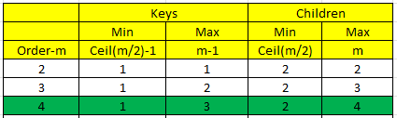
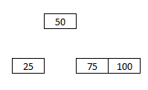
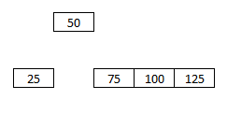
(2,4) Search Tree
Insertion

Slide 27

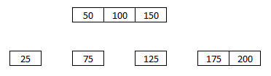
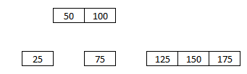
(2,4) Search Tree
Insertion

Slide 28
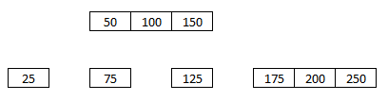
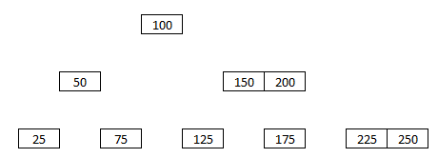
(2,4) Search Tree
Insertion

Slide 29
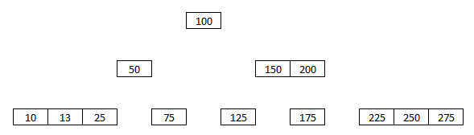
(2,4) Search Tree
Insertion

Slide 30
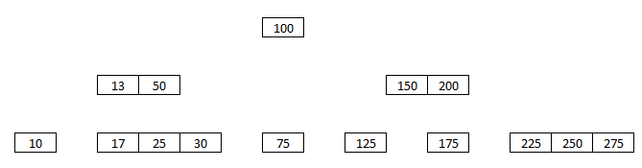
(2,4) Search Tree
Insertion

Slide 31
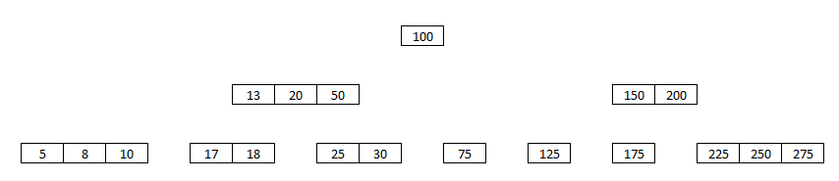
(2,4) Search Tree
Insertion

Slide 32
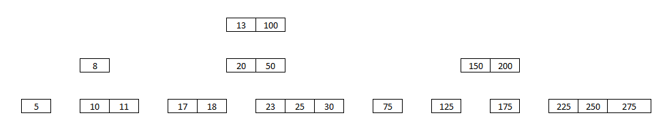
(2,4) Search Tree
Insertion

Slide 33
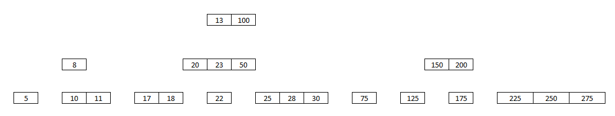
(2,4) Search Tree
Insertion

