Slide 1

Course Name :
Systems Programming
11th DEC 2022

Slide 2

IMP Note to Self
Systems Programming - V 3.0

Slide 3
IMP Note to Students
It is important to know that just login to the session does not guarantee the attendance.
Once you join the session, continue till the end to consider you as present in the class.
IMPORTANTLY, you need to make the class more interactive by responding to Professors queries in the session.
Whenever Professor calls your number / name ,you need to respond, otherwise it will be considered as ABSENT
Systems Programming - V 3.0

Slide 4
Agenda
Commands :
cat - to create, view, concatenate files.
mv - mv is used to move one or more files or directories
rm - removes the entries for a specified file, group of files.
cmp, comm, diff - to display the differences by comparing the files
chmod- used to change the access permissions
top - Displays list of running processes
head- Pick lines from the beginning
tail - Pick lines from the end
sort - Sort, merge and remove
wc - to find number of lines, word count, byte and characters.
tee - to view output and at the same time store it in a file
Systems Programming - V 3.0

Slide 5
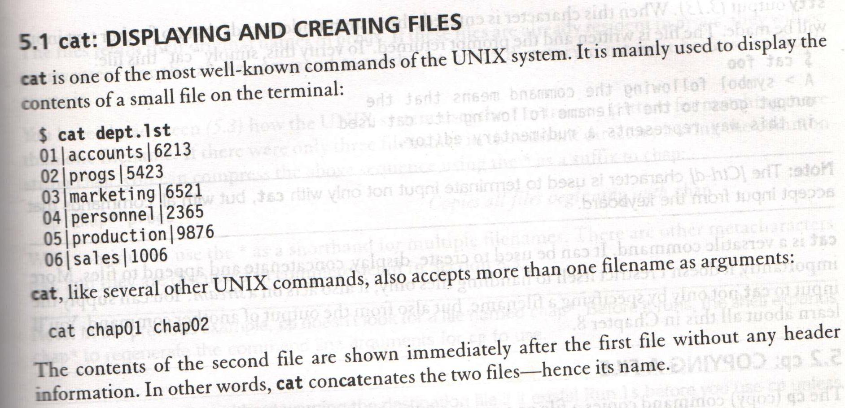
cat – DISPLAYING AND CREATING FILES
Systems Programming - V 3.0

Slide 6
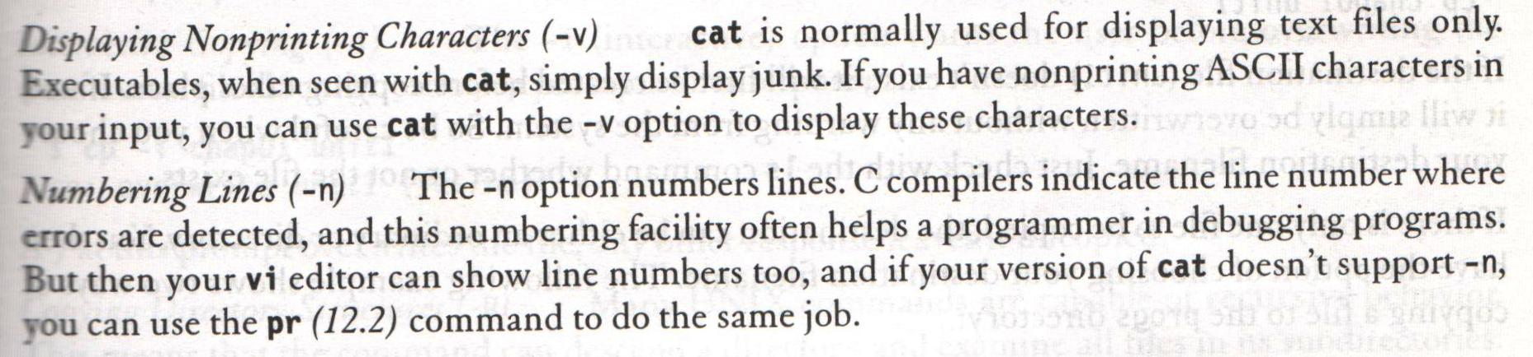
cat – DISPLAYING AND CREATING FILES
cat options ( -v and –n)
Systems Programming - V 3.0

Slide 7
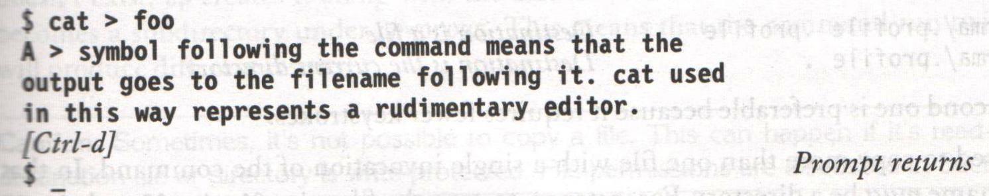
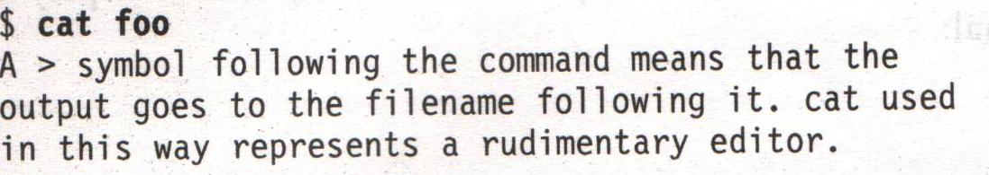
cat – DISPLAYING AND CREATING FILES
cat is also useful for creating files
Systems Programming - V 3.0

Slide 8
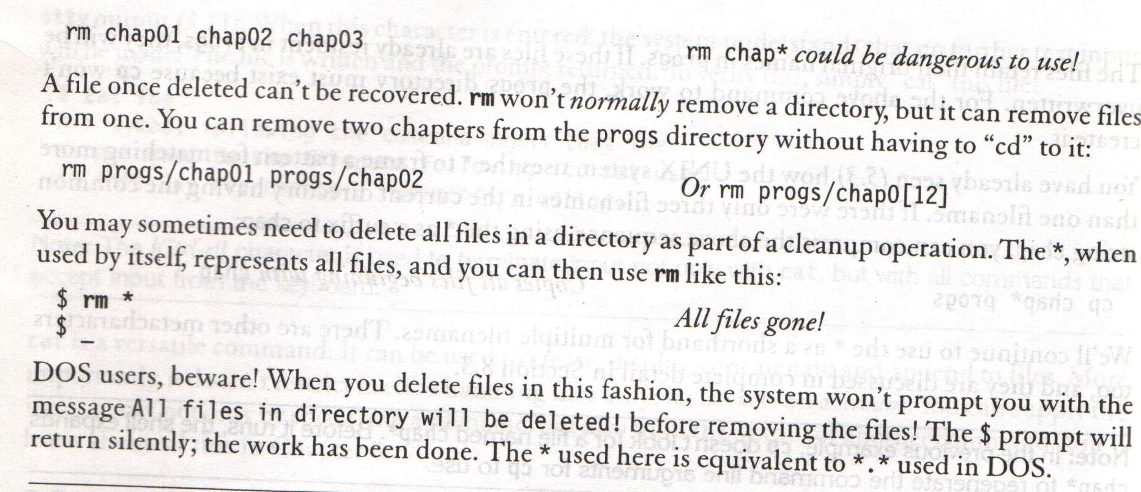
rm – DELETING FILES
Systems Programming - V 3.0

Slide 9
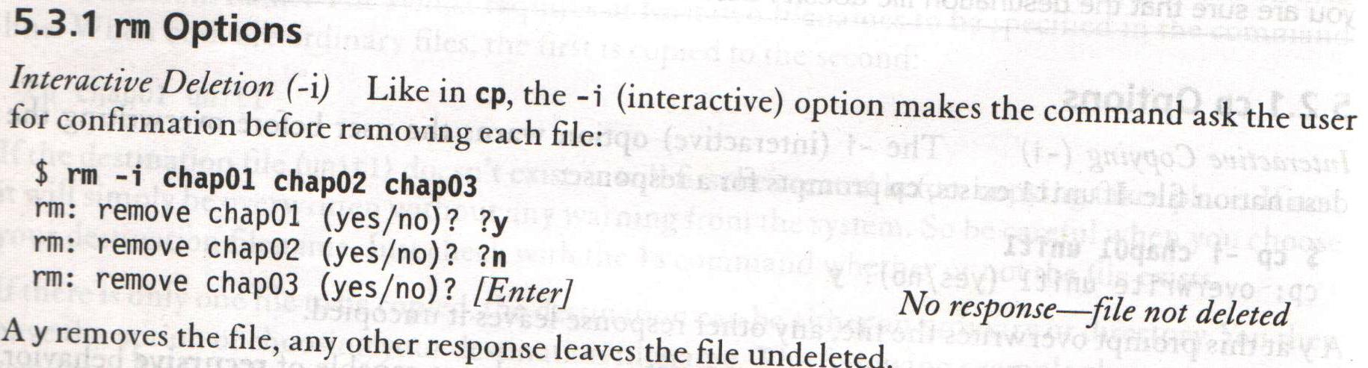
rm – DELETING FILES
Systems Programming - V 3.0

Slide 10
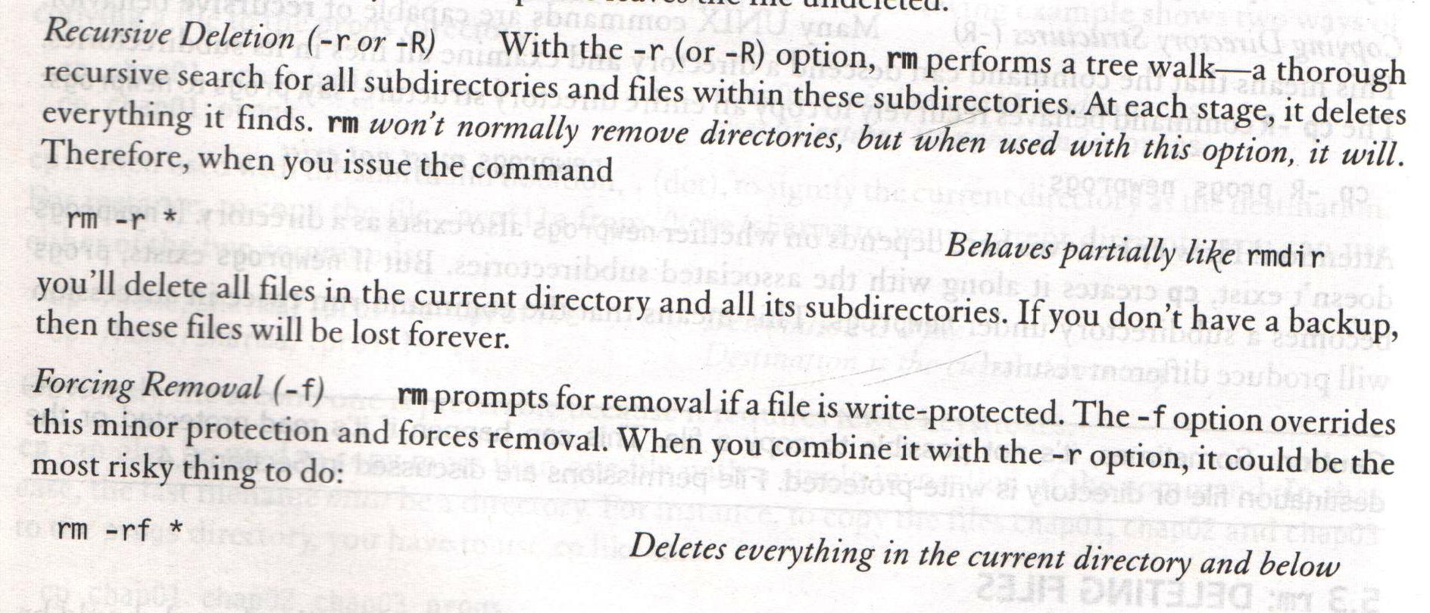
rm – DELETING FILES
Systems Programming - V 3.0

Slide 11
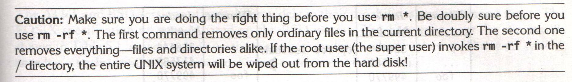
rm – DELETING FILES
Systems Programming - V 3.0

Slide 12
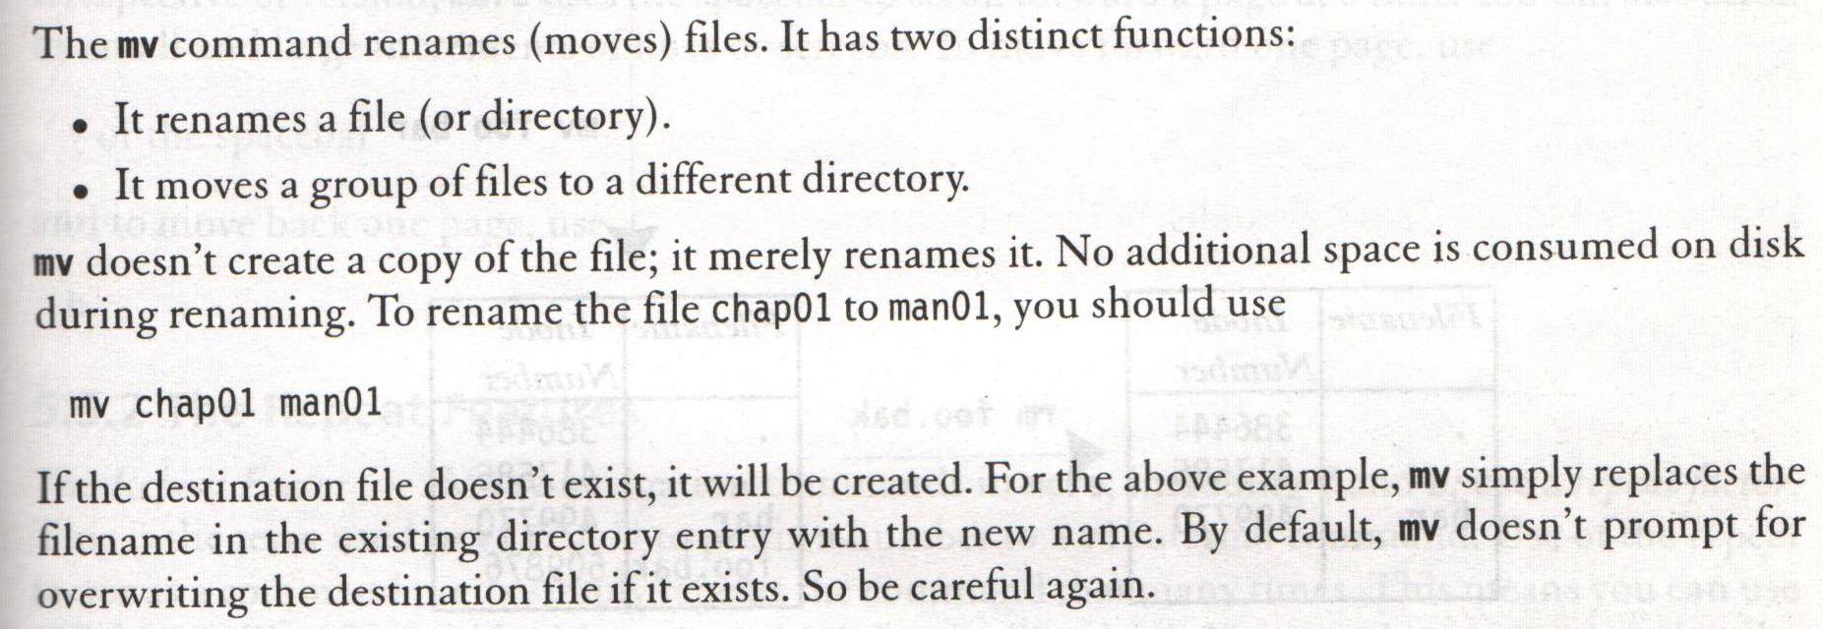
mv – RENAMING FILES
Systems Programming - V 3.0

Slide 13
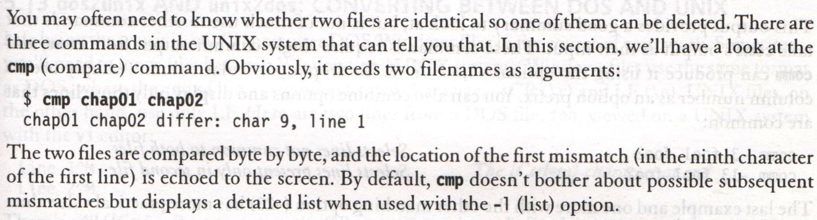
cmp – COMPARING TWO FILES
Systems Programming - V 3.0

Slide 14
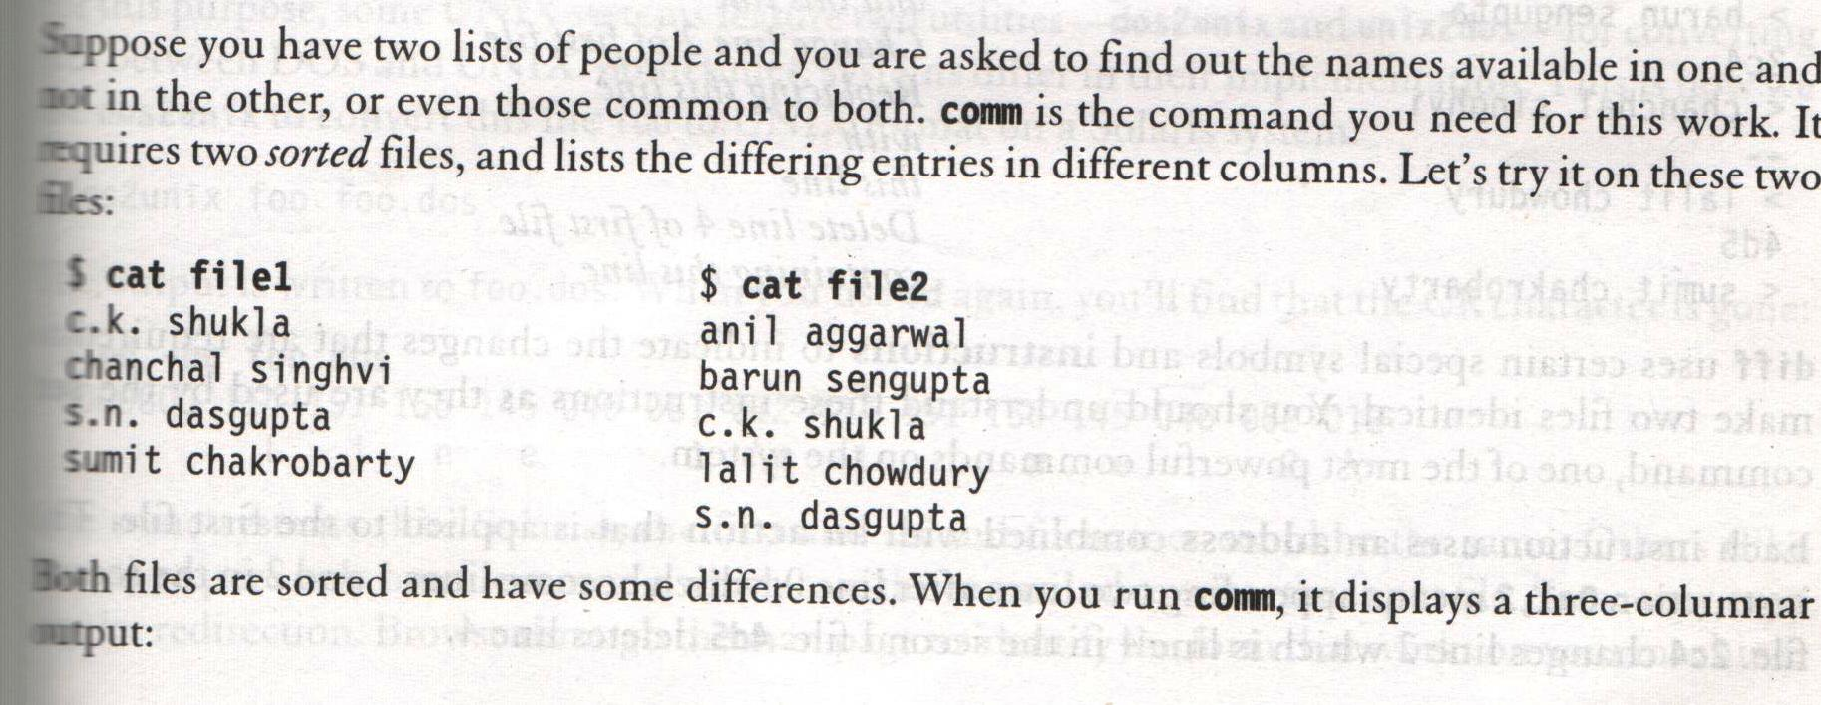
comm – WHAT IS COMMON?
Systems Programming - V 3.0

Slide 15
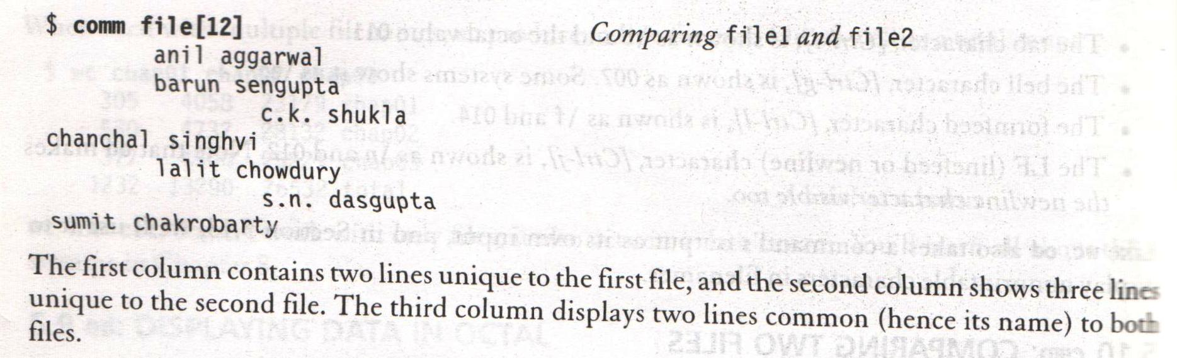
comm – WHAT IS COMMON?
Systems Programming - V 3.0

Slide 16
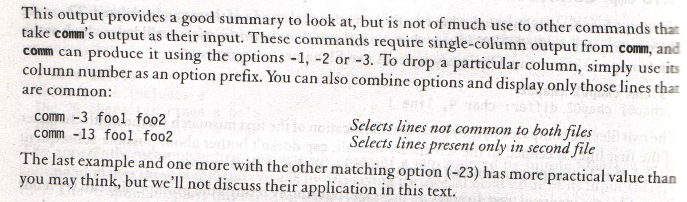
comm – WHAT IS COMMON?
Systems Programming - V 3.0

Slide 17
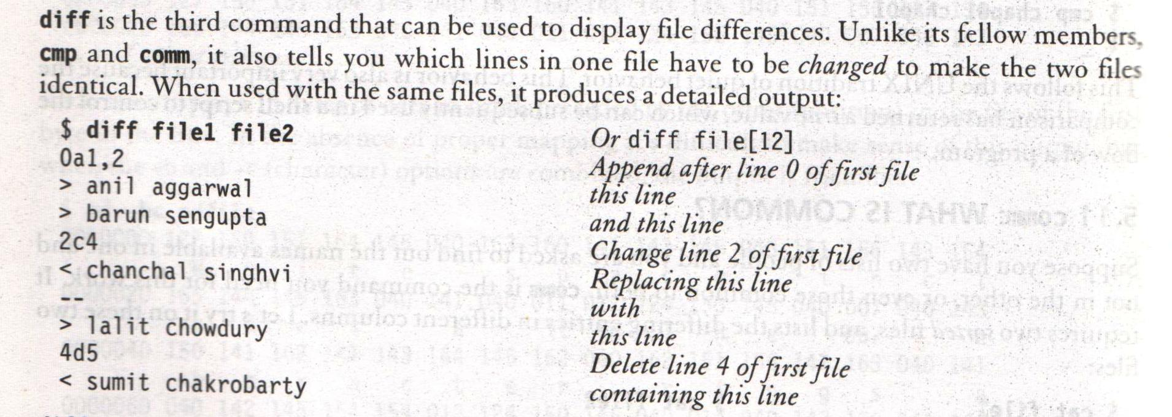
diff – CONVERTING ONE FILE TO OTHER
Systems Programming - V 3.0

Slide 18
umask: DEFAULT FILE AND DIRECTORY PERMISSIONS
Usually we have,
      rw-rw-rw- (octal 666) for regular files
      rwxrwxrwx (octal 777) for directories
The default is transformed by subtracting the user mask from it to remove one or more permissions
We can evaluate the current value of the mask as,
$ umask
022
Systems Programming - V 3.0

Slide 19
FILE OWNERSHIP
When you create a file, you become its owner (third column)
Group owner of the file (fourth column)
Several users may belong to a single group, but the privileges of the group are set by the owner of the file and not by the group members
Systems Programming - V 3.0

Slide 20
FILE OWNERSHIP
UNIX follows a three-tiered file protection system that determines a file’s access rights
Filetype owner (rwx) groupowner (rwx) others (rwx)
Example:
-rwxr-xr-- 1 kumar metal 20500 may 10 19:21 chap02
r w x r - x r - -
owner/user group owner others
Systems Programming - V 3.0

Slide 21
CHANGING FILE PERMISSIONS
A file or a directory is created with a default set of permissions, which can be determined by umask
Let us assume that the file permission for the created file is -rw-r--r—
Using chmod command, we can change the file permissions and allow the owner to execute his file
Systems Programming - V 3.0

Slide 22
RELATIVE AND ABSOLUTE PERMISSIONS
In a relative manner, specify the changes to the current permissions
In an absolute manner, specify the final permissions
Systems Programming - V 3.0

Slide 23
RELATIVE PERMISSIONS
chmod only changes the permissions specified in the command line and leaves the other permissions unchanged
Syntax
chmod category operation permission filename(s)
Systems Programming - V 3.0

Slide 24
RELATIVE PERMISSIONS
chmod takes an expression as its argument which contains:
user category (user, group, others)
operation to be performed (assign or remove a permission)
type of permission (read, write, execute)
Systems Programming - V 3.0

Slide 25
RELATIVE PERMISSIONS
Category operation permission
u - user + assign r - read
g - group - remove w - write
o - others = absolute x - execute
a - all (ugo)
Systems Programming - V 3.0

Slide 26
RELATIVE PERMISSIONS
Examples
-rw-r--r-- 1 kumar metal 1906 sep 23:38 xstart
chmod u+x xstart
-rwxr--r-- 1 kumar metal 1906 sep 23:38 xstart
The command assigns (+) execute (x) permission to the user (u), other permissions remain unchanged
Systems Programming - V 3.0

Slide 27
RELATIVE PERMISSIONS
chmod ugo+x xstart
chmod a+x xstart
chmod +x xstart
-rwxr-xr-x 1 kumar metal 1906 sep 23:38 xstart
chmod accepts multiple file names in command line
chmod u+x note note1 note3
Systems Programming - V 3.0

Slide 28
RELATIVE PERMISSIONS
Let initially
-rwxr-xr-x 1 kumar metal 1906 sep 23:38 xstart
chmod go-r xstart
Then, it becomes
-rwx--x--x 1 kumar metal 1906 sep 23:38 xstart
Systems Programming - V 3.0

Slide 29
ABSOLUTE PERMISSIONS
Need not to know the current file permissions
Set all nine permissions explicitly
A string of three octal digits is used as an expression
The permission can be represented by one octal digit for each category
For each category, we add octal digits
Systems Programming - V 3.0

Slide 30
ABSOLUTE PERMISSIONS
Octal Permissions Significance
0 - - - no permissions
1 - - x execute only
2 - w - write only
3 - w x write and execute
4 r - - read only
5 r - x read and execute
6 r w - read and write
7 r w x read, write and execute
Systems Programming - V 3.0

Slide 31
ABSOLUTE PERMISSIONS
Using relative permission
  chmod a+rw xstart
Using absolute permission
chmod 666 xstart
chmod 644 xstart
chmod 761 xstart
will assign all permissions to the owner, read and write permissions for the group and only execute permission to the others
Systems Programming - V 3.0

Slide 32
ABSOLUTE PERMISSIONS
777 signifies all permissions for all category, but still we can prevent a file from being deleted
000 signifies absence of all permissions for all category, but still we can delete a file
It is the directory permissions that determines whether a file can be deleted or not
Systems Programming - V 3.0

Slide 33
PERMISSIONS
Only owner can change the file permissions
User can not change other user’s file’s permissions
But the system administrator can do anything
Systems Programming - V 3.0

Slide 34
THE SECURITY IMPLICATIONS
Let the default permission for the file xstart is
-rw-r--r--
chmod u-rw, go-r xstart or
chmod 000 xstart
----------
This is simply useless but still the user can delete this file
Systems Programming - V 3.0

Slide 35
chmod RECURSIVELY
chmod -R a+x shell_scripts
This makes all the files and subdirectories found in the shell_scripts directory, executable by all users
Systems Programming - V 3.0

Slide 36
DIRECTORY PERMISSIONS
It is possible that a file cannot be accessed even though it has read permission, and can be removed even when it is write protected
The default permissions of a directory are
rwxr-xr-x (755)
A directory must never be writable by group and others
Systems Programming - V 3.0

Slide 37
DIRECTORY PERMISSIONS
This becomes 644 (666-022) for ordinary files and 755 (777-022) for directories
umask 000
Indicates, we are not subtracting anything and the default permissions will remain unchanged
Note that, changing system wide default permission seetings is possible using chmod but not by umask
Systems Programming - V 3.0

Slide 38
CHANGING FILE OWNERSHIP
On BSD and AT&T systems
Kumar – owner (user)
Metal – group owner
If sharma copies a file of kumar, then sharma will become its owner and he can manipulate the attributes
chown and chgrp
On BSD, only system administrator can use chown
On other systems, only the owner can change both
Systems Programming - V 3.0

Slide 39
chown Command
Changing ownership requires superuser permission, so use su command
ls -l note
-rwxr----x 1 kumar metal 347 may 10 20:30 note
chown sharma note; ls -l note
-rwxr----x 1 sharma metal 347 may 10 20:30 note
Systems Programming - V 3.0

Slide 40
chgrp Command
This command changes the file’s group owner
No superuser permission is required
ls –l dept.lst
-rw-r--r-- 1 kumar metal 139 jun 8 16:43 dept.lst
chgrp dba dept.lst;
ls –l dept.lst
-rw-r--r-- 1 kumar dba 139 jun 8 16:43 dept.lst
Systems Programming - V 3.0

Slide 41
sort : ordering a file
Sorting is the ordering of data in ascending or descending sequence. The sort command orders a file and by default, the entire line is sorted
This default sorting sequence can be altered by using certain options. We can also sort one or more keys (fileds) or use a different ordering rule.
sort options
The important sort options are:
-k n sorts on nth field
-k m,n starts sort on mth field and ends sort on nth field
-k m.n starts sort on nth column of mth field
-u removes repeated lines
-n sorts numerically
-r reverses sort order
-m list merges sorted files in list
-c checks if file is sorted
-o flname places output in file flname
Systems Programming - V 3.0

Slide 42
sort : ordering a file
sort –t“|” –k 2 shortlist
sorts the second field (name)
sort –t”|” –r –k 2 shortlist or
sort –t”|” –k 2r shortlist
sort order can be revered with this –r option.
sort –t”|” –k 3,3 –k 2,2 shortlist
sorting on secondary key is also possible as shown above.
sort –t”|” –k 5.7,5.8 shortlist
we can also specify a character position with in a field to be the beginning of sort as shown above (sorting on columns).
Systems Programming - V 3.0

Slide 43
head - display the start of a file
head displays the head, or start, of the file.
Syntax
head [options] file
Common Options
-n number number of lines to display, counting from the top of the file
-number same as above
Examples
By default head displays the first 10 lines. You can display more with the "-n number", or "-number" options, e.g., to display the first 40 lines:
head -40 filename or head -n 40 filename
Systems Programming - V 3.0

Slide 44
tail - display the end of a file
tail displays the tail, or end, of the file.
Syntax
tail [options] file
Common Options
-number number of lines to display, counting from the bottom of the file
Examples
The default is to display the last 10 lines, but you can specify different line or byte numbers, or a different starting point within the file. To display the last 30 lines of a file use the -number style:
tail -30 filename
Systems Programming - V 3.0

Slide 45
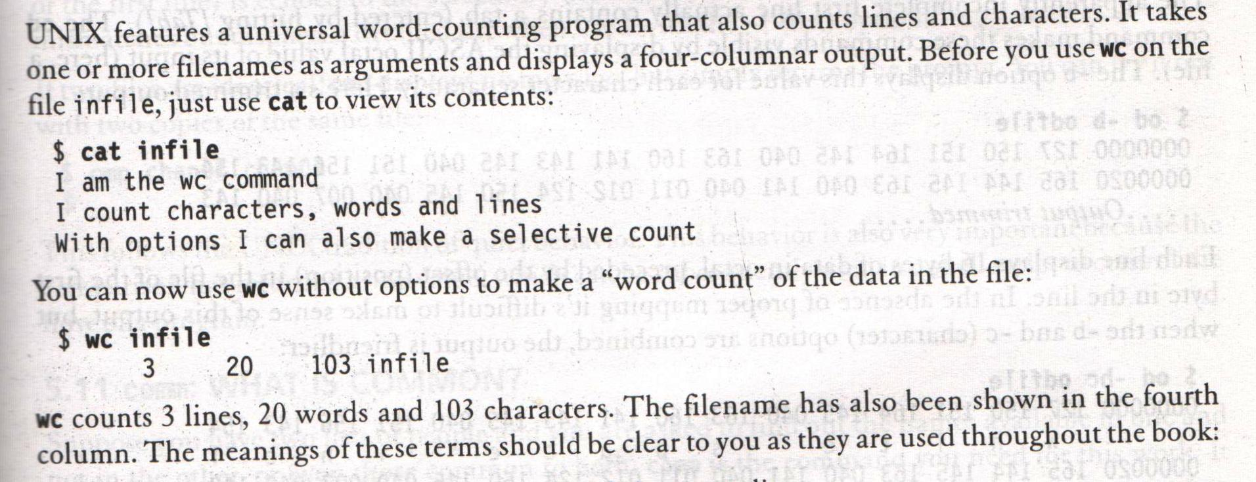
wc – COUNTING LINES, WORDS AND CHARACTERS
Systems Programming - V 3.0

Slide 46
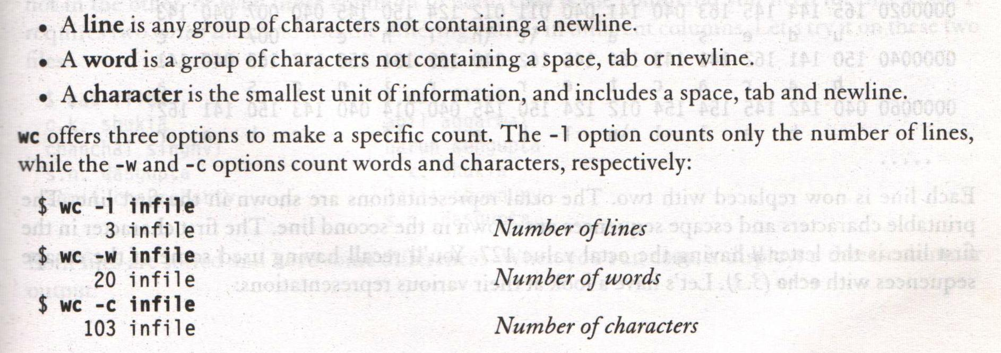
wc – COUNTING LINES, WORDS AND CHARACTERS
Systems Programming - V 3.0

Slide 47
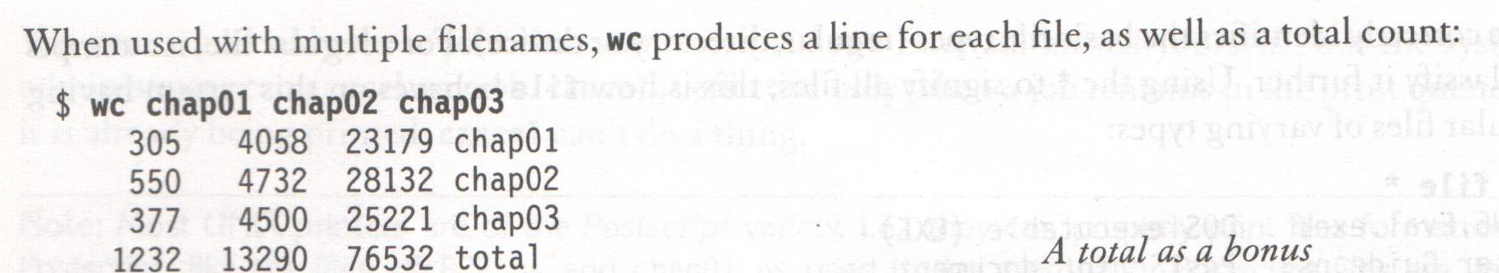
wc – COUNTING LINES, WORDS AND CHARACTERS
Systems Programming - V 3.0

Slide 48
Tee Command
Tee command is used to store and view (both at the same time) the output of any other command.
Tee command writes to the STDOUT, and to a file at a time as shown in the examples below
The following command writes the output only to the file and not to the screen.
$ ls > file
The following command (with the help of tee command) writes the output both to the screen (stdout) and to the file.
$ ls | tee file
Systems Programming - V 3.0

Slide 49
top - display top CPU processes
SYNOPSIS
top [-] [d delay] [p pid] [q] [c] [C] [S] [s] [i] [n iter] [b] DESCRIPTION
top provides an ongoing look at processor activity in real time.
It displays a listing of the most CPU-intensive tasks on the system, and can provide an interactive interface for manipulating processes.
It can sort the tasks by CPU usage, memory usage and runtime. can be better configured than the standard top from the procps suite.
Most features can either be selected by an interactive command or by specifying the feature in the personal or system-wide configuration file. See below for more information.
Systems Programming - V 3.0

Slide 50

Systems Programming - V 3.0

Slide 51

IMP Note to Self
Systems Programming - V 3.0

