Slide 1

Course Name :
Systems Programming
06th NOV 2022

Slide 2
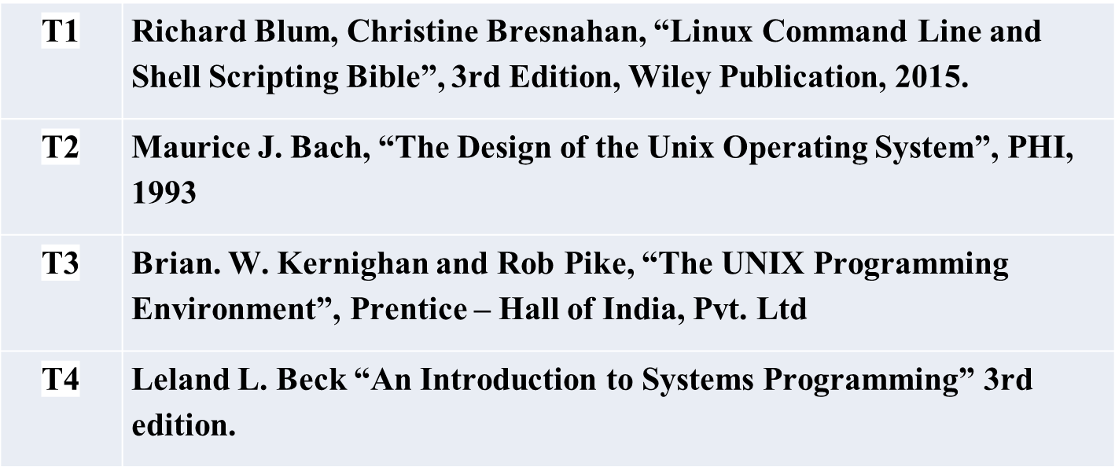
Systems Programming
Introduction to Systems Programming
Text Book(s)

Slide 3
Course Title : Systems Programming
Course No(s): SSWT ZC327 / CSIW ZC327
No | Course Objective
CO1 | To provide understanding of the files, directory and file systems.
CO2 | To provide insight into UNIX commands and Shell scripting.
CO3 | To provide understanding of the System calls and its usage with C programming.
CO4 | To provide understanding of assemblers, linkers and loaders

Slide 4
Agenda
What is an Operating System (OS)?
Functions of an OS
UNIX Operating System
UNIX Architecture, Feature of UNIX,
A Brief History of UNIX, Command Structure and Usage
Basic UNIX commands – passwd, date, who, who am i,
mail, write, man, pwd, ls.

Slide 5
What is UNIX ?
Unix is a Computer operating system that
  Sits between the hardware and the user/applications
  Manages resources
  provides high-level abstractions (e.g., files) and services (e.g., multiprogramming)
  provides Stability
  provides Multiuser capability
  provides Multitasking capability
  provides Communication
  provides Security
  Provides portability
  is Open source(most flavors)

Slide 6
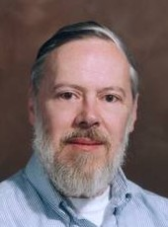
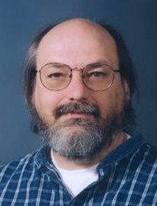
Little History of Unix
The UNIX operating system was born in the late 1960s.
It originally began as a one man project led by Ken Thompson of Bell Labs, and has since grown to become the most widely used operating system.
Ken Thompson with ideas and support from Rudd Canaday,
Doug McIlroy, Joe Ossanna and Dennis Ritchie, wrote a small
general-purpose time-sharing system PDP-7 as MULTICS
(MULTiplexed Information and Computing Service).
In the time since UNIX was first developed, it was named as
UNICS (UNiplexed Information and Computing Service), later
changed to UNIX and it has gone through many different
generations and even mutations.

Slide 7

Ritchie also designed and wrote a compiler for the C Programming language.
In 1973, Ritchie and Thompson rewrote the UNIX Kernel in C, breaking the tradition that system software is written in Assembly level language on PDP-11 machine.
Around 1974 it was licensed to Universities for “Educational purposes” and a few years later became available for commercial purpose.
In 1979, the “seventh edition” (V7) version of Unix was released, grandfather of all extant Unix systems.
After this point, the history of Unix becomes somewhat convoluted.
Since then, it has spread world-wide, with tens of thousands of systems installed, from Micro-Computers to Main-Frames.

Slide 8
What is OS ?
An Operating system (OS) A program that acts as an intermediary between a user of a computer and the computer hardware.
Operating system goals:
  Execute user programs and make solving user problems easier.
  Make the computer system convenient to use.
In simple terms, an operating system is a manager. It manages all the available resources on a computer, from the CPU, to memory, to hard disk accesses.
Tasks the operating system must perform:
  Control Hardware - The operating system controls all the parts of the computer and attempts to get everything working together.
  Run Applications - Another job the OS does is run application software.
  Manage Data and Files - The OS makes it easy for you to organize your computer. Through the OS you are able to do a number of things to data, including copy, move, delete, and rename it.

Slide 9
Computer System Components
1. Hardware – provides basic computing resources (CPU, memory, I/O devices).
2. Operating system – controls and coordinates the use of the hardware among the various application programs for the various users.
3. Applications programs – define the ways in which the system resources are used to solve the computing problems of the users (compilers, database systems, video games, business programs).
4. Users (people, machines, other computers).

Slide 10

Abstract View of System Components

Slide 11
Operating System is Responsible
Resource allocator – manages and allocates resources.
Control program – controls the execution of user programs and operations of I/O devices .
Kernel – the one program running at all times (all else being application programs).

Slide 12
Common Services of an OS
Process Management
Main Memory Management
File Management
Secondary Storage Management
I/O Subsystem Management

Slide 13
Process Management
A process is a program in execution. A process needs certain resources, including CPU time, memory, files, and I/O devices, to accomplish its task.
The operating system is responsible for the following activities in connection with process management.
  Process creation and deletion.
  process suspension and resumption.
  Provision of mechanisms for:
    process synchronization
    process communication

Slide 14
Main-Memory Management
Memory is a large array of words or bytes, each with its own address. It is a repository of quickly accessible data shared by the CPU and I/O devices.
Main memory is a volatile storage device. It loses its contents in the case of system failure.
The operating system is responsible for the following activities in connections with memory management:
  Keep track of which parts of memory are currently being used and by whom.
  Decide which processes to load when memory space becomes available.
  Allocate and deallocate memory space as needed.

Slide 15
File Management
A file is a collection of related information defined by its creator. Commonly, files represent programs (both source and object forms) and data.
The operating system is responsible for the following activities in connections with file management:
  File creation and deletion.
  Directory creation and deletion.
  Support of primitives for manipulating files and directories.
  Mapping files onto secondary storage.

Slide 16
Secondary-Storage Management
Since main memory (primary storage) is volatile and too small to accommodate all data and programs permanently, the computer system must provide secondary storage to back up main memory.
Most modern computer systems use disks as the principle on-line storage medium, for both programs and data.
The operating system is responsible for the following activities in connection with disk management:
  Free space management
  Storage allocation

Slide 17
I/O Subsystem Management
Keeping track of status of the I/O devices
Deciding who gets the device, for how long and when
Allocating a device to a process and de-allocation

Slide 18
The UNIX Operating System
Simple and yet powerful
A multiuser, multitasking, portable operating system
Interaction with the system via a command interpreter – shell
On the lighter side,
UNIX is simple. But, you need to be a genius to understand its simplicity!

Slide 19
Unix Architecture
The main concept that unites all the versions of Unix is the following four basics
Kernel − The kernel is the heart of the operating system, It interacts with the hardware and most of the tasks like memory management, task scheduling and file management.
Shell − The shell is the utility that processes your requests.
When you type in a command at your terminal, the shell interprets the command and calls the program that you want.
Ex: C Shell, Bourne Shell and Korn Shell are the most famous shells which are available with most of the Unix variants.
Commands and Utilities − There are various commands and utilities which you can make use of in your day to day activities.
Ex: cp, mv, cat and grep, etc. are few examples of commands and utilities.
Files and Directories − All the data of Unix is organized into files.
All files are then organized into directories. These directories are further organized into a tree-like structure called the filesystem.

Slide 20
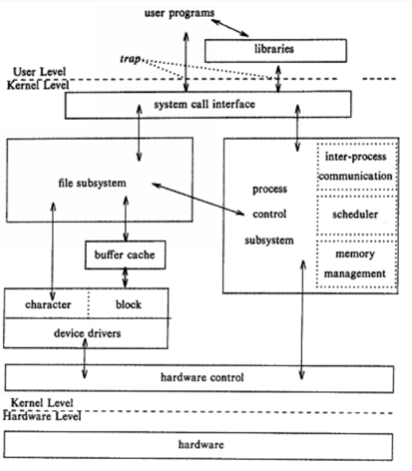
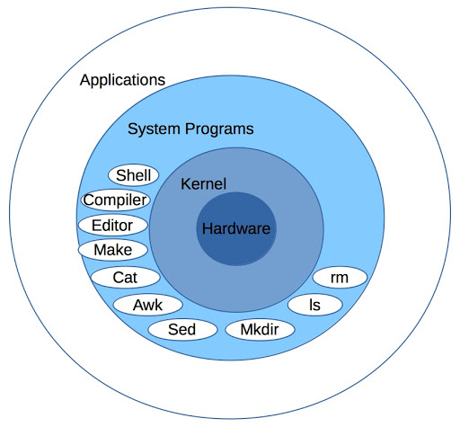
Unix Architecture

Slide 21
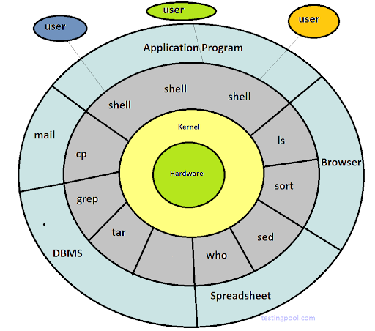
Unix Architecture
The block diagram of the UNIX OS kernel shows various modules and their relationships with each other
The system call and library interface made the border between user programs and the kernel.
System calls look like ordinary function calls in C programs.
Libraries map these function calls to the primitives needed to enter the operating system.
Assembly language programs may invoke system calls directly without a system call library.
Programs frequently use other libraries such as the standard I/O library to provide a more sophisticated use of the system calls.

Slide 22
Command Structure
A UNIX command is an action request given to the UNIX shell for execution.
All UNIX commands apply an action or a series of actions to some input data and create some output data.
All UNIX commands are case sensitive.
The command format is
$ verb [options] [arguments]
where
verb is the command name
options modify how the action is applied and
arguments provide additional information to the command
There are a few commands (like pwd) that don’t take any arguments,
some commands (like who, ls) that may or may not take any arguments and
some commands (like cut) that compulsorily take arguments.

Slide 23
Internal and External Commands
The commands that are built-in as part of the shell are called internal commands.
Example: echo command
A program or file having an independent existence in the /bin directory (or /usr/bin), is called as an external command.
Example: ls, wc, cal, bc, more …
PATH variable: Contains the sequence of directories that the shell searches to look for a command.
$ echo $PATH
/bin:/usr/bin:/usr/local/bin:/usr/local/java/bin:.
When you issue a command,
The shell sees if it is a built-in command. If so, it executes it directly.
If not a built-in, it searches the associated file in the directories specified in PATH. If found, it executes the file.
Otherwise, it triggers a error message.

Slide 24
Flexibility of Command Usage
A command can often be entered in more than one way.
If used judiciously, you can restrict the number of keystrokes to a minimum.
Examples:
Combining Commands
$ wc chap1 ; ls –l chap1
Command line that overflows
$ echo “This is
> a three line
> text message”
UNIX lets you type commands without waiting for a prompt; The commands are passed onto the shell for interpretation after the previous command has completed.

Slide 25
man pages
UNIX offers an online help facility in the man command.
man displays the documentation of the specified command.
Example:
$ man wc displays help on wc command
man uses a pager program, which displays this documentation one page at a time
man is configured to be used with a specific pager.
Two available pagers are:
more, a Berkeley pager, as an alternative to the AT&T pg command
less, the standard pager on Linux systems, also available on UNIX. It is modeled after vi editor and is more powerful than more..

Slide 26
A sample man Page
User Commands wc(1)‏
NAME
wc – displays a count of lines, words and characters in a file
SYNOPSIS
wc [-c | -m | -C] [-lw] [file ...]
DESCRIPTION
The wc utility reads one or more input files and, by default, writes the number of newline characters, words and bytes contained in each input file to the standard output. The utility also writes a total count for all named files, if more than one input file is specified.
OPTIONS
The following options are supported:
-c Count bytes.
-m Count characters.
-C same as –m.
-l Count lines.
-w Count words delimited by white spaces or new line characters ...
OPERANDS
The following operand is supported:
file A path name of an input file. If no file operands are specified, the standard input will be used.
EXIT STATUS
See largefile(5) for the description of the behavior of wc when encountering files greater than or equal to 2 Gbyte (2 **31 bytes)‏
SEE ALSO
cksum(1), isspace(3C), iswalpha(3C), iswspace(3C), largefile(5), ...

Slide 27
When things go wrong
Terminal settings directly impact keyboard operation, and you should know which keys to press when things don’t quite work as expected.
Keystroke or
command
Function
[Ctrl-h]
Erases text
[Ctrl-c] or Delete
Interrupts a command
[Ctrl-d]
Terminates login session or a program that expects its input from keyboard
[Ctrl-s]
Stops scrolling of screen output and locks keyboard
[Ctrl-q]
Resumes scrolling of screen output and unlocks keyboard
[Ctrl-u]
Kills command line without executing it
[Ctrl-\]
Kills running program but creates a core file containing the memory image of the program
[Ctrl-z]
Suspends process and returns shell prompt; use fg to resume job
[Ctrl-j]
Alternative to [Enter]
[[Ctrl-m]
Alternative to [Enter]
stty sane
Restores terminal to normal status

Slide 28
UNIX files and directories
All data in Unix is organized into files.
All files are organized into directories.
These directories are organized into a tree-like structure called the filesystem.
In Unix, there are three basic types of files −
Ordinary Files − An ordinary file is a file on the system that contains data, text, or program instructions. In this tutorial, you look at working with ordinary files.
Directories − Directories store both special and ordinary files.
For users familiar with Windows or Mac OS, Unix directories are equivalent to folders.
Special Files − Some special files provide access to hardware such as hard drives, CD-ROM drives, modems, and Ethernet adapters.

Slide 29
Directories and Files
A file is a set of data that has a name. The information can be an ordinary text, a user-written computer program, results of a computation, a picture, and so on.
The file name may consist of ordinary characters, digits and special tokens like the underscore, except the forward slash (/). It is permitted to use special tokens like the ampersand (&) in a filename.
Unix organizes files in a tree-like hierarchical structure, with the root directory, indicated
by a forward slash (/), at the top of the tree. See the Figure below, in which part of the hierarchy of files and directories on the computer is shown.

Slide 30
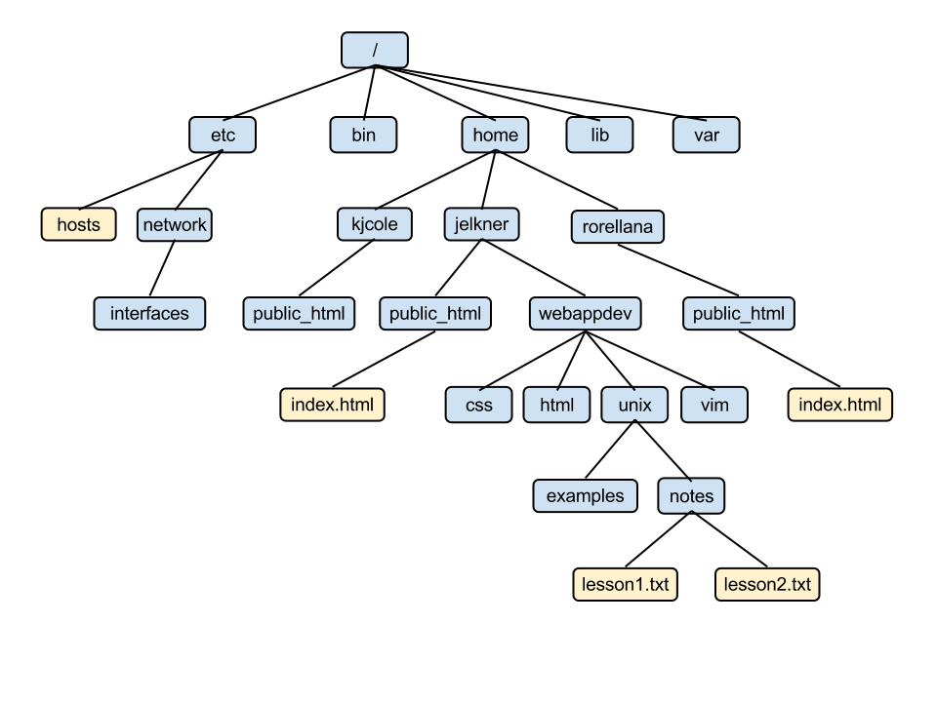
UNIX files and directories

Slide 31
Regular file
It may be text or binary file
Both the files are executable provided execution rights are set
They can be read or written by users with appropriate permissions
To remove regular files use rm command

Slide 32
Directory file
Folder that contains other files and
subdirectories
Provides a means to organize files in
hierarchical structure
To create : mkdir command
To remove : rmdir command

Slide 33
Some commands have large number of option. Don't panic.
Initiallly keep in mind :
where to give whitespaces. ?
  Between command and options
  Between command and arguemts
How options should be used?
Exceptions :
Some commands do not take any arguments/ options (pwd, whoami)‏
Some commands may or may not take arguments/ options (ls, who, uname)‏
Some command compulsorily need options (cut)‏

Slide 34
Basic Commands
banner- prints a banner
  Usage - $ banner Wipro
cal- calendar of the month.
  Syntax – cal [ [ month] year ]
    Takes 2 arguments
    Month (2 args) and year (1 arg)‏
  Usage - $cal 9 2009
  $cal 2010

Slide 35
date - displays current date and time
  $date +%m
  $date +%h
  $date +”%m %h”
Other format specifiers:
  d-the day of month
  y-the last two digits of the year
  H,M,S – Hr, Min & Sec respectively,
  D-date in format mm/dd/yy
  T-time in format hh:mm:ss

Slide 36
Echo - displays message on screen of issue prompt for input.
Usage
  $echo GNU/Linux
  $echo $SHELL $PATH
  $echo “Enter input value: \c”
  Enter input value:$

Slide 37
Escape sequences in echo and printf
Escape sequence significance
  \a Bell
  \b Backspace
  \c No new line
  \f Formfeed
  \n New Line
  \r Carriage Return
  \t Tab
  \v Vertical tab
  \\ Backslash
  \0n ASCII char represented by the octal value n
  $ echo ‘\07’ beep

Slide 38
In Linux bash shell interprets escape sequences only with the –e option.
Bash has –n option as substitute for \c
Korn shell doesn’t use –n.
Echo’s behaviour varies across shells so POSIX recommends printf as a replacement of echo.

Slide 39
passwd – changing your password
Passwd – note the spelling
user can change password only for his/her account.
Superuser can change the password of every user using the same command.
The command expects you to respond three times.
  Prompts for old password
  validates the current password
  If correct prompts for new password
  Prompts for re-entering new password

Slide 40
Incase you forget password contact the system administrator.
When you enter a password, the string is encrypted by the system, which is used by UNIX system to authenticate the password.
The encryption is stored in a file named shadow in the /etc directory.
Super user can see the encrypted password but cannot get back the original password.

Slide 41
password framing rules
Don’t choose a password similar to the old one.
Don’t use commonly used names like name of friend, pets etc. A system may check with its own dictionary and throw out those password that are easily guessed.
Use a mixture of alphabetic and non alphabetic chars.
Enterprise UNIX won’t allow passwords that are fully numeric or fully alphabetic.
Don’t write the password in an easily accessible document.

Slide 42
Who – who are the users
UNIX maintains an account of all users who are logged on to the system.
$who
root console Sep 19 12:50 (:0)‏
Krishna pts/5 Sep 19 12:50 (lab1.sys1.com)
Rama pts/2 Sep 19 13:01 (lab2.sys5.com)‏
Column 1 : Krishna - username
Column 2 : pts/2 device name of their respective terminal. These are actually the filenames associated with the terminals. Pts/2 indicates a file named 2 in the pts directory.
Column 3 ,4, 5 – month, date, login time respectively.
Column 6 : shows the machine name from where the user has
logged in

Slide 43
$who –H
-H gives the header option
$who –Hu
NAME LINE TIME IDLE PID COMMENTS
root console Sep 19 12:50 0:48 11041 (:0)‏
Krishna pts/5 Sep 19 12:50 0:33 11090 (sys1.lab1.com)
Rama pts/2 Sep 19 13:01 . 13456 (sys5.lab2.com)‏
$who am i

Slide 44
uname – knowing your machine
Displays the operating system features of the current machine
$uname -- displays the name of the O/S
Linux
$uname -r -- displays the release/version
2.6.32-21-generic -- kernel version 2.6
$uname -s -- implementation name
Linux
The complete name of the O/S is the combination of the output of the two options
$uname -rs
Linux 2.6.3-21-generic

Slide 45
$uname -n -- displays system name
Lab1sys2 -- which is a part of the domain -- name
$hostname -- an alternate command
Lab1sys2
Hostname is very much essential to identify your computer on the network.
Hostname is a part of your machine's domain name(sys1.lab2.com).

Slide 46
bc – The calculator
Unix has 2 types of calculator
Graphical – xcalc
  Available in x-window system, friendly
Text based – bc
  Less user friendly but extremely powerful.
bc is a pseudo-programming language featuring arrays, conditionals and loops. It also comes with a library for performing scientific calculations.
It can handle very very large numbers.
If a computation results in a 900 digit numbers, bc will show each and every digit,

Slide 47
Bc belongs to a class of filters that expects input from the keyboard when used without arguments.
$bc
12 + 12
24
[Ctrl+d] the eof character
bc shows output/result in next line.

Slide 48
$bc
12*12 ; 2^32 multiple calculations
144
4294967296
12/5
2 Decimal portion truncated
scale =2 truncated to 2 decimal places
32/3
10.66 Not rounded off, result is actually 10.66666

Slide 49
Mail Command Examples in Unix
The Mail command in unix or linux system is used to send emails to the users, to read the received emails, to delete the emails etc.
The syntax of mail command is:
mail [options] to-address [-- sendmail-options]
1. Sending sample email to user
The basic functionality of the mail command in unix or linux system is to send an email to the user.
echo "Mail body" | mail -s "Mail subject" to@example.com
Here the echo statement is used for specifying the body of the email. The -s option is used for specifying the mail subject. The mail command sends the email to the user to@example.com

Slide 50
2. Specifying the body in a file
You want to compose a mail which contains 100 lines in the body. Specifying the body with the echo statement is a tedious process. So write the contents of the body in a file and send the mail using one of the following options:
Using cat statement:
cat body.txt | mail -s "Mail subject" to@example.com
Using input redirection operator
mail -s "Mail subject" to@example.com < body.txt
Here the body.txt file contains the body of the email.
3. Send mail to more than one user You can send email to more than one user by specifying the users in comma separated list.
mail -s "Mail subject" "user1@example.com, user2@example.com" < body.txt

Slide 51
4. Using the cc and bcc option You can copy the emails to more number of users by using the -c and -b options. An example is shown below:
mail -s "Mail subject" -c "ccuser@gmail.com" -b "bccuser@yahoo.com" "user@example.com"
< body.txt
5. Specifying the from address So far the above examples send the emails with from address as the logged in user. You can explicitly specify the from-address using the -r option.
cat body.txt | mail -s "Mail subject" "to-user@example.com" -- -r from-user@example.com

Slide 52


