Slide 1

Course Name :
Systems Programming
20th NOV 2022

Slide 2

IMP Note to Self
Systems Programming - V 3.0

Slide 3
IMP Note to Students
It is important to know that just login to the session does not guarantee the attendance.
Once you join the session, continue till the end to consider you as present in the class.
IMPORTANTLY, you need to make the class more interactive by responding to Professors queries in the session.
Whenever Professor calls your number / name ,you need to respond, otherwise it will be considered as ABSENT
Systems Programming - V 3.0

Slide 4
Agenda
Files and directories in UNIX, file system.
Basics of UNIX File System (UFS).
What is inode in UFS?
Discussion about inode structure in UNIX
Discussion about various types of links [hard, symbolic] in UFS. Different between these links.
Discussion on choosing hard link Vs Symbolic link
Systems Programming - V 3.0

Slide 5
What is a file system?
Speaking broadly, a file system is the logical means for an operating system to store and retrieve data on the computers hard disks, be they local drives, network-available volumes, or exported shares in a storage area network (SAN)
Systems Programming - V 3.0

Slide 6
What is a file system?
A file system can refer to the methods and data structures that an operating system uses to keep track of files on a disk or partition
Linux keeps regular files and directories on block devices such as disks
A Linux installation may have several physical disk units, each containing one or more file system types
Partitioning a disk into several file system instances makes it easier for administrators to manage the data stored there
Systems Programming - V 3.0

Slide 7
What is a file system?
Overhead
view
sector
track
cylinder
Disk blocks are composed of one or more contiguous sectors
The same track on each platter in a disk makes a cylinder; partitions are groups of contiguous cylinders
Systems Programming - V 3.0

Slide 8
What is a file system?
File system instances reside on partitions
Partitioning is a means to divide a single hard drive into many logical drives
A partition is a contiguous set of blocks on a drive that are treated as an independent disk
A partition table is an index that relates sections of the hard drive to partitions
Systems Programming - V 3.0

Slide 9
The UNIX File System
The root directory has many subdirectories. The following table describes some of the subdirectories contained under root
Directory | Content
/bin | Common programs, shared by the system, the system administrator and the users.
/dev | Contains references to all the CPU peripheral hardware, which are represented as files with special properties.
/etc | Most important system configuration files are in /etc, this directory contains data similar to those in the Control Panel in Windows
/home | Home directories of the common users.
/lib | Library files, includes files for all kinds of programs needed by the system and the users.
/sbin | Programs for use by the system and the system administrator.
/tmp | Temporary space for use by the system, cleaned upon reboot, so don't use this for saving any work!
/usr | Programs, libraries, documentation etc. for all user-related programs.
/var | Storage for all variable files and temporary files created by users, such as log files, the mail queue, the print spooler area, space for temporary storage of files.
Systems Programming - V 3.0

Slide 10
UNIX and POSIX file attributes
File type : Type of file
Access permission : The file access permission (owner, group, others)
Hard link count : Number of hard links of a file
UID : The file owner user ID
GID : The file group ID
File size : The file size in bytes
Last access time : The time the file was last accessed
Last modify time : The time the file was last modified
Last change time : The time the file access permission
UID ,GID or hard link count was last changed
Inode number : The system inode number of the file
File system ID : The file system ID where the file is stored
Systems Programming - V 3.0

Slide 11
INTERNAL REPRESENTATION OF FILES
Inodes
Structure of a regular file
Directories
Conversion of a path name to an inode
Super block
Inode assignment to a new file
Allocation of disk blocks
Other file types
Systems Programming - V 3.0

Slide 12
File System Implementation
(Disk Layout)
Entire Disk
Master Boot
Record
Partition Table
Disk Partitions
Boot Block
Super Block
Inode List
Data Blocks
A Possible File System Instance Layout
Systems Programming - V 3.0

Slide 13
File system layout
The central structural concepts of a file system type are:
- Boot Block
- Super Block
- Inode List
- Data Block
Boot Block
Super Block
Inode List
Data Blocks
Systems Programming - V 3.0

Slide 14
Boot Block
Boot Block:
- Occupies the beginning of a file system
- Typically residing at the first sector, it may also contain the bootstrap code that is read into the machine at boot time
- Although only one boot block is required to boot the system, every file system may contain a boot block
Boot Block
Systems Programming - V 3.0

Slide 15
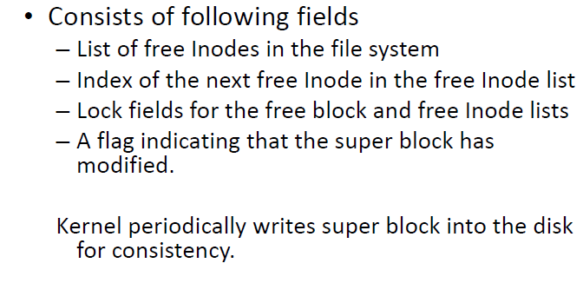
Super Block
Super Block:
- Describes the state of a file system
- How large it is
- How many files it can store
- Where to find free space in the file system
Boot Block
Super Block
Systems Programming - V 3.0

Slide 16
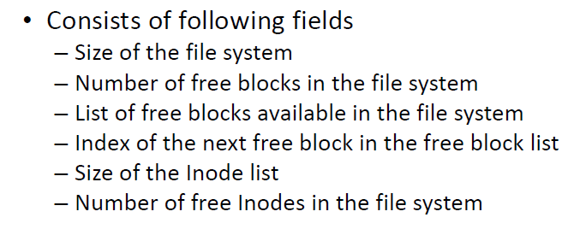
Super Block
Boot Block
Super Block
Systems Programming - V 3.0

Slide 17
Inode List
Inode List:
- An inode is the internal representation of a file
contains the description of the disk layout of the file data
- file owner
- permissions
- The inode list contains all of the inodes present in an instance of a file system
Boot Block
Super Block
Inode List
Systems Programming - V 3.0

Slide 18
Data Blocks
Data Blocks:
- Contain the file data in the file system
- Additional administrative data
- An allocated data block can belong to one and only
one file in the file system
Boot Block
Super Block
Inode List
Data Blocks
Systems Programming - V 3.0

Slide 19
What is a file system?
So what is a file system?
- A file system is a set of abstract data types that are implemented for the storage, hierarchical organization, manipulation, navigation, access, and retrieval of data
Systems Programming - V 3.0

Slide 20
Inodes in UNIX system
UNIX system has an inode table which keeps track of all files
Each entry in inode table is an inode record
Inode record contains all attributes of file including inode number and physical address of file
Information of a file is accessed using its inode number
Inode number is unique within a file system
A file record is identified by a file system ID and inode number
Inode record doesnot contain the name of the file
The mapping of filenames to inode number is done via directory files
Systems Programming - V 3.0

Slide 21
What is a file system?
The kernel deals on a logical level with file systems rather than with disks
The separate file systems that the system may use are not accessed by device identifiers
Instead they are combined into a single hierarchical tree structure that represents the file systems as one whole single entity
Systems Programming - V 3.0

Slide 22
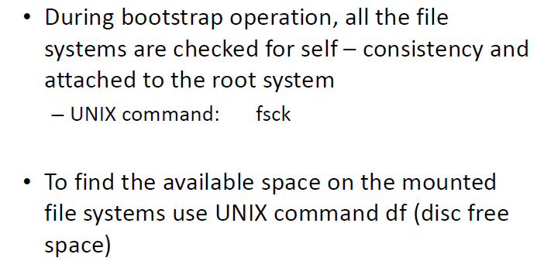
File system consistency check
Systems Programming - V 3.0

Slide 23
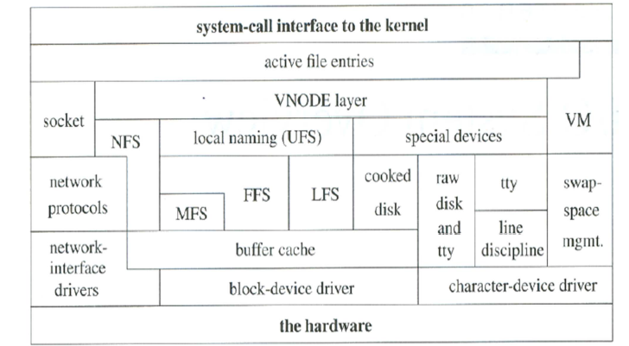
Kernel I/O structure
Systems Programming - V 3.0

Slide 24
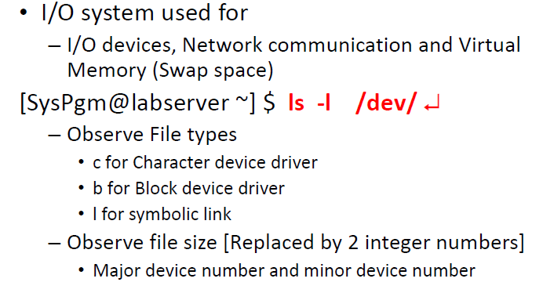
I/O in Unix ‐ Devices
Systems Programming - V 3.0

Slide 25
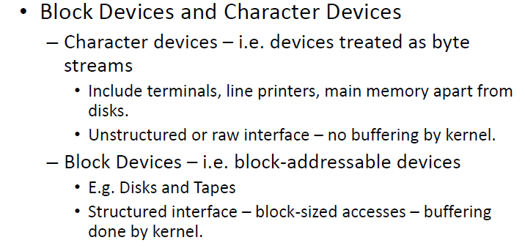
I/O in Unix ‐ Devices
Systems Programming - V 3.0

Slide 26
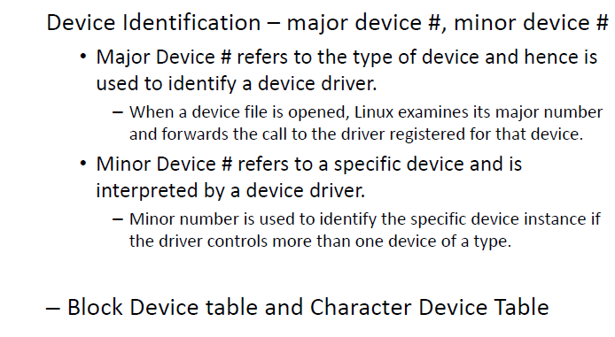
I/O in Unix ‐ Devices
Systems Programming - V 3.0

Slide 27
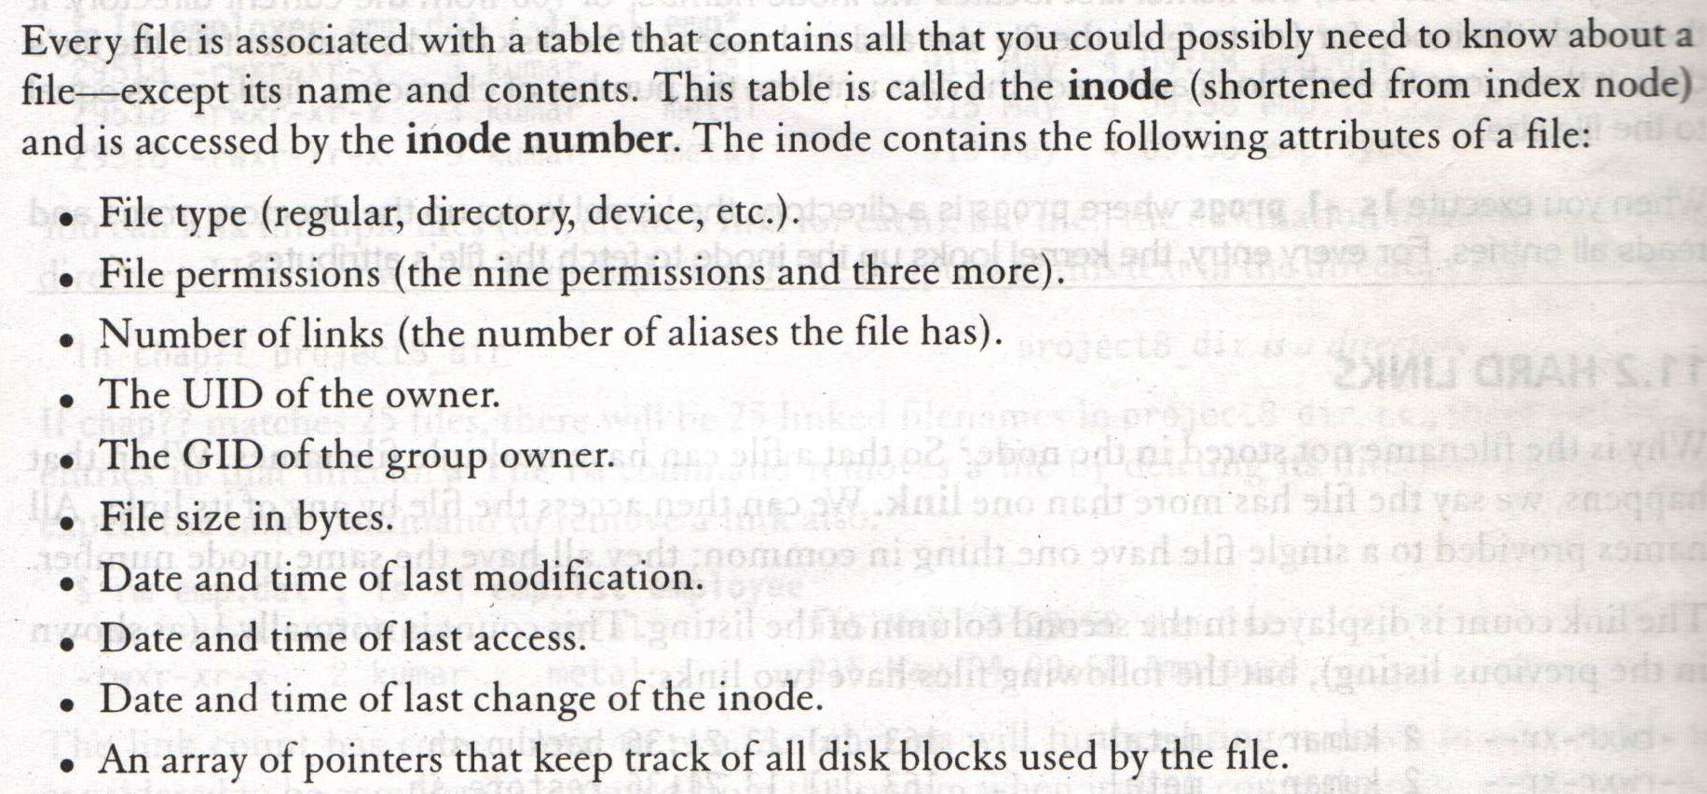
File Systems and inodes
Systems Programming - V 3.0

Slide 28
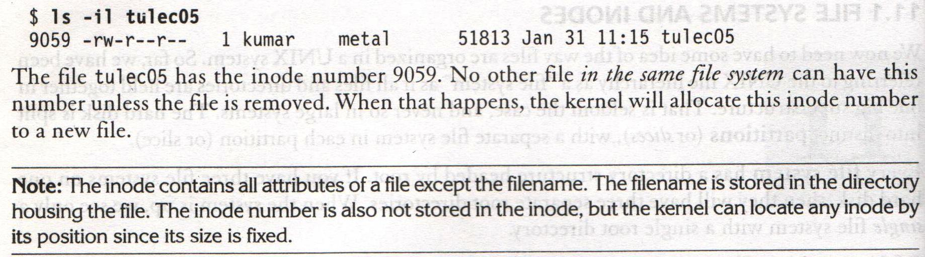
File Systems and inodes
Systems Programming - V 3.0

Slide 29
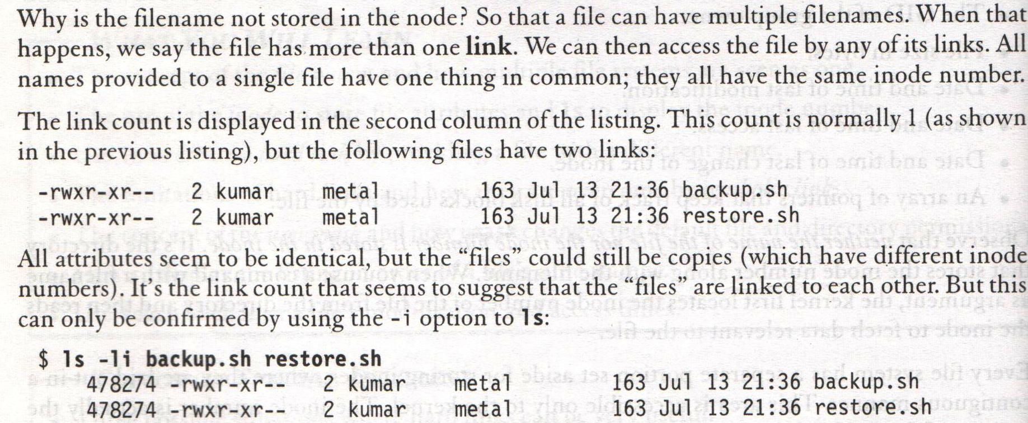
Hard Links
Systems Programming - V 3.0

Slide 30
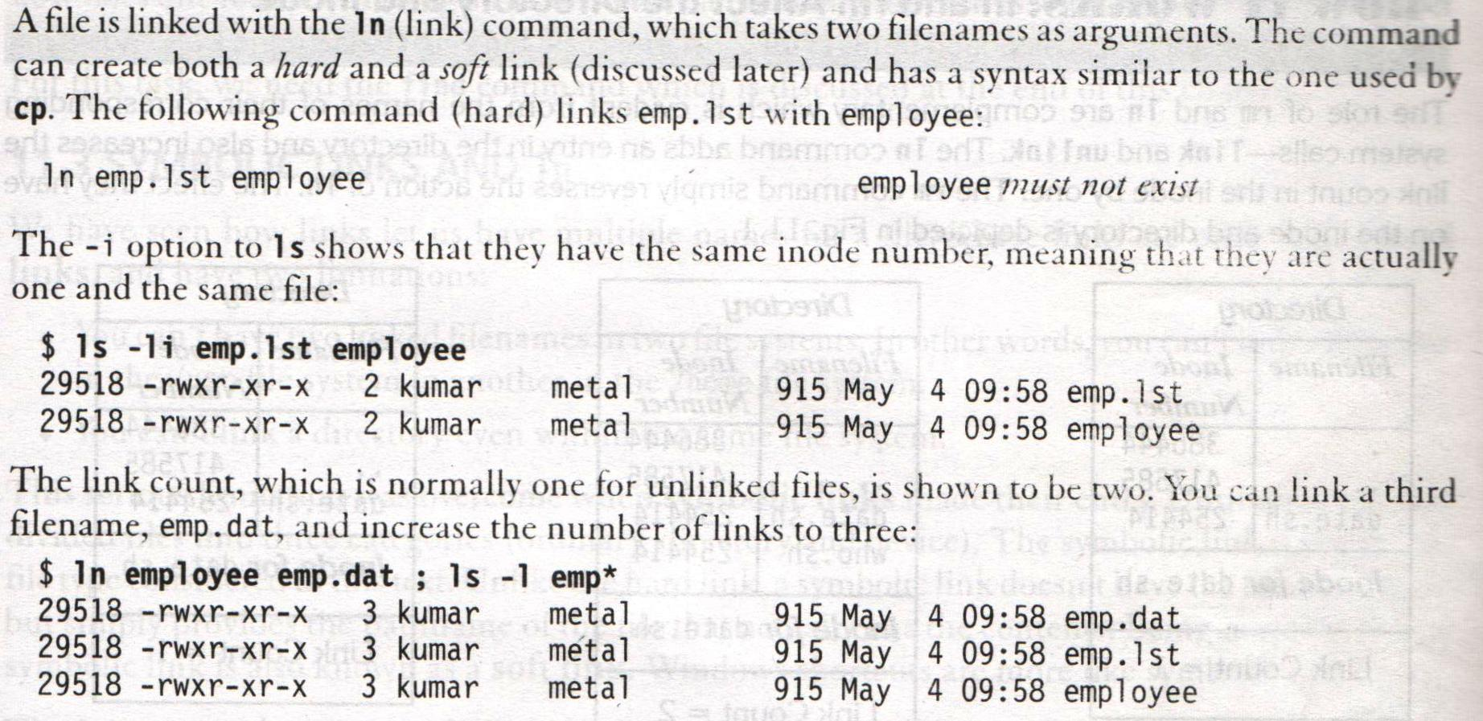
ln: Creating Hard Links
Systems Programming - V 3.0

Slide 31
WHERE TO USE HARD LINKS
ln data/ foo.txt input_files
Links provide some protection against accidental deletion
Because of links, we don’t need to maintain two programs as two separate disk files.
Systems Programming - V 3.0

Slide 32
LIMITATIONS OF HARD LINKS
We cant have two linked filenames in two file systems.
We cant link a directory even within the same file system
This can be solved by using symbolic links (soft links)
Systems Programming - V 3.0

Slide 33
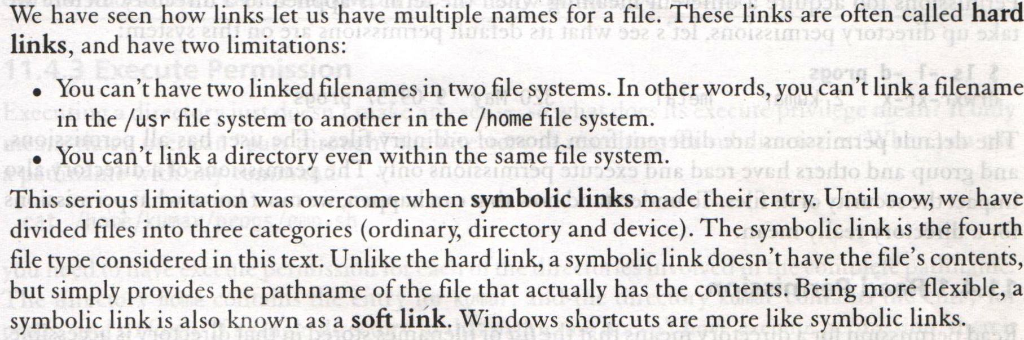
Symbolic Links
Systems Programming - V 3.0

Slide 34
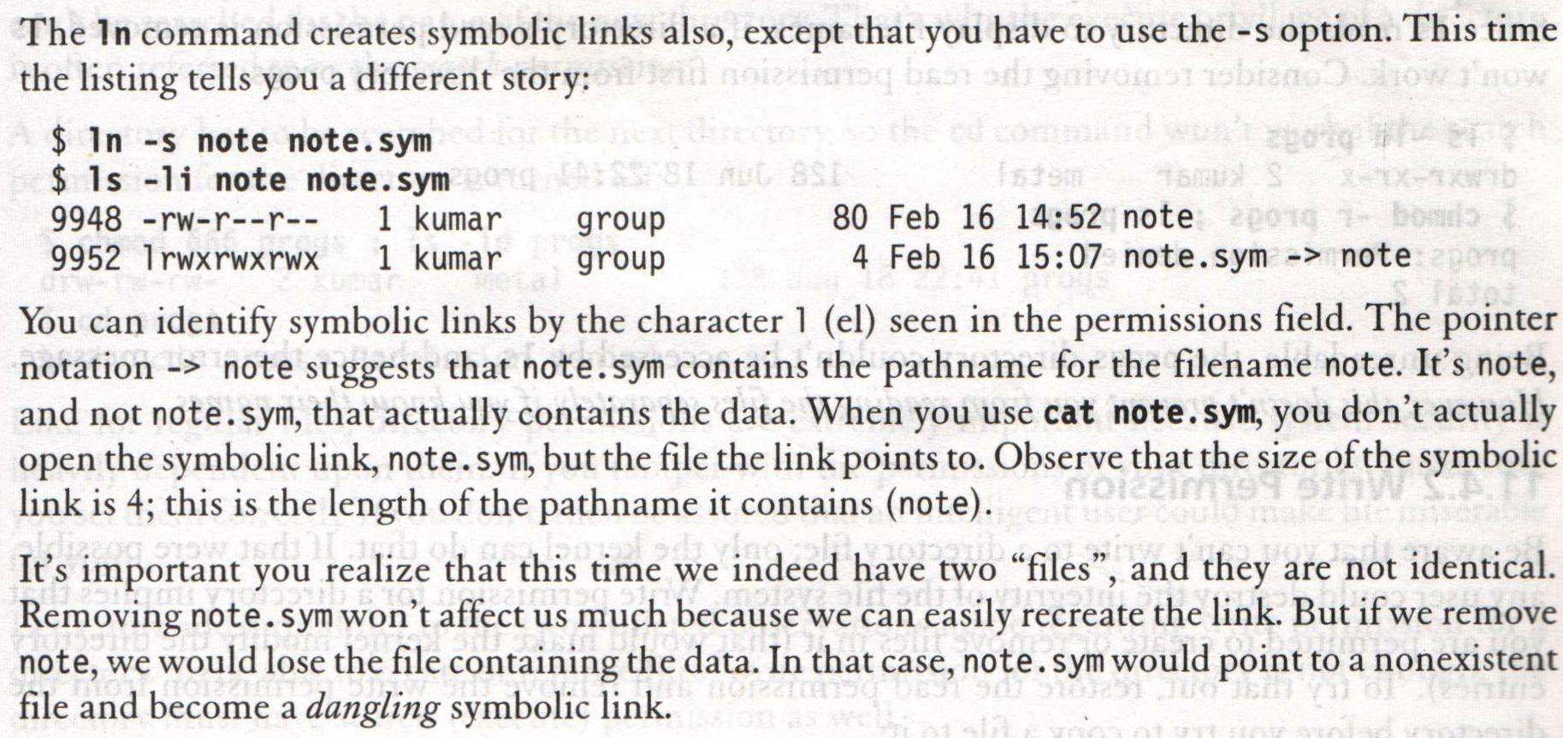
Symbolic Links
Systems Programming - V 3.0

Slide 35

Systems Programming - V 3.0

Slide 36

IMP Note to Self
Systems Programming - V 3.0

