Slide 1
By RKT
Instruction Architecture
Instruction sets &Addressing mode

Slide 2
Objectives
Machine instructions and program execution, including branching and subroutine call and return operations.
Addressing methods for accessing register and memory operands.
Assembly language for representing machine instructions, data, and programs.
Program-controlled Input/Output operations.

Slide 3
Memory Location, Addresses, and Operation
n
bits
Memory consists of many millions of storage cells, each of which can store 1 bit.
Data is usually accessed in n-bit groups. n is called word length.
first word
second word
•
•
•
i
th word
•
•
•
last word
Figure 2.5. Memory words.

Slide 4
Memory Location, Addresses, and Operation
32-bit word length example
32 bits
•
•
•
b
31
b
30
b
1
b
0
Sign bit:
b
=
0
for positive numbers
31
b
=
1
for negative numbers
31
(a) A signed integer
8 bits
8 bits
8 bits
8 bits
ASCII
ASCII
ASCII
ASCII
character
character
character
character
(b) Four characters

Slide 5
Memory Location, Addresses, and Operation
To retrieve information from memory, either for one word or one byte (8-bit), addresses for each location are needed.
A k-bit address memory has 2^{k} memory locations, namely 0 to 2^{k}-1, called memory space.
24-bit memory: 2²⁴ = 16,777,216 = 16M (1M=2²⁰)
32-bit memory: 2³² = 4G (1G=2³⁰)
1K(kilo)=2¹⁰
1T(tera)=2⁴⁰

Slide 6
Memory Location, Addresses, and Operation
It is impractical to assign distinct addresses to individual bit locations in the memory.
The most practical assignment is to have successive addresses refer to successive byte locations in the memory – byte-addressable memory.
Byte locations have addresses 0, 1, 2, …
If word length is 32 bits, they successive words are located at addresses 0, 4, 8,…

Slide 7
Big-Endian and Little-Endian Assignments
Big-Endian: lower byte addresses are used for the most significant bytes of the word
Little-Endian: opposite ordering. lower byte addresses are used for the less significant bytes of the word
W
ord
address
Byte address
Byte address
0
0
1
2
3
0
3
2
1
0
4
4
5
6
7
4
7
6
5
4
•
•
•
•
•
•
2
k
-
4
2
k
-
4
2
k
-
3
2
k
-
2
2
k
-
1
2
k
-
4
2
k
-
1
2
k
-
2
2
k
-
3
2
k
-
4
(a) Big-endian assignment
(b) Little-endian assignment

Slide 8
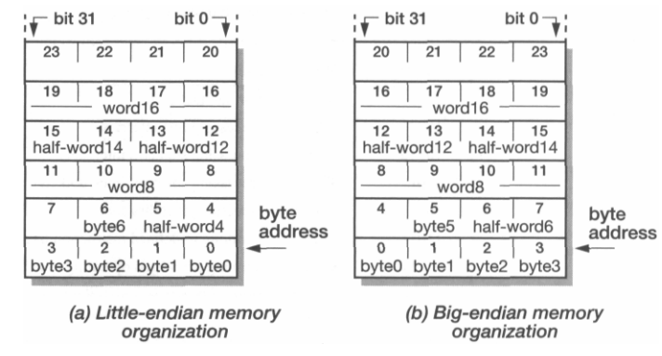
Little- and big-endian memory organizations
Most ARM chips can be configured to work with either memory arrangement, though they default to little-endian

Slide 9
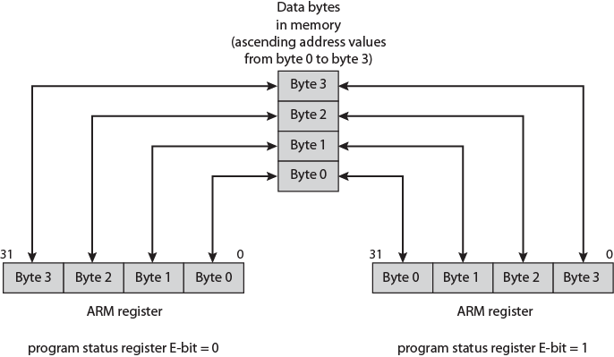
ARM Endian Support
E-bit in system control register
Under program control

Slide 10
Memory Location, Addresses, and Operation
Address ordering of bytes
Word alignment
Words are said to be aligned in memory if they begin at a byte address. that is a multiple of the number of bytes in a word.
16-bit word: word addresses: 0, 2, 4,….
32-bit word: word addresses: 0, 4, 8,….
64-bit word: word addresses: 0, 8,16,….
Memory Operation
Load (or Read or Fetch)
Copy the content. The memory content doesn’t change.
Address – Load
Registers can be used
Store (or Write)
Overwrite the content in memory
Address and Data – Store
Registers can be used

Slide 11
“Must-Perform” Operations
Data transfers between the memory and the processor registers
Arithmetic and logic operations on data
Program sequencing and control
I/O transfers
Assembly Language Notation
Represent machine instructions and programs.
Move LOC, R1 = R1←[LOC]
Add R1, R2, R3 = R3 ←[R1]+[R2]
or
Add R1, R2, R3 = R1 ←[R2]+[R3]

Slide 12
CPU Organization
Single Accumulator
Result usually goes to the Accumulator
Accumulator has to be saved to memory quite often
General Register
Registers hold operands thus reduce memory traffic
Register book keeping
Stack
Operands and result are always in the stack

Slide 13
Instruction Formats
Instruction
Opcode
Operand(s) or Address(es)
Three-Address Instructions
ADD R1, R2, R3 R1 ← R2 + R3 or R3 ← R1 + R2
Two-Address Instructions
ADD R1, R2 R1 ← R1 + R2
One-Address Instructions
ADD M AC ← AC + M[AR]
Zero-Address Instructions
ADD TOS ← TOS + (TOS – 1)
RISC Instructions
Lots of registers. Memory is restricted to Load & Store

Slide 14
Instruction Formats
Example: Evaluate (A+B) ∗ (C+D)
Three-Address
ADD R1, A, B ; R1 ← M[A] + M[B]
ADD R2, C, D ; R2 ← M[C] + M[D]
MUL X, R1, R2 ; M[X] ← R1 ∗ R2
Example: Evaluate (A+B) ∗ (C+D)
Two-Address
MOV R1, A ; R1 ← M[A]
ADD R1, B ; R1 ← R1 + M[B]
MOV R2, C ; R2 ← M[C]
ADD R2, D ; R2 ← R2 + M[D]
MUL R1, R2 ; R1 ← R1 ∗ R2
MOV X, R1 ; M[X] ← R1

Slide 15
Instruction Formats
Example: Evaluate (A+B) ∗ (C+D) One-Address
LOAD A ; AC ← M[A]
ADD B ; AC ← AC + M[B]
STORE T ; M[T] ← AC
LOAD C ; AC ← M[C]
ADD D ; AC ← AC + M[D]
MUL T ; AC ← AC ∗ M[T]
STORE X ; M[X] ← AC
Example: Evaluate (A+B) ∗ (C+D) RISC
LOAD R1, A ; R1 ← M[A]
LOAD R2, B ; R2 ← M[B]
LOAD R3, C ; R3 ← M[C]
LOAD R4, D ; R4 ← M[D]
ADD R1, R1, R2 ; R1 ← R1 + R2
ADD R3, R3, R4 ; R3 ← R3 + R4
MUL R1, R1, R3 ; R1 ← R1 ∗ R3
STORE X, R1 ; M[X] ← R1

Slide 16
ARM Data Types
Supports: 8 (byte), 16 (halfword), 32 (word) bits
Halfword and word accesses should be half word & word aligned respectively
Nonaligned access alternatives
Default
Treated as truncated
Bits[1:0] treated as zero for word
Bit[0] treated as zero for halfword
Load single word instructions rotate right word aligned data transferred by non word-aligned address one, two or three bytes Alignment checking
Data abort signal indicates alignment fault for attempting unaligned access
Unaligned access
Processor uses one or more memory accesses to generate transfer of adjacent bytes transparently to the programmer

Slide 17
ARM Data Types contnd.
Unsigned integer interpretation supported for all types
Twos-complement signed integer interpretation supported for all types
Majority of implementations do not provide floating-point hardware
Saves power and area
Floating-point arithmetic implemented in software
Optional floating-point coprocessor
Single- and double-precision IEEE 754 floating point data types
(1) load or store a 32-bit word or an 8-bit unsigned byte, and
(2) load or store a 16-bit unsigned halfword,
and load and sign extend a 16-bit halfword or an 8-bit byte

Slide 18
ARM Operation Types
The ARM architecture provides a large collection of operation types
The following are the principal categories:
Load and store instructions: only load and store instructions access memory locations; arithmetic and logical instructions are performed only on registers and immediate values encoded in the instruction
A Branch instructions: Allows a conditional branch forwards or backwards up to 32 MB.
Data-processing instructions:includes logical instructions (AND, OR, XOR), add and subtract instructions, and test and compare instructions
Multiply instructions: The integer multiply instructions operate on word or halfword operands and can produce normal or long results
Notes:
Branch instructions: the program counter is one of the general-purpose registers (R15), a branch or jump can also be generated by writing a value to R15. A subroutine call can be performed by a variant of the standard branch instruction. As well as allowing a branch forward or backward up to 32 MB, the Branch with Link (BL) instruction preserves the address of the instruction after the branch (the return address) in the LR (R14). Branches are determined by a 4-bit condition field in the instruction.
Multiply instructions:: For example, there is a multiply instruction that takes two 32-bit operands and produces a 64-bit result.

Slide 19
ARM Operation Types contnd.
Parallel addition and subtraction instructions
Extend instructions: There are several instructions for unpacking data by sign or zero extending bytes to halfwords or words, and halfwords to words.
Status register access instructions: ARM provides the ability to read and also to write portions of the status register.
Notes:
Parallel addition and subtraction instructions: In addition to the normal data processing and multiply instructions, there are a set of parallel addition and subtraction instructions, in which portions of two operands are operated on in parallel. For example, ADD16 adds the top halfwords of two registers to form the top halfword of the result and adds the bottom halfwords of the same two registers to form the bottom halfword of the result. These instructions are useful in image processing applications, similar to the x86 MMX instructions

Slide 20

ARM Condition Codes
Condition code flags
Condition code register / status register
N (negative)
Z (zero)
V (overflow)
C (carry)
Different instructions affect different flags
The Current Program Status Register (CPSR)
Notes:
There are two unusual aspects to the use of condition codes in ARM:
All instructions, not just branch instructions, include a condition code field,
which means that virtually all instructions may be conditionally executed.
Any combination of flag settings except 1110 or 1111 in an instruction’s condition code field signifies that the instruction will be executed only if the condition is met.
2. All data processing instructions (arithmetic, logical) include an S bit that signifies whether the instruction updates the condition flags.

Slide 21
Using Registers
Registers are faster
Shorter instructions
The number of registers is smaller (e.g. 32 registers need 5 bits)
Potential speedup
Minimize the frequency with which data is moved back and forth between the memory and processor registers.

Slide 22
Conditional Branch Instructions
A: 1 1 1 1 0 0 0 0
Example:
A: 1 1 1 1 0 0 0 0
B: 0 0 0 1 0 1 0 0
+(−B): 1 1 1 0 1 1 0 0
1 1 0 1 1 1 0 0
C = 1
Z = 0
S = 1
V = 0
Overflow can only happen when adding two numbers of the same sign
and getting a different sign. So, to detect overflow we don't care about any bits except
the sign bits. Ignore the other bits.

Slide 23
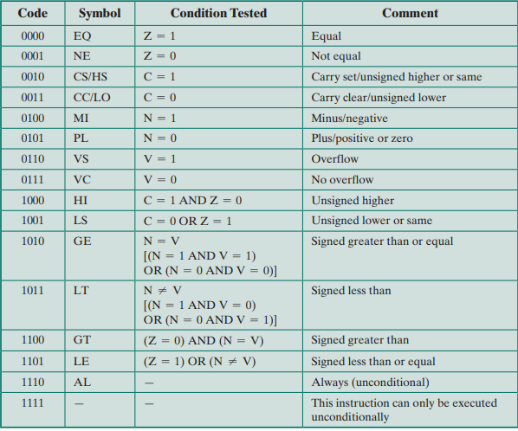
ARM Conditions for Conditional Instruction Execution
Notes:
The use of conditional execution and conditional setting of the condition flags helps in the design of shorter programs
that use less memory.
On the other hand, all instructions include 4 bits for the condition code, so there is a trade-off in that fewer bits
in the 32-bit instruction are available for opcode and operands
Because the ARM is a RISC design that relies heavily on register addressing, this seems to be a reasonable trade-off

Slide 24
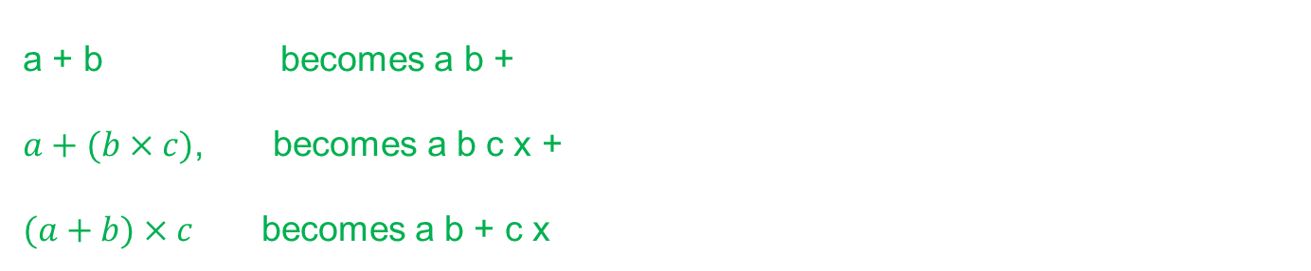
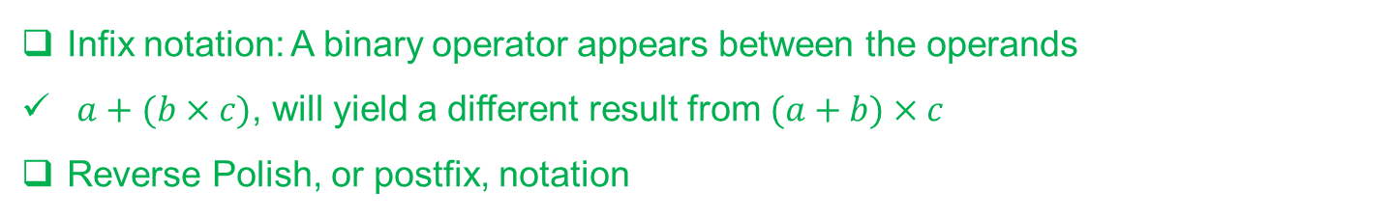
Expression Evaluation
Infix notation: A binary operator appears between the operands
$a+(b×c)$, will yield a different result from $(a+b)×c$
Reverse Polish, or postfix, notation
a + b becomes a b + $a+(b×c)$, becomes a b c x + $(a+b)×c$ becomes a b + c x
Regardless of the complexity of an expression, no parentheses are required when using reverse Polish
An expression in this form is easily evaluated using a stack
Rules
If the element is a variable or constant, push it onto the stack.
If the element is an operator, pop the top two items of the stack, perform the operation, and push the result.

Slide 25
Instruction Formats
TOS= TOS (operation)(TOS-1)
Example: Evaluate (A+B) ∗ (C+D)
Zero-Address
PUSH A ; TOS ← A
PUSH B ; TOS ← B
ADD ; TOS ← (A + B)
PUSH C ; TOS ← C
PUSH D ; TOS ← D
ADD ; TOS ← (C + D)
MUL ; TOS ← (C+D)∗(A+B)
POP X ; M[X] ← TOS
B
A

Slide 26

Instruction Formats
Example: Evaluate (A+B) ∗ (C+D)
Zero-Address
PUSH A ; TOS ← A
PUSH B ; TOS ← B
ADD ; TOS ← (A + B)
PUSH C ; TOS ← C
PUSH D ; TOS ← D
ADD ; TOS ← (C + D)
MUL ; TOS ← (C+D)∗(A+B)
POP X ; M[X] ← TOS
D
C
A+B

Slide 27

Instruction Formats
Example: Evaluate (A+B) ∗ (C+D)
Zero-Address
PUSH A ; TOS ← A
PUSH B ; TOS ← B
ADD ; TOS ← (A + B)
PUSH C ; TOS ← C
PUSH D ; TOS ← D
ADD ; TOS ← (C + D)
MUL ; TOS ← (C+D)∗(A+B)
POP X ; M[X] ← TOS
C+D
A+B

Slide 28
Instruction Formats
Example: Evaluate (A+B) ∗ (C+D)
Zero-Address
PUSH A ; TOS ← A
PUSH B ; TOS ← B
ADD ; TOS ← (A + B)
PUSH C ; TOS ← C
PUSH D ; TOS ← D
ADD ; TOS ← (C + D)
MUL ; TOS ← (C+D)∗(A+B)
POP X ; M[X] ← TOS
(C+D)*(A+B)

Slide 29
Addressing Modes

Slide 30
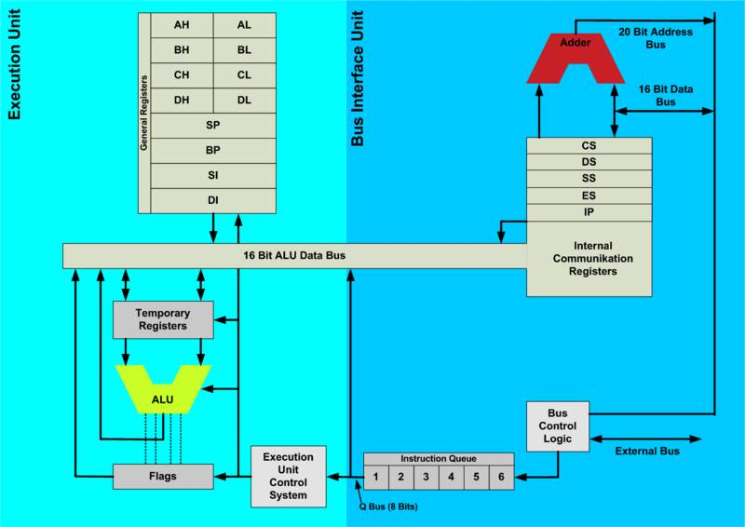
8086 Intel Microprocessor Architecture

Slide 31
Generating Memory Addresses
How to specify the address of branch target?
Can we give the memory operand address directly in a single Add instruction in the loop?
Use a register to hold the address of NUM1; then increment by 4 on each pass through the loop.

Slide 32
Addressing Modes
Instruction
Opcode
Mode
...
Implied
AC is implied in “ADD M[AR]” in “One-Address” instr.
TOS is implied in “ADD” in “Zero-Address” instr.
Immediate
The use of a constant in “MOV R1, 5”, i.e. R1 ← 5
Register
Indicate which register holds the operand

Slide 33
Addressing Modes
Register Indirect
Indicate the register that holds the number of the register that holds the operand
MOV R1, (R2)
Autoincrement / Autodecrement
Access & update in 1 instr.
Direct Address
Use the given address to access a memory location
R1
R2 = 3
R3 = 5

Slide 34
Addressing Modes
Indirect Address
Indicate the memory location that holds the address of the memory location that holds the data
Memory
AR = 101
100
101
0 1 0 4
102
103
104
1 1 0 A

Slide 35
Addressing Modes
Memory
Relative Address
EA = PC + Relative Addr
0
1
Program
PC = 2
2
+
100
Data
AR = 100
101
102
1 1 0 A
Could be Positive or Negative (2’s Complement)
103
104

Slide 36
Addressing Modes
Indexed
EA = Index Register + Relative Addr
Memory
Useful with “Autoincrement” or “Autodecrement”
XR = 2
+
100
AR = 100
101
102
1 1 0 A
103
Could be Positive or Negative (2’s Complement)
104

Slide 37
Addressing Modes
Base Register
EA = Base Register + Relative Addr
Memory
Could be Positive or Negative (2’s Complement)
AR = 2
+
100
0 0 0 5
BR = 100
101
0 0 1 2
102
0 0 0 A
Usually points to the beginning of an array
103
0 1 0 7
104
0 0 5 9

Slide 38
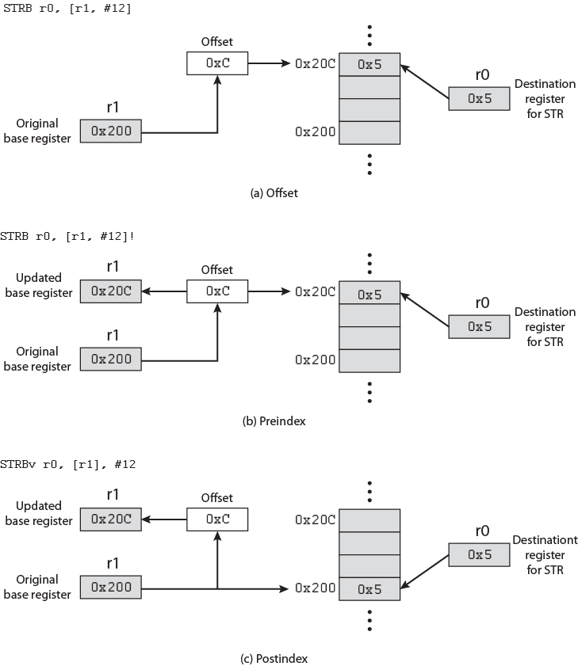
ARM Indexing Methods
RISC machine, unlike a CISC machine
has simple and relatively straightforward
set of addressing modes
ARM architecture departs somewhat from
this tradition by providing a relatively rich
set of addressing modes.
Notes:
Preindex: The memory address is formed in the same way as for offset addressing. The memory address is also written back to the base register. In other words, the base register value is incremented or decremented by the offset value. Figure b illustrates this method with the assembly language instruction STRB r0, [r1, #12]!. The exclamation point signifies preindexin
Postindex: The memory address is the base register value. An offset is added to or subtracted from the base register value and the result is written back to the base register. Figure c illustrates this method with the assembly language instruction STRB r0, [r1], #12.

Slide 39
ARM Addressing Modes Load/Store
Only instructions that reference memory
Indirectly through base register plus offset
Offset
Offset added to or subtracted from base register contents to form the memory address
Preindex
Memory address is formed as for offset addressing
Memory address also written back to base register
So base register value incremented or decremented by offset value

Slide 40
ARM Addressing Modes Load/Store
Postindex
Memory address is base register value
Offset added or subtracted Result written back to base register
Base register acts as index register for preindex and postindex addressing
Offset either immediate value in instruction or another register
If register scaled register addressing available
Offset register value scaled by shift operator
Instruction specifies shift size

Slide 41
ARM Data Processing Instruction Addressing & Branch Instructions
Data Processing
Register addressing
Value in register operands may be scaled using a shift operator
Or mixture of register and immediate addressing
Branch
Immediate
Instruction contains 24 bit value
Shifted 2 bits left
On word boundary
Effective range +/-32MB from PC.

Slide 42
ARM Load/Store Multiple Addressing
Load/store subset of general-purpose registers
16-bit instruction field specifies list of registers
Sequential range of memory addresses
Increment after, increment before, decrement after, and decrement before
Base register specifies main memory address
Incrementing or decrementing starts before or after first memory access

Slide 43
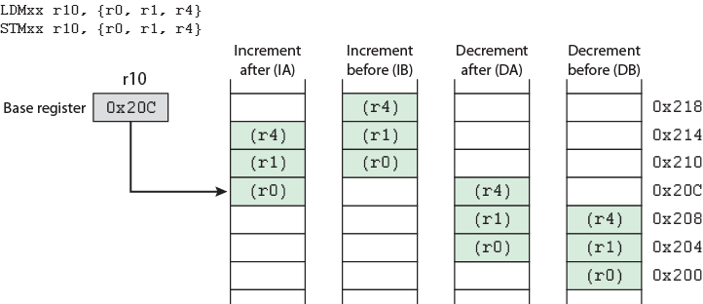
ARM Load/Store Multiple Addressing
Notes:
Load Multiple instructions load a subset (possibly all) of the general-purpose registers from memory. Store Multiple instructions store a subset (possibly all) of the general-purpose registers to memory. The list of registers for the load or store is specified in a 16-bit field in the instruction with each bit corresponding to one of the 16 registers. Load and Store Multiple addressing modes produce a sequential range of memory addresses. The lowest numbered register is stored at the lowest memory address and the highest numbered register at the highest memory address.
Four addressing modes are used
increment after, increment before, decrement after, and decrement before.
A base register specifies a main memory address where register values are stored in or loaded from in ascending (increment) or descending (decrement) word locations. Incrementing or decrementing starts either before or after the first memory access. These instructions are useful for block loads or stores, stack operations, and procedure exit sequences

Slide 44
Instruction Formats
Layout of bits in an instruction
Includes opcode
Includes (implicit or explicit) operand(s)
Usually more than one instruction format in an instruction set
Instruction Length
Affected by and affects:
Memory size
Memory organization
Bus structure
CPU complexity
CPU speed
Trade off between powerful instruction repertoire and saving space

Slide 45
Allocation of Bits
Number of addressing modes
Number of operands
Register versus memory
Number of register sets
Address range
Address granularity

Slide 46
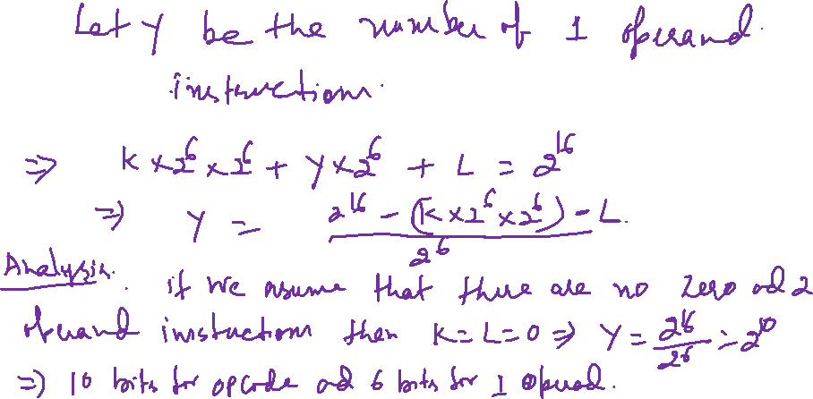
In class Example-1
Assume an instruction set that uses a fixed 16-bit instruction length. Operand specifiers are 6 bits in length. There are K two-operand instructions and L zero-operand instructions. What is the maximum number of one-operand instructions?

Slide 47
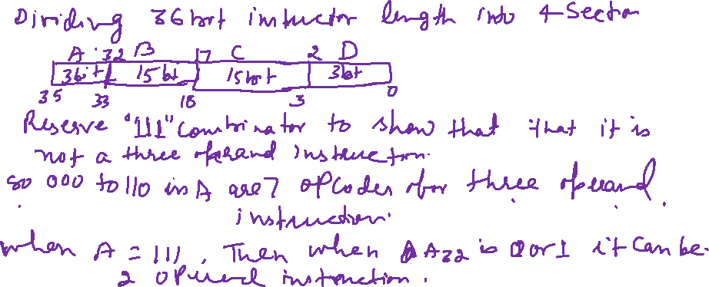
In class Example-1
Design a variable-length opcode to allow all of the following to be encoded in a 36-bit instruction:
• instructions with two 15-bit addresses and one 3-bit register number
• instructions with one 15-bit address and one 3-bit register number
• instructions with no addresses or registers

Slide 48

In class Example-1
Design a variable-length opcode to allow all of the following to be encoded in a 36-bit instruction:
• instructions with two 15-bit addresses and one 3-bit register number
• instructions with one 15-bit address and one 3-bit register number
• instructions with no addresses or registers

Slide 49
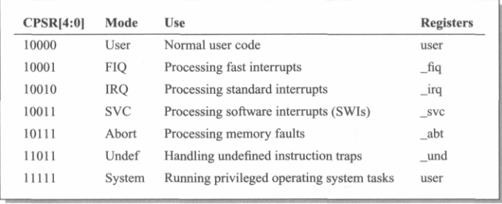
ARM CPSR format
The Current Program Status Register (CPSR)

Slide 50
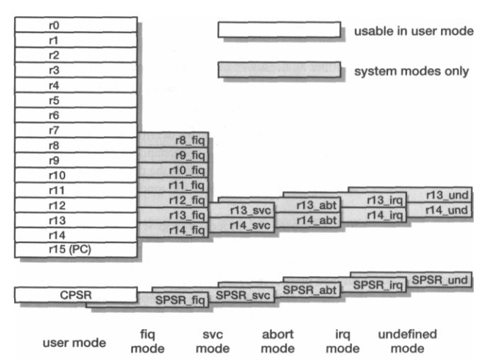
ARM's visible registers
When writing user-level programs, only the 15 general-purpose 32-bit registers (r0 to r!4), the program counter (r15) and the current program status register (CPSR) need be considered.
The remaining registers are used only for system-level programming and for handling exceptions (for example, interrupt)
Each privileged mode (except system mode) has associated with it a Saved Program Status Register, or SPSR. This register is used to save the state of the CPSR

Slide 51
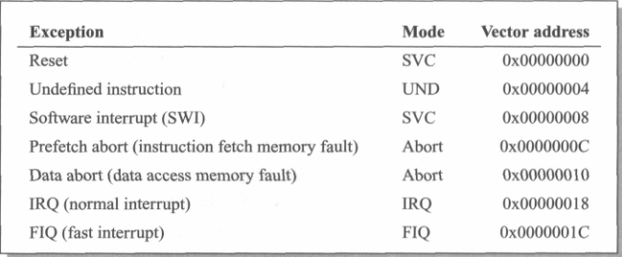
Exception in ARM
Changes to the operating mode corresponding to the particular exception. •
saves the address of the instruction following the exception entry instruction in r14 of the new mode.
saves the old value of the CPSR in the SPSR of the new mode address given in Table
When an exception arises, ARM completes the current instruction
. disables IRQs by setting bit 7 of the CPSR and, if the exception is a fast interrupt, disables further fast interrupts by setting bit 6 of the CPSR.
forces the PC to begin executing at the relevant vector
Vector address 0x00000014 is not used. Used for Address exceptions in earlier ARM processors with 26 bit address space

Slide 52
Exception return
Once the exception has been handled the user task is normally resumed. This requires the handler code to restore the user state exactly as it was when the exception first arose:
Any modified user registers must be restored from the handler's stack.
The CPSR must be restored from the appropriate SPSR.
The PC must be changed back to the relevant instruction address in the user instruction stream.
Exception priorities
reset (highest priority);
data abort;
FIQ;
IRQ;
prefetch abort;
SWI, undefined instruction

Slide 53

ARM Conditional execution
Each of the 16 values of the condition field causes the instruction to be executed or skipped according to the values of the N, Z, C and V flags in the CPSR
Every ARM instruction mnemonic may be extended by appending the two letters defined in the condition table (Symbols)

Slide 54
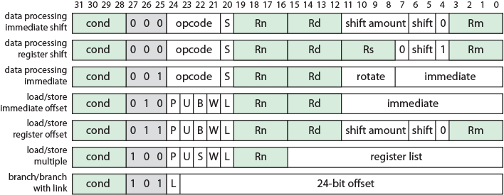
ARM Instruction Formats
S = For data processing instructions, updates condition codes
S = For load/store multiple instructions, execution restricted to supervisor mode
P, U, W = distinguish between different types of addressing_mode
B = Unsigned byte (B==1) or word (B==0) access
L = For load/store instructions, Load (L==1) or Store (L==0)
L = For branch instructions, is return address stored in link register
Notes:
All instructions in the ARM architecture are 32 bits long and follow a regular format
The first four bits of an instruction are the condition code
virtually all ARM instructions can be conditionally executed.
The next three bits specify the general type of instruction.
For most instructions other than branch instructions, the next five bits constitute an opcode and/or modifier bits for the operation.
The remaining 20 bits are for operand addressing.
The regular structure of the instruction formats eases the job of the instruction decode units

Slide 55

Branch and Branch with Link binary encoding.
Branch and Branch with Link instructions cause the processor to begin executing instructions from an address computed by sign extending the 24-bit offset specified in the instruction,
shifting it left two places to form a word offset, then adding it to the program counter which contains the address of the branch instruction plus eight bytes.
The range of the branch instruction is +/- 32 Mbytes
The Branch with Link variant, which has the L bit (bit 24) set, also moves the address of the instruction following the branch into the link register (r14) of the current processor mode.
This is normally used to perform a subroutine call, with the return being caused by copying the link register back into the PC.
Assembler computes the correct offset under normal circumstances.
Note:PC points eight bytes (two instructions) ahead of the current instruction
B{L} {condn} <target address>

Slide 56
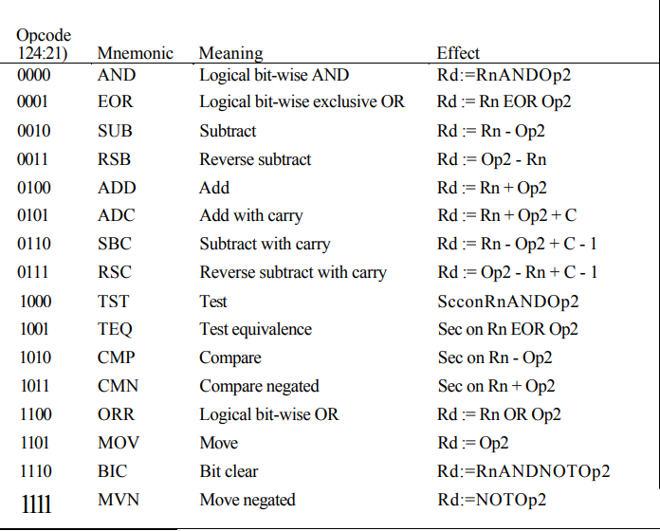
Data processing instructions
Notes:
The ARM data processing instructions are used to modify data values in registers. The operations that are supported include arithmetic and bit-wise logical combinations of 32-bit data types. One operand may be shifted or rotated en route to the ALU, allowing, for example, shift and add in a single instruction
The ARM data processing instructions employ a 3-address format, which means that the two source operands and the destination register are specified independently
One source operand is always a register; the second may be a register, a shifted register or an immediate value.
The shift applied to the second operand, if it is a register, may be a logical or arithmetic shift or a rotate and it may be by an amount specified either as an immediate quantity or by a fourth register
Multiply instructions use different formats

Slide 57
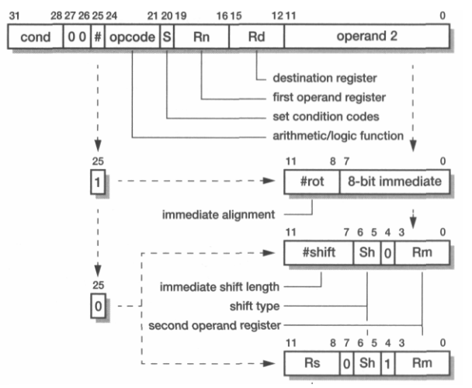
Data processing instructions
Notes:
When the instruction does not require all the available operands (for instance MOV ignores Rn and CMP ignores Rd) the unused register field should be set to zero. The assembler will do this automatically.
These instructions allow direct control of whether or not the processor's condition codes are affected by their execution through the S bit (bit 20). When clear, the condition codes will be unchanged; when set (and Rd is not r15) , all flag bits N,Z,C ,V change according to the operation result

Slide 58

Multiply instructions
ARM multiply instructions produce the product of two 32-bit binary numbers held in registers. The result of multiplying two 32-bit binary numbers is a 64-bit product
Notes:
Some forms of the instruction, available only on certain versions of the processor, store the full result into two independently specified registers; other forms store only the least significant 32 bits into a single register.
In all cases there is a multiply-accumulate variant that adds the product to a running total and both signed and unsigned operands may be used. The least significant 32 bits of the result are the same for signed and unsigned operands, so there is no need for separate signed and unsigned versions of the 32-bit result instructions

Slide 59
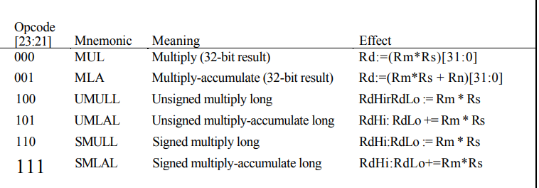
Multiply instructions.
Notes:
'RdHi:RdLo' is the 64-bit number formed by concatenating RdHi (the most significant 32 bits) and RdLo (the least significant 32 bits).’
[31:0]' selects only the least significant 32 bits of the result.
Simple assignment is denoted by ':=‘.
Accumulation (adding the right-hand side to the left) is denoted by'+=‘.
The S bit controls the setting of the condition codes as with the other data processing instructions.
When it is set in the instruction:
The N flag is set to the value of bit 31 of Rd for the variants which produce a 32- bit result, and bit 31 of RdHi for the long forms.
The Z flag is set if Rd or RdHi and RdLo are zero.
The C flag is set to a meaningless value.
The V flag is unchanged.

Slide 60
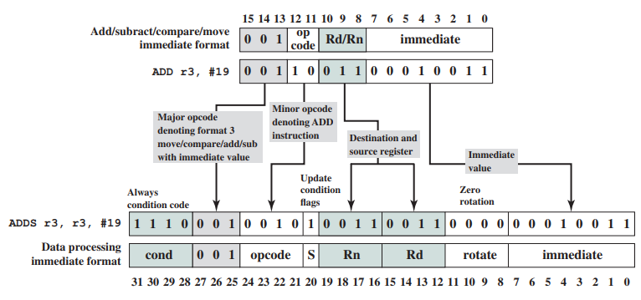
Expanding a Thumb ADD Instruction into its ARM Equivalent
The Thumb instruction set is a re- encoded subset of the ARM instruction set. Thumb is designed to increase the performance of ARM implementations that use a 16-bit or narrower memory data bus and to allow better code density than provided by the ARM instruction for both 16-bit and 32-bit processors
Notes:
The Thumb instruction set was created by analyzing the 32-bit ARM instruction set and deriving the best fit 16-bit instruction set, thus reducing code size. The savings is achieved in the following way:
Thumb instructions are unconditional, so the condition code field is not used. Also, all Thumb arithmetic and logic instructions update the condition flags, so that the update-flag bit is not needed. Savings: 5 bits
Thumb has only a subset of the operations in the full instruction set and uses only a 2-bit opcode field, plus a 3-bit type field. Savings: 2 bits
The remaining savings of 9 bits comes from reductions in the operand specifications. For example, Thumb instructions reference only registers r0 through r7, so only 3 bits are required for register references, rather than 4 bits. Immediate values do not include a 4-bit rotate

Slide 61
Assembler
Machines store and understand binary instructions
E.g. N= I + J + K initialize I=2, J=3, K=4
Program starts in location 101
Data starting 201
Code:
Load contents of 201 into AC
Add contents of 202 to AC
Add contents of 203 to AC
Store contents of AC to 204
Tedious and error prone
Address | Contents
101 | 0010 | 0010 | 101 | 2201
102 | 0001 | 0010 | 102 | 1202
103 | 0001 | 0010 | 103 | 1203
104 | 0011 | 0010 | 104 | 3204
201 | 0000 | 0000 | 201 | 0002
202 | 0000 | 0000 | 202 | 0003
203 | 0000 | 0000 | 203 | 0004
204 | 0000 | 0000 | 204 | 0000
Binary program

Slide 62
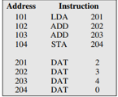
Improvements
Address | Contents
101 | 2201
102 | 1202
103 | 1203
104 | 3204
201 | 0002
202 | 0003
203 | 0004
204 | 0000
Use hexadecimal rather than binary
Code as series of lines
Hex address and memory address
Need to translate automatically using program
Add symbolic names or mnemonics for instructions
Three fields per line
Location address
Three letter opcode
If memory reference: address
Need more complex translation program
Hexadecimal program
Symbolic program

Slide 63
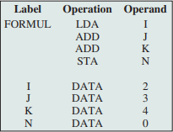
Symbolic Addresses
First field (address) now symbolic
Memory references in third field now symbolic
Now have assembly language and need an assembler to translate
Assembler used for some systems programming
Compliers
I/O routines
Assembly program

Slide 64
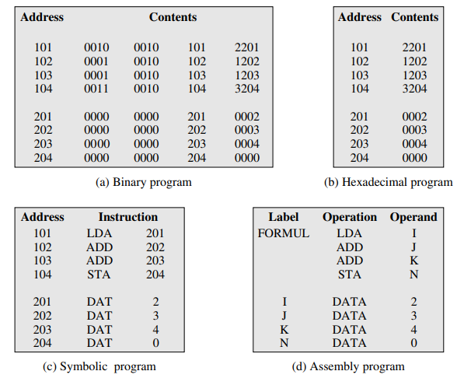
Computation of the Formula N = I + J + K

Slide 65
Adressing Mode In class example 3
Given the following memory values and a one-address machine with an accumulator, what values do the following instructions load into the accumulator?
• Word 20 contains 40.
• Word 30 contains 50.
• Word 40 contains 60.
• Word 50 contains 70.
a. LOAD IMMEDIATE 20
b. LOAD DIRECT 20
c. LOAD INDIRECT 20
d. LOAD IMMEDIATE 30
e. LOAD DIRECT 30
f. LOAD INDIRECT 30
Sol:
20
40
60
d. 30 e. 50 f . 70

Slide 66

In class example 4
Consider a 16-bit processor in which the following appears in main memory, starting at location 200:
The first part of the first word indicates
that this instruction loads a value into
an accumulator.
The Mode field specifies an addressing mode and, if appropriate, indicates a source register; assume that when used, the source register is R1, which has a value of 400.There is also a base register that contains the value 100.The value of 500 in location 201 may be part of the address calculation. Assume that location 399 contains the value 999, location 400 contains the value 1000, and so on. Determine the effective address and the operand to be loaded for the following address modes:

Slide 67

Contnd. Determine the effective address and the operand to be loaded for the following address modes
a. Direct d. PC relative g. Register indirect
b. Immediate e. Displacement,
c. Indirect f. Register
h. Autoindexing with increment using R1
Mode→ R1 and contains 400
Base register 100
Adrs 399 → 999 & 400→ 1000
A 500 1100
B 201 500
C 1100 1700
D 702 1302
E 600 1200
F R1 400
G 400 1000
H 400 1000

Slide 68
In class example 5
Assume a stack-oriented processor that includes the stack operations PUSH and POP. Arithmetic operations automatically involve the top one or two stack elements. Begin with an empty stack.What stack elements remain after the following instructions
are executed?
PUSH 4
PUSH 7
PUSH 8
ADD
PUSH 10
SUB
MUL
Push 4 4
Push 7 7,4
Push 8 8,7,4
ADD 15,4
PUSH 10 10,15,4
SUB 5,4
MUL 20

Slide 69
In class example 6
Compare zero-, one-, two-, and three-address machines by writing programs to compute
for each of the four machines.The instructions available for use are as follows:
X = (A + B X C) ∕ (D - E X F)
0 Address | 1 Address | 2 Address | 3 Address
PUSH M POP M ADD SUB MUL DIV | LOAD M STORE M ADD M SUB M MUL M DIV M | MOVE(x←y ) ADD (x←x+y ) SUB (x←x-y ) MUL (x←x X y ) DIV (x←x/y ) | MOVE (x←y ) ADD (x←y +z) SUB (x←y -z) MUL (x←y X Z) DIV (x←y/z )

Slide 70
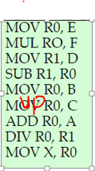

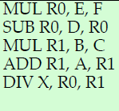
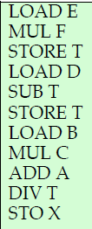
0 Address | 1 Address | 2 Address | 3 Address
PUSH M POP M ADD SUB MUL DIV | LOAD M STORE M ADD M SUB M MUL M DIV M | MOVE(x←y ) ADD (x←x+y ) SUB (x←x-y ) MUL (x←x X y ) DIV (x←x/y ) | MOVE (x←y ) ADD (x←y +z) SUB (x←y -z) MUL (x←y X Z) DIV (x←y/z )
C
B
A
X = (A + B X C) ∕ (D - E X F)

Slide 71
0 Address | 1 Address | 2 Address | 3 Address
PUSH M POP M ADD SUB MUL DIV | LOAD M STORE M ADD M SUB M MUL M DIV M | MOVE(x←y ) ADD (x←x+y ) SUB (x←x-y ) MUL (x←x X y ) DIV (x←x/y ) | MOVE (x←y ) ADD (x←y +z) SUB (x←y -z) MUL (x←y X Z) DIV (x←y/z )
BXC
A
X = (A + B X C) ∕ (D - E X F)

Slide 72
0 Address | 1 Address | 2 Address | 3 Address
PUSH M POP M ADD SUB MUL DIV | LOAD M STORE M ADD M SUB M MUL M DIV M | MOVE(x←y ) ADD (x←x+y ) SUB (x←x-y ) MUL (x←x X y ) DIV (x←x/y ) | MOVE (x←y ) ADD (x←y +z) SUB (x←y -z) MUL (x←y X Z) DIV (x←y/z )
F
E
D
A+BXC
X = (A + B X C) ∕ (D - E X F)

Slide 73
0 Address | 1 Address | 2 Address | 3 Address
PUSH M POP M ADD SUB MUL DIV | LOAD M STORE M ADD M SUB M MUL M DIV M | MOVE(x←y ) ADD (x←x+y ) SUB (x←x-y ) MUL (x←x X y ) DIV (x←x/y ) | MOVE (x←y ) ADD (x←y +z) SUB (x←y -z) MUL (x←y X Z) DIV (x←y/z )
ExF
D
A+BXC
X = (A + B X C) ∕ (D - E X F)

Slide 74
0 Address | 1 Address | 2 Address | 3 Address
PUSH M POP M ADD SUB MUL DIV | LOAD M STORE M ADD M SUB M MUL M DIV M | MOVE(x←y ) ADD (x←x+y ) SUB (x←x-y ) MUL (x←x X y ) DIV (x←x/y ) | MOVE (x←y ) ADD (x←y +z) SUB (x←y -z) MUL (x←y X Z) DIV (x←y/z )
D-ExF
A+BXC
X = (A + B X C) ∕ (D - E X F)

Slide 75
0 Address | 1 Address | 2 Address | 3 Address
PUSH M POP M ADD SUB MUL DIV | LOAD M STORE M ADD M SUB M MUL M DIV M | MOVE(x←y ) ADD (x←x+y ) SUB (x←x-y ) MUL (x←x X y ) DIV (x←x/y ) | MOVE (x←y ) ADD (x←y +z) SUB (x←y -z) MUL (x←y X Z) DIV (x←y/z )
A+BxC / D-ExF
X = (A + B X C) ∕ (D - E X F)

