Slide 1
Data Structures and Algorithms Design
Harish Aggarwal

Slide 2
Hashing

Slide 3
Re-Cap
Lecture-01
Introduction
Handout
Text Books, Reference Books
Marks Distribution
Algorithm Analysis
Pseudo Code
Random Access model
Time Complexity of Algorithms
Asymptotic Notations
Basic Maths Needed in the course
Lecture-02
General Rules and Problems
Mathematical analysis of Non-recursive algorithms
Mathematical analysis of Recursive algorithms
Iteration vs Recursion
Recurrence Tree
Iterative Substitution
Masters Theorem with example
Lecture-03
Abstract Data Types
Arrays and Linked Lists
List, Stack, Queues
Array and Linked Implementation
Add, Remove operations
Applications
Infix, PreFix, PostFix Notations
Lecture-04
Recurrence relation
Recursion Method (With help from Merge sort)
Substitution Method
Tree – Definitions
Binary Tree –
Proper, (Strict/Full), Complete, Perfect
Tree Traversal – PreOrder, InOrder, PostOrder

Slide 4
Re-Cap
Lecture-05
Sorting –
Bubble Sort
Insertion Sort
Selection Sort
Bucket Sort
Quick Sort
Complexity of Sorting Algorithms
Heaps
Heaps
Heapify
Heap Sort

Slide 5
Hash Tables (Intro-1)
Insert 6, 16, 22, 23, 11, 18 in this order
Advantage –
Direct Index to key
Search, Insert, Delete all take single operation
Disadvantage –
The range is still limited to 29
Waste of space

Slide 6
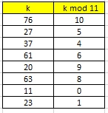

Hash Tables – (Intro – 2)
Insert Key (k) - 76, 27, 37, 61, 20, 63, 11, 23 in this order
h(k) = k mod 11
Advantage –
Direct Index to key
Search, Insert, Delete all take two operation
One for finding hash value
Another for search, insert, delete
Range of Key is unlimited

Slide 7
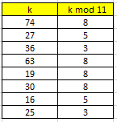
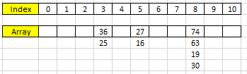
Hash Tables – (Intro – 3)
Insert Key (k) - 74, 27, 36, 63, 19, 30, 16, 25 in this order
h(k) = k mod 11
Advantage –
Direct Index to key
Search, Insert, Delete all take two operation
One for finding hash value
Another for search, insert, delete
Range of Key is unlimited
Disadvantage –
More than one key map to same index (Called as Collision)

Slide 8
Hash Tables – (Intro – 4)
Improve Hash Function
How to Deal with Collision
Chaining
Open Addressing
Linear Probing
Quadratic Probing
Double Hashing
Chaining
/ | K | /
/ | K | /
/ | K | /
/ | K_{i} | /
/ | K | /
/ | K | /
/ | K | /
/ | K | /
/ | K | /
/ | K | /
/ | K_{i} | /
/ | K | /

Slide 9
HashTables
Aim
To develop a search procedure with running time O(1).
Array is an immediate answer.
Example: Consider a sorted sequence stored in an array.
Focus on finding 44.
Binary search does it in O(log n) time
Can we retrieve faster than binary search?
11 | 22 | 28 | 33 | 44 | 49 | 55 | 58 | 66 | 77 | 79 | 88

Slide 10
HashTables
If 44 was stored in A[44], search would be done in one step.
Problem is if keys are very large.
Lot of cells will be empty and so inefficient in terms of space requirement.
Answer : Hash Tables
Uses an array of size proportional to the number of keys used.
Instead of using key as an array index, array index is computed from the key.

Slide 11
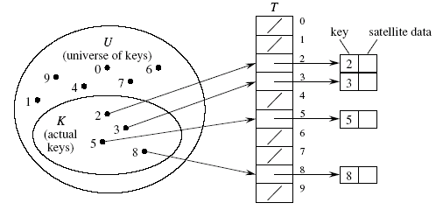
Array as Tables
It is also called Direct-address Hash Table.
• Each slot, or position, corresponds to a key in U.
• If there’s an element x with key k, then T [k] contains a pointer to x.
• Otherwise, T [k] is empty, represented by NIL.

Slide 12
Array as Tables
Store the records in a huge array where the index corresponds to the key
add - very fast O(1)
delete - very fast O(1)
search - very fast O(1)

Slide 13
Direct Address table
Disadvantage of Direct Address table
If the universe U is very large, storing a table of size |U| may be impractical.
The set K of keys actually stored may be small relative to U, so that most of the space allocated for table is wasted.

Slide 14
Hash Function
In direct addressing, an element with key k is stored in slot k.
With hashing, the hash function is used to compute the slot h(k)
h : U → {0, 1,….,m-1}
We say that h(k) is the hash value of k.
Aim
To reduce the range of array of indices that needs to be handled

Slide 15
Compression Maps
Division Method
h(k) = k mod m
Certain values of m may not be good:
Good values for m are prime numbers which are not close to exact powers of 2. For example, if you want to store 2000 elements then m=701 (m = hash table length) yields a hash function: h(k) = k mod 701

Slide 16
Compression Maps
MAD Method (Multiply, Add and Divide)
Define h(k) = (ak +b) mod n,
Where n is a prime number and a and b are chosen randomly so that a mod n ≠ 0.
This function is chosen in order to eliminate repeated patterns.

Slide 17
Hash function
Problem:
Two keys may hash to the same slot – collision
Ideal situation – avoid collision altogether
But it is generally difficult to design perfect hash. (e.g. when the potential key space is large)
Solution :
Find effective techniques for resolving collision

Slide 18
Collision Resolving
Collision resolution by chaining
In chaining, we put all elements that hash to same slot in a doubly linked list.
Slot j contains a pointer to the head of the list of all stored elements that hash to j
If there are no such elements, slot j contains NIL.

Slide 19
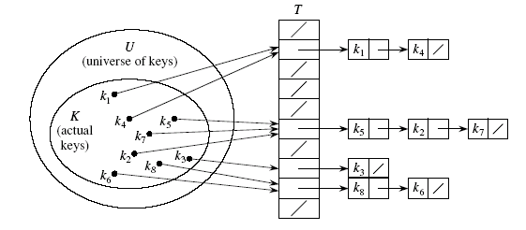
Chained Hash Table

Slide 20
Performance Analysis
Worst Case
All keys are hashed to the same slot, worst cast is O(n) time
Average Performance
Given a hash table T with m slots that stores n keys, Define load factor α for T as n/m
Load factor α means - average keys per slot.
n = Total number of elements
m = number of slots in Hash Table
Load Factor α = n/m
If n > m : There are more than one element in each slot of Hash Table (Average)
If n = m : There is exactly one element in each slot of Hash Table (Average)
If n < m : Some of the slots in Hash Table are empty and others just have one element(Average)

Slide 21
Performance Analysis
Assume
Simple uniform hashing.
Any key is equally likely to hash into any of the m slots, independent of where any other key hashes to. This assumption is called as Simple Uniform Hashing.
O(1) time to compute h(k).
Time to search for an element with key k depends linearly on the length of the list T [h(k)].
Expected length of a linked list = load factor = α = n/m.
We consider two cases:
Unsuccessful search
Successful search

Slide 22
Unsuccessful Search
Theorem:
An unsuccessful search takes expected time Θ(1+α).
Proof:
Any key not already in the table is equally likely to hash to any of the m slots.
To search unsuccessfully for any key k, need to search to the end of the list T[h(k)], whose expected length is α.
Adding the time to compute the hash function, the total time required is Θ(1+α).

Slide 23
Successful Search
Theorem:
A successful search takes expected time Θ(1+α).
Proof:
The probability that a list is searched is proportional to the number of elements it contains.
Assume that the element being searched for is equally likely to be any of the n elements in the table.
The number of elements examined during a successful search for an element x is 1 more than the number of elements examined when the sought for element was inserted.

Slide 24
Successful Search
/ | K | /
/ | K | /
/ | K | /
/ | K | /
/ | K | /
/ | K | /
/ | K_{i} | /
/ | K | /
n = Total number of elements
m = number of slots in Hash Table
Load Factor α = n/m (Number of elements in a slot)
Expected number of elements examined in a successful search is –
Θ(1+α)

Slide 25
Expected Cost - Interpretation
If n = O(m), then α=n/m = O(m)/m = O(1).
⇒ Searching takes constant time on average.
Insertion is O(1) in the worst case.
Deletion takes O(1) worst-case time when lists are doubly linked.
Hence, all dictionary operations take O(1) time on average with hash tables with chaining.

Slide 26
Open Addressing
An alternative to chaining for handling collisions
Idea
Store all keys in the hash table itself.
Each slot contains either a key or NIL.
To search for key k:
Examine slot h(k). Examining a slot is known as a probe.
If slot h(k) contains key k, the search is successful. If the slot contains NIL, the search is unsuccessful.
There's a third possibility: slot h(k) contains a key that is not k.
Compute the index of some other slot, based on k and which probe we are on.
Keep probing until we either find key k or we find a slot holding NIL.
Advantages: Avoids pointers; so can use a larger table.

Slide 27
Probe Sequence
Sequence of slots examined during a key search constitutes a probe sequence.
Probe sequence must be a permutation of the slot numbers.
We examine every slot in the table, if we have to.
We don't examine any slot more than once.
The hash function is extended to:
— h : U x {0, 1...., m -1} -> {0, 1, ...,m-1}
probe number slot number
<h(k,0), h(k,1),...,h(k,m-1)> should be a permutation of (0, 1,..., m-1).

Slide 28
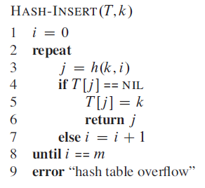
Insert Operation
Act as though we were searching, and insert at the first NIL slot found

Slide 29
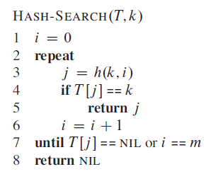
Search Operation
The search algorithm for key k probes the same sequence of slots that the insertion algorithm examined when k was inserted.

Slide 30
Deletion Operation
Cannot just turn the slot containing the key we want to delete to contain NIL.
Doing so might make it impossible to retrieve any key k during whose insertion we had probed this slot & found it occupied.
Use a special value DELETED instead of NIL when marking a slot as empty during deletion.
Search should treat DELETED as though the slot holds a key that does not match the one being searched for.
Insert should treat DELETED as though the slot were empty, so that it can be reused.
Disadvantage: Search time is no longer dependent on α.
Hence, chaining is more common when keys have to be deleted.

Slide 31
Probe Sequences
The ideal situation is uniform hashing:
Generalization of simple uniform hashing.
Each key is equally likely to have any of the m! permutations of <0, 1,..., m-1> as its probe sequence.
It is hard to implement true uniform hashing.
Approximate with techniques that at least guarantee that the probe sequence is a permutation of <0, 1,...,m-1>
Three commonly used techniques:
Linear Probing.
Quadratic Probing.
Double Hashing.
All guarantee that <h(k,0), h(k,1) ..... h(k,m-1)) is a permutation of <0, 1,..., m—l>
None of these fulfills assumptions of uniform hashing.
Can't produce all m! probe sequences.

Slide 32
Linear Probing
Given an Ordinary Hash function h’ : U -> {0, 1, 2, 3……….m-1}
Also called as Auxiliary Hash Function
h(k, i) = (h’(k)+i) mod m
Key : k
i : Probe Number
h’(k) : Auxiliary hash function
The initial probe determines the entire probe sequence.
T[h'(k)], T[h'(k)+1], ..., T[m-1], T[0], T[1], ..., T[h'(k)-1]
Hence, only m distinct probe sequences are possible.
Easy to Implement
Suffers from primary clustering :
Long runs of occupied sequences build up.
Long runs tend to get longer, since an empty slot preceded by i full slots gets filled next with probability (i+1)/m
Hence, average search and insertion times increase.

Slide 33

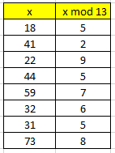
Linear Probing - Example
Example
h’(x) = x mod 13
h(x) = (h’(x) + i) mod 13
Insert 18, 41, 22, 44, 59, 32, 31, 73 in this order

Slide 34

Quadratic Probing
Hash function is of the form –
h(k, i) = (h'(k) + c₁i + C₂i²) mod m c₁$≠$ c₂
Key : k
i : Probe Number
h’(k) : Auxiliary hash function
The initial probe position is T[h'(k)], later probe positions are offset by amounts that depend on a quadratic function of the probe number i.
Must constrain c₁, c₂, and m to ensure that we get a full permutation of <0, 1,..., m-1>.
Can suffer from secondary clustering :
If two keys have the same initial probe position, then their probe sequences are the same.

Slide 35
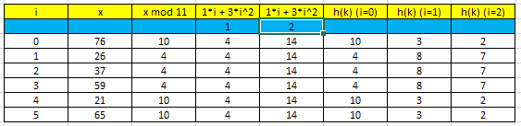

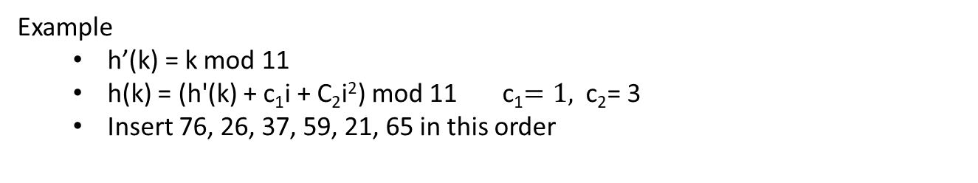
Quadratic Probing - Example
Example
h’(k) = k mod 11
h(k) = (h'(k) + c₁i + C₂i²) mod 11 c₁$=1,$ c₂= 3
Insert 76, 26, 37, 59, 21, 65 in this order

Slide 36
Double Hashing
h(k ,i) = (h₁(k) + i*h₂(k)) mod m
Key : k
i : Probe Number
h₁(k) + h₂(k) : Auxiliary hash function
Two auxiliary hash functions.
h1 gives the initial probe. h2 gives the remaining probes.
Θ(m²) different probe sequences.
One for each possible combination of h₁(k) and h₂(k).
Close to the ideal uniform hashing.
Best method available for open addressing

Slide 37
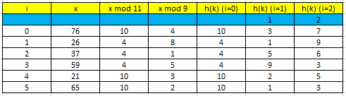

Double Hashing - Example
Example
h₁(k) = k mod 11 m=11
h₂(k) = k mod 9
h(k) = (h₁(k) + ih₂(k)) mod 11
Insert 76, 26, 37, 59, 21, 65 in this order

Slide 38
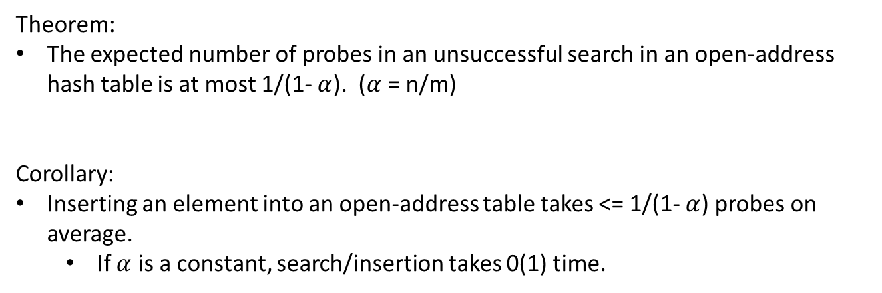
Performance of Open Addressing
Theorem:
The expected number of probes in an unsuccessful search in an open-address hash table is at most 1/(1- $α$). ($α$ = n/m)
Corollary:
Inserting an element into an open-address table takes <= 1/(1- $α$) probes on average.
If $α$ is a constant, search/insertion takes 0(1) time.

