Slide 1
Data Structures and Algorithms Design
Harish Aggarwal

Slide 2
Binary Search Trees

Slide 3
Re-Cap
Lecture-01
Introduction
Handout
Text Books, Reference Books
Marks Distribution
Algorithm Analysis
Pseudo Code
Random Access model
Time Complexity of Algorithms
Asymptotic Notations
Basic Maths Needed in the course
Lecture-02
General Rules and Problems
Mathematical analysis of Non-recursive algorithms
Mathematical analysis of Recursive algorithms
Iteration vs Recursion
Recurrence Tree
Iterative Substitution
Masters Theorem with example
Lecture-03
Abstract Data Types
Arrays and Linked Lists
List, Stack, Queues
Array and Linked Implementation
Add, Remove operations
Applications
Infix, PreFix, PostFix Notations
Lecture-04
Recurrence relation
Recursion Method (With help from Merge sort)
Substitution Method
Tree – Definitions
Binary Tree –
Proper, (Strict/Full), Complete, Perfect
Tree Traversal – PreOrder, InOrder, PostOrder

Slide 4
Re-Cap
Lecture-05
Sorting –
Bubble Sort
Insertion Sort
Selection Sort
Bucket Sort
Quick Sort
Complexity of Sorting Algorithms
Heaps
Heaps
Heapify
Heap Sort
Lecture-06
Hashing
Collisions
Handling collisions –
Chaining,
Linear Probing,
Quadratic Probing
Double Hashing

Slide 5
Binary Search Trees (BSTs)
As the name suggests, the main use of this representation is for searching. In this representation we impose restriction on the kind of data a node can contain.

Slide 6
Binary Search Trees
A Binary Search Tree (BST) is a binary tree with the following properties:
The key of a node is always greater than the keys of the nodes in its left subtree
The key of a node is always smaller than the keys of the nodes in its right subtree
Operations on BST
Building a BST from given elements
Search, Insertion, Deletion
14
16
10
C
8
11
15
18
9
22
A
D
2
3
Note: Many textbooks would depict that a BST cannot have duplicates and the = is not discussed. Nevertheless, refer to Introduction to Algorithm by CLRS – Chapter 12.

Slide 7
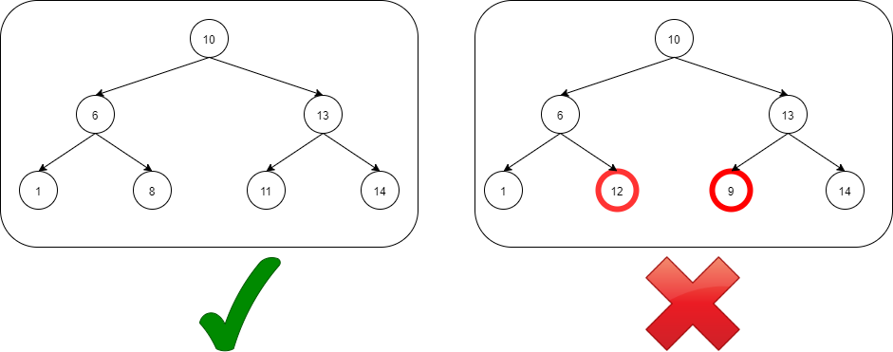
Binary Search Trees

Slide 8
BST – Inorder gives Sorted!
An Inorder traversal of a binary search trees visits the keys in increasing order.
Outputs keys in sorted order.
6
2
9
Inorder Traversal (Left, root, right)
1,2,4,6,8,9 ➔ Sorted !
1
4
8

Slide 9
Operations on BST
Main Operations: Following are the main operations that are supported by binary search trees:
Find/find minimum/find maximum element in binary search trees.
Inserting an element in binary search trees.
Deleting an element from binary search trees.

Slide 10
Building a BST
Build a BST from a sequence of nodes read one a time
Example: Inserting (in this order!)
65
65
65
89
50
89
50
38
59

Slide 11
Building a BST
65
65
50
89
50
89
38
59
38
59
99
35
91
95
32

Slide 12
Building a BST
65
50
89
38
59
66
99
35
43
32
91
31
95
3
92

Slide 13
Building a BST
65
89
50
99
38
59
66
91
35
43
58
60
75
95
32
82
31
92
3
16

Slide 14
92
Building a BST (2)
89
75
91
95
66
82
3
99
16
59
58
60
32
65
31
50
38
35
43

Slide 15
Building a BST
Totally Different BST for given set of numbers
Depends on the order of insertion
Height of the tree could be different for same set of numbers

Slide 16
Recursive Search of Binary Tree
Node Find( Node n, Value key) {
if (n == null) // Not found
return( n );
else if (n.data == key) // Found it
return( n );
else if (n.data > key) // In left subtree
return Find( n.left );
else // In right subtree
return Find( n.right );
}

Slide 17
Example Binary Searches
Find ( 2 )
10
10 > 2, left
5 > 2, left
2 = 2, found
5
30
2
25
45
29

Slide 18
Example Binary Searches
Find ( 28 )
10
28 > 10 , Right
28 < 30, left
28 > 25, Right
28 < 29, Right
Null (Not found)
5
30
2
25
45
29

Slide 19
Finding minimum element in Binary search trees
In BSTs, the minimum element, is the left-most node, which does not has left child. In the BST below, the minimum element is 4.
Tree-Minimum(x)
1. while left[x] ≠ NIL
2. do x ← left[x]
3. return x
Time complexity O(n) in the worst case
Space complexity O(n) for recursive Stack
10
6
16
4
9
13
7

Slide 20
Finding max element in Binary search trees
In BSTs the Maximum element is the right –most node which does not have right child. In the BSTs above the maximum element is 16.
Tree-Maximum(x)
1. while right[x] ≠ NIL
2. do x ← right [x]
3. return x
Time complexity O(n) in the worst case
Space complexity O(n) for recursive Stack
10
6
16
4
9
13
7

Slide 21
Complexity of Search
Running time of searching in a BST is proportional to the height of the tree.
If n is the number of nodes in a BST, then
Best Case – O(logn)
Worst Case – O(n)

Slide 22
Binary Search Tree - Insertion
Insert Algorithm
If value we want to insert < key of current node, we have to go to the left subtree
Otherwise we have to go to the right subtree
If the current node is empty (not existing) create a node with the value we are inserting and place it here.

Slide 23
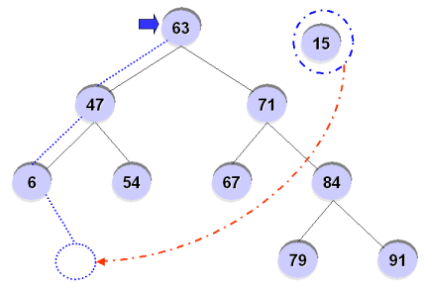
Insertion - Example
For example, inserting ’15’ into the BST?

Slide 24
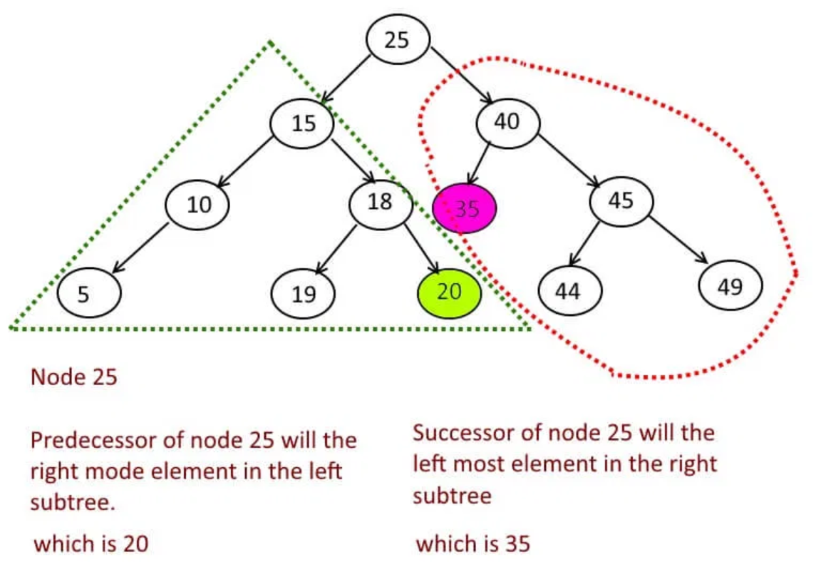
Where is In-order Predecessor & Successor ?
If X has two children then its in-order predecessor is the maximum value in its left subtree and its in-order successor is the minimum value in its right subtree.
X
Predecessor of X
Successor of X
Note : When the node X does not have children, how to find the predecessor ? Refer CLRS

Slide 25
Binary Search Tree - Deletion
Similar to the insert function, after deletion of a node, the property of the BST must be maintained.
There are 3 possible cases
Case1 : Node to be deleted has no children
Just delete the node.
Case2 : Node to be deleted has only one child
Replace the node with its child and make the parent of the deleted node to be a parent of the child of the deleted node
Case3 : Node to be deleted has two children
Find minimum value of right subtree
Delete minimum node of right subtree but keep its value
Minimum Node can be a Leaf – Follow Case 1
Minimum Node can be having only one Right Child – Follow Case 2
Replace the value of the node to be deleted by the minimum value whose node was deleted earlier.
Alternatively, Use Max Node in the Left Sub Tree and follow the steps as above

Slide 26
Binary Search Tree - Deletion
Case 1 - Node to be deleted has No children
- Just delete the Node
Delete - 3, 9, 11, 15, 17, 22
14
16
10
8
11
15
18
9
17
22
2
3

Slide 27
Binary Search Tree - Deletion
Case 2 - Node to be deleted has One children
- Replace the node with its child and make the parent of the deleted node to be a parent of the child of the deleted node
- 25, 40, 42
30
25
40
22
45
12
24
48
42
10
43
47
50
15

Slide 28
Binary Search Tree - Deletion
Case 3 - Node to be deleted has Two children
Find minimum value of right subtree
Delete minimum node of right subtree but keep its value
Minimum Node can be a Leaf – Follow Case 1 – Just Delete the Node
Minimum Node can be having only one Right Child – Follow Case 2
Replace the value of the node to be deleted by the minimum value whose node was deleted earlier.
12, 22, 30, 45, 48
15, 24, 38, 47, 50 (Corresponding Min in Right Sub Tree)
30
25
40
22
45
38
12
24
42
48
39
10
43
47
50
15

Slide 29
92
Binary Search Tree
- Deletion
89
75
91
95
66
82
3
99
16
59
58
60
32
65
31
50
38
35
43

Slide 30
Binary Search Tree - Deletion
Case 3 - Node to be deleted has Two children
Find minimum value of right subtree
Delete minimum node of right subtree but keep its value
Minimum Node can be a Leaf – Follow Case 1 – Just Delete the Node
Minimum Node can be having only one Right Child – Follow Case 2
Replace the value of the node to be deleted by the minimum value whose node was deleted earlier
30,
38 (Corresponding Min in Right Sub Tree)
30
25
47
22
50
38
12
24
48
55
45
10
49
53
58
15
44
46

Slide 31
Binary Search Tree - Disadvantages
Unbalanced Binary Search Trees are bad
Worst case Performance is O(n)
No better than sequential searching.
We look at correcting this problem.

Slide 32
Applications of BST
BSTs are used for a lot of applications due to its ordered structure :
BSTs are used for indexing and multi-level indexing in DB.
They are also helpful to implement various searching algorithms.
It is helpful in maintaining a sorted stream of data.
TreeMap and TreeSet data structures offered by high level languages are internally implemented using self-balancing BSTs

Slide 33
Additional Reading
Appendix

Slide 34
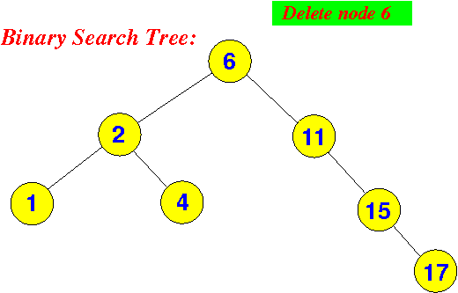
Exercises
Insert into an initially empty binary search tree the following elements (in this order): C A B L M. Draw the tree after each insertion.
Insert into an initially empty binary search tree the following elements (in this order): 30, 40, 23, 58, 48, 26, 11, 13. Draw the tree after each insertion. Delete node 30, 48, 13. Show each step clearly.
Try deleting 6 :
Notes:
\

