Slide 1
Data Structures and Algorithms Design
Harish Aggarwal

Slide 2
Mid-Sem Review

Slide 3
Re-Cap
Lecture-01
Introduction
Handout
Text Books, Reference Books
Marks Distribution
Algorithm Analysis
Pseudo Code
Random Access model
Time Complexity of Algorithms
Asymptotic Notations
Basic Maths Needed in the course
Lecture-02
General Rules and Problems
Mathematical analysis of Non-recursive algorithms
Mathematical analysis of Recursive algorithms
Iteration vs Recursion
Recurrence Tree
Iterative Substitution
Masters Theorem with example
Lecture-03
Abstract Data Types
Arrays and Linked Lists
List, Stack, Queues
Array and Linked Implementation
Add, Remove operations
Applications
Infix, PreFix, PostFix Notations
Lecture-04
Recurrence relation
Recursion Method (With help from Merge sort)
Substitution Method
Tree – Definitions
Binary Tree –
Proper, (Strict/Full), Complete, Perfect
Tree Traversal – PreOrder, InOrder, PostOrder

Slide 4
Re-Cap
Lecture-05
Sorting –
Bubble Sort
Insertion Sort
Selection Sort
Bucket Sort
Quick Sort
Complexity of Sorting Algorithms
Heaps
Heaps
Heapify
Heap Sort
Lecture-06
Hashing
Collisions
Handling collisions –
Chaining,
Linear Probing,
Quadratic Probing
Double Hashing
Lecture-07
Binary Search Tree
Addition, Deletion of Node
Search

Slide 5
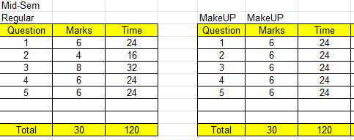
Marks BreakUp

Slide 6
Sample Question
Give pseudo code for Merge Sort. Use the array below to demonstrate how your code will work. That is – Show the state of Array after every loop.
Assume X as the last two digits of your role number. Then choose your Row given by X mod 9.
For. E.g.
If your role number is 2023cs04031. The your row corresponds to 31 mod 9 = Row 4
If your role number is 2023cs04025. The your row corresponds to 25 mod 9 = Row 7

