Slide 1

SMART HEAL
Integrated Hospital Management and Patient Care System
Community Service Project
By PEELA BHAVYA SRI - 24L31A43D1 RONGALA VINAY VARSHIT - 24L31A43F3 SARA VAKOTA SHANMUKHA ASHRITH - 24L31A43F7 TELU SRINIVASA CHANDRA MOULI - 24L31A43H6 Under the Guidance of Mrs.Y.Swathi Assistant Professor, CSE-AI

Slide 2

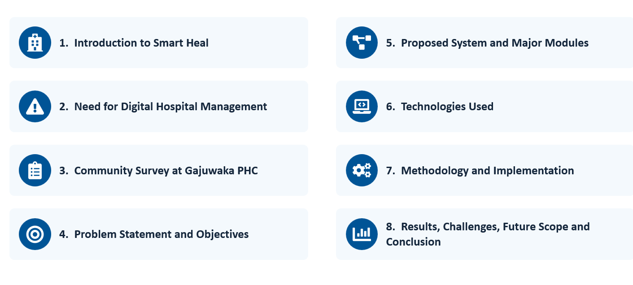
Presentation Outline:
Department of Computer Science & Engineering- Artificial Intelligence
2

Slide 3

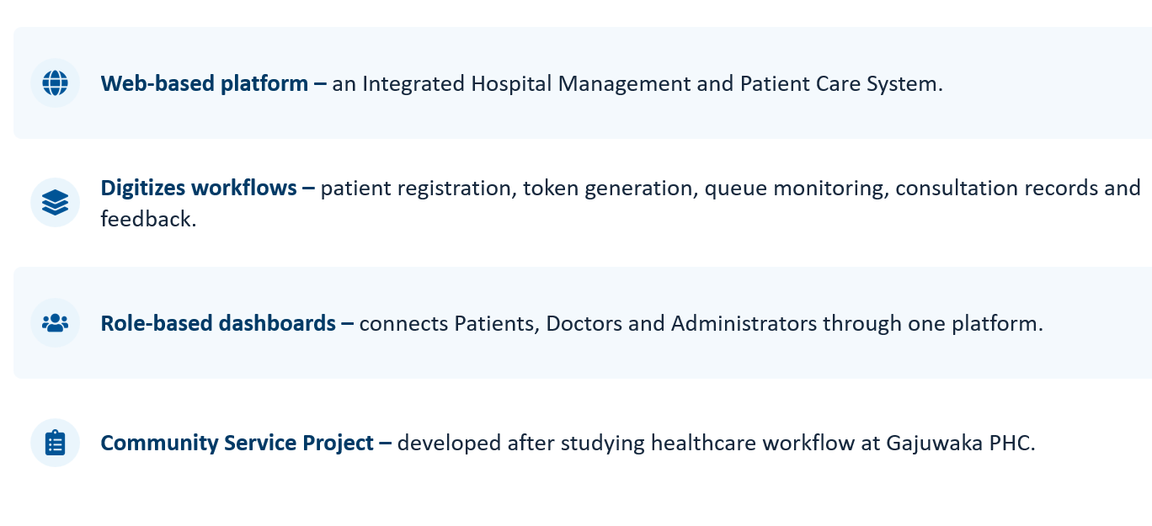
Introduction to Smart Heal
Department of Computer Science & Engineering- Artificial Intelligence
3

Slide 4

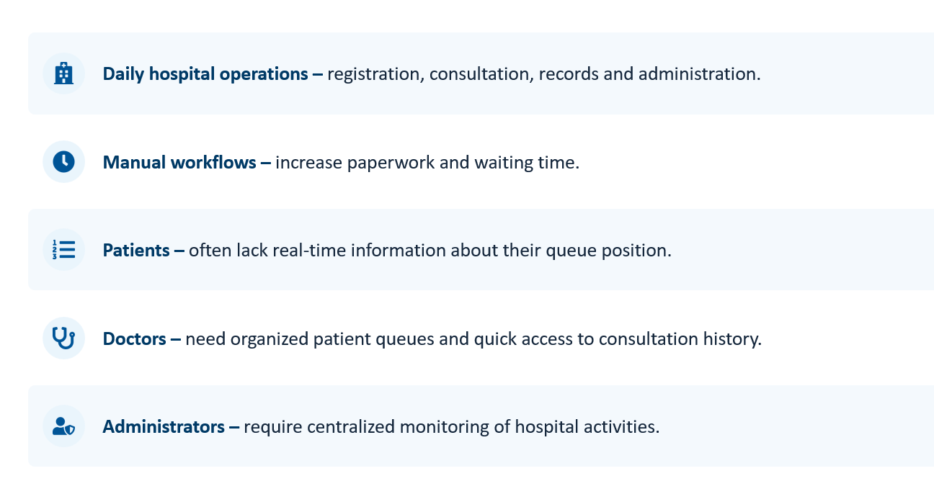
Need for Digital Hospital Management
.
Department of Computer Science & Engineering- Artificial Intelligence
4

Slide 5

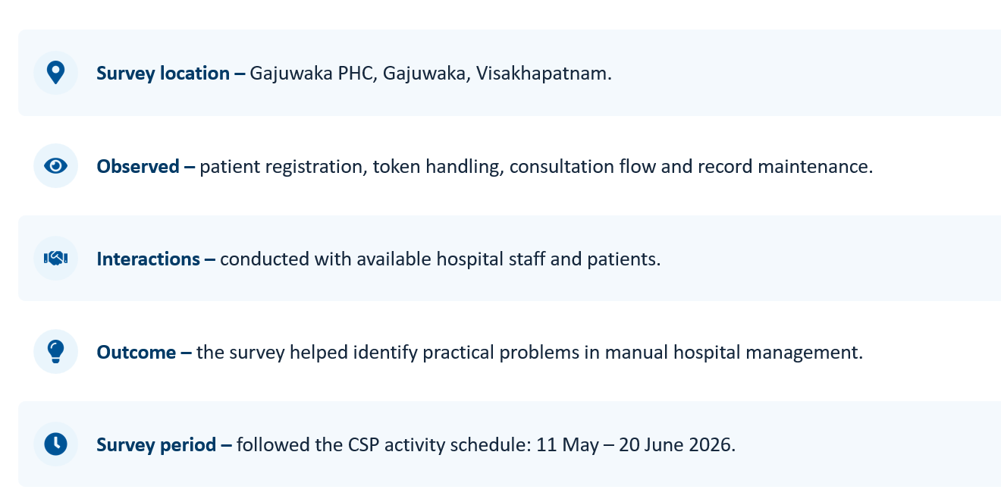
Community Survey at Gajuwaka PHC
Department of Computer Science & Engineering- Artificial Intelligence
5

Slide 6

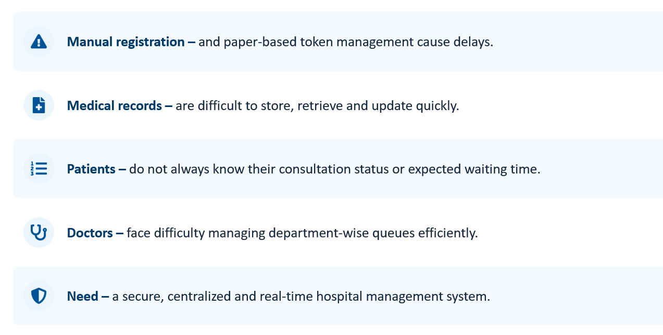
Problem Statement
.
Department of Computer Science & Engineering- Artificial Intelligence
6

Slide 7

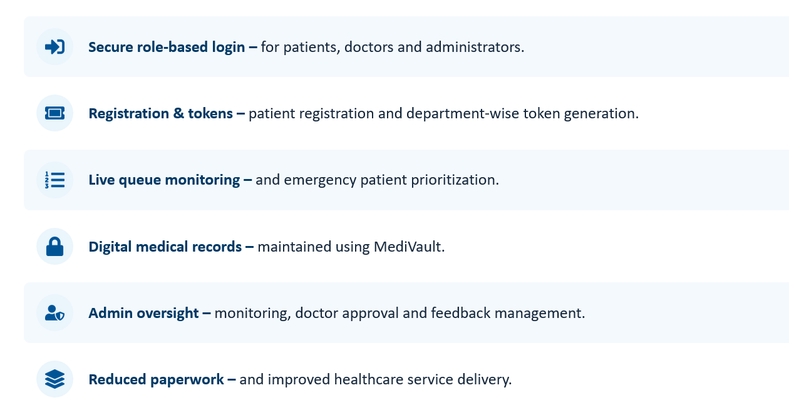
Objectives of the Project
Department of Computer Science & Engineering- Artificial Intelligence
7

Slide 8

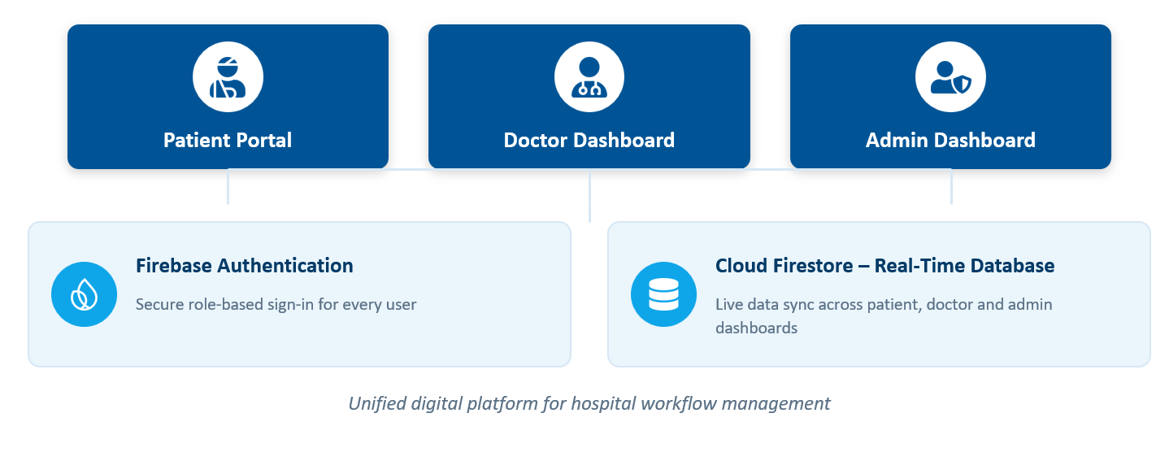
Proposed System Overview
Department of Computer Science & Engineering- Artificial Intelligence
7

Slide 9

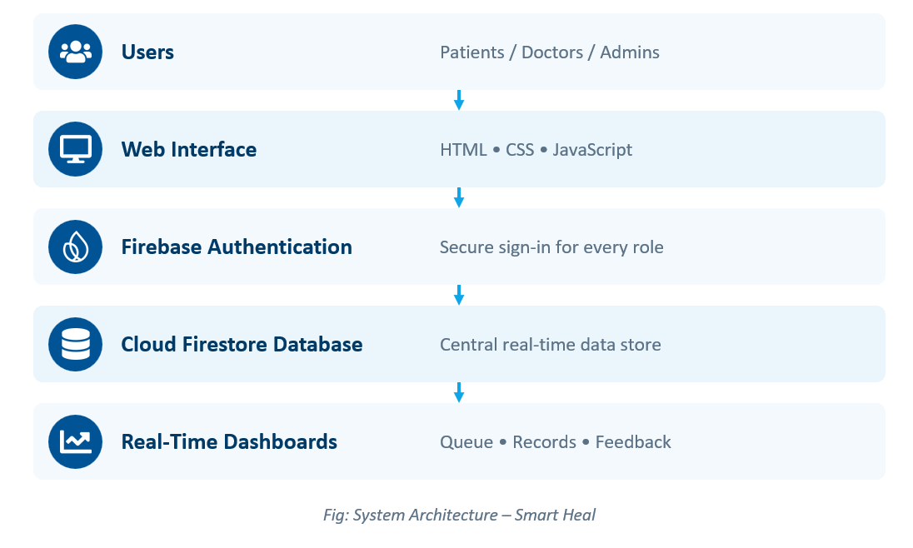
System Architecture
Department of Computer Science & Engineering- Artificial Intelligence
7

Slide 10

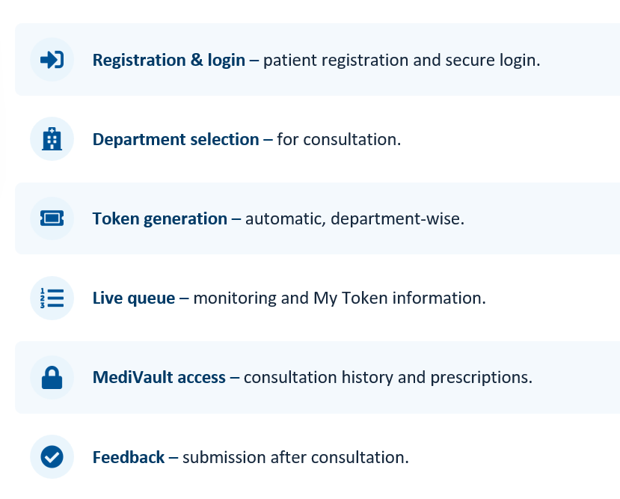
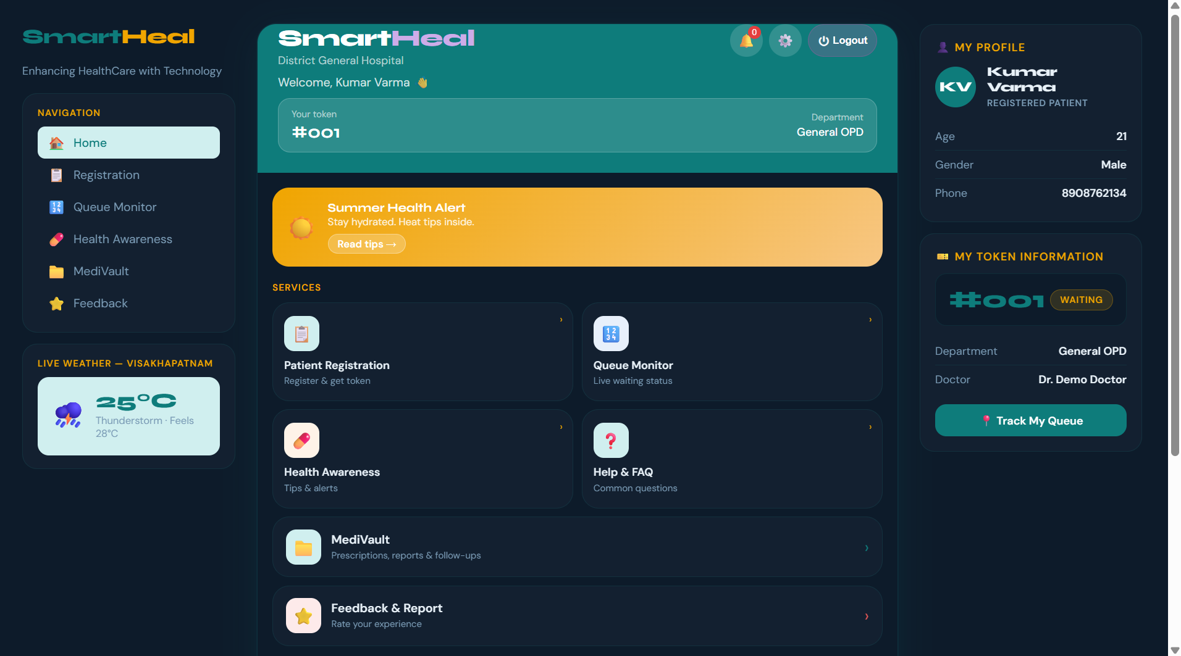
Patient Portal
Patient Portal
Department of Computer Science & Engineering- Artificial Intelligence
10

Slide 11

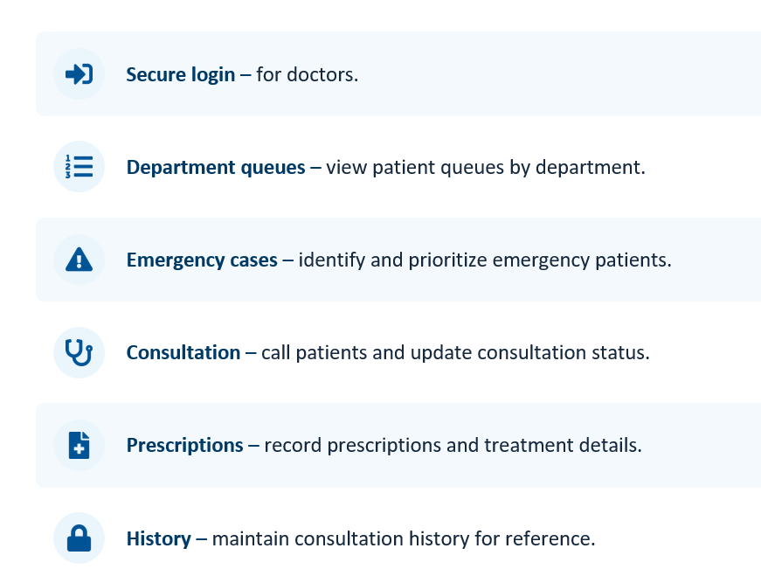
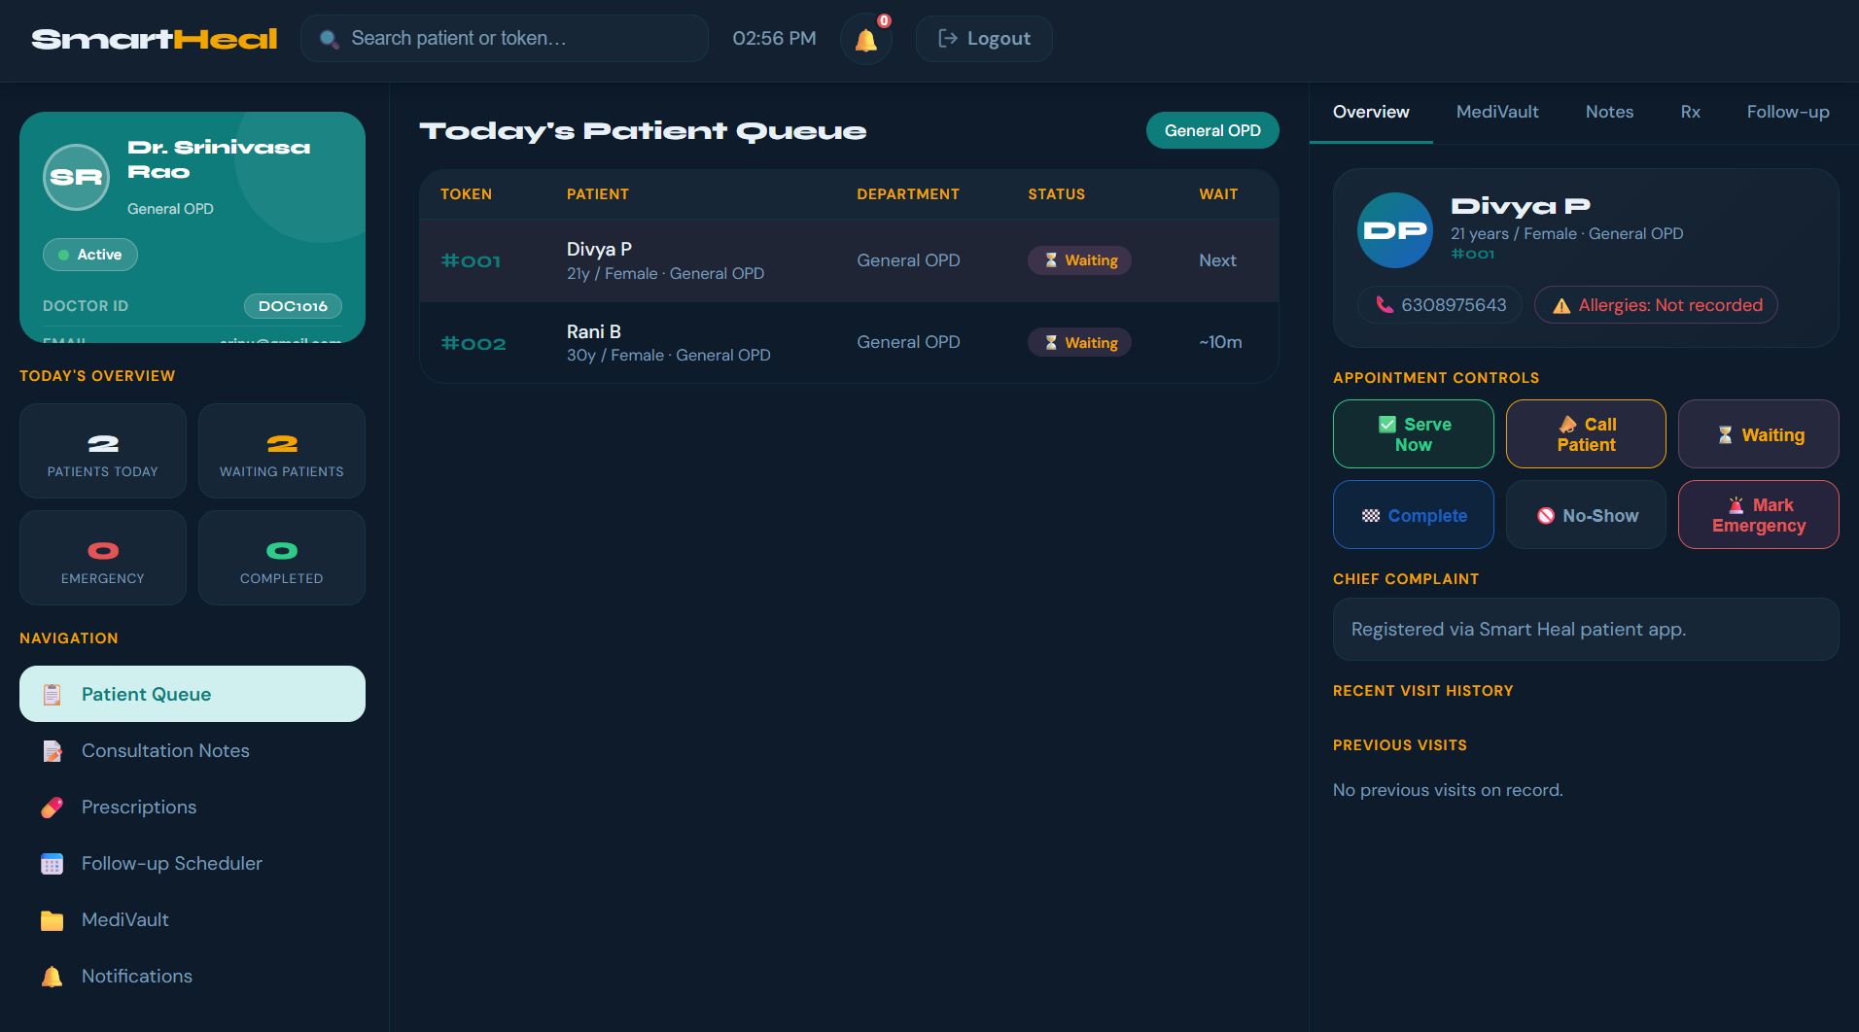
Doctor Dashboard
Department of Computer Science & Engineering- Artificial Intelligence
11

Slide 12

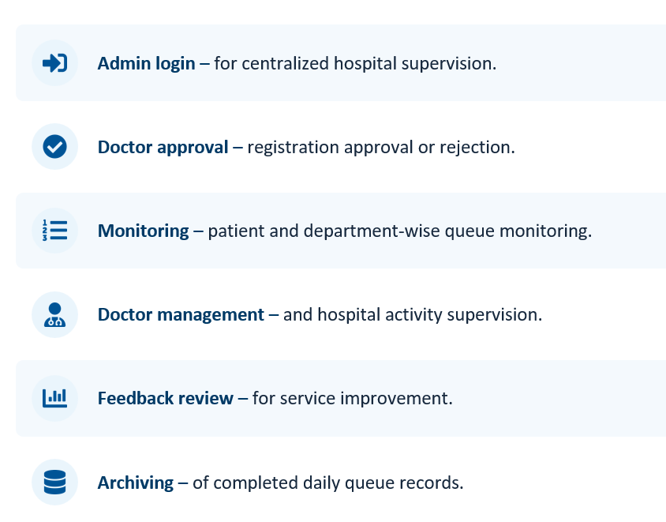
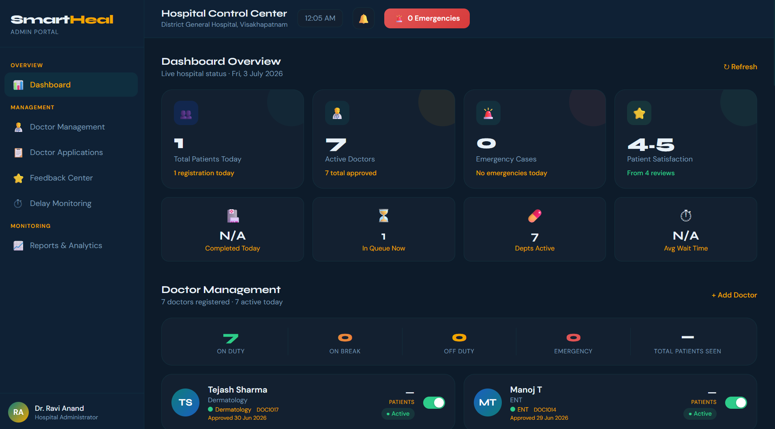
Administrator Dashboard
Department of Computer Science & Engineering- Artificial Intelligence
12

Slide 13

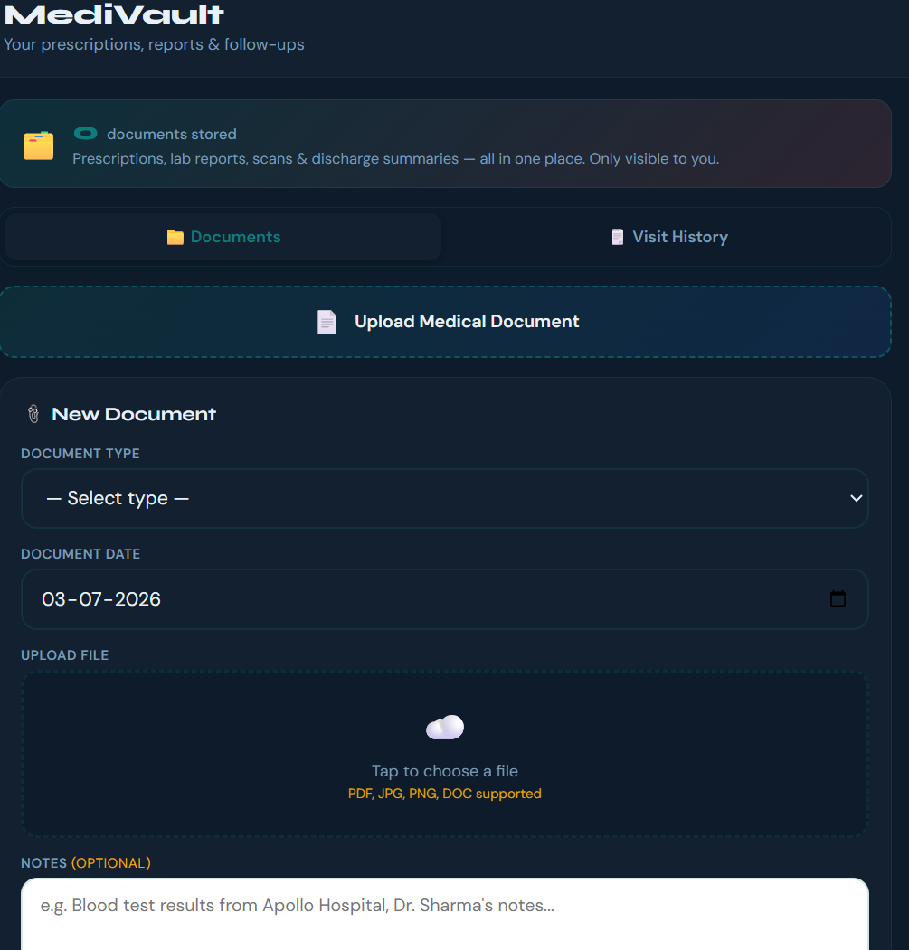
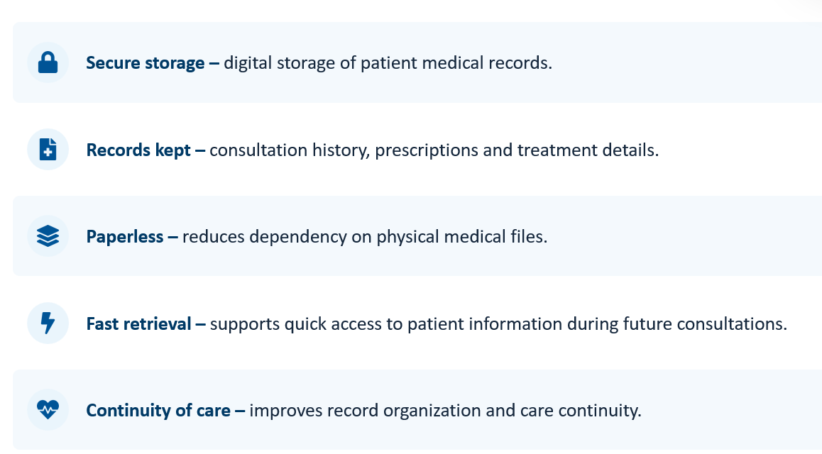
MediVault Module
Department of Computer Science & Engineering- Artificial Intelligence
13

Slide 14

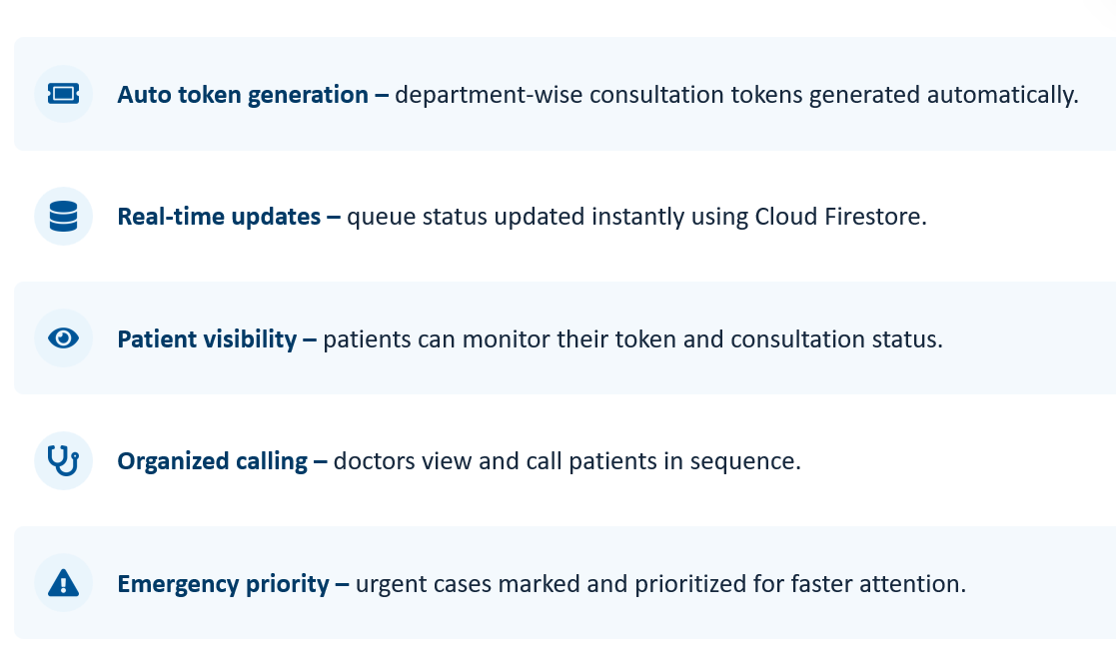
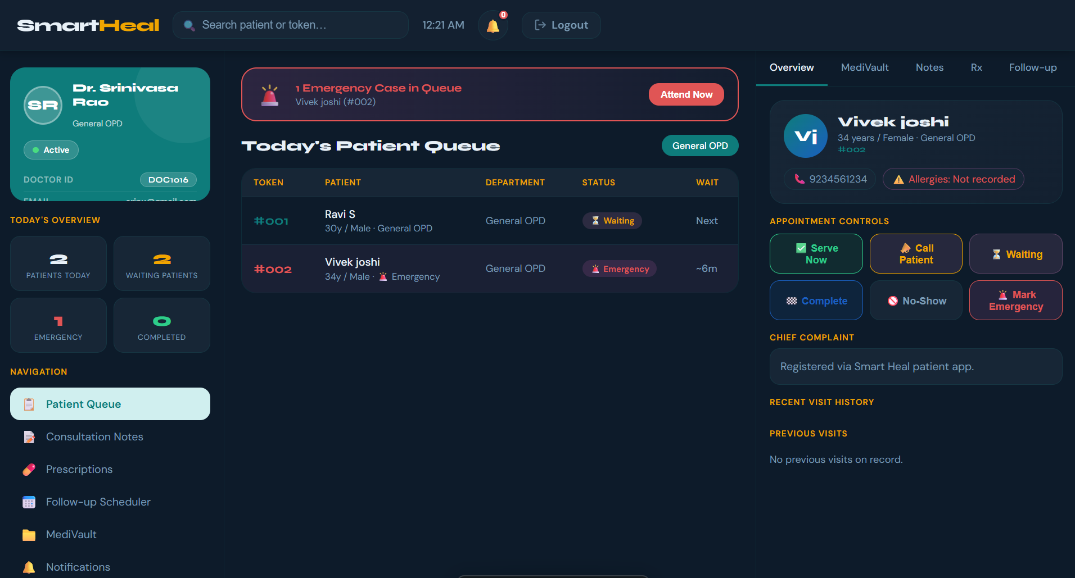
Queue Management & Emergency Handling
Department of Computer Science & Engineering- Artificial Intelligence
14

Slide 15

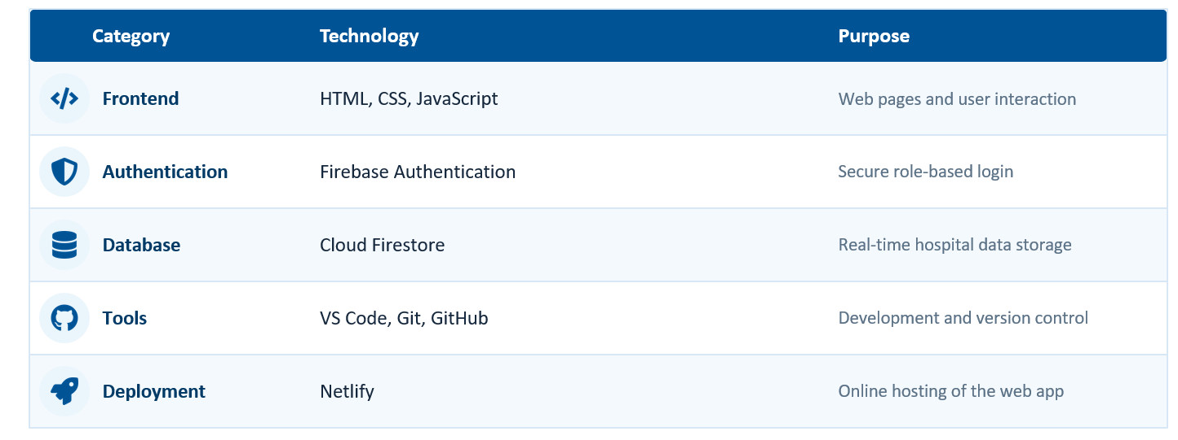

Technologies Used
Deployment Link: https://fabulous-genie-2336c7.netlify.app/
Department of Computer Science & Engineering- Artificial Intelligence
15

Slide 16

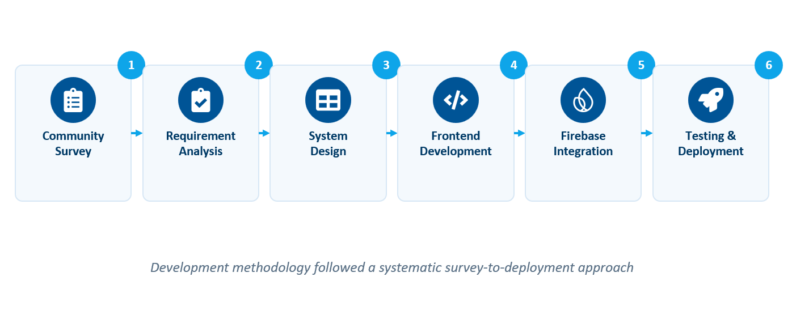
Development Methodology
Commnity Survey
Requirement Analysis
System Design
Frontend Development
Firebase Integration
Testing & Deployment
Development methodology followed a systematic survey-to-deployment approach
Department of Computer Science & Engineering- Artificial Intelligence
16

Slide 17
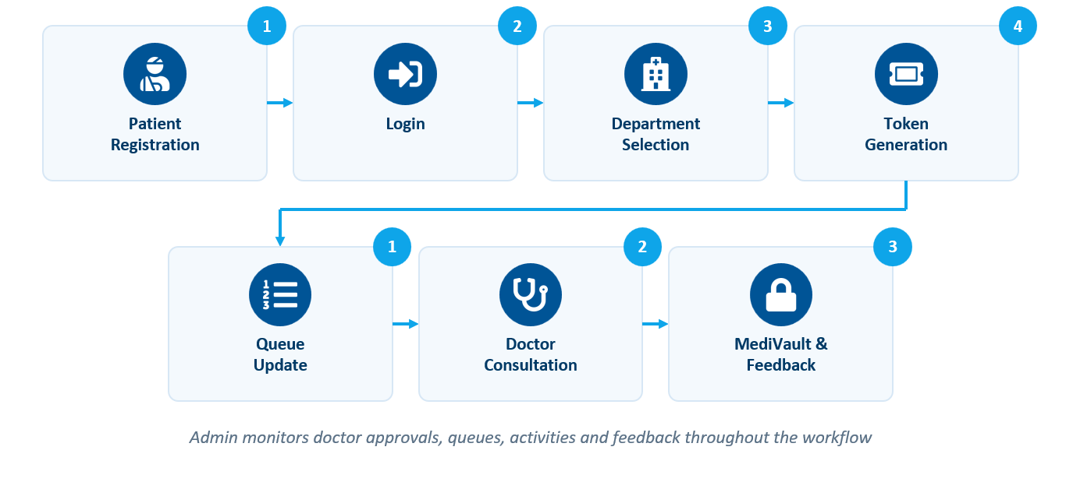
System WorkFlow
System Workflow
Patient Registration
Login
Department Selection
Token Generation
Queue Update
Doctor Consultation
MediVault & Feedback
Admin monitors doctor approvals, queues, activities and feedback throughout the workflow
Department of Computer Science & Engineering- Artificial Intelligence
17

Slide 18

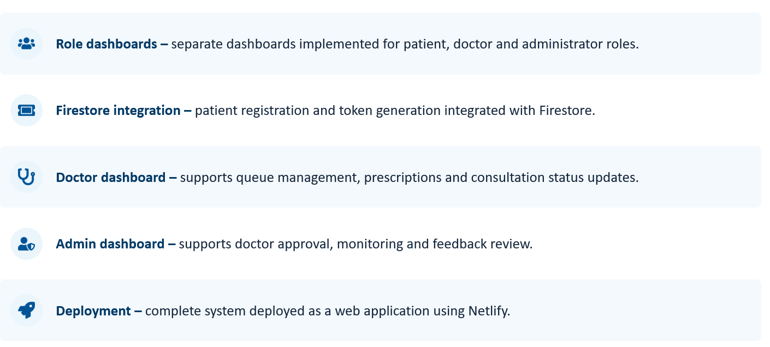
Implementation Highlights
.
Department of Computer Science & Engineering- Artificial Intelligence
18

Slide 19

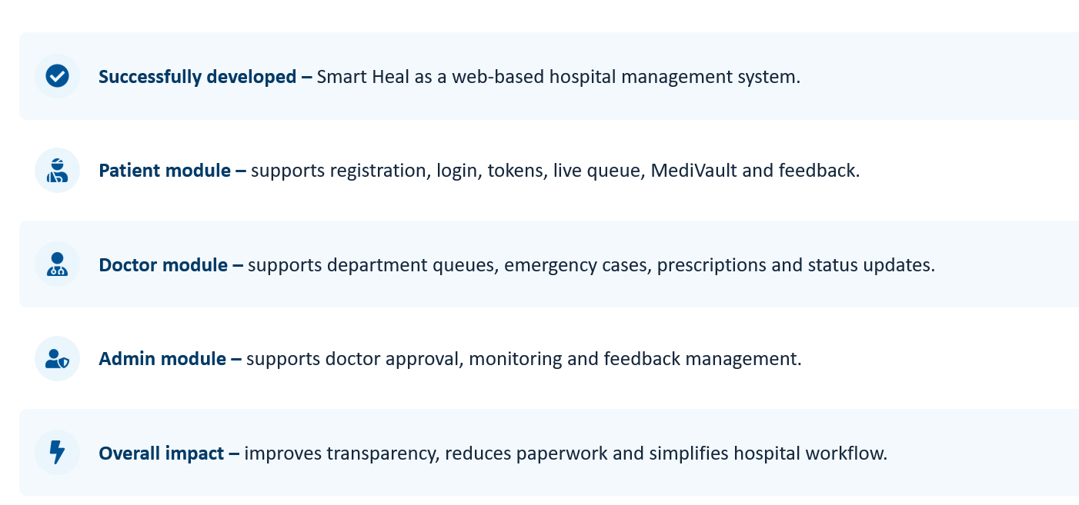
Results and Outcomes
Department of Computer Science & Engineering- Artificial Intelligence
19

Slide 20
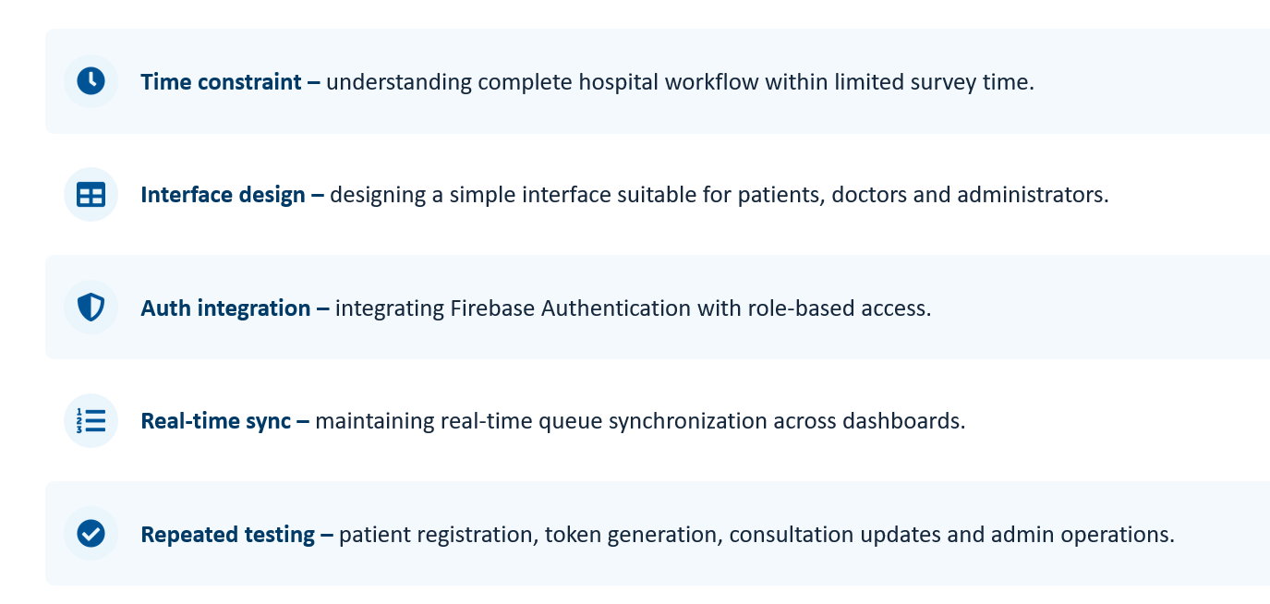
Challenges Faced
Department of Computer Science & Engineering- Artificial Intelligence
20

Slide 21

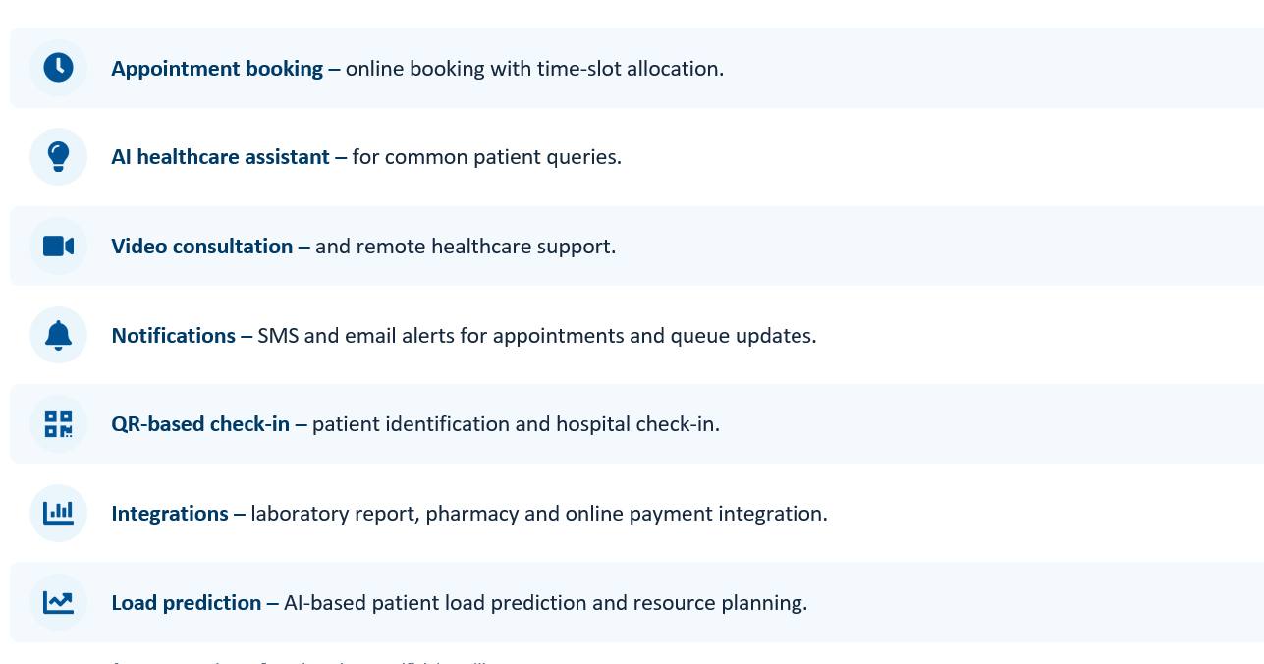
Future Scope
Department of Computer Science & Engineering- Artificial Intelligence
21

Slide 22

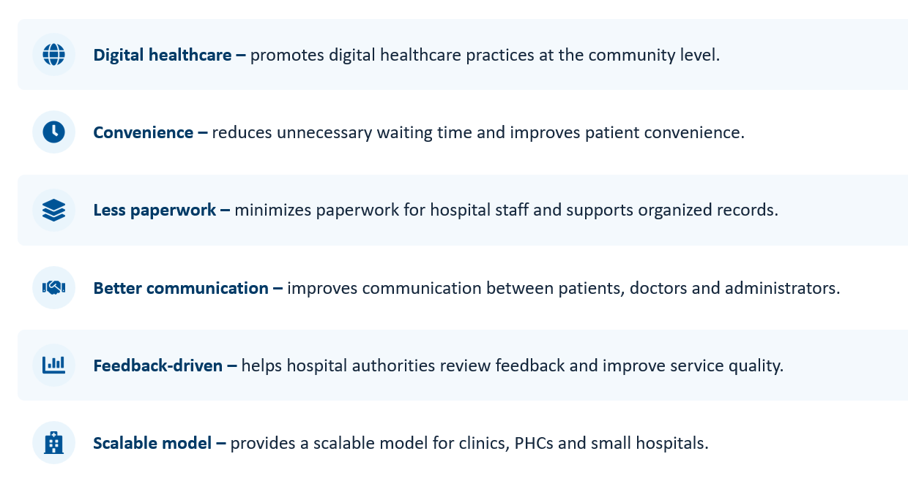
Social Impact
.
Department of Computer Science & Engineering- Artificial Intelligence
22

Slide 23

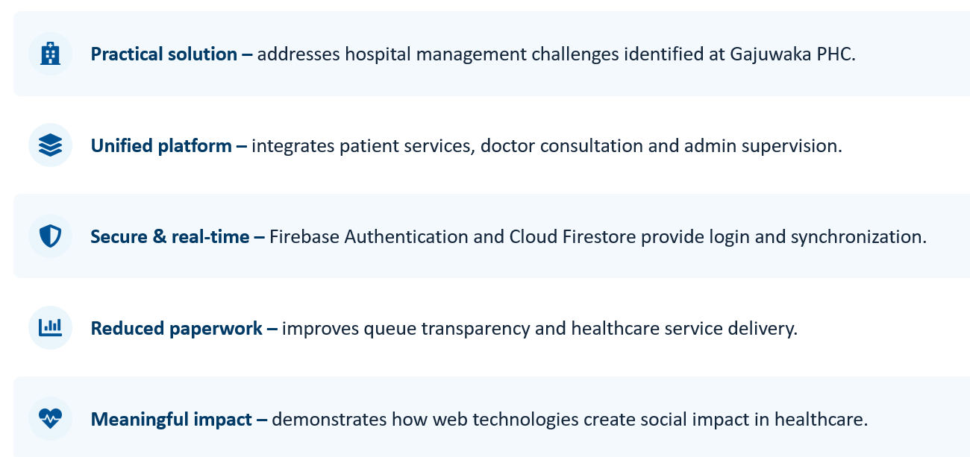
Conclusion
Department of Computer Science & Engineering- Artificial Intelligence
23

