Slide 1
VENDING MACHINE CONTROLLER SIMULATOR
Problem Solving Using Programming (JAVA)
Student Name: Bhavya | Roll No: 2620030161
Student Name: Akash | Roll No: 2620030182

Slide 2
Abstract
PROJECT OVERVIEW
A menu-driven Java console application that simulates common vending machine operations.
CORE GOAL
WHAT THE SYSTEM DOES
Simulate product selection, payment, inventory updates, and safe purchase validation.
The Vending Machine Controller Simulator lets a user view products, insert money, purchase items, check balance, restock inventory, and identify low-stock products.
JAVA CONCEPTS IN PRACTICE
The project applies Java foundations, control flow, methods, arrays, object-oriented programming, strings, exception handling, and the Stream API to manage products and purchases.

Slide 3
Understanding the Problem Statement
PROBLEM & SOLUTION
Why a vending machine needs reliable product, stock, and payment checks.
THE PROBLEM
OUR SOLUTION
Manual tracking of product availability, prices, and payments can lead to errors. Purchases must be blocked when stock or balance is insufficient.
A menu-driven Java program displays products, accepts money, validates purchases, updates stock and balance, supports restocking, and reports low-stock items.
MAIN FUNCTIONS
01
View products
02
Insert money & purchase
03
Check balance
04
Restock / low stock

Slide 4
CO 1 | From Problem to Program
# | TOPIC USED | PURPOSE IN OUR CODE
1 | Variables & data types | Store product IDs and stock as int, prices and balance as double, and names as String.
2 | Input and output | Scanner reads menu choices, amounts, product IDs, and quantities; println() and printf() show results.
3 | Arithmetic & assignment operators | Use + to add inserted money and - to subtract the product price from the balance.
4 | Relational operators & conditions | Compare product IDs and check whether stock is available or balance covers the price.
5 | Scanner input & formatted output | Read input with Scanner; format prices and balances using printf().
6 | Validation and expressions | Validate positive amounts and quantities; typecasting and bitwise operators are not used in this version.
CO 1 / MODULE 1
Computational Thinking & Java Foundations

Slide 5
CO 2 | Control Flow
# | TOPIC USED | PURPOSE IN OUR CODE
1 | if conditions | Check product ID, stock availability, sufficient balance, and valid amounts.
2 | switch, case & default | Route the menu choice to view products, insert money, purchase, check balance, restock, low stock, or exit.
3 | break and switch cases | Repeat the main menu until the user selects 0 to exit.
4 | do-while loop | Traverse the product array to display products, search IDs, and list low-stock items.
5 | for & enhanced for loops | Each switch case performs one operation and ends with break.
6 | Termination condition | The loop ends when choice == 0; invalid input is caught and the menu continues.
CO 2 / MODULE 2
Selection, Loops & Termination

Slide 6
CO 3 | Methods & Arrays
# | TOPIC USED | PURPOSE IN OUR CODE
1 | Modular methods | Separate product display, money insertion, purchasing, restocking, and low-stock reporting into methods.
2 | Parameters & return values | Pass product IDs, amounts, and quantities to methods; findProduct() returns a Product or null.
3 | One-dimensional array | Product[] stores the four products and lets the program process them together.
4 | Array traversal and search | Loops traverse products; findProduct() searches the array by product ID.
5 | Recursion | Recursion is not implemented in the current version.
6 | 2D arrays and sorting | Two-dimensional arrays, method overloading, and sorting are not implemented in this version.
CO 3 / MODULE 3
Decomposition with Methods, Recursion & Arrays

Slide 7
CO 4 | OOP & Exception Handling
# | TOPIC USED | PURPOSE IN OUR CODE
1 | Classes & objects | Product stores item details; VendingMachine manages inventory and purchases; VendingMachineApp runs the menu.
2 | Constructors | Product(...) initializes ID, name, price, and stock; VendingMachine() initializes inventory.
3 | Encapsulation & accessors | Private fields protect product details and balance; getters provide controlled access.
4 | Validation & exceptions | IllegalArgumentException and IllegalStateException reject invalid amounts, IDs, stock, and purchases.
5 | try-catch handling | try-catch handles invalid numeric input and expected operation errors; inheritance and polymorphism are not implemented.
6 | Safe state updates | Balance and stock are updated only after purchase checks pass.
CO 4 / MODULE 4
Object-Oriented Design & Safe Error Handling

Slide 8
CO 5 | Strings, Search & Libraries
# | TOPIC USED | PURPOSE IN OUR CODE
1 | String operations & validation | Read console input with nextLine().trim(); store product names and build status/error messages.
2 | Concatenation & formatting | Combine messages with product names; use String.format() and printf() to format output.
3 | Product searching | findProduct() searches the Product[] array for a matching product ID; sorting is not implemented.
4 | Java library methods | Use Arrays.stream() for low-stock filtering and standard String methods for input/output.
5 | File input/output | File storage is not implemented; product inventory resets when the application restarts.
6 | Future improvement | Add file I/O later to save inventory and transaction history between runs.
CO 5 / MODULE 5
Strings, Searching & Library Methods

Slide 9
CO 6 | Collections & Streams
# | TOPIC USED | PURPOSE IN OUR CODE
1 | Arrays and streams | Product[] stores inventory; Arrays.stream(products) creates a stream to process it.
2 | Typed arrays | Product[] keeps all entries as Product objects; ArrayList, HashMap, and HashSet are not used.
3 | Lambda expressions & functional interfaces | product -> product.getStock() <= 2 filters products that have two or fewer items remaining.
4 | Stream terminal operation | toArray(Product[]::new) collects the filtered products into an array.
5 | Stream filter | filter() selects low-stock products for display; map() and collect() are not used.
6 | Why it is useful | The Stream API makes low-stock filtering concise and readable; collection classes are future scope.
CO 6 / MODULE 6
Functional Programming with Streams

Slide 10
Conclusion
WRAP-UP
What the project demonstrates.
PROJECT OUTCOME
POSSIBLE FUTURE IMPROVEMENTS
The simulator combines product display, money insertion, purchasing, balance checks, restocking, and low-stock reporting in one Java application.
Add file-based inventory, transaction history, refunds/change, a graphical interface, database storage, and polymorphism.
Overall, the project applies core Java concepts to simulate vending machine operations and inventory control.

Slide 11
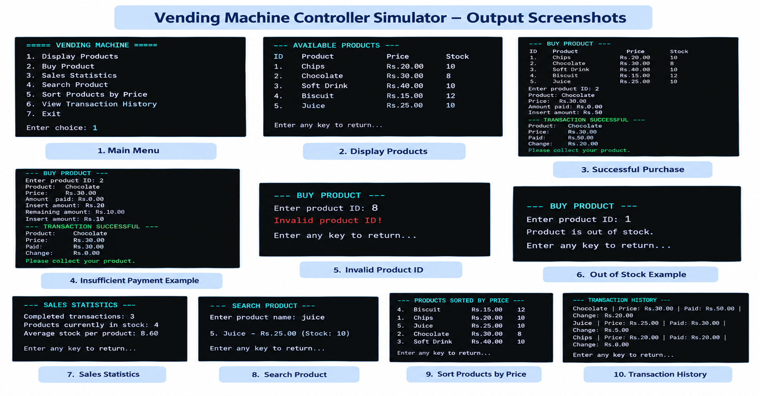
OUTPUT SCREENSHOTS

Slide 12
GITHUB LINK & GEO-TAG PHOTO
Project: Vending Machine Controller Simulator
GitHub Repository
Number of Commits | 4
Geo-tag Photo
Code file | VendingMachineApp.java
Compile | javac VendingMachineApp.java
Run | java VendingMachineApp

