Slide 1


Saheli
Women's Wellness Companion
Empowering women through AI-powered wellness support, fitness guidance, nutrition awareness, mental wellbeing, and personalized healthcare insights.
Presented by :K.Bhavya Sri Valli
P.L.Prasanna Valli

Slide 2

About Saheli
Saheli is an AI-powered Women's Wellness Companion that unifies physical health, mental wellbeing, nutrition, fitness, medication tracking, and women's healthcare awareness into one intelligent ecosystem. With AI-driven recommendations and a supportive community, Saheli makes wellness simple, accessible, and personalized for every woman.
Holistic
Complete wellness in one platform
Community-Driven
Safe, supportive, anonymous
Accessible
User-friendly web application

Slide 3
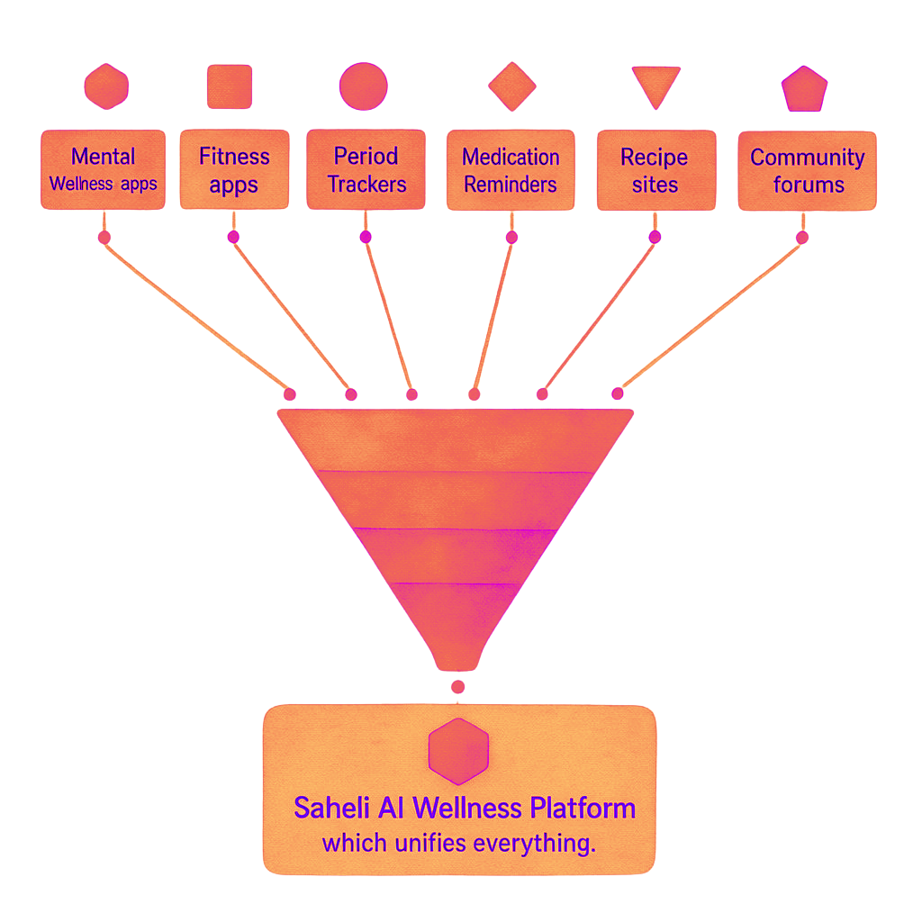

The Problem
Women juggle multiple apps and websites to manage their health — yet no single platform connects the dots. Mental wellness, fitness, nutrition, period tracking, and medication reminders all exist in silos. Sensitive health conversations often go unheard.
What's Missing
Mental wellness resources are scattered and hard to find
Fitness guidance is disconnected from nutrition planning
Period tracking lacks personalized health insights
Medication reminders are easily forgotten
No safe space to discuss sensitive health issues
No trusted, centralized wellness platform for women
The need: A centralized AI-powered platform that provides complete wellness support in one place.

Slide 4







Features of Saheli
Seven intelligent modules working together to support every dimension of a woman's wellness journey.
Mental Awareness
Fitness
Period Awareness
AI-based emotional support, stress management, and confidence building.
Personalized workout plans, daily activity guidance, and habit tracking.
Cycle tracking, hormonal health education, and personalized recommendations.
Cooking & Nutrition
Creative Space
SaheliX – AI Medication Tracker
Tailored recipes, meal planning, and balanced diet guidance.
A supportive environment to share hobbies, artwork, and inspiration.
Smart reminders, health guidance, and 24/7 virtual assistance.
Saheli Community Form
A safe, anonymous space to ask questions and support one another.

Slide 5

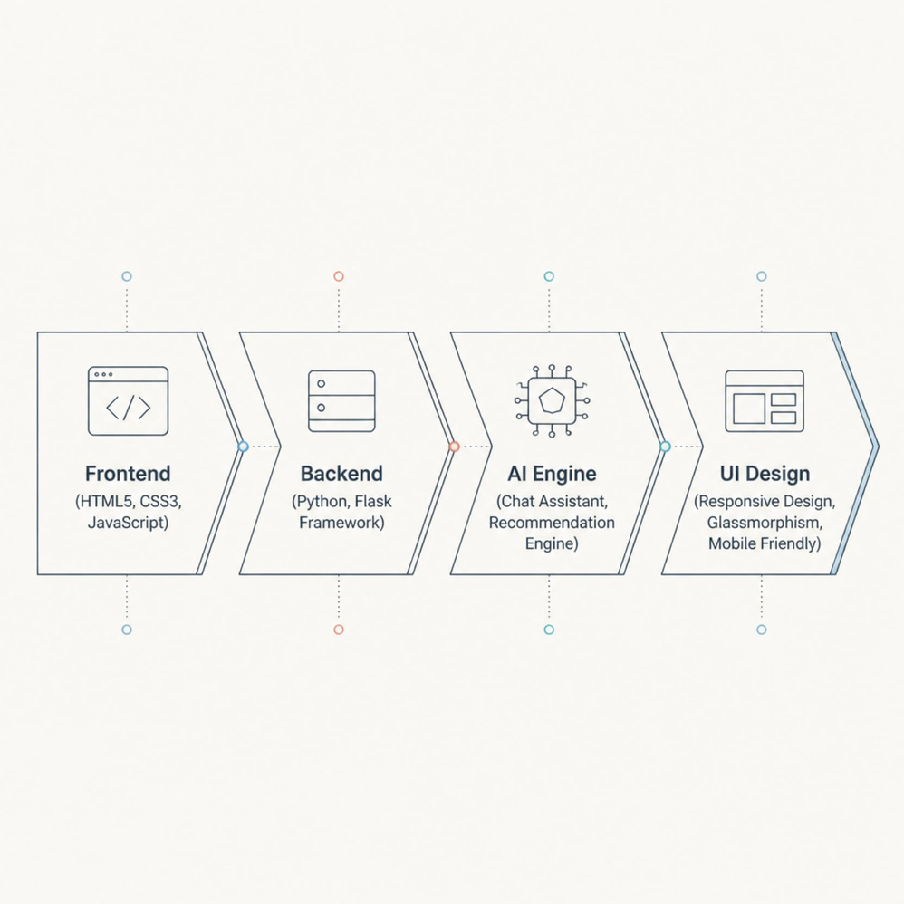
Technologies Used
Saheli is built on a modern, lightweight stack designed for speed, scalability, and a beautiful user experience — from the first click to the AI recommendation.
Frontend
Backend
HTML5 · CSS3 · JavaScript
Python
Chat Assistant · Recommendation Engine
UI Design
Responsive · Glassmorphism · Mobile-Friendly

Slide 6
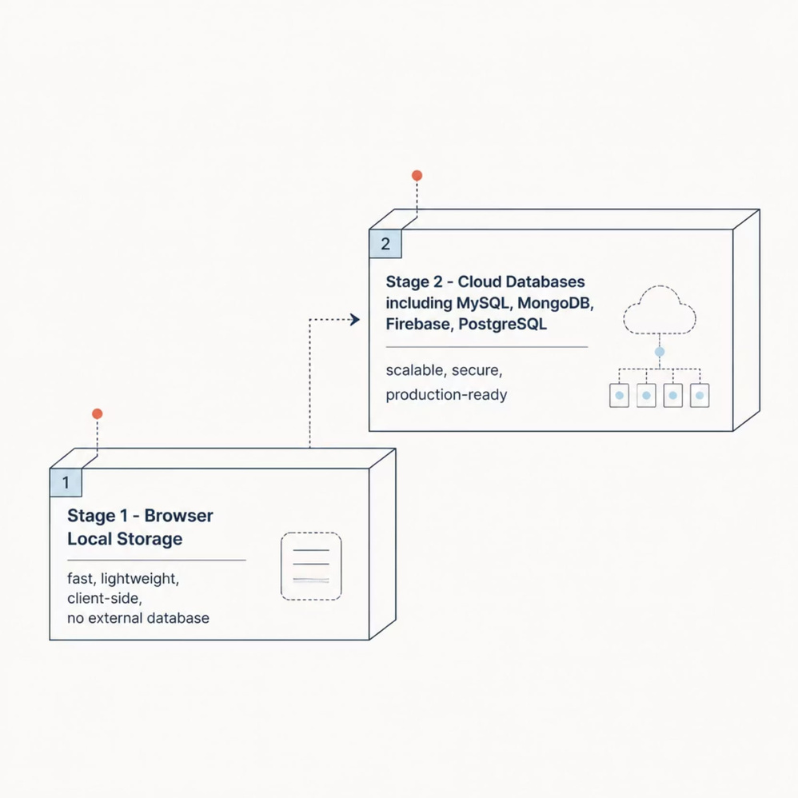
Data Storage
Current Implementation
Stage 1- Browser Local Stage
→Fast ,client-side, no external database
Future Upgrade Path
Stage-2
MySQL & PostgreSQL for structured data
MongoDB for flexible document storage
Firebase for real-time sync
Cloud storage for scalability
Browser Local Storage
Fast, lightweight, and secure client-side storage — ideal for prototype deployment with zero external dependencies.

Slide 7

System Architecture
From user interaction to personalized insight — Saheli's architecture is clean, modular, and AI-driven at every layer.
User Frontend
Flask Backend
AI Processing
Local Storage
Each module operates independently yet feeds into a unified AI recommendation engine, ensuring every woman receives cohesive, personalized wellness guidance across all dimensions of her health.

Slide 8
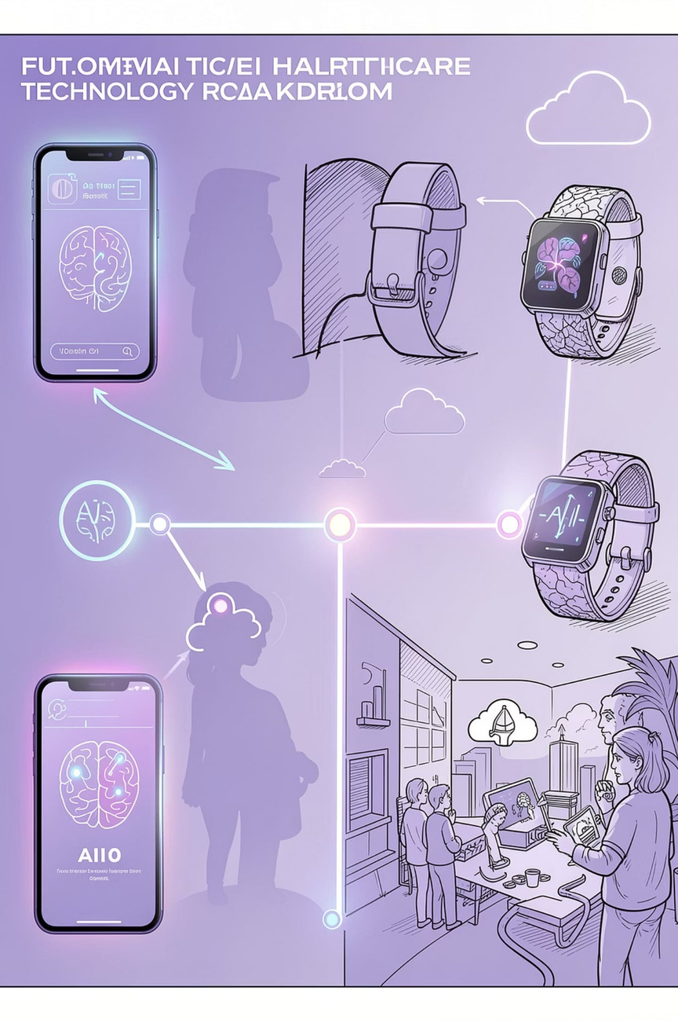

Future Enhancements
Saheli's roadmap is built to scale — from a powerful web prototype to a full-featured, AI-native women's health platform.
1
Phase 1 — Launch
Cloud database integration, mobile app (Android & iOS), multilingual support
2
Phase 2 — Intelligence
AI health prediction, ML-based insights, voice-enabled assistant, personalized health reports
3
Phase 3 — Care
Doctor appointment booking, video consultation, pregnancy & maternal care module
4
Phase 4 — Ecosystem
Wearable device integration, emergency SOS support, enterprise partnerships

Slide 9
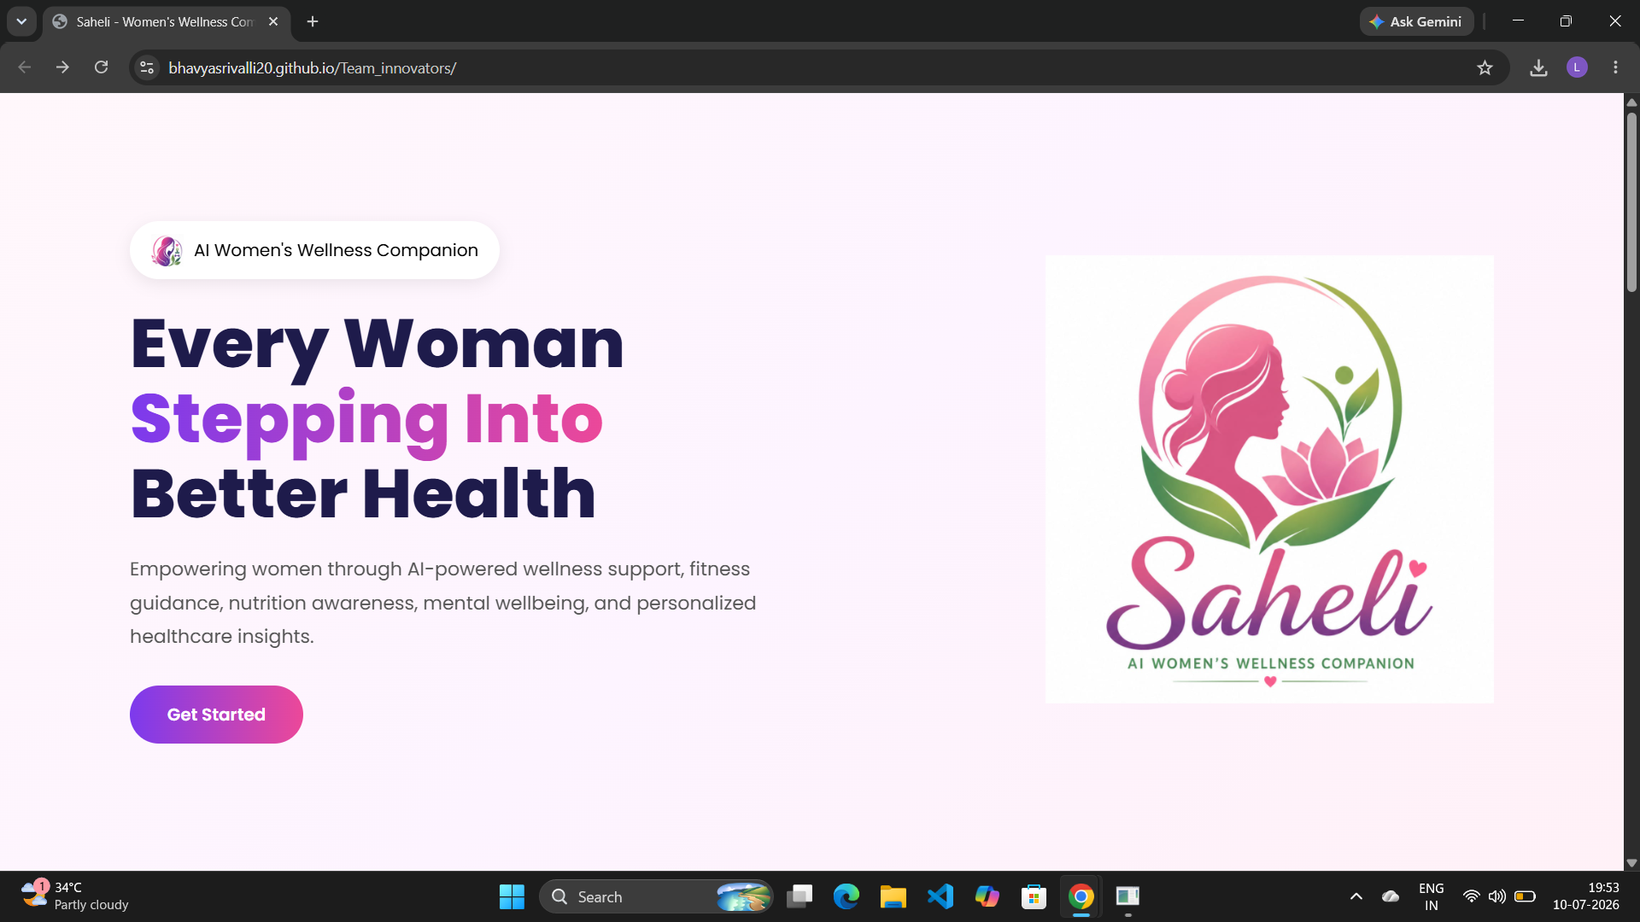
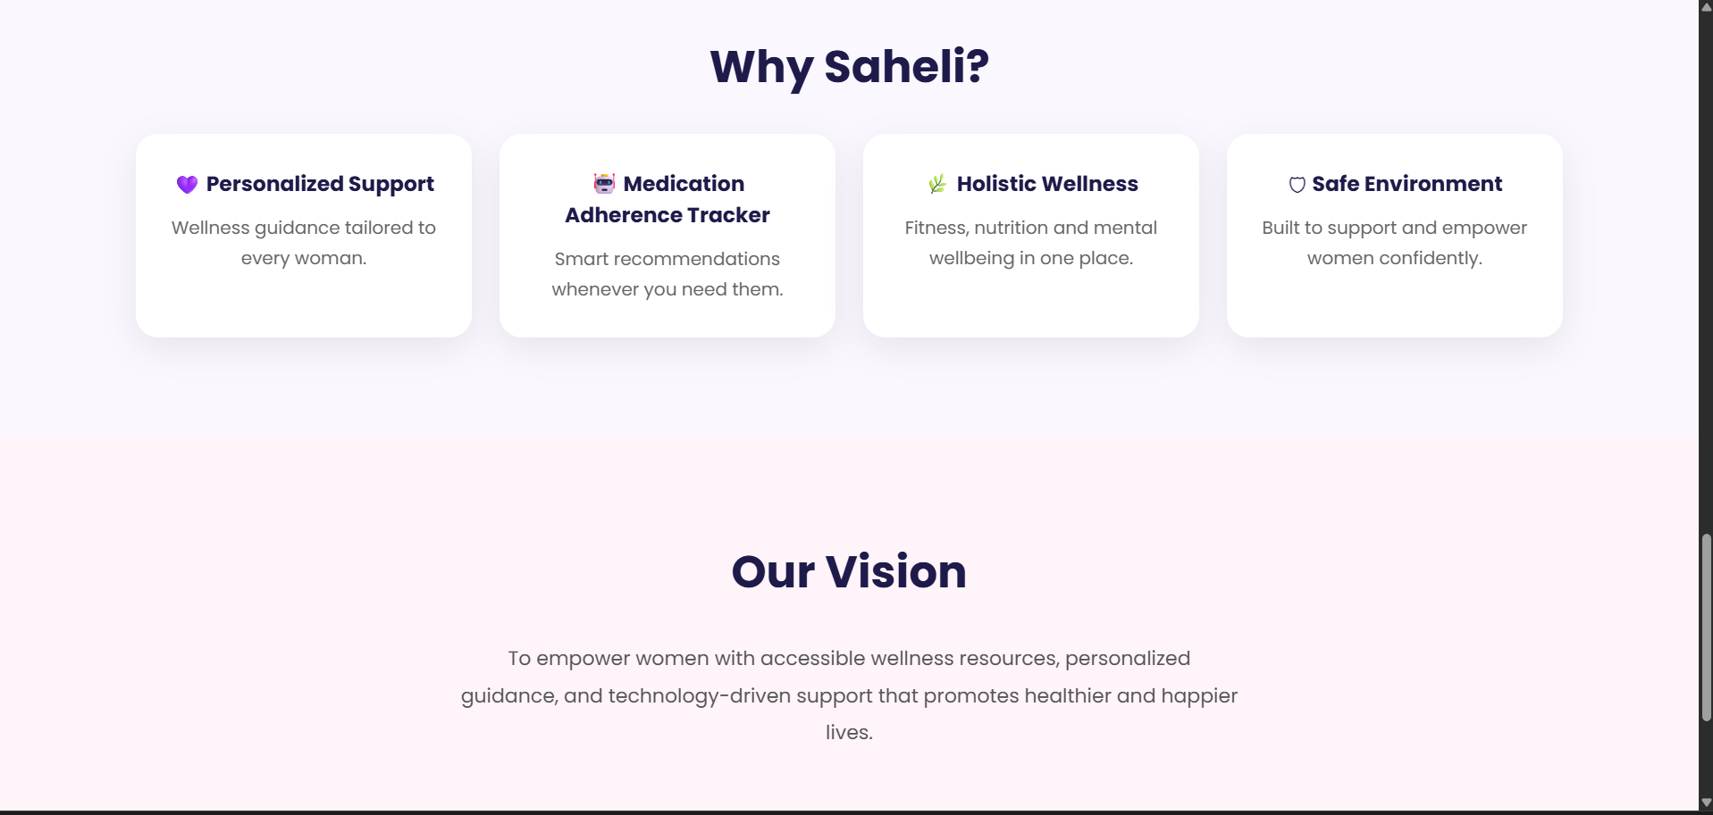
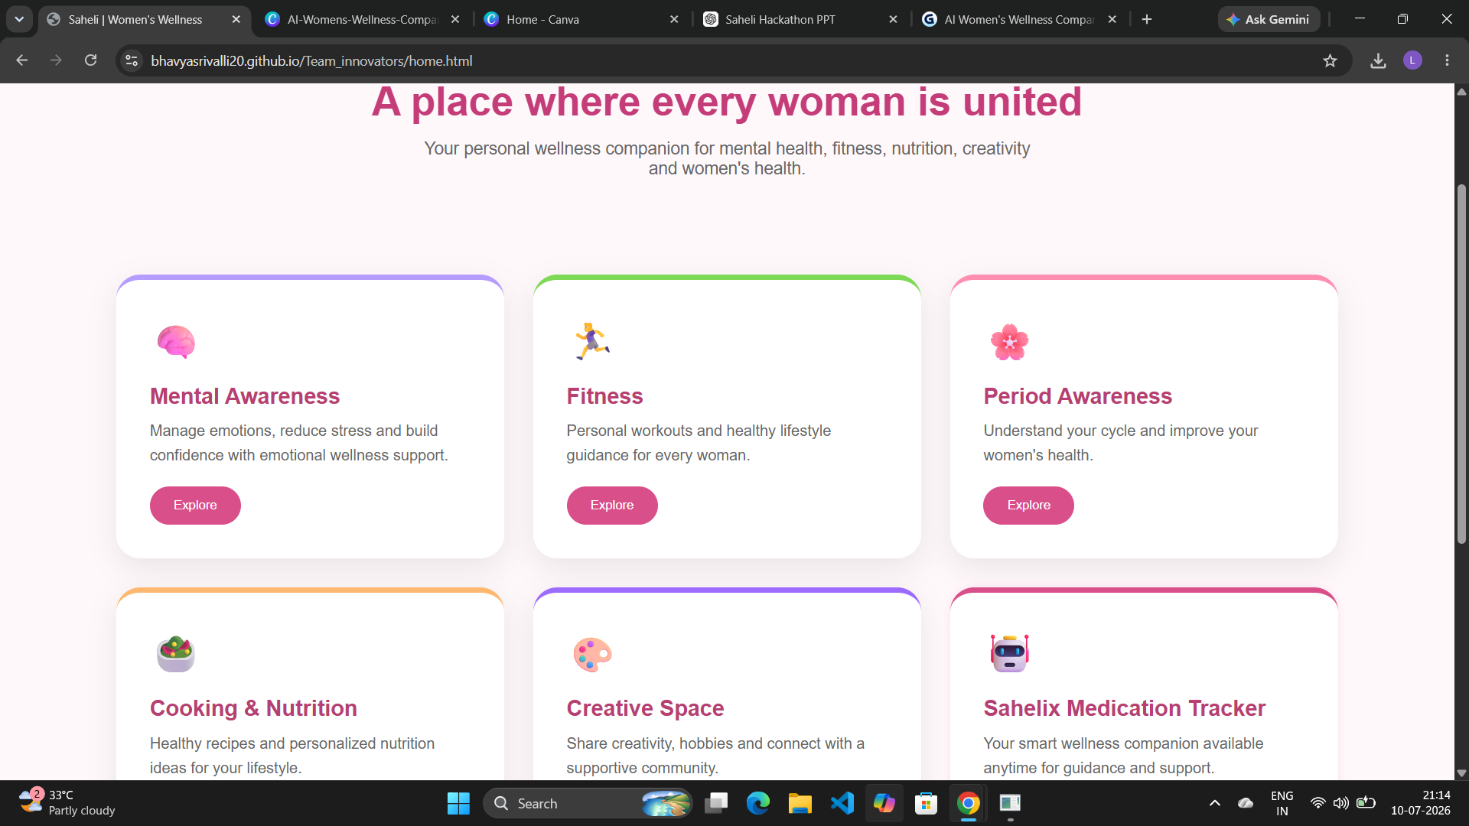
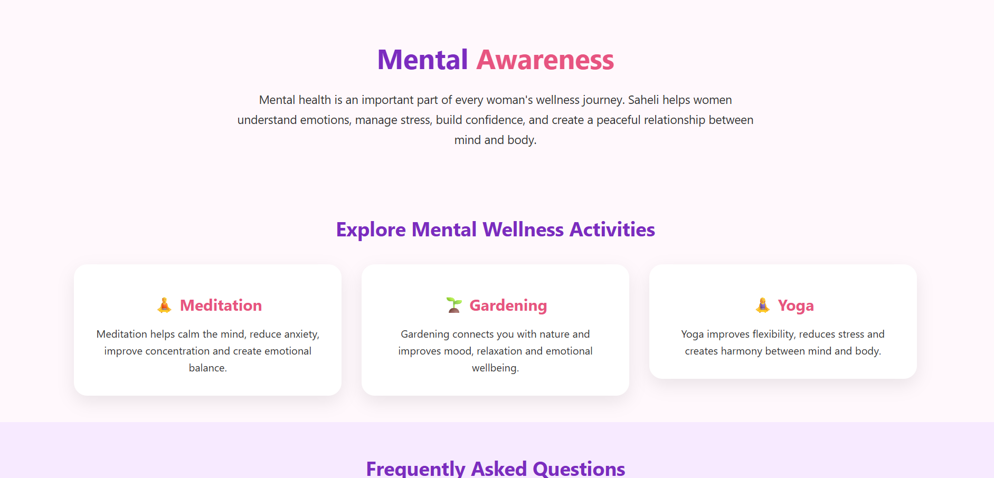
Website Preview
A glimpse into the Saheli experience — clean, intuitive, and designed for every woman.

Slide 10
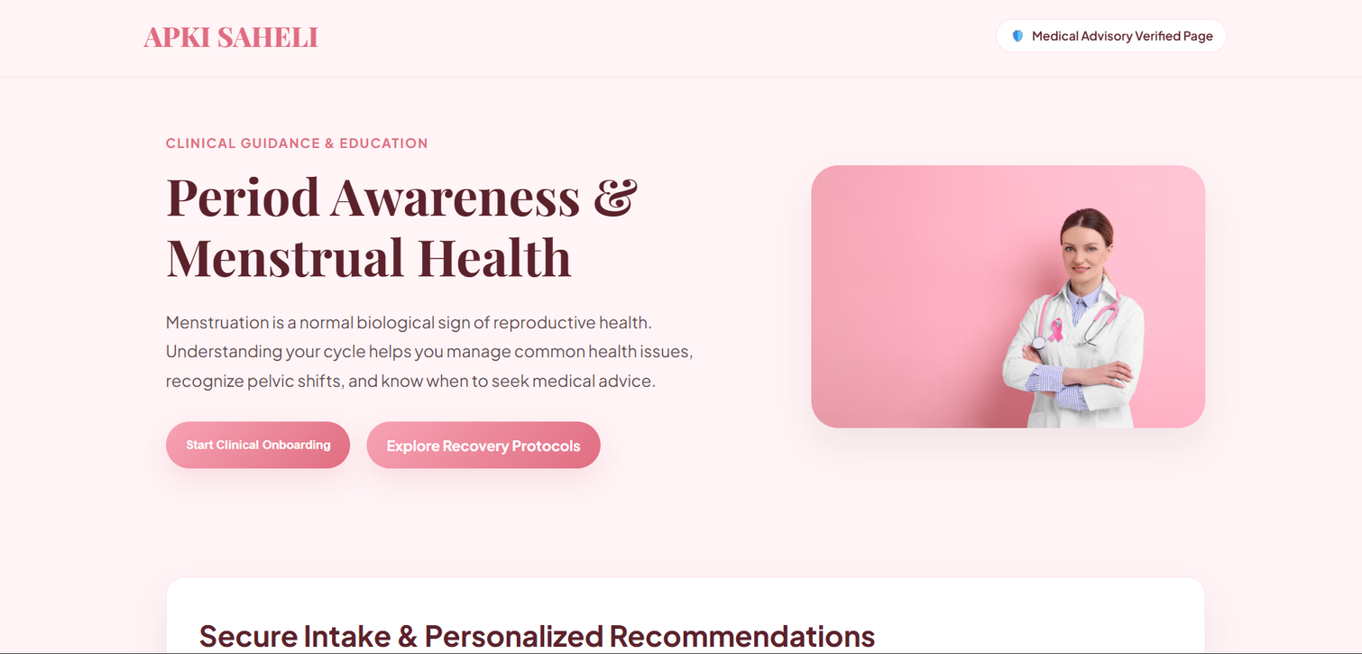
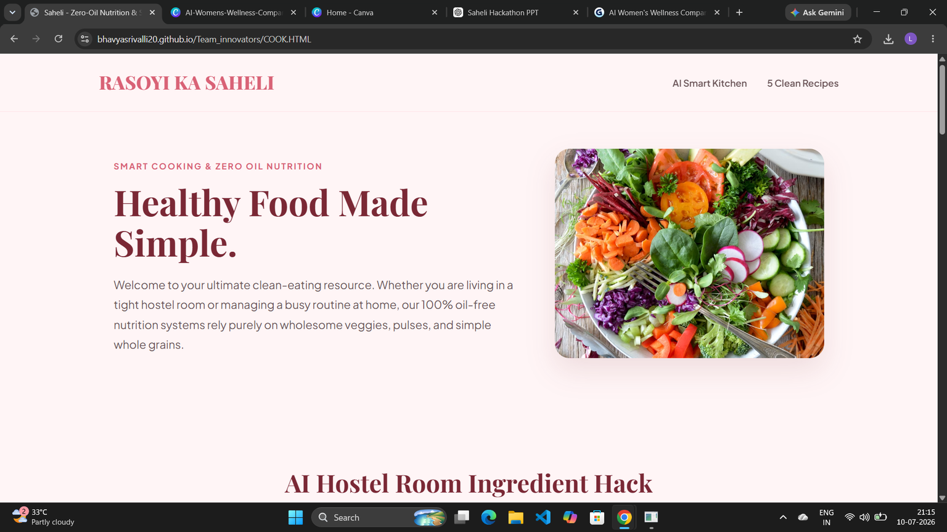

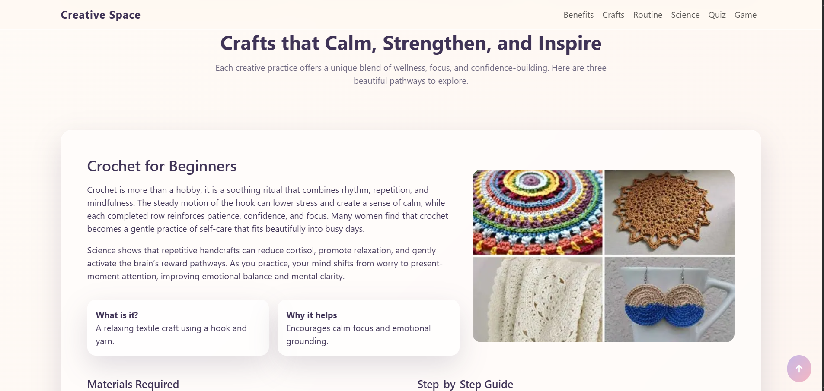
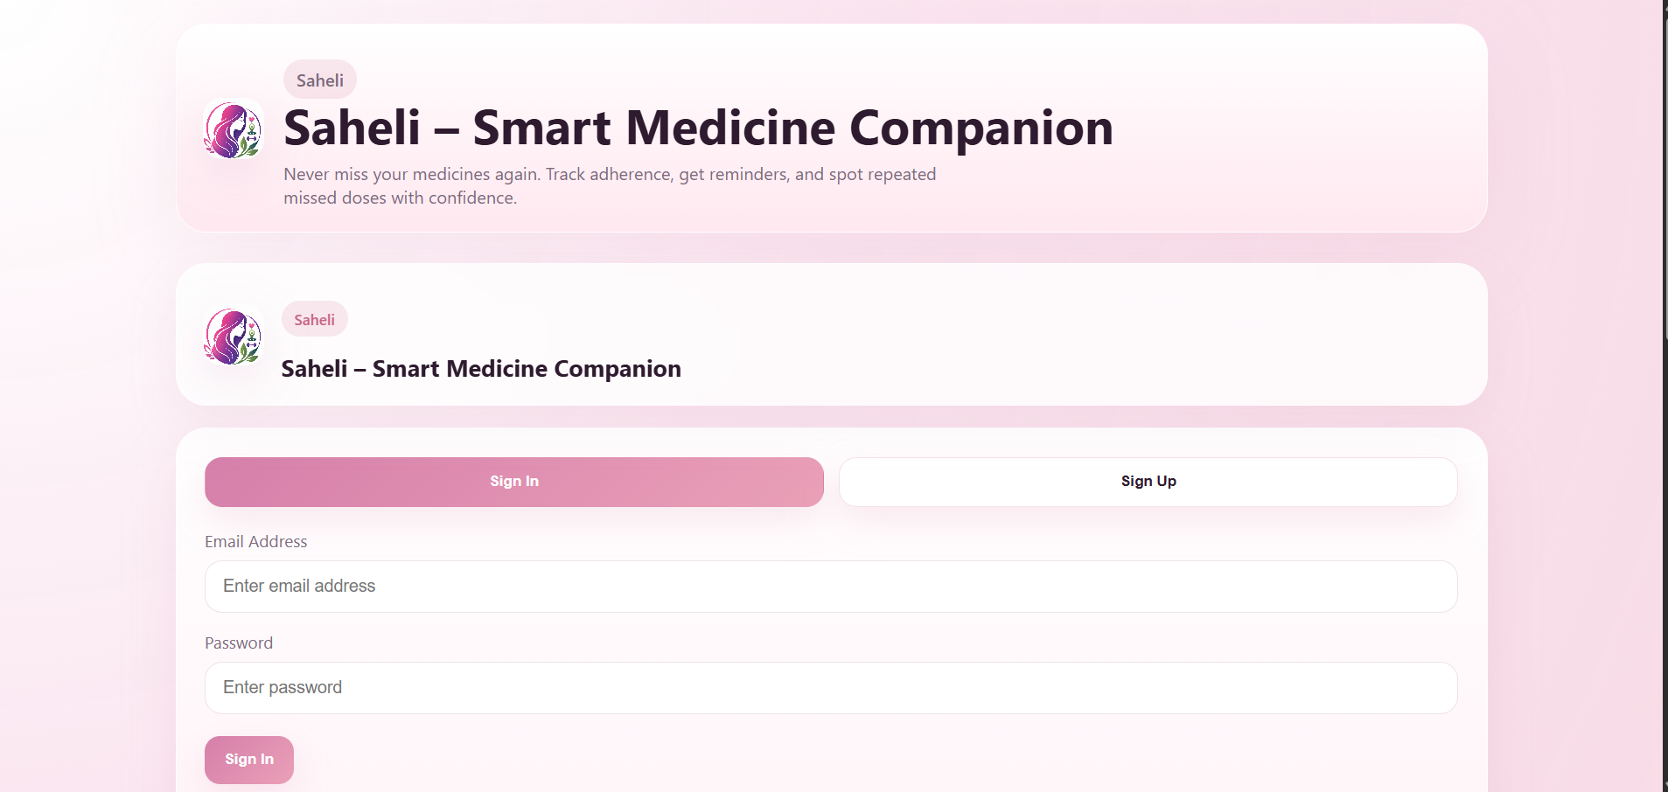
Website Preview
A glimpse into the Saheli experience — clean, intuitive, and designed for every woman.

Slide 11

Conclusion:
Why Saheli?
Personalized Support
Wellness guidance tailored to every woman's unique needs.
AI Medication Tracker
Smart reminders and continuous wellness support, 24/7.
Holistic Wellness
Mental health, fitness, nutrition, and AI — all in one platform.
Safe Environment
A secure, anonymous community designed to empower women.
"Empowering Every Woman, One Healthy Step at a Time."
Our vision is to make accessible wellness resources, personalized guidance, and AI-driven technology available to every woman — promoting healthier, happier, and more confident lives.

Slide 12


