Slide 1
RUBIC: Online Parallelism Tuning for Co-located Transactional Memory Applications
- Proposed by
Amin Mohtasham João Barreto
amohtasham@gsd.inesc-id.pt joao.barreto@tecnico.ulisboa.pt
INESC-ID Lisboa/ Instituto Superior Técnico, Universidade de Lisboa, Portugal
- Reviewed by
Bhavy Bhut

Slide 2
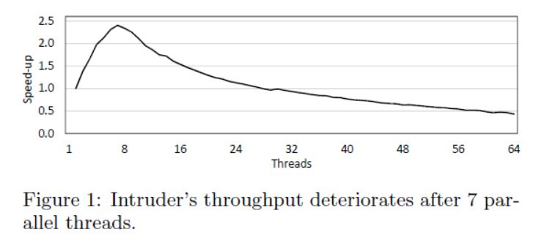
Problem
As more cores become available in commodity systems, the scalability limits of TM applications become more difficult.
To address this issue online parallelism tuning techniques were proposed.
Running parallel workload with as many threads as the number of hardware can lead to waste of hardware resources.

Slide 3
RUBIC
RUBIC is parallelism tuning method for TM applications.
RUBIC helps to adapt parallelism level so that processes can efficiently space share the hardware.
It enhances overall performance by 26%.
Most applications reach performance peak after a certain number of threads.
As shown in fig. 1, Intruder achieves the highest speed up with only 7 parallel threads on 4-socket, 64 core machine at 64 threads.
RUBIC tries to solve this problem for Malleable applications.

Slide 4
RUBIC
Malleable applications are flexible applications and can set their parallelism level prior to or during their execution.
Online solutions are well suited for dynamic execution environments.
Ex. Offline is like postpaid and online is like prepaid.

Slide 5
Three issues of Malleable applications
Oversubscription:
System is considered oversubscribed when its total number of software threads exceeds the number of hardware contexts.
System wide optimization:
Overall performance is usually defined as an aggregate function of each process performance.
To maximize overall performance, some processes may be required to Sacrifice.
Fairness:
All processes must receive enough resources to make some progress.
It also known as equality.

Slide 6
RUBIC
RUBIC is highly adaptive online parallelism tuning method for malleable TM applications that overcomes all of the mentioned issues in single and multi-process environments.
RUBIC employs a sophisticated online feedback loop control within each running process that makes decisions only based on that process local observations.

Slide 7
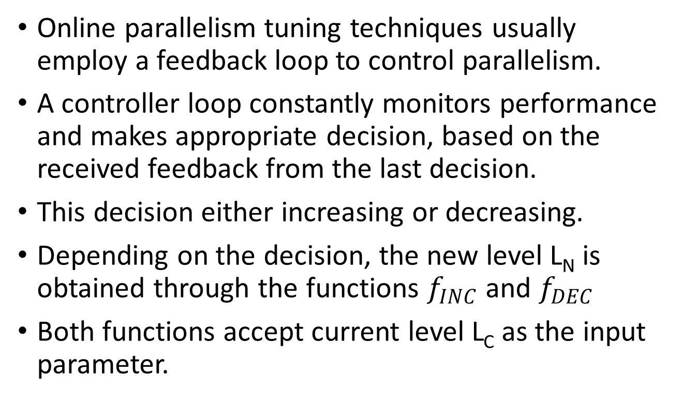
Motivation for RUBIC
Online parallelism tuning techniques usually employ a feedback loop to control parallelism.
A controller loop constantly monitors performance and makes appropriate decision, based on the received feedback from the last decision.
This decision either increasing or decreasing.
Depending on the decision, the new level L_{N} is obtained through the functions $f_{INC}$ and $f_{DEC}$
Both functions accept current level L_{C} as the input parameter.

Slide 8
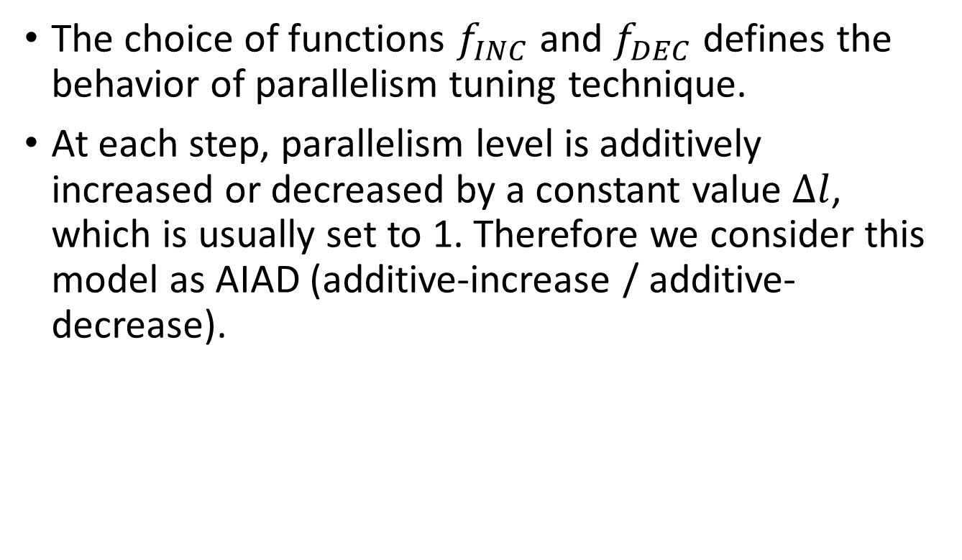
Additive increase / Additive decrease
The choice of functions $f_{INC}$ and $f_{DEC}$ defines the behavior of parallelism tuning technique.
At each step, parallelism level is additively increased or decreased by a constant value $∆l$, which is usually set to 1. Therefore we consider this model as AIAD (additive-increase / additive-decrease).

Slide 9
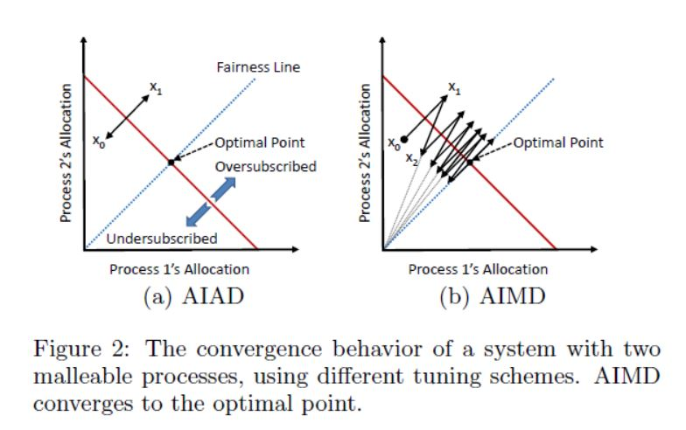
Additive vs Multiplicative Decrease

Slide 10
Additive Increase Multiplicative Decrease
Fig 2(a) is behavior of AIAD in two process system.
Starting from an arbitrary point X₀, both processes additively increase their parallelism level.
Therefore, the system’s state at an angle of 45⁰, to point X₁, system becomes oversubscribed.
System’s state oscillates between points X₀ and X₁ and never converges to the optimal point.
We can somewhat overcome this issue by replacing the additive decrease phase with a multiplicative decrease (MD).

Slide 11
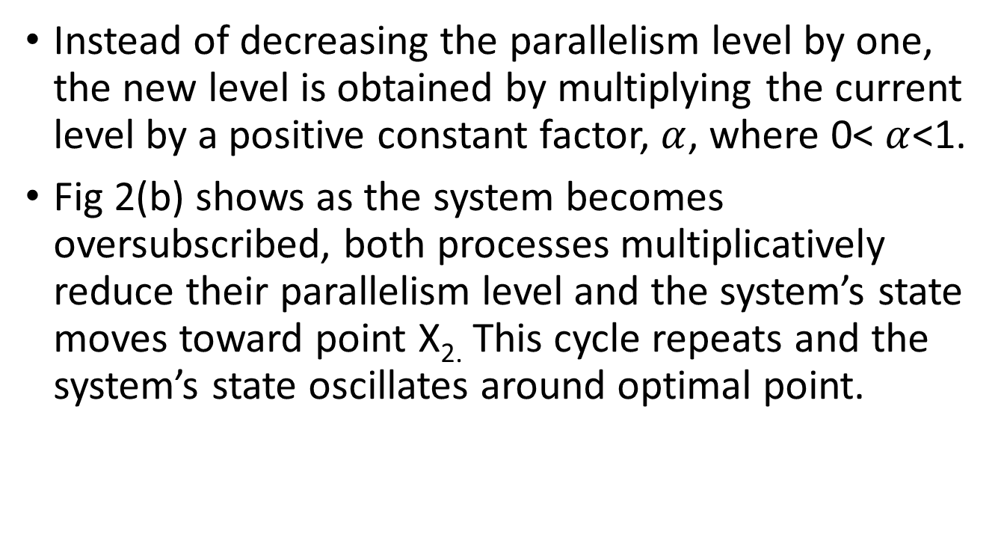
Additive Increase Multiplicative Decrease
Instead of decreasing the parallelism level by one, the new level is obtained by multiplying the current level by a positive constant factor, $α$, where 0< $α$<1.
Fig 2(b) shows as the system becomes oversubscribed, both processes multiplicatively reduce their parallelism level and the system’s state moves toward point X_{2.} This cycle repeats and the system’s state oscillates around optimal point.

Slide 12
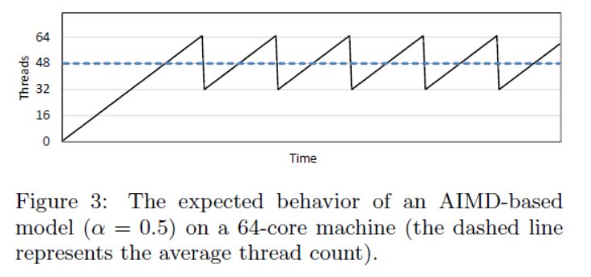
Cubic Increase Multiplicative Decrease
But AIMD introduces a new problem to the system, the oscillations around the optimal point are expensive and cause overall undersubscription.

Slide 13
Cubic Increase Multiplicative Decrease
Fig 3 shows that each time parallelism level exceeds 64, controller detects performance drop and multiplicatively decreases parallelism level.
In this example, the average parallelism level is 48, which means 25% of the hardware cores (16 out of 64) are left unused.
To enhance the system utilization, a new growth function, a cubic function is introduced.

Slide 14
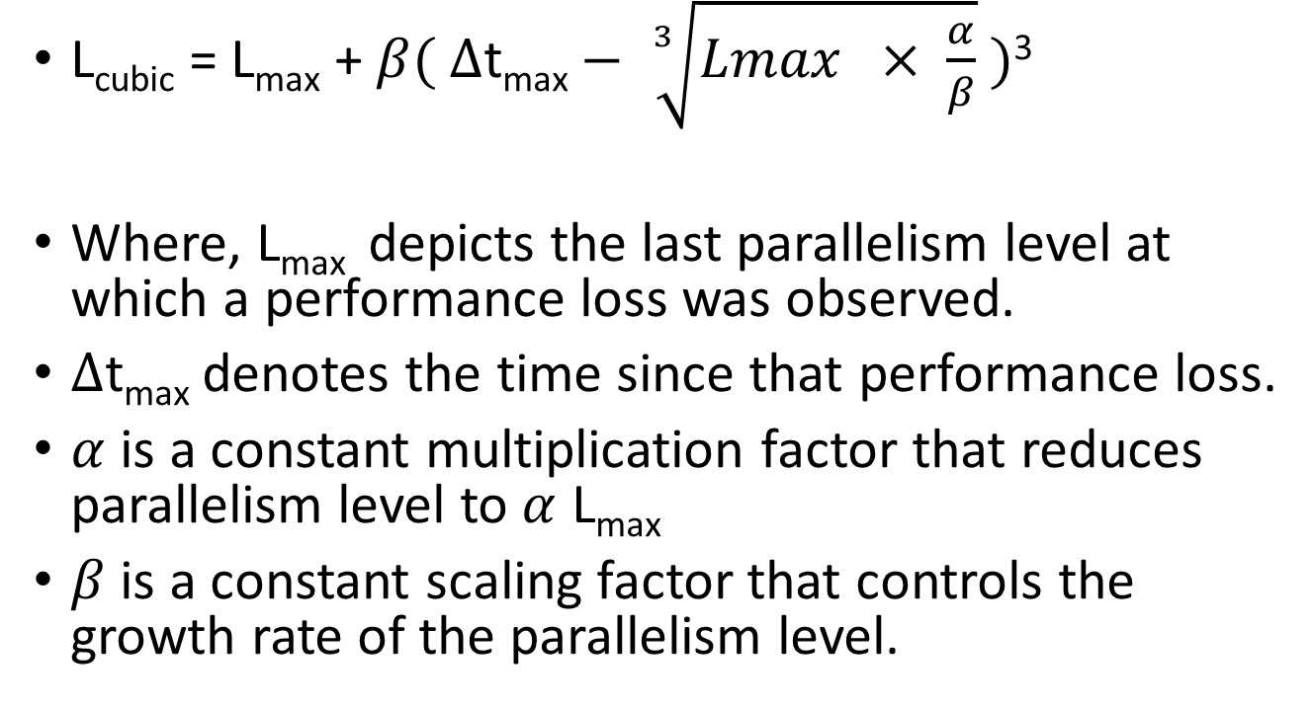
Cubic Increase Multiplicative Decrease
L_{cubic} = L_{max} + $β( ∆\text{t}\text{max}− \sqrt[3]{Lmax × \frac{α}{β}} )$³
Where, L_{max} depicts the last parallelism level at which a performance loss was observed.
$∆\text{t}\text{max}$ denotes the time since that performance loss.
$α$ is a constant multiplication factor that reduces parallelism level to $α$ L_{max}
$β$ is a constant scaling factor that controls the growth rate of the parallelism level.

Slide 15
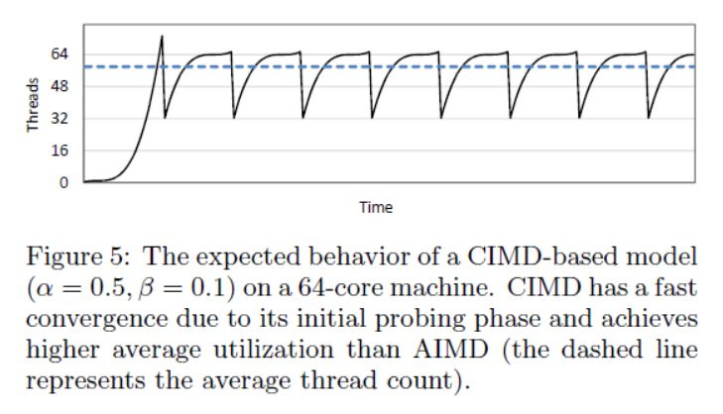
Cubic Increase Multiplicative Decrease
Fig 5 shows cubic increase / multiplicative decrease functions where the average parallelism level is close to 60, which implies the system utilization is enhanced from 75% with AIMD to 94% with cubic growth.

Slide 16
Parallelism Tuning with RUBIC Algorithm
Assume that each process includes a pool of s/w worker threads and run a malleable parallel workload. As soon as a s/w thread completes its current task, it picks new task from a task queue.
Each process runs a monitoring thread that is responsible for running RUBIC controller.
This thread is created with higher priority than other threads so that it performs it’s duty even when system is oversubscribed.
The controller periodically measures process throughput and updates T_{c} variable, in a loop.
At the end of each iteration, the value of T_{c} is stored in T_{p.}

Slide 17
Parallelism Tuning with RUBIC Algorithm
To measure throughput, each worker thread maintains a local counter and after finishing task, worker thread increases it’s counter by one.
At each round, monitoring thread reads all thread local counters and calculates T_{c}
After each measurement, controller compares T_{c} with T_{p}.
If T_{c} is greater than T_{p} then controller increases parallelism level according to cubic growth function and if less than T_{p} then reduces parallelism level according to multiplicative reduction function.

Slide 18
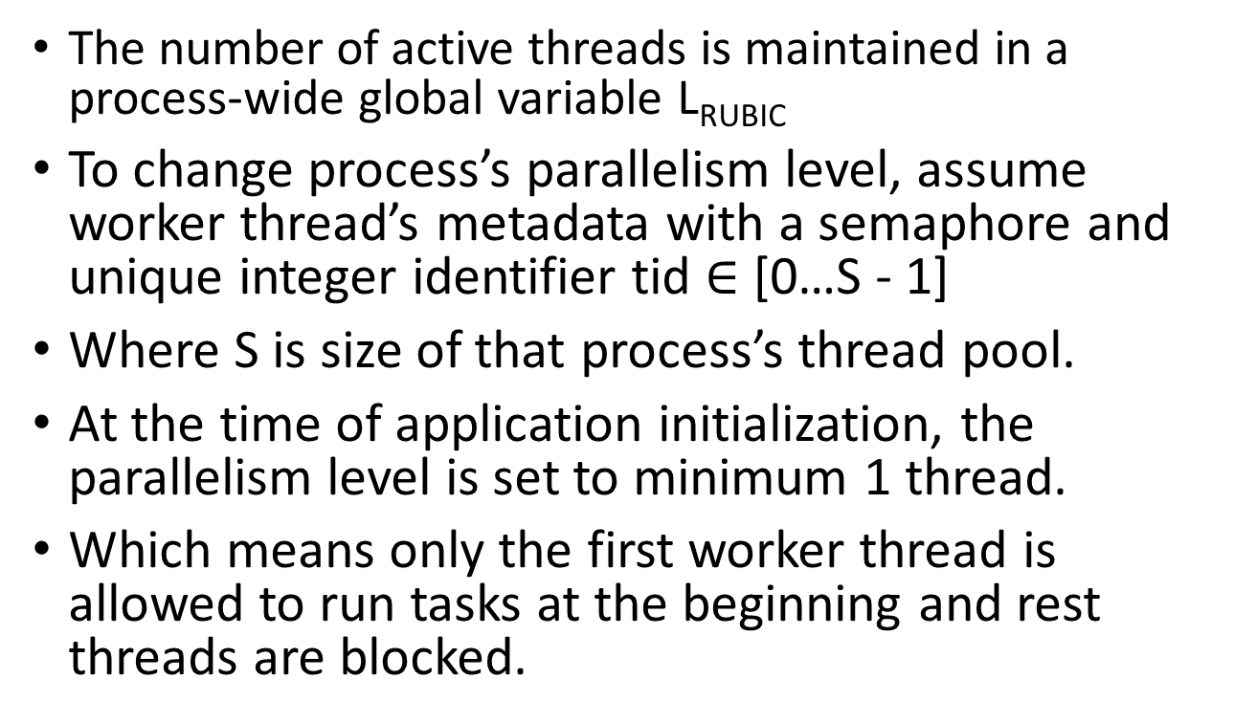
Parallelism Tuning with RUBIC Algorithm
The number of active threads is maintained in a process-wide global variable L_{RUBIC}
To change process’s parallelism level, assume worker thread’s metadata with a semaphore and unique integer identifier tid $∈$ [0…S - 1]
Where S is size of that process’s thread pool.
At the time of application initialization, the parallelism level is set to minimum 1 thread.
Which means only the first worker thread is allowed to run tasks at the beginning and rest threads are blocked.

Slide 19
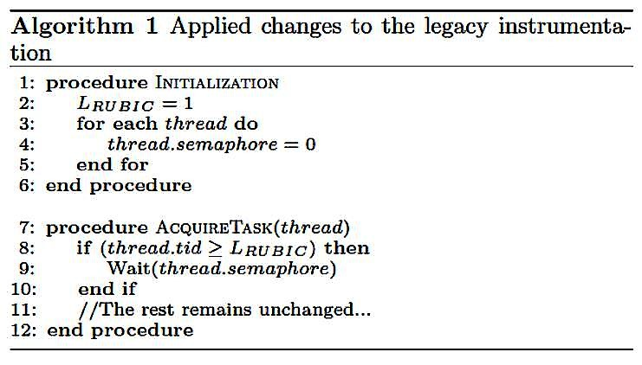
Parallelism Tuning with RUBIC Algorithm
Before acquiring task from the task queue, each thread compares its tid with global variable L_{RUBIC}
If tid is greater than L_{RUBIC} , it means the thread must be blocked and it waits in semaphore which initialized to 0. (Reset)
Otherwise thread acquires task and executes.

Slide 20
Parallelism Tuning with RUBIC Algorithm
Lines 6 – 15 in algorithm 2 is Increase function and 25 – 35 is reduction function.
First lets talk about Increase Function,
After cubic growth, controller runs additive increase phase and increment parallelism level by one. Because this helps to make more accurate decisions.
In Lines 20 – 23, controller signals blocked worker threads.

Slide 21
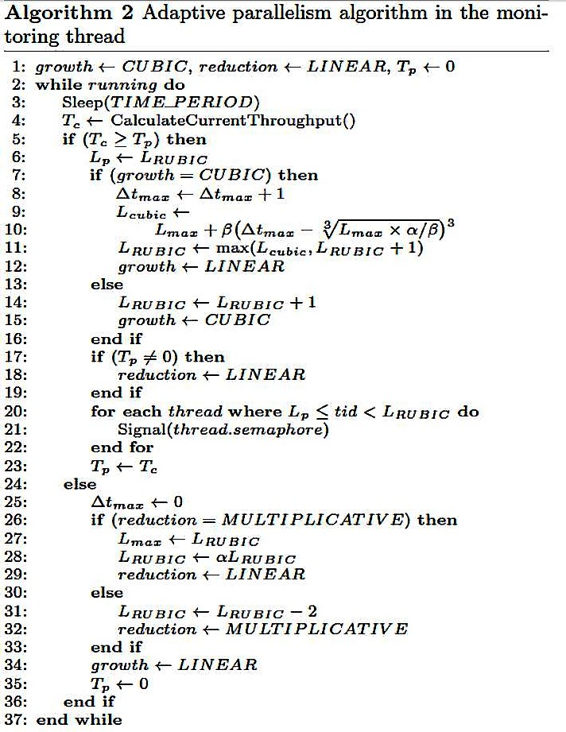

Slide 22
Parallelism Tuning with RUBIC Algorithm
Now Reduction Function,
Reduction function has two phases, multiplicative and linear.
Because same as Increase function this helps to avoid unnecessary multiplicative phases as much as possible.
Generally performance drop due to dynamic operational changes in workload or available hardware resources. For example, a new process joins system.
If linear decrease does not produce desired outcome, and performance loss still exists in next round then multiplicative decrease happens.

Slide 23
Allocation Policies
Before considering result of RUBIC, need to understand this policies.
There is mainly four different allocation policies:
Greedy
EqualShare
F2C2
EBS (Exploration based scaling)

Slide 24
Allocation Policies
Greedy: each process tries to take over all the hardware by spawning as many parallel threads as h/w context.
EqualShare: This is naïve approach, each process takes an equal share of the h/w context, regardless of workload.
F2C2: By this mechanism, controller initially doubles the parallelism level instead of increasing by one. After first performance loss, it halves the parallelism level and switches to pure AIAD.
ECS: It is pure AIAD.

Slide 25
Performance Results
We will consider performance results in two stages.
Pairwise Execution
Single Process Execution

Slide 26
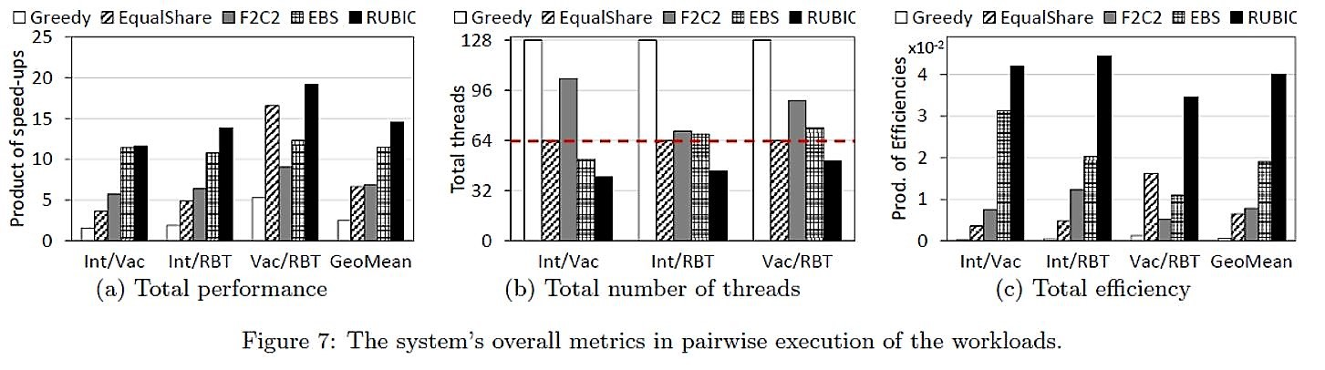
Pairwise Execution
Figure 7 depicts the system's overall metrics for the pairwise execution of the workloads.
It shows that RUBIC achieves the best results, while Greedy proves to be the worst policy.
In Figure 7a, The poor performance of Greedy and EqualShare is due to ignoring the running workloads and oversubscribing the system.

Slide 27
Pairwise Execution
EqualShare performs better with the Vac/RBT pair. This is because both running workloads scale up to 32 threads. But, EqualShare is not the best policy, as it still suffers from ignoring the running workloads and improper resource allocation.
With the Int/Vac pair, EBS's performance is comparable to RUBIC's. However, this situation is not the case for the other pairs, where RUBIC outperforms EBS because of EBS's unfair allocation and oversubscription.

Slide 28
Pairwise Execution
On average, RUBIC enhances the system's overall performance by 26% and 500% with regard to the second-best policy (EBS) and the worst policy (Greedy), respectively.
In Figure 7b, All adaptive policies should keep the total number of threads below the oversubscription line (the dashed line).
RUBIC meets that expectation.

Slide 29
Pairwise Execution
Figure 7c, depicts total efficiency, RUBIC is showing highest efficiency due to higher performance and lower resource consumption.
On average over all pairwise experiments, RUBIC proves to be 2 and 66 times more efficient than the second-most efficient policy (EBS) and the least efficient policy (Greedy), respectively.

Slide 30
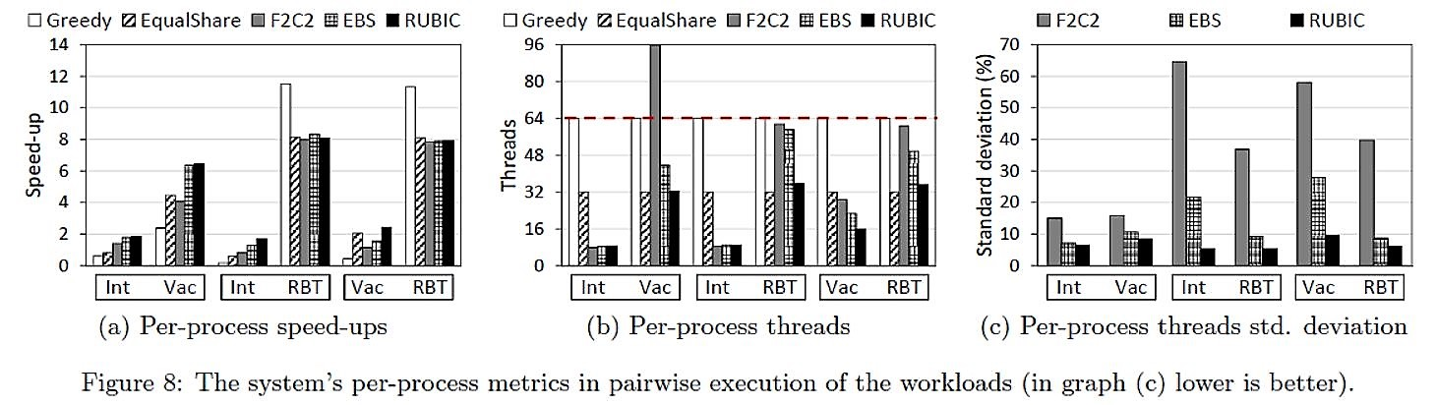
Pairwise Execution
Figure 8 demonstrates the per-process statistics of the pairwise execution of the workloads.
In Figure 8a (and unlike Figure 7a), Greedy does not lead to the worst speed-up In the RBT workload. But, Greedy achieves very low speed-up for both Intruder and Vacation workloads. This justifies Greedy's very low overall performance.

Slide 31
Pairwise Execution
In Figure 8b, we can wee that RUBIC spawns less number of threads and achieves higher speed-up. This proves RUBIC to be the most stable adaptive policy and F2C2 is the most unstable solution.
Figure 8c shows how RUBIC allocates less threads to RBT to reduce the pressure on its Intruder and Vacation counterparts. Consequently, both Intruder and Vacation experience a performance boost, which highly affects the system's overall performance. This interesting feature of RUBIC is also known as proportional fairness.

Slide 32
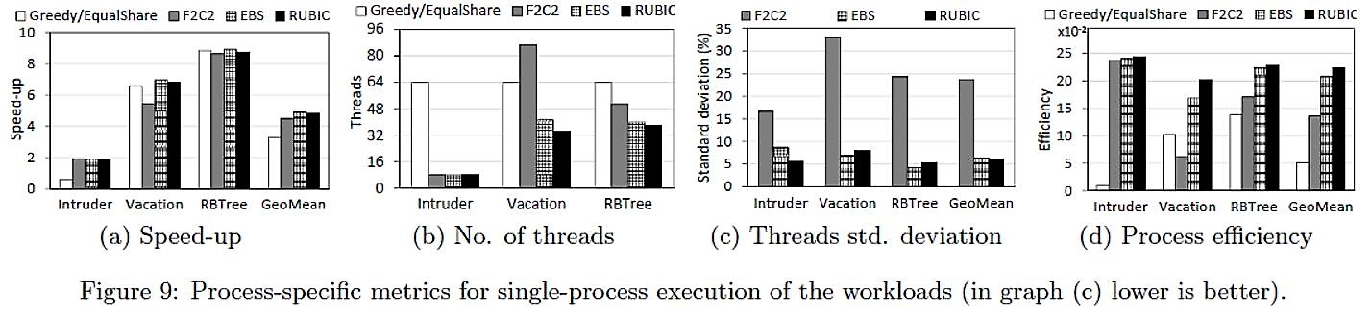
Single Process Execution
Although RUBIC originally targets multi-process environments, it is also relevant to evaluate it in single-process scenarios.
Figure 9a depicts the achieved speed-up of all the policies.
Figure 9b shows that RUBIC achieves the speed-up by allocating slightly less threads to the running process.
However, RUBIC's thread allocation is closest one to the best performing policy (i.e. EBS), RUBIC is the most stable policy by having the lowest standard deviation in its allocation results throughout the repeated experiments, showed in Figure 9c.

Slide 33
What if process arrives at later stage?
Assume two processes, P1 and P2, run an identical workload.
P2 arrives 5 seconds after P1 starts running and the whole experiment lasts for 10 seconds.
We will see how P1 behaves before P2's arrival and how both processes behave as P2 joins the system.
Use a conflict-free red-back-tree workload (i.e.100% read-only transactions). This workload is highly scalable and scales up to the number of h/w contexts so it will fight over resources.
With 2 running processes a fair and efficient allocation state is when the processes equally share the hardware and each uses 32 s/w threads.

Slide 34
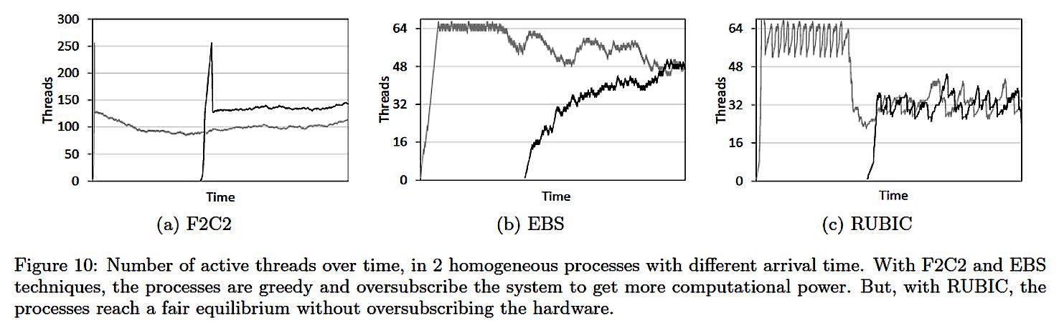
In Figure 10a, for F2C2, after P2's arrival, both processes fall into a race and greedily increase their resource usage.
In Figure 10b, for EBS, as P2 joins the system, both processes behave randomly and they do not converge to the optimal allocation, which is 32 threads per process.
Figure 10c depicts RUBIC's behavior. In the beginning, P1 runs the initial probing phase and quickly converges to 64 threads. From this point on, P1 oscillates around the optimal level (e.g., 64) until P2 joins the system. As P2 joins system, it does multiplicative decreases. Therefore, both processes, almost immediately, get close to 32 threads and both start oscillating around the optimal allocation line (i.e. 32 threads).

Slide 35
Open issues or drawbacks
As shown previously in Figure 8a, RBT workload always achieves the highest speed up with Greedy.
RUBIC not able to address wasted computational power caused by aborted transactions.
RUBIC focus on tuning transactions (threads) as overall process. Like, it doesn’t have solution for tuning transactions inside a single process. This is contradictory to this approach.
RUBIC is applicable to malleable applications.
Parallelism is measured by controller so it increases burden for controller.

Slide 36
Future Work
Plan to extend RUBIC to support a wider range of the target applications, including non-transactional and non-malleable parallel applications.

