Slide 1
An Internet-of-Things Enabled Connected Navigation System for Urban Bus Riders
- Proposed by
Marcus Handte, Stefan Foell, Stephan Wagner, Gerd Kortuem, and Pedro José Marrón
- Reviewed by
Bhavy Bhut (810917417)

Slide 2
Problem
For rapidly growing cities of today, it is challenging to provide effective transport services.
Bus networks in dense urban areas are complex and difficult to navigate.
Existing transport information systems help travelers plan an upcoming journey.
No direct support available to support surrounding information during journey.
To tackle this problem for public transportation, UBN (Urban Bus Navigator) proposed.
UBN is IoT enabled navigation system for urban bus riders.
Bhavy Bhut

Slide 3
UBN Introduction
UBN is a personalized bus navigation system with ability to seamlessly interconnect bus passengers with real-world public bus infrastructure.
UBN provides two novel information services:
1. micro-navigation
2. crowd-aware
Micro-navigation is fine grained contextual guidance of passengers along with boarded bus recognizing and tracking passengers journey progress.
Crowd aware recommendation collects and predicts crowd levels on bus journeys to suggest better and less crowded routes.
Bhavy Bhut

Slide 4
Motivation
Research on public transportation traditionally focused on methods to improve efficiency of physical transport system.
Instead of resolving operational transport issues, UBN is designed for passenger centric information system.
OneBusAway is first mobile app that brought estimated arrival times.
Most of apps use GPS for suggesting bus stops in the surrounding of a user and GTFS (Google Transit Feed Specification).
But, GTFS lacks qualitative travel information.
Crowding on public transport is a dimension of qualitative travel.
Bhavy Bhut

Slide 5
Motivation
Other approaches to identify crowd levels:
Some public transportation adopt automated fare collection system which can provide statistics about number of passengers with digital boarding passes.
Due to high investment costs and lack of integration it is not adopted.
Other way is to enable bus passengers to use their mobile phones for manually sharing travel experiences (Tiramisu).
In today’s busy life, fully automated approaches are required.
Current traveler information systems provide support in singular travel context.
E.g. before journey is started, when searching for close-by stop and waiting for a bus.
Bhavy Bhut

Slide 6
UBN – Urban Bus Navigator
UBN is developed incorporation with EMT Madrid and currently it is implemented in Madrid, Spain.
UBN is enhanced with IoT features to address public transportation information needs.
After analyzed bus journeys in Madrid, a model is developed for public transport journey which encompasses tasks that passengers must be able to accomplish to use public transport.
Bhavy Bhut

Slide 7
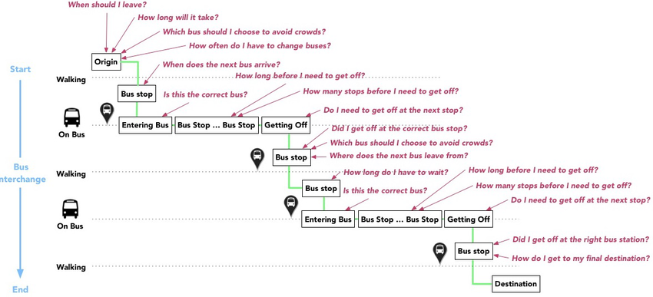
UBN – Urban Bus Navigator
Figure 1: Contextual information needs of bus users from start to end of bus journeys where passenger switches buses halfway
Bhavy Bhut

Slide 8
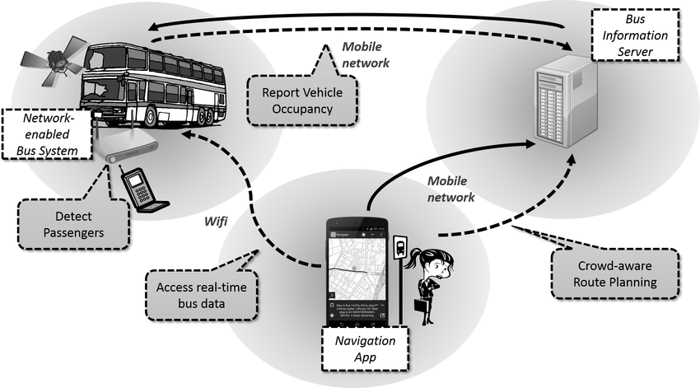
UBN – Urban Bus Navigator
Micro-Navigation decisions are highly contextual: it depend not just on time and location but also on traveler’s transport mode.
E.g standing at a bus stop, riding on a bus
Figure 2: UBN System
Bhavy Bhut

Slide 9
UBN – Urban Bus Navigator
UBN key innovations:
IoT based distributed software and hardware that connects bus riders mobile device with bus vehicles using Wifi.
Micro-navigation solution to provide continuous trip assistance
Crowd density estimation approach to sense number of passengers on buses.
By monitoring signals, it provides enhanced real time bus route recommendation to avoid overcrowding.
Bhavy Bhut

Slide 10
UBN – Architecture
Network enabled urban bus system with WiFi equipped buses vehicles.
WiFi (Ad-Hoc) used to establish local networks for sharing bus data with passengers mobile phones.
All buses are equipped with industrial on-board computer system that is connected to external sensors, GPS receiver and 3G network interface to provide positioning data and free internet connectivity, respectively.
Access points are configures with well-known SSID that announces the bus network uniquely in all buses in Madrid.
Upon request system can share GPS position, Current Route and Next stop.
Bhavy Bhut

Slide 11
UBN – Architecture
For bus crowd density estimation,
WiFi enabled devices carried by passengers sent probe requests.
By keeping track of MAC addresses of the device, it is able to count the mobile devices.
Bus often move through densely populated areas where devices are merely close to vehicle but not located in bus.
To handle this issue, t_{threshold} (180s) is used.
For travelers’ privacy, UBN counts total no of unique MAC addresses for total passengers per segment.
Bhavy Bhut

Slide 12
UBN – BCIS
Same as traditional transport information system, UBN consists bus crowd information server (BCIS).
Bus crowd information server collect real-time occupancy from buses operating on different routes.
By utilizing this information server adds two components:
Predicting bus occupancy from crowd level histories
Least crowded route recommendation
By analyzing this data, it is seen that on Mondays significant more passenger loads are observed than on sundays.
Predictions are based on crowd level histories where it use set of temporal and structural datasets.
Bhavy Bhut

Slide 13
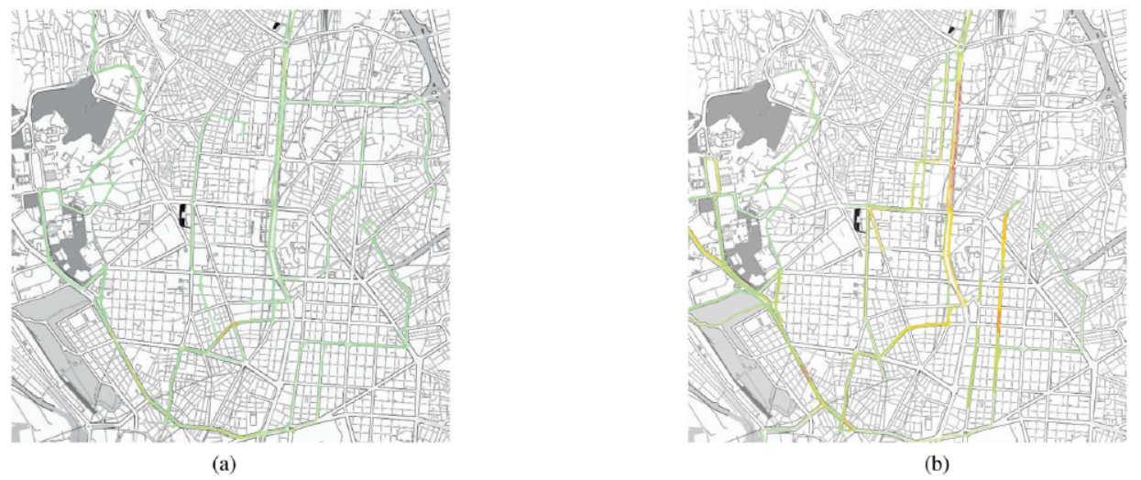
UBN – BCIS
Figure 3: Visualization of bus crowd density in Madrid on two different days of the week (9-10 AM) (a) Sunday Morning (b) Monday Morning
Bhavy Bhut

Slide 14
UBN – BCIS
This datasets us feature vector < R, S_{orig}, S_{dest}, T_{day}, T_{hour} >
R denoting the bus route
S_{orig} and S_{dest} denoting the origin and destination stop on the route segment
T_{hour} denoting the hour (i.e., 0–23)
T_{day} denoting the type of day (e.g., 0 for Monday to Friday, 1 for Saturday, and 2 for Sunday)
Route ranking is performed using a variant of the A* algorithm.
Bhavy Bhut

Slide 15
UBN – Bus navigation app
To provide bus navigation service, a smartphone application for bus passengers is developed.
This application supports micro-navigation which provides continuous guidance throughout all stages of a bus journey.
For example:
Which bus I should take? Is the bus just pulled up at stop?
On which bus I am riding? Is it correct bus?
Navigation app runs background process that automatically tries to establish WiFi connections (common SSID) to buses in the surroundings of the user.
Real time vehicle status can be queried to obtain knowledge of the route operated by bus and next stop along the route.
It can also used to monitor trip progress of the user.
Bhavy Bhut

Slide 16
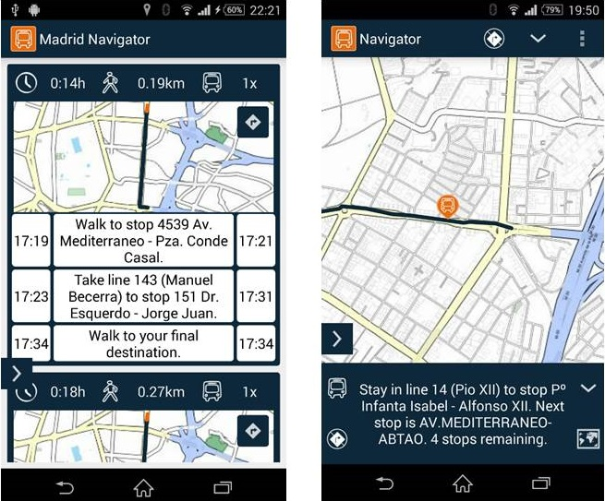
UBN – Bus navigation app
Figure 4: Mobile user interface of the bus navigation app
Bhavy Bhut

Slide 17
UBN – Bus navigation app
Navigation app provides following information:
Walking instructions
Next Bus Departure
Prepare for Alighting
- Number of stops remaining
Missed Alighting
- If user still found on the bus an alert is dispalyed
Wrong Bus Alert
For disabled passengers, using text-to-speech engine app is able to generate spoken navigation instructions.
Bhavy Bhut

Slide 18
Evaluation of UBN
UBN is deployed in Madrid since July 2013.
UBN is evaluated in two approach:
Technical Evaluation
User Experience Evaluation
From technical evaluation, the ability to differentiate between people outside the buses and actual passengers on the buses is crucial.
Crowd level frequencies is 42.8% low, 42.1% medium and 15.1% high. This frequencies are based on 14 days observations in Madrid.
Exact match accuracy is 61.9% which means the resulting average error lies at 5.1 passengers and distribution is shown in figure 5.
Bhavy Bhut

Slide 19
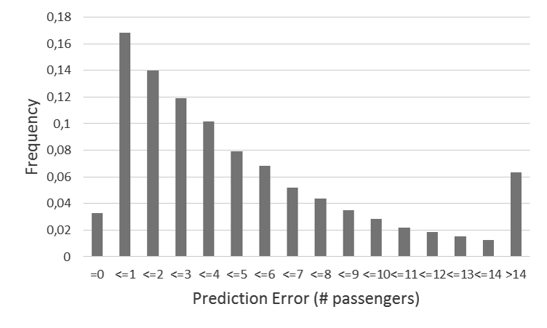
Evaluation of UBN
Figure 5: Error distribution of bus crowd prediction
Bhavy Bhut

Slide 20
Evaluation of UBN
User experience evaluation performed through two studies.
First is to collect qualitative feedback where 41% user agreed with maximum rating of 5 stars.
Second study is to gain deeper understanding of the subject where authors recruited ten participants to use UBN app for one week and all of them gave positive feedback.
Bhavy Bhut

Slide 21
Conclusion and Open problems of UBN
UBN is distributed IoT system comprising an embedded bus computing system, backend computing infrastructure and a mobile smartphone app.
UBN design is generic so it can be adopted to any city that has a digital transport infrastructure.
UBN able to handle uncertainties involved in bus journeys but contains errors in predicting crowd level.
As UBN is based on unique MAC address count, it failed to address exclusive scenarios like if 1 person has more than 2 devices.
Bhavy Bhut

